Slide 1
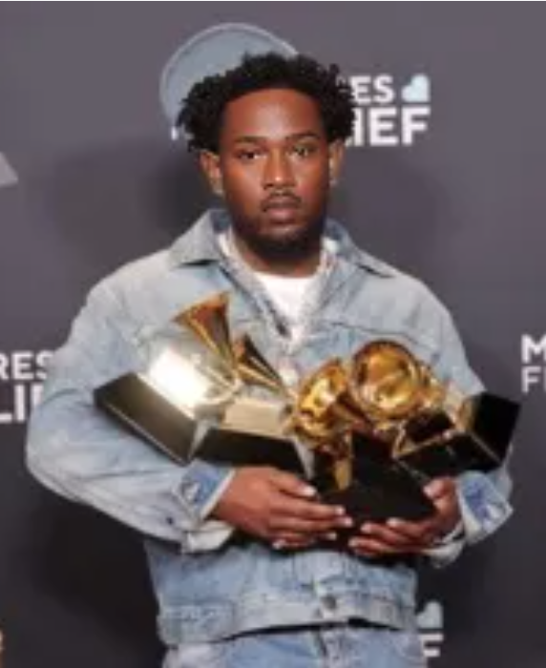
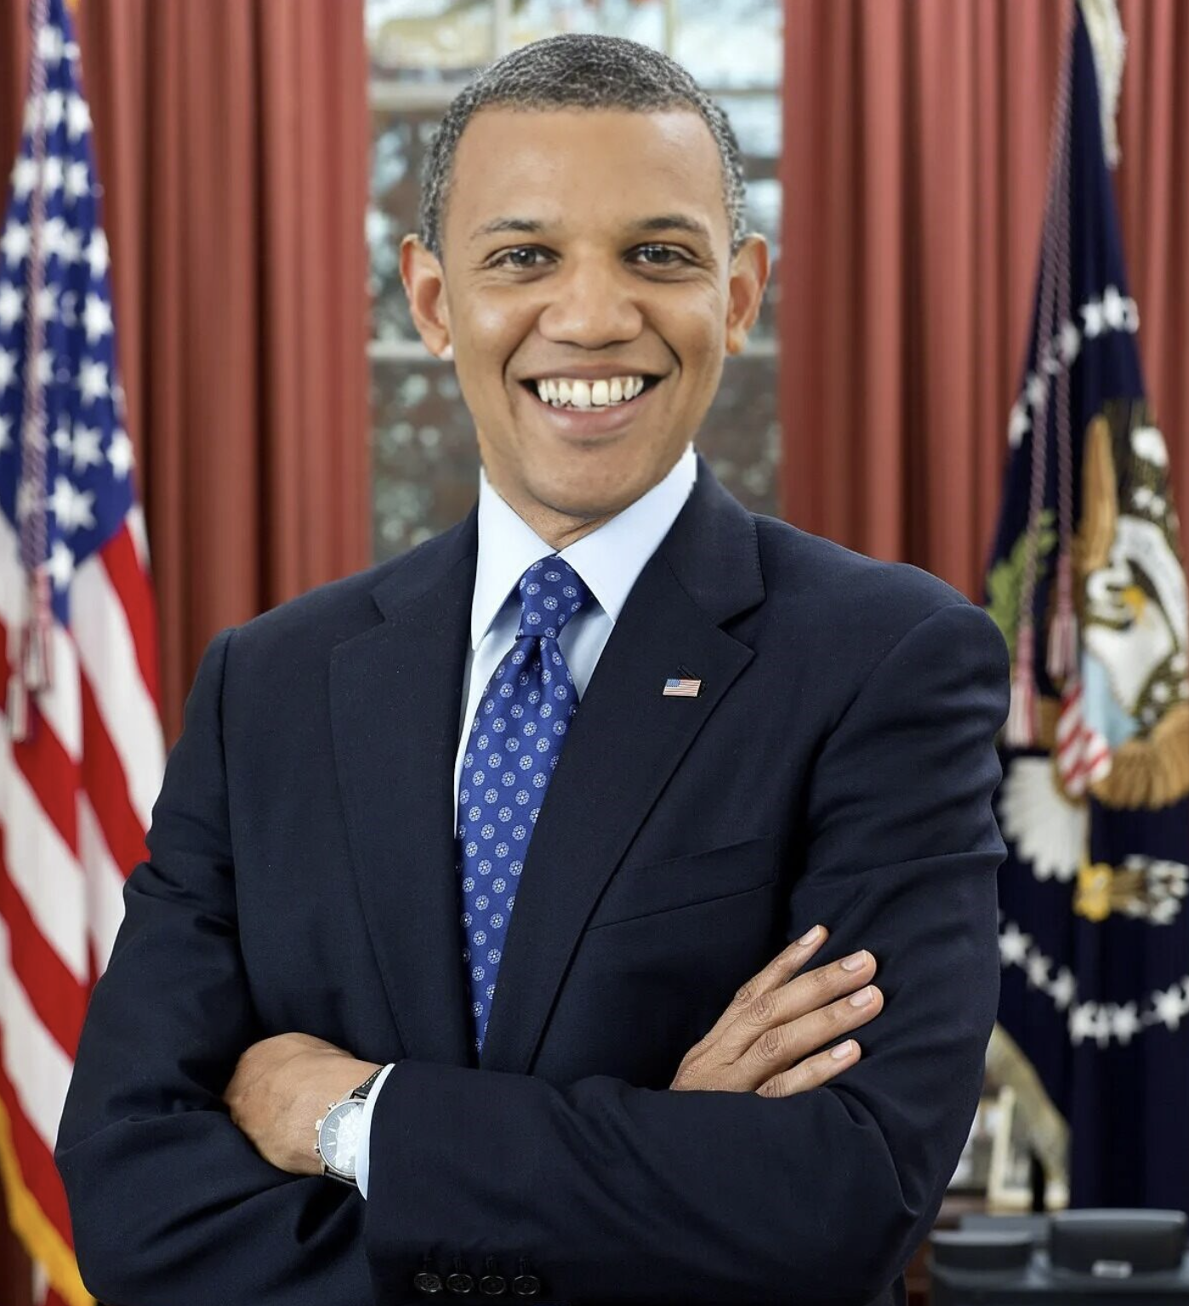
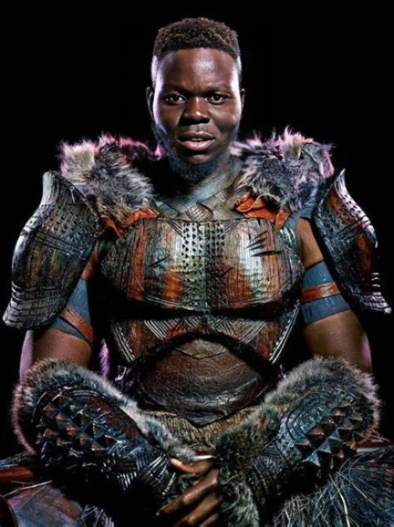
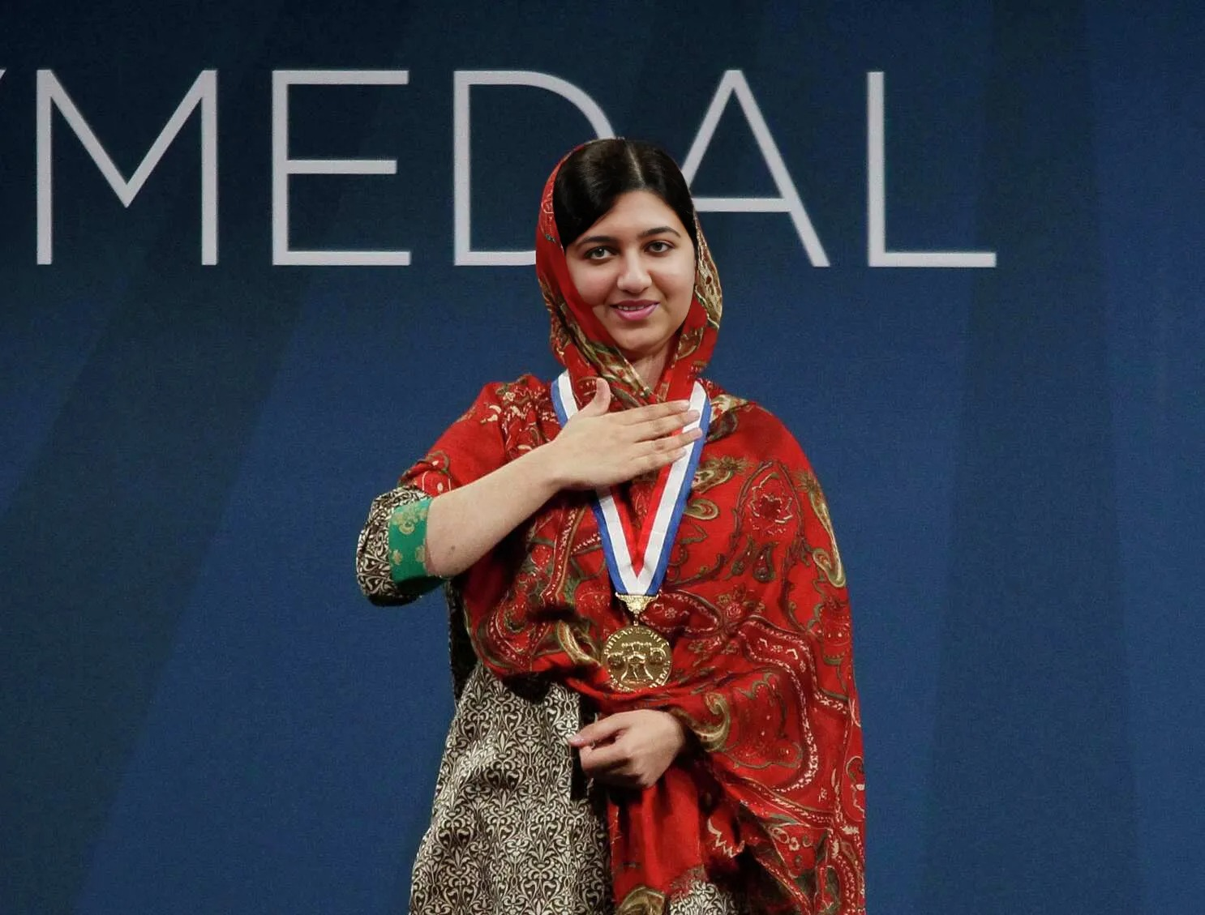

DeepFake Detection
Advised by Dr. Picone
Jouri Ghazi
Jahtega Djukpen
Ashton Bryant
Zacary Louis
A Nobel Peace Prize winner
An Oscar Winning Actor
The 44th President of the United States
A Multi-Grammy award Artist
A Nobel Peace Prize winner
An Oscar Winning Actor
The 44th President of the United States
A Multi-Grammy award Artist
These are synthesized images, we will be developing a DeepFake detection method.
Notes:
Jouri

Slide 2
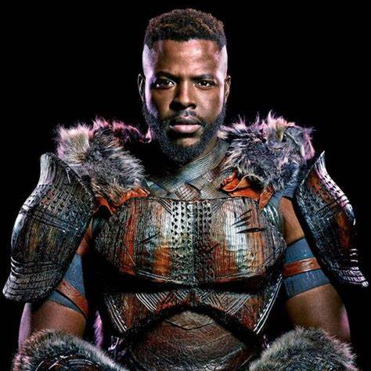
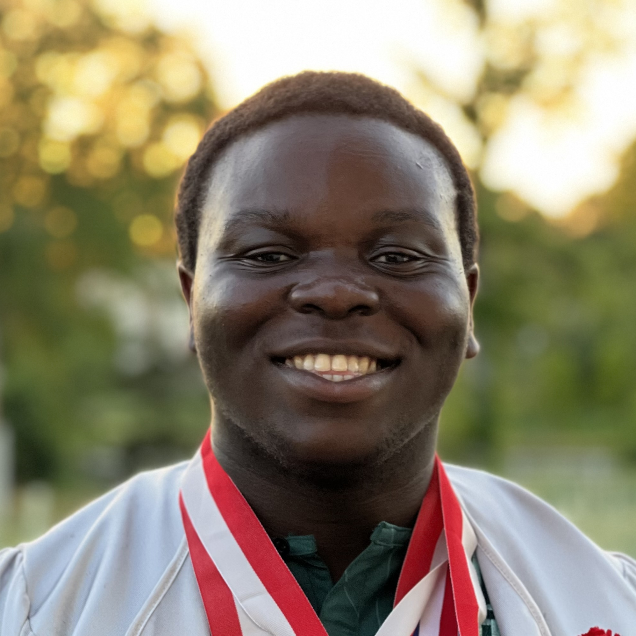
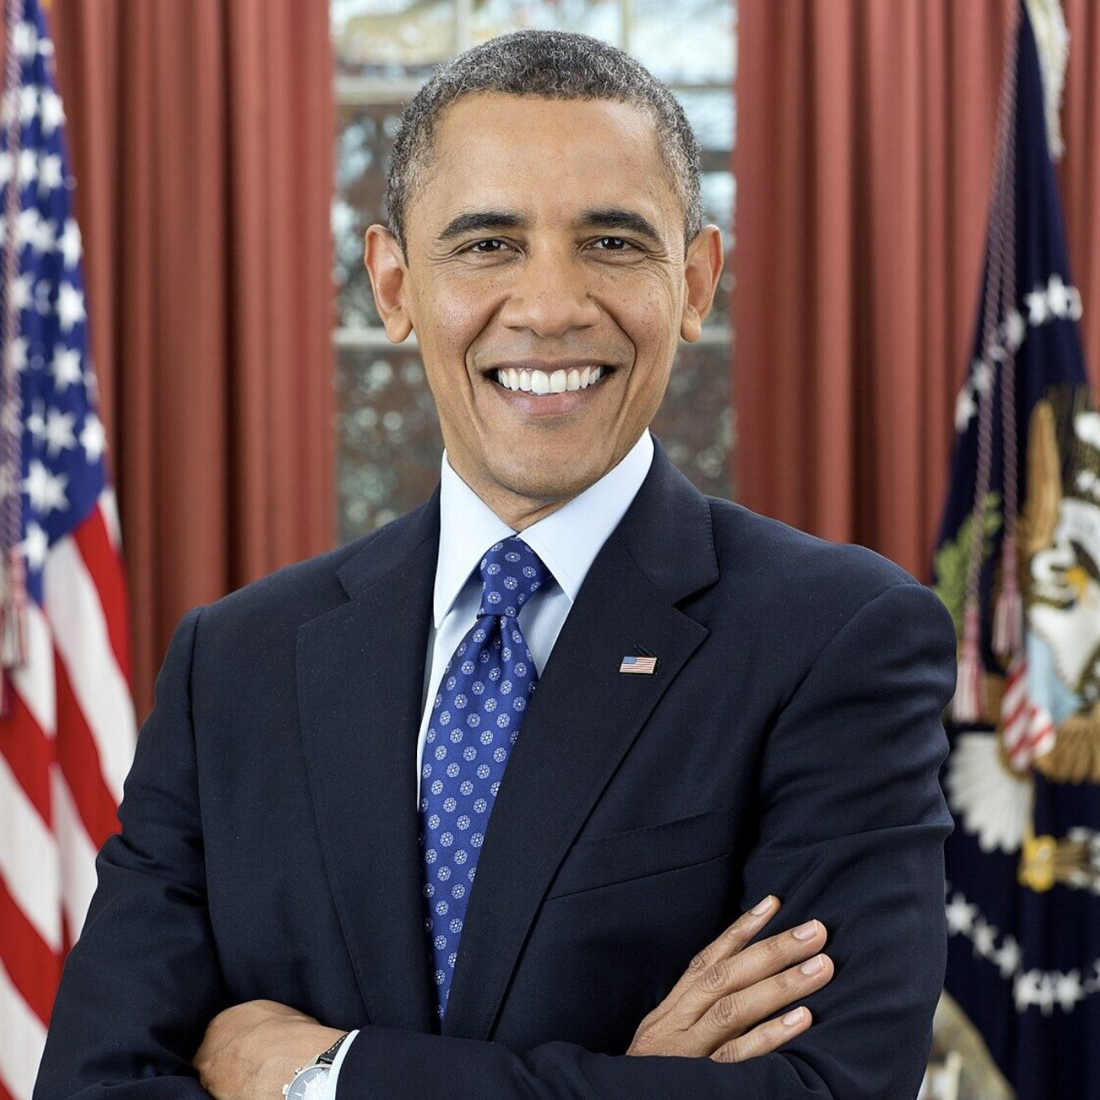
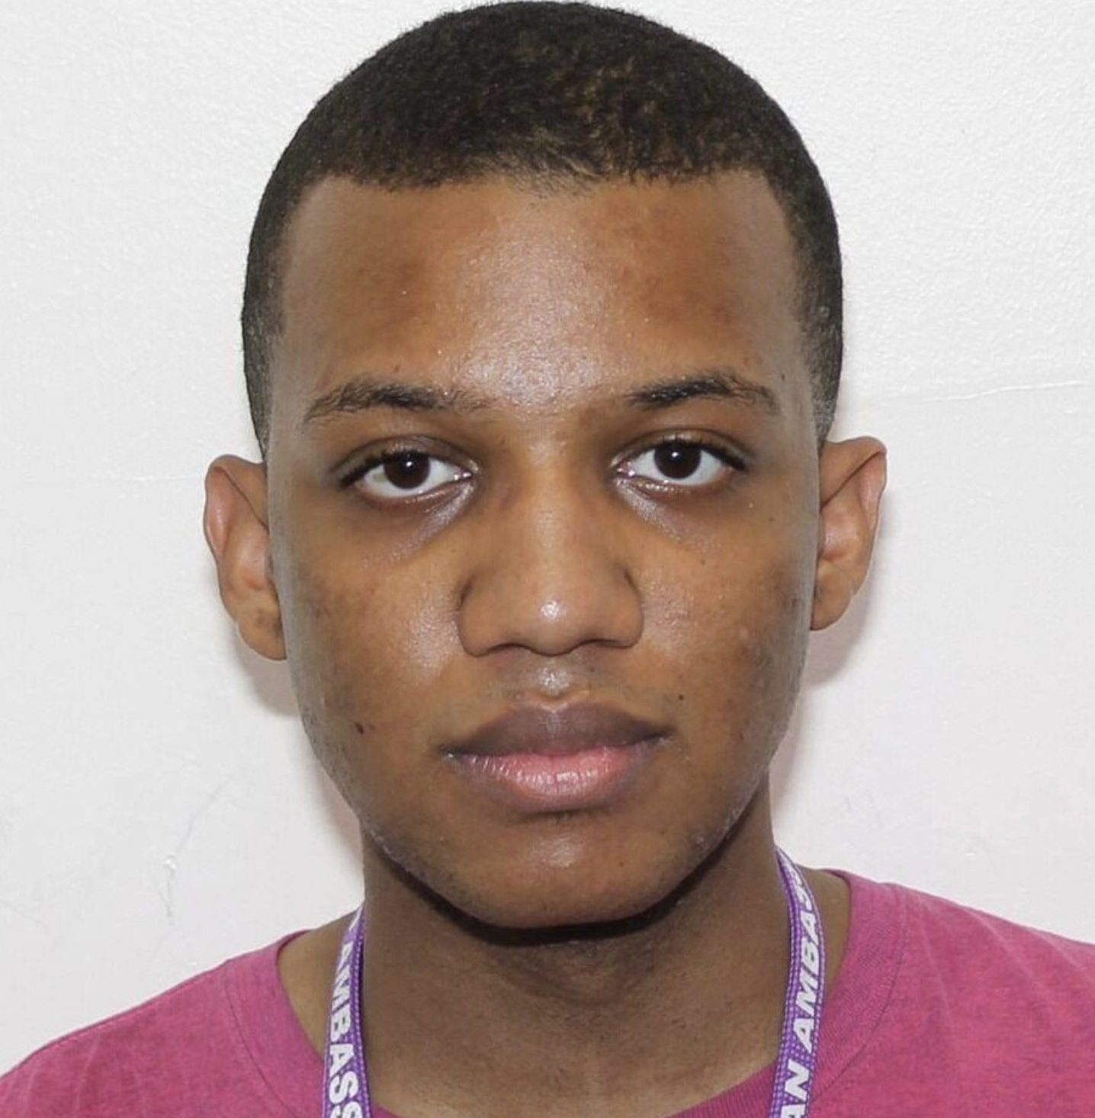
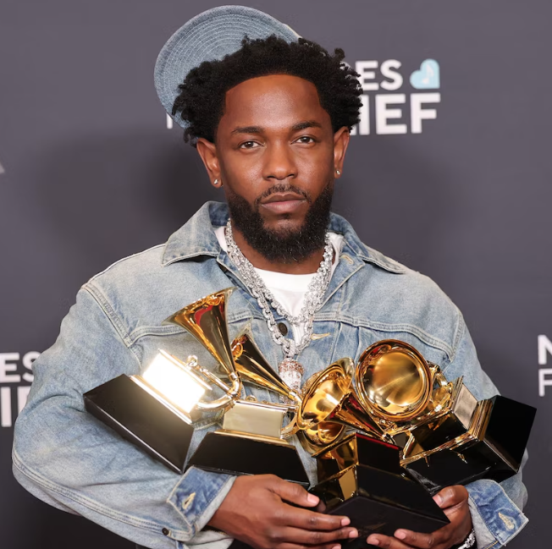
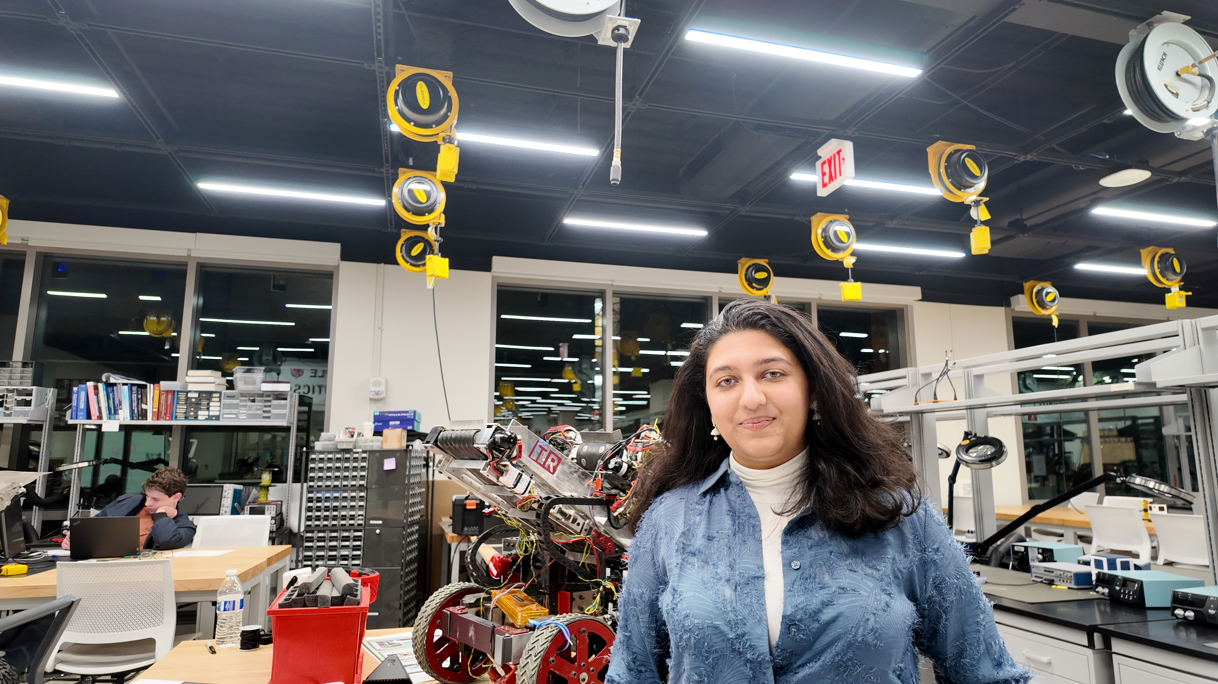

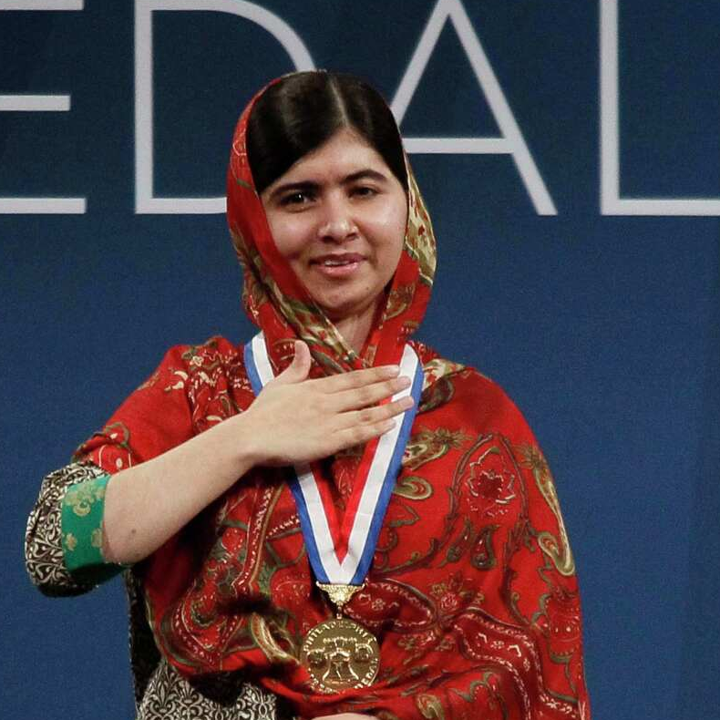
What is a DeepFake?
A form of AI-Generated content
Target
Source
Face Swap
These images were created within a few minutes using https://deepfakemaker.io/
Notes:
Jouri

Slide 3
DeepFake News
Watch out – even small businesses are now now facing threats from deepfake attacks
Laws Struggle to Address Students Making Deepfakes
GovTech Tues September 23 2025 8:33 EDT
TechRadar Wed 24 September 2025 12.26 EDT
She thought she was flirting with her favorite celebrity. A heartbreaking deepfake scam cost her everything
Friend stole my face for deepfake nudes – now I want tougher laws
BBC Fri September 19 2025 12:00 EDT
Daily Mail Wed 24 September 2025 10:22 EDT
Taylor Swift And Travis Kelce’s
Engagement Sparks Wave Of Scams And Deepfakes
Actress Angel Aquino calls for stronger laws after falling victim to deepfake
The Blast Fri September 5 2025 11:30 EDT
CBN News Tues September 4 2025 5:18 EDT
Notice the
Victims
News Source
Date
Problem Statement
Artificially generated and manipulated images such as DeepFakes, have become easier to create, and harder to detect. These images pose a serious risk to the credibility of public figures, resulting in great emotional, financial and political turmoil.
Needs Statement
An accurate and reliable DeepFake detector is needed to protect individuals such as celebrities, politicians, and even corporations who are frequent victims of DeepFake misuse.
Notes:
Jahtega

Slide 4
DeepFake News
Watch out – even small businesses are now now facing threats from deepfake attacks
Laws Struggle to Address Students Making Deepfakes
GovTech Tues September 23 2025 8:33 EDT
TechRadar Wed 24 September 2025 12.26 EDT
She thought she was flirting with her favorite celebrity. A heartbreaking deepfake scam cost her everything
Friend stole my face for deepfake nudes – now I want tougher laws
BBC Fri September 19 2025 12:00 EDT
Daily Mail Wed 24 September 2025 10:22 EDT
Taylor Swift And Travis Kelce’s
Engagement Sparks Wave Of Scams And Deepfakes
Actress Angel Aquino calls for stronger laws after falling victim to deepfake
The Blast Fri September 5 2025 11:30 EDT
CBN News Tues September 4 2025 5:18 EDT
Notice the
Victims
News Source
Date
Problem Statement
Artificially generated and manipulated images such as DeepFakes, have become easier to create, and harder to detect. These images pose a serious risk to the credibility of public figures, resulting in great emotional, financial and political turmoil.
Needs Statement
An accurate and reliable DeepFake detector is needed to protect individuals such as celebrities, politicians, and even corporations who are frequent victims of DeepFake misuse.
DeepFakes pose a risk to everyone, making us all stakeholders in their detection and mitigation.
Notes:
Jahtega

Slide 5









Problem Statement
Artificially generated and manipulated images such as DeepFakes, have become easier to create, and harder to detect. These images pose a serious risk to the credibility of public figures, resulting in great emotional, financial and political turmoil.
Needs Statement
An accurate and reliable DeepFake detector is needed to protect individuals such as celebrities, politicians, and even corporations who are frequent victims of DeepFake misuse.
DeepFakes poses a risk to everyone, making us all stakeholders in their detection and mitigation.
Requirement & Constraints Criteria
Project Progress
Web Application
Upload Image
Find Faces
Find Bounding Box
Is this image real?
User uploaded image
Haar Cascade Model
(x, y, width, height)
Present Results
Classify
Data to DCT
This Semester:
Develop Detection Model
User Interface (UI)
Our three solutions lie here
Identify Face
Using developed RF Model
Output to UI
Extract features
Feature Extraction
Classification
Requirement & Constraints Criteria
Performance
Measuring how correctly our solution distinguishes real from fake content across datasets.
Notes:
Zacary

Slide 6




Project Progress
Web Application
Upload Image
Find Faces
Find Bounding Box
Is this image real?
User uploaded image
Haar Cascade Model
(x, y, width, height)
Present Results
Classify
Data to DCT
This Semester:
Develop Detection Model
Our three solutions lie here
User Interface (UI)
Using developed RF Model
Output to UI
Extract features
Identify Face
Feature Extraction
Classification
Requirement & Constraints Criteria
Performance
Efficiency
Code Maintainability
Measuring how well our solution classifies real from fake content across datasets.
Delivering fast, results while minimizing resource usage, ensuring smooth performance.
Ease in which a codebase can be understood, modified, tested, and developed over time.
Usability
Ethic & Security
Demonstration app is intuitive, accessible, offering results with low user effort.
Ensuring user privacy, protecting data, and promoting responsible detection with fairness and transparency.
Notes:
Ashton

Slide 7








Requirement & Constraints
Criteria | Requirement Constraint | Unit | Goal Value | Negotiable / Non-Negotiable | Standard
Accuracy | Requirement | % | 95% | Negotiable | N/A
Precision | Requirement | % | 90% | Negotiable | N/A
Recall | Requirement | % | 85% | Negotiable | N/A
F1 Score | Requirement | % | 85% | Negotiable | N/A
Performance
Measuring how correctly our solution distinguishes real from fake content across datasets.
Actual / Predicted | Predicted Real | Predicted Fake
Actual Real | TP | FN
Actual Fake | FP | TN
True (T)
False (F)
Positive (P)
Negative (N)
correct
incorrect
real
fake
classification
classification
image
image
Accuracy
Precision
Recall
F1 Score
$$\frac{ TP+TN }{TP+FP+TN+FN}$$
$$\frac{ TP}{TP+FP}$$
$$\frac{ TP}{TP+FN}$$
$$2×\frac{ Precision×Recall}{Precision+Recall}$$
How often the model classifies an image correctly
Proportion of correct positive predictions to all positive cases
Proportion of positive cases correctly identified
Combines precision and recall into a balanced metric
Notes:
Jouri

Slide 8
Requirement & Constraints
Criteria | Requirement Constraint | Unit | Goal Value | Negotiable / Non-Negotiable | Standard
Algorithm Process Time | Requirement | ms/pixel | 2500 | Negotiable | N/A
Website boot time | Requirement | Sec | 5 | Negotiable | N/A
Resource Usage | Constraint | Gb | < 128 | Non-Negotiable | ISIP
Dataset Generalizability | Requirement | % | 60% | Negotiable | N/A
Efficiency
Delivering fast, results while minimizing resource usage and ensuring smooth performance.
Criteria | Requirement Constraint | Unit | Goal Value | Negotiable / Non-Negotiable | Standard
ISIP Guideline | Constraint | Pass/Fail | Pass | Non-Negotiable | ISIP
Documentation | requirement | Pass/Fail | Pass | Non-Negotiable | ISO 12207
Code Maintainability
Ease with which a codebase can be understood, modified, tested, and extended over time.
Notes:
Jahtega

Slide 9
Requirement & Constraints
Criteria | Requirement Constraint | Unit | Goal Value | Negotiable / Non-Negotiable | Standard
Interpretability | Requirement | Pass/Fail | Pass | Negotiable | WACG
Accessibility | Requirement | Pass/Fail | Pass | Negotiable | WACG
User Interface | Requirement | Pass/Fail | Pass | Negotiable | WACG
Usability
Demonstration app is intuitive, accessible, offering results with minimal user effort.
Criteria | Requirement Constraint | Unit | Goal Value | Negotiable / Non-Negotiable | Standard
Algorithmic Transparency | Constraint | Pass/Fail | Pass | Non-negotiable | IEEE7003- 2024 Standard
Website Security | Requirement | Pass/Fail | Pass | Non-Negotiable | ISO 2701
Ethic & Security
Ensuring user privacy, protecting data, and promoting responsible detection with fairness and transparency.
Notes:
Zacary

Slide 10
Proposed Solutions
Dataset
Input Layer
Input
+
Tree 1
Tree 2
Tree N
Entry Flow
Convolution Layer
Pooling Layer
+
+
Result 1
Result 2
Result N
+
Middle Flow
Inner Layer
+
Averaging
+
Exit Flow
Classification
Outer Layer
Classification
Random Forest
CNN
Xception
Notes:
Jouri

Slide 11






Proposed Solutions: Random Forest
Dataset
Tree 1
Tree 2
Tree N
Each tree is trained on a random subset of the training data
Based on the principle of “wisdom of the crowd”
Trained on extracted statistical features of the images
Result 1
Result 2
Result N
Features Extracted using DCT
$$\left[\begin{matrix}{RGB}_{11} & ⋯ & {RGB}_{1n} \\ ⋮ & ⋱ & ⋮ \\ {RGB}_{m1} & ⋯ & {RGB}_{mn}\end{matrix}\right]$$
$$\left[\begin{matrix}C_{11} & ⋯ & C_{1n} \\ ⋮ & ⋱ & ⋮ \\ C_{m1} & ⋯ & C_{mn}\end{matrix}\right]$$
Averaging
Classification
RGB Values
Cosine coefficients
Machine Learning
This method was our baseline, achieving 55%
Notes:
Jouri

Slide 12







Proposed Solutions: CNN
Input Layer
Convolution Layer
Pooling Layer
Deep Learning model that processes grid data like images.
Automatically learns features such as edges.
Uses convolution for image detection and pooling for feature reduction.
Inner Layer
Convolution Layer
Pooling Layer
Input Layer
Inner Layer
Outer Layer
Outer Layer
Feeds image into model
Extracts features from image
Down samples information
Learn complex patterns
Outputs final classification
Notes:
Jouri

Slide 13





Proposed Solutions: Xception
Input
+
Entry Flow
Similar to CNN but looks at image details more carefully.
Studies each feature separately, then combines features.
Faster and more accurate in classifying images.
+
+
+
Middle Flow
+
+
Exit Flow
Entry Flow
Middle Flow
Depth wise Separable Convolution
Pointwise Convolutional
Classification
Extracts basic image features
Learns complicated patterns extracted from entry flow
Analyze each channel
Combines meaningful features from depth wise
Notes:
Jouri

Slide 14
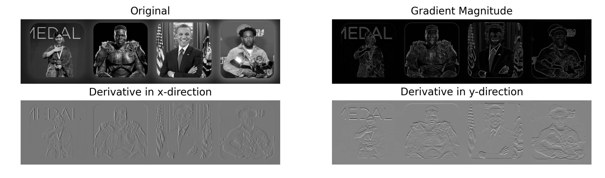
Convolutional Neural Network
CNNs are effective in analyzing images, automatically extracting features from pixels. This model was chosen as our Preliminary Design solution.
Extract hierarchical features in convolutional layer:
Lower Layers: edges, lines, colors
Input Layer
Middle Layers: patterns, shapes, textures
Higher Layers: faces objects signs of manipulation
Convolution Layer
Pooling Layer
Original
Gradient Magnitude
Inner Layer
Outer Layer
X-Direction Derivative
Y-Direction Derivative
Prewitt filter: A manual example of lower Convolutional layers
Notes:
Jouri

Slide 15
Convolutional Neural Network
Components of CNN that need to be designed and tuned for effective classification
Input Layer
Color channels, height, width of image
Definitions:
Activation Function
Convolutional Layers
Number of filters, filter size, filter stride, activation function, number of layers
Introduces nonlinearity, allows the network to learn complex patterns beyond simple linear combinations.
Pooling type, pool size, stride, placement
Pooling Type
Pooling Layers
Method used to summarize and down sample feature extracted to reduce spatial dimension.
Fully Connected Layers
Number of layers, neurons per layer, activation functions, dropout rate
Dropout Rate
Parameter used to prevent overfitting by randomly turning off some neurons during training.
1 Neuron for binary classification, Activation function
Output Layers
Notes:
Jouri

Slide 16



Dataset Breakdown
Number of Real Images
Source of Real Images
Number of Fake Images
Source of Fake Images
Dataset Name
OpenForensics
45,473
Google Images
70,325
GAN (AI-Generated)
The dataset is split into 3 parts:
Training
Development
Evaluation
44,097 images
63,885 images
7,308 images
Used to teach a machine learning model to learn patterns
Used during training to fine tune model to prevent overfitting
Used to assess a model's performance metrics
Notes:
Ashton

Slide 17



Test Plan
dataset 1
(evaluation)
Train Model
dataset 1
(training)
dataset 2
(evaluation)
Evaluate Model
Revise Model
Update:
Accuracy
Confidence Score
Confusion Matrix
dataset 1
(development)
Notes:
Ashton

Slide 18
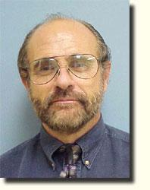
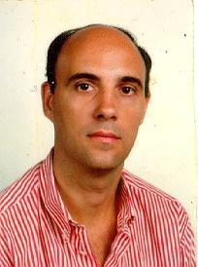
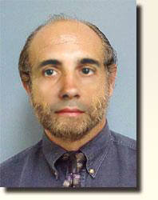
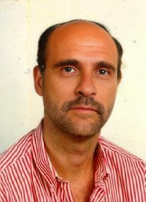
Evaluation Dataset
A secondary evaluation dataset is created to assess generalization, testing the model's performance on new and unseen data
This dataset will be 100 Fake images and 100 Real images
Images Sourced form Caltech
Images made from Photoshop and DeepfakeMaker
Original Images
DeepFake Maker
Photoshop
Notes:
Ashton

Slide 19




Design Plan
DATASET RESEARCH & SPECIFICATION
DATASET EXTRACTION & COLLECTION
I/O SETUP
IMAGE PROCESSING
MACHINE LEARNING TRAINING
MACHINE LEARNING REVISION
INTERFACE DESIGN & OPTIMIZATION
Notes:
Zac

Slide 20
GANT Milestones
Milestones | 25-Aug | 1-Sep | 8-Sep | 15-Sep | 22-Sep | 29-Sep | 6-Oct | 13-Oct | 20-Oct | 27-Oct | 3-Nov | 10-Nov | 17-Nov | 24-Nov | 1-Dec | 8-Dec | 15-Dec
Problem Statement
Design Citeria
Research Evaluation Dataset
Host Website on Web
Research CNNs
Presentation 1
Create Parallel Dataset
Create Evaluation Dataset
Requirement and Constraints
Potential Solutions
Preliminary Design
Presentation 2
Train CNN Model
Design Document
Presentation 3
Explore Xception Model
Testing Methods
Preliminary Results
Final Presentation
Poster Day
Notes:
Ashton

Slide 21
Team DeepTRUTH
Thanks you for your attention
Jouri Ghazi
Jahtega Djukpen
Ashton Bryant
Zacary Louis
Questions & Comments?

Slide 22
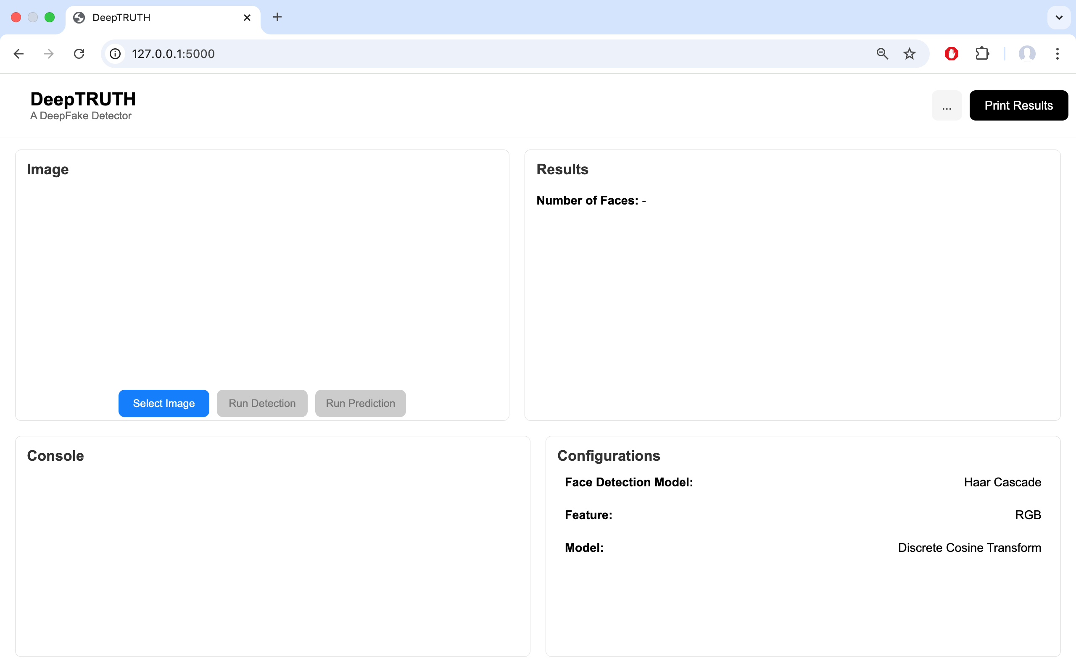
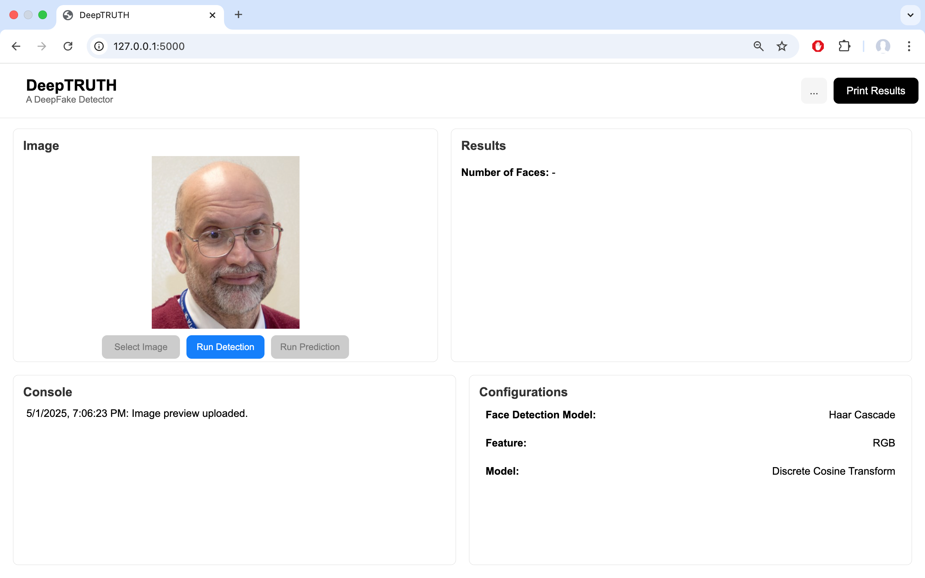
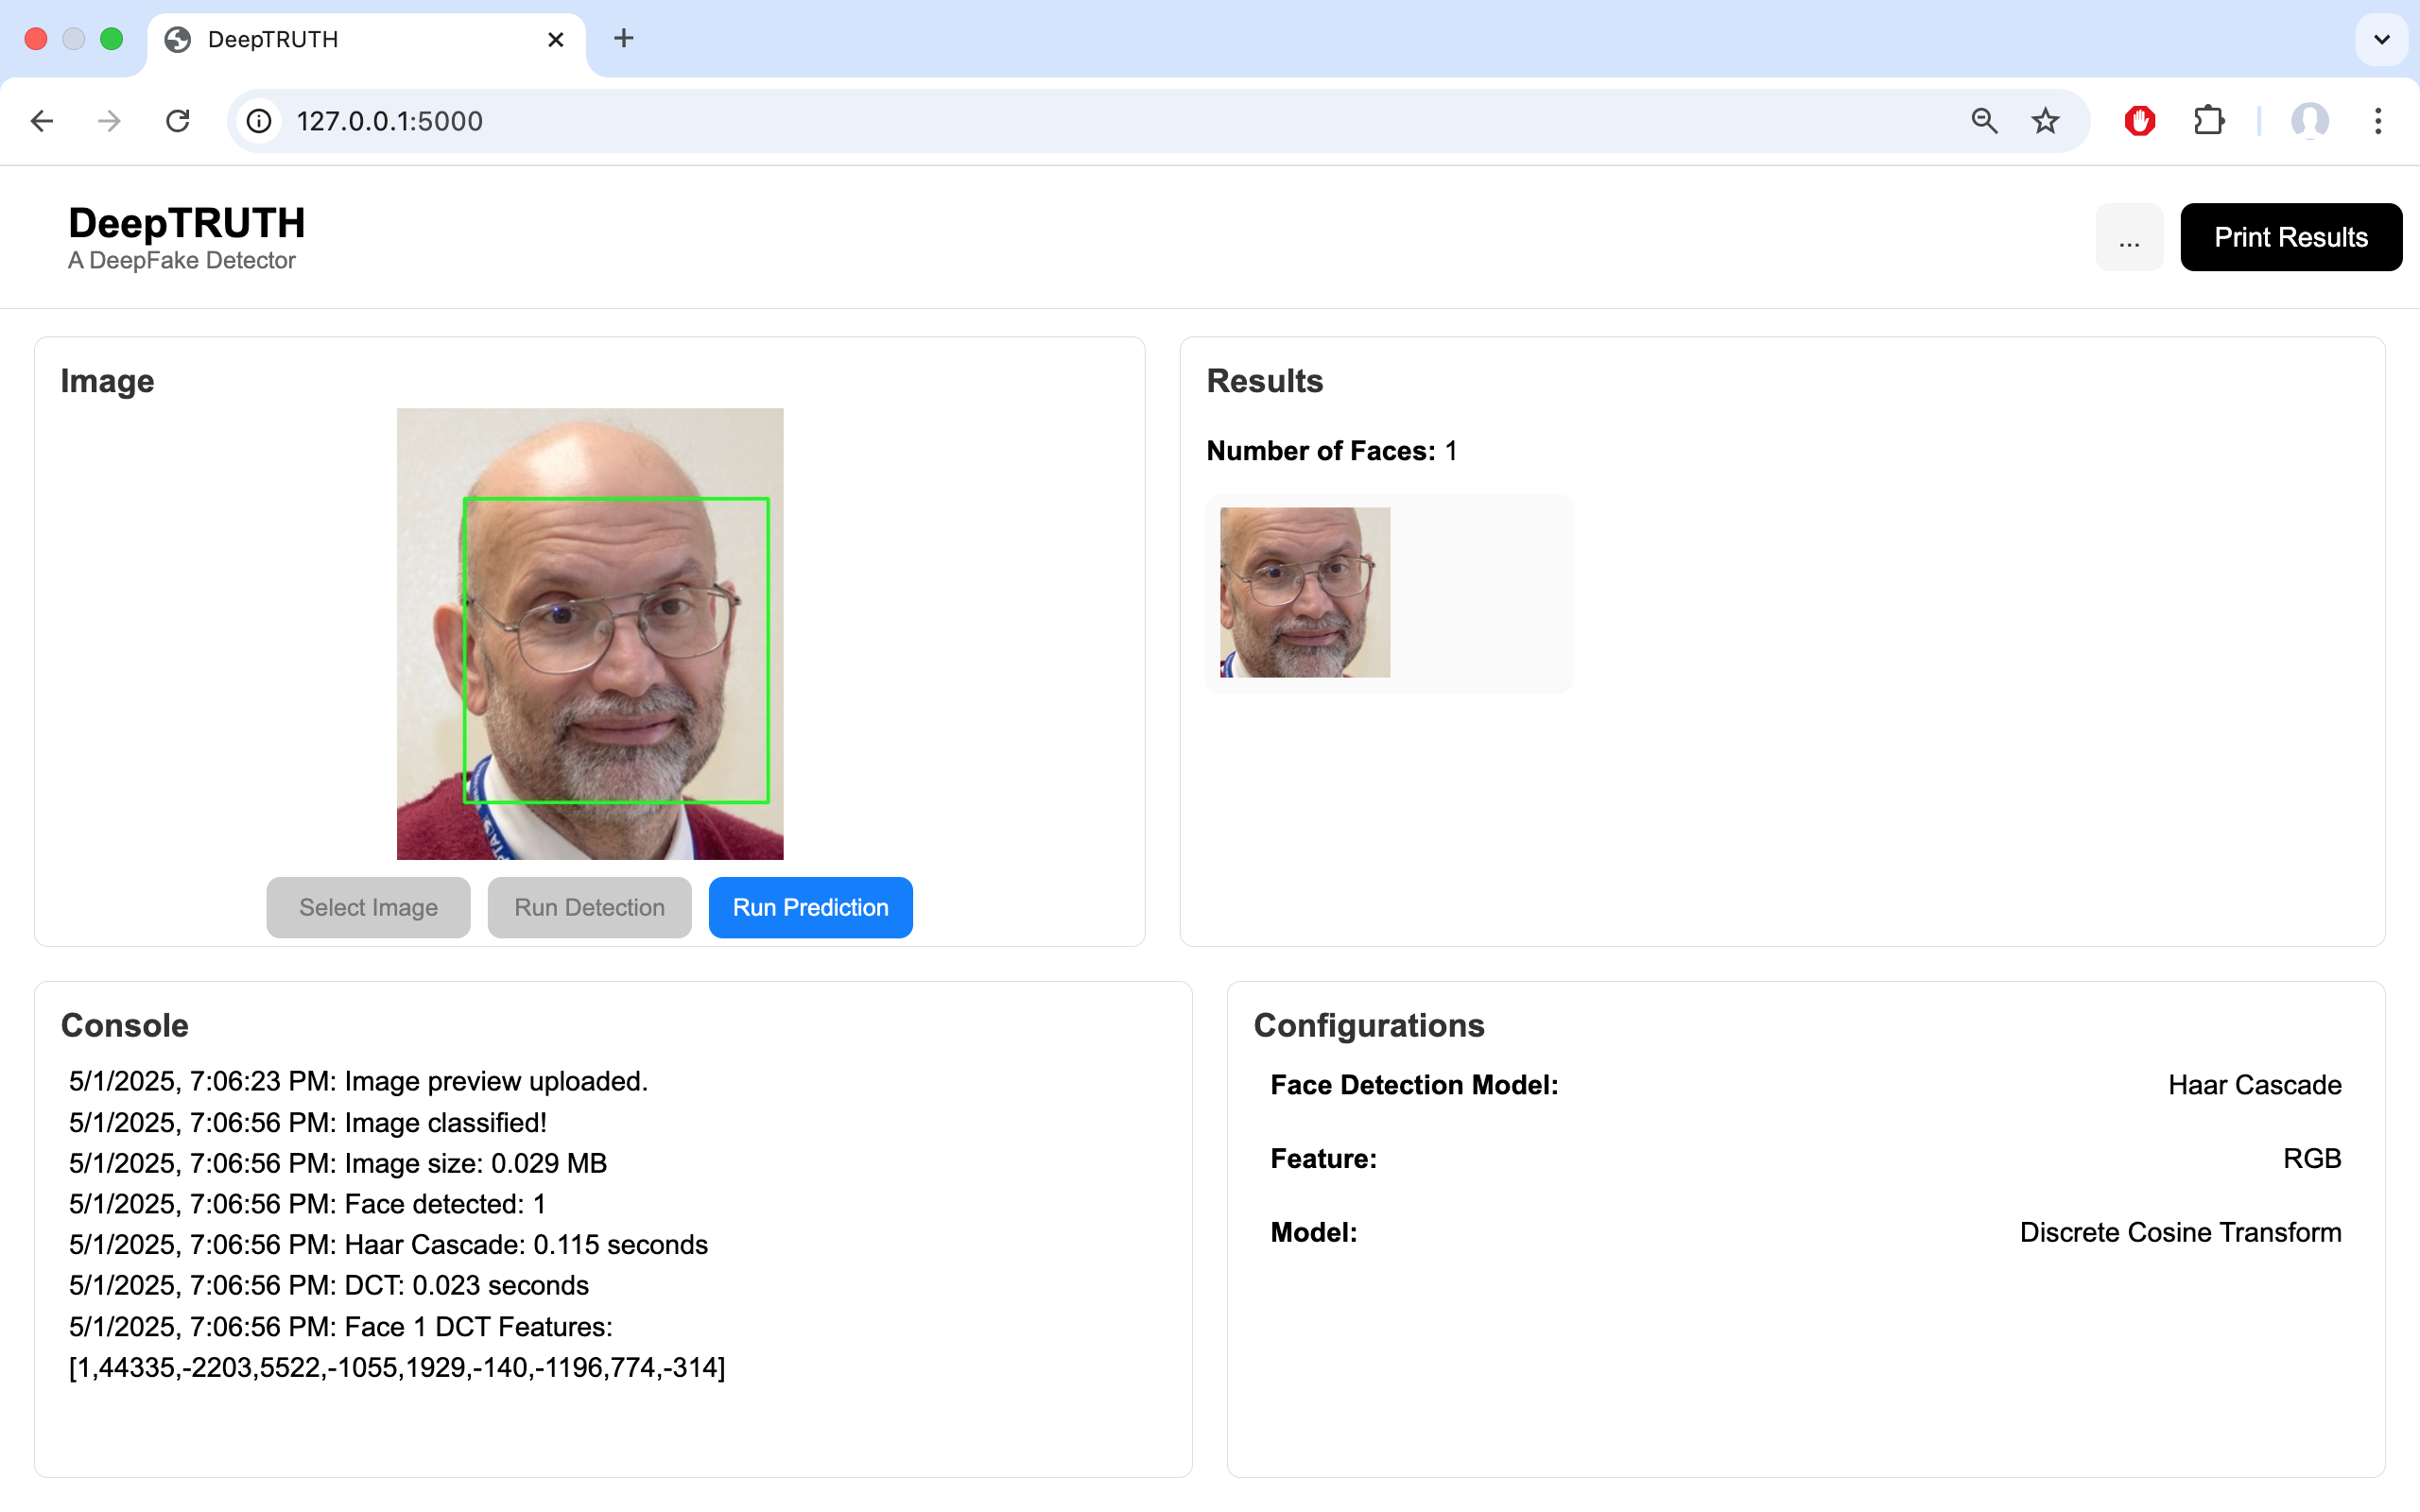
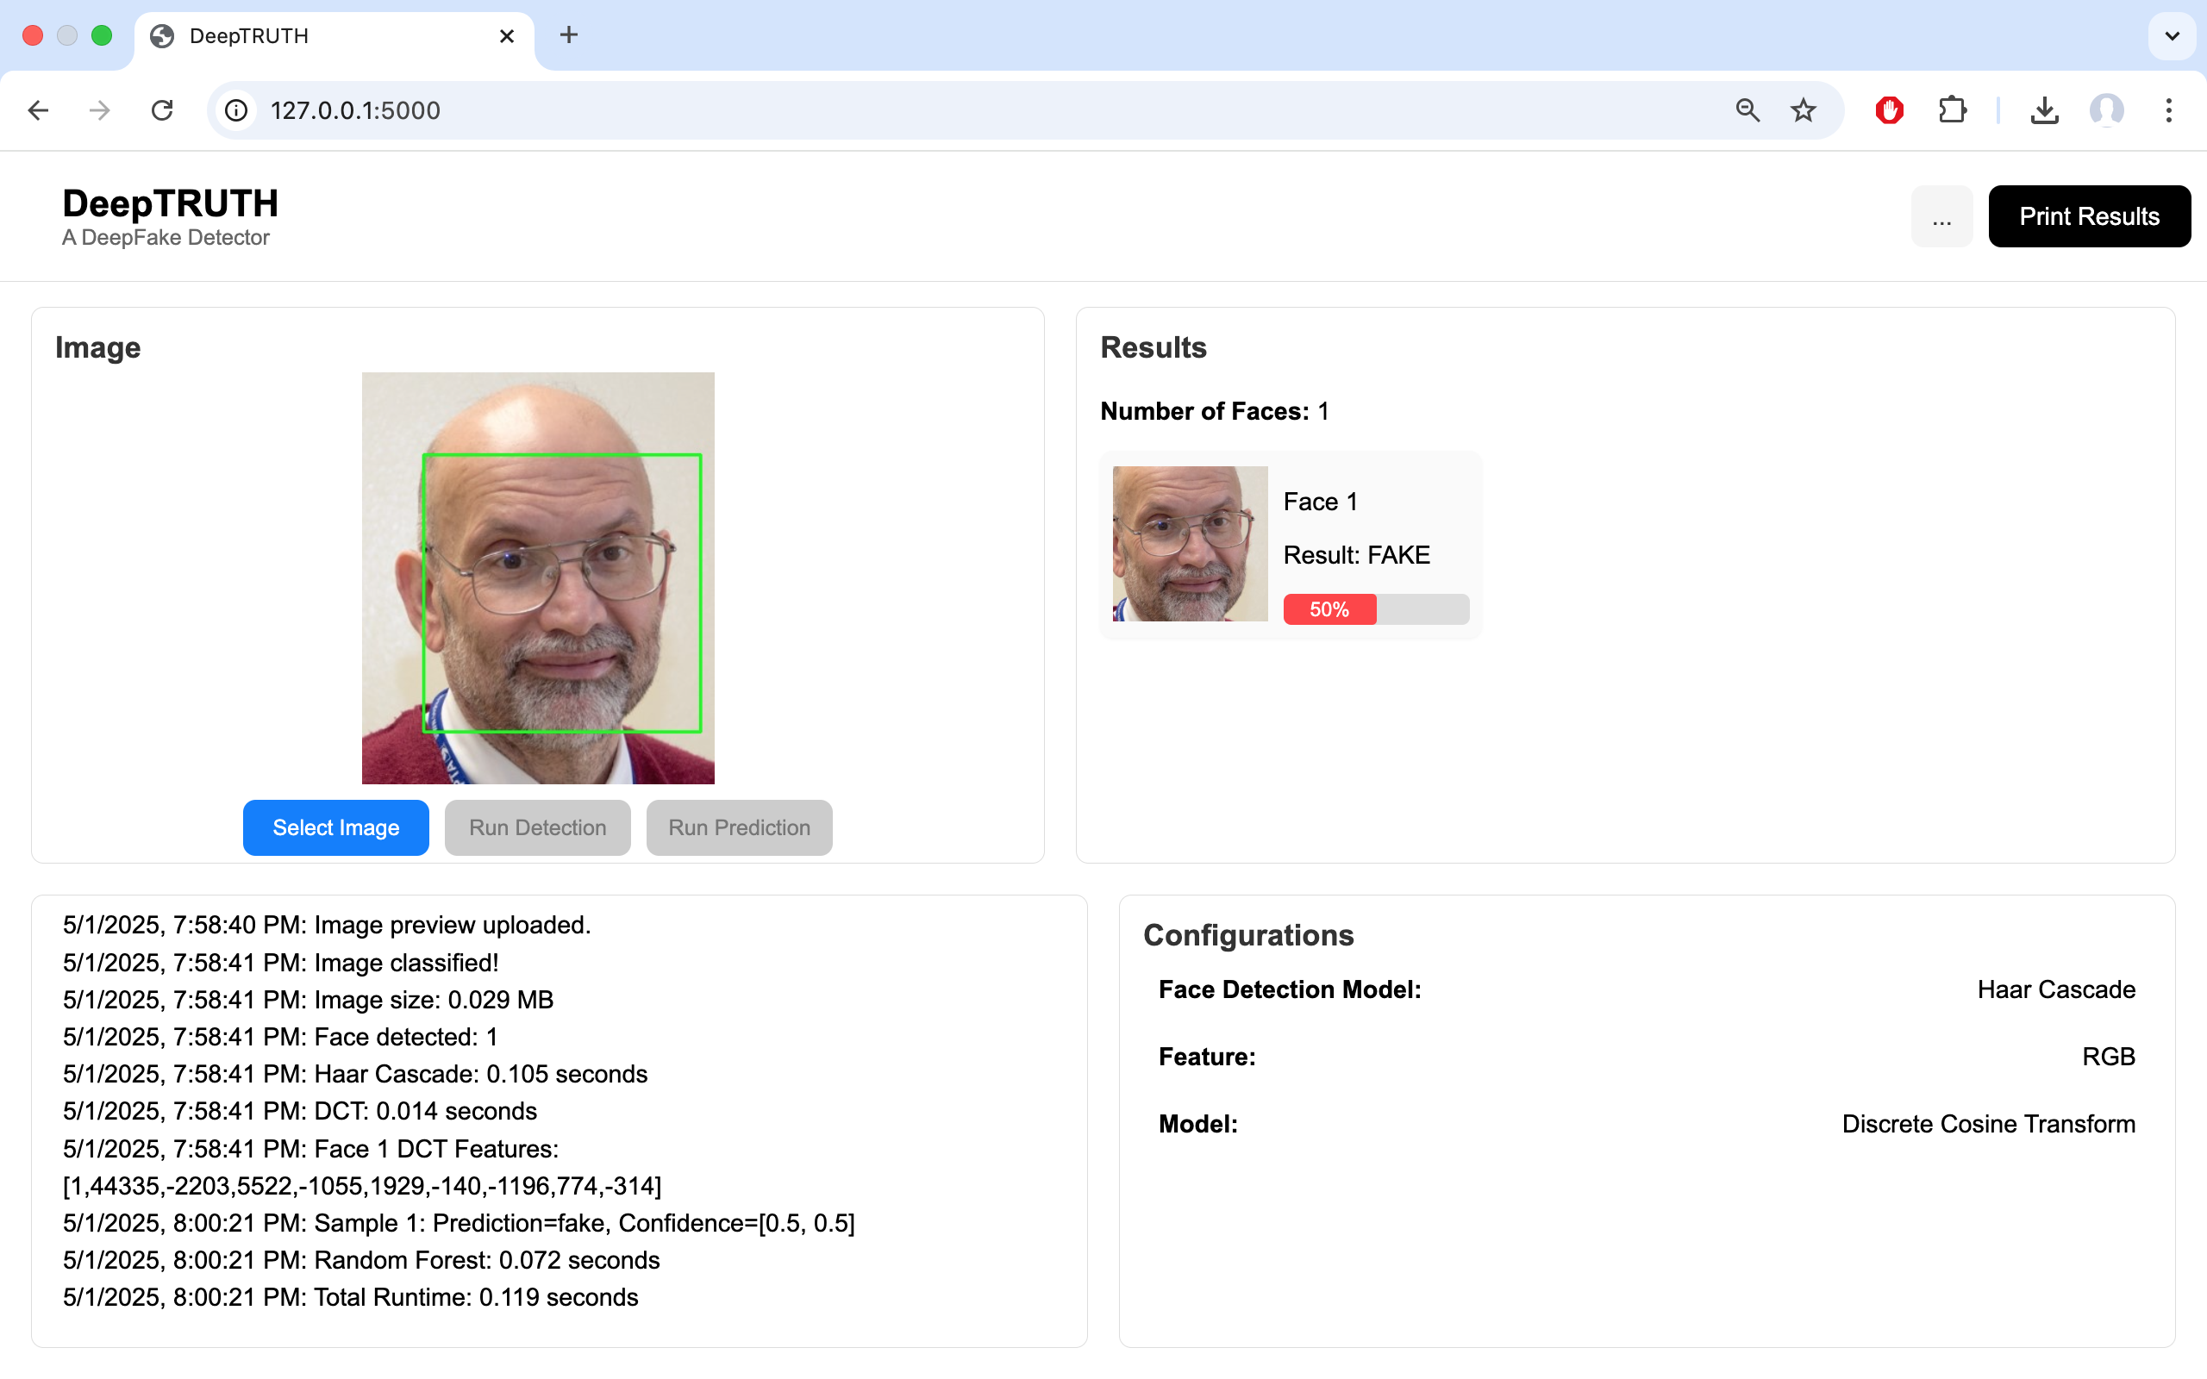
Current Functioning Prototype
User Uploads Image
Face Identified
Prediction Made
Notes:
Zacary

