Slide 1
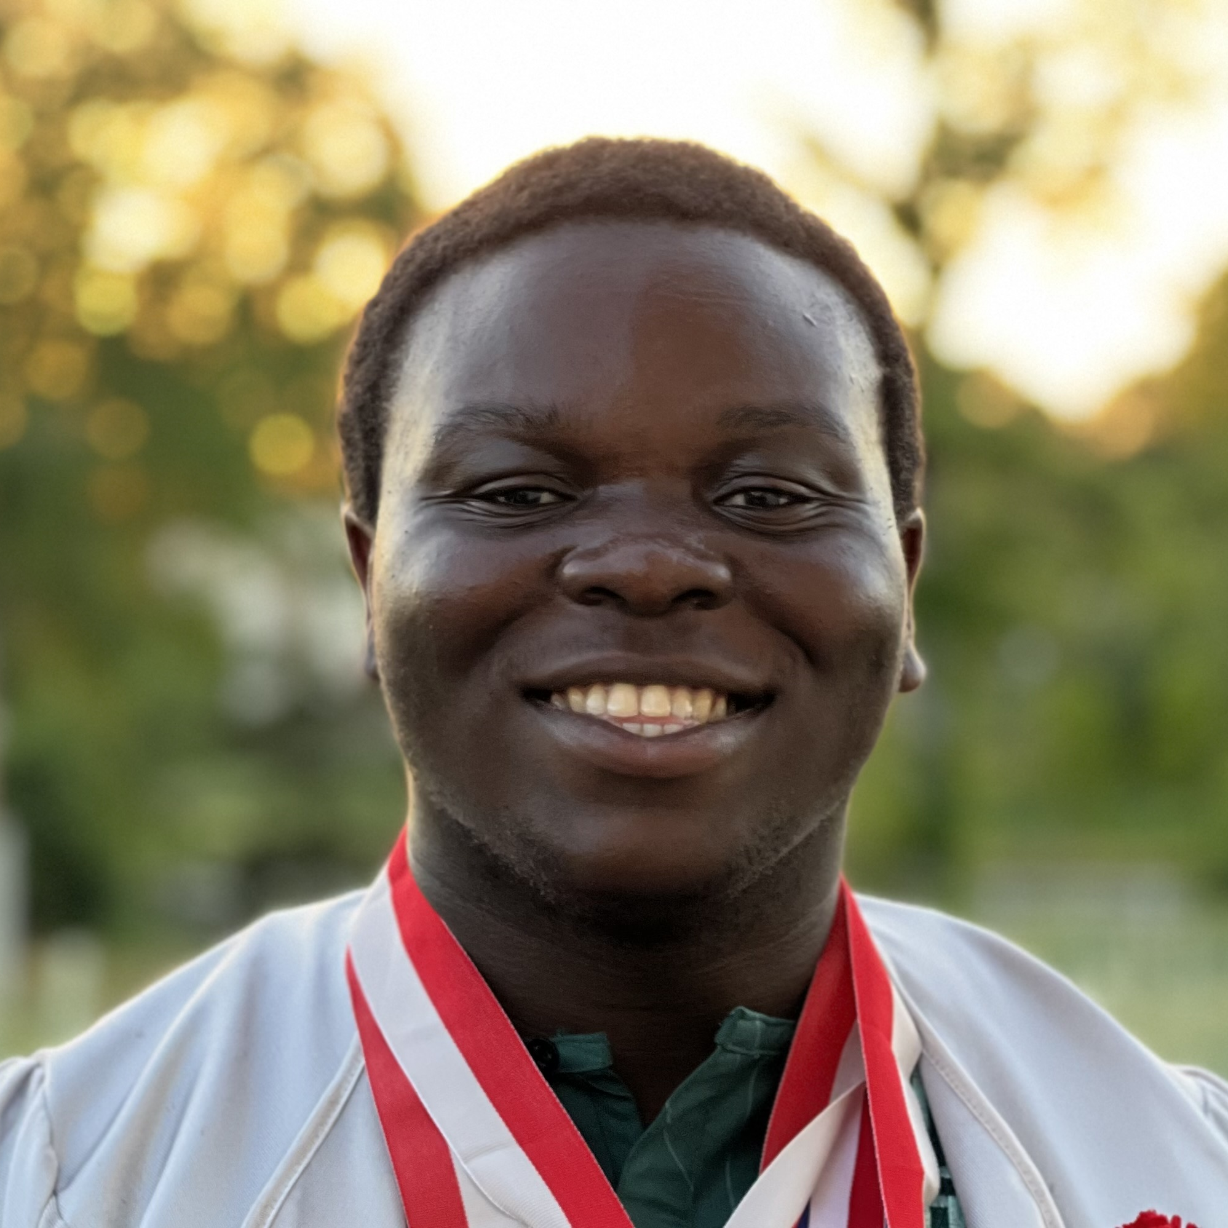
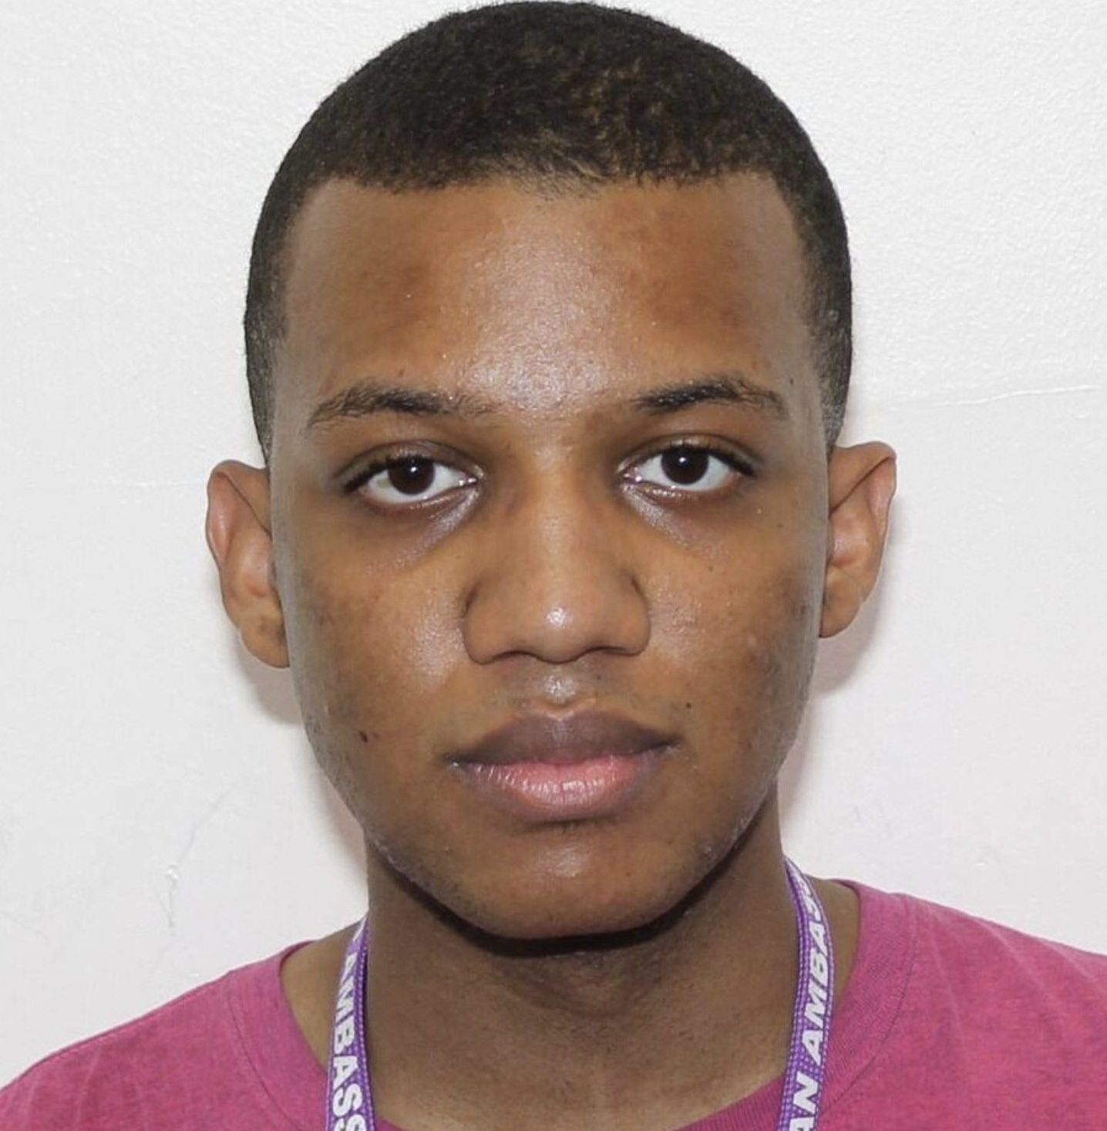
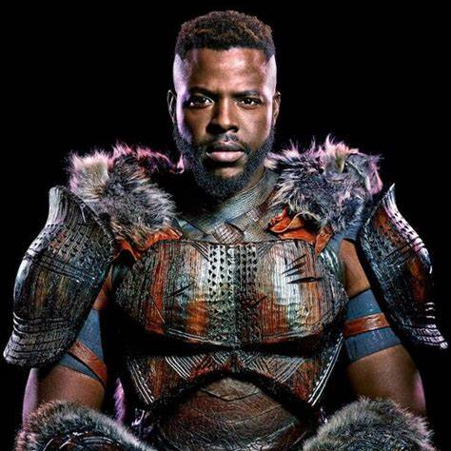
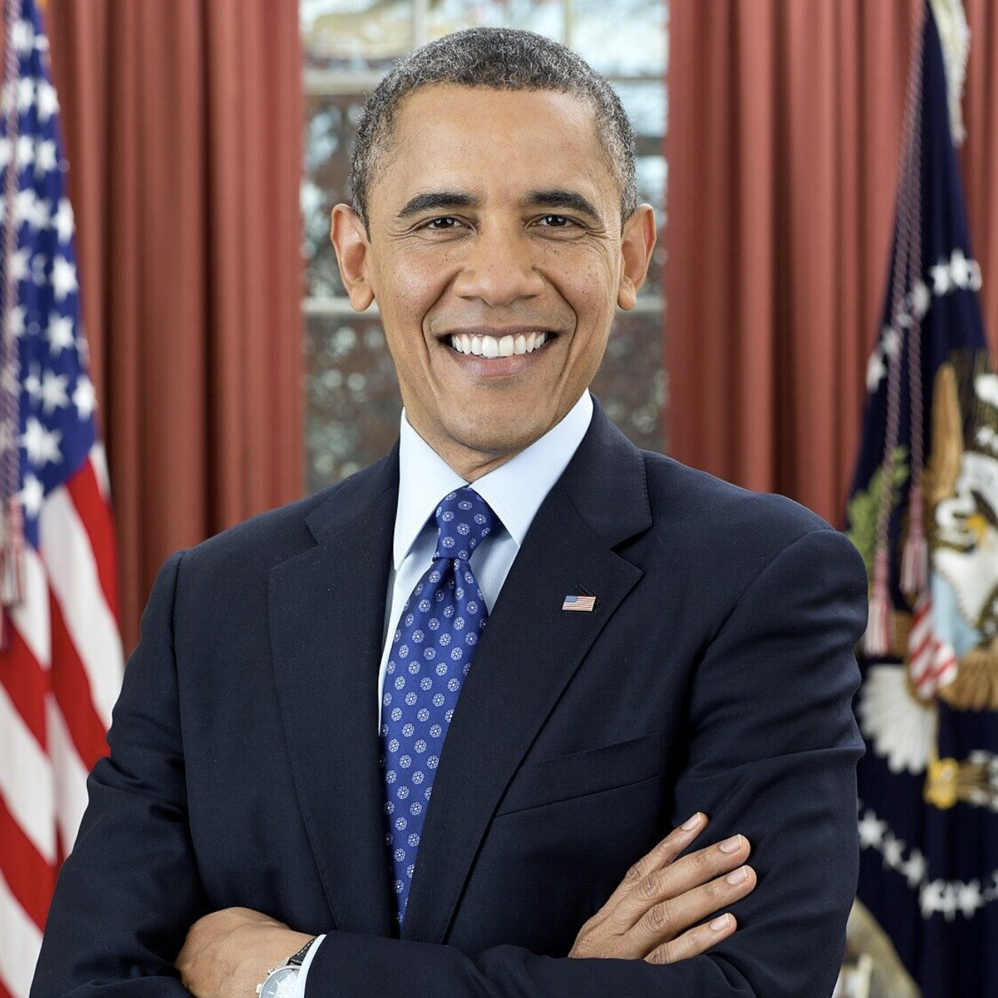
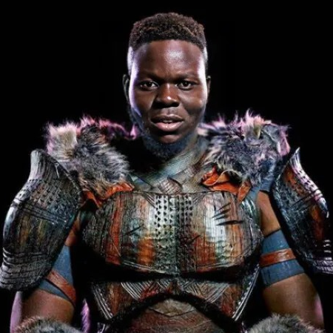
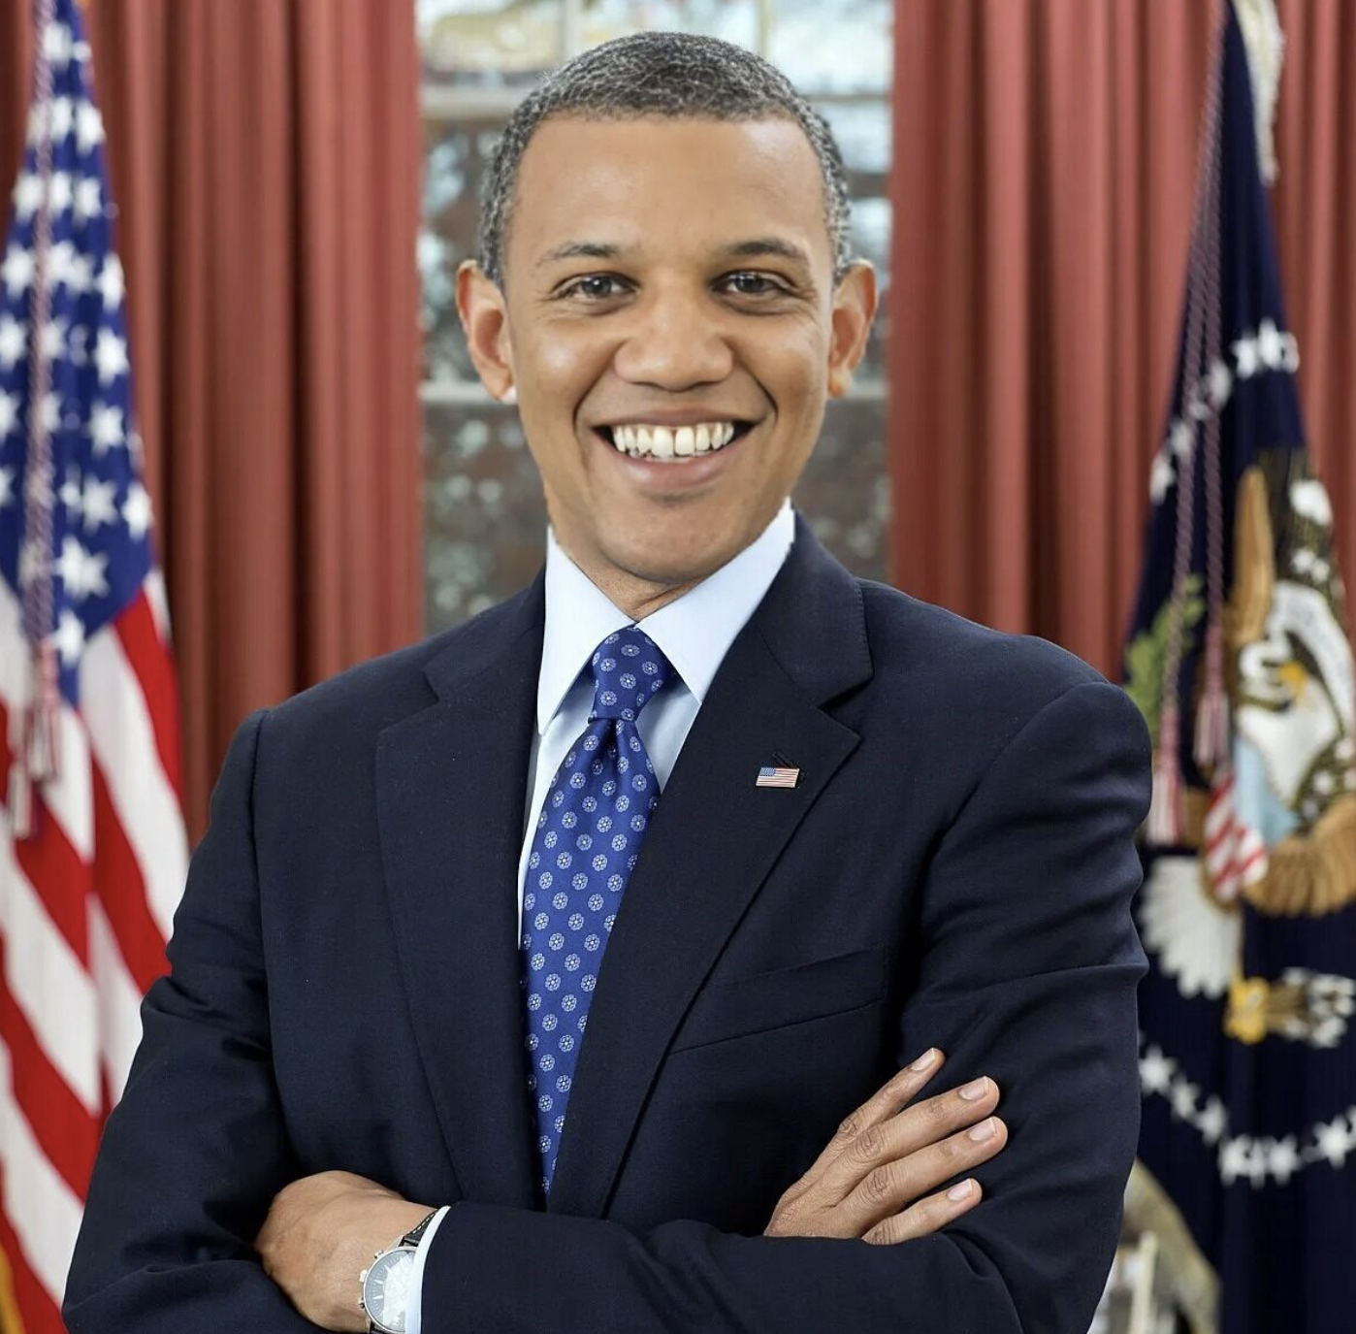
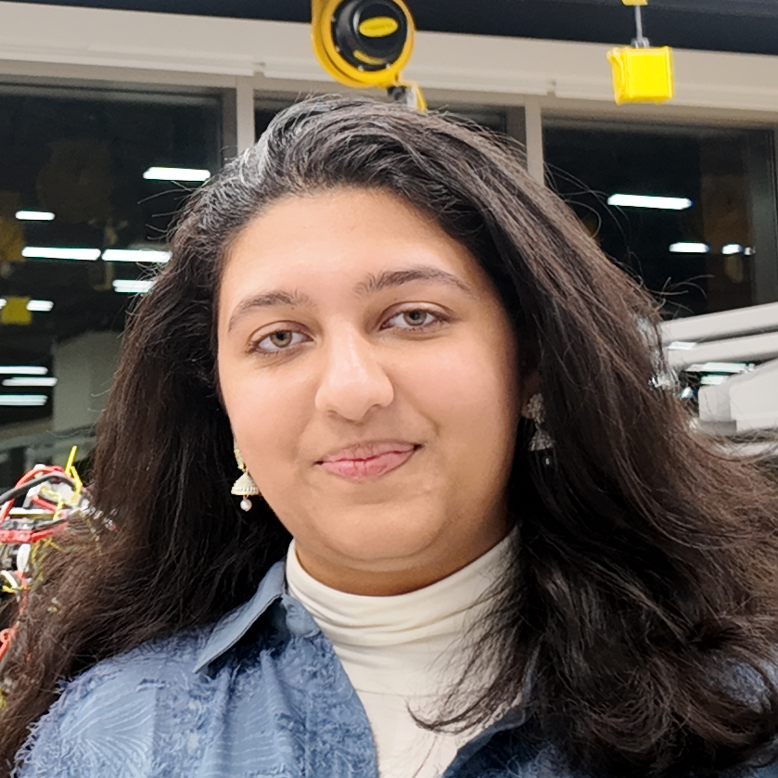

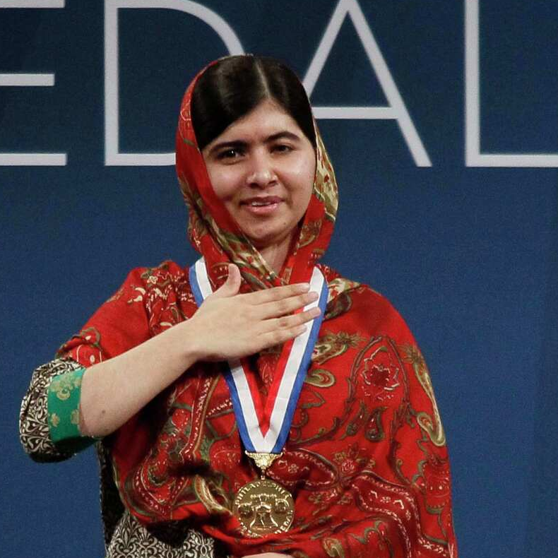

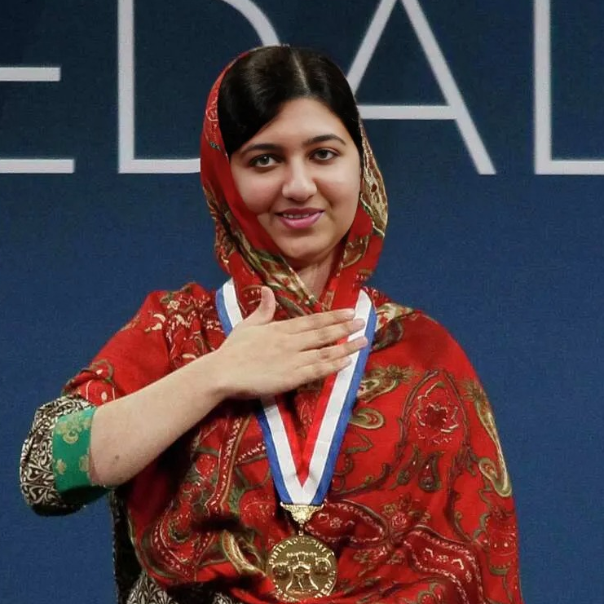

What is a DeepFake?
A form of AI-Generated content:
Target
Source
Face Swap
These images were created within a few minutes using https://deepfakemaker.io/
Notes:
Jahtega

Slide 2
Problem Statement
Artificially generated and manipulated images such as DeepFakes, have become easier to create, and harder to detect. These images pose a serious risk to the credibility of public figures, resulting in great emotional, financial and political turmoil. An accurate and reliable DeepFake detector is needed to protect individuals such as celebrities, politicians, and even corporations who are frequent victims of DeepFake misuse.
DeepFakes pose a risk to everyone, making us all stakeholders in their detection and mitigation.
Notes:
Jahtega

Slide 3









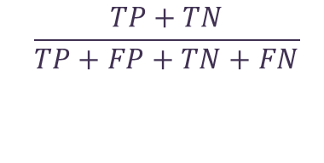

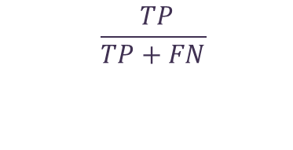
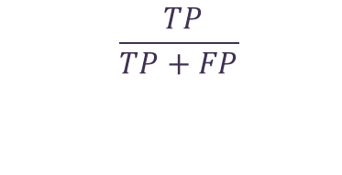
Requirement & Constraints
Criteria | Requirement / Constraint | Goal Value | Negotiability | Standard
Accuracy | Requirement | 95% | Negotiable | N/A
Precision | Requirement | 90% | Negotiable | N/A
Recall | Requirement | 85% | Negotiable | N/A
F1 Score | Requirement | 85% | Negotiable | N/A
Performance
Measuring how correctly our solution distinguishes real from fake content across datasets.
Actual / Predicted | Predicted Real | Predicted Fake
Actual Real | TP | FN
Actual Fake | FP | TN
True (T)
False (F)
Positive (P)
Negative (N)
correct
incorrect
real
fake
classification
classification
image
image
Accuracy
Precision
Recall
F1 Score
$$\frac{ TP+TN }{TP+FP+TN+FN}$$
$$\frac{ TP}{TP+FP}$$
$$\frac{ TP}{TP+FN}$$
$$2×\frac{ Precision×Recall}{Precision+Recall}$$
How often the model classifies an image correctly
Proportion of correct positive predictions to all positive cases
Proportion of positive cases correctly identified
Combines precision and recall into a balanced metric
Criteria | Requirement / Constraint | Goal Value | Negotiability | Standard
Interpretability | Requirement | Pass | Negotiable | WACG
Accessibility | Requirement | Pass | Negotiable | WACG
User Interface | Requirement | Pass | Negotiable | WACG
Usability
Demonstration app is intuitive, accessible, offering results with low user effort.
Interpretability
Accessibility
User Interface
All content is interpretable, maintains appropriate color contrast, and uses text for UI feedback.
App is usable with mouse or keyboard and is compatible with screen readers and assistive technologies.
Interface is intuitive, and easy to navigate, with components clearly labeled.
Criteria | Requirement / Constraint | Goal Value | Negotiability | Standard
Process Time | Requirement | 2.50 sec/face | Negotiable | N/A
Site Start time | Requirement | 5 Seconds | Negotiable | N/A
Resource Usage | Constraint | < 128 RAM | Non-Negotiable | ISIP
Generalizability | Requirement | 60% | Negotiable | N/A
Efficiency
Delivering fast, results while minimizing resource usage, ensuring smooth performance.
Algorithm Process Time
Website Boot Time
Resource Usage
Generalizability
Our final algorithm classification time should below 2500 ms per face.
Our website should be readily live and accessible, hosted on the ISIP server.
Our application should use less than 128 GB of RAM on the Neuronix Cluster.
The models should classify images from different DeepFake methods.
Criteria | Requirement / Constraint | Goal Value | Negotiability | Standard
ISIP Guideline | Constraint | Pass | Non-Negotiable | ISIP
Documentation | requirement | Pass | Non-Negotiable | ISO 12207
Code Maintainability
Ease with which a codebase can be understood, modified, tested, and extended over time.
Criteria | Requirement / Constraint | Goal Value | Negotiability | Standard
Algorithmic Transparency | Constraint | Pass | Non-negotiable | IEEE7003- 2024 Standard
Website Security | Requirement | Pass | Non-Negotiable | ISO 27001
Ethic & Security
Ensuring user privacy, protecting data, and promoting responsible detection with fairness and transparency.
ISIP Guideline
ISO 12207
IEEE 7003
ISO 27001
We should follow ISIP’s naming conventions and commenting style.
Create documents such as read me files and user guides, which are accessible.
Documenting race or gender bias in the model to confirm the system works as intended.
The application should not store uploaded photos, keeping all user data private.
Notes:
Jouri

Slide 4





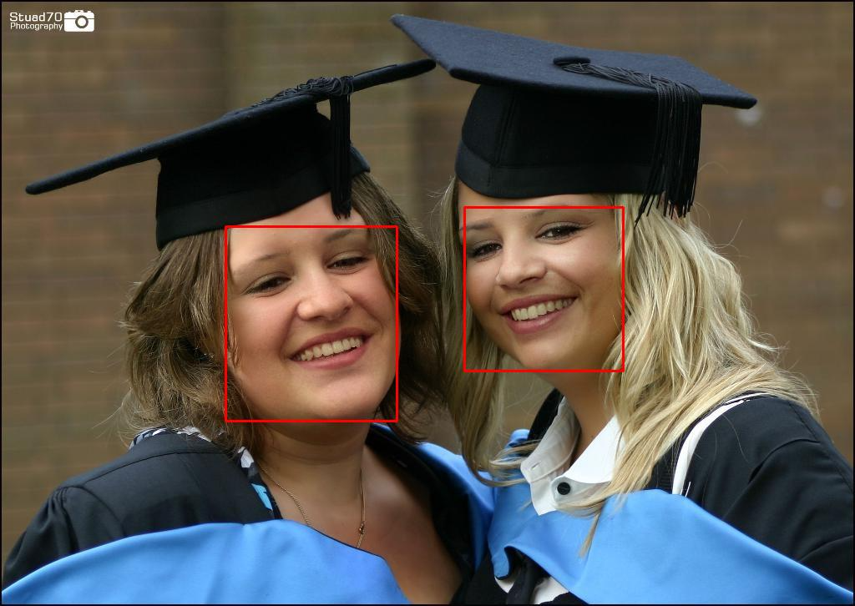
Requirement & Constraints
Criteria | Requirement Constraint | Goal Value | Negotiable / Non-Negotiable | Standard
ISIP Guideline | Constraint | Pass | Non-Negotiable | ISIP
Documentation | requirement | Pass | Non-Negotiable | ISO 12207
Code Maintainability
Ease with which a codebase can be understood, modified, tested, and extended over time.
Criteria | Requirement Constraint | Goal Value | Negotiable / Non-Negotiable | Standard
Algorithmic Transparency | Constraint | Pass | Non-negotiable | IEEE7003- 2024 Standard
Website Security | Requirement | Pass | Non-Negotiable | ISO 27001
Ethic & Security
Ensuring user privacy, protecting data, and promoting responsible detection with fairness and transparency.
ISIP Guideline
ISO 12207
IEEE 7003
ISO 27001
We should follow ISIP’s naming conventions and commenting style.
Create documents such as read me files and user guides, which are accessible.
Documenting race or gender bias in the model to confirm the system works as intended.
The application should not store uploaded photos, keeping all user data private.
Engineering Design
Our project was developed in 3 portions:
Dataset Management
Model Training
Web Tool Development
The process of labeling data to train AI models.
Training a detector to classify by feeding it processed data.
A platform for users to upload images and detect DeepFakes.
Dataset Breakdown
Number of Real Images
Number of Fake Images
Source of Real Images
Source of Fake Images
Dataset Name
OpenForensics
45,473
70,325
Google Images
GAN (AI-Generated)
Two Lists of Information
ID
Image_id
Iscrowd
Area
Category_ID
Bbox
segmentation
FACE[1]
Annotations
Image ID
Face ID
Iscrowd
Area
Category ID
BBox
Segmentation
IMG_1_FACE[1]
Real or Fake
Bounding box
Segmentation
Images
Image ID
File Name
Width
Height
…
IMAGE[1]
IMG_1_FACE[N]
ID
Image_id
Iscrowd
Area
Category_ID
Bbox
segmentation
FACE[2]
…
Real or Fake
Bounding box
Segmentation
IMAGE[1]
ID
Image_id
Iscrowd
Area
Category_ID
Bbox
segmentation
IMG_N_FACE[1]
IMAGE[N]
…
IMG_N_FACE[N]
ID
Image_id
Iscrowd
Area
Category_ID
Bbox
segmentation
Bounding Box [x, y, width, height]
Notes:
Jouri

Slide 5
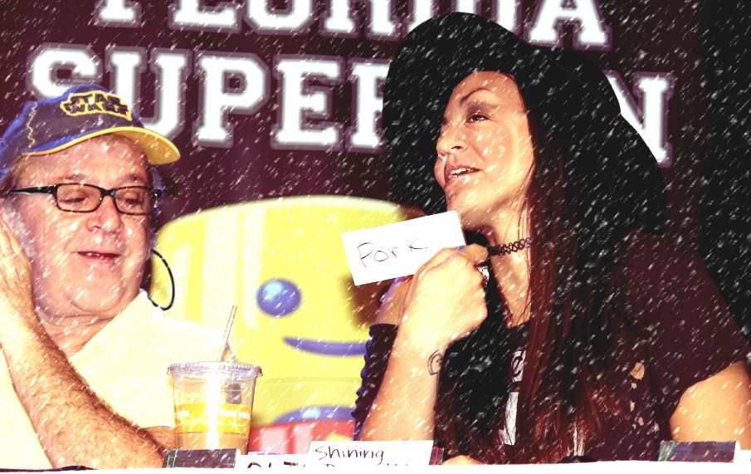
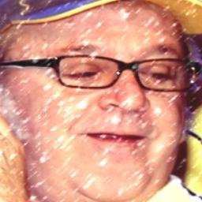
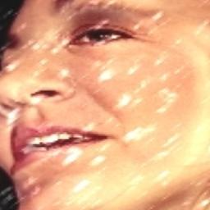



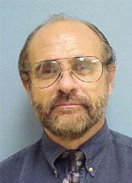
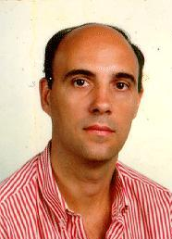
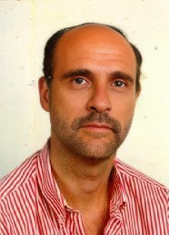
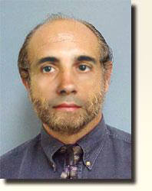
Dataset Management
Number of Real Images
Number of Fake Images
Source of Real Images
Source of Fake Images
Dataset Name
OpenForensics
45,473
70,325
Google Images
GAN (AI-Generated)
Original Annotation
Images
Image ID
File Name
Width
Height
Annotations
Image ID
Face ID
Iscrowd
Area
Category ID
BBox
Segmentation
ID
Image_id
Iscrowd
Area
Category_ID
Bbox
segmentation
IMG_ N _FACE[1]
IMAGE[N]
…
IMG_ N _FACE[N]
ID
Image_id
Iscrowd
Area
Category_ID
Bbox
segmentation
Bounding Box [x, y, width, height]
Dataset Reformatting
A parallel dataset of faces is created to better train and develop the model
This dataset is made up of images that contain one face each.
Original Image
Face 1
Face 2
IMAGE[1]
/* _0.jpg
/* _1.jpg
110,836 Real faces
Filenames ending in *_0. jpg are real, and *_1.jpg are fake
105,093 Fake faces
Train
Develop
Validate
150,866 Faces
49,718 Faces
15,345 Faces
Used to teach a model patterns
Used to fine tune model to prevent overfitting
Used to assess a model's performance metrics
Caltech Dataset
A secondary evaluation dataset is created to assess generalizability (the model's performance on unseen data). This dataset is made up of 100 Fake images and 100 Real images. The original images are sourced from Caltech. DeepFakes made from Photoshop and DeepfakeMaker.
DeepFake Maker
Original Images
Photoshop
Notes:
Ashton- fix animation

Slide 6
Dataset Reformatting
A parallel dataset of faces is created to better train and develop the model
This dataset is made up of images that contain one face each.
Original Image
Face 1
Face 2
IMAGE[1]
/* _0.jpg
/* _1.jpg
110,836 Real faces
Filenames ending in *_0. jpg are real, and *_1.jpg are fake
105,093 Fake faces
Train
Develop
Validate
150,866 Faces
49,718 Faces
15,345 Faces
Used to teach a model patterns
Used to fine tune model to prevent overfitting
Used to assess a model's performance metrics
Notes:
Jahtega

Slide 7
Caltech Dataset
A secondary evaluation dataset is created to assess generalizability (the model's performance on unseen data). This dataset is made up of 100 Fake images and 100 Real images. The original images are sourced from Caltech. DeepFakes made from Photoshop and DeepfakeMaker.
DeepFake Maker
Original Images
Photoshop
Notes:
Ashton

Slide 8


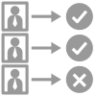




















Model Development
Training set
Three implemented solutions:
Development set
Legend:
Training set
Development set
Validation set
Input dataset
Random Forest
Phase
Train
Model
Develop
Model
Evaluate
Model
DeepTRUTH CNN
Performance metrics
Efficientnet B0
Continuously Update Model
Outputted
Loss/Batch
Outputted
Loss/Batch
Update
Confusion Matrix
Random Forest
This model was our baseline, achieving 55% accuracy.
Dataset
Tree 1
Tree 2
Tree N
Each tree is trained on a random subset of the training data
Based on the principle of “wisdom of the crowd”
Trained on extracted statistical features of the images
Result 1
Result 2
Result N
Averaging
N Estimators
Max Depth
Min Samples Split
Max Leaf Nodes
Number of trees in the forest
Maximum depth of each tree
When a node in the tree is allowed to split
How many end leaves a tree can have
Classification
Convolutional Neural Network
Input Layer
Convolution Layer
Pooling Layer
Model that processes grid data like images.
Automatically learns features such as edges.
Uses convolution for feature detection and reduction.
Inner Layer
Convolution Layer
Pooling Layer
Input Layer
Inner Layer
Outer Layer
Outer Layer
Feeds image into model
Extracts features from image
Down samples information
Learn complex patterns
Outputs final classification
EfficientNet B0 (EB0)
Conv 3x3
Input Image
MBConv1, 3x3
Block 1
MBConv6, 3x3
Block 2
MBConv6, 3x3
MBConv6, 5x5
CNN model designed for image classification.
Pretrained on ImageNet-1K, 1.2 million images.
A baseline used for transfer learning, repurposing learned features.
Block 3
MBConv6, 5x5
MBConv6, 3x3
MBConv6, 3x3
Block 4
MBConv6, 3x3
MBConv6, 5x5
MBConv6, 5x5
Block 5
Initial Conv
Block N
MBConvN
NxN
Feature Map
MBConv6, 5x5
MBConv6, 3x3
Block 6
Extracts basic patterns and edges
Allows model to progressively extract features
Expand, filters then compresses the data
Determines feature detector size
Map of detected features
Feature Map
Notes:
Ashton

Slide 9

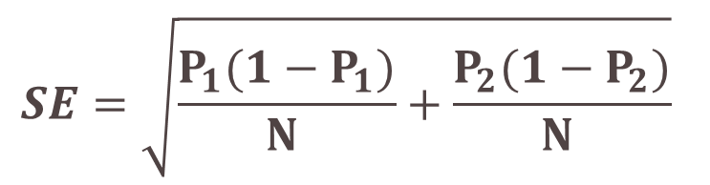
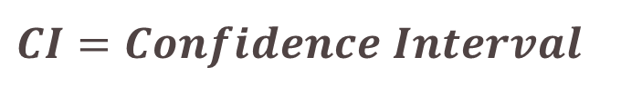


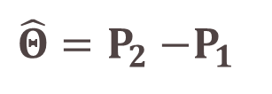








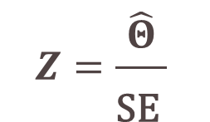
Model Performance
The dataset is split into 3 parts, when model is trained then each subsection is decoded.
Model | Random Forest |  |  | DeepTRUTH |  |  | EB0 |  |  | Goal Value
 | Train | Development | Validation | Train | Development | Validation | Train | Development | Validation
Accuracy | 98.90% | 54.60% | 54.70% | 98.54% | 96.41% | 94.44% | 98.97% | 99.36% | 98.90% | 95%
Precision | N/A |  |  | 99.46% | 95.01% | 89.84% | 99.89% | 99.33% | 98.10% | 90%
Recall | N/A |  |  | 97.97% | 96.46% | 92.13% | 98.31% | 99.16% | 98.36% | 85%
F1 | N/A |  |  | 98.71% | 95.73% | 90.97% | 99.10% | 99.25% | 98.23% | 85%
Model | DeepTRUTH | EB0 | Goal Value
 | CalTECH | CalTECH
Accuracy | 60.64% | 60.64% | 60%
Precision | 70.07% | 96.60% | N/A
Recall | 65.95% | 60.43% | N/A
F1 | 67.76% | 74.35% | N/A
The CalTECH dataset is used to determine the models generalizability
DeepFake Maker
Photoshop
Statistical Significance
A measure used to determine if differences in accuracy indicates a meaningful improvement.
$$Ν$$
$$Ρ_{1}$$
$$Ρ_{2}$$
$$\hat{Θ}$$
$$SE$$
$$Z$$
$${CI}_{low}$$
$${CI}_{up}$$
$$Sig$$
Dataset | Total Faces | Accuracy |  | Difference | Standard Error | Z Statistic | CI Lower | CI Upper | Significant?
 |  | DeepTRUTH | EB0
Train | 150866 | 98.54% | 98.97% | 0.43% | 4.0E-04 | 10.65 | 0.35% | 0.51% | Yes
Development | 49718 | 96.41% | 99.36% | 2.95% | 9.1E-04 | 32.50 | 2.77% | 3.13% | Yes
Evaluation | 15345 | 94.44% | 98.90% | 4.46% | 2.0E-03 | 21.94 | 4.06% | 4.86% | Yes
Caltech | 223 | 60.64% | 60.64% | 0.00% | 4.6E-02 | 0.00 | -9.07% | 9.07% | No
$$Z_{α/2}=1.96, 95\% confidence$$
$$\hat{Θ}=Ρ_{2}{−Ρ}_{1}$$
$$SE=\sqrt{\frac{Ρ_{1}(1−Ρ_{1})}{Ν }+\frac{Ρ_{2}(1−Ρ_{2})}{Ν }}$$
$$CI=Confidence Interval$$
$$Z=\frac{\hat{Θ}}{\text{SE} }$$
$${CI}_{low}=\hat{Θ}−Z_{α/2}∙SE$$
$${CI}_{up}=\hat{Θ}+Z_{α/2}∙SE$$
Notes:
Ashton

Slide 10



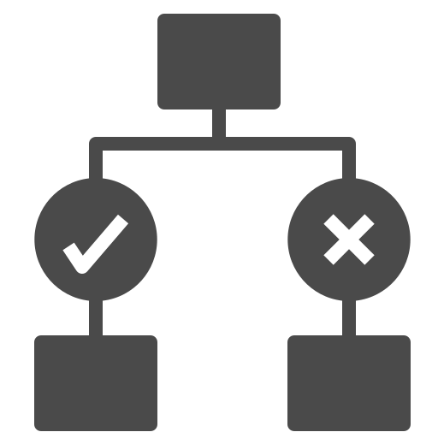


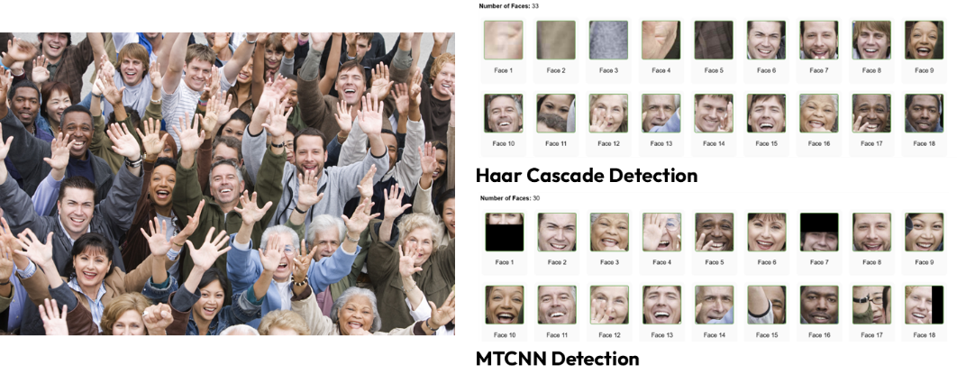
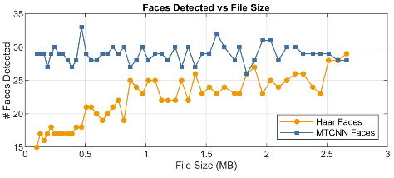
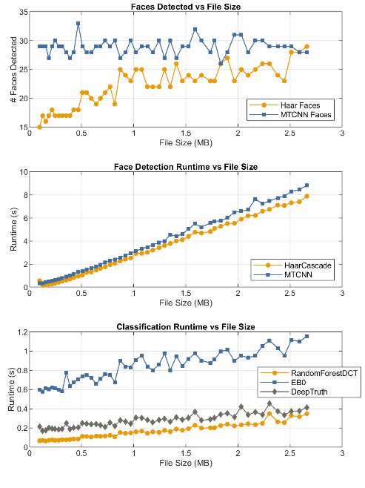
Website Overview
System Workflow
User Button
Selected Options
Returned Results
Random Forest
Upload Image
Image Displayed
Select Face Detection Method
Haar Cascade Detection
Return Detection Results
Select Face Classification Method
Return Classification Results
DeepTRUTH
MTCNN Detection
EB0
Front End
Back End
Is this image real?
System Architecture
HTML, CSS
Upload Image
Java
Haar Cascade or
MTCNN
Random Forest or
DeepTRUTH or EB0
Python
Detect Faces
Classify Faces
Present Results
Application Run Time
A variety of images were used to test the application
Original Image
 | Faces Detected | HAAR+ RNF | HAAR + DeepTRUTH | HAAR+ EB0 |  | Faces Detected | MTCNN + RNF | MTCNN+ DeepTRUTH | MTCNN+ EB0
Size (MB) | Haar Cascade | ms/Face | ms/Face | ms/Face |  | MTCNN | ms/Face | ms/Face | ms/Face
0.25 | 17 | 24.94 | 31.94 | 56.59 |  | 30 | 23.73 | 27.70 | 41.67
0.64 | 19 | 84.63 | 91.32 | 113.32 |  | 29 | 65.55 | 69.93 | 84.34
1.13 | 22 | 144.36 | 150.64 | 176.00 |  | 29 | 125.14 | 129.90 | 149.14
1.74 | 23 | 218.78 | 222.65 | 248.17 |  | 28 | 206.21 | 209.39 | 230.36
2.38 | 24 | 307.79 | 312.29 | 309.79 |  | 29 | 276.00 | 279.72 | 302.48
 | Average | 156.10 | 161.57 | 156.77 |  | Average | 139.33 | 143.33 | 161.60
All possible combinations perform better than goal amount
Image was scaled up by 1.1x per iteration
Notes:
Zac- change animation – sequentially

Slide 11
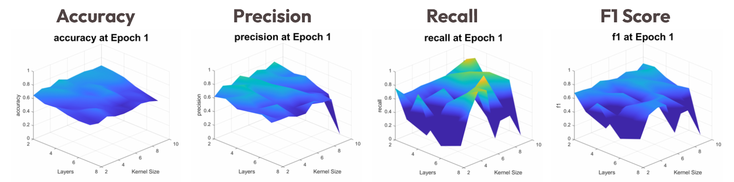
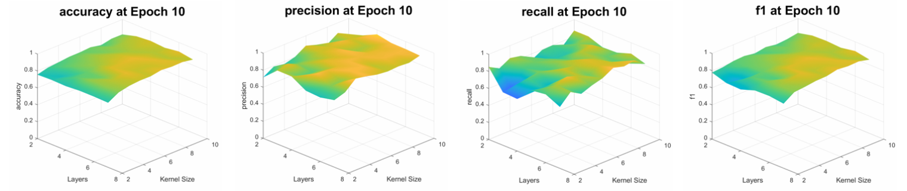
CNN DeepTRUTH Model
The number of layers and the size of the kernels were iterated, and the model was evaluated on the validation data after each epoch.
Kernel: A filter in the form of a small matrix
Layer: level of processing that extracts features to learn
Notes:
Jouri

Slide 12

Project Results
 | Criteria | Goal Value | Achieved Value | Justification
Performance | Accuracy | 95% | 98.90% | The EB0 Model performed the best
 | Precision | 90% | 98.10%
 | Recall | 85% | 98.36%
 | F1 Score | 85% | 98.23%
Efficiency | Algorithm Process time | 1500 ms/Face | < 161.60 ms/Face | MTCNN+EB0 took the longest
 | Website boot time | 5 Seconds | < 1 Second | Webtool available online
 | Resource Usage | < 128 GB RAM | <16 GB RAM | Runs on laptop
 | Dataset Generalizability | 60% | 60.64% | Performance on Caltech Dataset
Code Maintainability | ISIP Guide Compliance | Pass | Pass | Produced proper documentation for all software
 | Documentation | Pass | Pass
Usability | Interpretability | Pass | Pass | Feedback console & confidence information
 | Accessibility | Pass | Pass | Keyboard tested
 | User Interface | Pass | Pass | High contrast colors + simple UI
Ethics & Security | Algorithmic Transparency | Pass | Pass | No bias in model performance across gender detected
 | Website Security | Pass | Pass | All dependencies on CSV’s removed, photo data cleared
This project was entirely software based and thus required no additional cost.
Visit our website at: https://isip.piconepress.com/projects/dfake/
Future Work
If someone were to continue this project, they could:
Investigate dataset quality
Our application’s performance lies in its generalizability, and deepfake detection remains a moving target as content generation methods evolve.
Train on alternative DeepFake datasets
Implement DeepFake audio or video detection
DeepFake detection is a moving target as content generation methods evolve.
Notes:
Jahtega

Slide 13
Selected References
[1]
F. Juefei-Xu, R. Wang, Y. Huang, Q. Guo, L. Ma, and Y. Liu, “Countering Malicious DeepFakes: Survey, Battleground, and Horizon,” arXiv.org, 2021. https://arxiv.org/abs/2103.00218
T.-N. Le, H. Nguyen, J. Yamagishi, and I. Echizen, “OpenForensics: Large-Scale Challenging Dataset For Multi-Face Forgery Detection And Segmentation In-The-Wild.”
M. Tan and Q. Le, “Efficientnet: Rethinking model scaling for convolutional neural networks,” in International Conference on Machine Learning. PMLR, 2019, pp. 6105–6114.
J. M. S. Prewitt, “Object enhancement and extraction,” in Picture Processing and Psychopictorics, B. Lipkin and A. Rosenfeld, Eds., New York, NY, USA: Academic Press, 1970, pp. 75–149.
[2]
[3]
[4]
Notes:
Jahtega

Slide 14

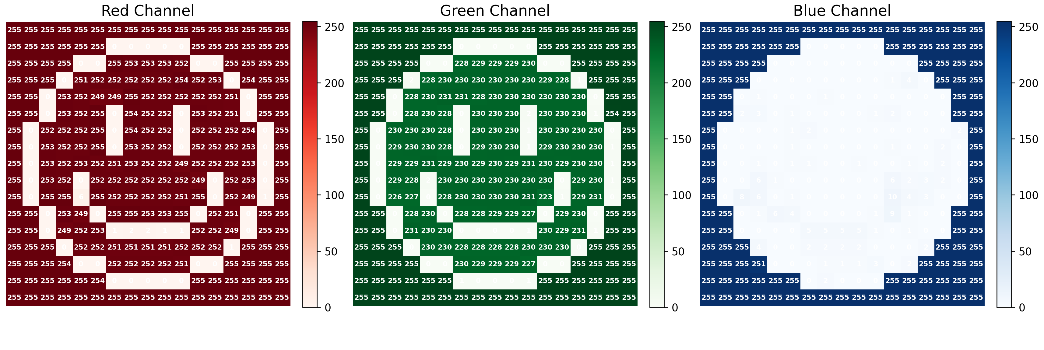
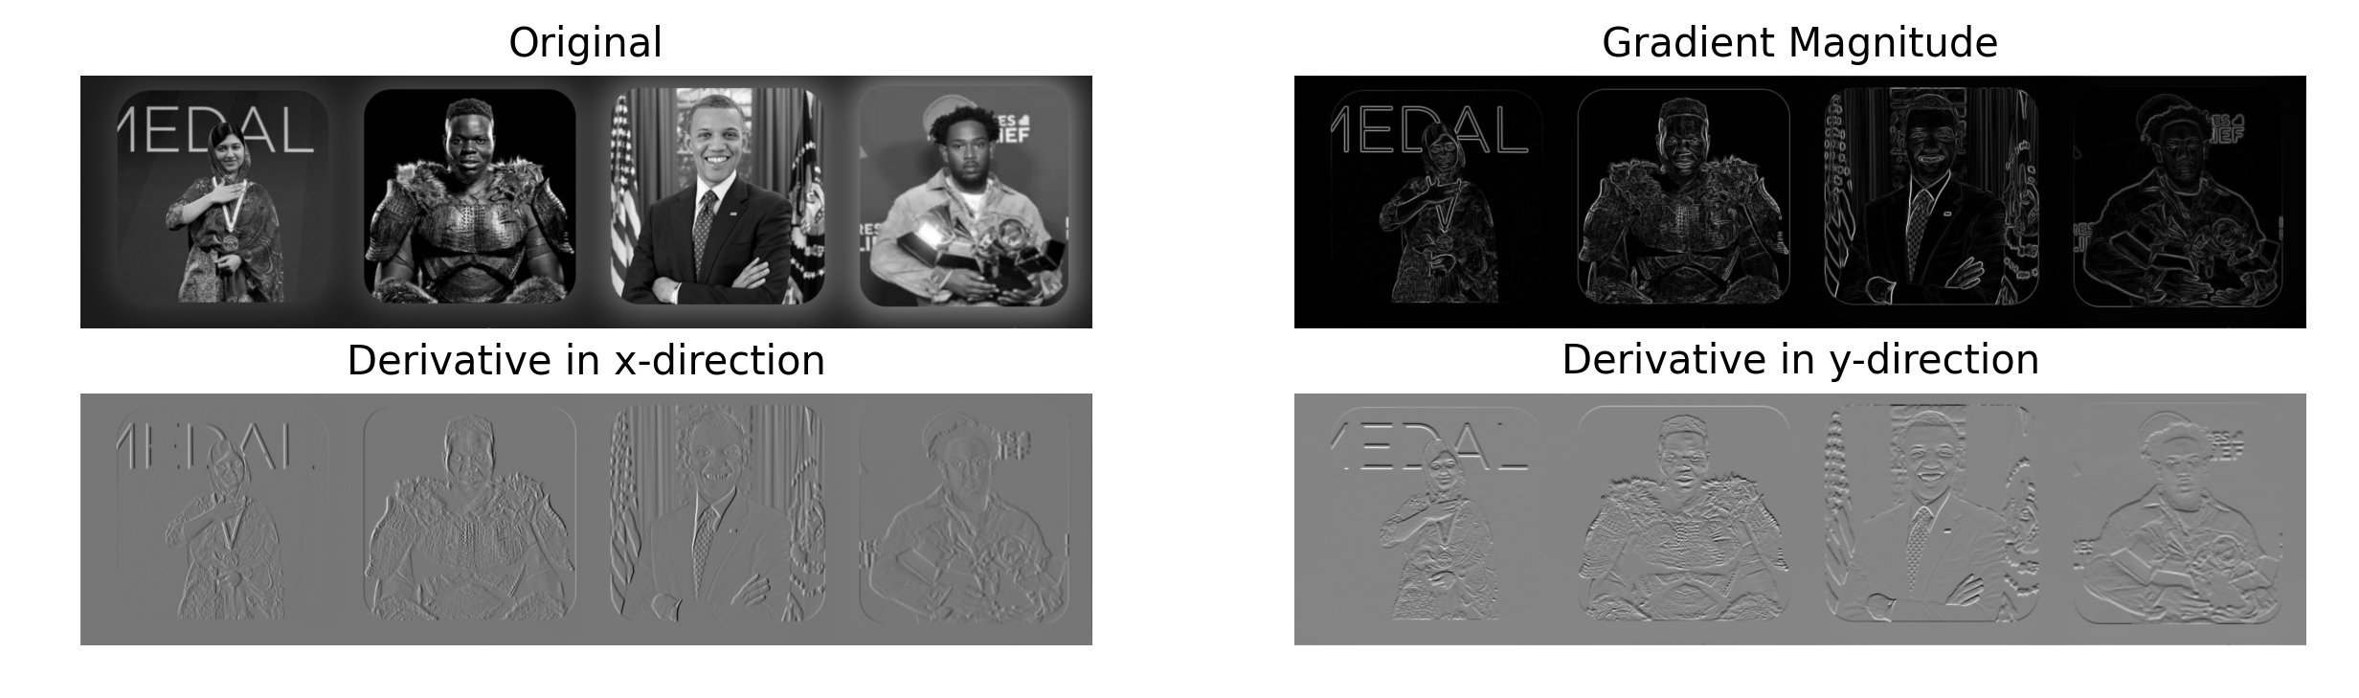






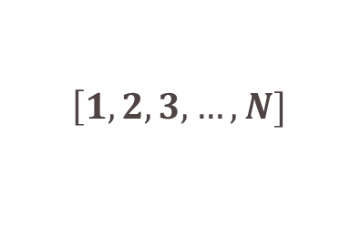

Convolutional Neural Network
Components of CNN that need to be designed and tuned for effective classification:
Input Layer
Color channels, height, width of image
Definitions:
Activation Function
Convolutional Layers
Number of filters, filter size, filter stride, activation function, number of layers
Introduces nonlinearity, allows the network to learn complex patterns beyond simple linear combinations.
Pooling type, pool size, stride, placement
Pooling Type
Pooling Layers
Method used to summarize and down sample feature extracted to reduce spatial dimension.
Fully Connected Layers
Number of layers, neurons per layer, activation functions, dropout rate
Dropout Rate
Parameter used to prevent overfitting by randomly turning off some neurons during training.
1 Neuron for binary classification, Activation function
Output Layers
Tensors
Tensors are multi-dimensional arrays used by CNNs to process images
$$\left[\begin{matrix}1 & 2 \\ 3 & 4\end{matrix}\right]$$
$$\left[\begin{matrix}1 & 2 \\ 3 & 4\end{matrix}\right]$$
$$\left[\begin{matrix}1 & 2 \\ 3 & 4\end{matrix}\right]$$
$$\left[\begin{matrix}1 & 2 \\ 3 & 4\end{matrix}\right]$$
$$\left[1]\right.$$
$$\left[1, 2, 3, …, N]\right.$$
$$,$$
$$,$$
Scalars
Vectors
Matrix
Tensors
Single value
List of values
Grid of values
Multiple grids
Each color is quantified by a vector of RGB
RGB(253 229 0)
The values could be mapped to a matrix to form a tensor.
The dimension of this tensor is
(row, column, color channel)
RGB(255 255 255)
RGB(255 255 255)
Batch, Loss, Epoch
Dataset
Batch
Loss Rate
Lets say we have a large dataset
Into Model
A subset of the data can be fed model at once
Predictions are from the true labels
Image 1
Image 2
Image 3
Image 1
~0.5
Image 2
Image 3
Image 4
Image 5
Image 6
Image 4
~0.25
Image 5
Image 6
..
..
...
Image N
Image N+1
Image N+2
Image N
~ideally close to 0.0
Image N+1
Image N+2
Epochs are complete pass throughs in the entire training dataset within the model.
The models performance should increase with more epochs
CNN Edge Detection
Extracted features in convolutional layer:
Lower Layers: edges, lines, colors
Middle Layers: patterns, shapes, textures
Higher Layers: faces objects signs of manipulation
Prewitt filter: A manual example of lower Convolutional layers
Original
Gradient Magnitude
X-Direction Derivative
Y-Direction Derivative
Notes:
Jouri

