Slide 1
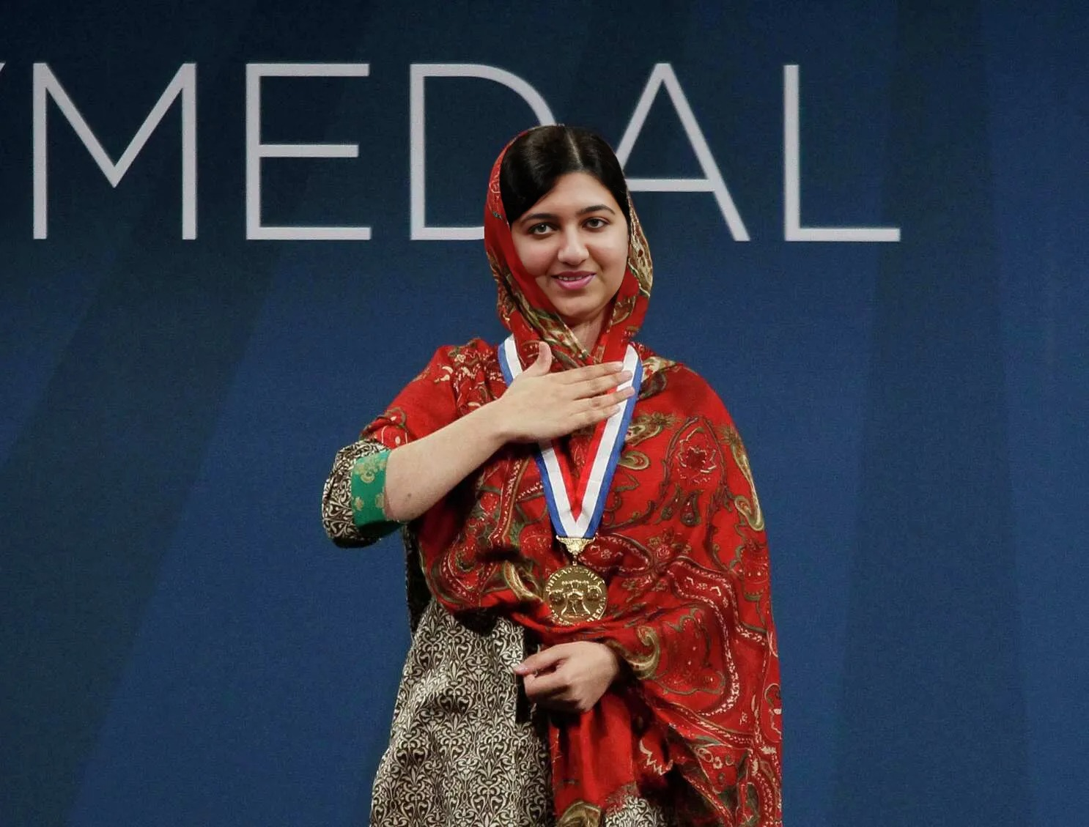
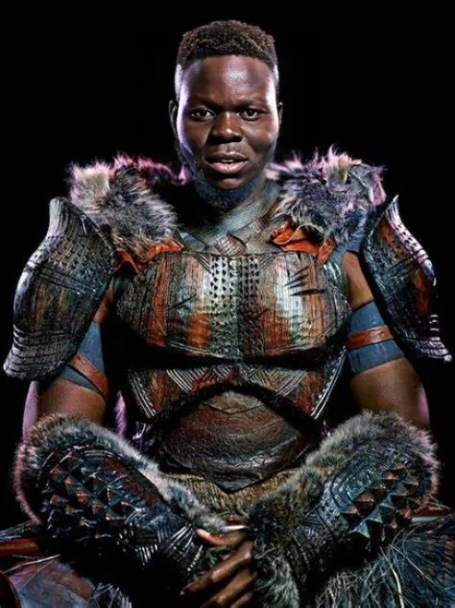
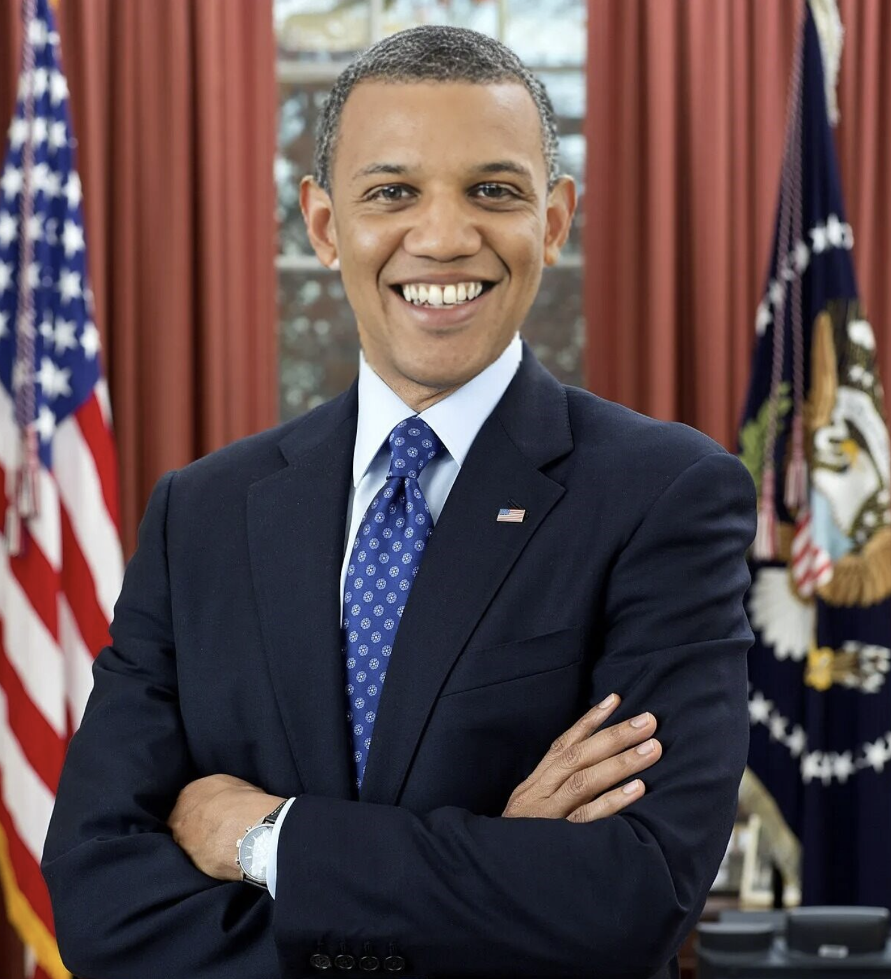





Meet Team DeepTruth!
Jouri Ghazi
Jahtega Djukpen
Ashton Bryant
Zacary Louis
A Nobel Peace Prize winner
An Oscar Winning Actor
The 44th President of the United States
A Multi-Grammy award Artist
These images are:
Is this image real?
DEEPFAKES!
100% Confidence
Curious User
Uploads Image
Process Image
Present Results
Notes:
Jouri

Slide 2

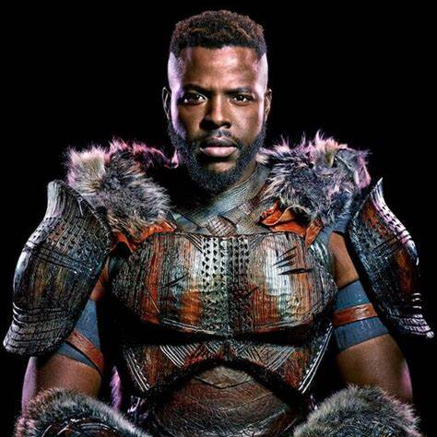

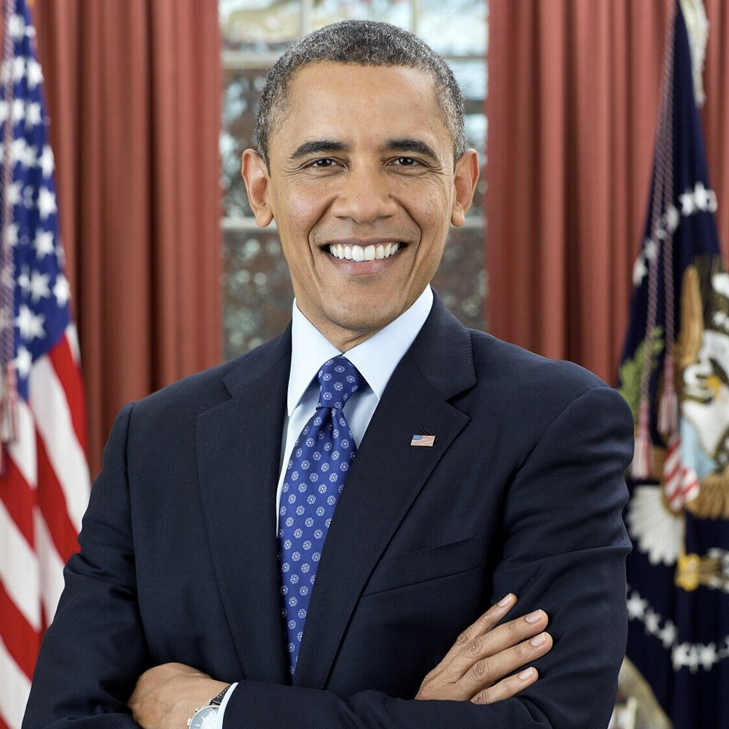
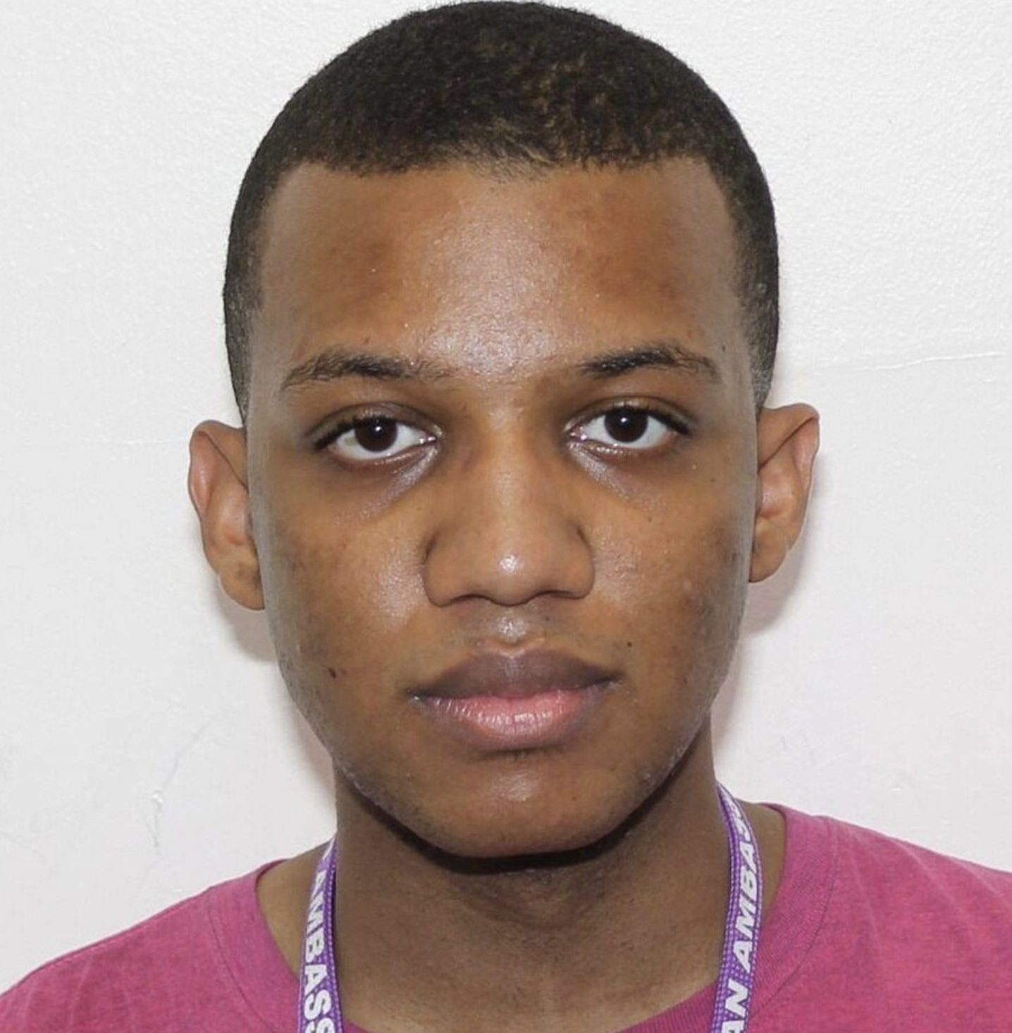

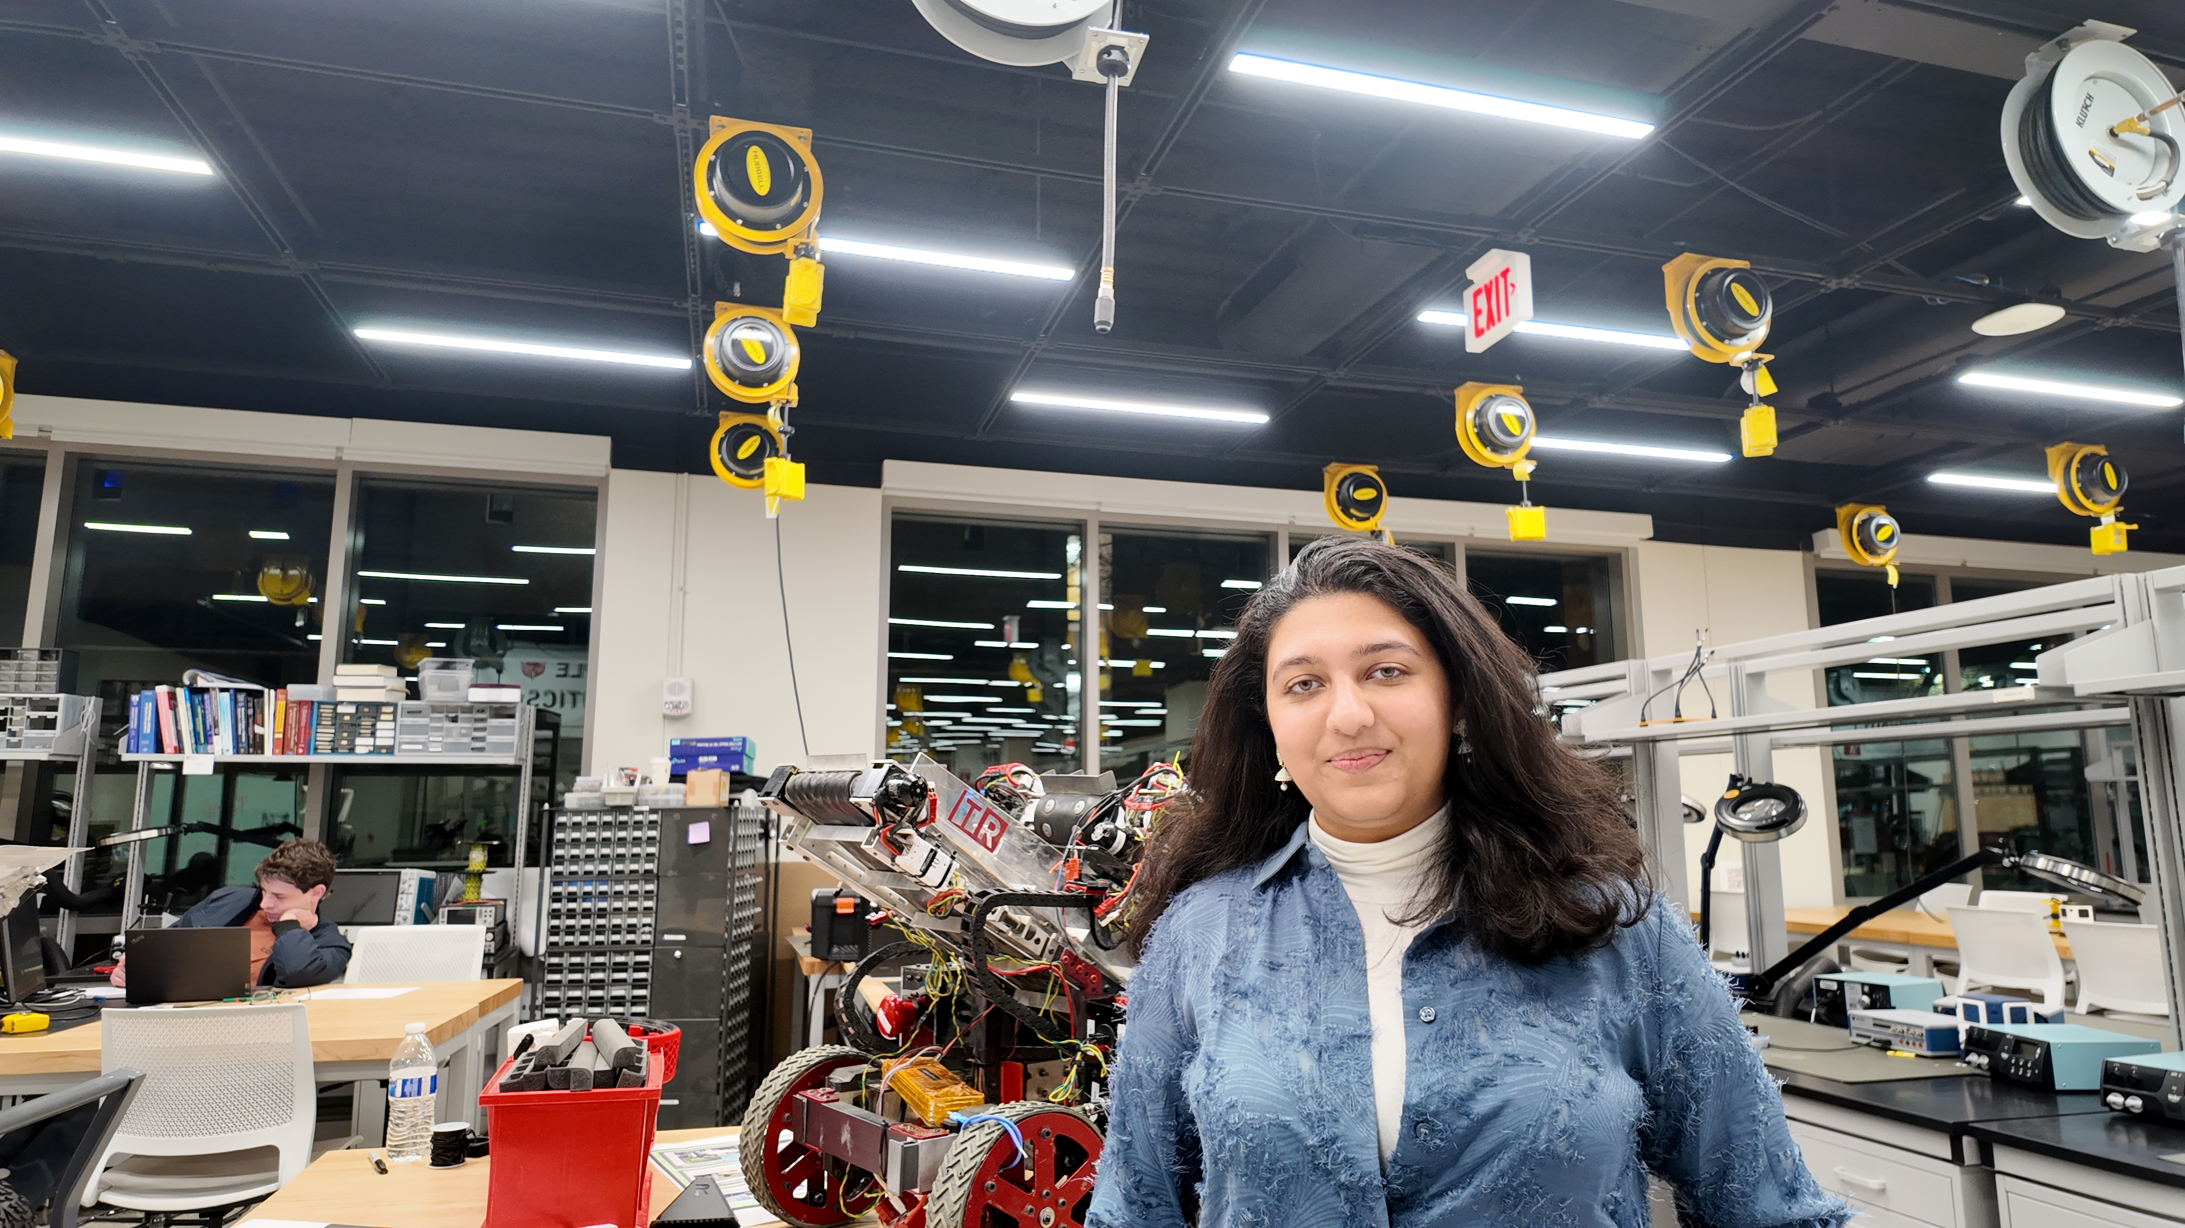
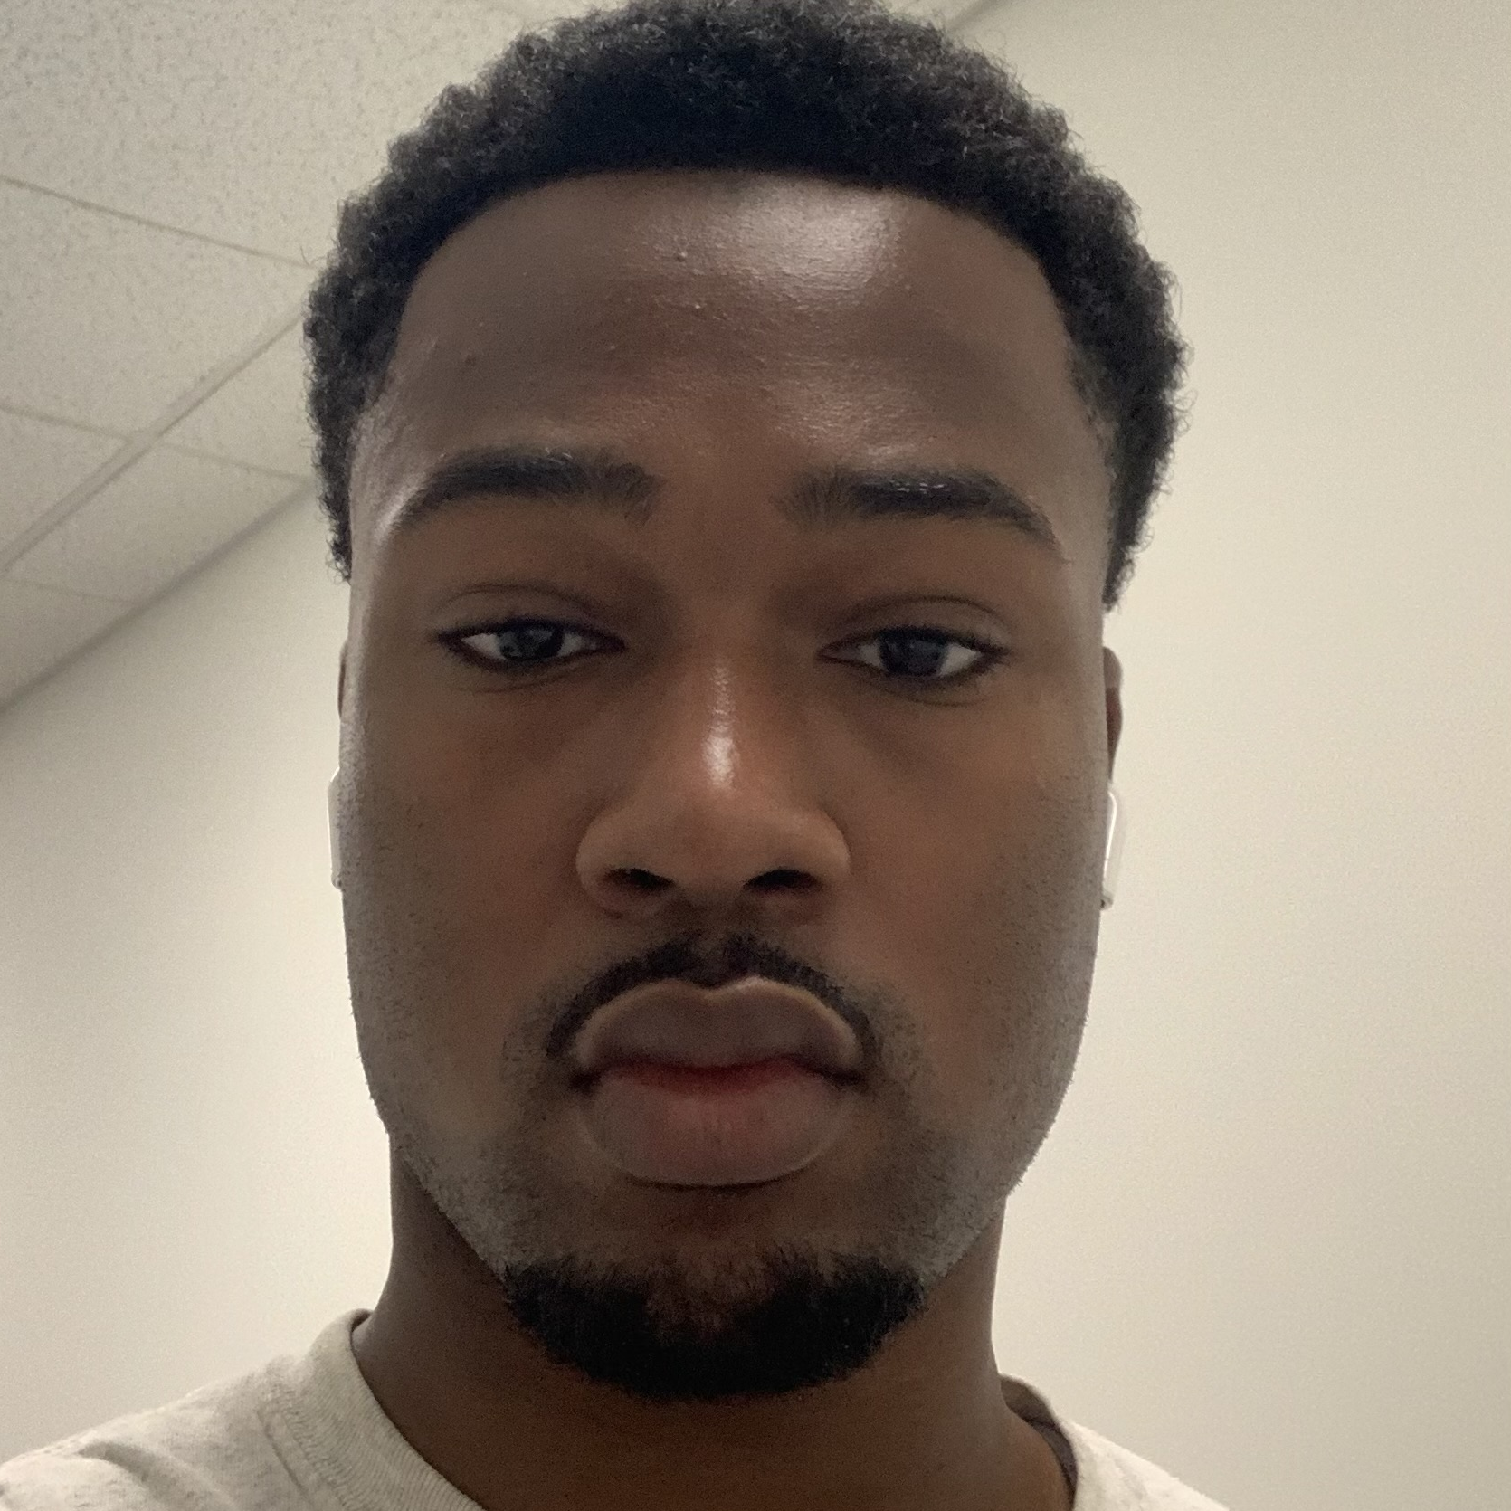
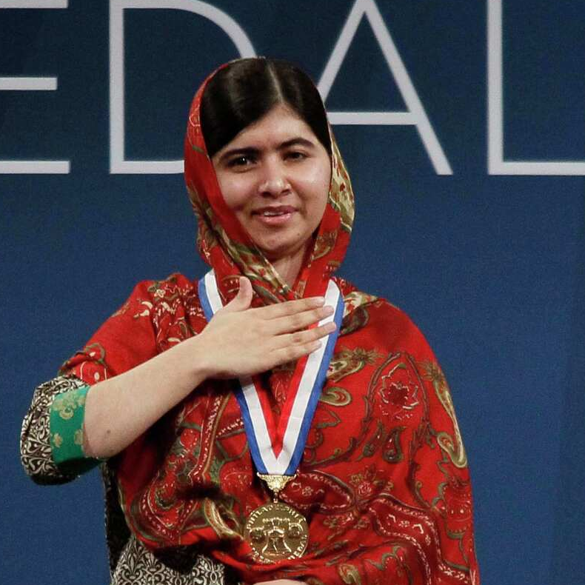
DeepFake Detection
Advised by Dr. Picone
As DeepFakes have become easier to create and harder to detect, we will develop a detection method
These images are:
Is this image real?
DEEPFAKES!
100% Confidence
Curious User
Uploads Image
Process Image
Present Results
What is a DeepFake?
A form of AI-Generated content
Target
Source
Face Swap
These images were created within a few minutes using https://deepfakemaker.io/
Notes:
Jouri

Slide 3
DeepFake Detection
Advised by Dr. Picone
As DeepFakes have become easier to create and harder to detect, we will develop a detection method
These images are:
Is this image real?
DEEPFAKES!
100% Confidence
Curious User
Uploads Image
Process Image
Present Results
What is a DeepFake?
A form of AI-Generated content
Target
Source
Face Swap
These images were created within a few minutes using https://deepfakemaker.io/
DeepFake News
Woman Speaks Out After Being Scammed by Ad With Deepfake of Her Doctor: 'Desperate and in Pain'
Jussie Smollett Reacts to Kendrick Lamar 'Heart Part 5' Deepfake
Billboard Tues December 2 2025 7.00 EDT
TODAY News Wed 3 December 2025 08.00 EST
Imper.ai launches with $28M to stop deepfake-driven cyber impersonation attacks
AI Deepfakes Surge in 2025, Driving $50B Scam Losses
Web Pro News Mon December 1 2025 2:00 EST
Tech Funding News Thur 4 December 2025 08.00 EST
Retiree warns others after losing $3K to crypto fraud using AI video of prime minister
South Korea Faces Rising Deepfake Threat Amid Political Tensions
The Chosun Thur 4 December 2025 18.33 EST
Fox 9 Sun November 30 2025 3:02 PM EST
Notice the
Victims
News Source
Date
Notes:
Jahtega

Slide 4
What is a DeepFake?
A form of AI-Generated content
Target
Source
Face Swap
These images were created within a few minutes using https://deepfakemaker.io/
DeepFake News
Woman Speaks Out After Being Scammed by Ad With Deepfake of Her Doctor: 'Desperate and in Pain'
Jussie Smollett Reacts to Kendrick Lamar 'Heart Part 5' Deepfake
Billboard Tues December 2 2025 7.00 EDT
TODAY News Wed 3 December 2025 08.00 EST
Imper.ai launches with $28M to stop deepfake-driven cyber impersonation attacks
AI Deepfakes Surge in 2025, Driving $50B Scam Losses
Web Pro News Mon December 1 2025 2:00 EST
Tech Funding News Thur 4 December 2025 08.00 EST
Retiree warns others after losing $3K to crypto fraud using AI video of prime minister
South Korea Faces Rising Deepfake Threat Amid Political Tensions
The Chosun Thur 4 December 2025 18.33 EST
Fox 9 Sun November 30 2025 3:02 PM EST
Notice the
Victims
News Source
Date
Notes:
Jahtega – update news

Slide 5



DeepFake News
Woman Speaks Out After Being Scammed by Ad With Deepfake of Her Doctor: 'Desperate and in Pain'
Jussie Smollett Reacts to Kendrick Lamar 'Heart Part 5' Deepfake
Billboard Tues December 2 2025 7.00 EDT
TODAY News Wed 3 December 2025 08.00 EST
Imper.ai launches with $28M to stop deepfake-driven cyber impersonation attacks
AI Deepfakes Surge in 2025, Driving $50B Scam Losses
Web Pro News Mon December 1 2025 2:00 EST
Tech Funding News Thur 4 December 2025 08.00 EST
Retiree warns others after losing $3K to crypto fraud using AI video of prime minister
South Korea Faces Rising Deepfake Threat Amid Political Tensions
The Chosun Thur 4 December 2025 18.33 EST
Fox 9 Sun November 30 2025 3:02 PM EST
Notice the
Victims
News Source
Date
Proposed Solution
Web Application
Upload Image
Find Faces
Find Bounding Box
Is this image real?
User uploaded image
Face Detection Model
(x, y, width, height)
Present Results
Classify
Classify using AI model
Random Forest
DeepTRUTH
Efficientnet-B0
User Interface (UI)
Identify Face
Output to UI
Classification
Meet Team DeepTruth!
Jouri Ghazi
A Nobel Peace Prize winner
Jahtega Djukpen
An Oscar Winning Actor
Ashton Bryant
The 44th President of the United States
Zacary Louis
A Multi-Grammy award Artist
Notes:
Zacary

Slide 6
Proposed Solution
Web Application
Upload Image
Find Faces
Find Bounding Box
Is this image real?
User uploaded image
Face Detection Model
(x, y, width, height)
Present Results
Classify
Classify using AI model
Random Forest
DeepTRUTH
Efficientnet-B0
User Interface (UI)
Identify Face
Output to UI
Classification
Meet Team DeepTruth!
Jouri Ghazi
Jahtega Djukpen
Ashton Bryant
Zacary Louis
A Nobel Peace Prize winner
An Oscar Winning Actor
The 44th President of the United States
A Multi-Grammy award Artist
Notes:
Jouri

