Slide 1
SD ADVISOR MEETING 9
DeepTRUTH
Advisor: Dr. Picone
Team: Jouri, Jahtega, Zacary, Ashton

Slide 2
Initial Training Tests
1. train by image: if 1 face is fake-> the whole image is fake
  Train/dev/eval based on the whole images DCT features
2. train by face: case-by-face,
  Train/dev/eval based on the image only features

Slide 3
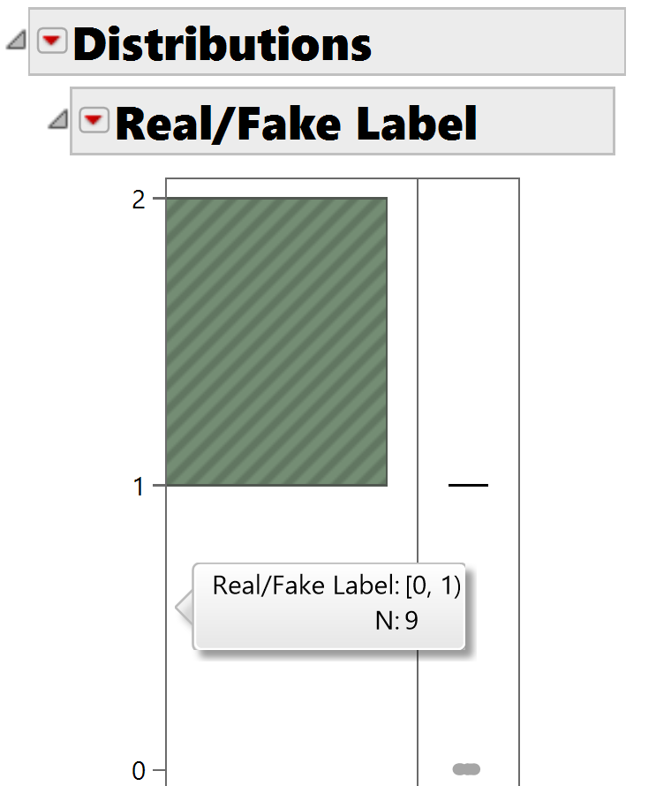
Train by image
 | Total Vectors Per Image
 | Train | Dev | Eval
Real (0) | 168 | 33 | 9
Fake (1) | 17089 | 18862 | 7299
Total | 17257 | 18895 | 7308
Used data distribution feature in JMP

Slide 4
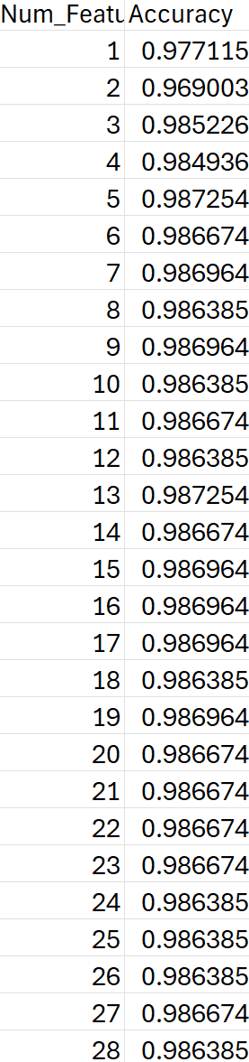
Train and evaluate on whole dataset
98% accuracy!
I’m guessing the model predicted each image as fake – not good ☹
Dataset bias!

Slide 5
Train and evaluate on whole dataset
New approach: Train and eval on equal real and fake images
# real ≈ # fake
Also will be alternating the number of features trained and RF estimators

Slide 6
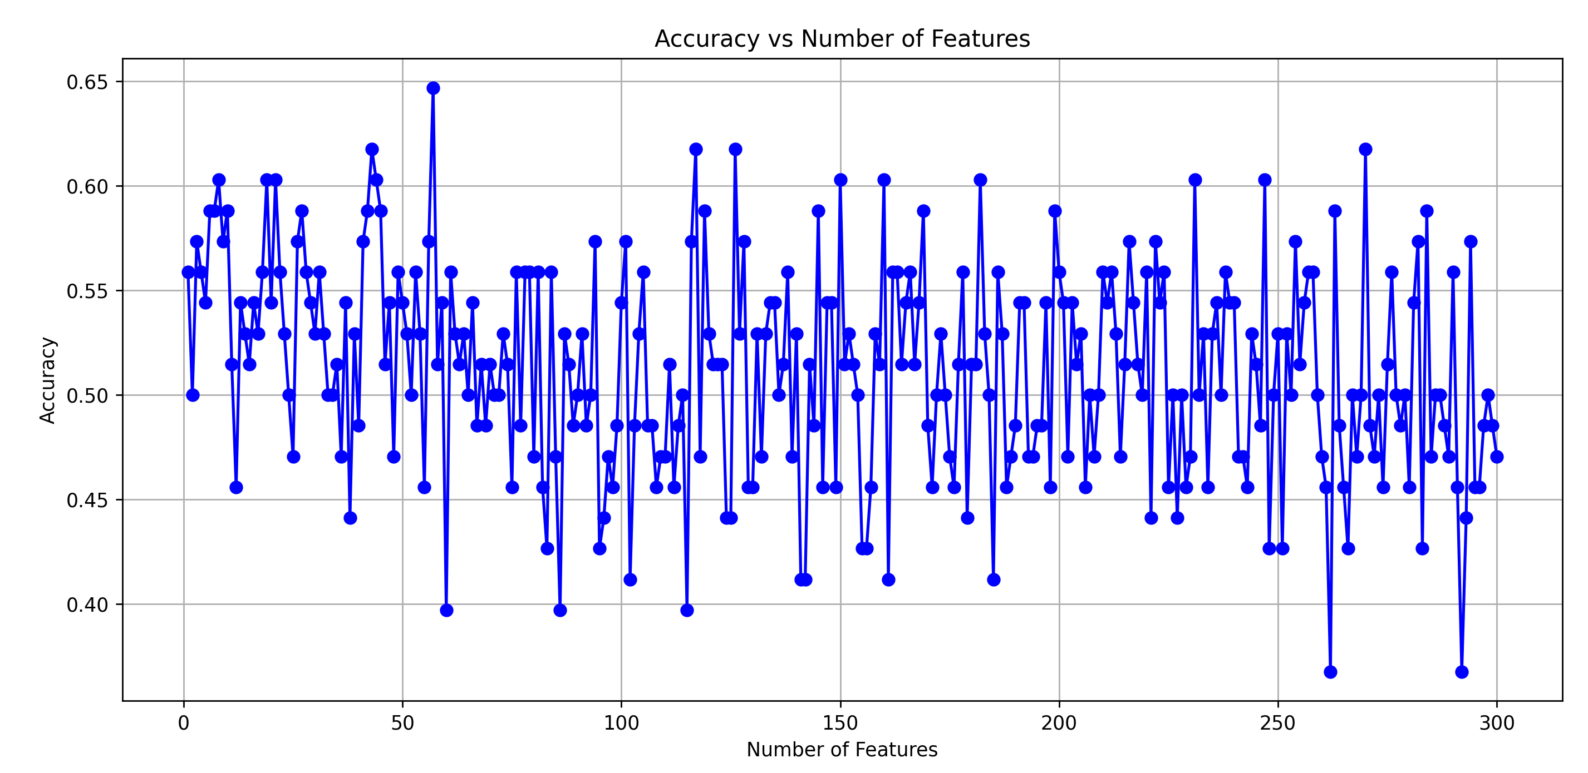

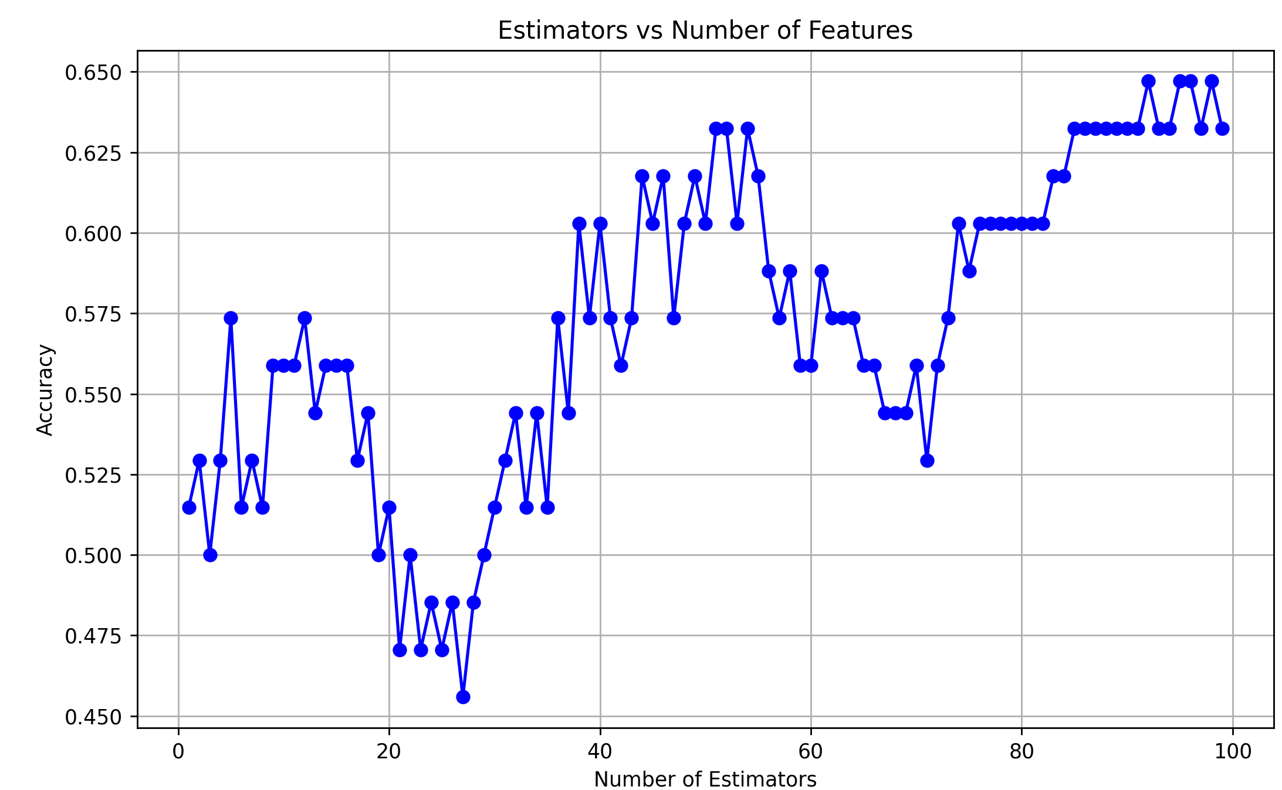

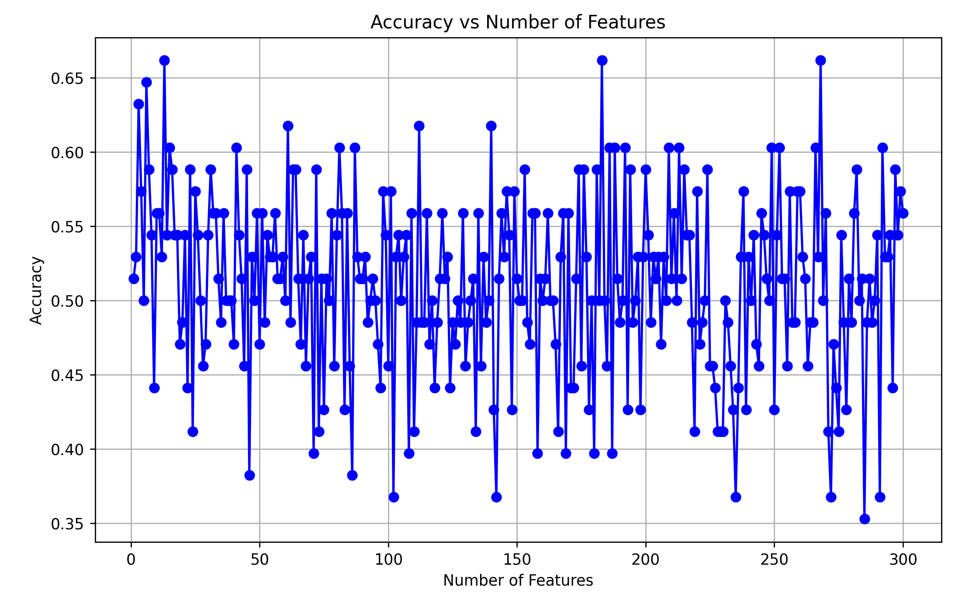
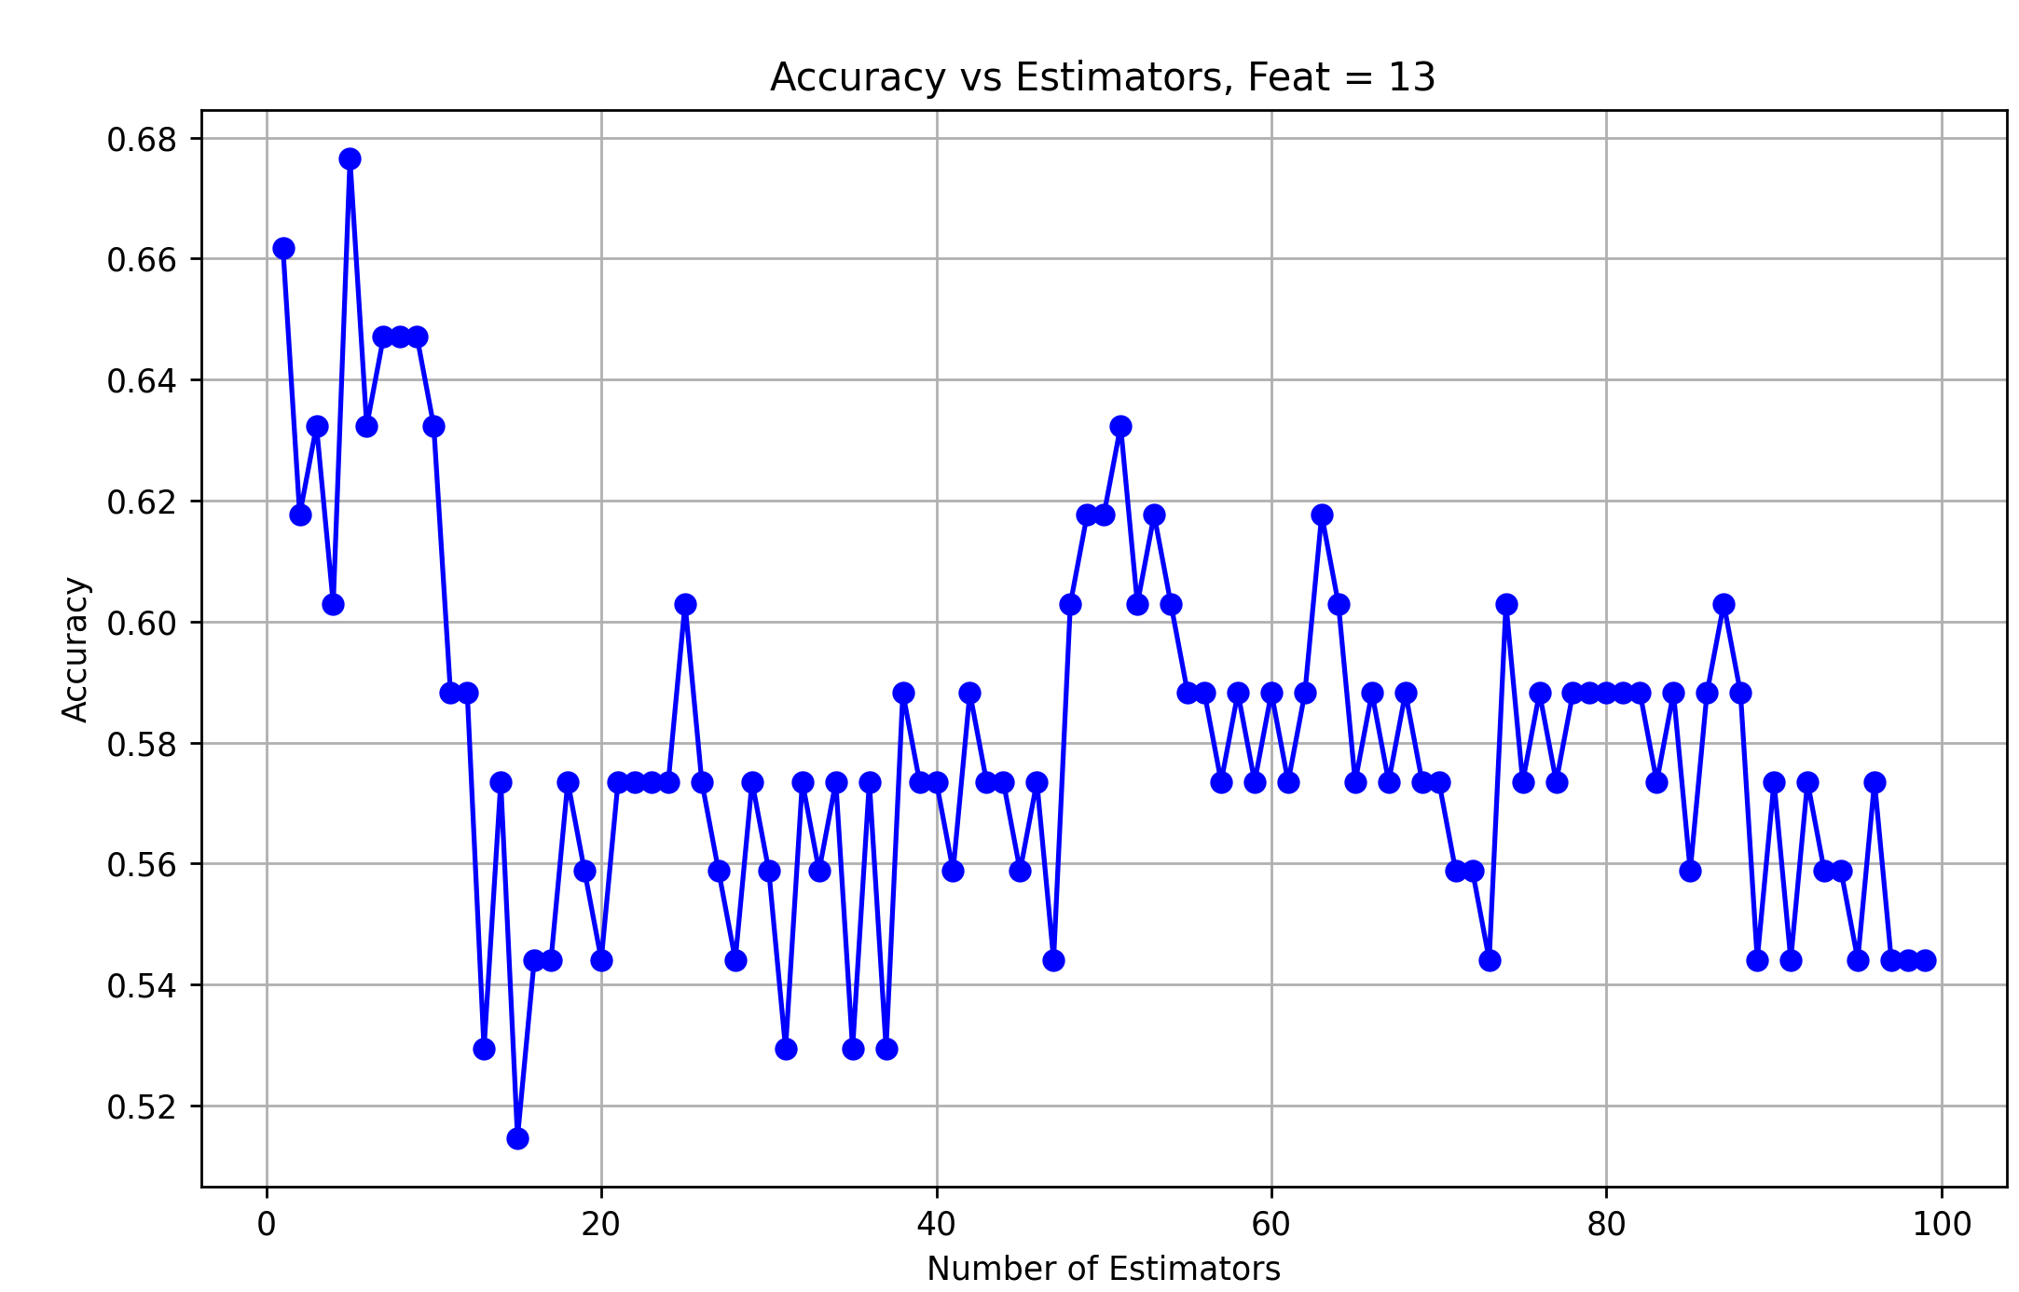
N = 100
Features = 100
N = 1
N = 5
acc = 67.64%

Slide 7
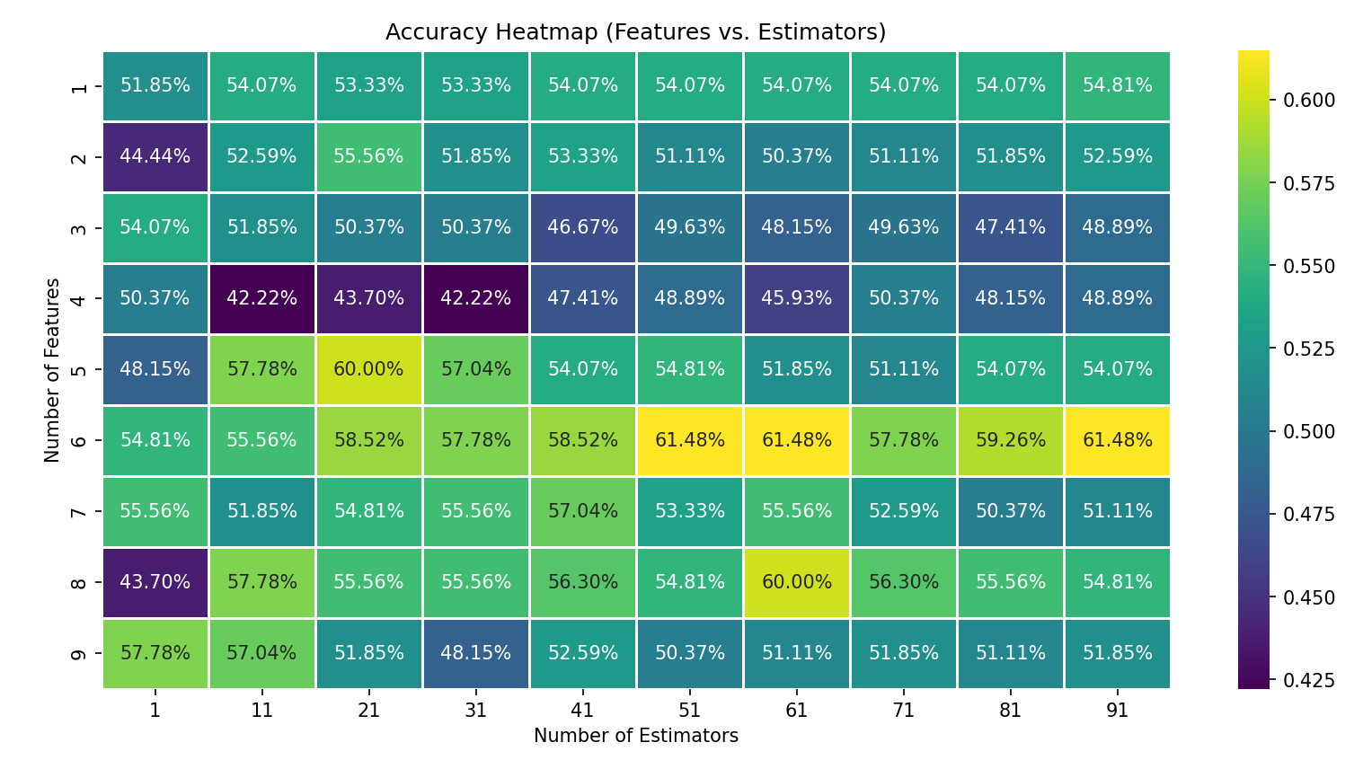
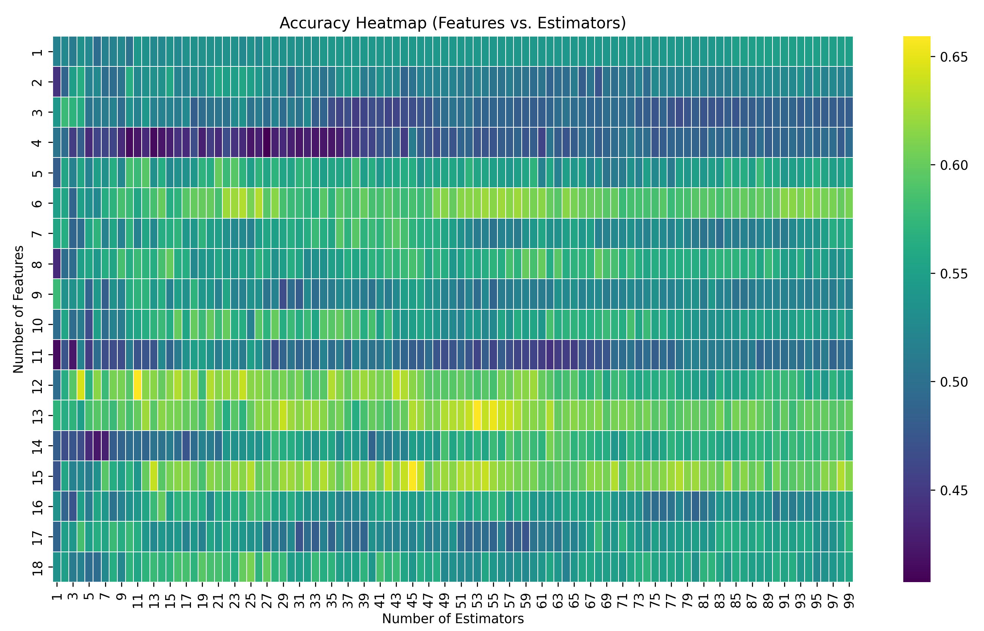
Iterating the number of estimators to the number of features. Does more features = better accuracy?
Best combination:
6.0 features
51.0 estimators
61.48% accuracy
Best combination:
12.0 features
11.0 estimators
65.93% accuracy

Slide 8
Best combination:
6.0 features
51.0 estimators
61.48% accuracy
Best combination:
12.0 features
11.0 estimators
65.93% accuracy
65.93% is great, right? I then took the model and evaluated on the remaining unused data and got a 49.93% accuracy ☹. Assuming this is due to training on such a small dataset

Slide 9
Initial Training Tests
1. train by image: if 1 face is fake-> the whole image is fake
  Train/dev/eval based on the whole images DCT features
2. train by face: case-by-face,
  Train/dev/eval based on the image only features

Slide 10
Train by face
 | Total Vectors Per Image
 | Train | Dev | Eval
Real (0) | 85006 | 21048 | 10563
Fake (1) | 65860 | 28669 | 4782
Total | 150866 | 49717 | 15345
This looks promising (fingers crossed)
Used data distribution feature in JMP

Slide 11
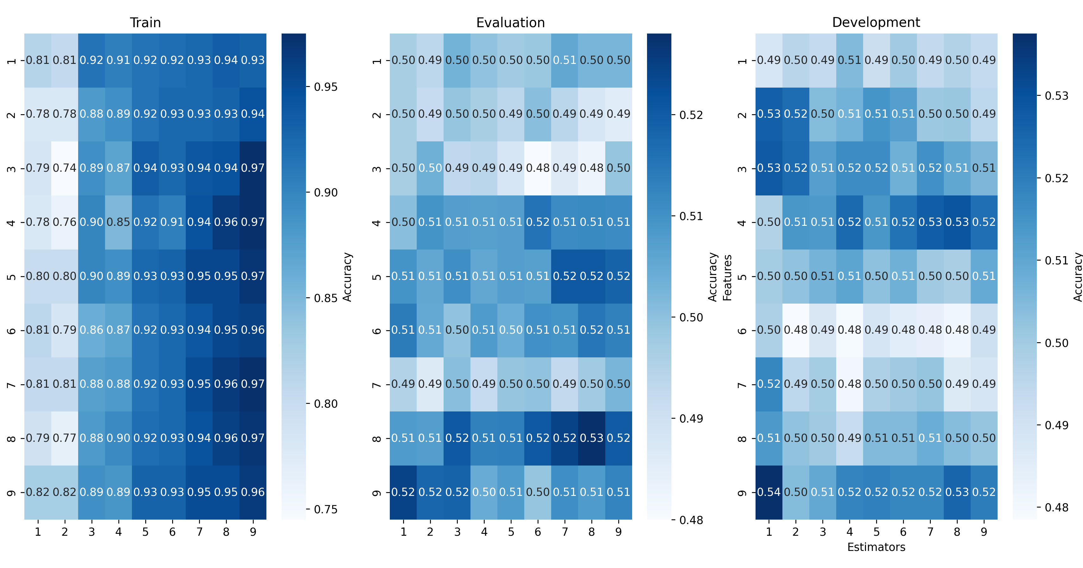
  First 10 features

Slide 12
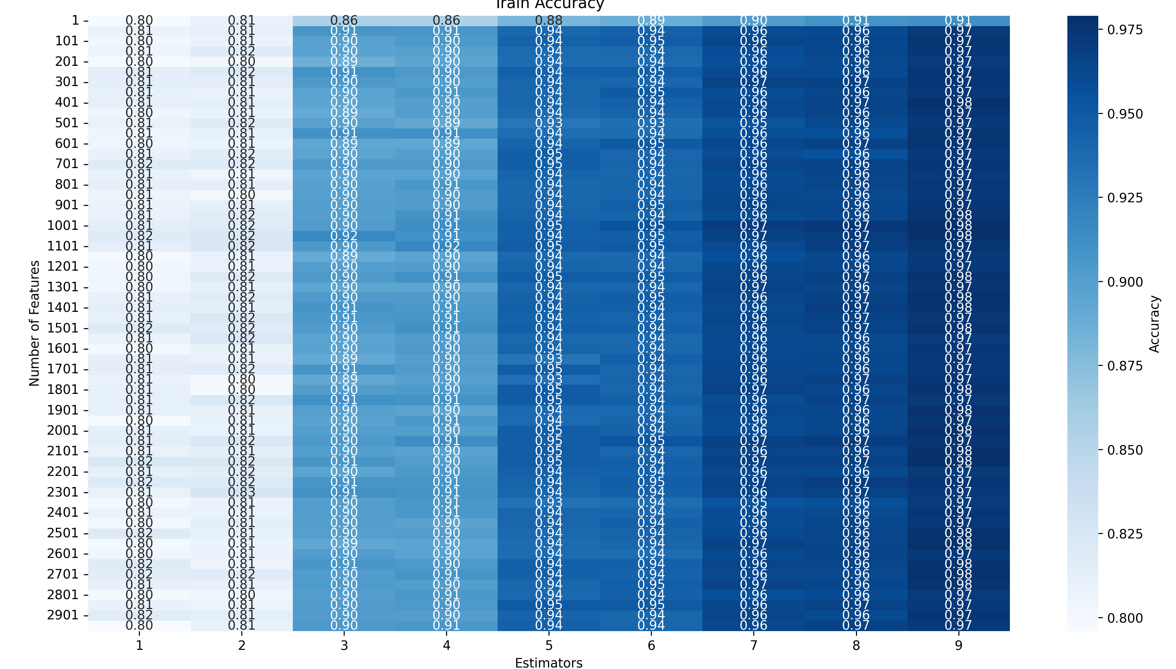
  First 10 features

Slide 13
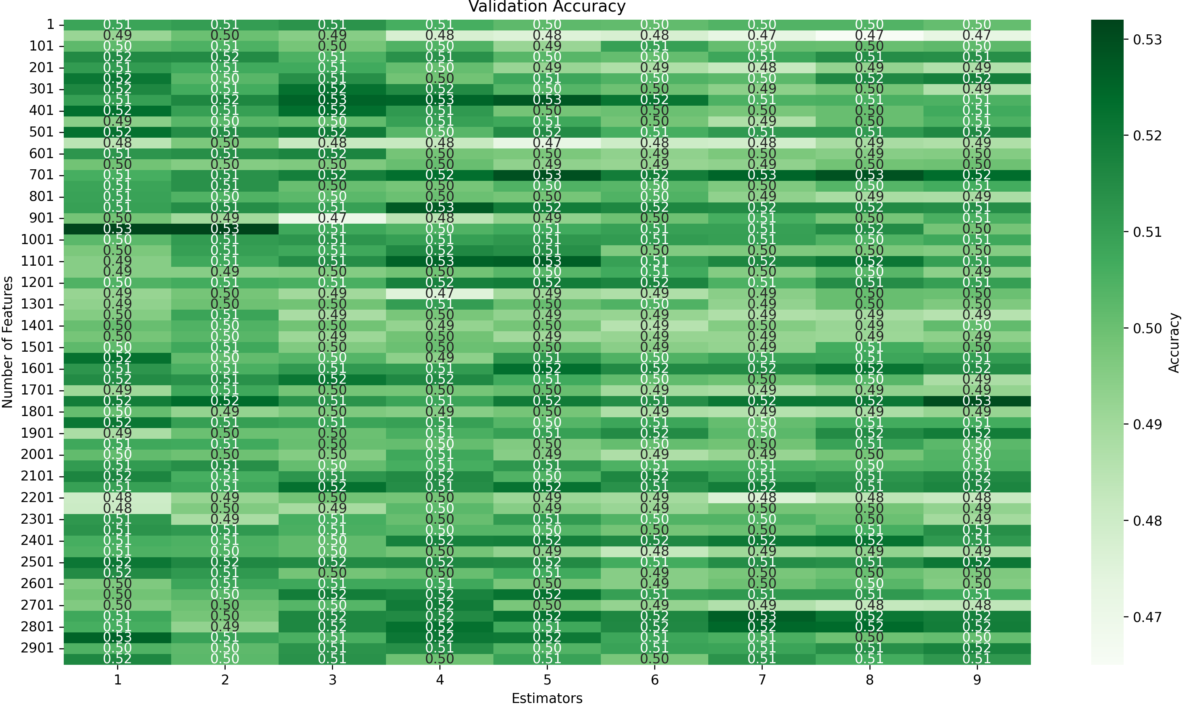
  VAL 1-3k features

Slide 14
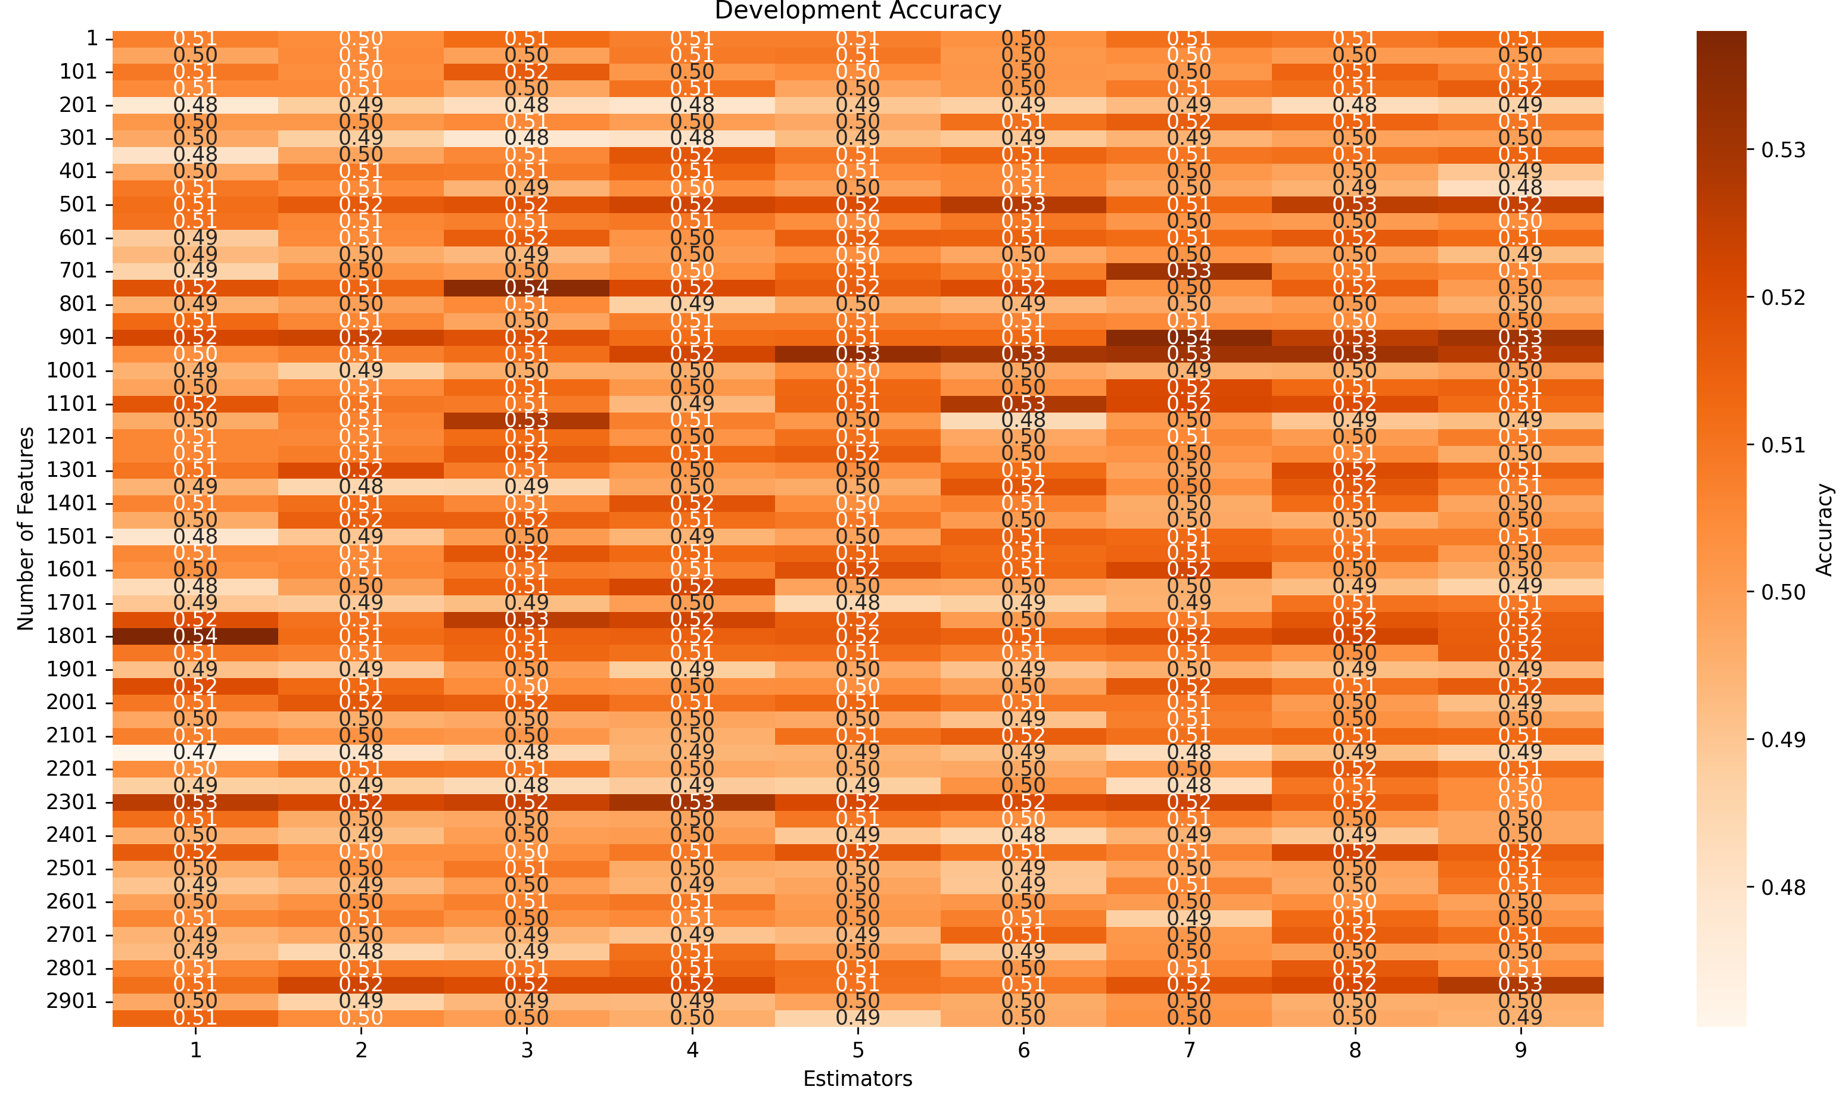
  DEV 1-3k features

Slide 15
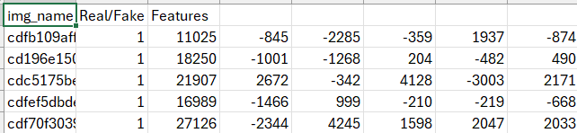
Jahtega Update
Nedc_dfake_gen_feats_v2.py

Slide 16
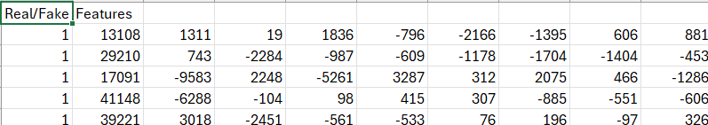
Jahtega Update
Nedc_dfake_gen_feats_v3.py

