Slide 1
SD ADVISOR MEETING 8
DeepTRUTH
Advisor: Dr. Picone
Team: Jouri, Jahtega, Zacary, Ashton

Slide 2
Questions
Do we want to understand how the annotations align with the feature vectors?
How do we run the website through the server?
Datatypes –
  RGB -> 0-255 (8bits)
  HSL -> 0-1 (floats)
  When choosing features, should we consider the datatype?

Slide 3


Slide 4


Ashton Updates
All files in dataset have a corresponding annotation file
Problem files were moved to the PROBLEMS directory

Slide 5
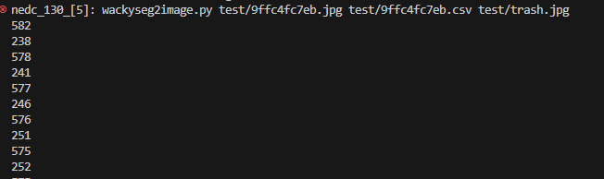
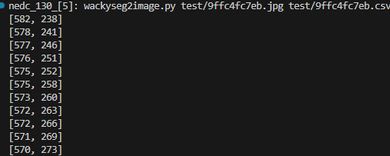
Segmentation

Slide 6
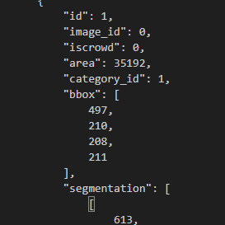
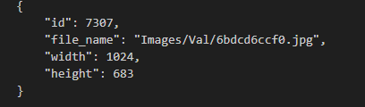
Understanding the Dataset annotations
Each image has an:
- ID
- file_name
-width & height
Each face has an:
- ID
- image_id
- iscrowd
- area
- category_id
- bbox
- segmentation
Each image has multiple faces

Slide 7
Understanding the Dataset annotations
ID
Image_id
Iscrowd
Area
Category_ID
Bbox
segmentation
IMG_1_FACE[1]
…
IMAGE[1]
IMG_1_FACE[N]
ID
Image_id
Iscrowd
Area
Category_ID
Bbox
segmentation
ID
Image_id
Iscrowd
Area
Category_ID
Bbox
segmentation
IMAGE[2]
IMG_2_FACE[1]
…
…
IMG_2_FACE[N]
ID
Image_id
Iscrowd
Area
Category_ID
Bbox
segmentation
IMAGE[N]
ID
Image_id
Iscrowd
Area
Category_ID
Bbox
segmentation
IMG_N_FACE[1]
…
IMG_N_FACE[N]
ID
Image_id
Iscrowd
Area
Category_ID
Bbox
segmentation

Slide 8
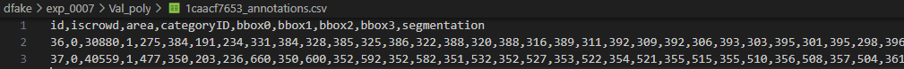
Annotation
ID | iscrowd | area | Category ID | bbox0 | bbox1 | bbox2 | bbox3 | segmentation
36
37
Iscrowd = ?
area = ?
Category ID = Real/fake
We don’t know how Bbox[n] it works
Segmentation = ?

Slide 9
Encoding data
Annotations
Feature Gen
Vector classify
Features
Parameter file

Slide 10
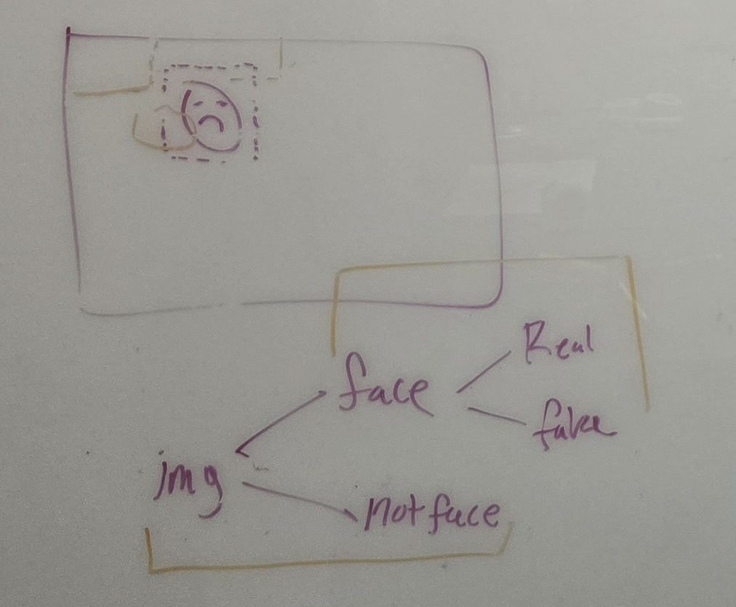
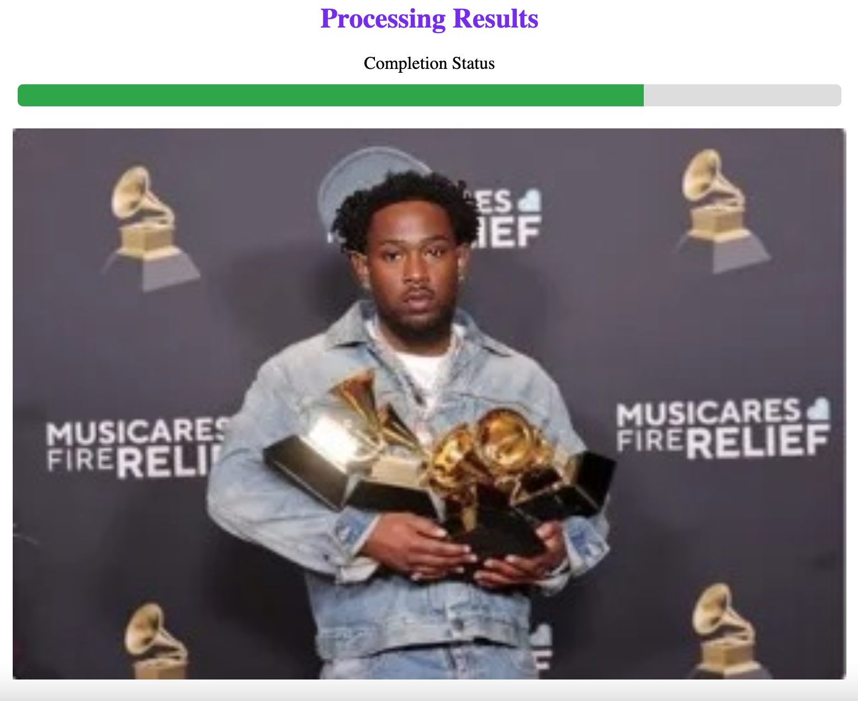
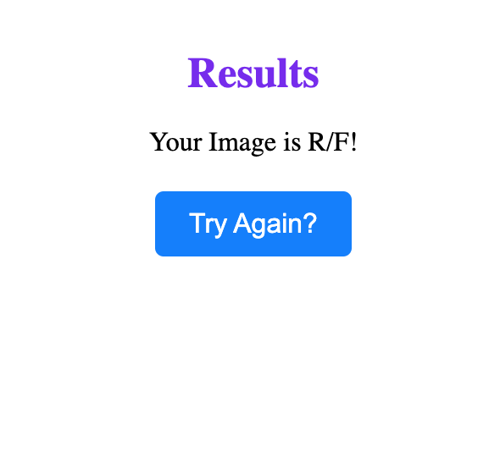
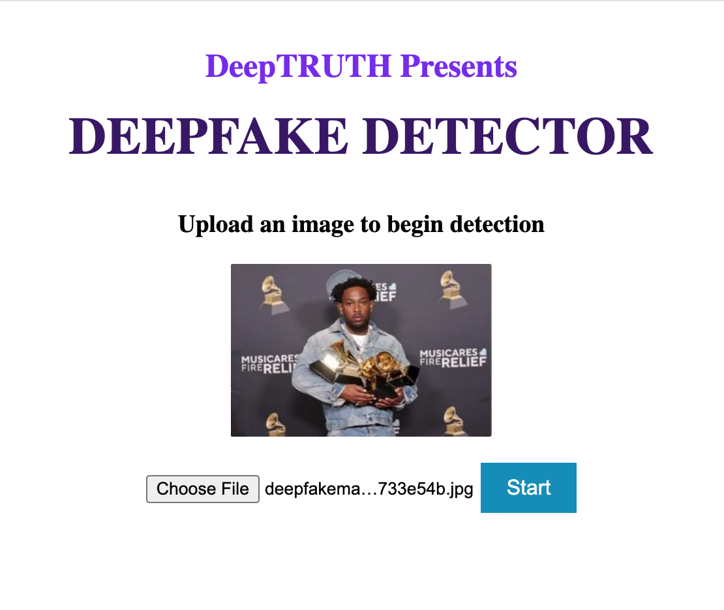
Web App

Slide 11
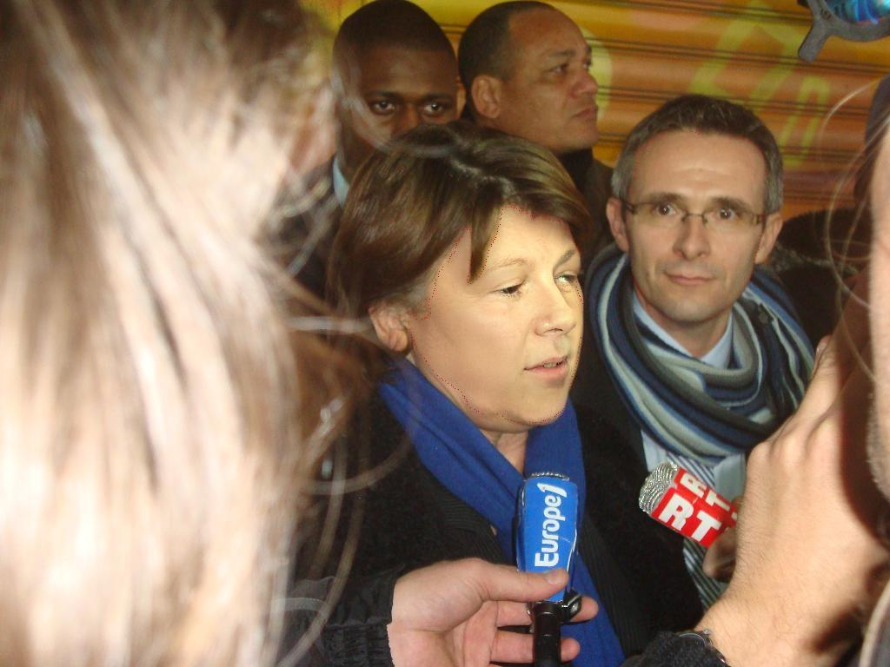

Segmentation

Slide 12
Jouri Updates
Developing software that finds the face(s) within an image
  Creates a segmentation boundary
Works well when the image is clear and well defined, not when the image is lower quality
There are a variety of face classification models, each with their own tradeoffs and different accuracies and speeds
This software would be used in the website tool to extract the face from the image

Slide 13
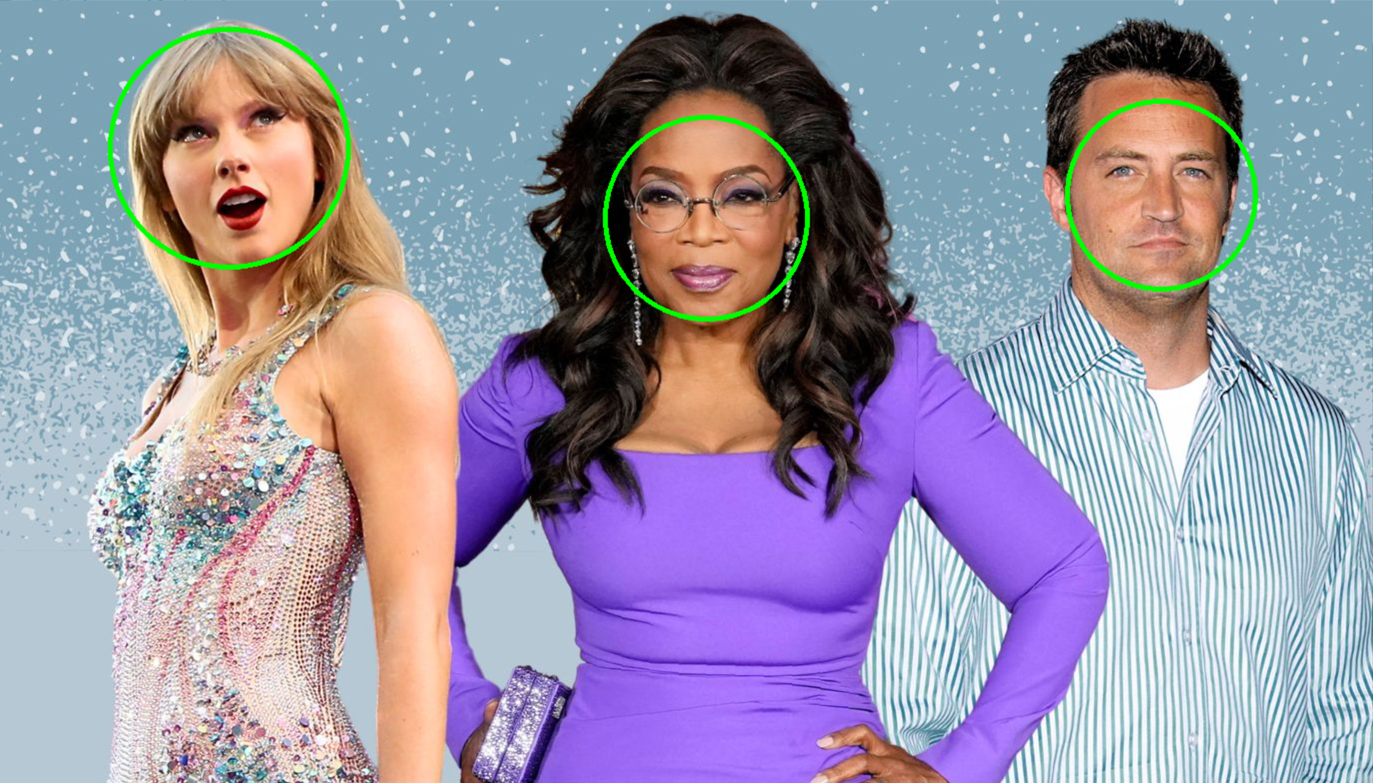
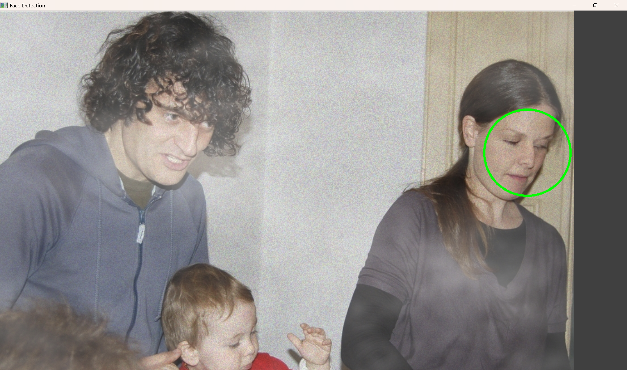
Haar Cascade
Software outputs the image with circle

Slide 14
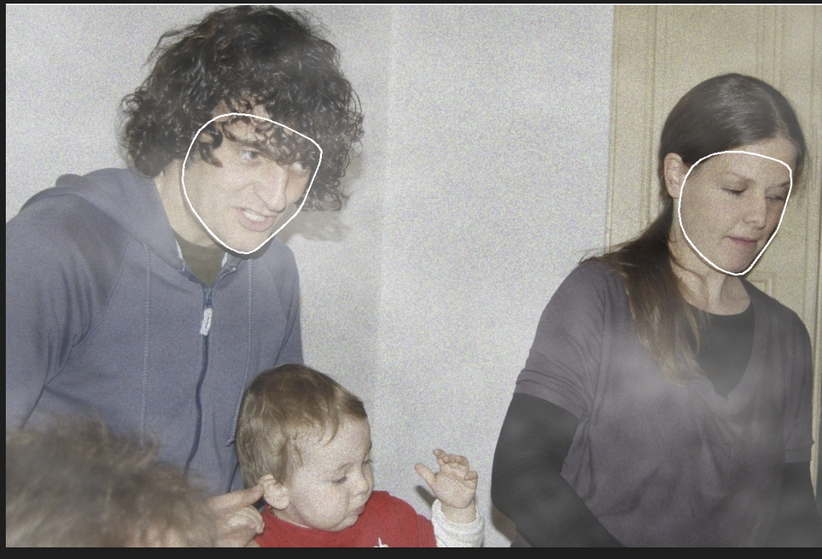
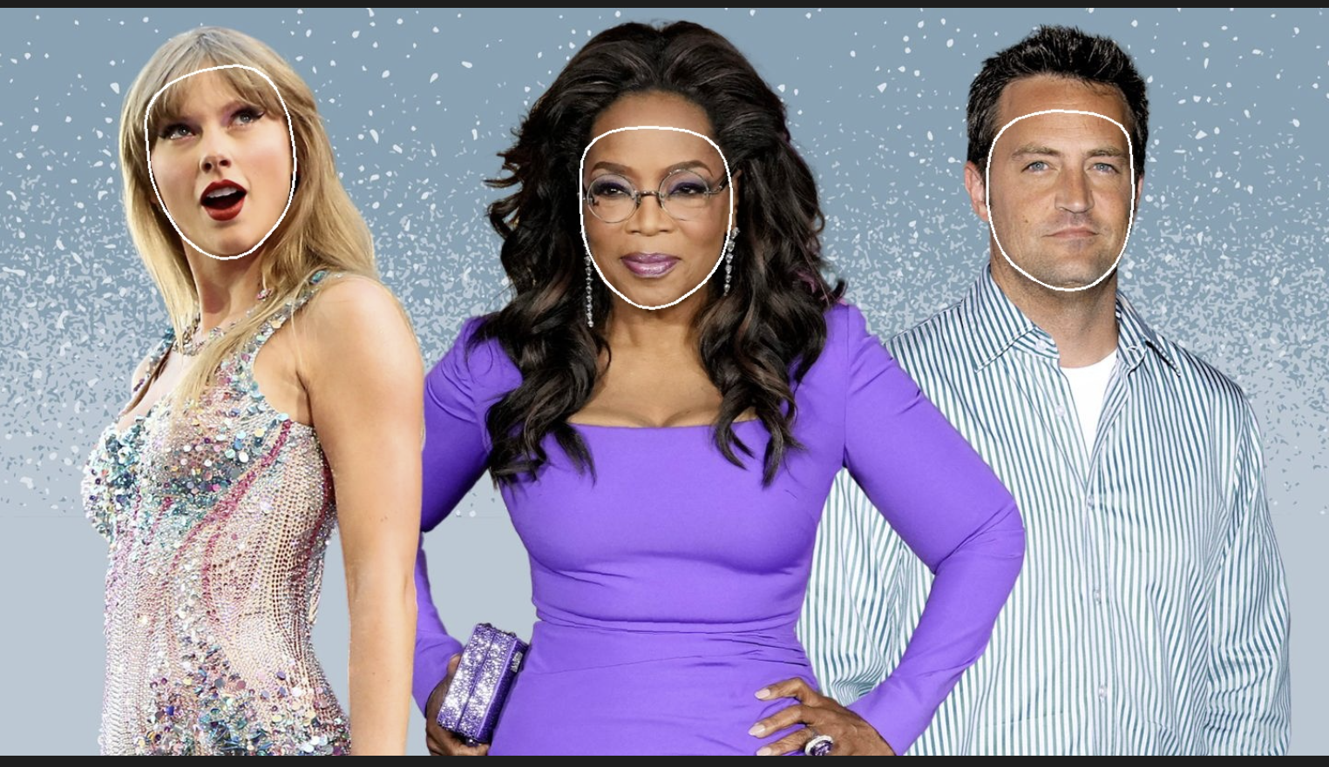
MediaPipe Face Mesh
Software outputs the image with segmentation

Slide 15
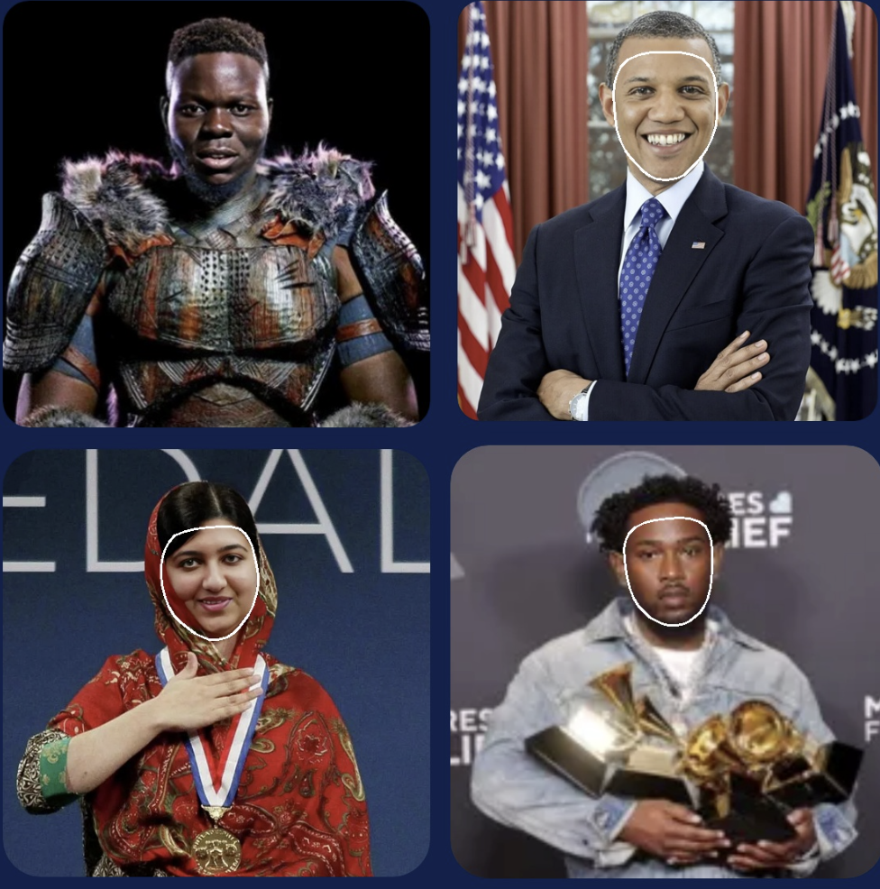
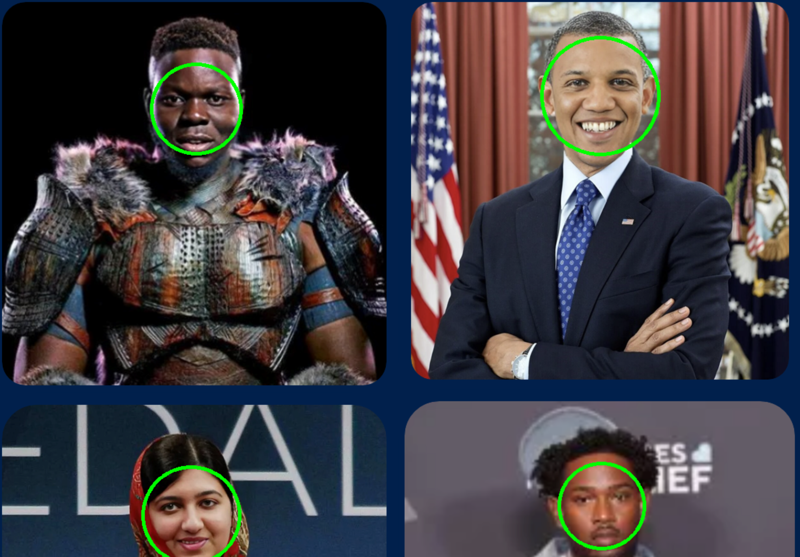
MediaPipe Face Mesh
How does it do with DeepFakes?
Haar Cascade

Slide 16
Jouri Updates
Haar Cascade [Tested]
MediaPipe Face Mesh [Tested]
HOG _ SVM
CNN
MTCNN
YOLO
Fast R-CNN
These are a list of other models I found, will look into which is best for our application
Needs: high accuracy, simple complexity, fast speed

Slide 17
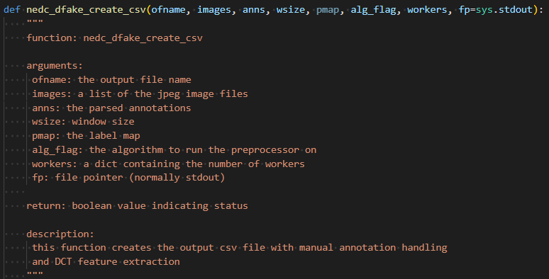
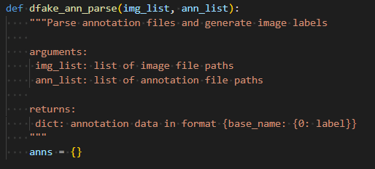
Jahtega Updates
Tool does what its meant to do
  Takes annotation and image files and spits out csv with feature vector
  Ended up writing custom functions for the annotation parsing and the csv
  The output csv files contain one feature vector for the entire image.

Slide 18
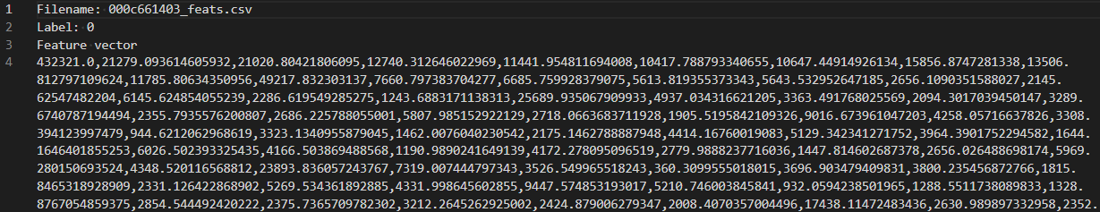
Jahtega Update
Sample feature csv

Slide 19
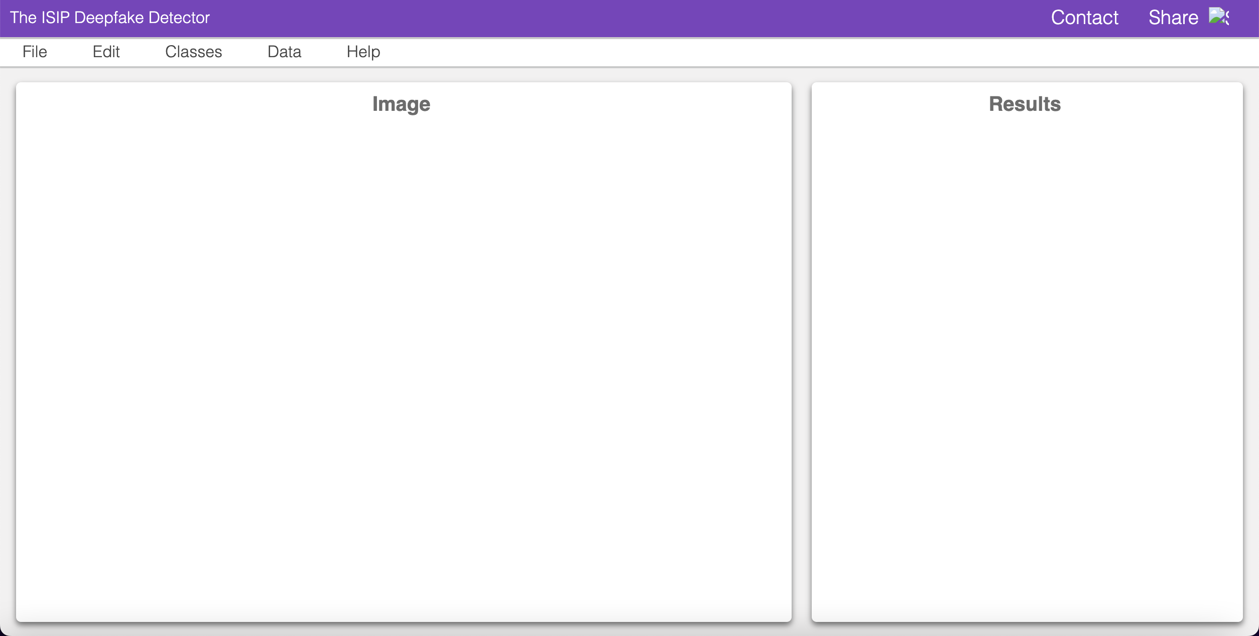
Zacary Update
Initializing development based off IMLD team, will personalize the website after successfully integrating tools

