Slide 1
Meeting 6

Slide 2
Question
Do we want to understand how the annotations align with the feature vectors?
How do we run the website through the server?
Datatypes –
RGB -> 0-255 (8bits)
HSL -> 0-1 (floats)
When choosing features, should we consider the datatype?

Slide 3
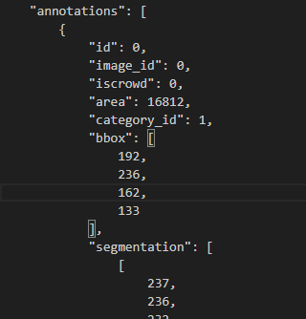
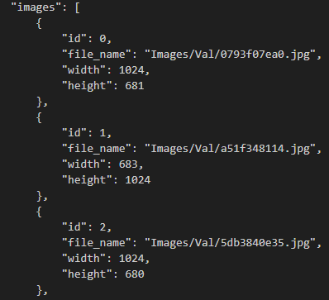
Annotations

Slide 4
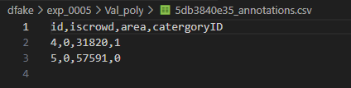
Annotation CSVs Part 1
File Name: ‘imagefilename’_annotations.csv
Face id | Iscrowd | Area | Real or fake
 | 0 or 1 |  | 0 or 1

Slide 5
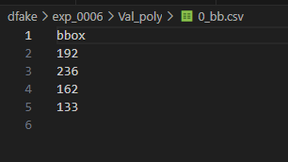
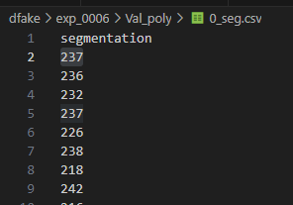
Annotation CSVs Part 2
File Name:
‘face id’_’seg/bb’.csv

Slide 6
Annotation CSVs Part 3
Face id
bb.csv
Image name
Annotations.csv
seg.csv
Face id

Slide 7
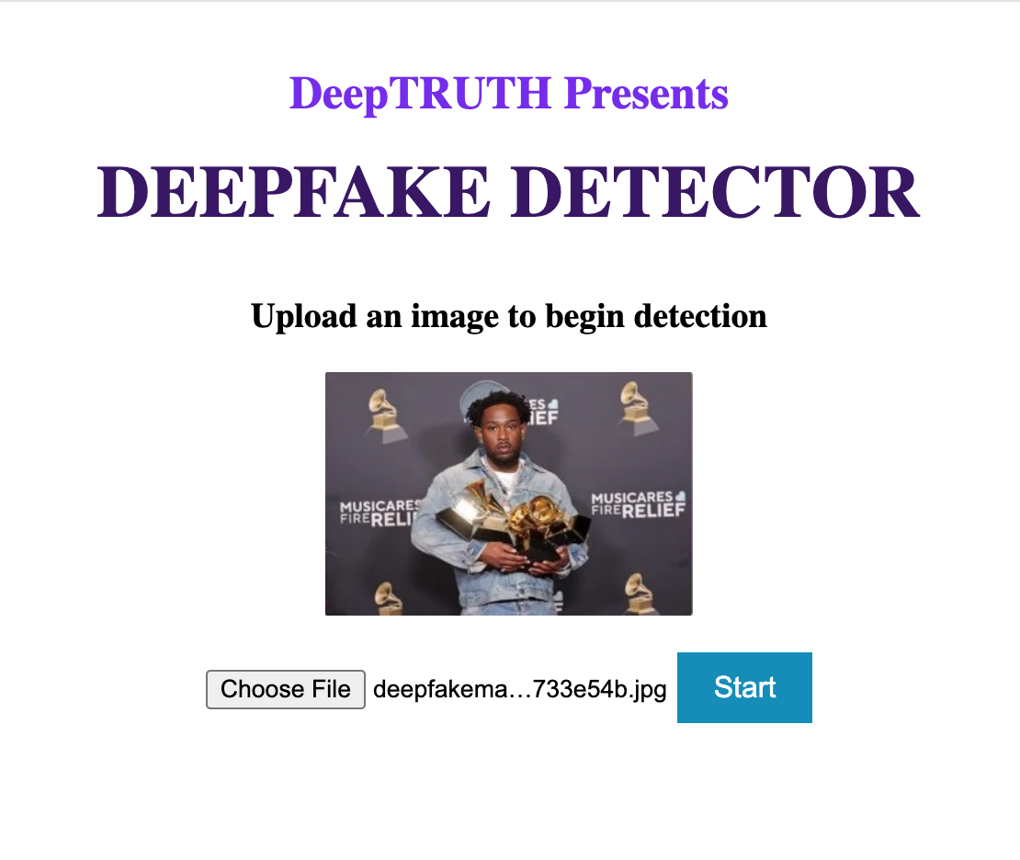
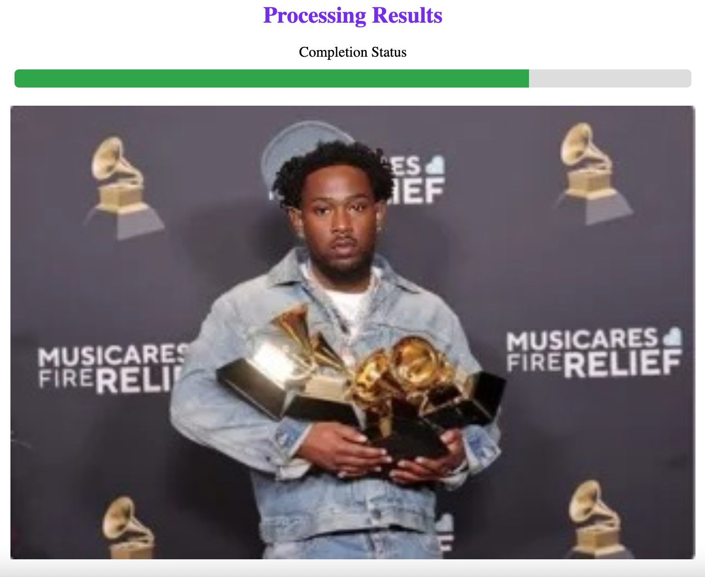
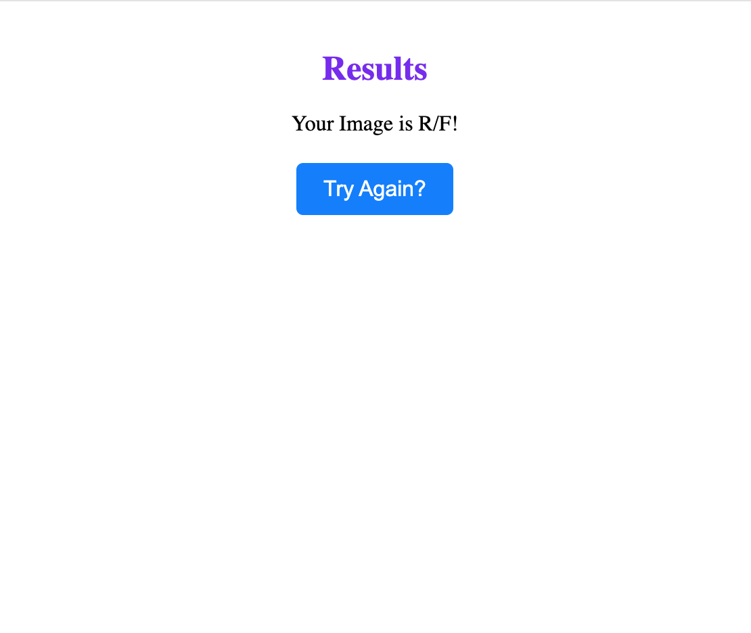
Web App

