Slide 1
SD ADVISOR MEETING 5
DeepTRUTH
Advisor: Dr. Picone
Team: Jouri, Jahtega, Zacary, Ashton

Slide 2
Feature extraction
Name | Real (1)/ Fake (0) | R | G | B
IMG1.jpg | 1 | 1 | 2 | 3
 |  | 1 | 2 | 3
 |  | 1 | 2 | 3
 |  | 1 | 2 | 3
CONTINUE FOR ALL VALUES
IMG2.jpg | 0 | 1 | 2 | 3
 |  | 1 | 2 | 3
 |  | 1 | 2 | 3
 |  | 1 | 2 | 3
CONTINUE FOR ALL VALUES
IMG3.jpg | 0 | 1 | 2 | 3
 |  | 1 | 2 | 3
 |  | 1 | 2 | 3
  We need to agree on the file format of the extracted data
  Csv for training, evaluation, dev images
  Columns: image name, real/fake, R,G,B, height/width
  Timekeeping: time per image, time to train, time to predict
Image:
RGB
CSV
Random Forest code
JSON
R/F Label, ID

Slide 3
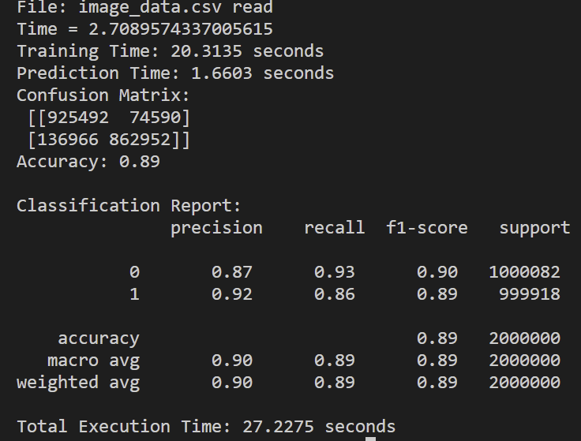
RF implementation
While waiting for image data to be processed & start the RF process, I generated a FAKE 3 feature (RGB) dataset.
Keeping track of time to train and evaluate
Printing confusion matrix, and classification report
RESULTS OF FAKE DATASET

Slide 4
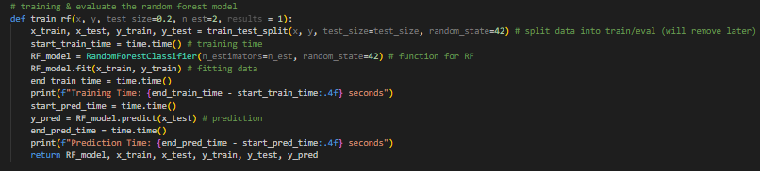
RF implementation
  RF implementation for now – using fake dataset
  Question: should we be using the the RandomForestClassifier() function, or “building the forest”?

Slide 5
Feature extraction
We will start with RGB for now, but we may consider looking into a variety of image features
  YUV (Luminance and Chrominance: U, V): Separates brightness from color
  HSV (Hue, Saturation, Value) : Separates chromatic content (hue) from brightness
  Will look into more image features and decide on the best one for our application.
Addressing presentation 1 feedback
  “What will you do to make sure your system works across multiple datasets without retraining?”
  “How will this system work if the image is something you have never seen before? How will lighting conditions impact things?”

Slide 6
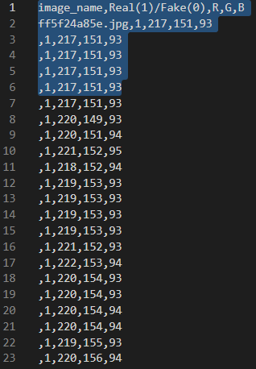
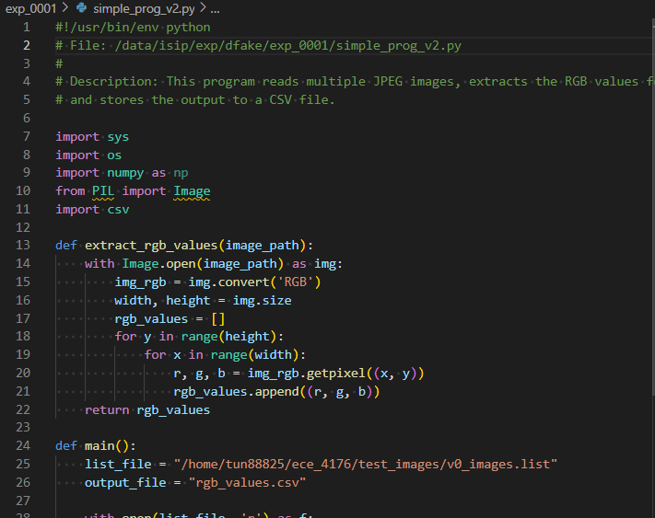
Jahtega update

Slide 7
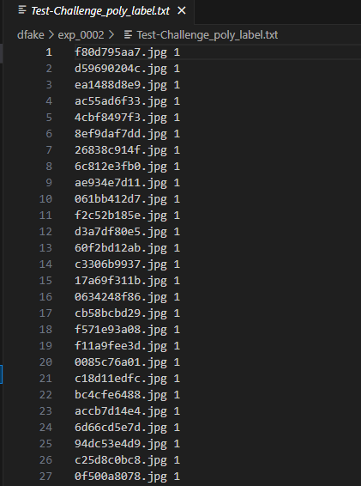
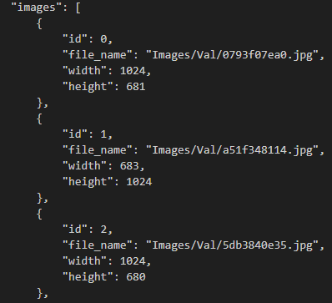
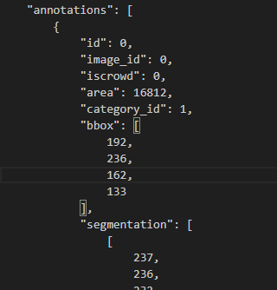
Ashton update
Parsed Json label files

Slide 8
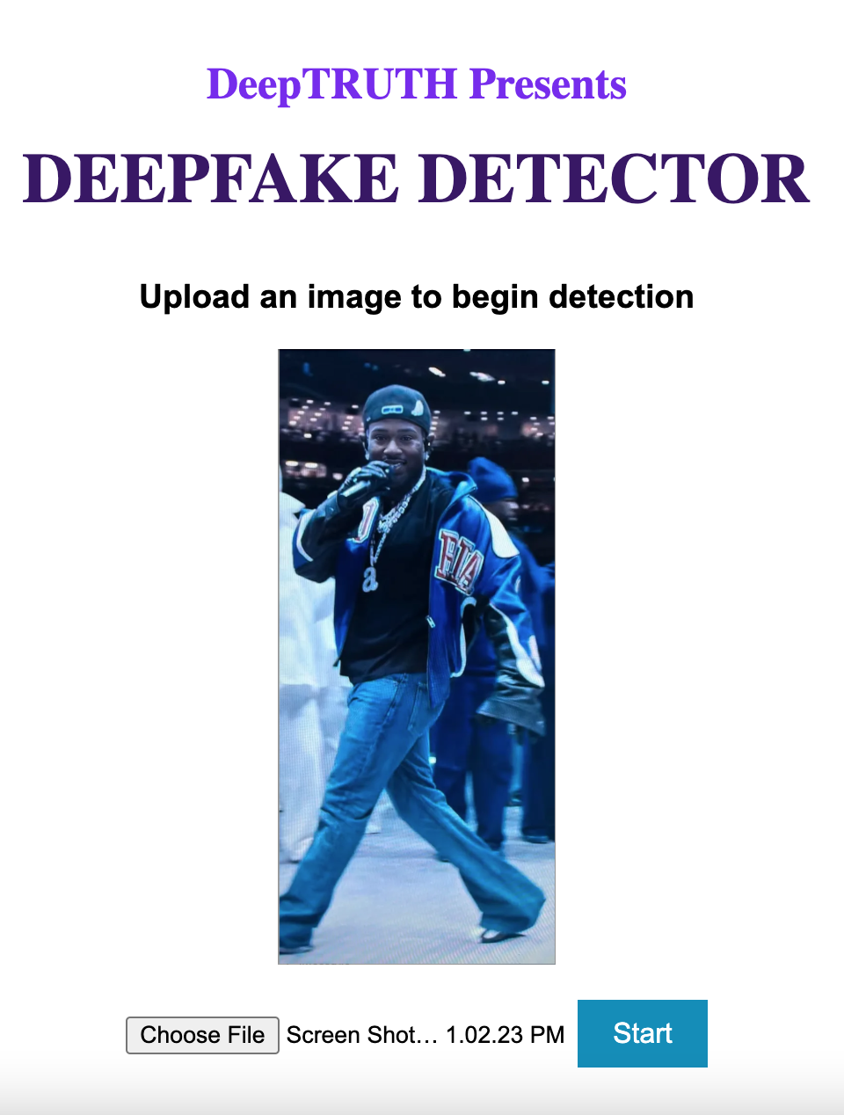
Website Development
Developing the web app to integrate with the algorithm
3 Pages, Home/Upload Screen, Processing Screen, Results Screen
Website deletes the images processing

