Slide 1
SD ADVISOR MEETING 3
DeepTRUTH
Advisor: Dr. Picone
Team: Jouri, Jahtega, Zacary, Ashton

Slide 2
Updated Problem Statement
Artificially generated/manipulated images (Deepfakes) have become more widespread, easier to create, and harder to detect. Thus, we will use a trained machine-learning algorithm to detect these forged images and distinguish them from authenticated images.

Slide 3
Action Item 1: Blind Test Exercise

Slide 4
Blind Test Exercise

Slide 5
Action Item 2: Literature Review

Slide 6
Some Papers
Improving Deepfake Detection by Mixing Top Solutions of the DFDC (IEEE)(2022)
  Web Link: https://ieeexplore.ieee.org/document/9909905
MODEL ATTRIBUTION OF FACE-SWAP DEEPFAKE VIDEOS (IEEE)(2022)
  Web Link: https://ieeexplore.ieee.org/document/9897972
DF40: Toward Next-Generation Deepfake Detection (NeurIPS)(2024)
  Web Link: https://www.nature.com/articles/s41467-024-51998-z
Human detection of political speech deepfakes across transcripts, audio, and video(2024)
  Web Link: https://nips.cc/virtual/2024/poster/97670
Notes:
Does a comparative analysis on the 5 best methods from Facebook’s DFDC and combines them for improved performance
11 citations
They examine the additional problem of model attribution(representative of the future of the field)
This group’s aim was to create a more universal detector. To do this, their dataset includes 40 deepfake techniques, 4 evaluation protocols, and 8 methods for detection
This is an interesting study on human detection ability across media(audio, video, and text). They found that people were best with audio and visual cues.

Slide 7
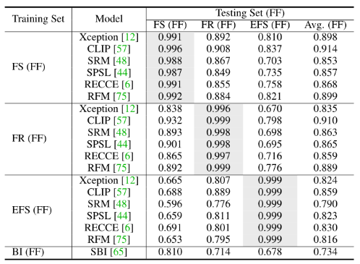
The detection Models used for DF40

Slide 8
Action Item 3: Performance Metrics & Classification Methods

Slide 9
Performance Metrics
Actual / Predicted | Deepfake (Positive) | Real (Negative)
Deepfake (Positive) | True Positive (TP) | False Negative (FN)
Real (Negative) | False Positive (FP) | True Negative (TN)
Accuracy*
Precision*
Recall*
F1-Score*
Area under curve of receiver operating characteristics (ROC-AUC)
False Positive/Negative Rate (FPR/FNR)*
Equal Error Rate (EER)
True/False Detection Rate (TDR/FDR)* - TDR is the same as recall
Pixel-wise Binary Classification Accuracy (PBCA)
* Calculated from confusion matrix

Slide 10
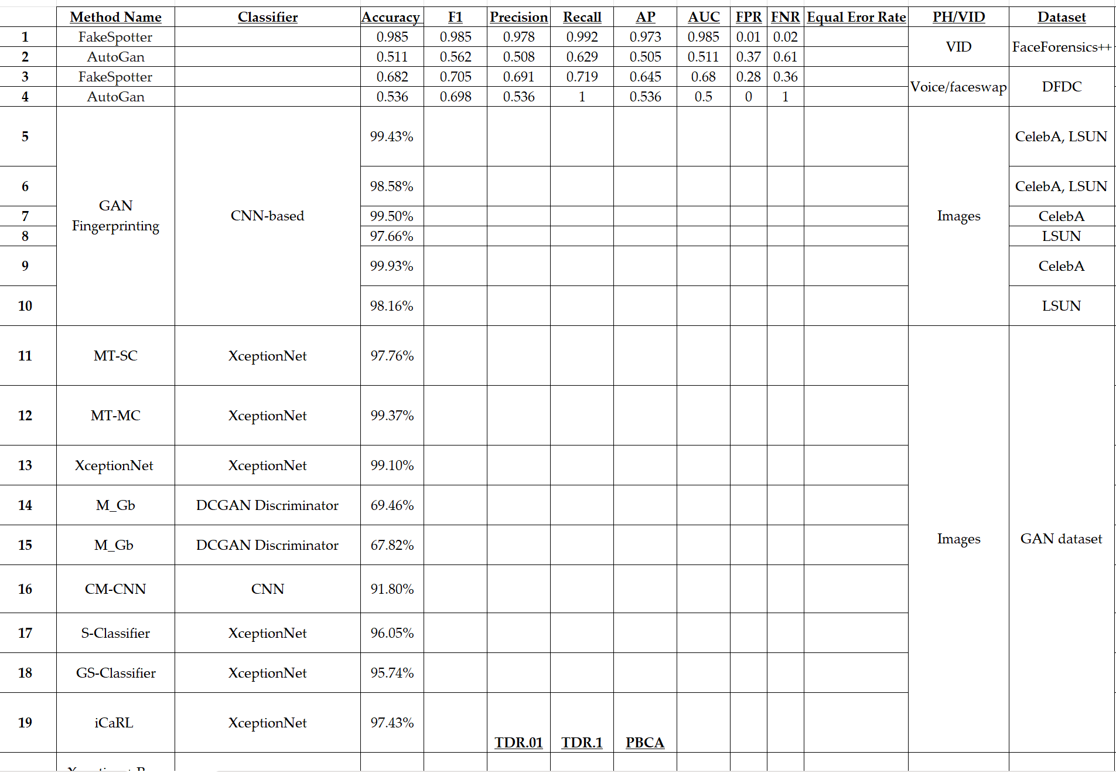
Also noted: Classification method, dataset used, GAN generation method

Slide 11
Classification Discussion
Classification Method | Usage | Examples
Machine Learning | May work with feature extraction methods | Support Vector Machine (SVM), Random Forest (RF), Decision Trees (DT), k-Nearest Neighbors (k-NN)
Deep Learning* | Works with learning features from images/videos | Convolutional Neural Networks (CNNs), Recurrent Neural Networks (RNNs), Long Short-Term Memory (LSTMs)
Multitask Learning** | Using multiple classification methods | Multi-Task Learning (MTL), Boosting Classifiers, Few-Shot Learning (FSL)
Feature Based | Extracting features from images for classification | Fourier Transform & Classification Co-occurrence matrices & classification
Self supervised learning** | Detecting generated content based on self learned features | One-Class SVM, Adversarial Training (GAN Discriminator),
* Most mentioned in Deepfake detection studies
** personally unfamiliar with for now but may investigate if required

Slide 12
Classification Discussion
Deep Learning | Average | Usage | Layers
XceptionNet | 97.57% | Image Classification | Depthwise Separable Convolutions, Entry/Middle/Exit Flow
VGG16 | 89.02% | Image recognition & Feature extraction | 16 layers
Deep Convolutional GAN (DCGAN) | 68.64% | Discriminator used | Convolutional layers in Generator and Discriminator
CNN - Based | 98.88% | Based on feature extraction | Custom implementation- Case by case
FaceForensics++ | 92.43% | Pre-trained deep learning models (Xception, ResNet, etc.) | [FF referred to as a dataset & model]

Slide 13
Action Item 4: Interface Design

Slide 14
Features
Upload interface
DF Detector
Results Visualization
Survey

Slide 15
QUESTIONS
Action Items
Machine Learning vs Deep Learning
  Which model is best?
DEEPFAKE DETECTOR
Upload an image to begin detection
UPLOAD IMAGE
JPG PNG BMP GIF TIF WEBP HEIC AVIF PDF, # MB limit.

Slide 16
DeepTRUTH Presents
DEEPFAKE DETECTOR
Upload an image to begin detection
UPLOAD IMAGE
JPG PNG BMP GIF TIF WEBP HEIC AVIF PDF, # MB limit.
CAN YOU DETECT THE DEEPFAKE?

Slide 17
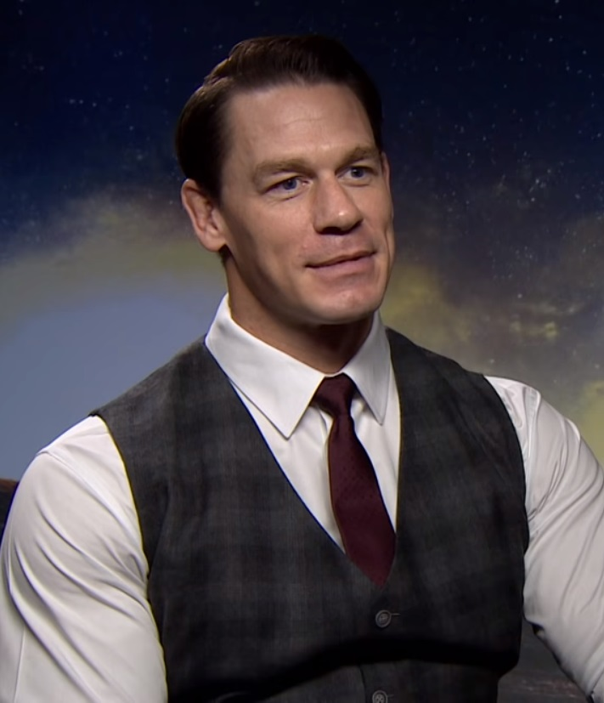
DEEPFAKE DETECTOR
Upload an image to begin detection
UPLOAD IMAGE
JPG PNG BMP GIF TIF WEBP HEIC AVIF PDF, # MB limit.

Slide 18

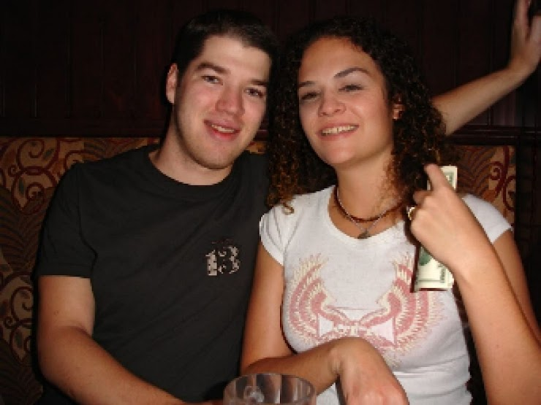
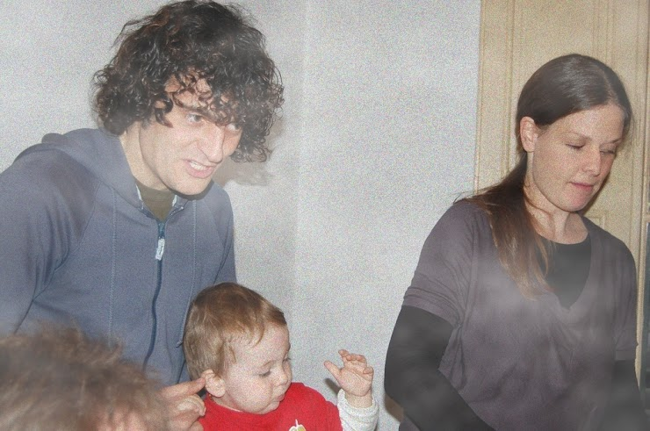
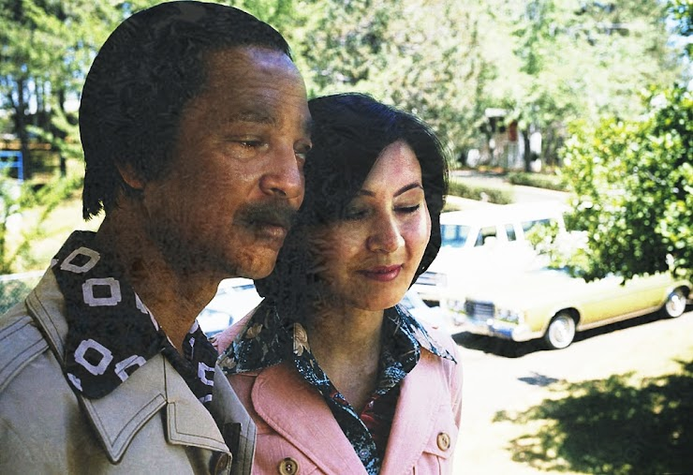
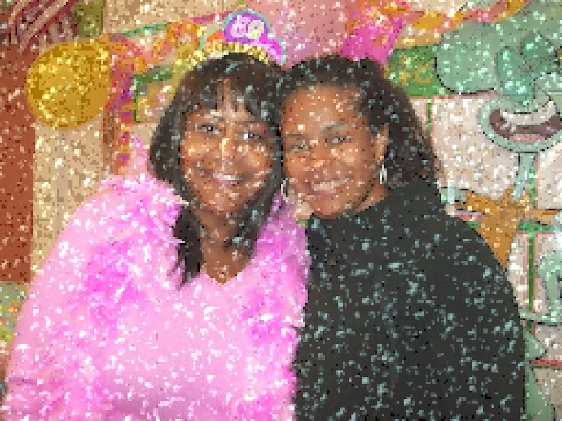
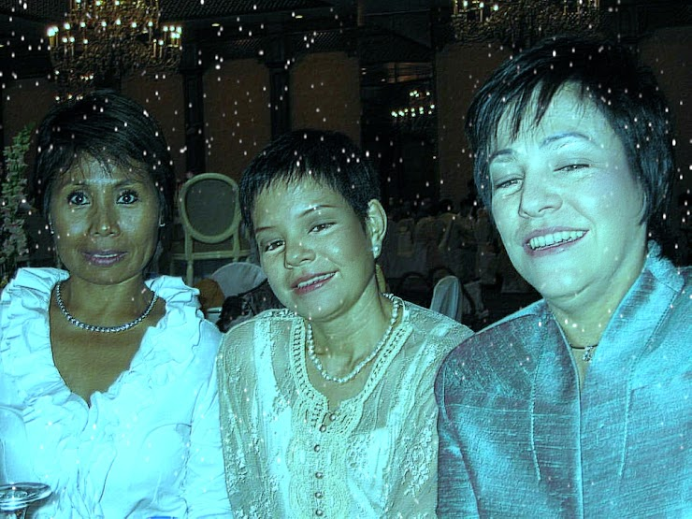
DEEPFAKE DETECTOR
GRAPH
RGB COLORS?
FREQUENCY?
ACCURACY METRICS?
TIME?
Upload an image to begin detection
UPLOAD IMAGE
REAL/FAKE
[SOMETHING ELSE]
JPG PNG BMP GIF TIF WEBP HEIC AVIF PDF, # MB limit.

Slide 19
DETECT THE DEEPFAKE!
Upload an image to begin detection
UPLOAD IMAGE
JPG PNG BMP GIF TIF WEBP HEIC AVIF PDF, # MB limit.

Slide 20
DETECT THE DEEPFAKE!
Performance Metrics:
[ ] Seconds
[ ] Average accuracy
[ ] Our models accuracy
Upload an image to begin detection
UPLOAD IMAGE
JPG PNG BMP GIF TIF WEBP HEIC AVIF PDF, # MB limit.

