Slide 1
SD ADVISOR MEETING 2
Group name: DeepTRUTH
Advisor: Dr. Picone
Team: Jouri, Jahtega, Zacary, Ashton

Slide 2
Action Items 1 & 2 Literature Review and Dataset selection

Slide 3
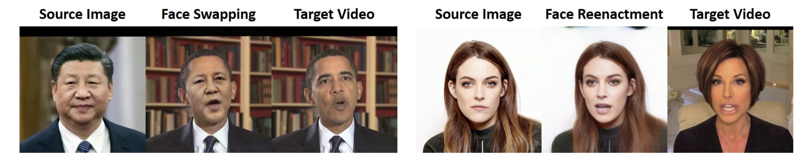
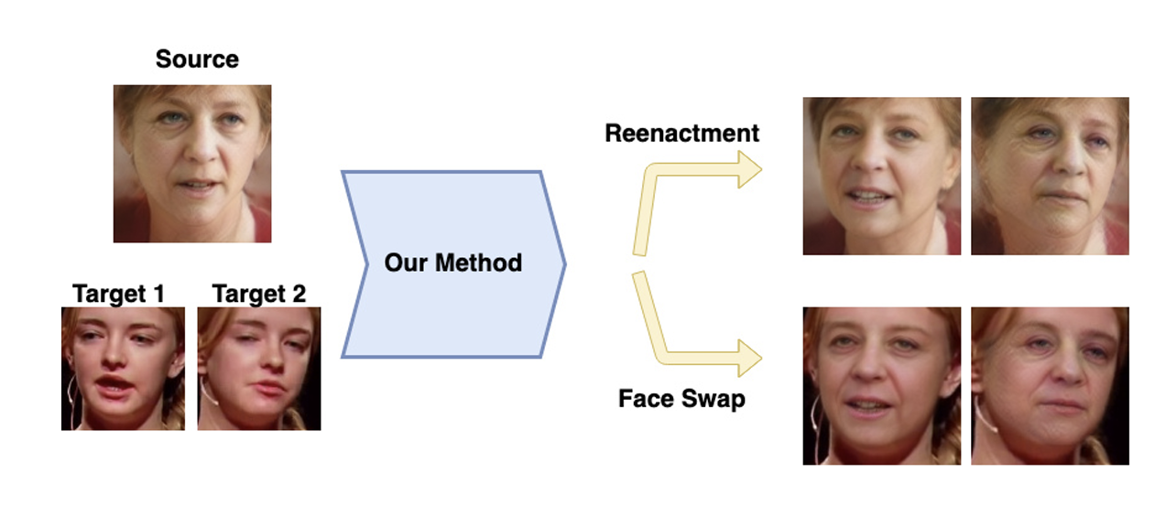
CHOOSING A DATASET
Face swapping
aims to change the facial identity but to keep other face attributes constant
UADFV, FF-DF, CelebDF, DFD, DFDC, DeeperForensics-1.0, and ForgeryNet
Face reenactment
focuses on changing attributes of the face image while keeping the face identity the same
NeuralTextures, and Face2Face

Slide 4
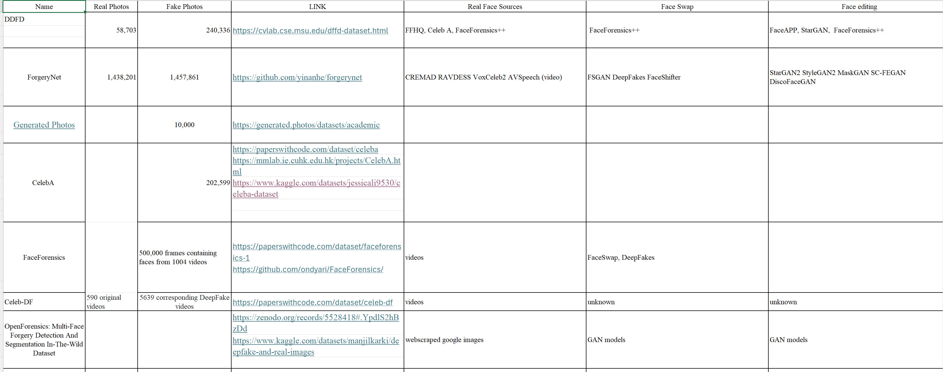
CHOOSING A DATASET
Dataset selection
REAL vs. FAKE photos
Real Face Sources
Face Swap method
Facial reenactment method
Face synthesis
Data labelling
extra notes: image size, # of people per shot

Slide 5
DATASET SELECTED
OpenForensics
REAL vs. FAKE photos: 45,473 Real 70,325 Fake
Real Face Sources: Web scrapped Google Images
Face Swap method: GAN Models
Facial reenactment method: GAN Models
Face synthesis: GAN Models
extra notes: image size, # of people per shot
Average of 2.9 faces per image
Label
" Each face was labeled with various ground-truths such as forgery category (real/fake), bounding box, segmentation mask, forgery boundary, and facial landmarks (cf. Fig. 2). Our rich annotation can be utilized for various tasks and even multi-task learning"

Slide 6
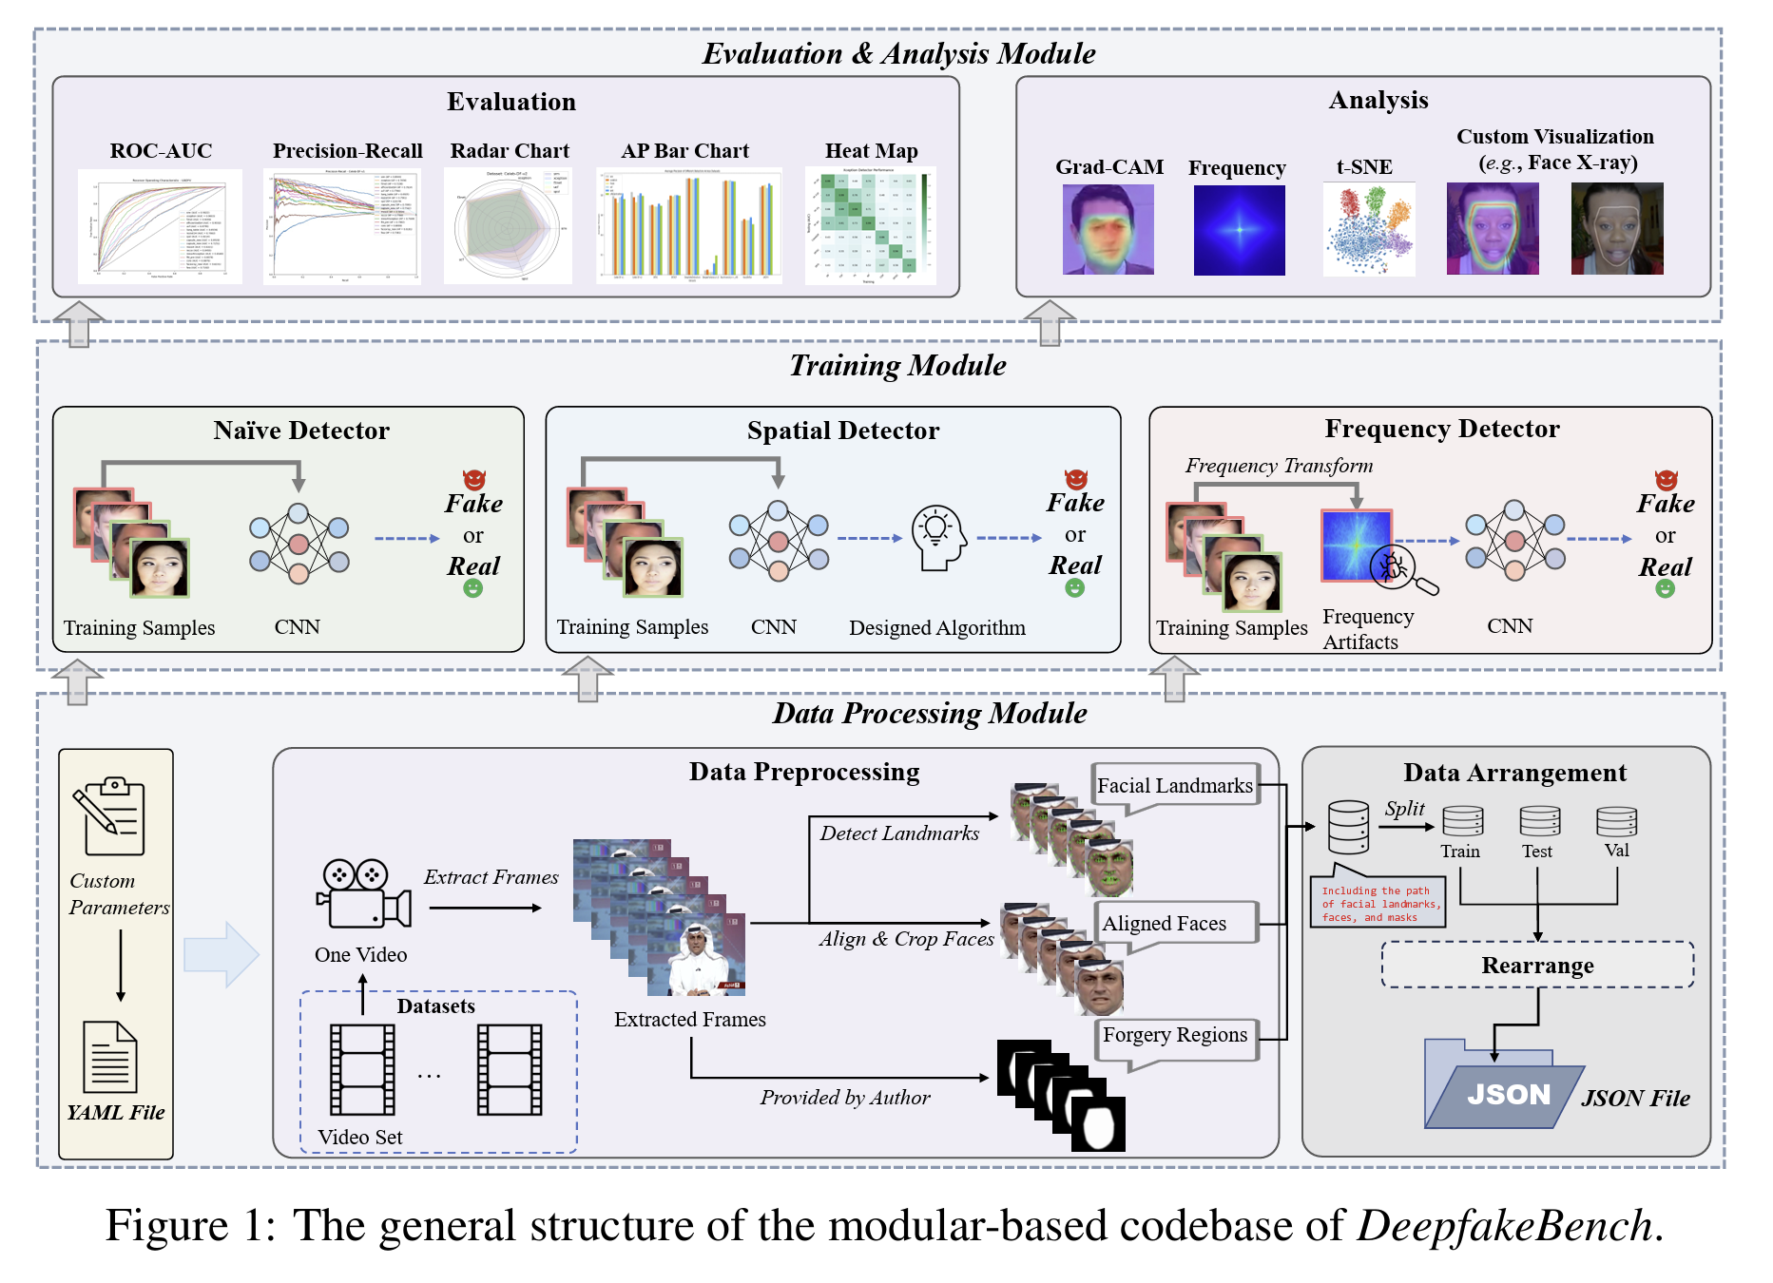
Literature Review
Paper: DeepfakeBench: A Comprehensive Benchmark of Deepfake Detection (2023)
Provides a process from dataset selection, a list of datasets, data processing, the experimental setup and analysis benchmarks

Slide 7
Action 4: UPDATED PROBLEM STATEMENT
Training and employing a Neural Network to detect whether an image has been partially manipulated using the naïve method.

Slide 8
Design Requirements and Constraints
Three or more requirements drafted (1)
Has quantitative target values (1)
Narrative describing why these requirements and target values were selected (1)
Three or more constraints drafted (1)
Has quantitative target values (1)
Narrative describing why these constraints and target values were selected (1)

Slide 9
Action Item 3: 1st presentation content considerations: Outline
Hook/Intro: What are deepfakes? Why are they relevant? Why is recognizing them important
What is the current research and technologies regarding deepfake recognition?
What are we focusing on in this project?(Focused problem statement)
What’s our solution?(Proposal of baseline system, high level view)
What choices have we made so far?(dataset, architecture, etc.) What choices will have to make in the future?(ML algorithm, things like GPu acceleration,
Why are we making these choices?(Design constraints)
Next steps
Overall Milestones/Goals for the semester(i.e. working software simulation by end of semester, submission/presentation of abstract at SPMB)

Slide 10
NEXT STEPS…
Acquiring dataset
Setting up database: training – evaluation ratio
Setting up cluster*
I/O*
*discuss in meeting

