Slide 1
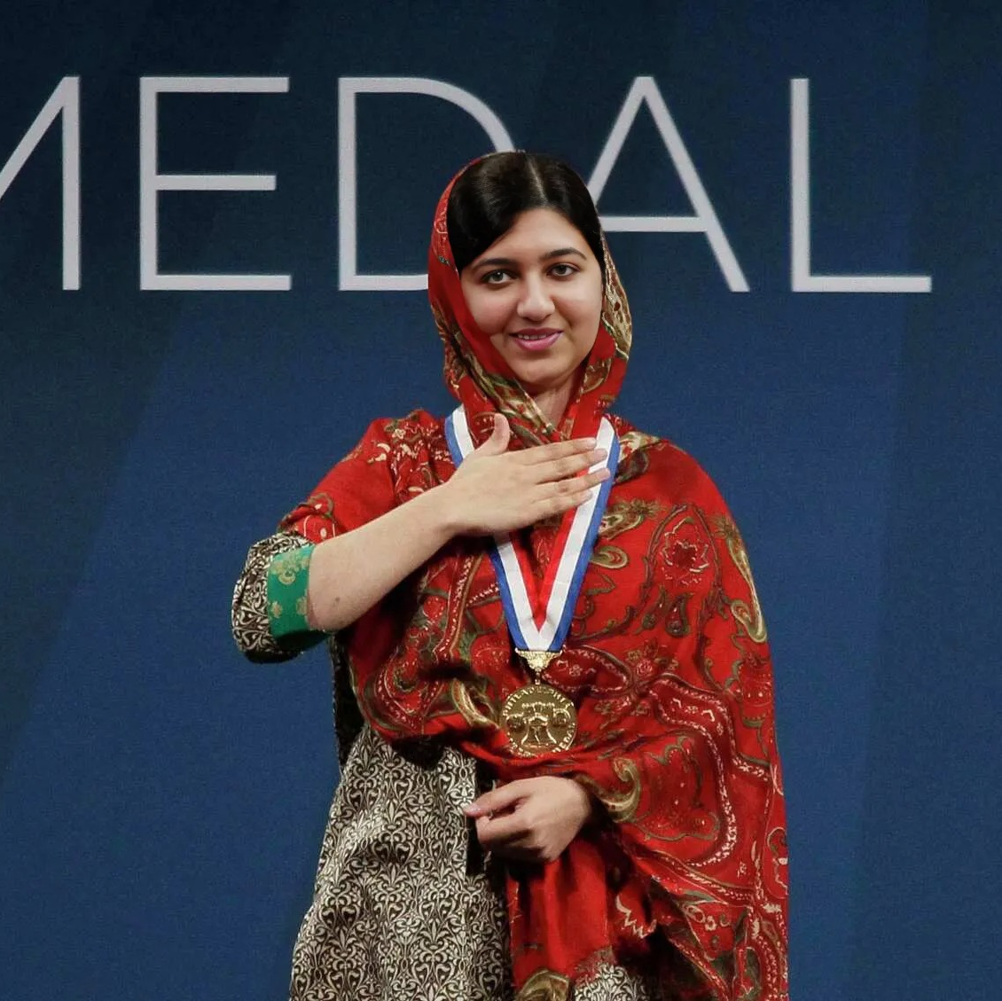
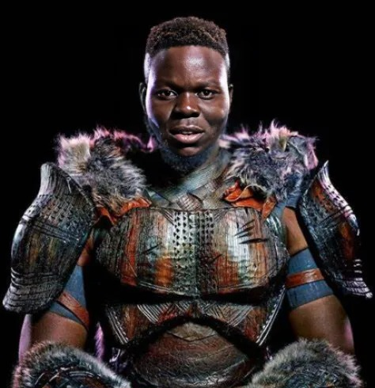
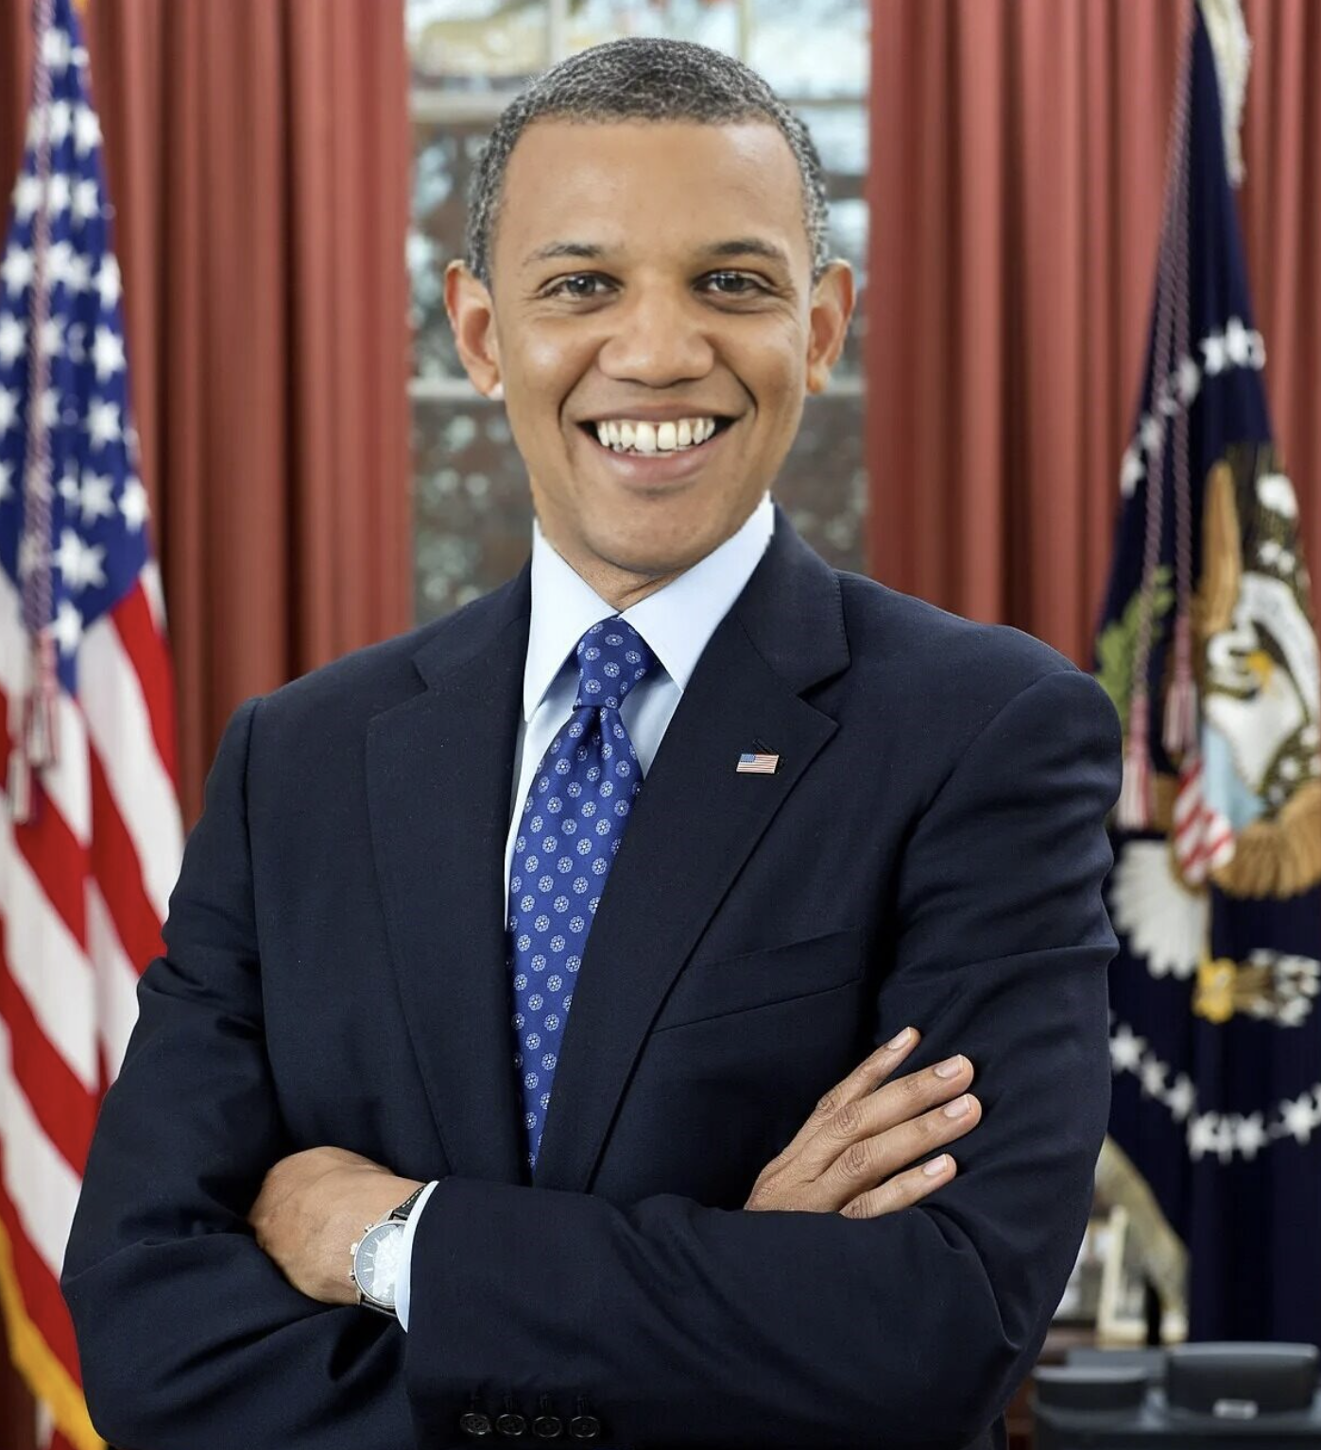
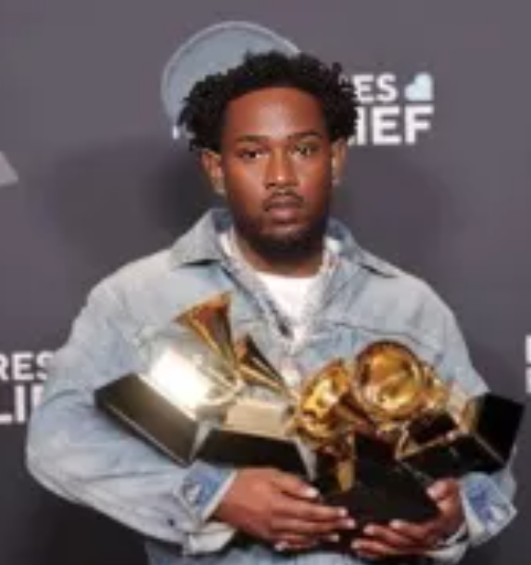




Meet Team DeepTruth!
Jouri Ghazi
Jahtega Djukpen
Ashton Bryant
Zacary Louis
A Nobel Peace Prize winner
An Oscar Winning Actor
The 44th President of the United States
A Multi-Grammy award Artist
These images are:
Is this image real?
DEEPFAKES!
100% Confidence
Curious User
Uploads Image
Process Image
Present Results
Notes:
Jouri

Slide 2

DeepFake Detection
Advised by Dr. Picone
DeepFakes are easier to create, and harder to detect, posing security risks. We’ll develop a detection method
These images are:
Is this image real?
DEEPFAKES!
100% Confidence
Curious User
Uploads Image
Process Image
Present Results
Notes:
Jouri

Slide 3
DeepFake News
Iowa school district confronted by female students over nude AI-generated deepfake photos
Deepfake is destroying real lives in South Korea
CNN Tues 29 April 2025 6:33 EDT
The Des Moines Register Thurs 1 May 2025 2.04 CT
Ex-educator sentenced for AI deepfake framing school principal as racist
Teen boy suspended from prestigious private school after discovery of deepfake image of a teacher
Daily News Tues 29 April 2025 5:0 EDT
Daily Mail Thurs 1 May 2025 21:15 EDT
Scammers in North Korea use deepfake tech and artificial intelligence to falsify identity and gain intel
Video Of Trump Supporting India Against Pakistan Is A Deepfake
Daily Mail Thurs 1 May 2025 21:15 EDT
MSN Fri 2 May 2025 6:33 EST
Notice the
Victims
Date
News Source
Notes:
Jahtega

Slide 4
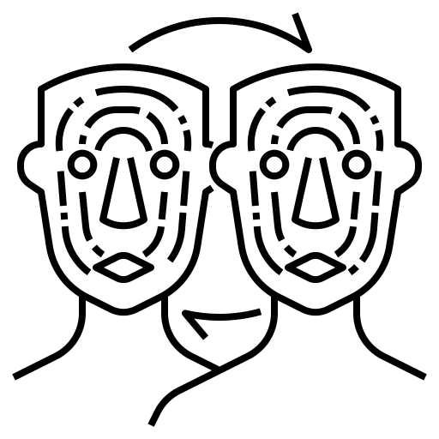
Problem Statement
Artificially generated and manipulated images such as DeepFakes, have become easier to create, and harder to detect. These images pose a serious risk to the credibility of public figures, resulting in great emotional, financial and political turmoil. A DeepFake detector would protect individuals such as celebrities, politicians, and even corporations who are frequent victims of DeepFake misuse.
Notes:
Jahtega

Slide 5
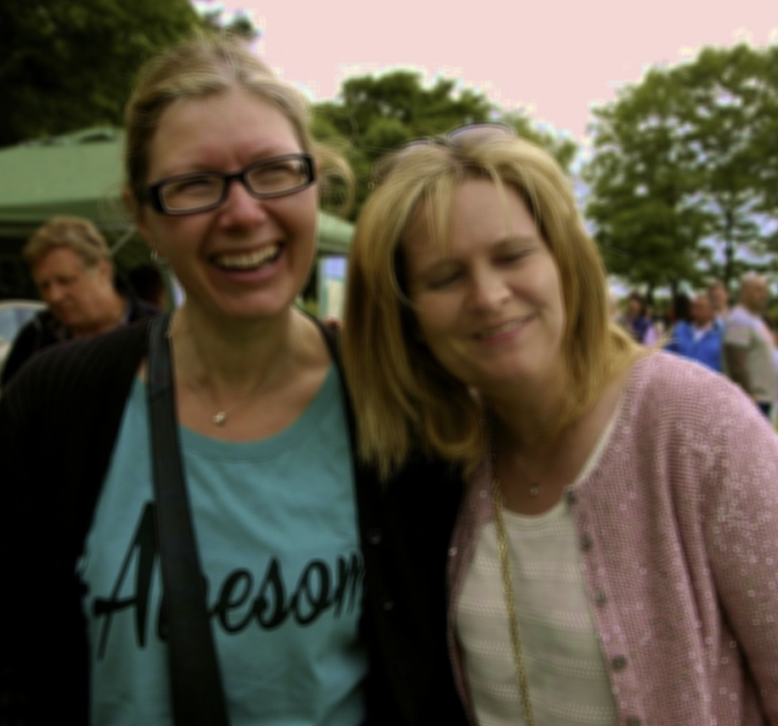

Proposed Solution
Web Application
Image Processor
Is this image real?
Flask
Javascript
Python
Upload
Image
Python Image Library
Random Forest
DeepTRUTH
(our proposed model)
RGB(R,G,B)
$$\left[\begin{matrix}{RGB}_{11} & ⋯ & {RGB}_{1n} \\ ⋮ & ⋱ & ⋮ \\ {RGB}_{m1} & ⋯ & {RGB}_{mn}\end{matrix}\right]$$
HTML
CSS
Present
Results
Feature
Extraction
Machine Learning
Classifier
Notes:
Jouri

Slide 6



Requirements
Runtime
Image Size
Performance Accuracy
Requirement
Metric
Seconds/pixel²
Types
Accuracy %
Normalized ratio
(1500 ms / 1K x1K)
Target Value
PNG, JPEG, WEBP
At least 95%
Allows for real time image processing and classification
Create a wide range of useable
Why?
Ensuring reliable model performance
Notes:
Zac

Slide 7



Engineering Design
Constraints
Server Environment
Dataset Availability
Constraint
Scalability
Metric
Status
Statuses
% of Datasets Available
Target Value
Pass/Fail
Python 3.9.16, Rocky Linux 8.1, Flask 3.1.0
Pass/Fail
Website UI must scale with the number of faces in the image.
All software must be compatible with Neuronix Cluster
Why?
Used for training deepfake detectors
Dataset Annotation
The process of labeling data to train AI models
Notes:
Zac

Slide 8

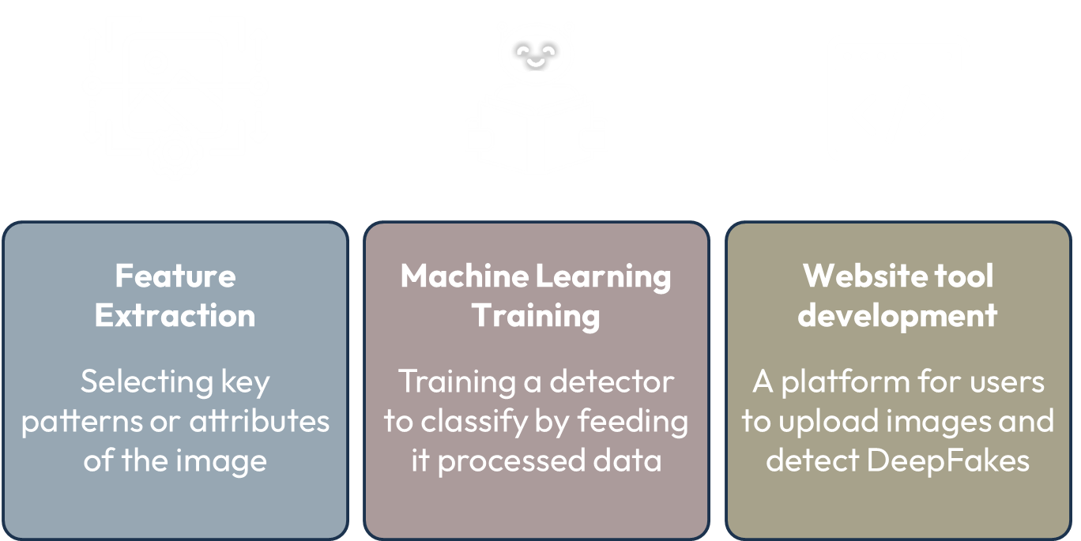

Constraints
Hosted on Neuronix
Dataset Availability
Constraint
Scalability
Metric
Status
Statues
% of Datasets Available
Target Value
Pass/Fail
Pass/Fail
Pass/Fail
Website UI must scale with the number of faces in the image.
Website must be hosted on Neuronix cluster for server support.
Why?
Used for training deepfake detectors
Engineering Design
Dataset Annotation
Feature Extraction
Machine Learning Training
Website tool development
The process of labeling data to train AI models
Selecting key patterns or attributes of the image
Training a detector to classify by feeding it processed data
A platform for users to upload images and detect DeepFakes

Slide 9



Dataset Breakdown
Number of Real Images
Source of Real Images
Number of Fake Images
Source of Fake Images
Dataset Name
OpenForensics
45,473
Google Images
70,325
GAN (AI-Generated)
The dataset is split into 3 parts:
Training
Development
Evaluation
44,097 images
63,885 images
7,308 images
Used to teach a machine learning model to learn patterns
Used during training to fine tune model to prevent overfitting
Used to assess a model's performance metrics

Slide 10
Dataset Annotation
Two Lists of Information
ID
Image_id
Iscrowd
Area
Category_ID
Bbox
segmentation
Real or Fake
Bounding box
Segmentation
Real or Fake
Bounding box
Segmentation
Real or Fake
Bounding box
Segmentation
Images
Image ID
File Name
Width
Height
Annotations
Image ID
Face ID
Iscrowd
Area
Category ID
BBox
Segmentation
IMG_1_FACE[1]
IMAGE[1]
…
FACE[1]
FACE[2]
FACE[3]
IMG_1_FACE[N]
ID
Image_id
Iscrowd
Area
Category_ID
Bbox
segmentation
…
ID
Image_id
Iscrowd
Area
Category_ID
Bbox
segmentation
IMG_N_FACE[1]
IMAGE[N]
…
Real or Fake
Bounding box
Segmentation
IMG_N_FACE[N]
ID
Image_id
Iscrowd
Area
Category_ID
Bbox
segmentation
FACE[1]
IMAGE[1]
FACE[N]
Real or Fake
Bounding box
Segmentation
IMAGE[1]
A picture of 3 best friends

Slide 11




Reformatting Annotation
Face ID | IsCrowd | Area | CategoryID | BBox1 | BBox2 | BBox3 | BBox4 | Segmentation
Face 1
Face 2
…
IsCrowd
Area
CategoryID
BBox(N)
Segmentation
If value is of a crowd or a single object
Identifier to assign object to category
Size of annotated object in pixels
Frame defined by
[x, y, width, height]
Region of image defining mask
Single = 0
Crowd = 1
Real = 0
Fake = 1

Slide 12





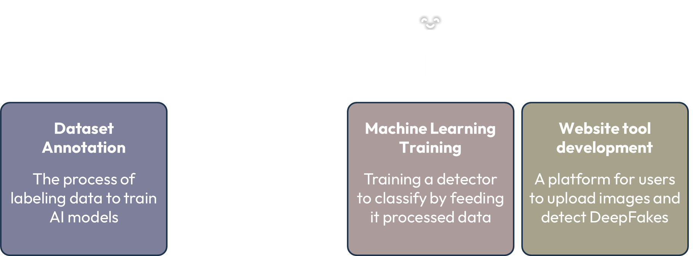
Future Work
Standards
Dataset Practices
Find new dataset we can evaluate on
Data portioning best practices
Three subsets: Training, Testing, and Evaluation​
​
Investigate other DeepFake generation methods for future model development
Ethical Labeling: Data labels should not inject bias
FAIR Principles​: Findable, Accessible, Interoperable, and Reusable data
Source: https://www.alation.com/blog/data-ethics-in-ai-6-key-principles-for-responsible-machine-learning/, https://www.go-fair.org/fair-principles/​
Engineering Design
Feature Extraction
Selecting key patterns or attributes of the image

Slide 13
Future Work
Standards
Dataset Practices
Find new dataset we can evaluate on
Data portioning best practices
Three subsets: Training, Testing, and Evaluation​
​
Investigate other DeepFake generation methods for future model development
Ethical Labeling: Data labels should not inject bias
FAIR Principles​: Findable, Accessible, Interoperable, and Reusable data
Source: https://www.alation.com/blog/data-ethics-in-ai-6-key-principles-for-responsible-machine-learning/, https://www.go-fair.org/fair-principles/​
Engineering Design
Feature Extraction
Selecting key patterns or attributes of the image

Slide 14



Feature Extraction
Select important patterns, attributes from the image to train a ML model to classify between real and fake content
Using RGB color space as an example:
$$\left[\begin{matrix}R_{11} & ⋯ & R_{1n} \\ ⋮ & ⋱ & ⋮ \\ R_{m1} & ⋯ & R_{mn}\end{matrix}\right]$$
$$\left[\begin{matrix}G_{11} & ⋯ & G_{1n} \\ ⋮ & ⋱ & ⋮ \\ G_{m1} & ⋯ & G_{mn}\end{matrix}\right]$$
$$\left[\begin{matrix}B_{11} & ⋯ & B_{1n} \\ ⋮ & ⋱ & ⋮ \\ B_{m1} & ⋯ & B_{mn}\end{matrix}\right]$$
Image
Process Image
Quantitative Values
Notes:
Jahtega

Slide 15

Tool Used
Output
Input
Image List
Annotation List
CSV file that contains feature vectors for each image
Options:
Parameter File
Window size
DCT Size
DCT Coefficients
Generate Features Tool
Nedc_dfake_gen_feats.py
Using this framework, we specify the size of the DCT and the number of coefficients to extract.
Notes:
Jahtega

Slide 16






Discrete Cosine Transform
Converts a sequence of numbers to a sum of cosines different frequencies
$$\left[\begin{matrix}{RGB}_{11} & ⋯ & {RGB}_{1n} \\ ⋮ & ⋱ & ⋮ \\ {RGB}_{m1} & ⋯ & {RGB}_{mn}\end{matrix}\right]$$
$$\left[\begin{matrix}C_{11} & ⋯ & C_{1n} \\ ⋮ & ⋱ & ⋮ \\ C_{m1} & ⋯ & C_{mn}\end{matrix}\right]$$
RGB Values
Cosine coefficients
We would use the NEDC Tool to perform this transform
Widely used in signal processing
Converts data into frequency components
Applied in data compression
Notes:
Jahtega

Slide 17
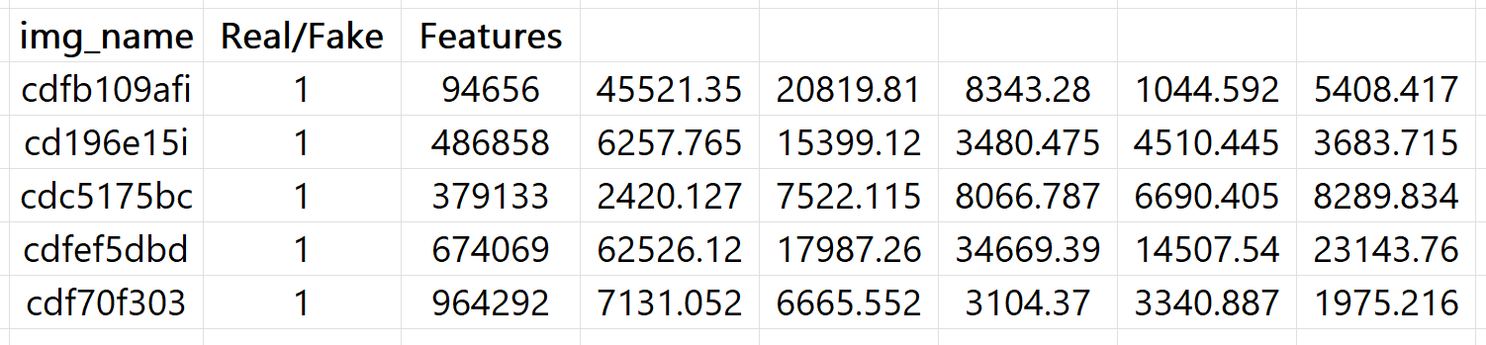


Feature Extraction Results
Img_name | Real/Fake | Features | Coefficient[1] | Coefficient[N]
Image 1
Image 2
Image N
$$C_{N}$$
Real/Fake
Features
Coefficient
Identifier to assign object to category
Extracted values from image
Coefficient of Cosine
Notes:
Jahtega

Slide 18



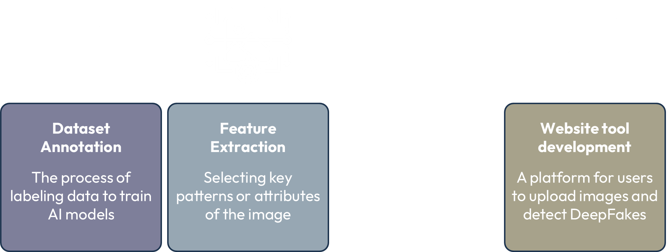
Future Works
Standards
PEP 8 – Style Guide for Python Code
Documentation: Clearly commenting code and the use of .usage and
.help files.
Research other features to extract, such as other color spaces
Code Structure/format: Header, imports, global variables, function
definitions, main program
Naming Conventions: i.e. lowercase function names​
Source: https://peps.python.org/pep-0008/#introduction​
Engineering Design
Dataset Annotation
Feature Extraction
Machine Learning Training
Website tool development
The process of labeling data to train AI models
Selecting key patterns or attributes of the image
Training a detector to classify by feeding it processed data
A platform for users to upload images and detect DeepFakes
Notes:
Jahtega

Slide 19
Future Works
Standards
PEP 8 – Style Guide for Python Code
Documentation: Clearly commenting code and the use of .usage and
.help files.
Research other features to extract, such as other color spaces
Code Structure/format: Header, imports, global variables, function
definitions, main program
Naming Conventions: i.e. lowercase function names​
Source: https://peps.python.org/pep-0008/#introduction​
Engineering Design
Dataset Annotation
Feature Extraction
Machine Learning Training
Website tool development
The process of labeling data to train AI models
Selecting key patterns or attributes of the image
Training a detector to classify by feeding it processed data
A platform for users to upload images and detect DeepFakes

Slide 20
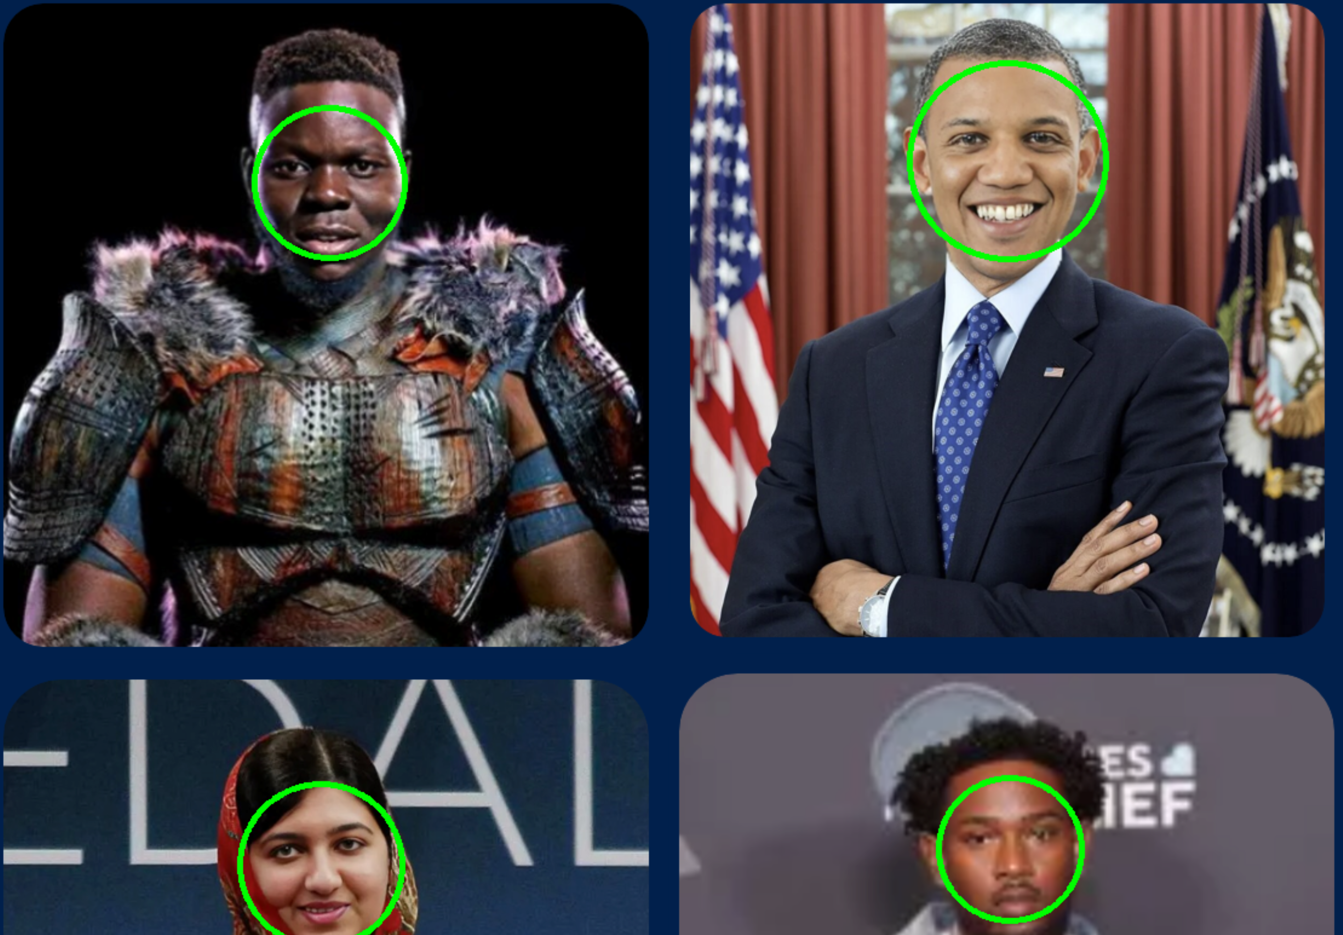
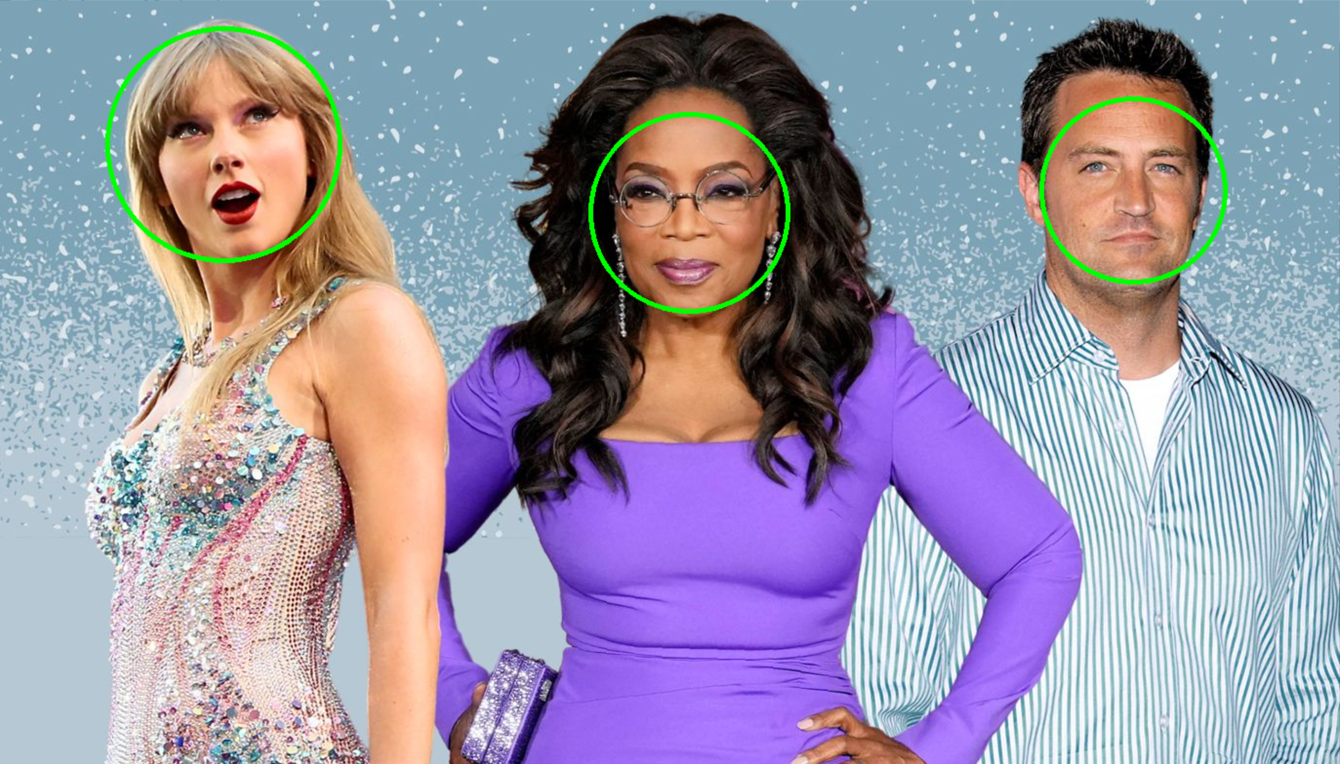
DeepFake Detection Design
Breaking down the problem
Is the face real?
Is there a face?
Yes
Present result
Yes
No
Present result
Image
No
End program
Step 1:
Develop a tool that can recognize faces and provide a bounding box with high accuracy.
Haar Cascade, a machine learning model used in face detection
Engineering Design
Notes:
Jahtega

Slide 21
DeepFake Detection Design
Breaking down the problem
Dataset
Is the face real?
Is there a face?
Yes
Yes
Decision Tree 1
Decision Tree 2
Decision Tree N
No
Result 1
Result 2
Result N
Averaging
Final Result
Notes:
Jahtega

Slide 22








Machine Learning Metrics
These metrics help evaluate performance of a machine learning model
Actual / Predicted | Predicted Real | Predicted Fake
Actual Real | TP | FN
Actual Fake | FP | TN
True (T)
False (F)
Positive (P)
Negative (N)
correct
incorrect
real
fake
classification
classification
image
image
Accuracy
Precision
Recall
F1 Score
$$\frac{ TP+TN }{TP+FP+TN+FN}$$
$$\frac{ TP}{TP+FP}$$
$$\frac{ TP}{TP+FN}$$
$$2×\frac{ Precision×Recall}{Precision+Recall}$$
How often the model classifies an image correctly
Proportion of correct positive predictions to all positive cases
Proportion of positive cases correctly identified
Combines precision and recall into a balanced metric
For al these metrics, a score of 1 is considered perfect
Notes:
Jahtega

Slide 23



Test Plan
dataset 1
(evaluation)
Train Model
dataset 1
(training)
Evaluate Model
Revise Model
Update:
Accuracy
Confidence Score
Confusion Matrix
dataset 1
(development)
Notes:
Jahtega

Slide 24
Visualized DCT
DCT Coefficients
…
…
…
1
1024
2048
3072
1
1
…
4
1
…
4
1
…
4
2
1
1
1
3
Image
…
…
…
4
…
4
4
4
N
RED Channel
Green Channel
Blue Channel

Slide 25
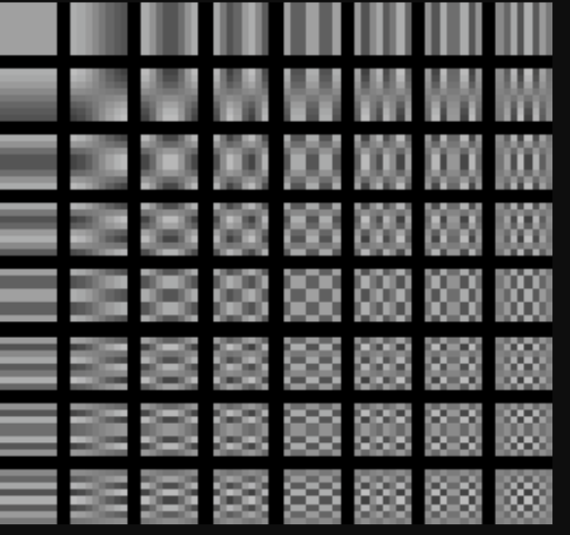
Discrete Cosine Transform
1
32
1
32
1
32
1
…
32 X 32
Matrix of DCT Values for the RED channel
1
…
32 X 32
Matrix of DCT Values for the GREEN channel
1
…
32 X 32
Matrix of DCT Values for the BLUE channel
…
…
…
…
…
…
…
…
…
…
…
…
…
…
…
…
…
…
…
…
…
32
…
32
…
32
…
Brightness
Horizontal Frequencies
Low Freq.
Low Frequency
Quantifies subtle changes
Smooth gradients
Vertical Frequencies
Combined Frequencies
High Frequency
Sudden changes in pixel values
High Freq.
Edges, borders, fine textures
Example 8x8 DCT Matrix

Slide 26
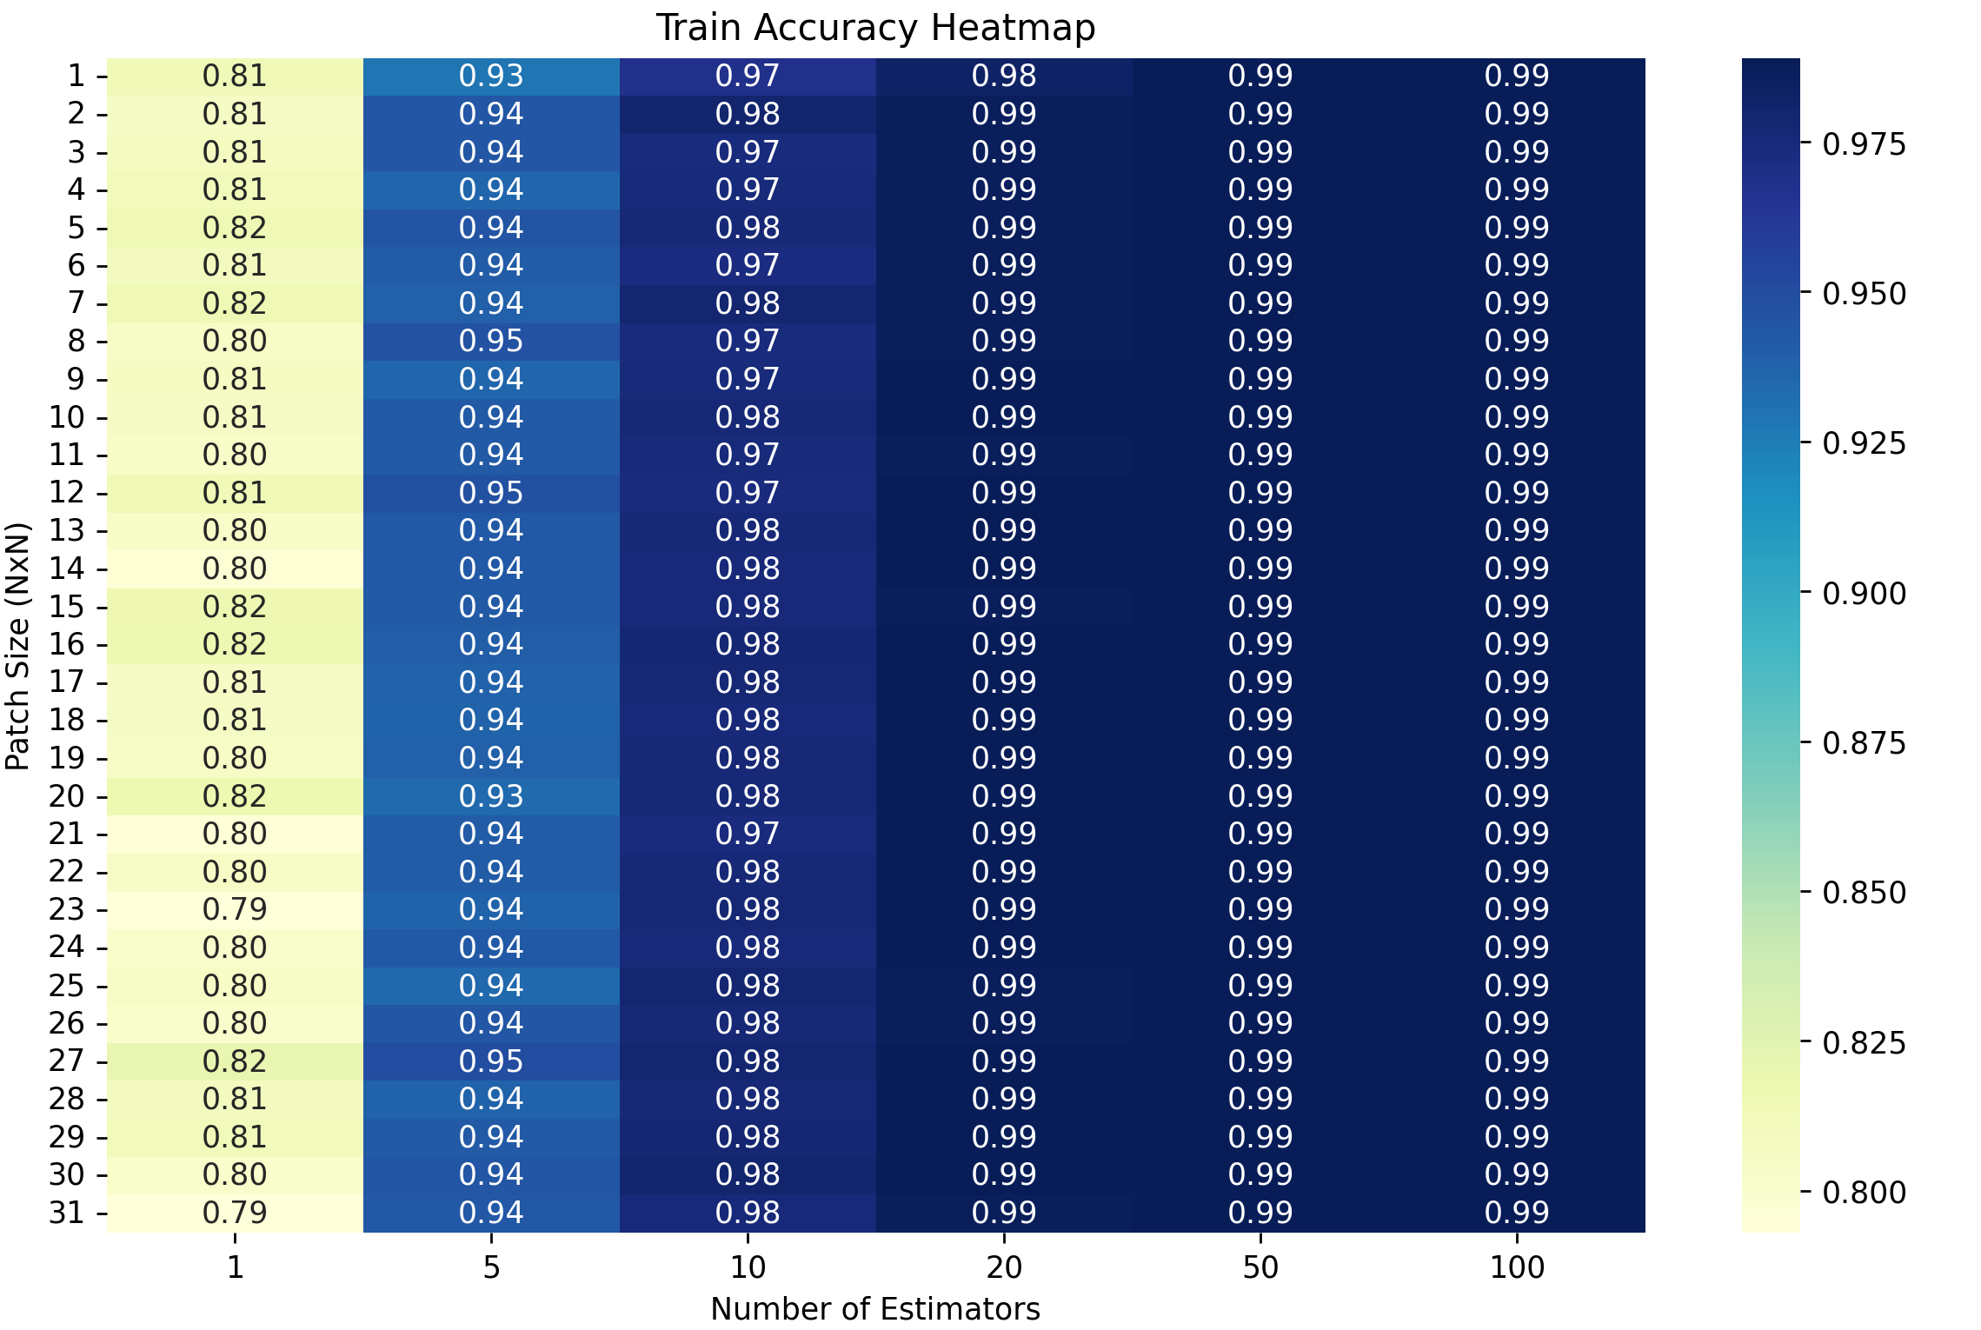
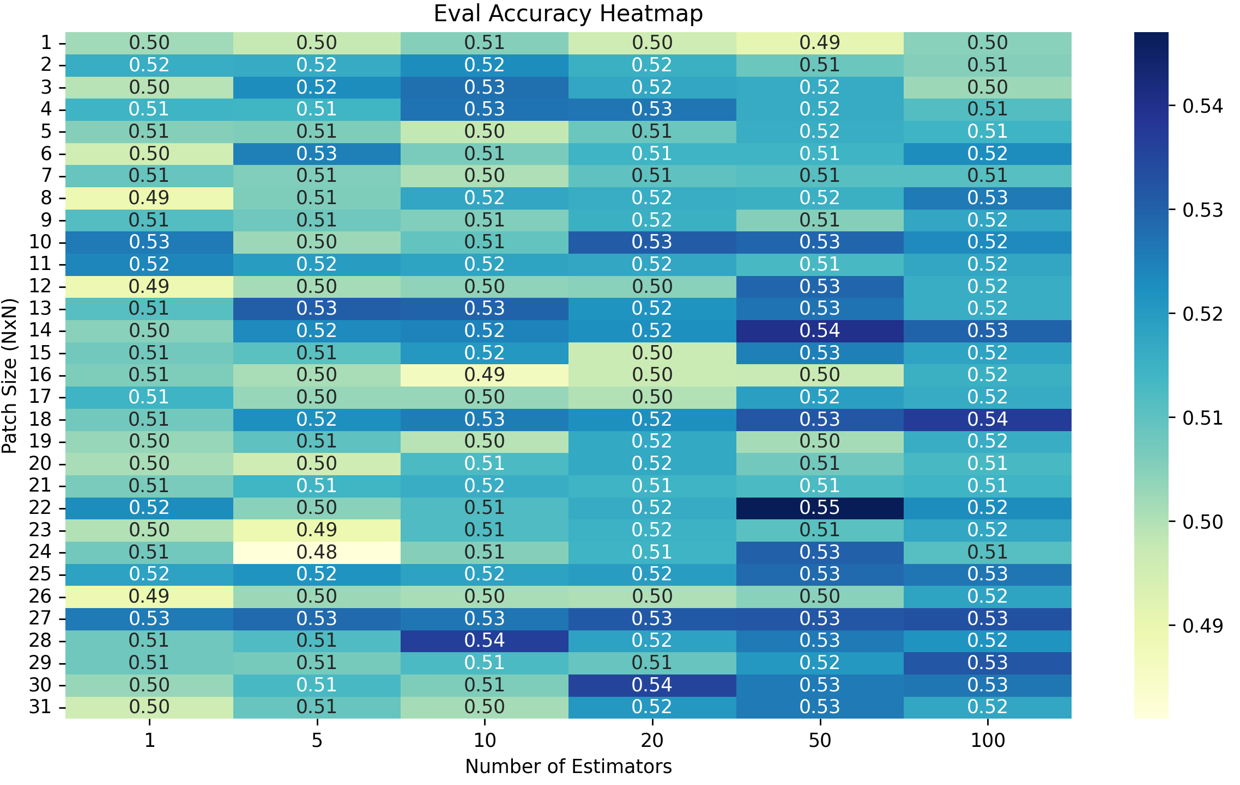
Machine Learning Results
NxN patch size
HEATMAP
# of estimators
# of tree estimators vs NxN patch size
# of tree estimators vs NxN patch size
The model is evaluated on the train to assess overfitting
The model is evaluated on the evaluation performance on unseen data
Best Results (from heatmaps):
Train Accuracy: 98.90% (Patch 1, Estimators 50)
Eval Accuracy: 54.70% (Patch 22, Estimators 50)
Notes:
Jahtega

Slide 27


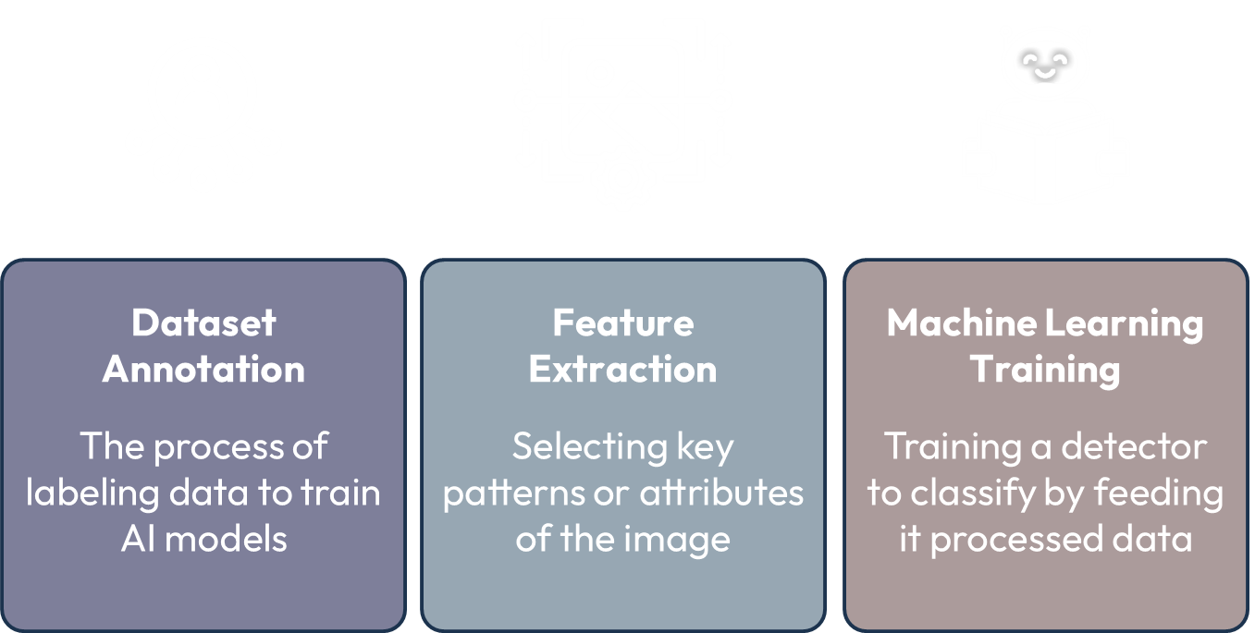
Future Works
Standards
Common Practice in ML
Research signal processing methods to process DCT
Fairness Indicators: Ensure transparency in classification, and mitigate bias
Tune parameters of Random Forest
Reproducible results: Use fixed seeds, consistent Python library versions and documentation
Implement Neural Network method
Source: https://developers.google.com/machine-learning/guides/rules-of-ml
Engineering Design
Dataset Annotation
Feature Extraction
Machine Learning Training
Website tool development
The process of labeling data to train AI models
Selecting key patterns or attributes of the image
Training a detector to classify by feeding it processed data
A platform for users to upload images and detect DeepFakes
Notes:
Jahtega

Slide 28
Future Works
Develop Machine Learning model
Input
Image List
File.dat
Features
Options:
algorithm
classify
Output
Trained model
Classified data
Score
ML Experiment tool
Nedc_ml_vector_classify.py
Engineering Design
Dataset Annotation
Feature Extraction
Machine Learning Training
Website tool development
The process of labeling data to train AI models
Selecting key patterns or attributes of the image
Training a detector to classify by feeding it processed data
A platform for users to upload images and detect DeepFakes

Slide 29







Website Tool Development
Goals
Tools Used
Building a fast, secure, and user-Friendly way to detect deepfakes
Upload
Flask, Web Framework
Allows users to submit images for detection
Receives user input
Processes data
Maps URL to functions
Data Protection
Protecting user privacy preventing data leaks
HTML, Structure
Structure of website
Organizes content
Real-time Analysis
Users receive instant feedback
CSS, Styling
View Results
Styling webpage
Manages colors, font, positioning
Users can understand the outcome detection

Slide 30




Future Works
Standards
ADA Compliance
launch our tool on a public domain server
Web Content Accessibility Guidelines
Perceivability: Criterion 1.4.1 Use of Color,
Color isn’t the only indicator, use text
develop website functionality and usability
Operability: Criterion 2.2.4 No Timing
Website is functional without time constraints
Source: https://www.w3.org/TR/WCAG22/#use-of-color​
Engineering Design
Dataset Annotation
Feature Extraction
Machine Learning Training
Website tool development
The process of labeling data to train AI models
Selecting key patterns or attributes of the image
Training a detector to classify by feeding it processed data
A platform for users to upload images and detect DeepFakes
Notes:
Jahtega

Slide 31
Future Works
Standards
ADA Compliance
launch our tool on a public domain server
Web Content Accessibility Guidelines
Perceivability: Criterion 1.4.1 Use of Color,
Color isn’t the only indicator, use text
develop website functionality and usability
Operability: Criterion 2.2.4 No Timing
Website is functional without time constraints
Source: https://www.w3.org/TR/WCAG22/#use-of-color​
Engineering Design
Dataset Annotation
Feature Extraction
Machine Learning Training
Website tool development
The process of labeling data to train AI models
Selecting key patterns or attributes of the image
Training a detector to classify by feeding it processed data
A platform for users to upload images and detect DeepFakes
Dataset Annotation
Investigate other DeepFake datasets for future model development

Slide 32

Prototype Demonstration
Web Application
Upload Image
Find Faces
Find Bounding Box
Is this image real?
User uploaded image
Haar Cascade Model
(x, y, width, height)
Present Results
Classify
Data to DCT
User Interface (UI)
Identify Face
Using developed RF Model
Output to UI
Extract features
Feature Extraction
Classification
Notes:
Jouri

Slide 33
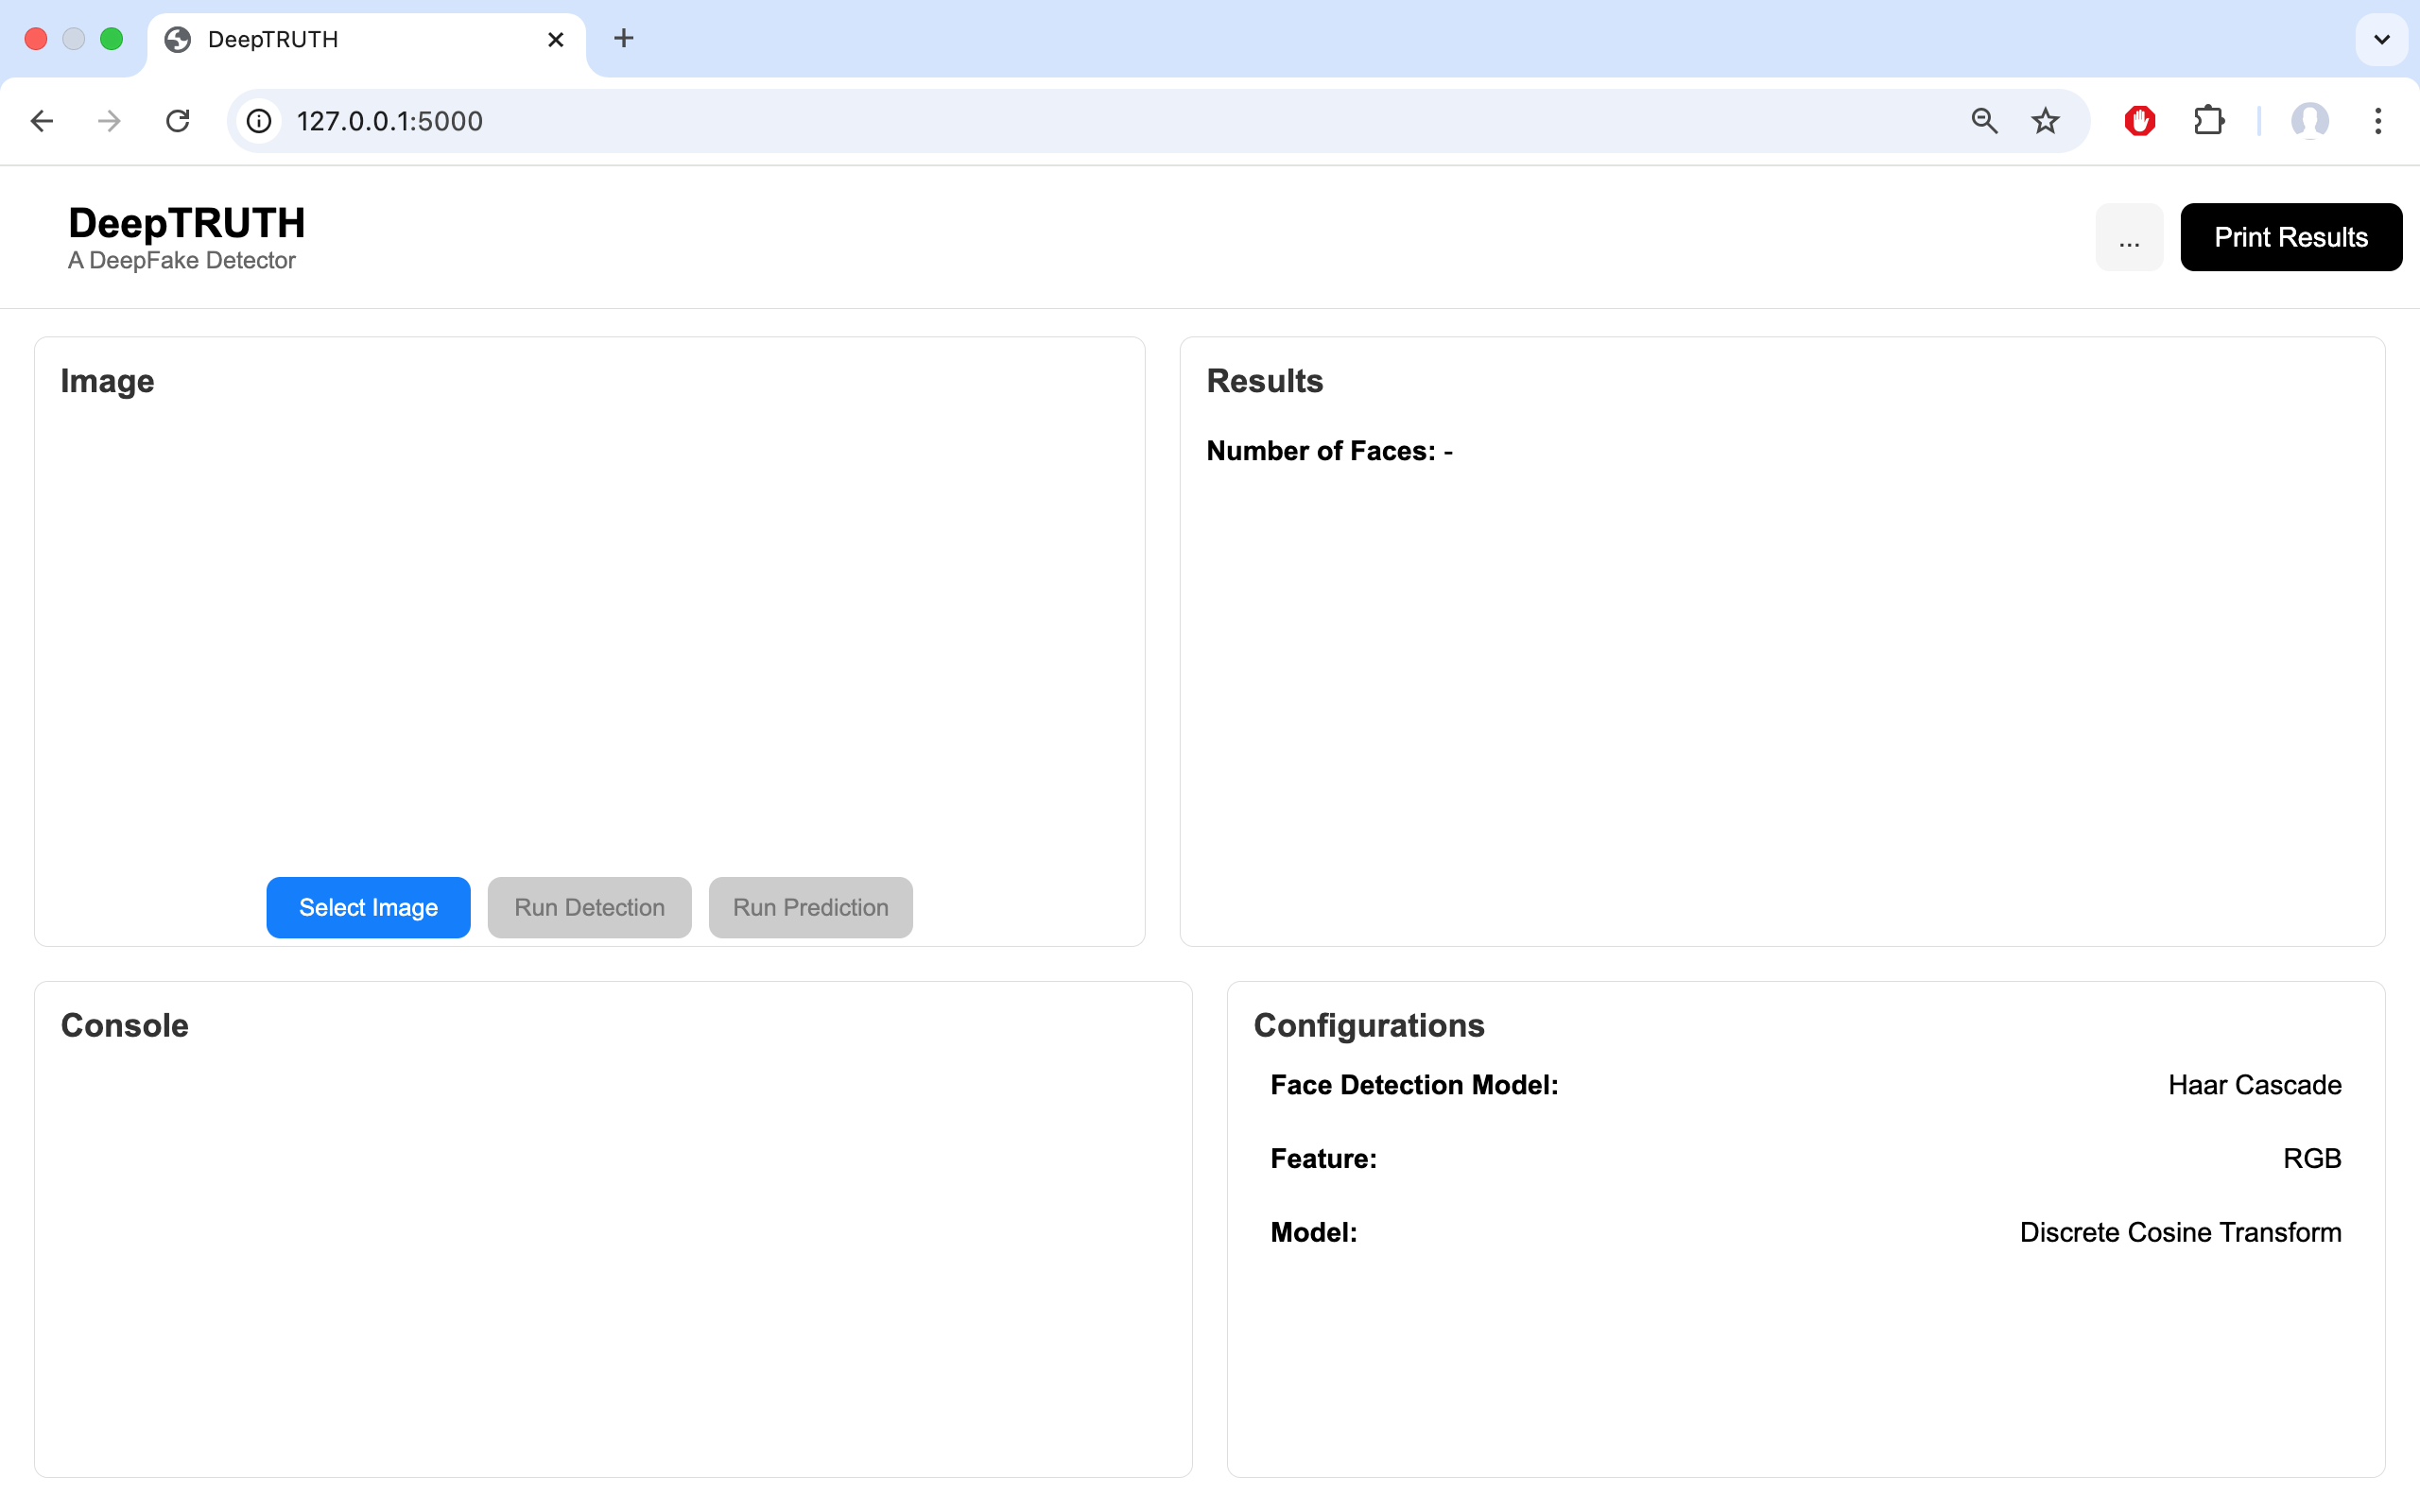
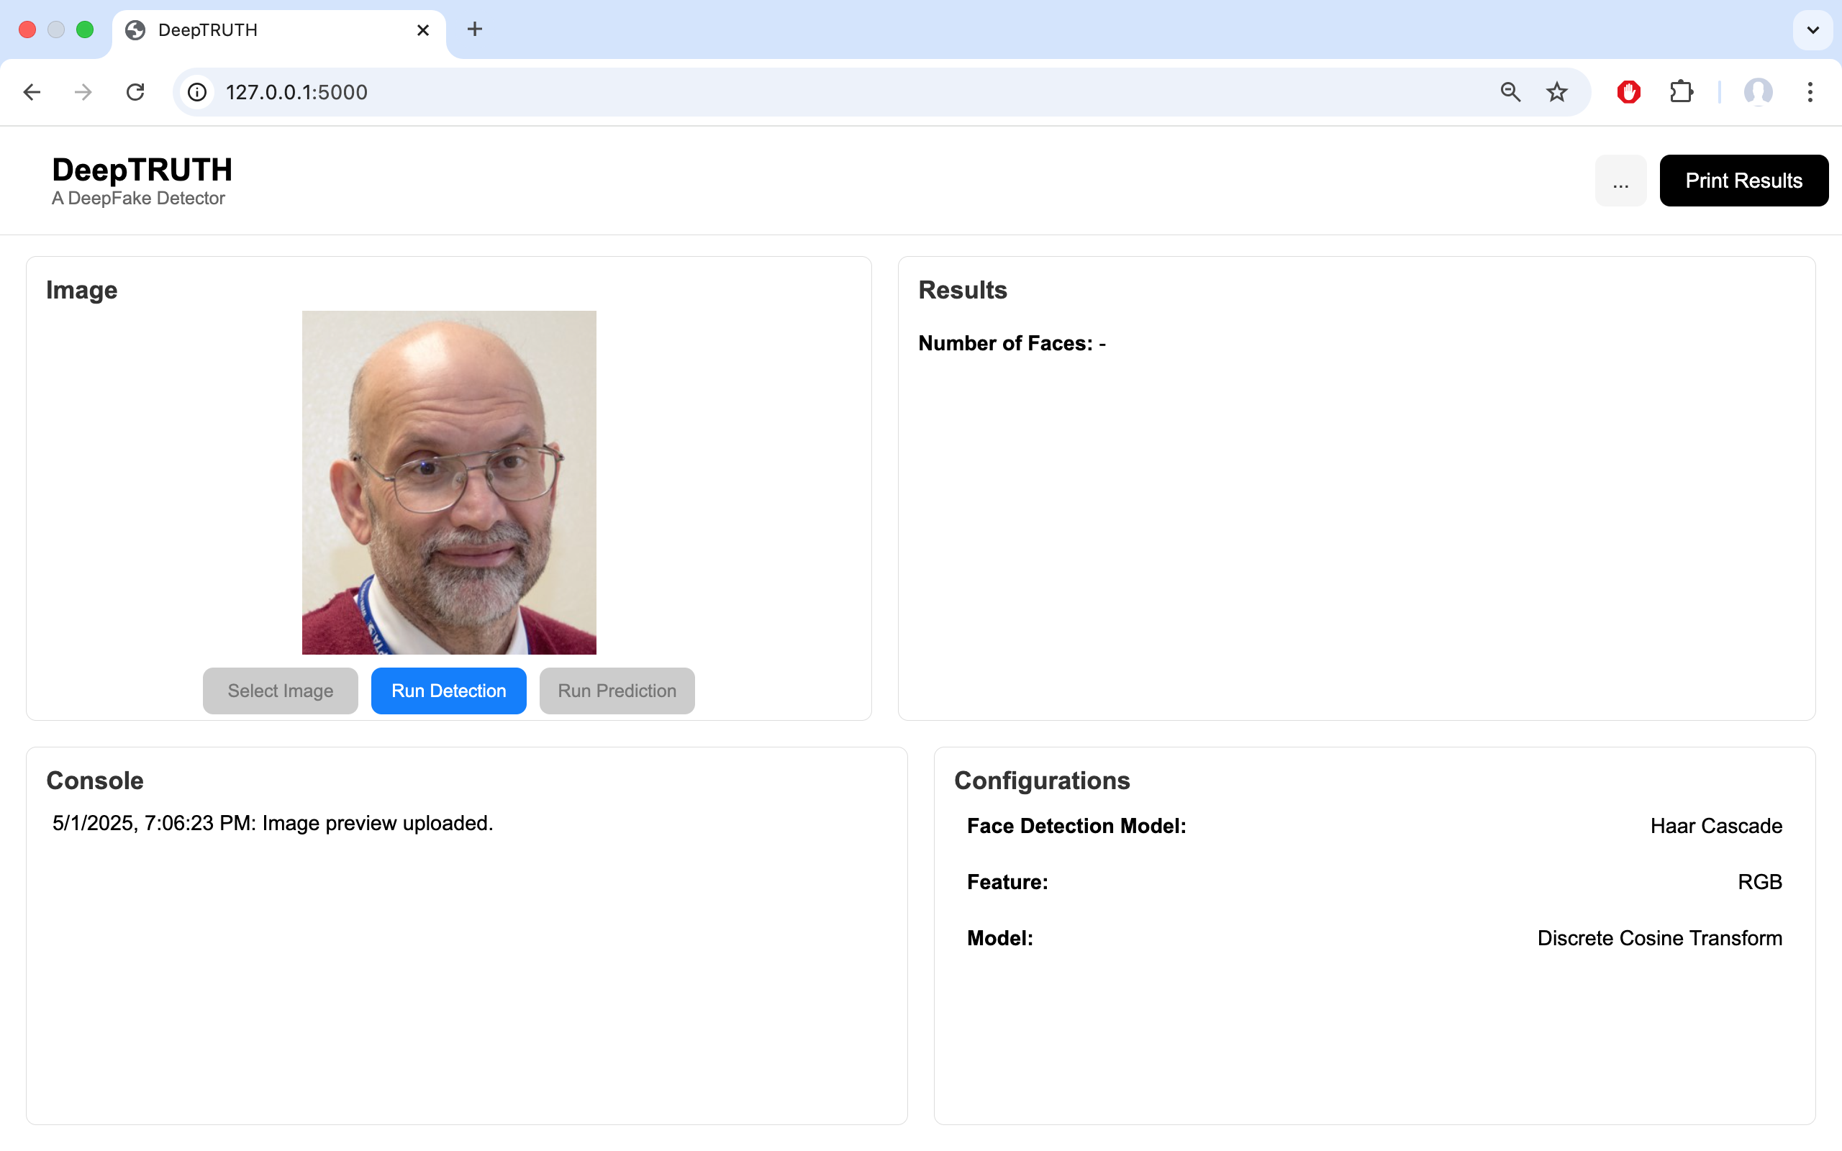
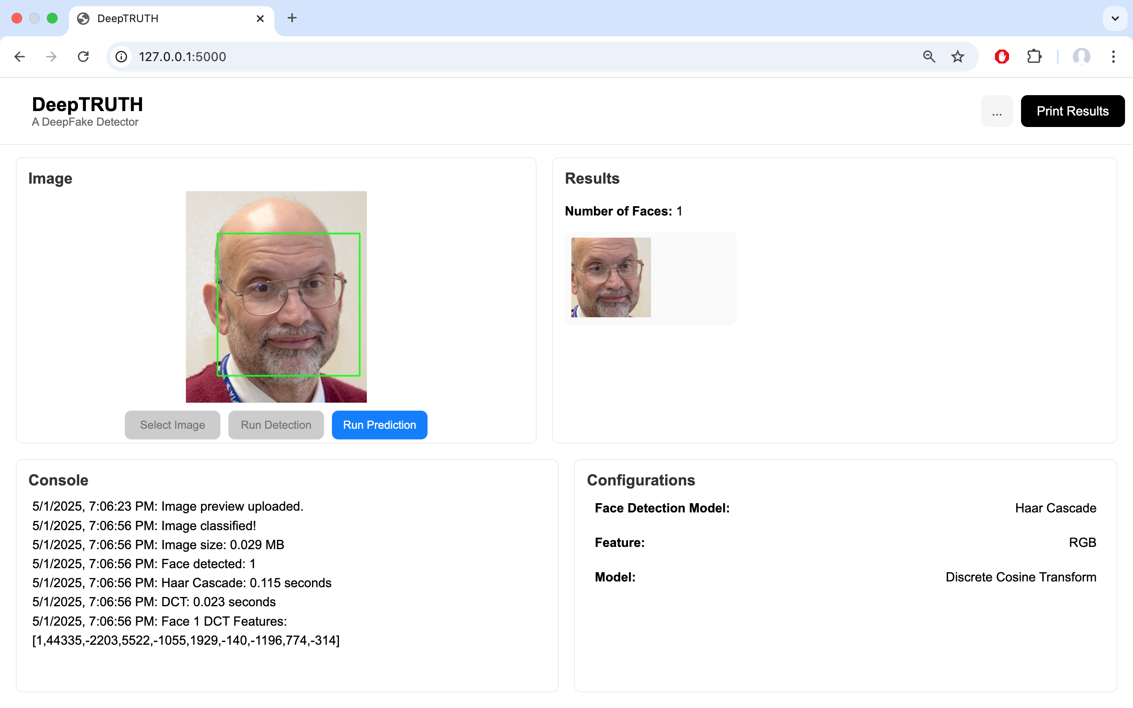
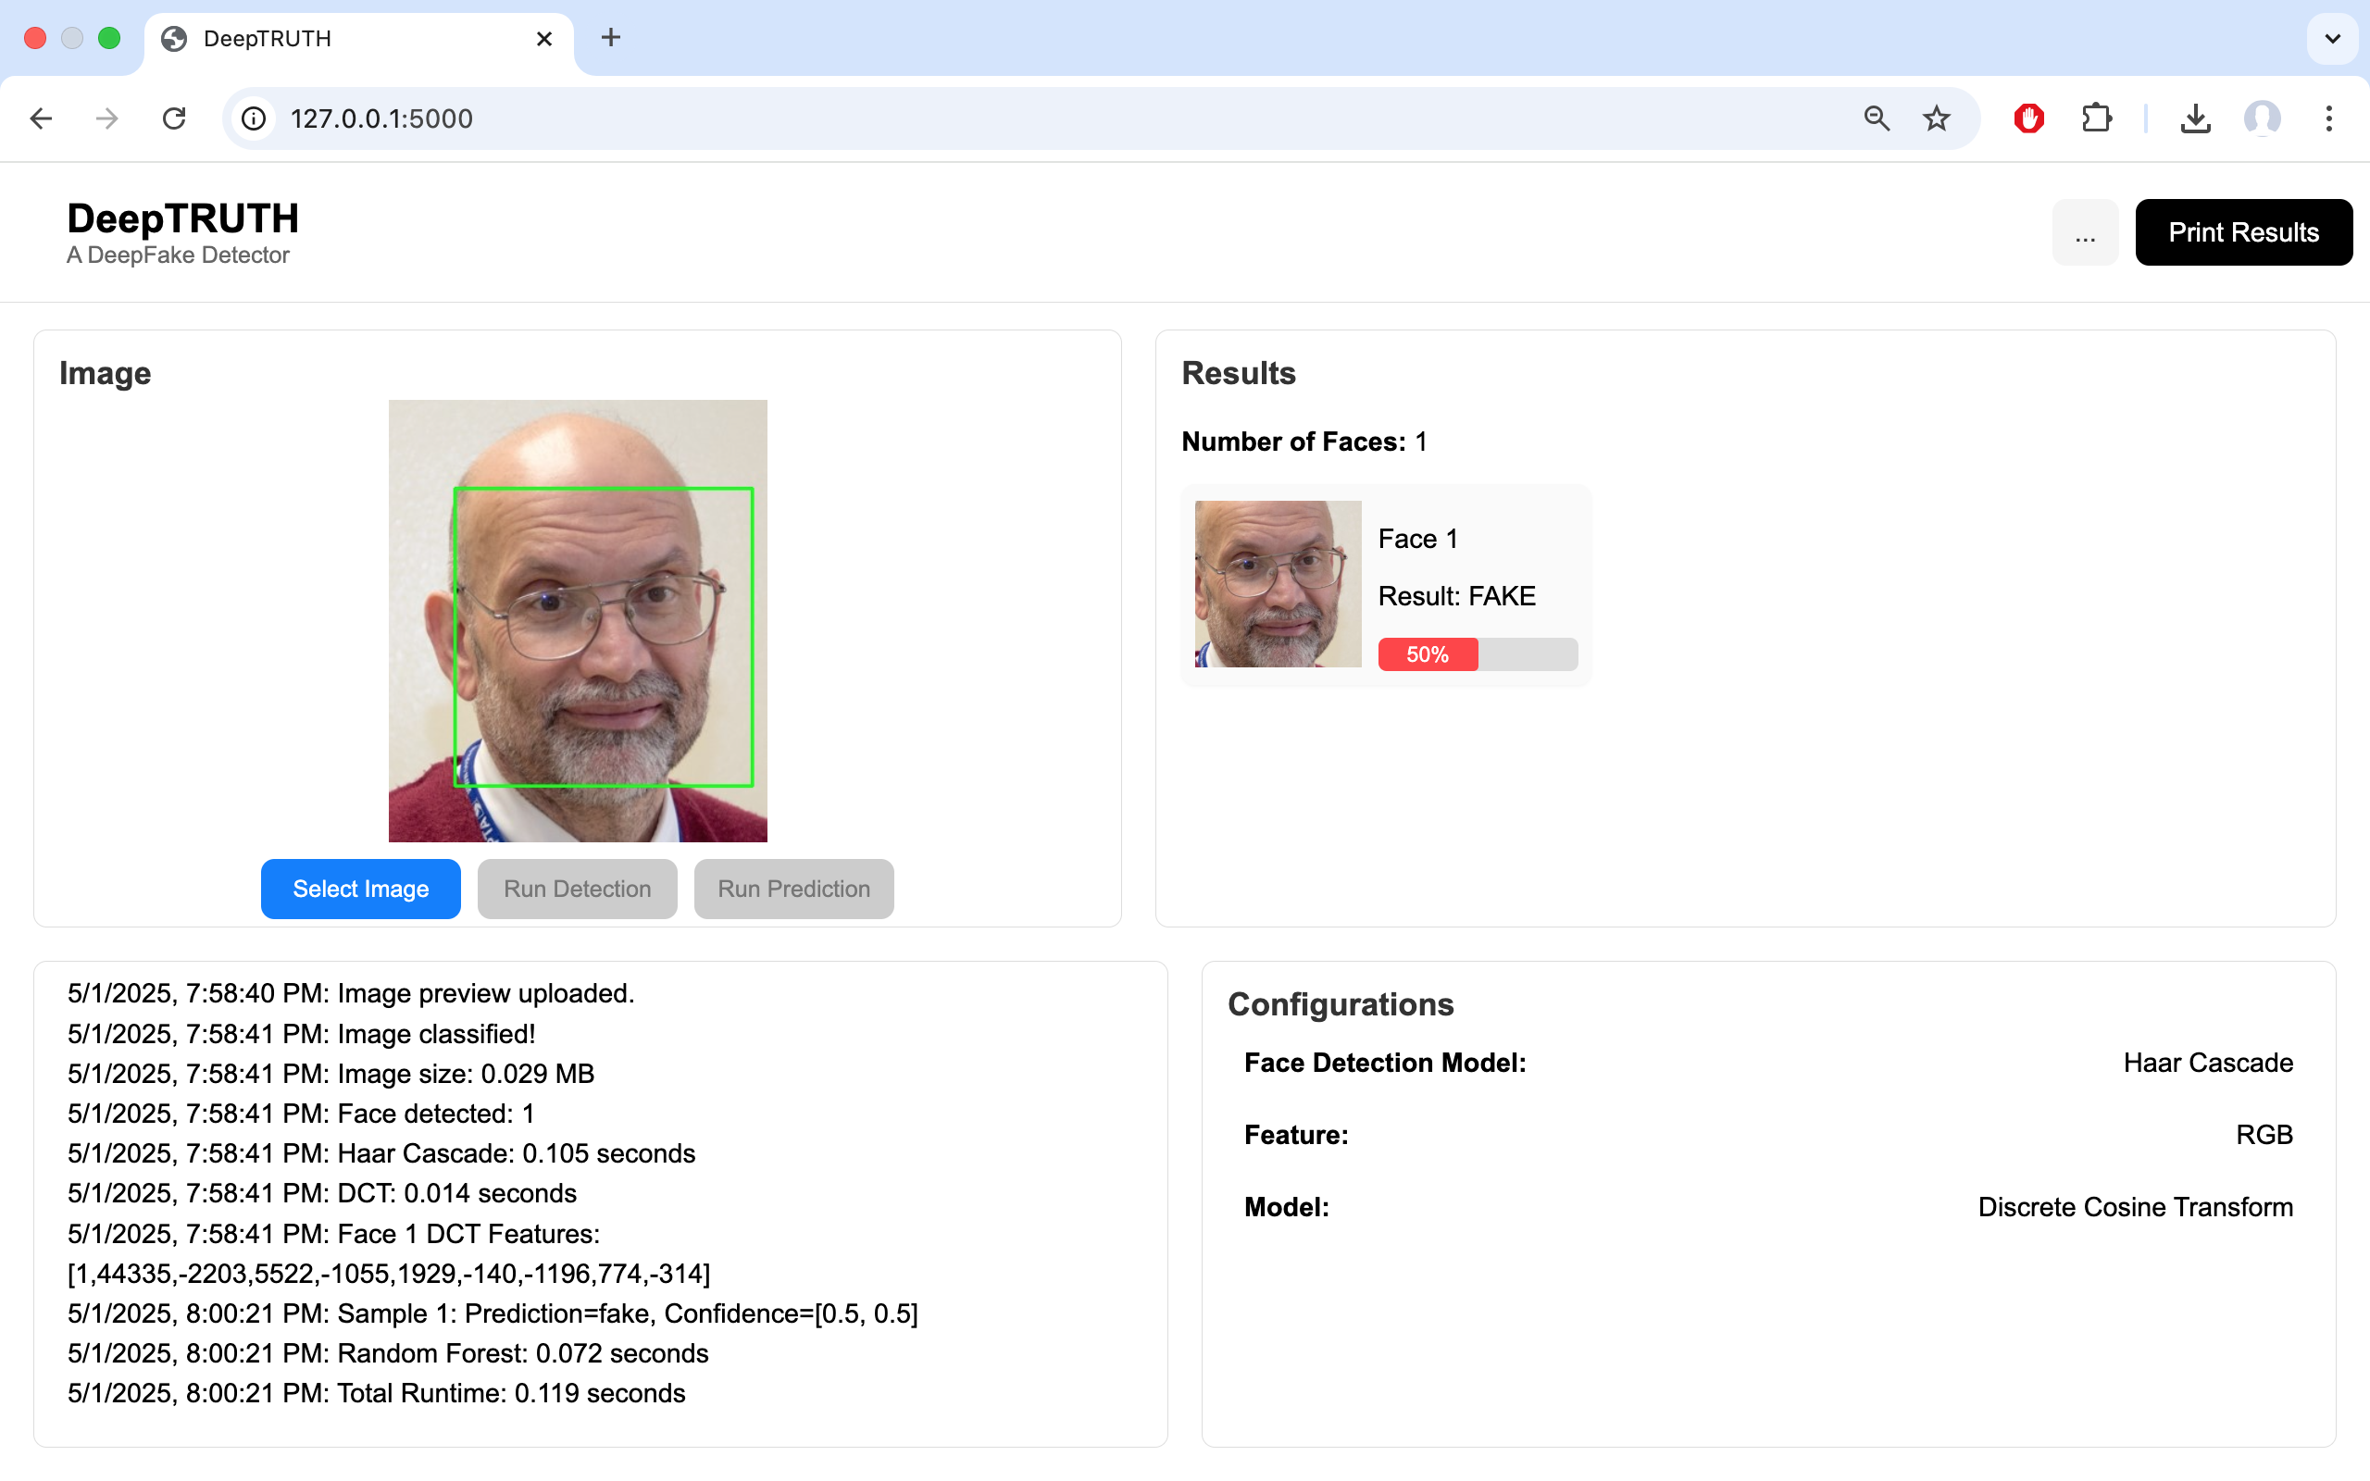
Prototype Demonstration
User Uploads Image
Face Identified
Prediction Made
Output to UI
Dataset Annotation
Investigate other DeepFake datasets for future model development
Notes:
Jahtega

Slide 34
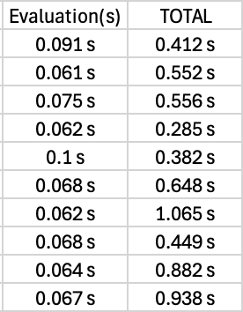
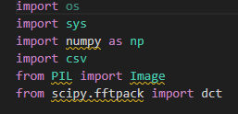
Did we meet the requirements?
Runtime
Image Type
Performance Accuracy
Uses Python Image Library for processing images. This allows support to most images formats
Best Results:
Train Accuracy: 98.90%)
Eval Accuracy: 54.70%
Notes:
Zac

Slide 35
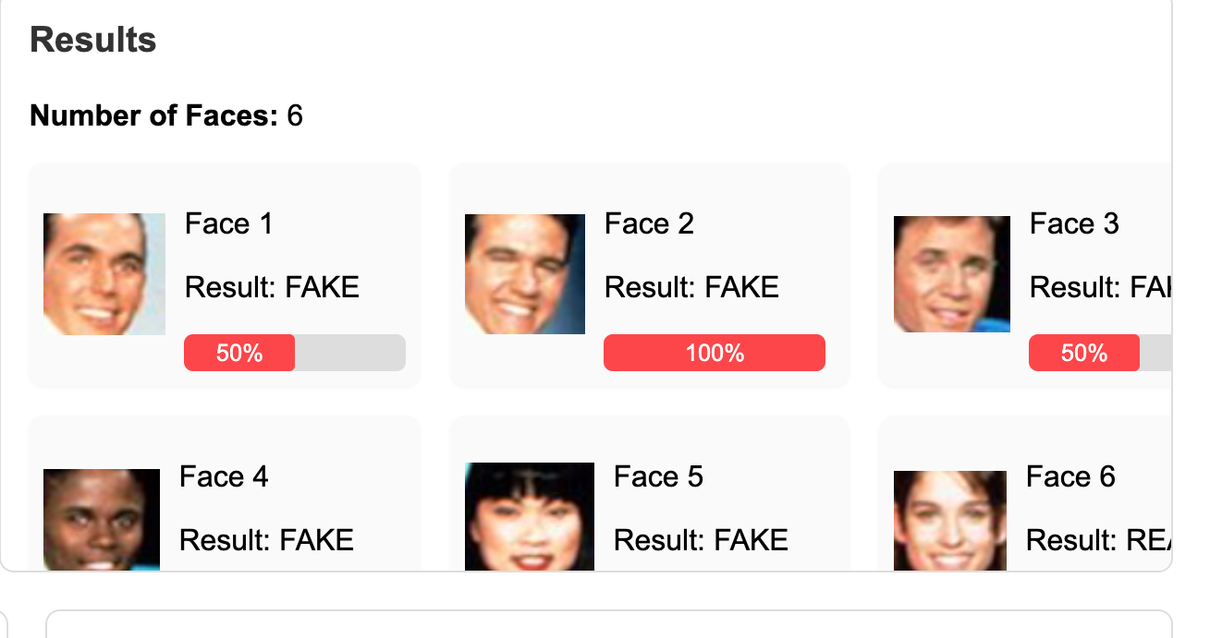


Engineering Design
Did we meet the constraints?
Hosted on Neuronix
Dataset Availability
Scalability
Website is still not hosted on server
Notes:
Zac

Slide 36
Future Works
Dataset Annotation
Feature Extraction
Machine Learning Training
Website tool development
Investigate other DeepFake datasets for future model development
Research different features to extract, assessing the trade-offs between them
Launch our site on a public domain server, develop site functionality
Develop Random Forest algorithm using NEDC tools

Slide 37
Team DeepTRUTH
Thanks you for your attention
Jouri Ghazi
Jahtega Djukpen
Ashton Bryant
Zacary Louis
Questions & Comments?

