Slide 1
SD ADVISOR MEETING 10
DeepTRUTH
Advisor: Dr. Picone
Team: Jouri, Jahtega, Zacary, Ashton

Slide 2
Ashton Updates – DCT Groups p1
Name of Paper | Year | Type | Accuracy | Notes
Leveraging Frequency Analysis for Deep Fake Image Recognition | 2019-2020 | DCT with CNN |  | Explores DCT within the context of forensics. Also explores up sampling.
Fighting Deepfakes by Detecting GAN DCT Anomalies | 2021 | CTF (DCT with CNN) | 89.8 | Uses DCT followed by CNN. Their DCT splits the image into 8 x 8 blocks with overlap when images are small. The Maximum likelihood expectation (MLE) is calculated for each block and arranged in a matrix. The matrix is organized in a zigzag motion with 0 at top left and 63 at bottom right (see photo in paper)

Slide 3
Ashton Updates – DCT Groups p2
Name of Paper | Year | Type | Accuracy | Notes
Tensor-Based Deepfake Detection in Scaled and Compressed Images | 2022 | DCT -> Xception | 99.4 | Uses DCT followed by CNN. Their DCT splits the image into 8 x 8 blocks with overlap when images are small. The Maximum likelihood expectation (MLE) is calculated for each block and arranged in a matrix. The matrix is duplicated with multiple version of the same image at different compression levels (ill explained in paper). This is feed into a custom version of XceptionNet (CNN model)
Exploiting Facial Relationships and Feature Aggregation for Multi-Face Forgery Detection | 2024 | CNN | 99.52 (test dev) 0.92.04 test-chal | Uses convolution layers to obtain spatial features. Uses FFT on these features. Uses a learnable high pass feature to remove low frequency from image. IFFT the features back and sum them with the original features. Then use cosine similarity to compare faces and conv with 1x1. Then use global feature aggregation and a loss function

Slide 4
Ashton Updates – FFT Groups p1
Name of Paper | Year | Type | Accuracy | Notes
M2TR: Multi-modal Multi-scale Transformers for Deepfake Detection | 2022 | multi model transf. | 98.2 test-dev 84.35 test-chal | Uses a stack multiscale transformer and frequency filter in parallel. The MST uses patches of the image with conv. The frequency filter uses FFT with a learnable filter (high pass). Fusion is preformed on the transformer features and frequency features.
Exploiting Facial Relationships and Feature Aggregation for Multi-Face Forgery Detection | 2024 | CNN | 99.52 (test dev) 92.04 test-chal | Uses convolution layers to obtain spatial features. Uses FFT on these features. Uses a learnable high pass feature to remove low frequency from image. IFFT the features back and sum them with the original features. Then use cosine similarity to compare faces and conv with 1x1. Then uses global feature aggregation and a loss function

Slide 5
Ashton Updates – Patches and Transformers
Name of Paper | Year | Type | Accuracy | Notes
What Makes Fake Images Detectable? Understanding Properties that Generalize | 2020 | patches with deep leanring models | Resnet 96.48 test-dev 69.76 test chal Xception 96.69 test-dev 71.01 test-chal | Uses small patches with truncate deep learning models. The patches allow localized predictions. The difference between Resnet and Xception is a 1x1 conv layer after the truncated models.
Locate and Verify: A Two-Stream Network for Improved Deepfake Detection | 2023 | patches but more complex | 99.15 test-dev 81.50 test-chal | Use RGB and Spatial Rich Model (SRM) in training. Uses non overlapping patches with feature fusion

Slide 6
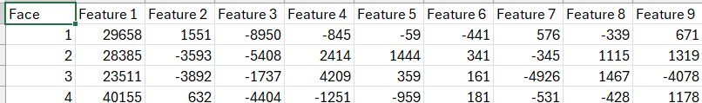
Jahtega Updates
Refactored the gen_feats program into a function that we hope to integrate with the prototype
Nedc_dfake_gen_feats_v3.py will be ready for review by this evening

Slide 7
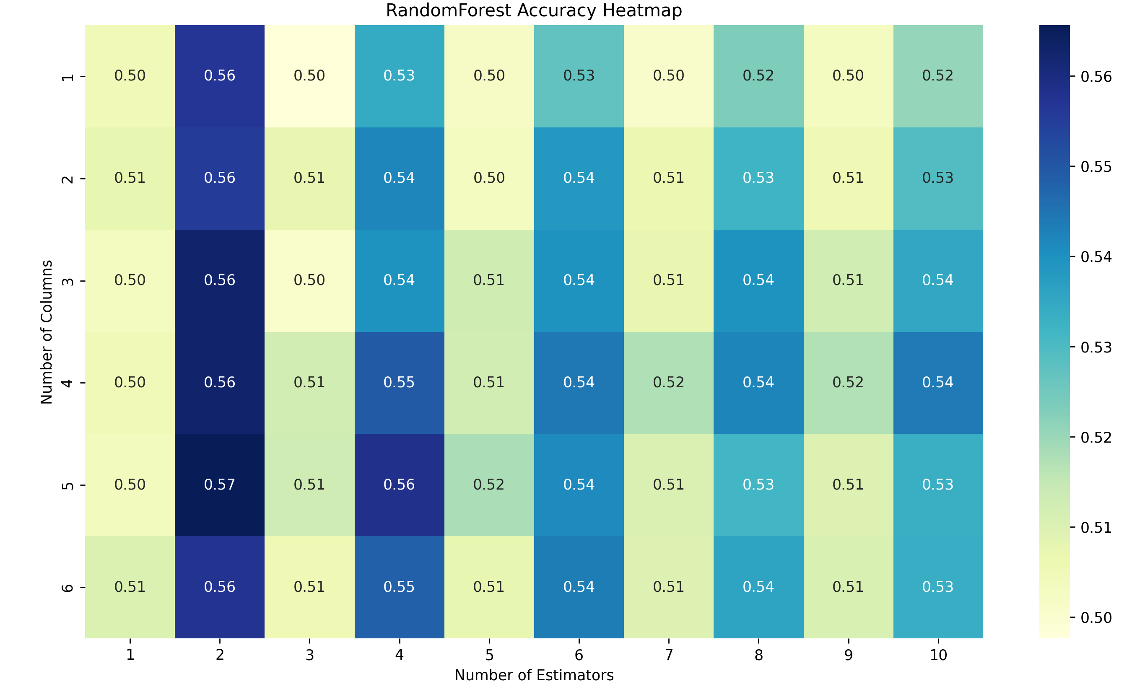
RNF Training & Evaluation
When training on RNF model, observed odd # of estimators performs worse?

Slide 8
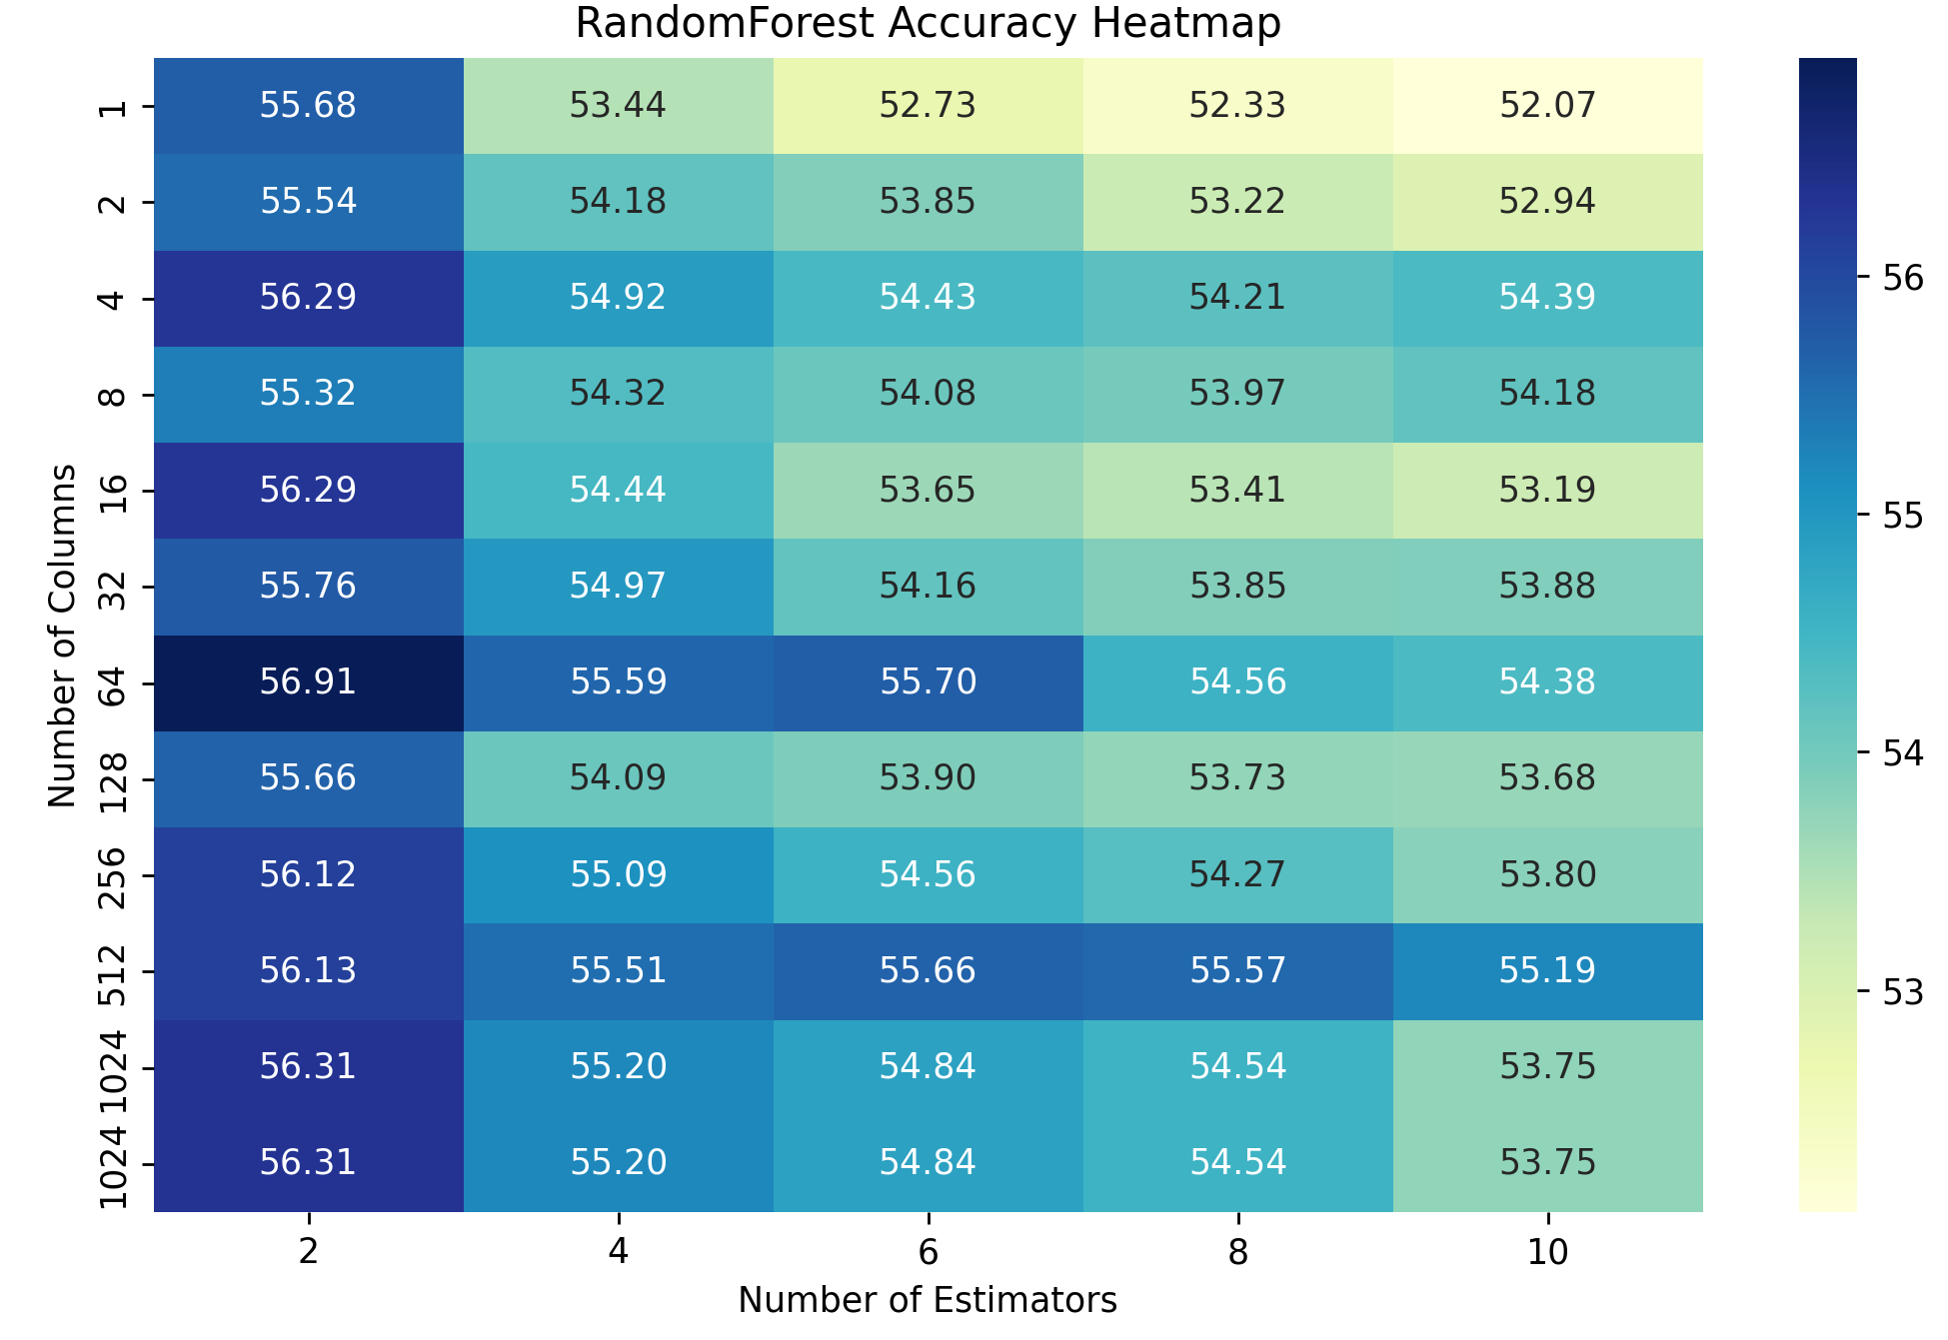
RNF Training & Evaluation
2^0 2^1 …… 2^10
Continued using 2 estimators

Slide 9
RNF Training & Evaluation
 | Estimators | 2
 | Features | 10,000
 | TRAIN |  |  | TRAIN + DEV
 | Train | Dev | Eval | Train | Dev | Eval
R | 81.92% | 51.59% | 60.30% | 81.97% | 81.62% | 60.20%
G | 81.75% | 51.28% | 60.38% | 81.91% | 81.53% | 60.29%
B | 81.72% | 51.44% | 60.34% | 82.27% | 81.36% | 60.46%
ALL | 81.73% | 51.18% | 60.55% | 81.86% | 81.28% | 60.13%

Slide 10
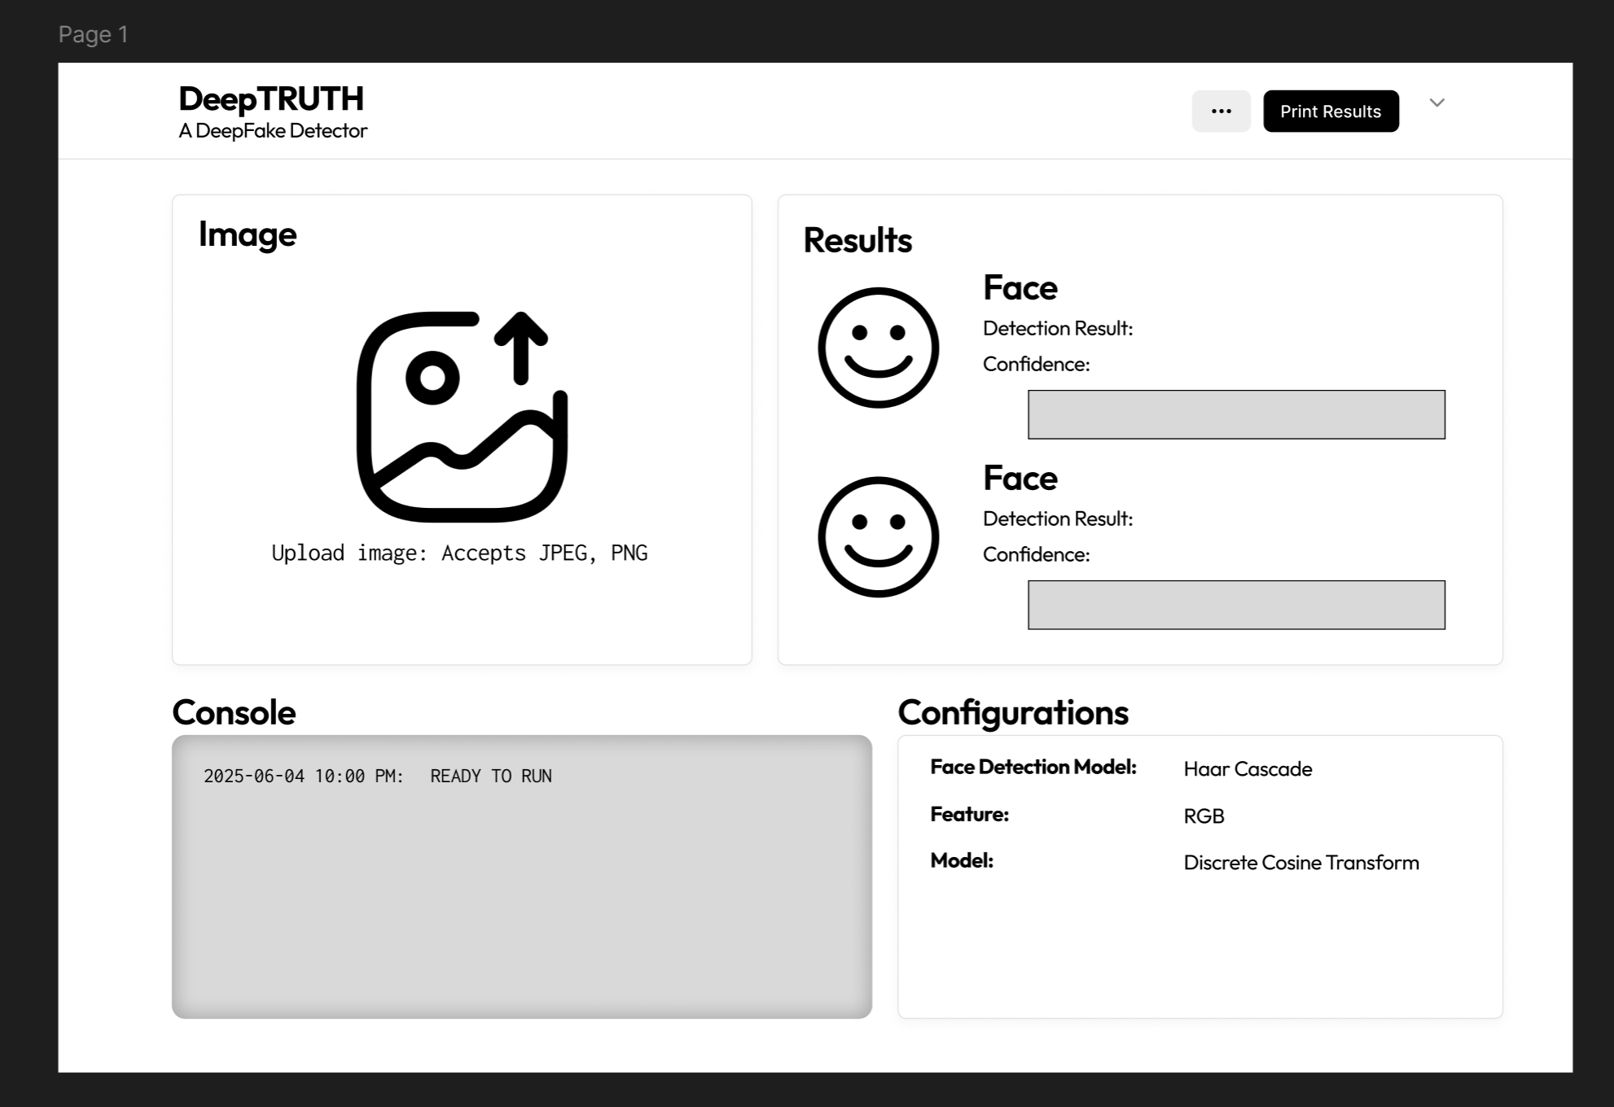
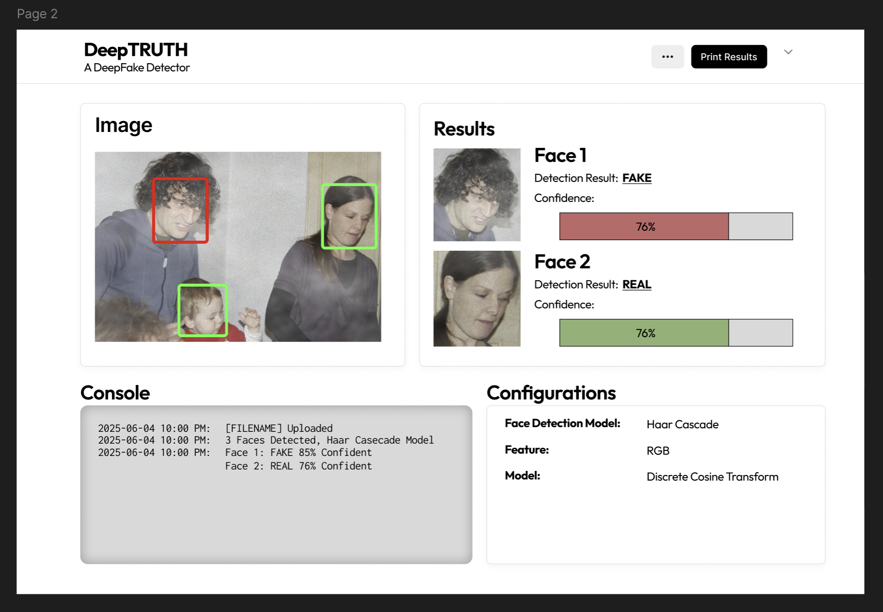
Web App Design

Slide 11
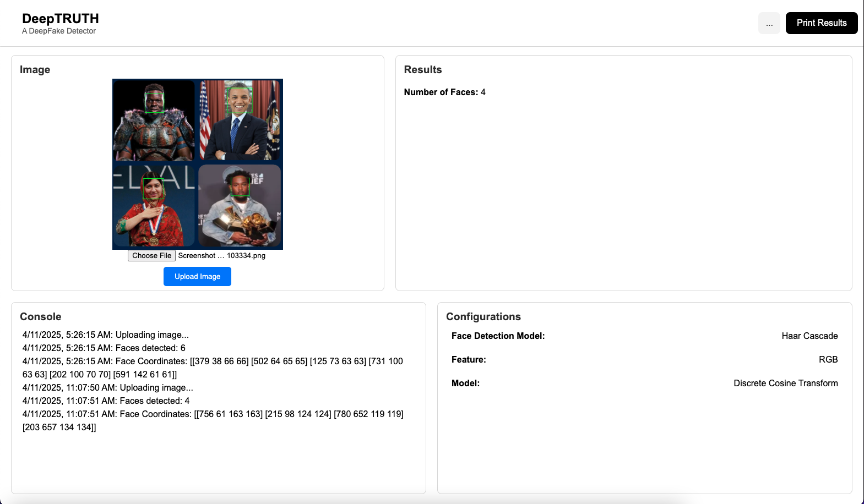
Current Web App

