Slide 1
SD ADVISOR MEETING 7
DeepTRUTH
Advisor: Dr. Picone
Team: Jouri, Jahtega, Zacary, Ashton

Slide 2
Question
Do we want to understand how the annotations align with the feature vectors?
How do we run the website through the server?
Datatypes –
RGB -> 0-255 (8bits)
HSL -> 0-1 (floats)
When choosing features, should we consider the datatype?

Slide 3
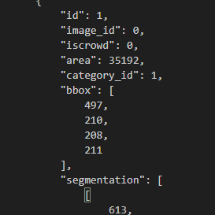
Understanding the Dataset annotations
Each image has an:
- ID
- file_name
-width & height
Each face has an:
- ID
- image_id
- iscrowd
- area
- category_id
- bbox
- segmentation
Each image has multiple faces

Slide 4
Understanding the Dataset annotations
ID
Image_id
Iscrowd
Area
Category_ID
Bbox
segmentation
IMG_1_FACE[1]
…
IMAGE[1]
IMG_1_FACE[N]
ID
Image_id
Iscrowd
Area
Category_ID
Bbox
segmentation
ID
Image_id
Iscrowd
Area
Category_ID
Bbox
segmentation
IMAGE[2]
IMG_2_FACE[1]
…
…
IMG_2_FACE[N]
ID
Image_id
Iscrowd
Area
Category_ID
Bbox
segmentation
IMAGE[N]
ID
Image_id
Iscrowd
Area
Category_ID
Bbox
segmentation
IMG_N_FACE[1]
…
IMG_N_FACE[N]
ID
Image_id
Iscrowd
Area
Category_ID
Bbox
segmentation

Slide 5
Annotation
ID | iscrowd | area | Category ID | bbox0 | bbox1 | bbox2 | bbox3 | segmentation
36
37
Iscrowd = ?
area = ?
Category ID = Real/fake
We don’t know how Bbox[n] it works
Segmentation = ?

Slide 6
Encoding data
Annotations
Feature Gen
Vector classify
Features
Parameter file

Slide 7
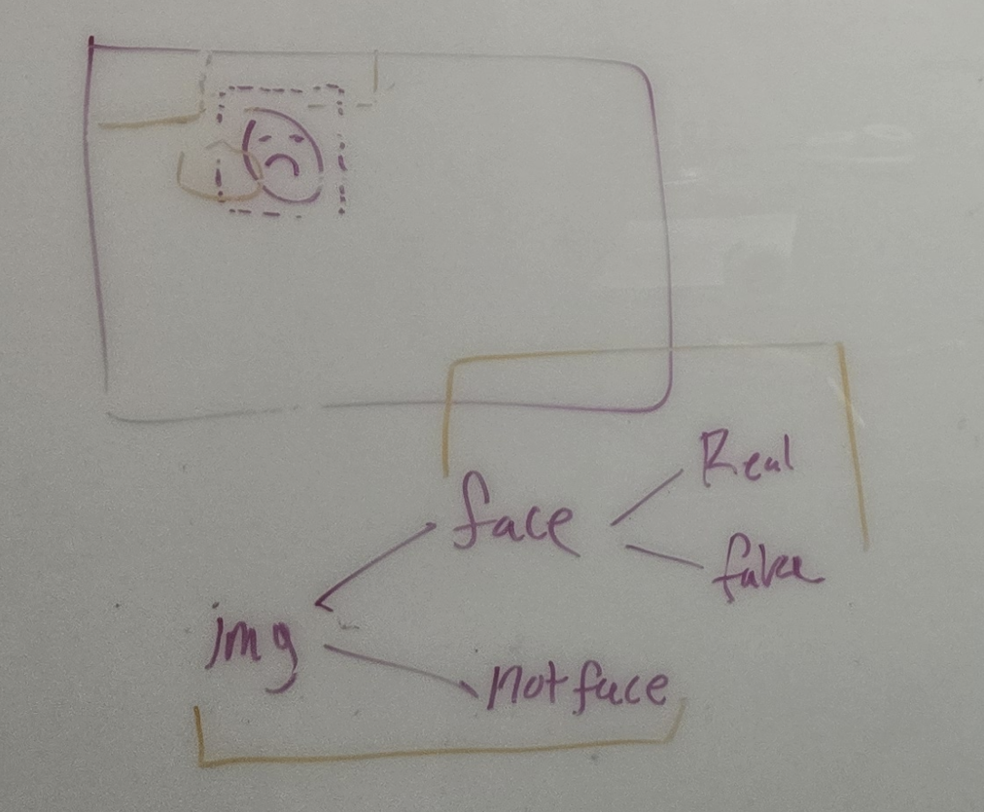
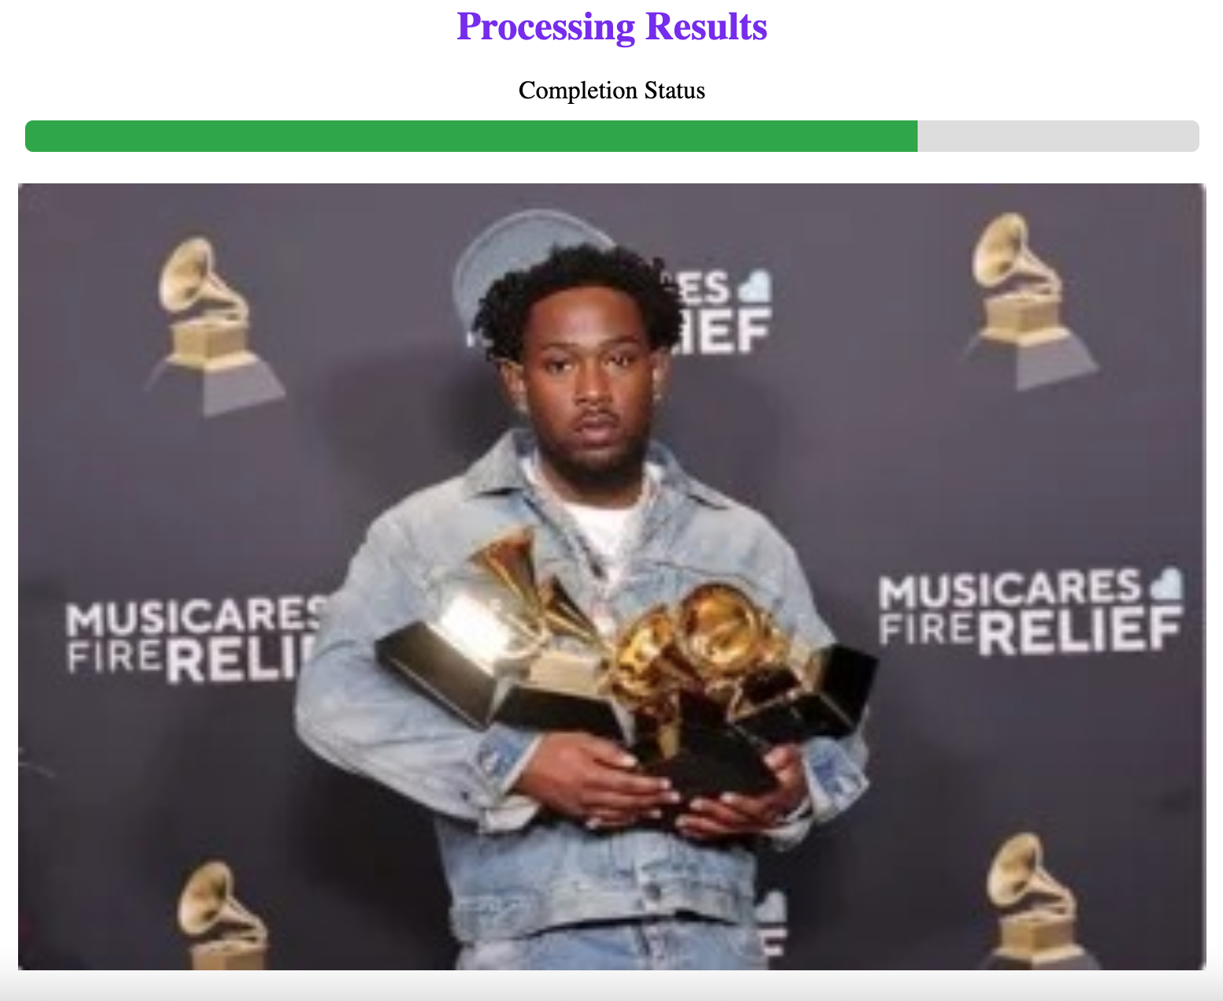
Web App

