Slide 1
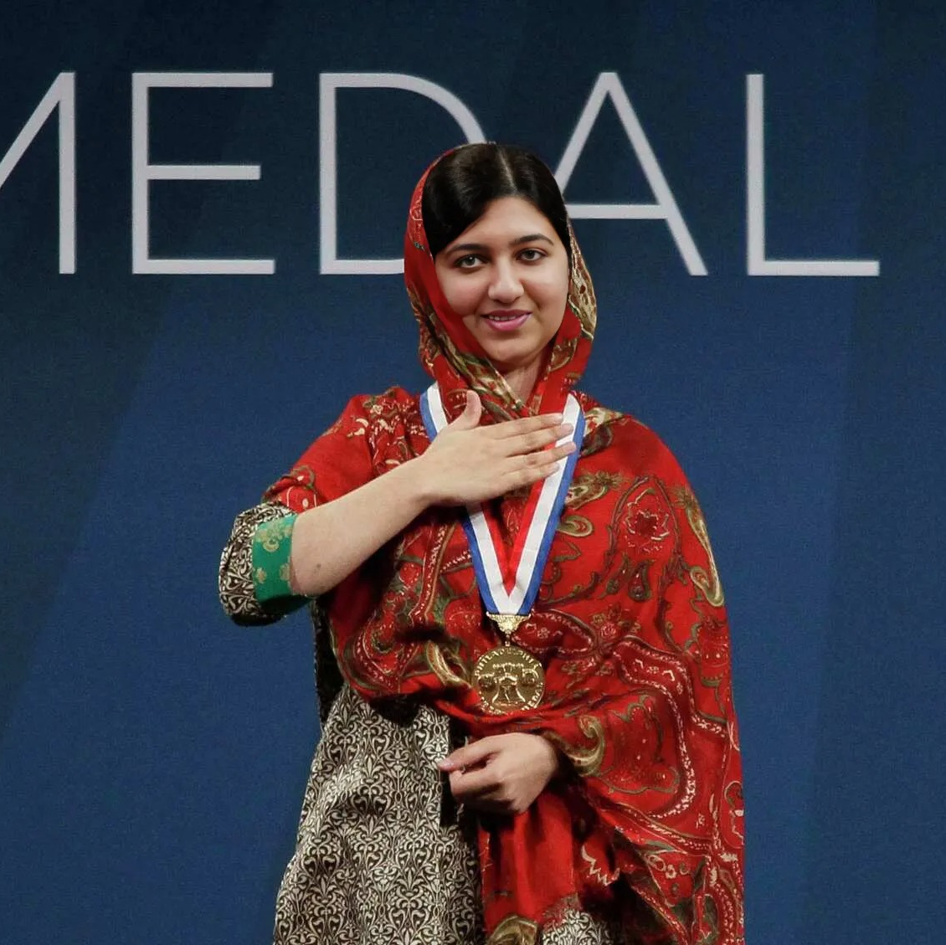
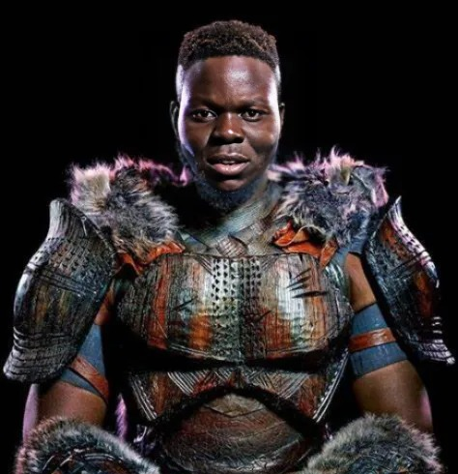
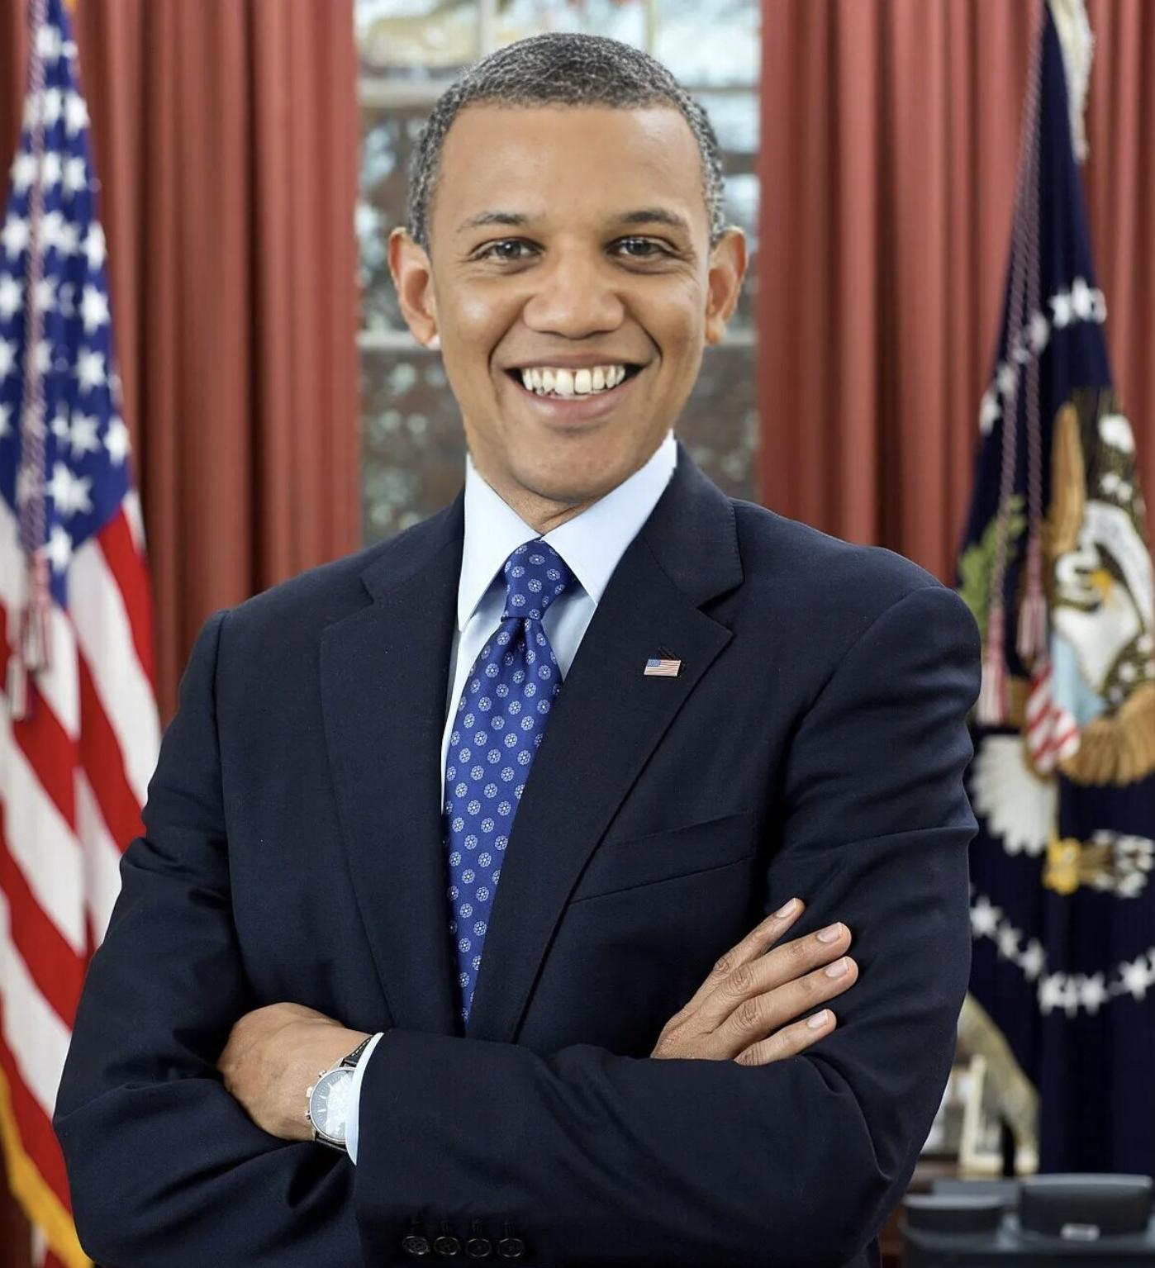
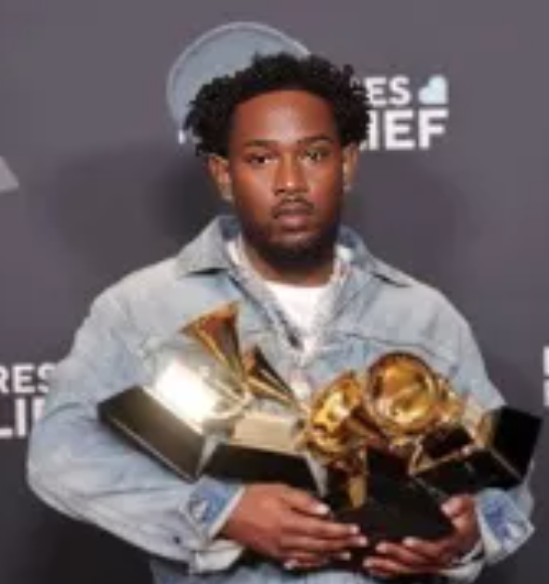
Meet Team DeepTruth!
Jouri Ghazi
Jahtega Djukpen
Ashton Bryant
Zacary Louis
A Nobel Peace Prize winner
An Oscar Winning Actor
The 44th President of the United States
A Multi-Grammy award Artist
These images are:
Is this image real?
DEEPFAKES!
100% Confidence
Curious User
Uploads Image
Process Image
Present Results
Notes:
Jouri

Slide 2
DeepFake Detection
Advised by Dr. Picone
These images are:
Is this image real?
DEEPFAKES!
100% Confidence
Curious User
Uploads Image
Process Image
Present Results
Notes:
Jouri

Slide 3
DeepFake News
How AI is being used to create explicit deepfake images that harm children
Top City [market] analyst cloned in AI deepfake scam
PBS Wed 22 Mar 2025 05.35 EDT
The Times Fri Mar 21 2025 22:50 GMT
TV meteorologist devastated as 'degrading' semi-nude deepfakes of her spread across the internet
Scammers use Al Roker's image in a recent deepfake video
Today News Tues Mar 26, 2025 08.35 EDT
Daily Mail Tues Mar 26, 2025 21.54 EDT
Deepfake Threats To Corporations
Forbes Mon 24 Mar 2025 10.00 EDT
Notice the
Victims
Date
News Source
Notes:
Jahtega

Slide 4
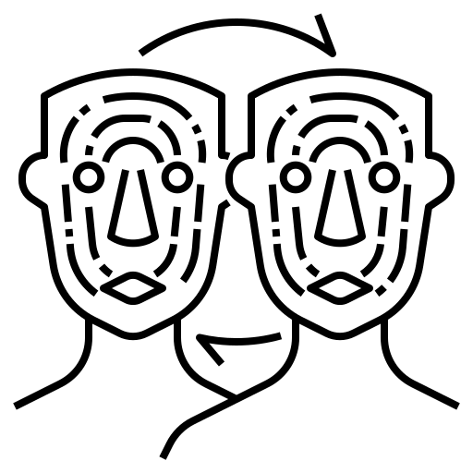
Problem Statement
Artificially generated and manipulated images such as DeepFakes, have become easier to create, and harder to detect. These images pose a serious risk to the credibility of public figures, potentially leading to great financial consequences. A DeepFake detector would benefit individuals such as celebrities, politicians, and even corporations who are frequent targets of DeepFake misuse.
Notes:
Jahtega

Slide 5
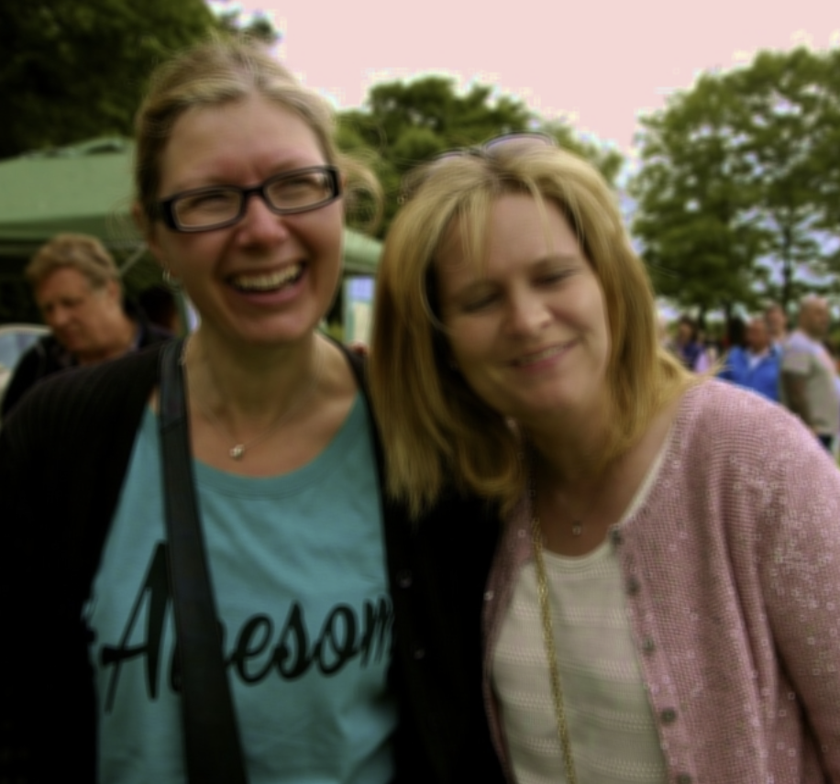
Proposed Solution
Web Application
Image Processor
Is this image real?
Flask
Javascript
Python
Upload
Image
Python Image Library
Random Forest
DeepTRUTH
(our proposed model)
RGB(R,G,B)
$$\left[\begin{matrix}{RGB}_{11} & ⋯ & {RGB}_{1n} \\ ⋮ & ⋱ & ⋮ \\ {RGB}_{m1} & ⋯ & {RGB}_{mn}\end{matrix}\right]$$
HTML
CSS
Present
Results
Feature
Extraction
Machine Learning
Classifier
Notes:
Jouri

Slide 6
Requirements
Unbiased & Diverse Dataset
Performance Accuracy
Requirement
Runtime
Metric
Seconds/pixel²
Demographic Parity Ratio
Accuracy %
Normalized ratio
(1500 ms / 1K x1K)
Between 0.8 and 1.0
Target Value
At least 95%
Allows for real time image processing and classification
Prevent misclassification or discrimination
Why?
Ensuring reliable model performance
Notes:
Zac

Slide 7
Engineering Design
Constraints
Dataset Ethics/Consent
Dataset Availability
Constraint
Explainability
Metric
Consent Rate & Transparency
AUC Score
% of Datasets Available
Target Value
Pass/Fail
≤85%
Pass/Fail
Protecting privacy, and rights from unauthorized manipulation
To understand why a classification decision was made
Why?
Used for training deepfake detectors
Dataset Annotation
The process of labeling data to train AI models
Notes:
Zac

Slide 8
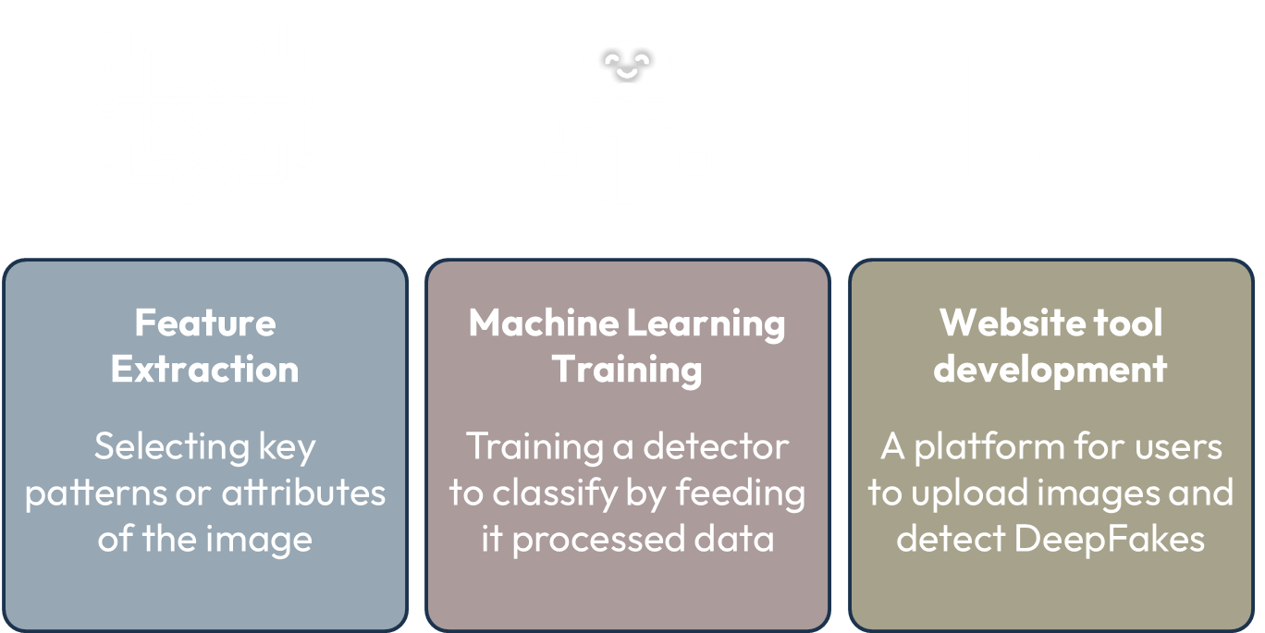
Constraints
Dataset Ethics/Consent
Dataset Availability
Constraint
Explainability
Metric
Consent Rate & Transparency
AUC Score
% of Datasets Available
Target Value
Pass/Fail
≤85%
Pass/Fail
Protecting privacy, and rights from unauthorized manipulation
To understand why a classification decision was made
Why?
Used for training deepfake detectors
Engineering Design
Dataset Annotation
Feature Extraction
Machine Learning Training
Website tool development
The process of labeling data to train AI models
Selecting key patterns or attributes of the image
Training a detector to classify by feeding it processed data
A platform for users to upload images and detect DeepFakes

Slide 9
Dataset Breakdown
Number of Real Images
Source of Real Images
Number of Fake Images
Source of Fake Images
Dataset Name
OpenForensics
45,473
Google Images
70,325
GAN (AI-Generated)
The dataset is split into 3 parts:
Training
Development
Evaluation
44,097 images
63,885 images
7,308 images
Used to teach a machine learning model to learn patterns
Used during training to fine tune model to prevent overfitting
Used to assess a model's performance metrics
Notes:
Added test challenge to development. I think that the numbers one the bottom should have the same sum as those on the top. Also added commas

Slide 10
Understanding the Annotation
Two Lists of Information
ID
Image_id
Iscrowd
Area
Category_ID
Bbox
segmentation
IMG_1_FACE[1]
Images
Image ID
File Name
Width
Height
Annotations
Image ID
Face ID
Iscrowd
Area
Category ID
BBox
Segmentation
IMAGE[1]
…
IMG_1_FACE[N]
ID
Image_id
Iscrowd
Area
Category_ID
Bbox
segmentation
…
ID
Image_id
Iscrowd
Area
Category_ID
Bbox
segmentation
IMG_N_FACE[1]
IMAGE[N]
…
IMG_N_FACE[N]
ID
Image_id
Iscrowd
Area
Category_ID
Bbox
segmentation

Slide 11
Dataset Annotation
Real or Fake
Bounding box
Segmentation
Real or Fake
Bounding box
Segmentation
Real or Fake
Bounding box
Segmentation
FACE[1]
FACE[2]
FACE[3]
Real or Fake
Bounding box
Segmentation
FACE[1]
IMAGE[1]
FACE[N]
Real or Fake
Bounding box
Segmentation
IMAGE[1]
A picture of 3 best friends

Slide 12
Reformatting Annotation
Face ID | IsCrowd | Area | CategoryID | BBox1 | BBox2 | BBox3 | BBox4 | Segmentation
Face 1
Face 2
…
IsCrowd
Area
CategoryID
BBox(N)
Segmentation
If value is of a crowd or a single object
Identifier to assign object to category
Size of annotated object in pixels
Frame defined by
[x, y, width, height]
Region of image defining mask
Single = 0
Crowd = 1
Real = 0
Fake = 1

Slide 13
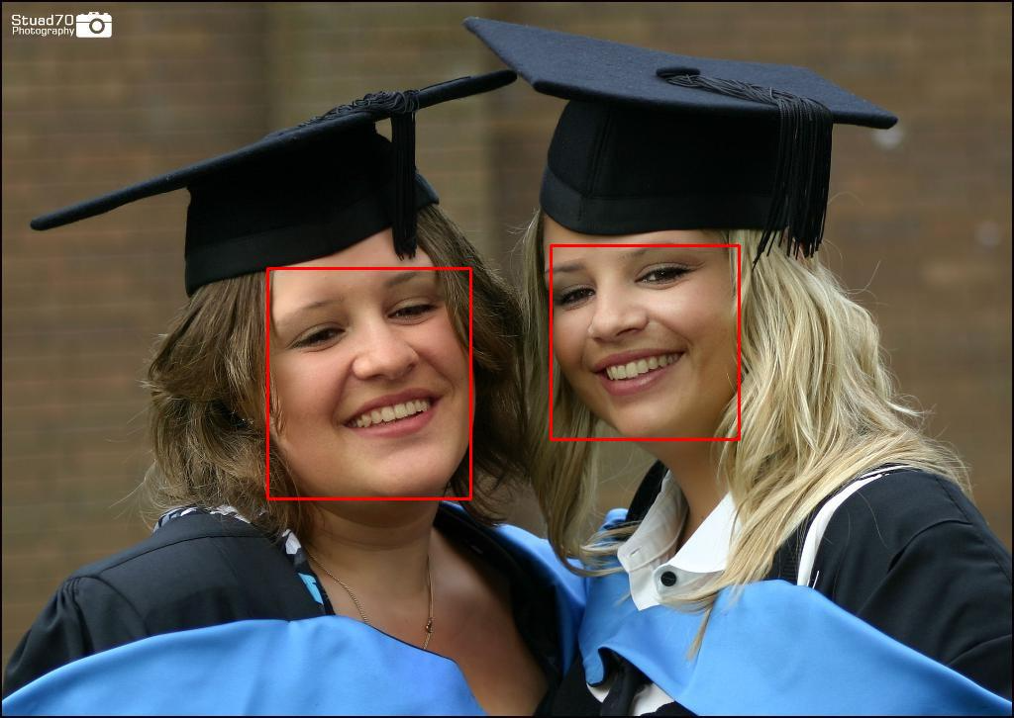
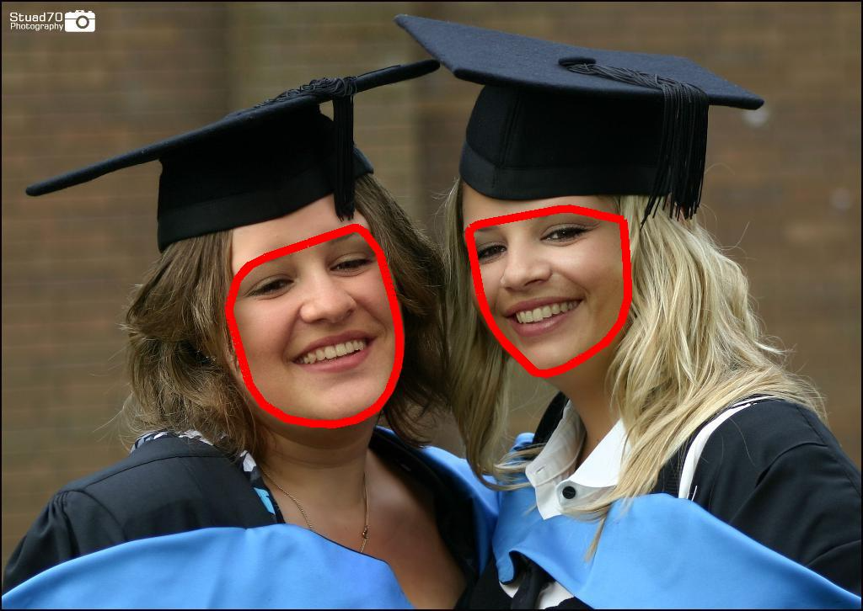
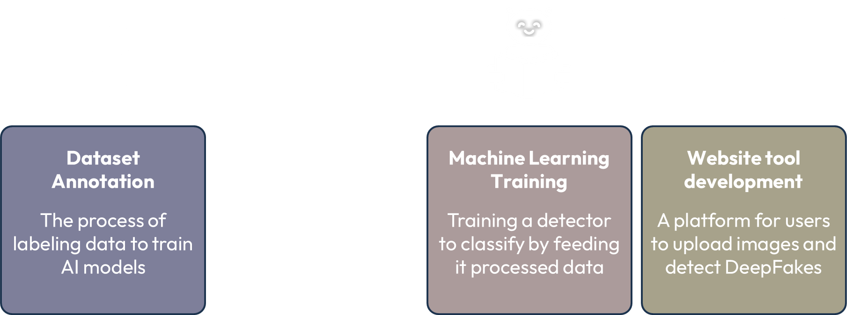
Visualizing Parameters
Developed software to map the annotation parameters to each face to visualize dataset
Bounding Box
Segmentation
Frame defined by [x, y, width, height]
Region of image defining mask
Engineering Design
Feature Extraction
Selecting key patterns or attributes of the image

Slide 14
Visualizing Parameters
Developed software to map the annotation parameters to each face to visualize dataset
Bounding Box
Segmentation
Frame defined by [x, y, width, height]
Region of image defining mask
Engineering Design
Feature Extraction
Selecting key patterns or attributes of the image

Slide 15
Feature Extraction
Select important patterns, attributes from the image to train a ML model to classify between real and fake content
Using RGB color space as an example:
$$\left[\begin{matrix}R_{11} & ⋯ & R_{1n} \\ ⋮ & ⋱ & ⋮ \\ R_{m1} & ⋯ & R_{mn}\end{matrix}\right]$$
$$\left[\begin{matrix}G_{11} & ⋯ & G_{1n} \\ ⋮ & ⋱ & ⋮ \\ G_{m1} & ⋯ & G_{mn}\end{matrix}\right]$$
$$\left[\begin{matrix}B_{11} & ⋯ & B_{1n} \\ ⋮ & ⋱ & ⋮ \\ B_{m1} & ⋯ & B_{mn}\end{matrix}\right]$$
Image
Process Image
Quantitative Values
Notes:
Jahtega

Slide 16
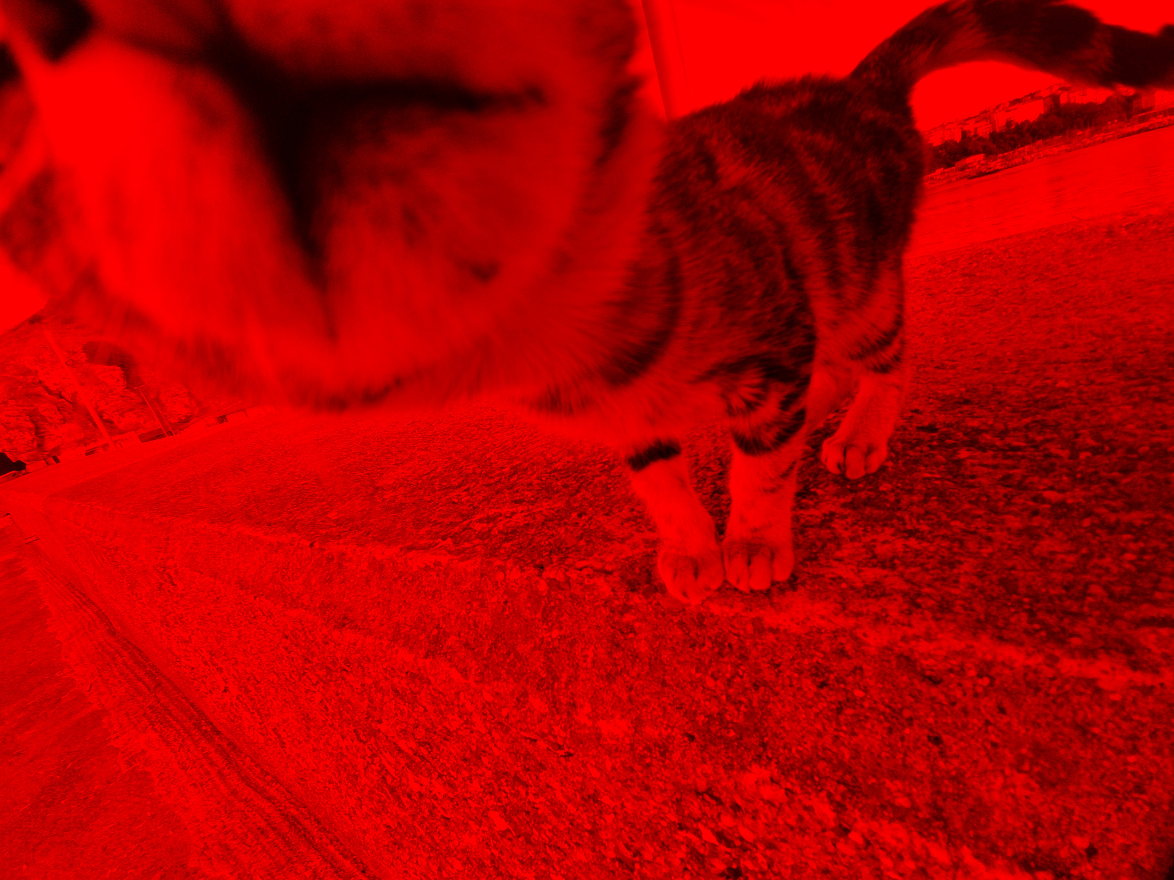
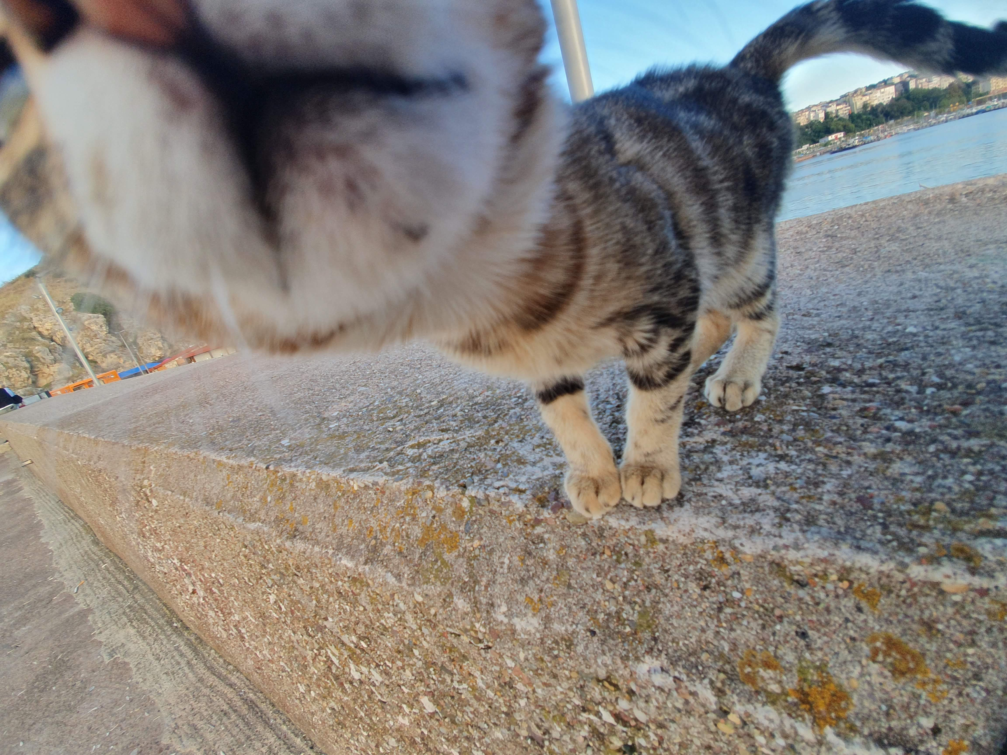
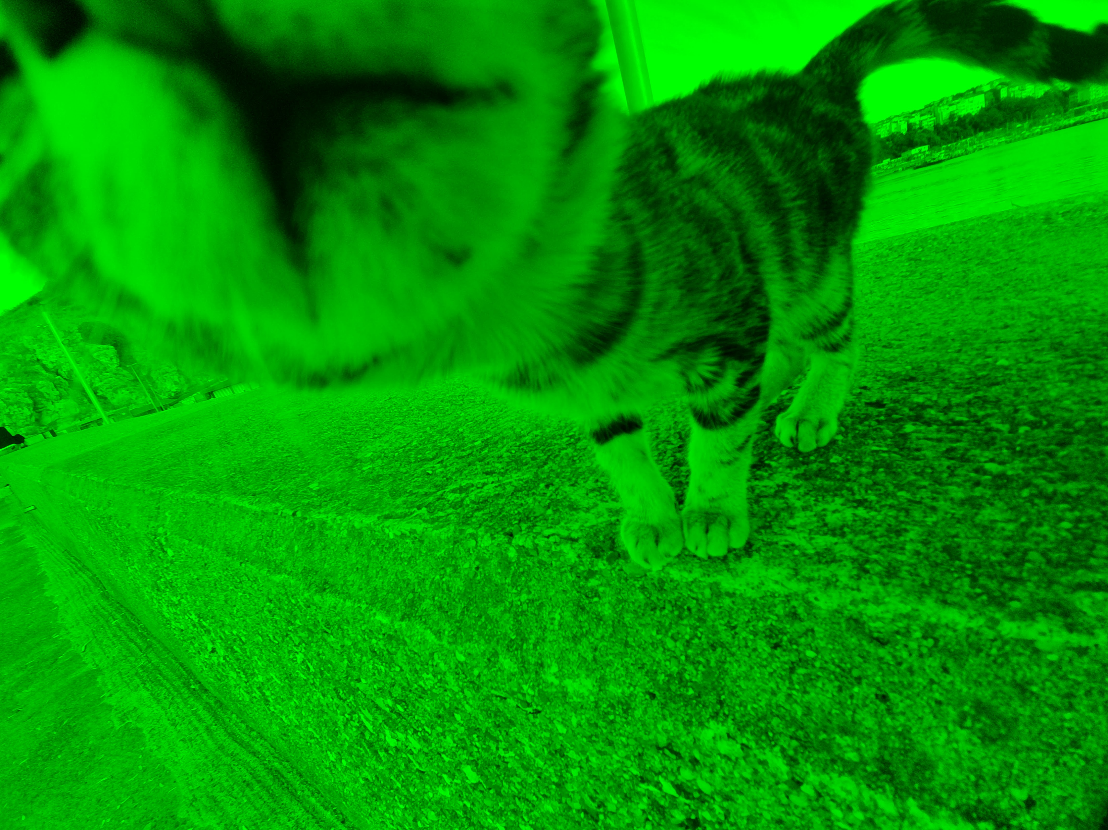
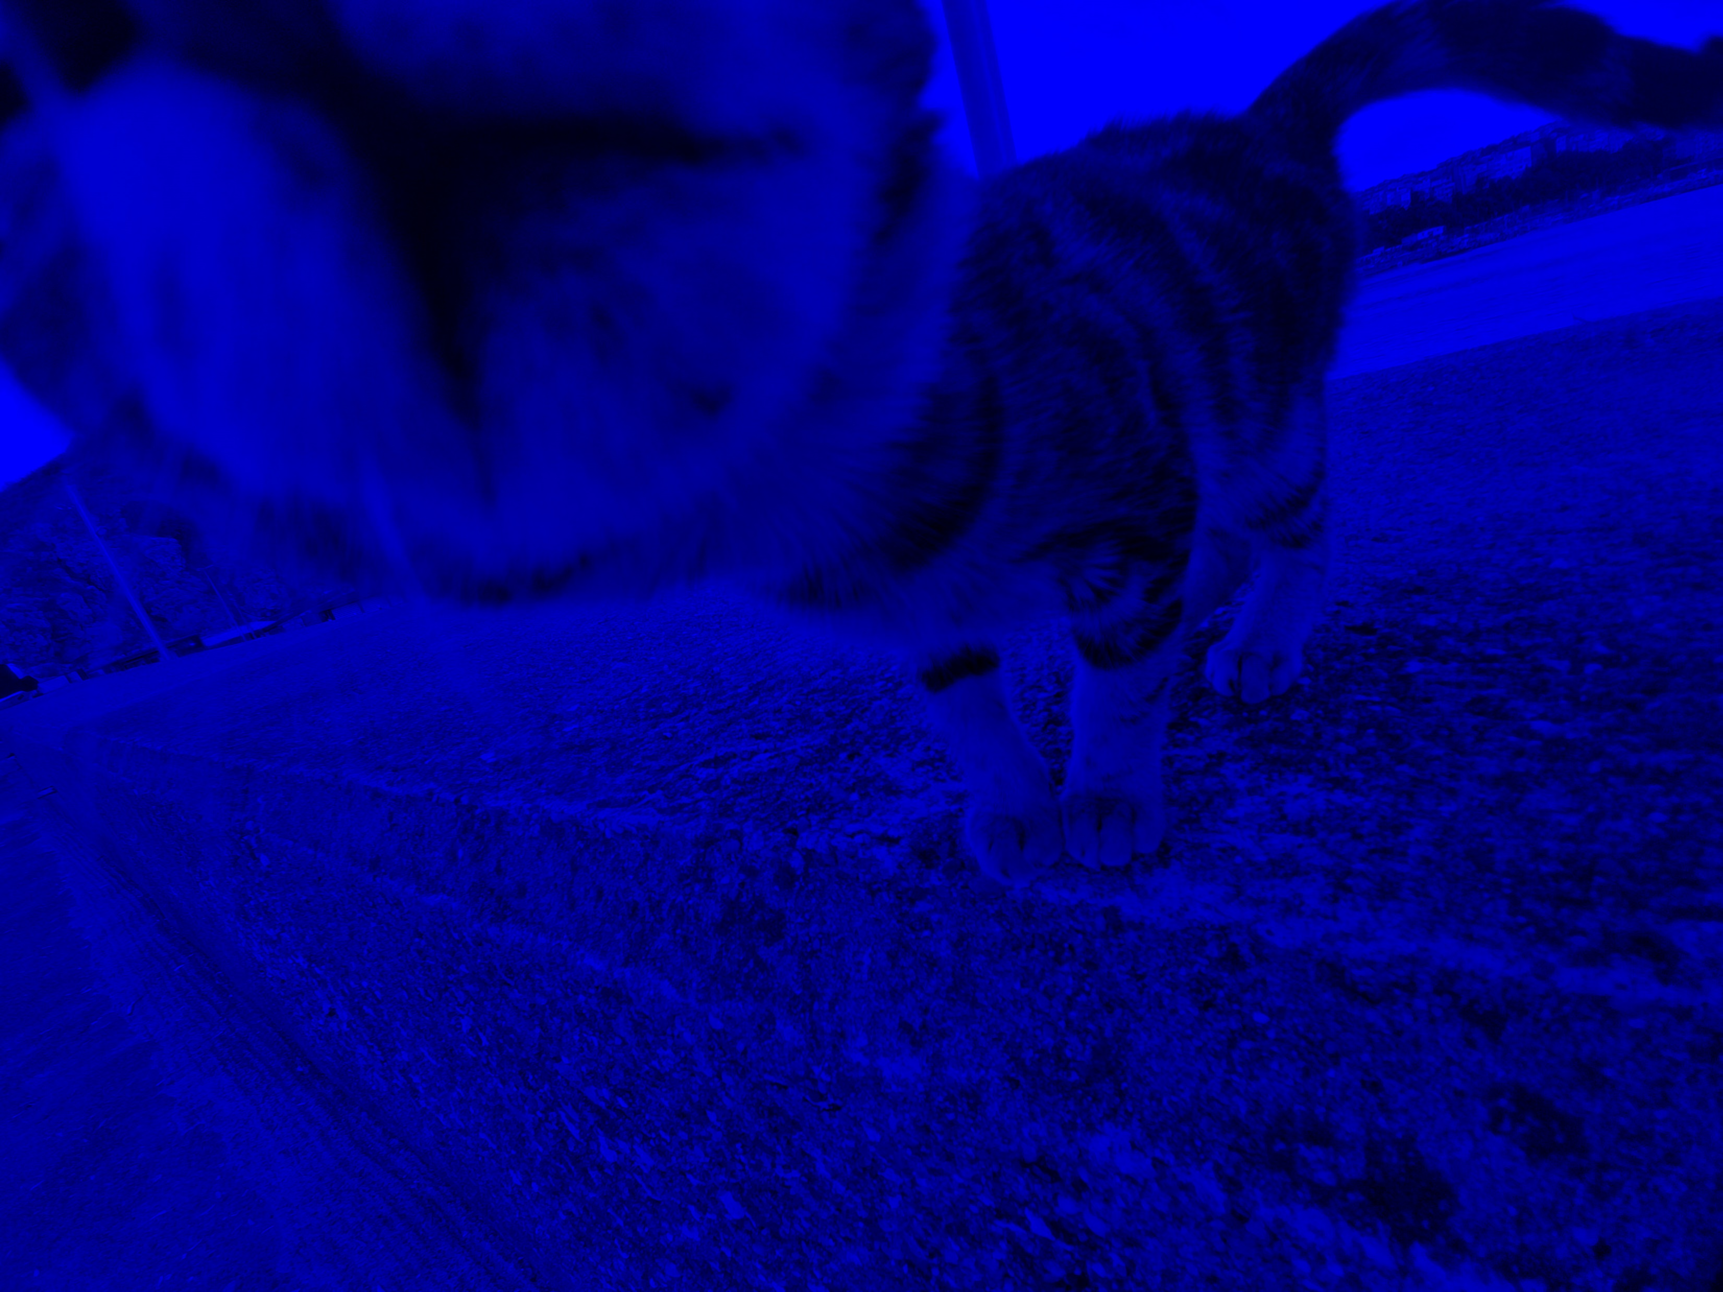
Feature Extraction
Color Space | Components | Range | Bits
RGB | Red (R) | 0 to 255 | 8
 | Green (G) | 0 to 255 | 8
 | Blue (B) | 0 to 255 | 8
HSV | Hue (H) | 0 to 360 | 16
 | Saturation (S) | 0 to 255 | 8
 | Value (V) | 0 to 255 | 8
Hue
Saturation
R
Value
G
B
Original Image
RGB Color Space
HSV Color Space
Notes:
Jahtega

Slide 17
Tool Used
Output
Input
Image List
Annotation List
CSV file that contains feature vectors for each image
Options:
Parameter File
Window size
DCT Size
DCT Coefficients
Generate Features Tool
Nedc_dfake_gen_feats.py
Using this framework, we specify the size of the DCT and the number of coefficients to extract.
Notes:
Jahtega

Slide 18
Discrete Cosine Transform
Converts a sequence of numbers to a sum of cosines different frequencies
$$\left[\begin{matrix}{RGB}_{11} & ⋯ & {RGB}_{1n} \\ ⋮ & ⋱ & ⋮ \\ {RGB}_{m1} & ⋯ & {RGB}_{mn}\end{matrix}\right]$$
$$\left[\begin{matrix}C_{0} \\ ⋮ \\ C_{N}\end{matrix}\right]$$
RGB Values
Cosine coefficients
We would use the NEDC Tool to perform this transform
Widely used in signal processing
Converts data into frequency components
Applied in data compression
Notes:
Jahtega

Slide 19
Feature Extraction Results
Img_name | Real/Fake | Features | Coefficient[1] | Coefficient[N]
Image 1
Image 2
Image N
$$C_{N}$$
Real/Fake
Features
Coefficient
Identifier to assign object to category
Extracted values from image
Coefficient of Cosine
Notes:
Jahtega

Slide 20
Feature Extraction: Future Works
Integrate the features extracted to training model
Research other features to extract, such as other color spaces
Engineering Design
Dataset Annotation
Feature Extraction
Machine Learning Training
Website tool development
The process of labeling data to train AI models
Selecting key patterns or attributes of the image
Training a detector to classify by feeding it processed data
A platform for users to upload images and detect DeepFakes
Notes:
Jahtega

Slide 21
Feature Extraction: Future Works
Integrate the features extracted to training model
Research other features to extract, such as other color spaces
Engineering Design
Dataset Annotation
Feature Extraction
Machine Learning Training
Website tool development
The process of labeling data to train AI models
Selecting key patterns or attributes of the image
Training a detector to classify by feeding it processed data
A platform for users to upload images and detect DeepFakes

Slide 22
Machine Learning
Implementing a Random Forest as our baseline model
Dataset
Decision Tree 1
Decision Tree 2
Decision Tree N
Result 1
Result 2
Result N
Averaging
Final Result
Notes:
Jahtega

Slide 23
Test Plan
dataset 1
(evaluation)
Train Model
dataset 1
(training)
Evaluate Model
Revise Model
Update:
Accuracy
Confidence Score
Confusion Matrix
dataset 1
(development)
Notes:
Jahtega

Slide 24
Confusion Matrix
A measurement tool that helps evaluate performance of a machine learning model
Evaluation:
Annotation:
True
False
Positive
Negative
correct
incorrect
real
fake
classification
classification
image
image
Actual / Predicted | Predicted Real | Predicted Fake
Actual Real | True Positive (TP) | False Negative (FN)
Actual Fake | False Positive (FP) | True Negative (TN)
Actual / Predicted | Predicted Real | Predicted Fake
Actual Real
Actual Fake
Notes:
Jahtega

Slide 25
Machine Learning Metrics
These metrics help evaluate performance of a machine learning model
Actual / Predicted | Predicted Real | Predicted Fake
Actual Real | TP | FN
Actual Fake | FP | TN
Accuracy
Precision
Recall
F1 Score
$$\frac{ TP+TN }{TP+FP+TN+FN}$$
$$\frac{ TP}{TP+FP}$$
$$\frac{ TP}{TP+FN}$$
$$2×\frac{ Precision×Recall}{Precision+Recall}$$
How often the model classifies an image correctly
Proportion of correct positive predictions to all positive cases
Proportion of positive cases correctly identified
Combines precision and recall into a balanced metric
For al these metrics, a score of 1 is considered perfect
Notes:
Jahtega

Slide 26
DeepFake Detection Design
Breaking down the problem
Is the face real?
Is there a face?
Yes
Present result
Yes
No
Present result
Image
No
End program
Notes:
Jahtega

Slide 27
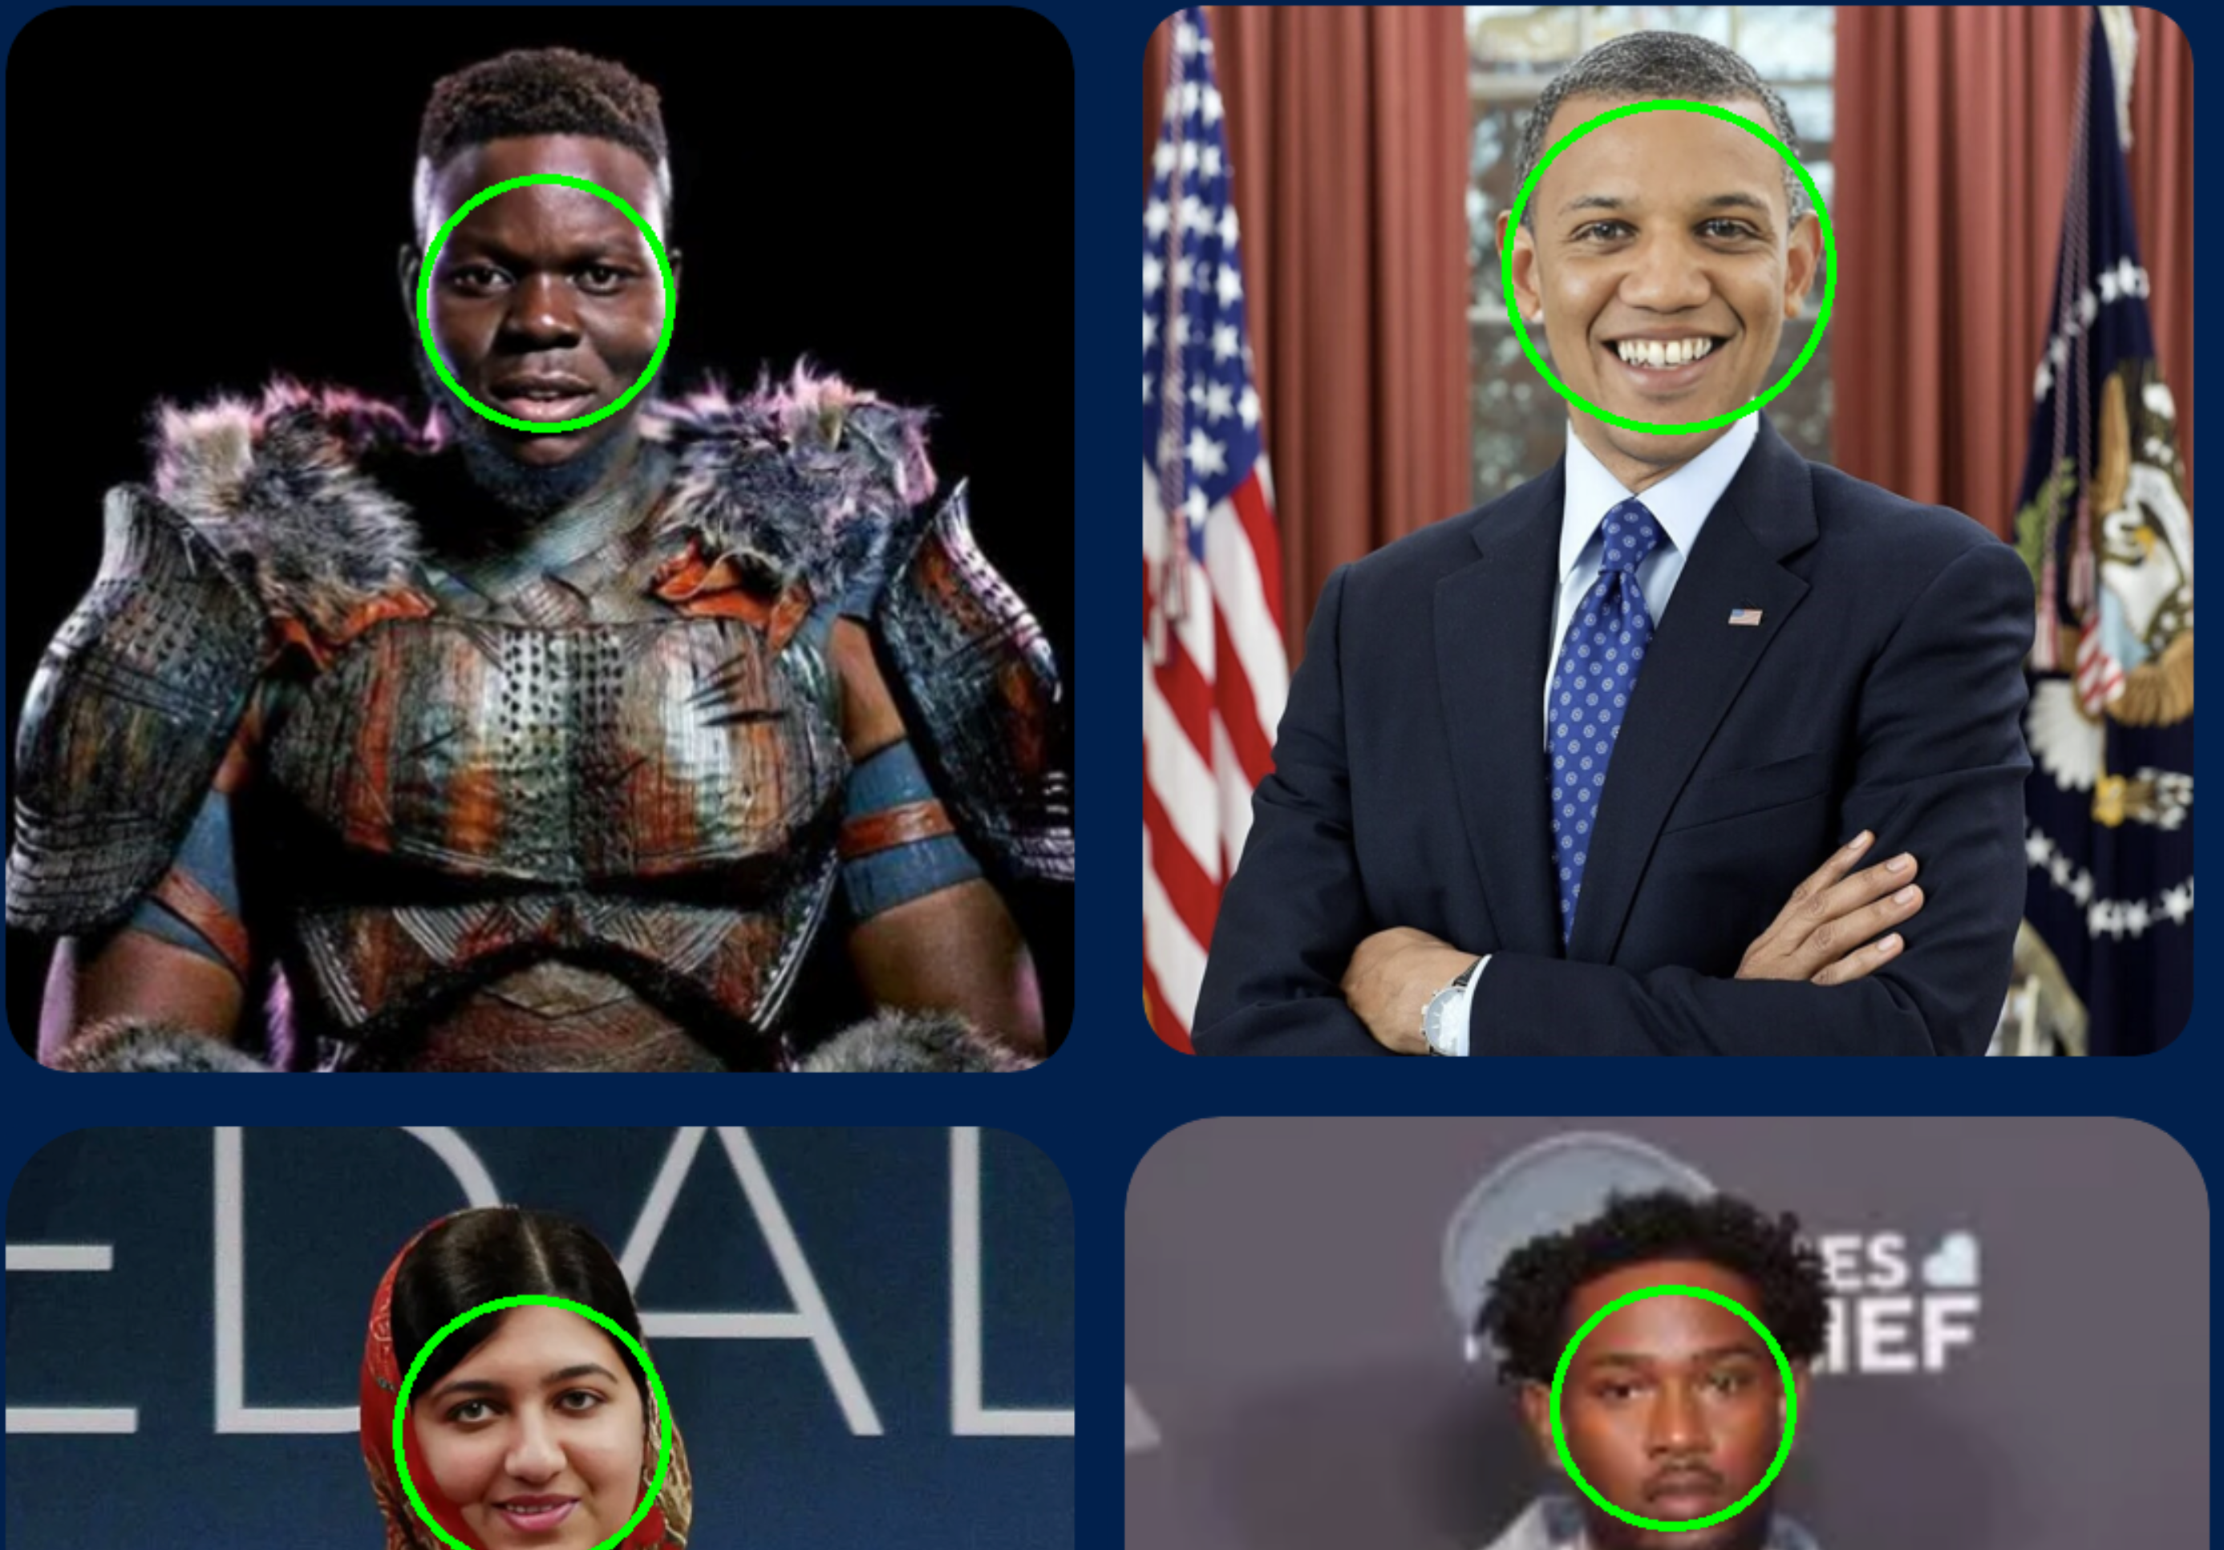
DeepFake Detection Design
Develop a tool that is able to recognize faces and provide a bounding box with high accuracy
Is there a face?
Yes
Image
No
Haar Cascade, a machine learning model used in face detection
Notes:
Jahtega

Slide 28
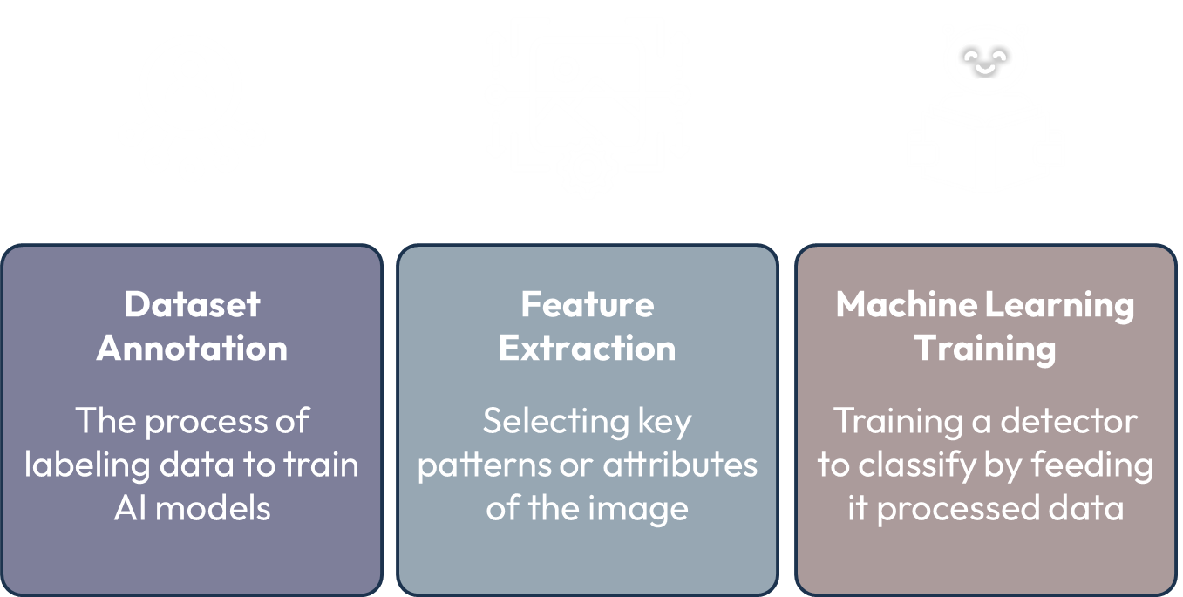
Future Works
Develop Machine Learning model
Input
Output
CSV of Features
Options:
algorithm
classify
Trained model
Classified data
Score
ML Experiment tool
Nedc_ml_vector_classify.py
Engineering Design
Dataset Annotation
Feature Extraction
Machine Learning Training
Website tool development
The process of labeling data to train AI models
Selecting key patterns or attributes of the image
Training a detector to classify by feeding it processed data
A platform for users to upload images and detect DeepFakes
Notes:
Jahtega

Slide 29
Future Works
Develop Machine Learning model
Input
Image List
File.dat
Features
Options:
algorithm
classify
Output
Trained model
Classified data
Score
ML Experiment tool
Nedc_ml_vector_classify.py
Engineering Design
Dataset Annotation
Feature Extraction
Machine Learning Training
Website tool development
The process of labeling data to train AI models
Selecting key patterns or attributes of the image
Training a detector to classify by feeding it processed data
A platform for users to upload images and detect DeepFakes

Slide 30
Website Tool Development
Building a fast, secure, and user-Friendly way to detect deepfakes
Usability
Upload
Data Protection
Ensures accessibility, ease of use for all users
Allows users to submit images for detection
Protecting user privacy preventing data leaks
Real-time Analysis
View Results
Users receive instant feedback
Users can understand the outcome detection

Slide 31
Website Development
can be divided into 2 parts:
Backend
Frontend
Handles server
Handles website behavior
Handles user requests
Data management
Serves web pages to users
Structure content on site
Defines elements
Paragraphs, buttons, forms
Creates forms for users
Notes:
Jahtega

Slide 32
Website Development
Tools used:
Backend
Frontend
Frontend
Flask, Web Framework
HTML, Structure
CSS, Styling
Receives user input
Processes data
Maps URL to functions
Structure of website
Organizes content
Styling webpage
Manages colors, font, positioning
Notes:
Jahtega

Slide 33
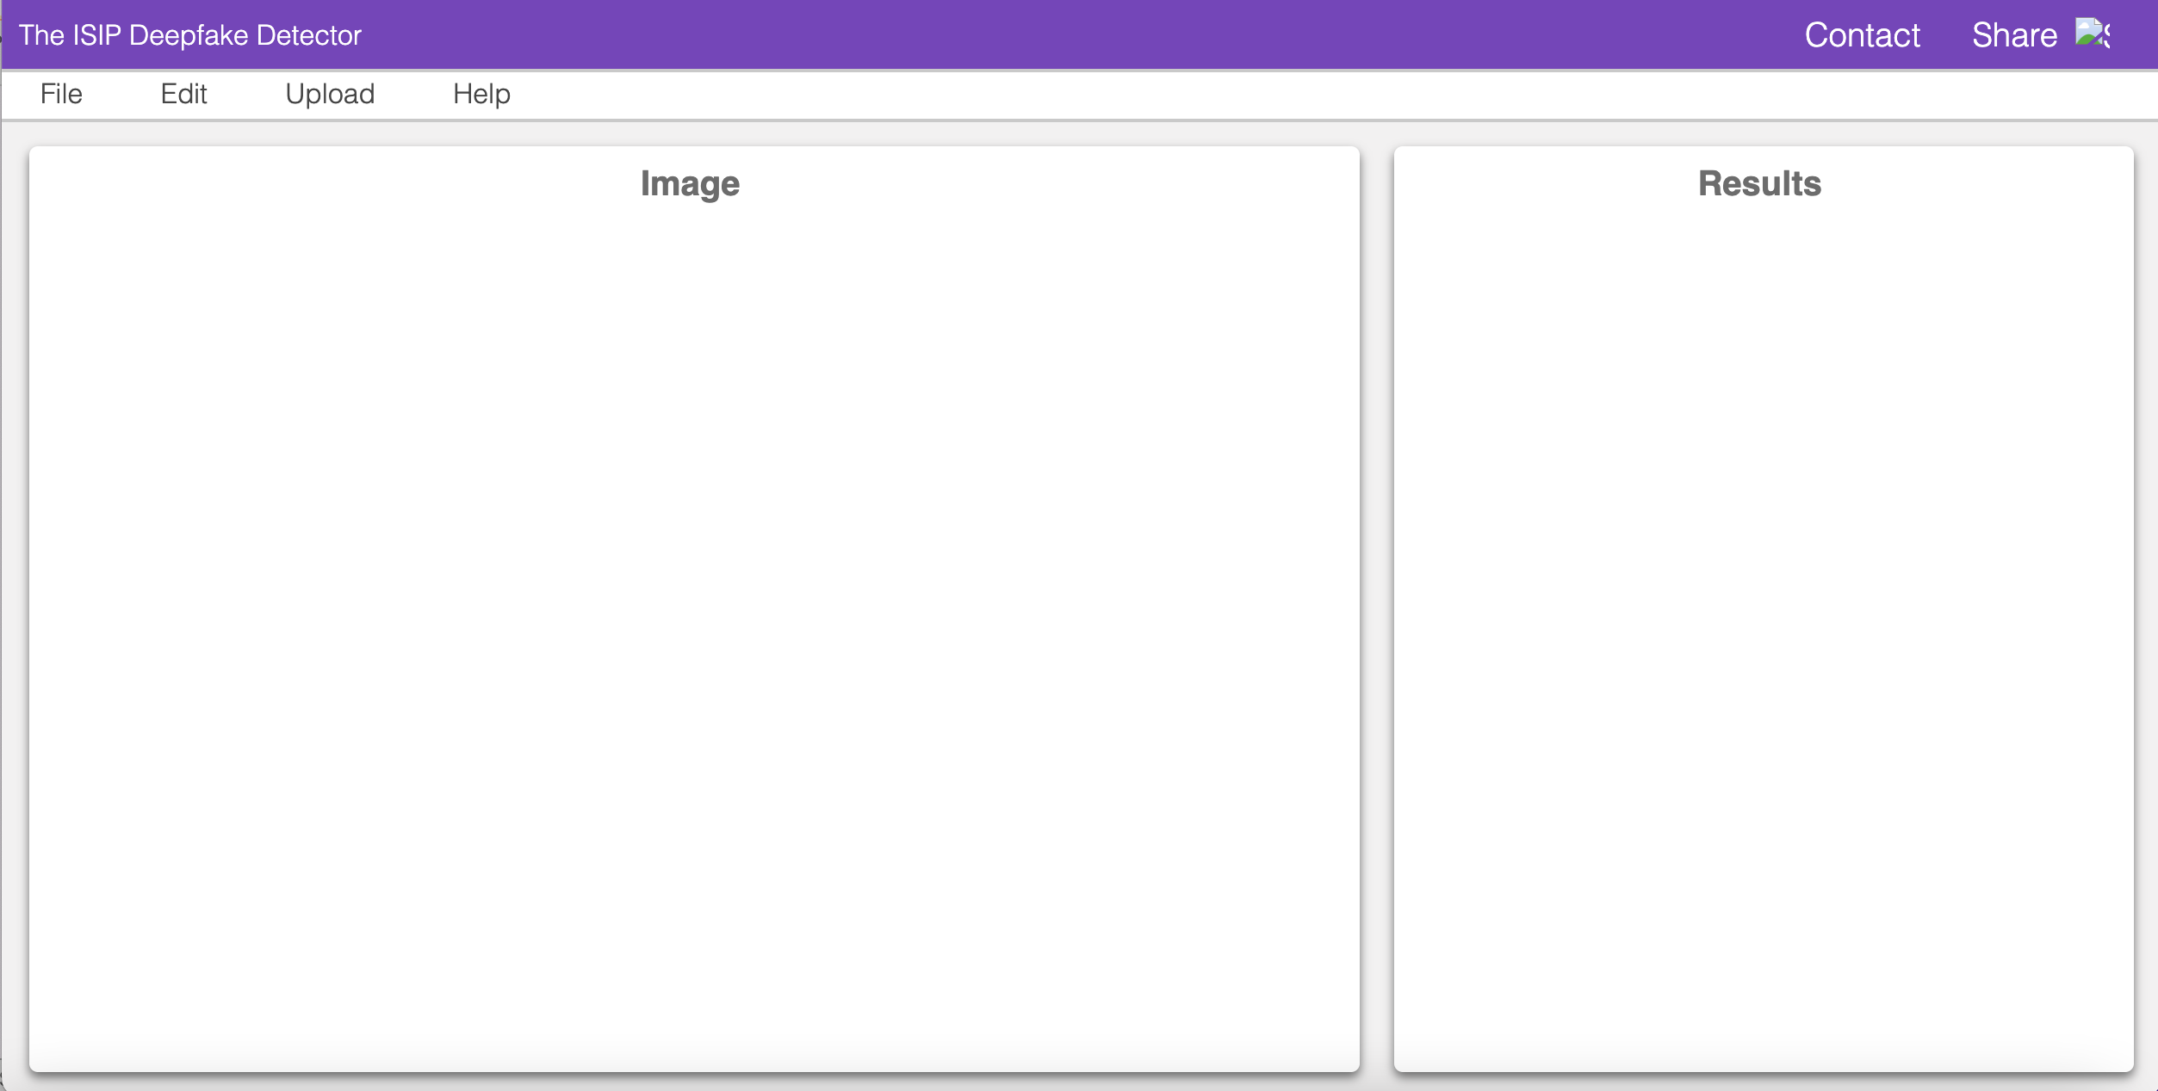
Website Development
Our current prototype:
Upload Image for analysis
Image and processed artifacts that shown here
ML classification result and confidence score shown here
Notes:
Jahtega

Slide 34
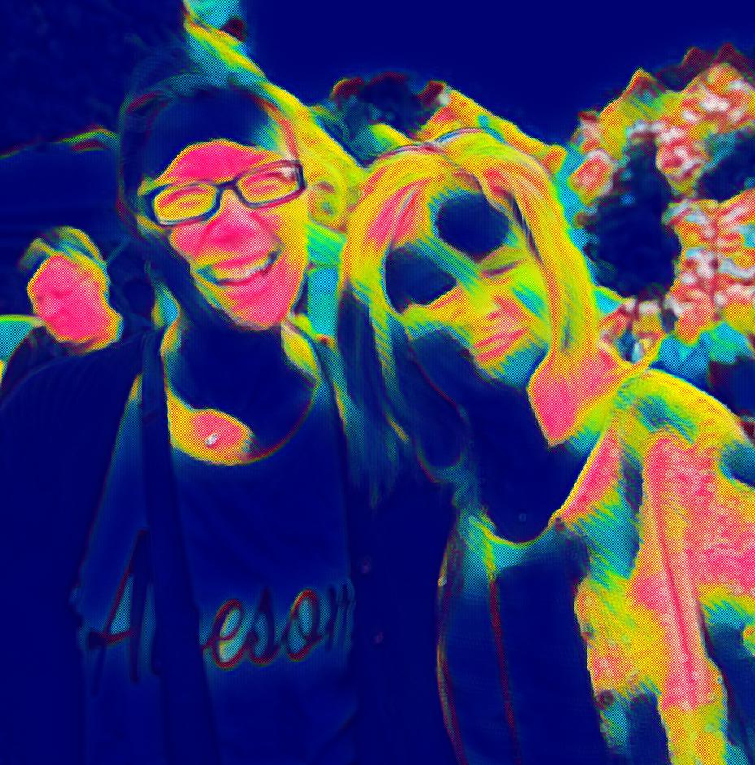
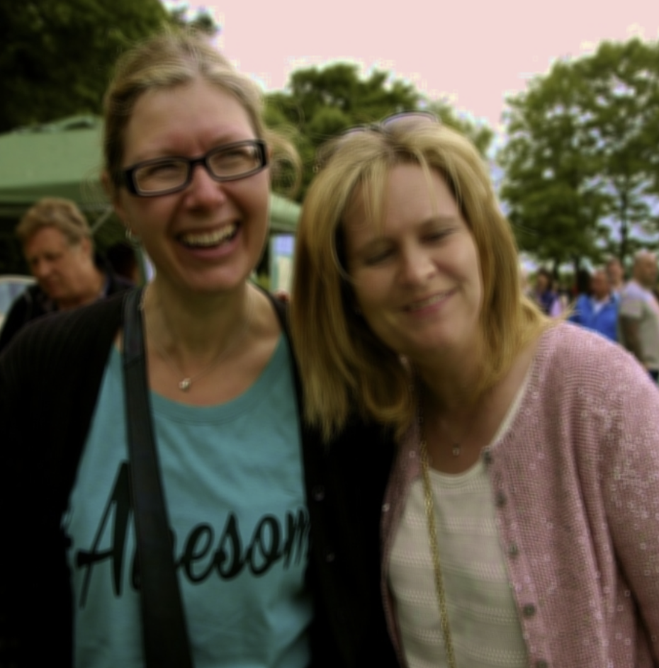
Website Development Future Works
Schematic demonstration:
This image is
GENERATED
Heatmap to show manipulated areas
Answered with:
59% Confidence
Notes:
Jahtega

Slide 35
Website Development Future Works
launch our tool on a public domain server
DeepTruth Detection
User
Public Domain
Develop website functionality and usability
Engineering Design
Dataset Annotation
Feature Extraction
Machine Learning Training
Website tool development
The process of labeling data to train AI models
Selecting key patterns or attributes of the image
Training a detector to classify by feeding it processed data
A platform for users to upload images and detect DeepFakes
Notes:
Jahtega

Slide 36
Website Development Future Works
launch our tool on a public domain server
DeepTruth Detection
User
Public Domain
Develop website functionality and usability
Engineering Design
Dataset Annotation
Feature Extraction
Machine Learning Training
Website tool development
The process of labeling data to train AI models
Selecting key patterns or attributes of the image
Training a detector to classify by feeding it processed data
A platform for users to upload images and detect DeepFakes
Dataset Annotation
Investigate other DeepFake datasets for future model development

Slide 37
Engineering Design
Dataset Annotation
Feature Extraction
Machine Learning Training
Website tool development
The process of labeling data to train AI models
Selecting key patterns or attributes of the image
Training a detector to classify by feeding it processed data
A platform for users to upload images and detect DeepFakes
Future Works
Dataset Annotation
Feature Extraction
Machine Learning Training
Website tool development
Investigate other DeepFake datasets for future model development
Research different features to extract, assessing the trade-offs between them
Launch our site on a public domain server, develop site functionality
Develop Random Forest algorithm using NEDC tools

Slide 38
Team DeepTRUTH
Thanks you for your attention
Jouri Ghazi
Jahtega Djukpen
Ashton Bryant
Zacary Louis
Questions & Comments?

