Slide 1
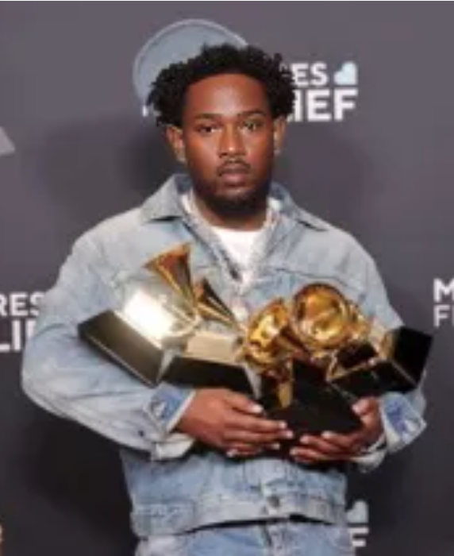
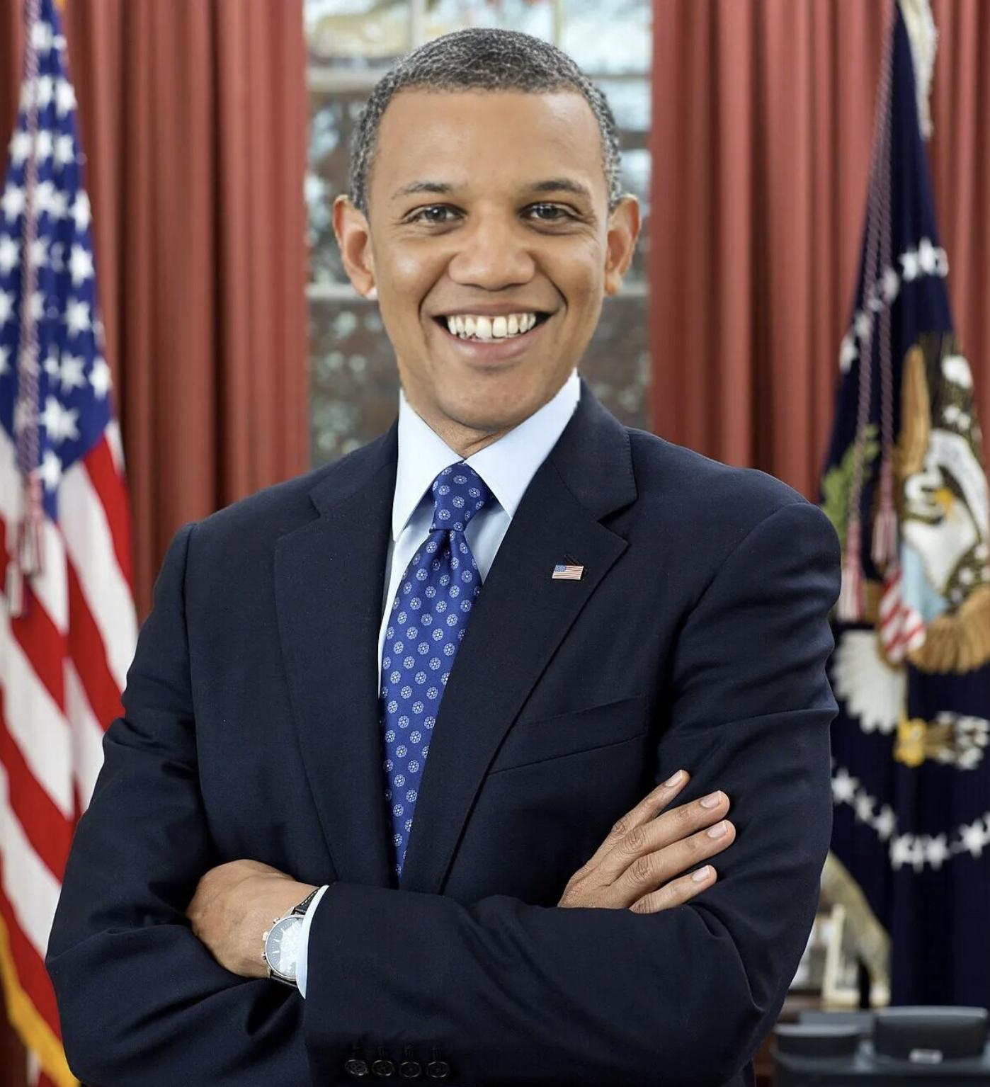
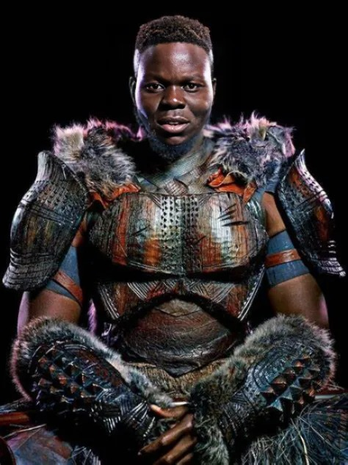
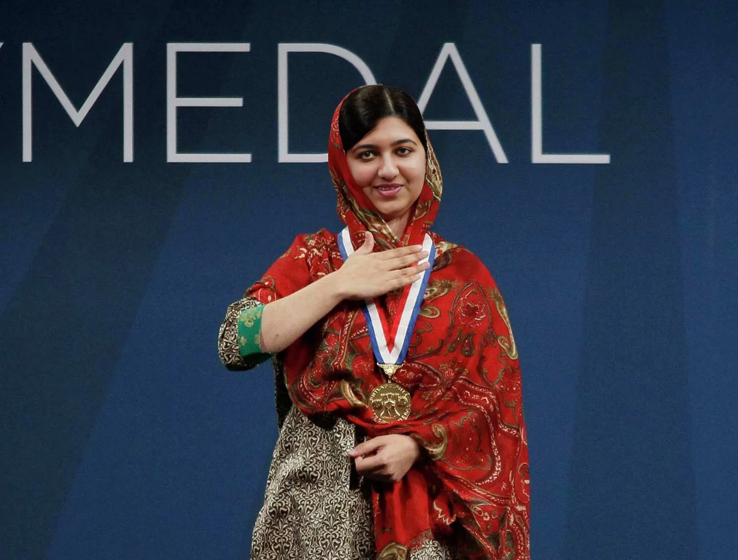
DeepFake Detection
Advised by Dr. Picone
Jouri Ghazi
Jahtega Djukpen
Ashton Bryant
Zacary Louis
A Nobel Peace Prize winner
An Oscar Winning Actor
The 44th President of the United States
A Multi-Grammy award Artist
A Nobel Peace Prize winner
An Oscar Winning Actor
The 44th President of the United States
A Multi-Grammy award Artist
These are synthesized images, we will be developing a DeepFake detection method.
Notes:
Jouri

Slide 2
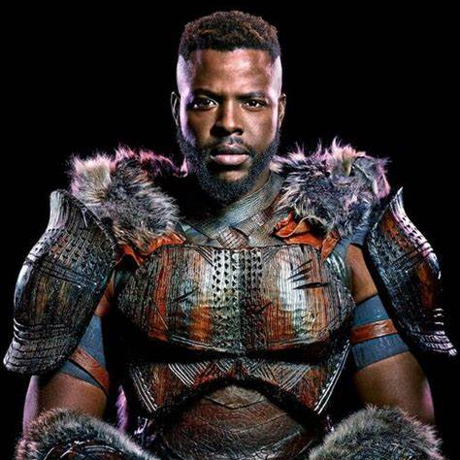
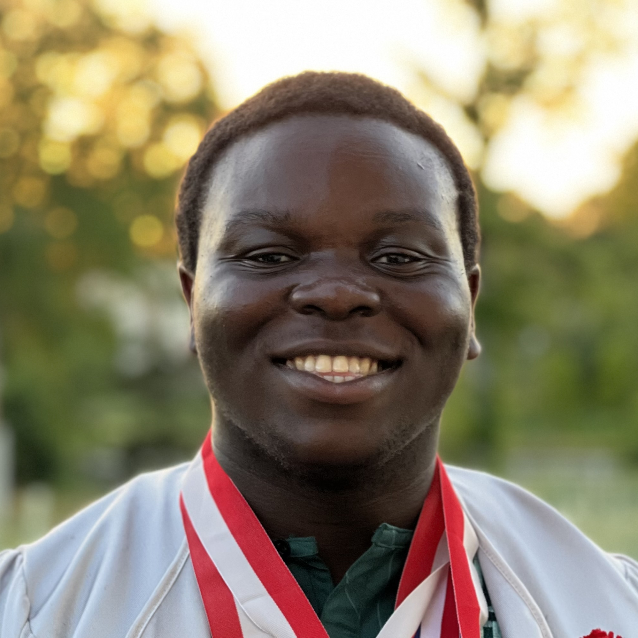
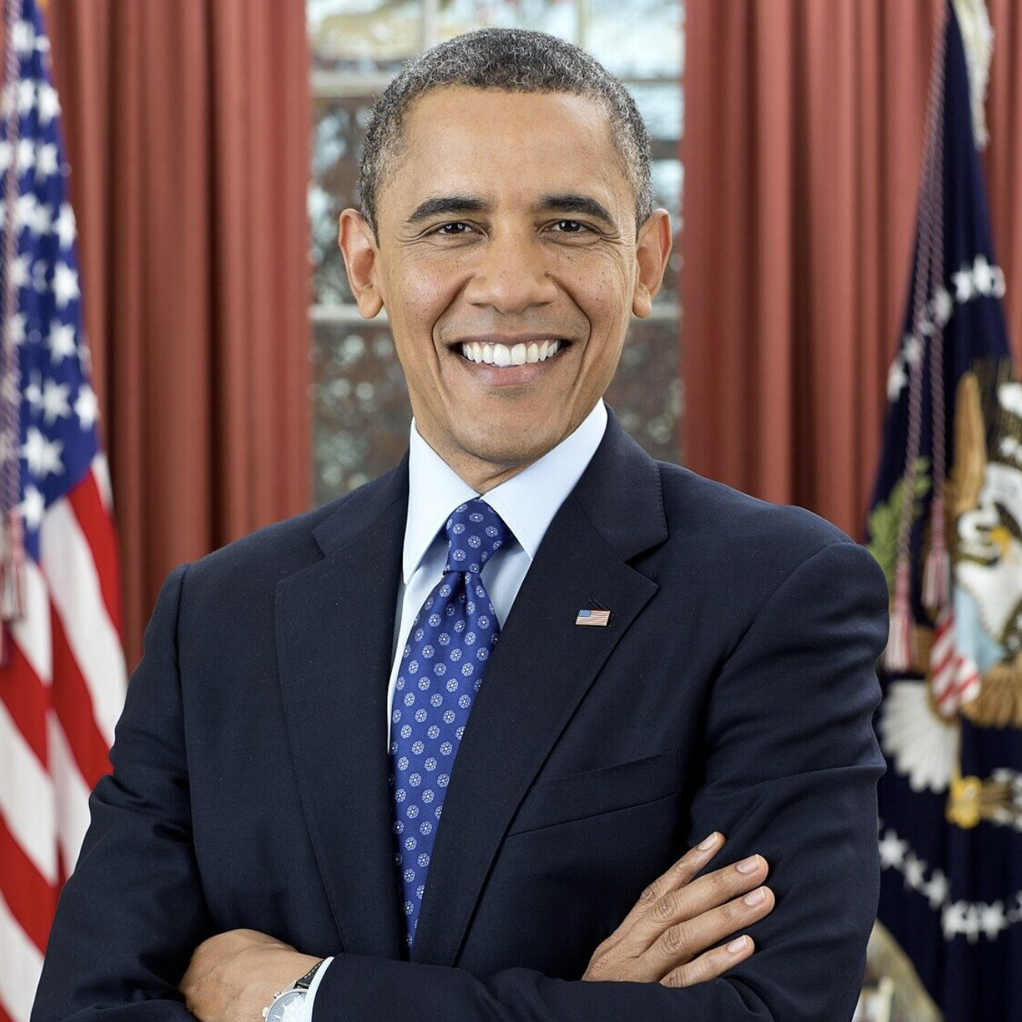
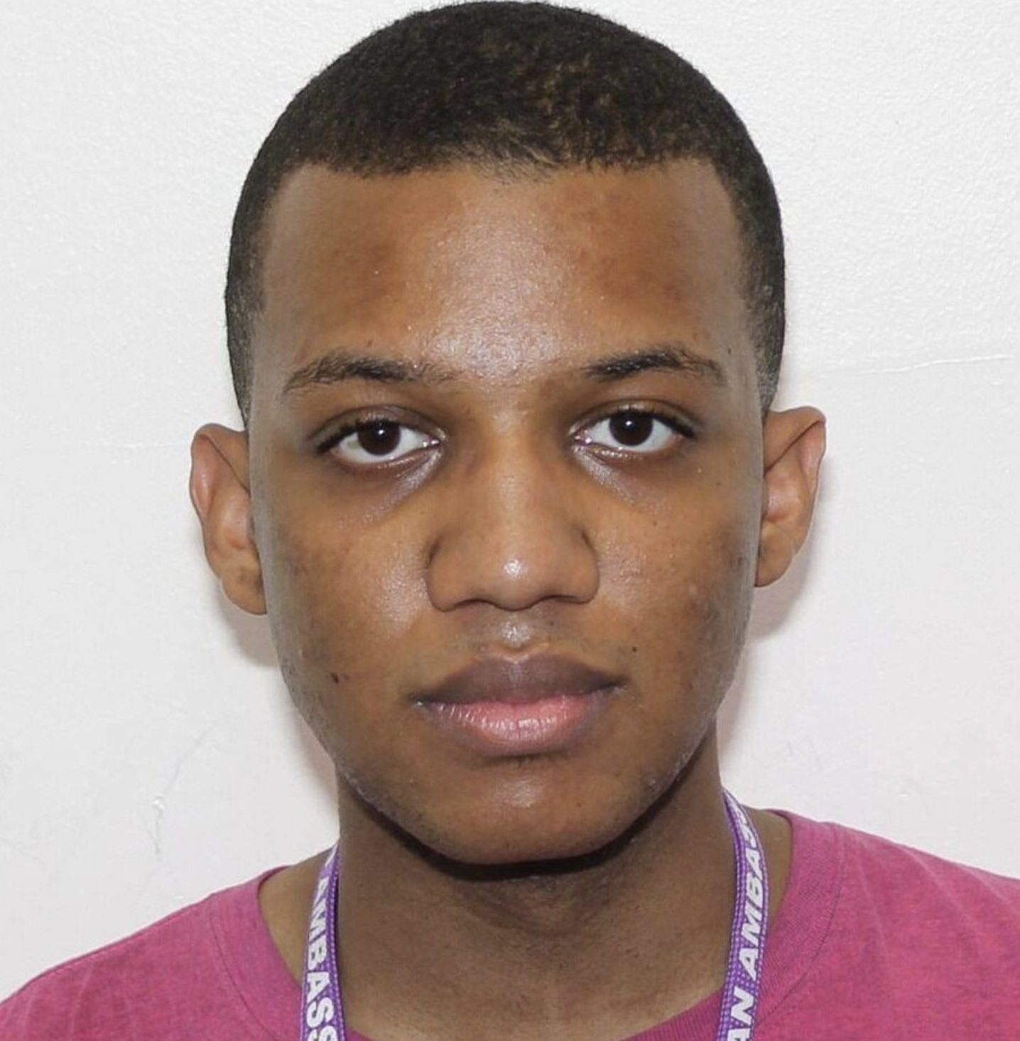
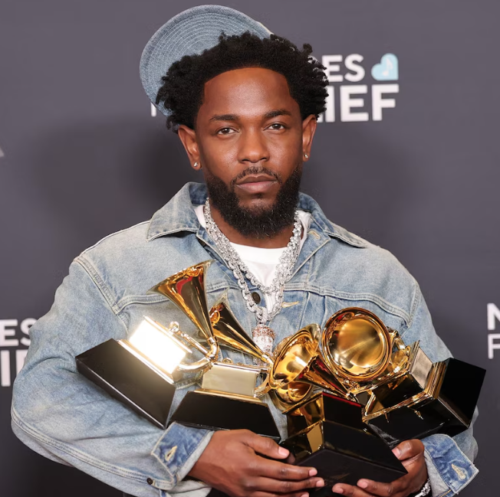
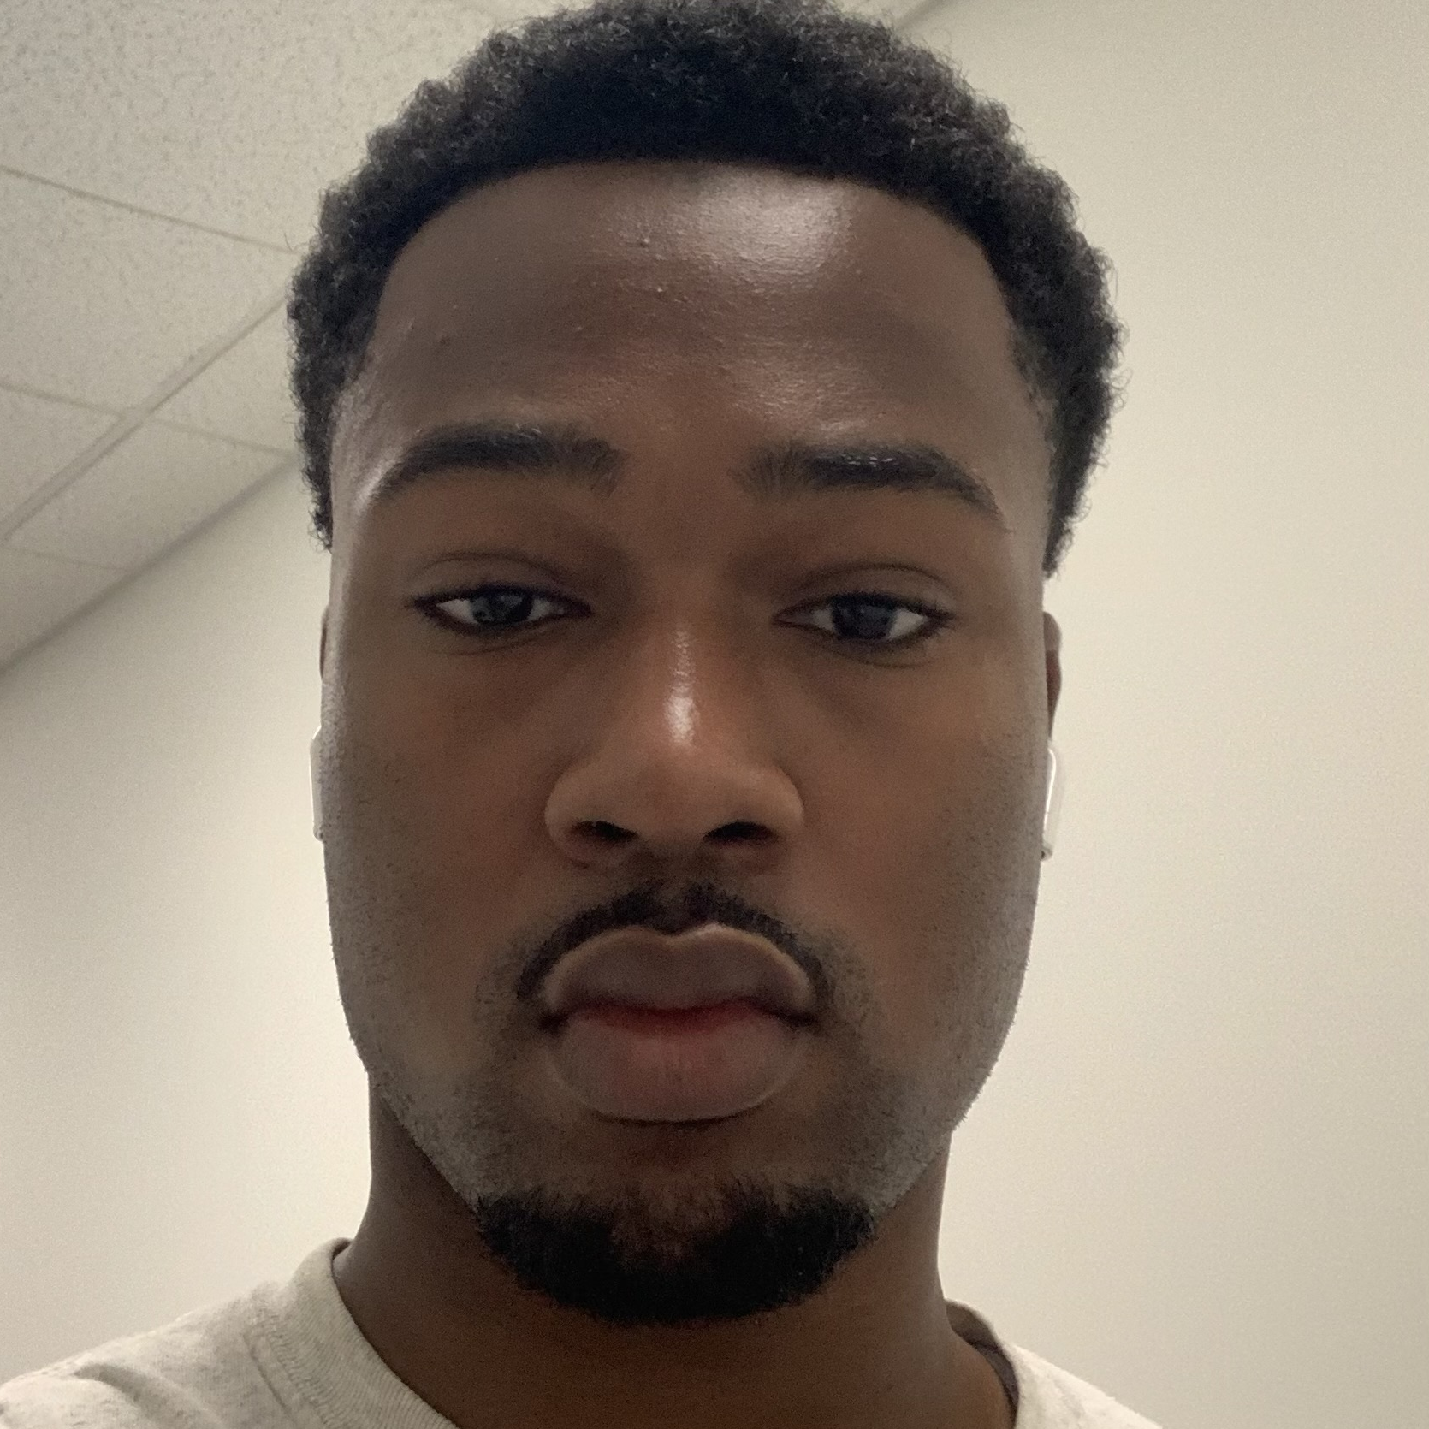
What is a DeepFake?
A form of AI-Generated content
Target
Source
Face Swap
These images were created within a few minutes using https://deepfakemaker.io/
Notes:
Jouri

Slide 3
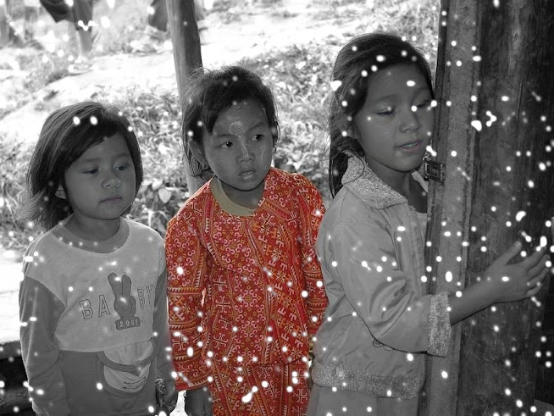
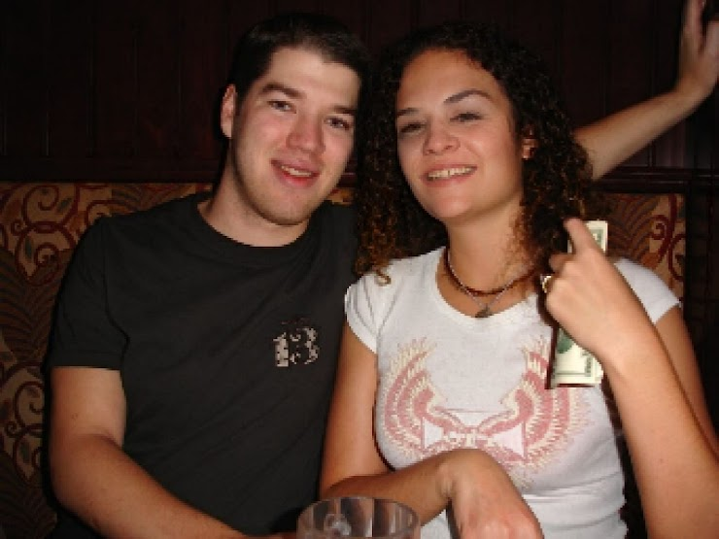
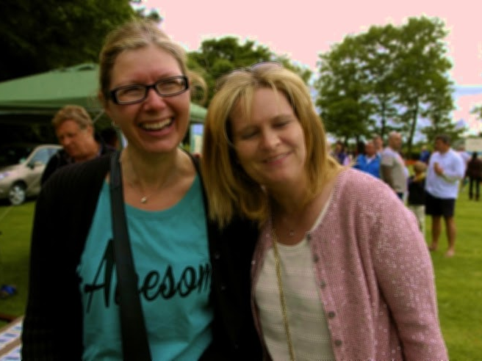
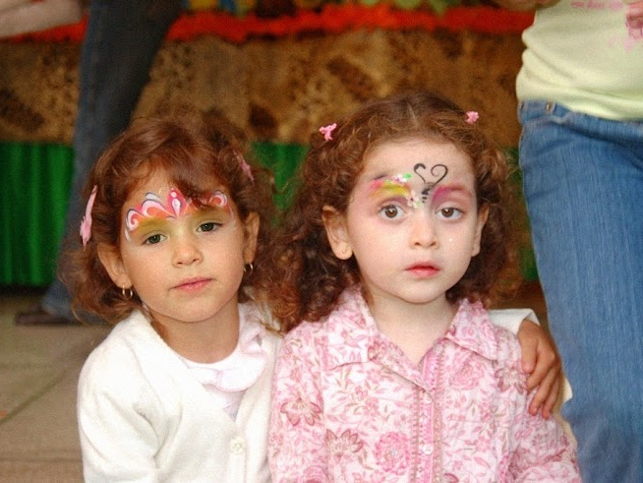
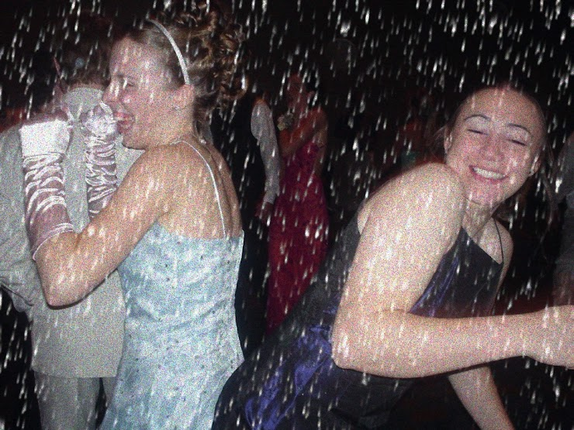
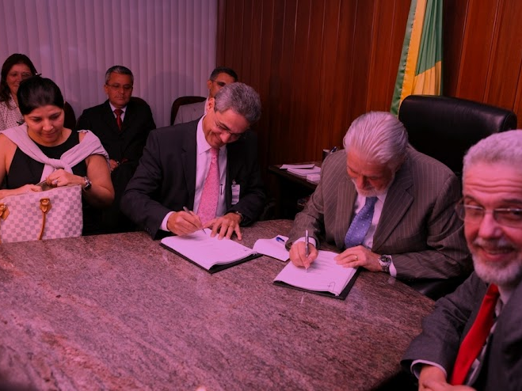
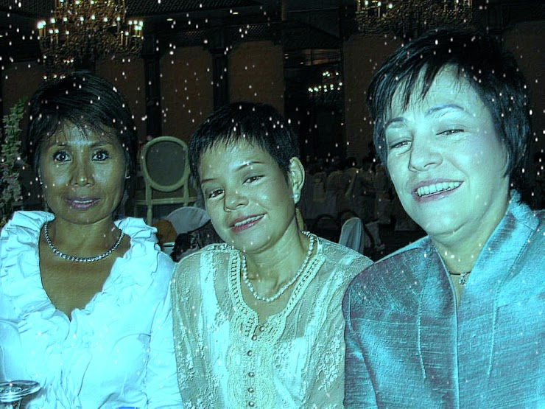
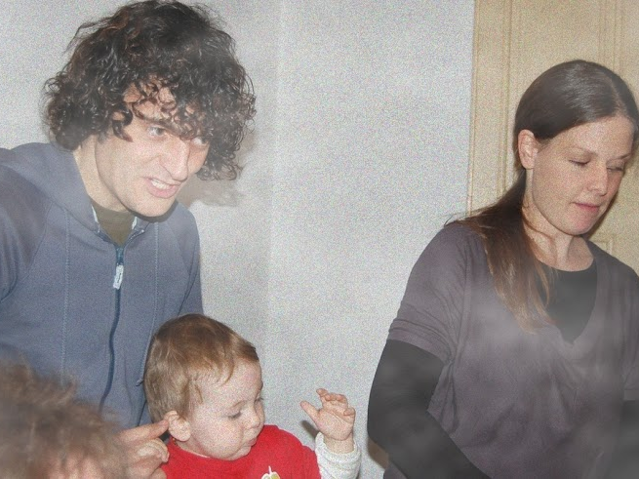
Detect the DeepFake!
Is this Real / Generated?
Notes:
Jouri

Slide 4
Survey
Conducted a survey
Calculate Results
30 Questions
11 Anonymous Responses
Is this Real / Generated?
60% Accuracy
Actual / Predicted | Predicted Real | Predicted Fake
Actual Real | Correctly classified real images | Real images wrongly classified as fake
Actual Fake | False images wrongly classified as Real | Correctly classified generated images
Actual / Predicted | Predicted Real | Predicted Fake
Actual Real | True Pos.: 101 | False Neg.: 64
Actual Fake | False Pos.: 66 | True Neg.: 99
Notes:
Jouri

Slide 5
Problem Statement
UK universities automating interviews face ‘deepfake’ applicants
Macron shares his deepfakes for AI summit attention
The Guardian Wed 12 Feb 2025 02.00 EST
BBC Mon 10 Feb 2025 02.00 EST
AI Deepfake Ad Featuring Mark Zuckerberg And Drake In ‘F Kanye’ T-Shirts Goes Viral
Trump's 'make peace or die' message to Putin is deepfake — yet it fooled Russians
Forbes Tues Feb 11, 2025 06.57 EST
voice of america english news Wed 12 Feb 2025 6:51 EST
Grieving son is scammed out of his father's inheritance in elaborate deepfake plot
Daily Mail Mon Feb 10 2025 6:51 EST
Notes:
Jahtega
Artificially generated and manipulated images such as DeepFakes, have become easier to create, and harder to detect. These images pose a serious risk to the credibility of public figures, potentially leading to great financial consequences. A DeepFake detector would benefit individuals such as celebrities, politicians, and even corporations who are frequent targets of DeepFake misuse.

Slide 6
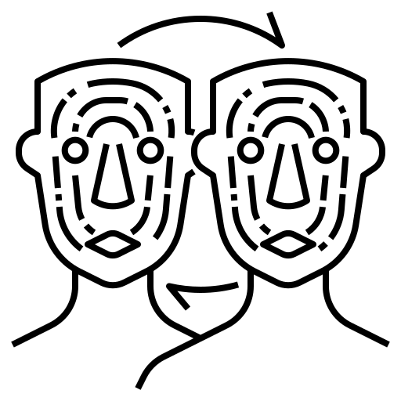
Problem Statement
Artificially generated and manipulated images such as DeepFakes, have become easier to create, and harder to detect. These images pose a serious risk to the credibility of public figures, potentially leading to great financial consequences. A DeepFake detector would benefit individuals such as celebrities, politicians, and even corporations who are frequent targets of DeepFake misuse.
Notes:
Jahtega
Artificially generated and manipulated images such as DeepFakes, have become easier to create, and harder to detect. These images pose a serious risk to the credibility of public figures, potentially leading to great financial consequences. A DeepFake detector would benefit individuals such as celebrities, politicians, and even corporations who are frequent targets of DeepFake misuse.

Slide 7
Current Solutions
Notable Legislation
Protection Methods
Detection Methods
Pennsylvania Senate Bill 1213
New PA state la
Amends Titles 18 and 61 to include the use of DeepFakes
H.R.5586 DEEPFAKES Accountability Act
- New Bill that will establish legal boundaries for the use of DeepFakes
Use Digital Watermarks to protect your content
Use Multi-Factor Authentication to protect against fraud
Report Deepfakes to reduce their spread
Websites like Deepware, Sensity AI, and Intel’s Face Catcher.
While they are tightlipped about their algorithms, they all follow the same basic process.
User Uploads Image, video, or audio, and the websites tools scan the content to determine whether it is authentic or not.
Notes:
Jahtega
Pennsylvania Senate Bill 1213(https://www.legis.state.pa.us/cfdocs/billinfo/billinfo.cfm?syear=2023&sind=0&body=S&type=B&bn=1213) (https://legiscan.com/PA/bill/SB1213/2023)
Includes artificially generated content like DeepFakes into child sexual abuse material under law. Amends Titles 18 and 61
H.R.5586 DEEPFAKES Accountability Act(https://www.congress.gov/bill/118th-congress/house-bill/5586/text#:~:text=%E2%80%94Any%20person%20who%20has%20been,person%20who%20violates%20subsection%20(a)
Establishes disclosure mandates, penalties, and exceptions regarding the creation and use of DeepFakes.

Slide 8
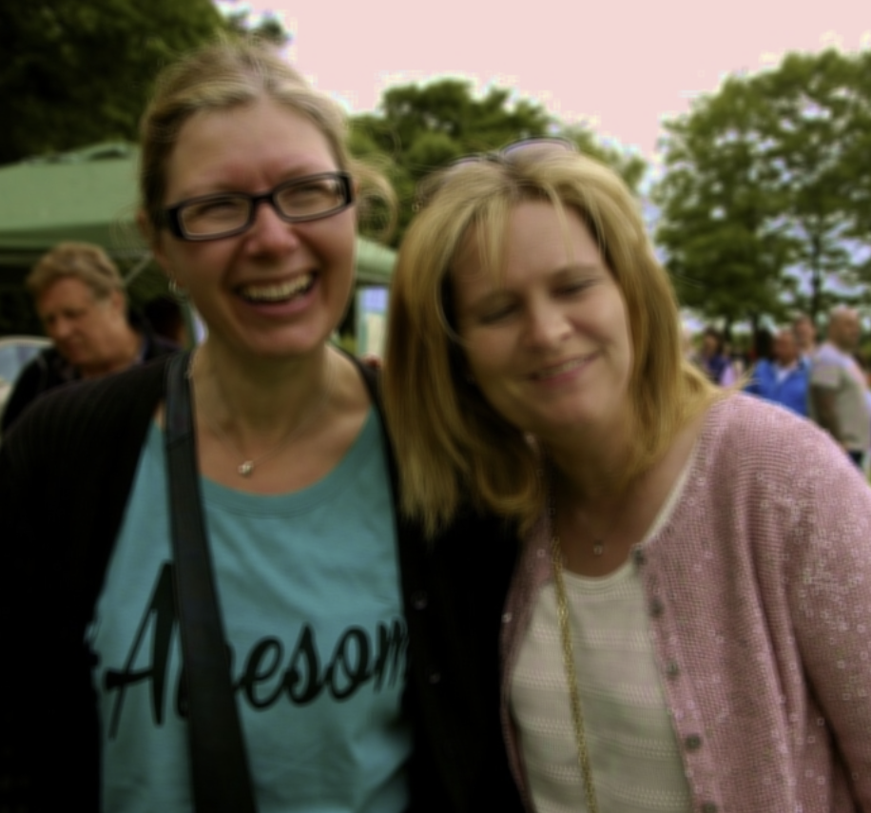
Proposed Solution
Web Application
Image Processor
Is this image real?
Upload Image
RGB(R,G,B)
$$\left[\begin{matrix}{RGB}_{11} & ⋯ & {RGB}_{1n} \\ ⋮ & ⋱ & ⋮ \\ {RGB}_{m1} & ⋯ & {RGB}_{mn}\end{matrix}\right]$$
Feature Extraction
Machine Learning
Present Results
Notes:
Jouri

Slide 9
Proposed Solution: Tools Used
Web Application
Image Processor
Flask
Javascript
Python
Is this image real?
Upload Image
Python Image Library
XceptionNet
Random Forest
DeepTRUTH
HTML
CSS
Feature Extraction
Machine Learning
Present Results
Notes:
Jouri

Slide 10
Feature Extraction
$$\left[\begin{matrix}R_{11} & ⋯ & R_{1n} \\ ⋮ & ⋱ & ⋮ \\ R_{m1} & ⋯ & R_{mn}\end{matrix}\right]$$
$$\left[\begin{matrix}G_{11} & ⋯ & G_{1n} \\ ⋮ & ⋱ & ⋮ \\ G_{m1} & ⋯ & G_{mn}\end{matrix}\right]$$
$$\left[\begin{matrix}B_{11} & ⋯ & B_{1n} \\ ⋮ & ⋱ & ⋮ \\ B_{m1} & ⋯ & B_{mn}\end{matrix}\right]$$
RGB(R,G,B): Ranges from 0 to 255, specifying intensity.
Notes:
Jahtega

Slide 11
Machine Learning
$$\left[\begin{matrix}R_{11} & ⋯ & R_{1n} \\ ⋮ & ⋱ & ⋮ \\ R_{m1} & ⋯ & R_{mn}\end{matrix}\right]$$
Hidden
Input
Output
$$\left[\begin{matrix}G_{11} & ⋯ & G_{1n} \\ ⋮ & ⋱ & ⋮ \\ G_{m1} & ⋯ & G_{mn}\end{matrix}\right]$$
$$\left[\begin{matrix}B_{11} & ⋯ & B_{1n} \\ ⋮ & ⋱ & ⋮ \\ B_{m1} & ⋯ & B_{mn}\end{matrix}\right]$$
This image is:
Real / Generated
Implementing Random Forest & Xception model
Model Input
Trained Model
Results
Notes:
Ashton

Slide 12
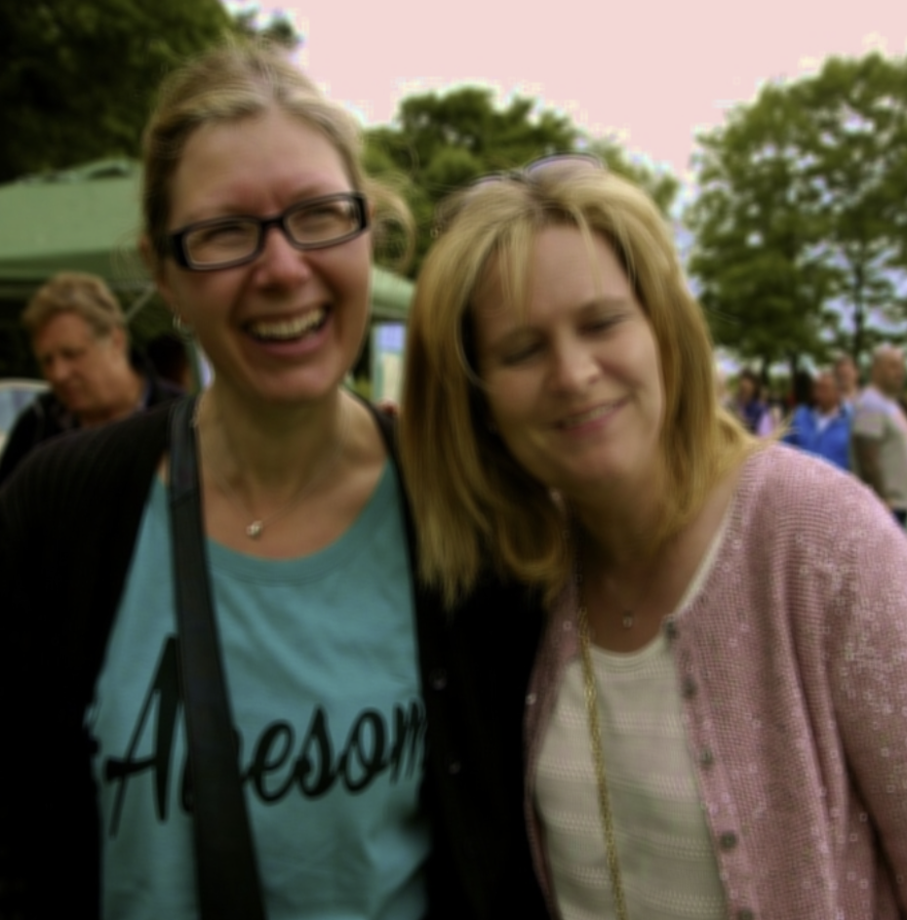
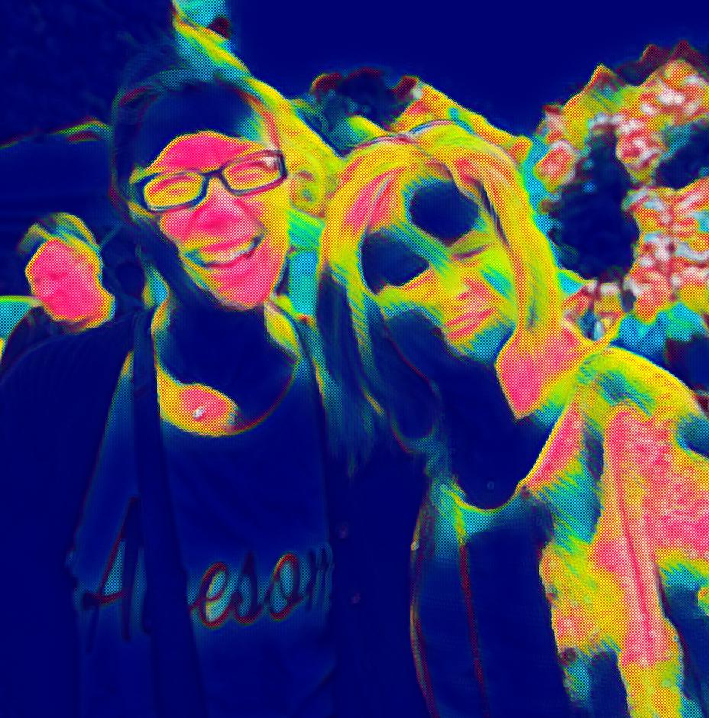
Interpret & Present Results
This image is
GENERATED
Answered with:
59% Confidence
Notes:
Ashton

Slide 13
Requirements
Requirement | Metric | Target Value,​ Range, or pass fail | Justification
Runtime | Seconds/pixel² | Normalized ratio (1500 ms / 1K x1K) | Achieve a balance in computational efficiency and complexity
Unbiased & Diverse Dataset | Demographic Parity Ratio | Between 0.8 and 1.0 | Avoid skewed and inaccurate outputs for broader applicability
Performance Accuracy | Accuracy | 95% | Perform on par with current algorithms
Load Performance | Seconds/pixel² | Normalized ratio (1500 ms / 1K x1K) | Ensure system can handle and process data efficiently
Train Time | Hours | 48 hours | Faster train time allows for increase in development
Notes:
Zac

Slide 14
Constraints
Constraint | Metric | Target Value,​ Range, or pass fail | Justification
Deepfake Ethics/Consent | Consent Rate/Transparency | Pass/Fail | We want to comply with all legal standards
Computational Complexity | Big-O Notation, Processing Throughput | O(n log n) or better | Ensures efficient performance for real-time or near-real-time applications.
Open-source Resources/Datasets | % Data Source from open-source repositories | Pass/Fail | Ensure dataset compliance with research standards
Explainability | AUC Score | Pass/Fail ≤85% | High AUC ensures explainability in model decision-making
Dataset Availability | % of Dataset Publicly Accessible | Pass/Fail | Encourages transparency and reproducibility in research.
Notes:
Zac

Slide 15
Design Plan
DATASET RESEARCH & SPECIFICATION
DATASET EXTRACTION & COLLECTION
I/O SETUP
IMAGE PROCESSING
MACHINE LEARNING TRAINING
MACHINE LEARNING REVISION
INTERFACE DESIGN & OPTIMIZATION
Notes:
Zac

Slide 16
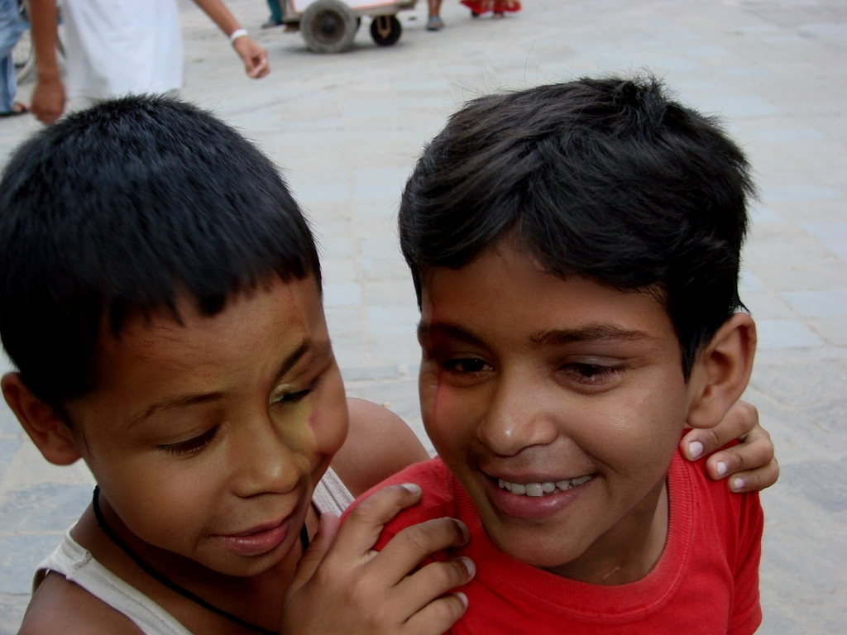
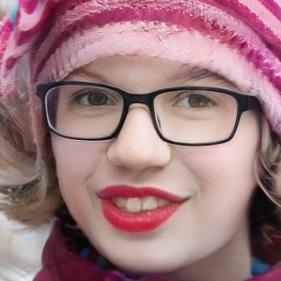
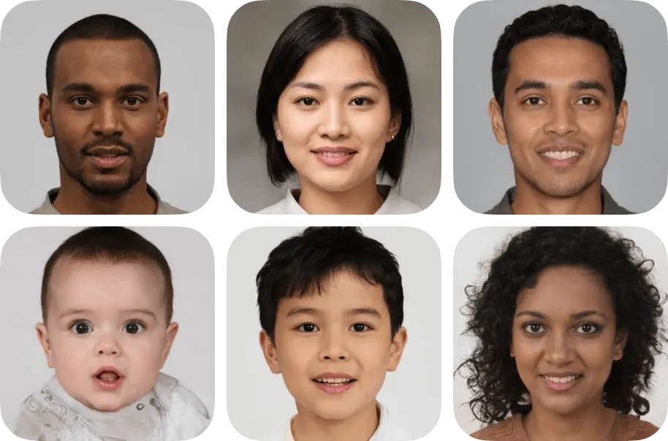
Dataset
DataSet | Number of Real | Number of Fake | Source | Fake Method
OpenForensics | 45473 | 70325 | Google Images | GAN
DFFD | 58703 | 240336 | Celebrity Images | FaceForensics++
Generated Photos | 0 | 10000 | Synthetic | Proprietary Tools
OpenForensics
DFFD
Generated Photos
Notes:
Ashton

Slide 17
Models Used
Our baseline model
Random Forest
Xception
Dataset
Input
Decision Tree 1
Decision Tree 2
Decision Tree N
Depth-wise Convolution
Pointwise Convolution
Result 1
Result 2
Result N
Averaging
Final Result
Notes:
Ashton

Slide 18
GANT Milestones
Milestones | Sprint 1 |  | Sprint 2 |  | Pres. 1 | Sprint 3 |  | Sprint 4 |  | Pres. 2 | Sprint 5 |  | Sprint 6 |  | Prototype Demo Prep / Final Pres
 | 13-Jan | 24-Jan | 27-Jan | 7-Feb | 15-Feb | 16-Feb | 1-Mar | 9-Mar | 22-Mar | 29-Mar | 30-Mar | 12-Apr | 13-Apr | 26-Apr | 17-Apr | 25-Apr | 2-May
Dataset Research
Dataset selection & extraction
I/O setup
Presentation 1
Recreate Opensource Results
Develop Model and Trainer
Develop Decoder
Presentation 2
Train Model
Design Frontend
Integrate Frontend
Extensive Testing
Prepare Prototype
Prepare Presentation
Notes:
Gant chart
Ashton

Slide 19
Test Plan
dataset 1
(evaluation)
Train Model
dataset 1
(training)
dataset 2
(evaluation)
Evaluate Model
Revise Model
Update:
Accuracy
Confidence Score
Confusion Matrix
dataset 1
(validation)
Notes:
Jouri

Slide 20
Team DeepTRUTH
Thanks you for your attention
Jouri Ghazi
Jahtega Djukpen
Ashton Bryant
Zacary Louis
Questions & Comments?

