Slide 1
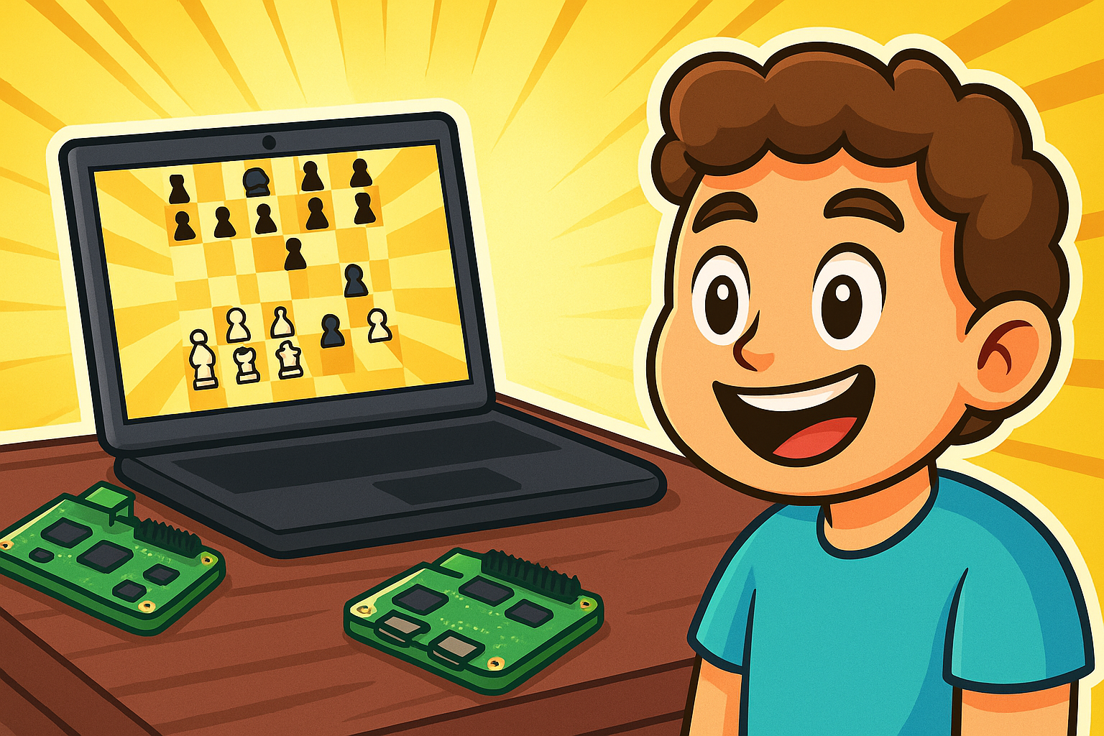
AI Chess on Raspberry Pi: Inspiring the Next Generation of Engineers
Notes:
Dylan

Slide 2
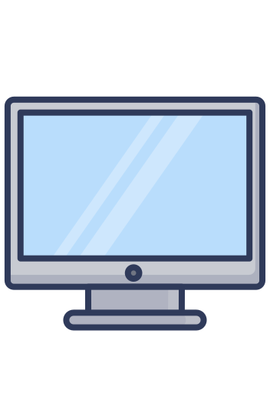
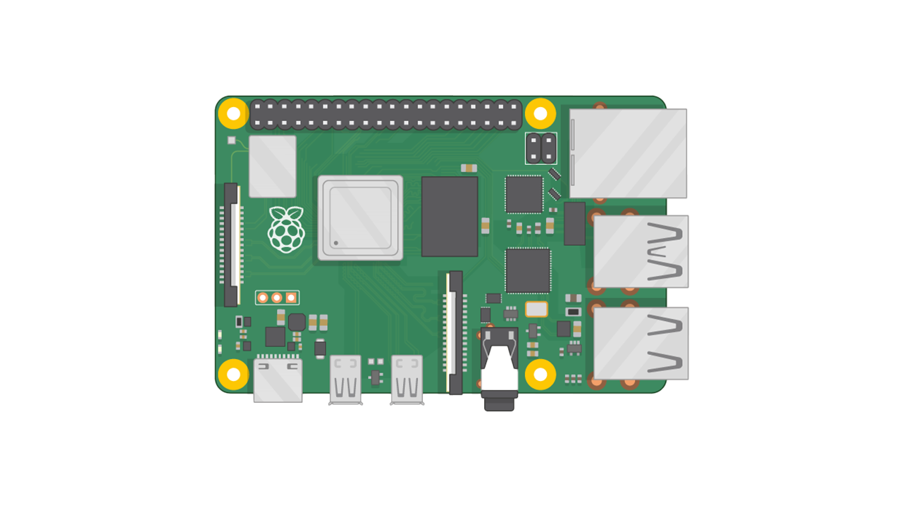
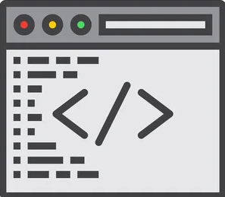


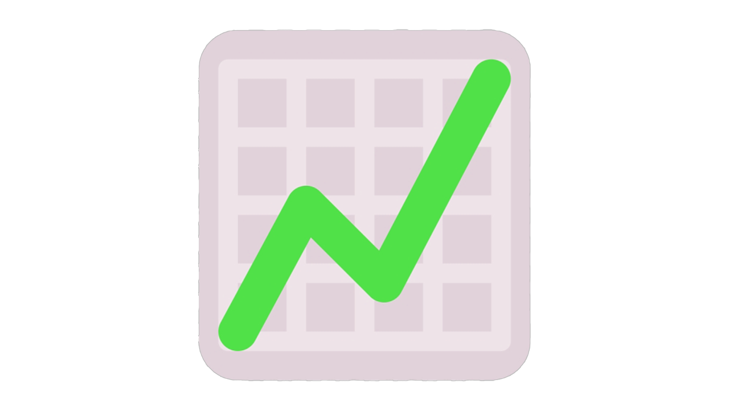
Our Project Aims to Inspire Upcoming students to pursue a career in Electrical & Computer Engineering
HARDWARE + SOFTWARE
High school Students should get excited about having the skillset of hardware and software. Not just software.
High school Students Obtaining Skills in both of these areas will open them up to more Job opportunities and areas of growth in the future
SOFTWARE
# of ECE Students (2022)
# of ECE Students (2027)
≈30
≈100+
(+233% increase)
Notes:
Dylan

Slide 3
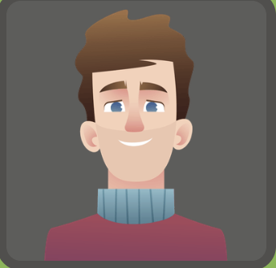




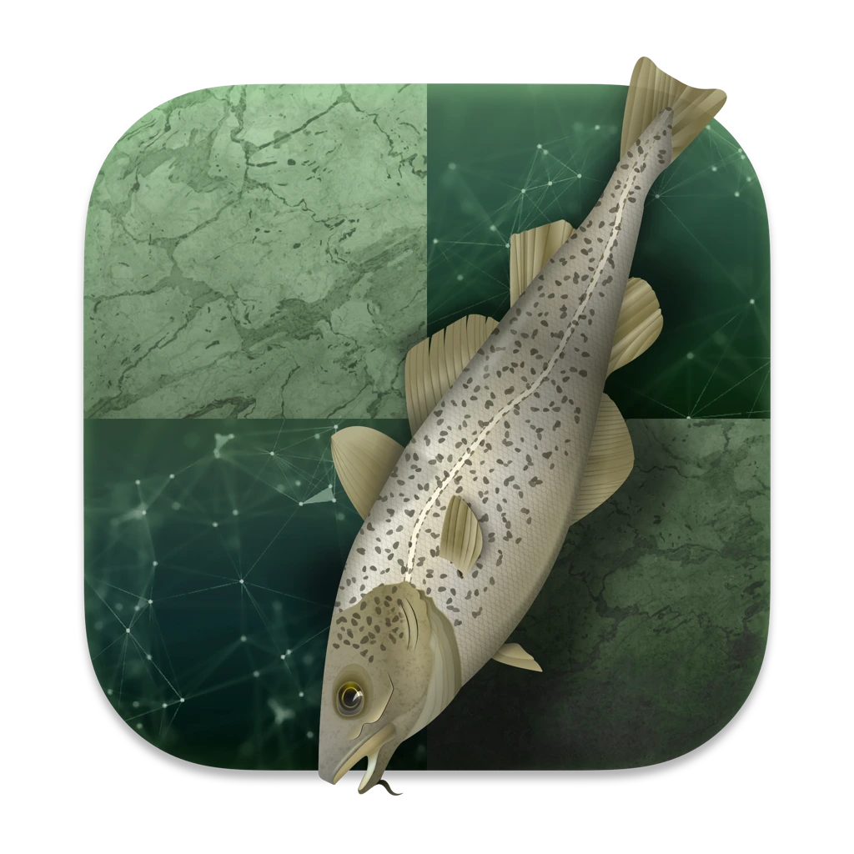

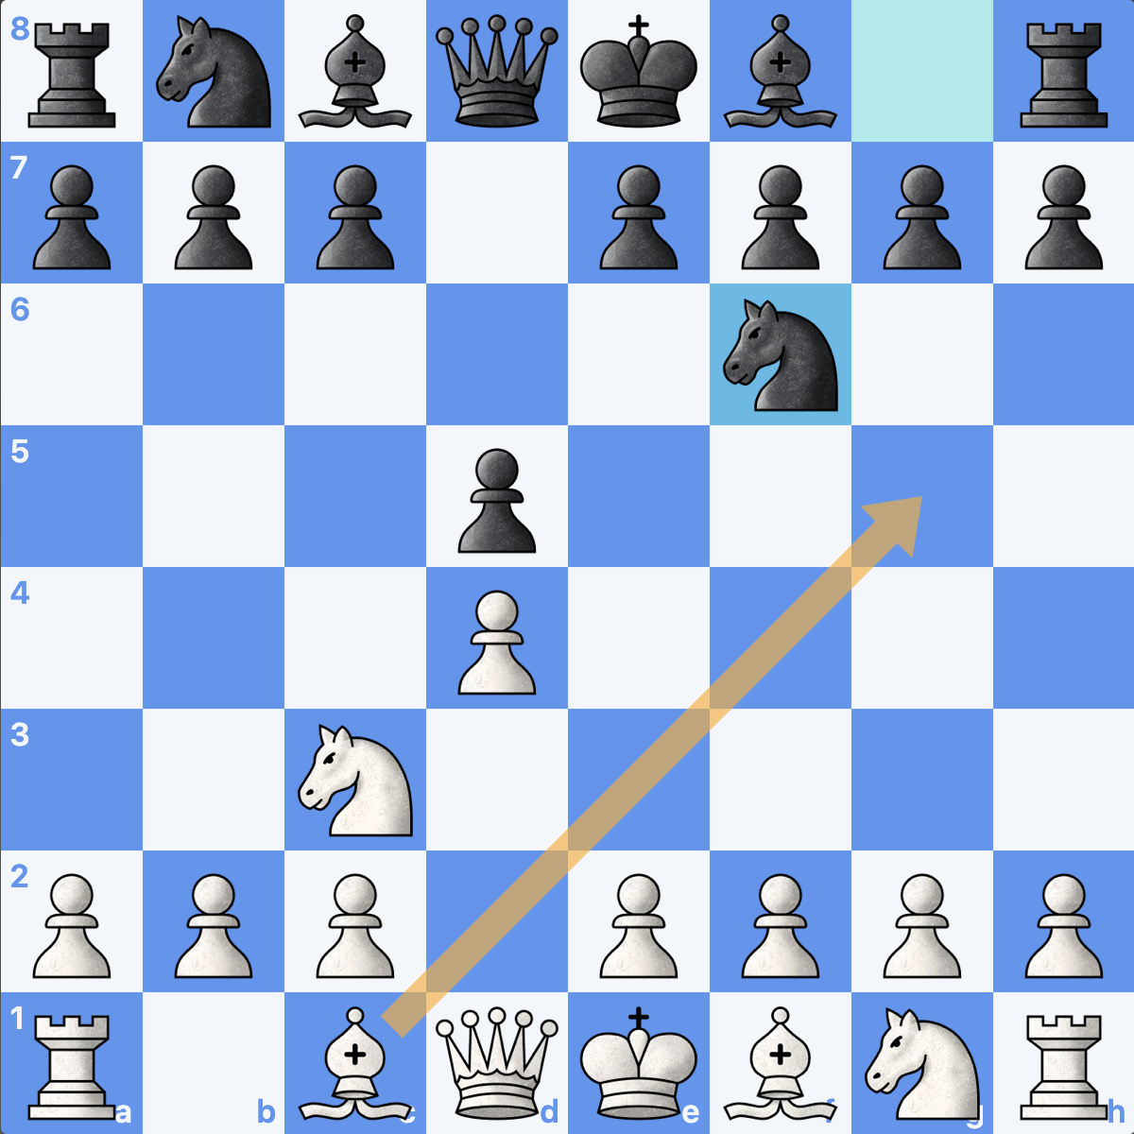



Our Solution to this Issue is to have Raspberry Pi’s play each other in chess
User interaction
START
STOP
Laptop / User Interface (GUI)
Output
Raspberry PI #1
Chess Engine / Ai Modeling
Raspberry PI #2 or USER
Communication / Networking
OR
Notes:
Dylan

Slide 4
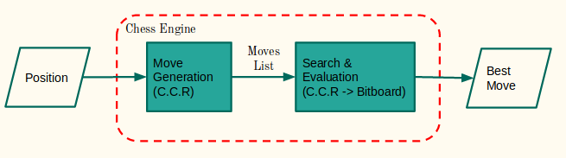
Brief Overview of Chess Engines
Produce a list of legal next moves
Evaluate each of those moves to find the optimal one
Repeat recursively to predict moves well in advance

Slide 5
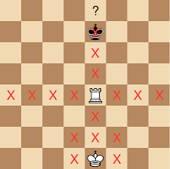
Chess Engine: Move Generation
We need to generate a list of VALID moves to evaluate
This component needs a thorough "understanding" of the rules of chess
Exhaustive search (or is it?)

Slide 6

Chess Engine: Move Evaluation
How likely is a given move to bring us toward checkmate? Need a way of ranking the possible moves
Two main ways of evaluating moves: minimize loss or maximize gains?
We call this minimax evaulation

Slide 7



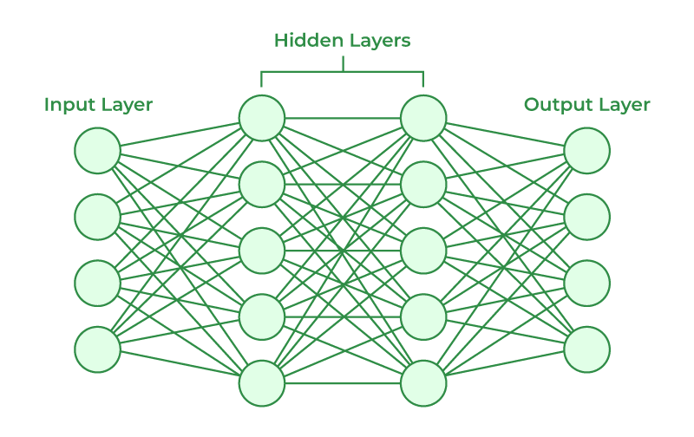
Stockfish
Fast, efficient, and powerful
NNUE neural network architecture
Winner of the Top Chess Engine Championship
UCI interface
Notes:
Shane

Slide 8
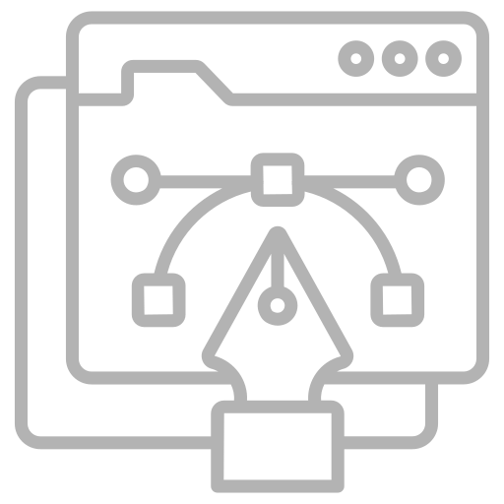


Design Requirements
User Interface
Customizable
Portability and Longevity
Notes:
Sam
Our Design Requirements can be broken down into 3 categories:
Our Design must include some kind of User Interface; this allows one to actively interact and modify the chess engine via a GUI.
Our Design must be customizable, this in regard to two factors: Both in difficulty and speed. The user must be able to change the difficulty of game, as well as the Speed at which the games are played at
Our Design must be Portable and work long-term. Languages used must not be prone to version control issues. Device portability also works in two aspects: physically moving this device around, as well as not relying on exclusive external connections

Slide 9
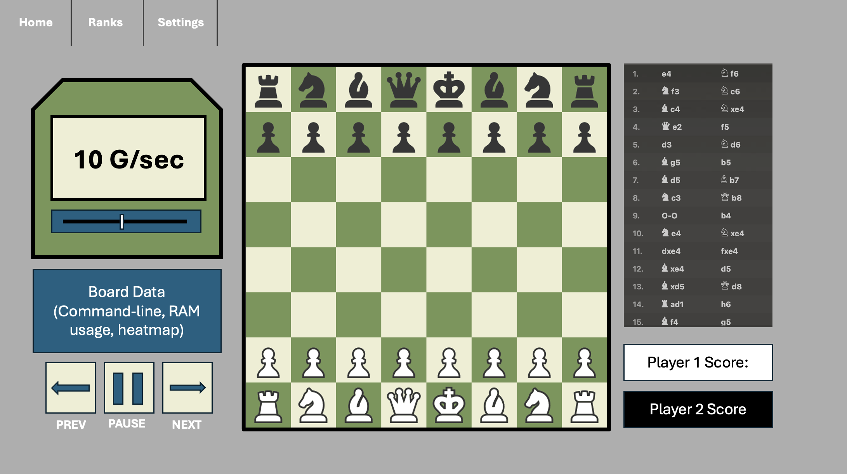
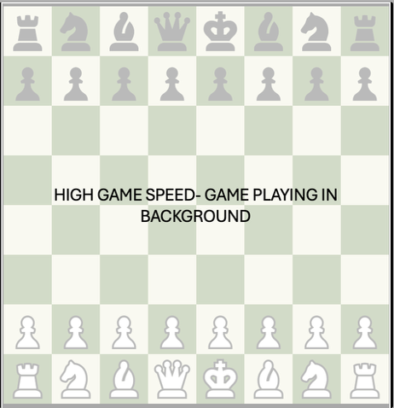
Include UI to interact with Game
Notes:
Zephan

Slide 10
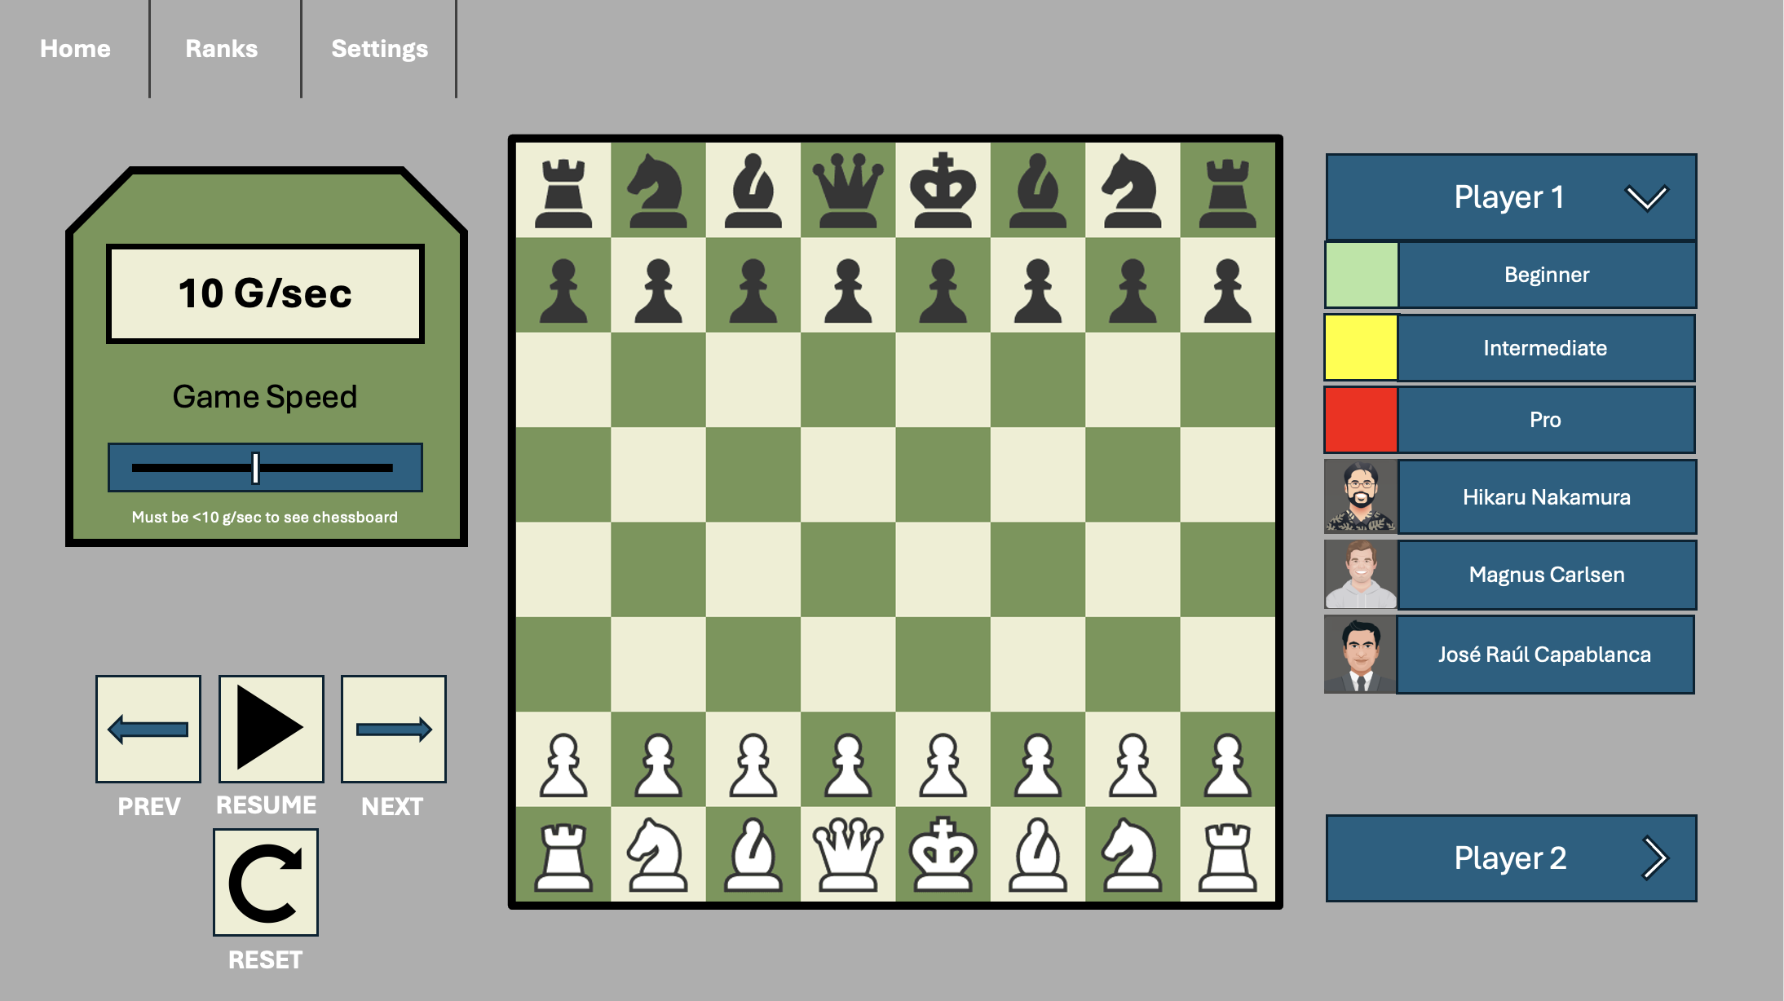
Ability to Change Complexity
Notes:
Zephan

Slide 11


Portability and Longevity
Compatible; Version adjustments not required
Not compatible; version adjustments may be required
Notes:
Dylan

Slide 12
Design Constraints
Board Specs
Programming Language
Networking
Notes:
Zephan

Slide 13
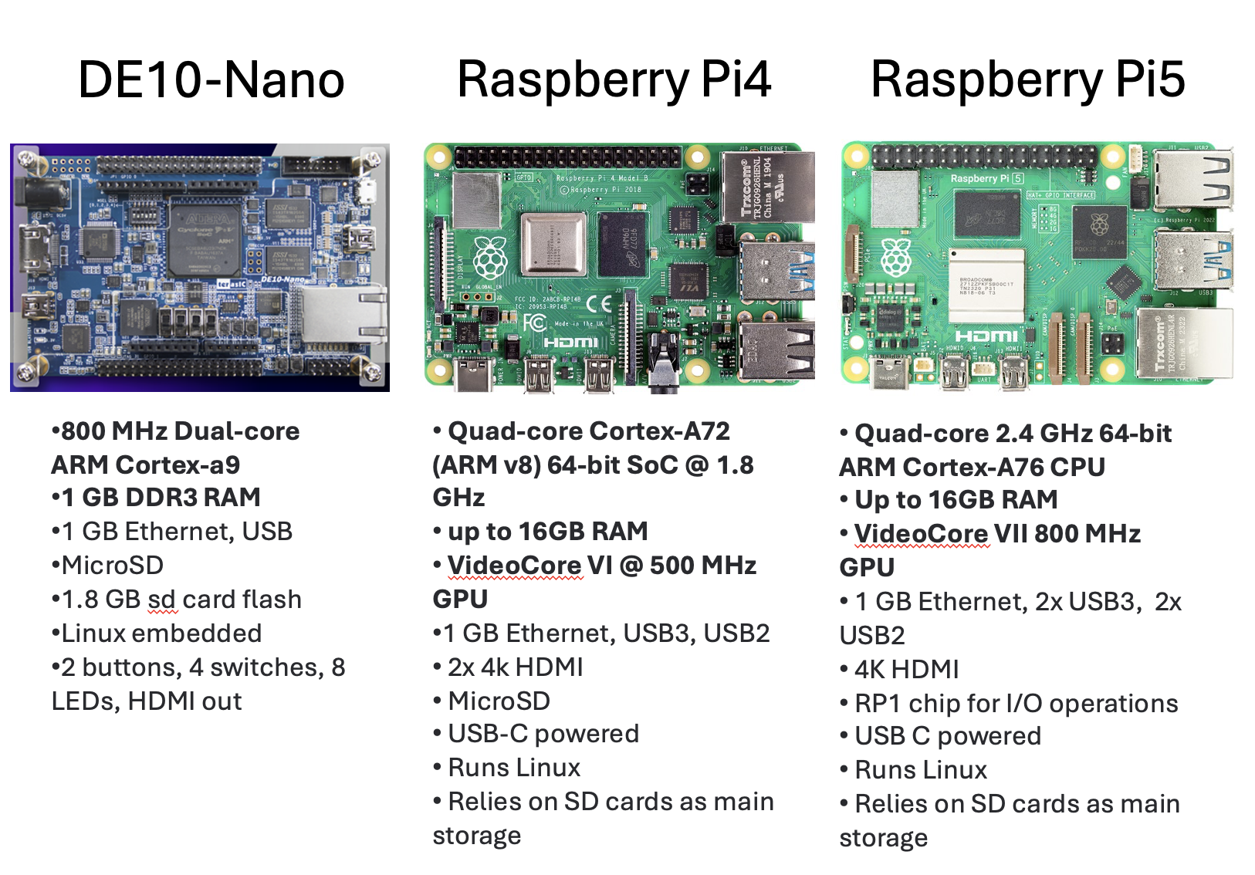
Design must work within specifications of Raspberry PI 4
Notes:
Zephan
Why stop FPGA

Slide 14



Must use universal programming language for the GUI
Can Use:
Can’t Use:
Notes:
Dylan

Slide 15

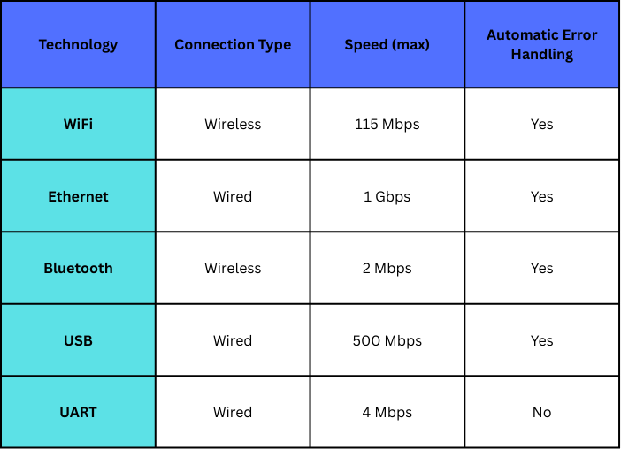


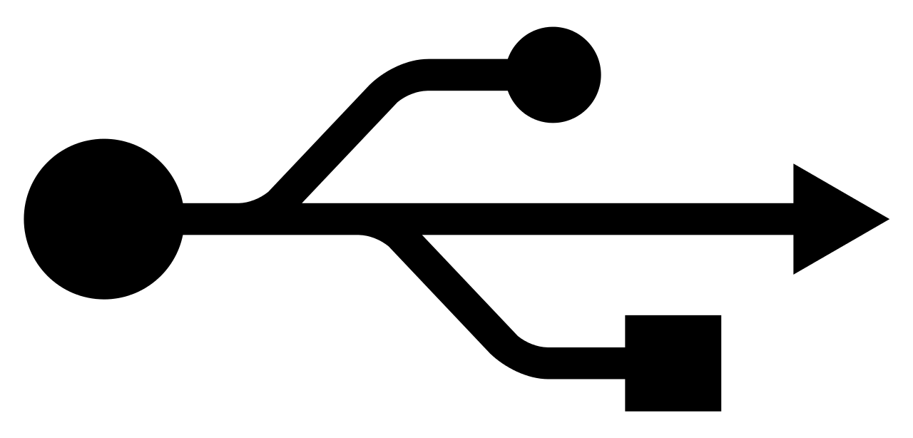
Board-to-Board Communications
Notes:
Shane
Table on Network Spec

Slide 16


USB Gadget Framework
Enables a USB device (i.e. Raspberry Pi) to take on various USB device roles
Mass storage
Ethernet
Human Interface Device

Slide 17
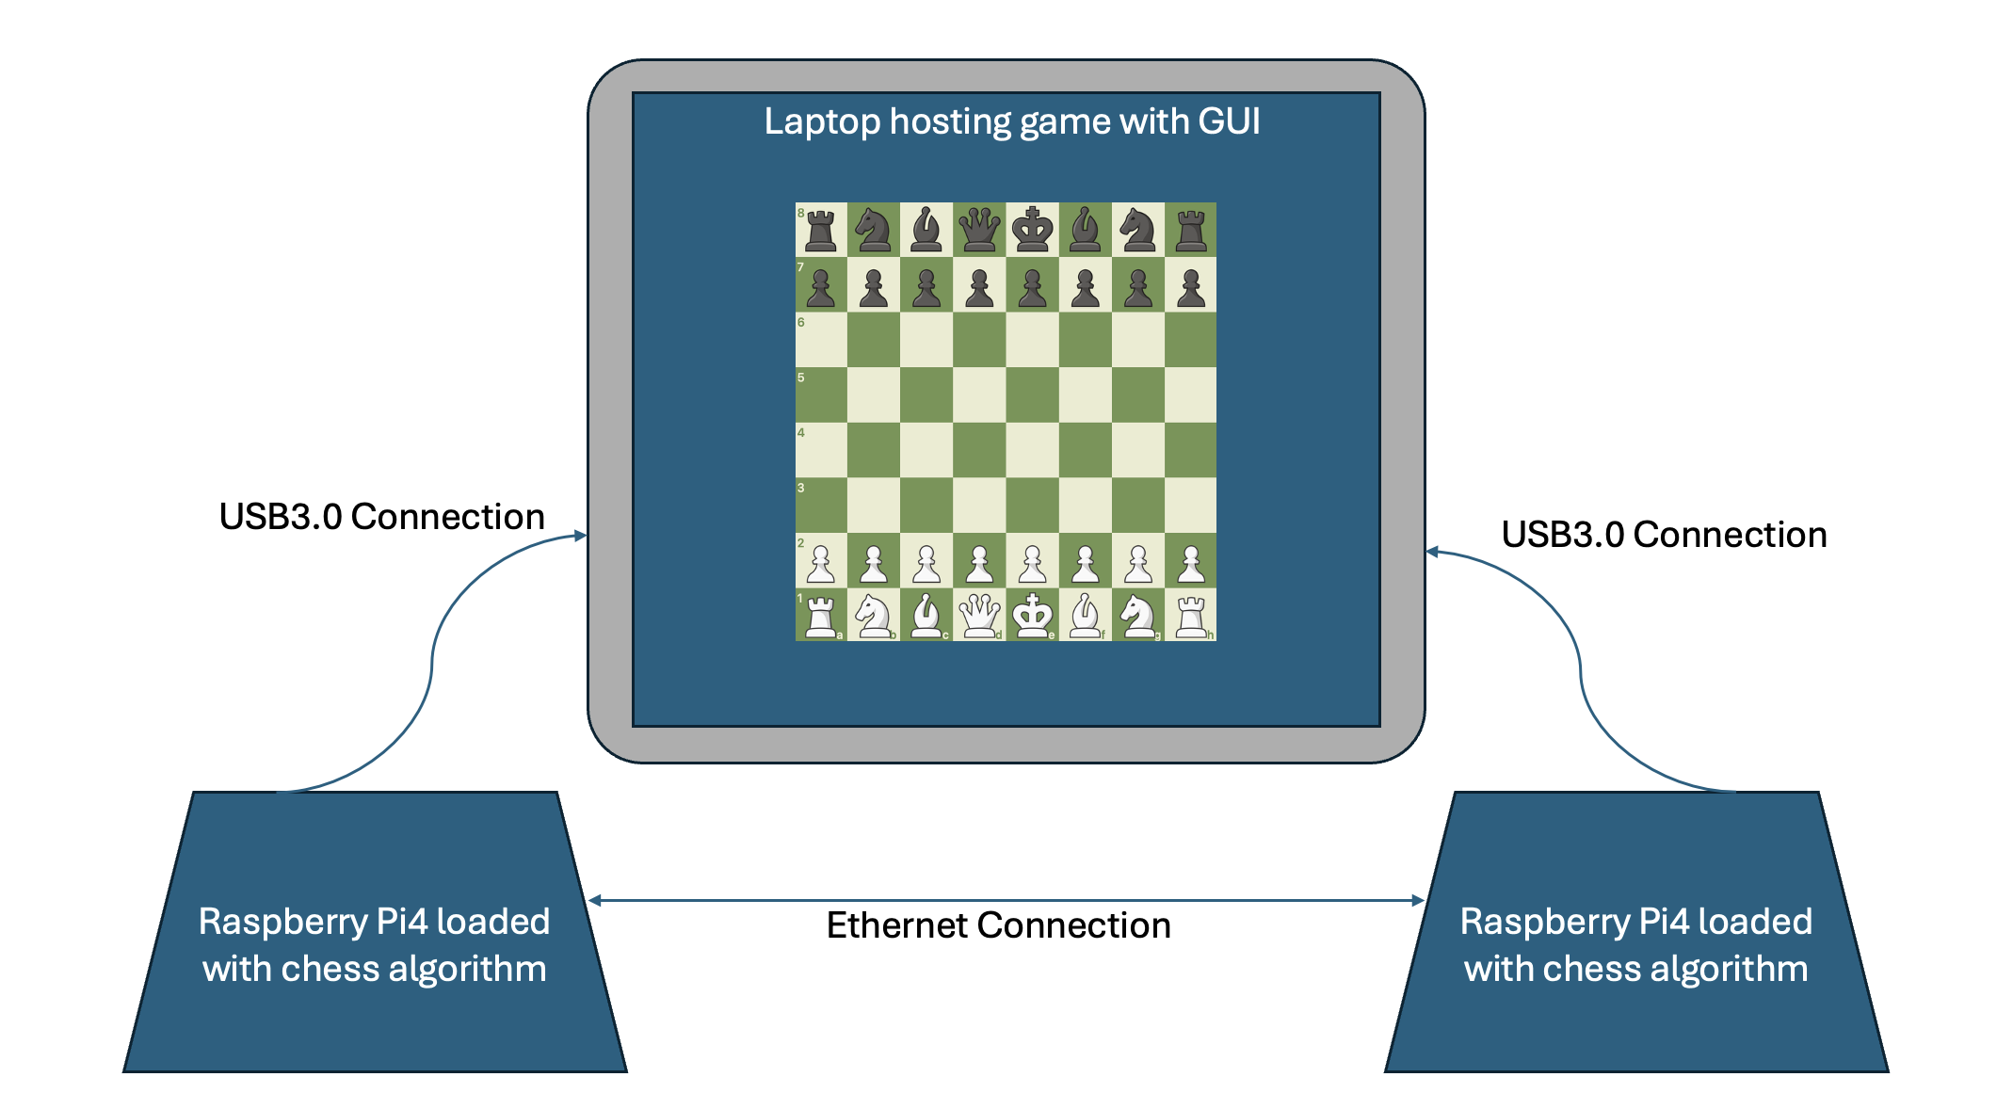
High Level Front-End (Design Plan)
Notes:
Sam
For our high level design. We wanted to imagine what it would like for a high schooler to walk in and see our design. The perspective they would see would like this diagram:
We will have Raspberry Pies placed on a table across from each other. Both connected to some kind of monitor that will display our GUI system. On the outside, it would look quite simple

Slide 18
Simplified System Diagram

Slide 19
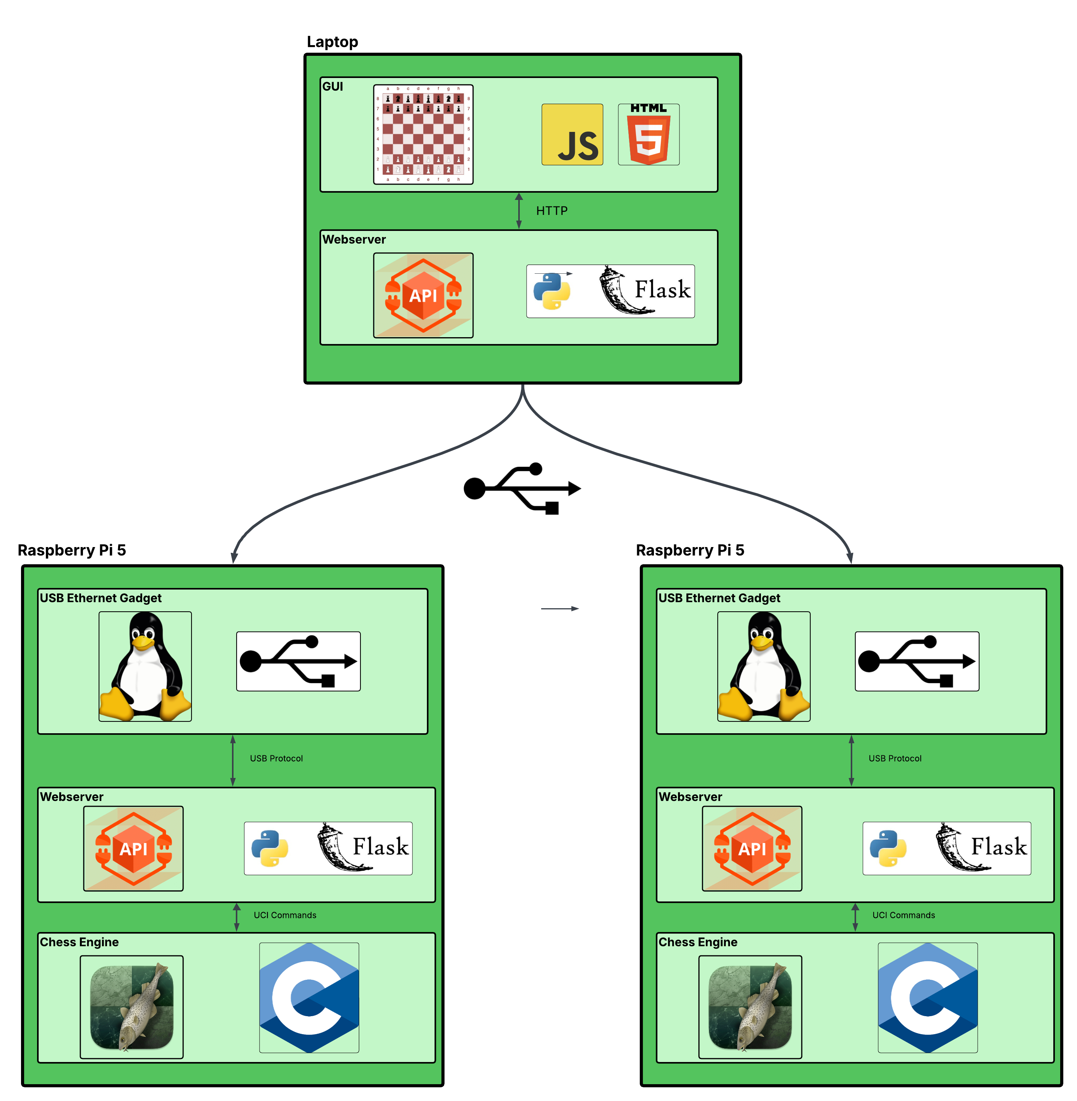

Slide 20
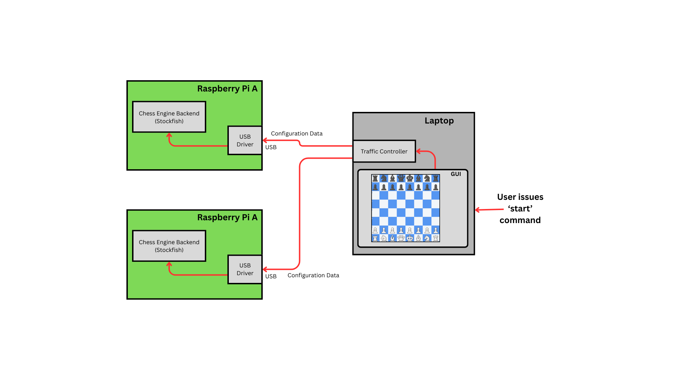
User begins game, laptop configures boards

Slide 21
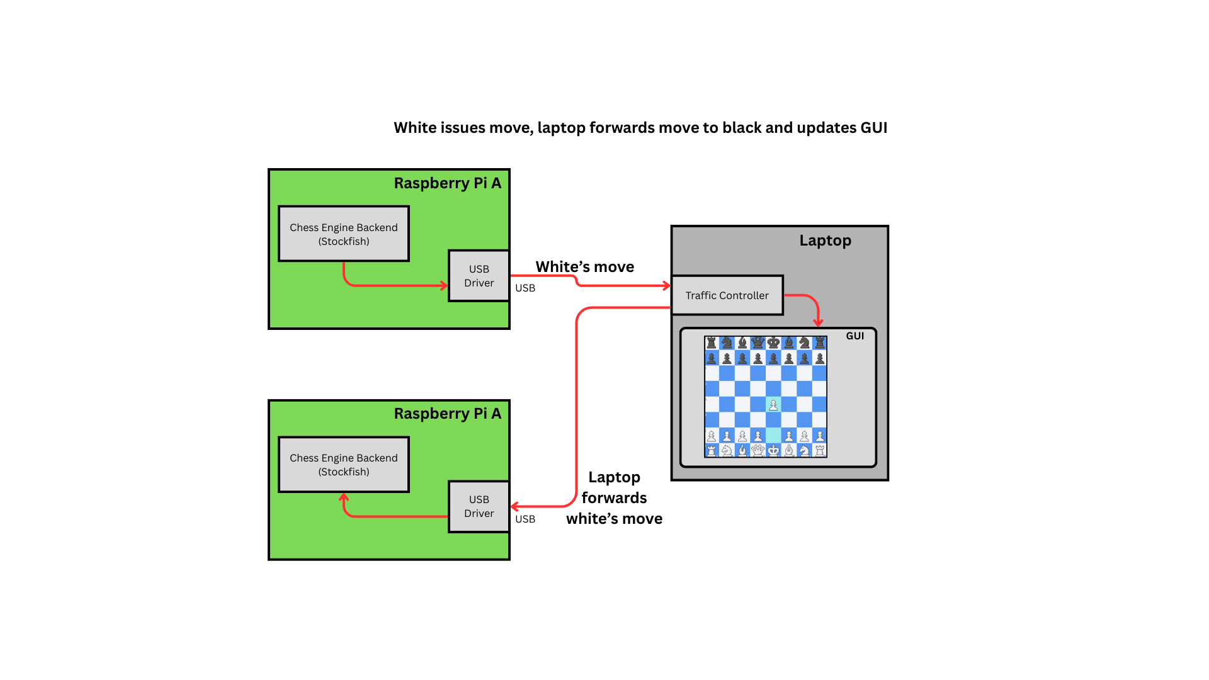

Slide 22
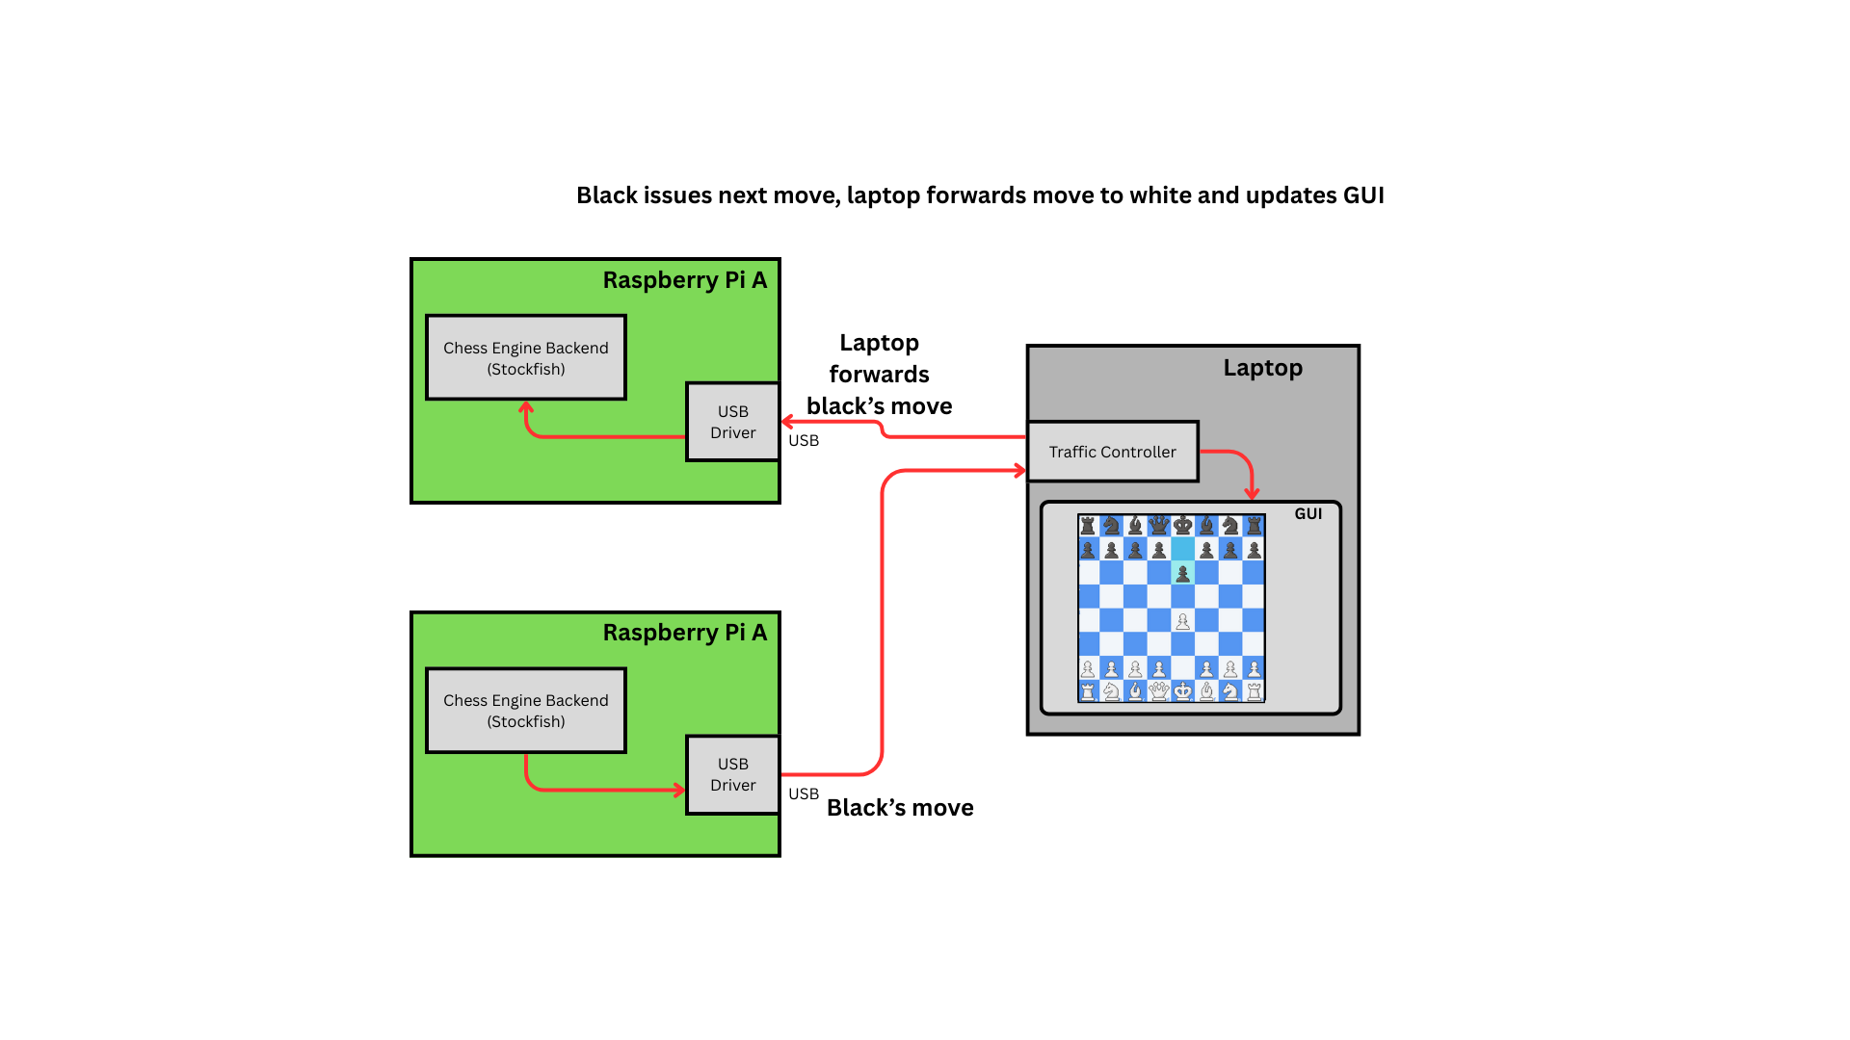

Slide 23
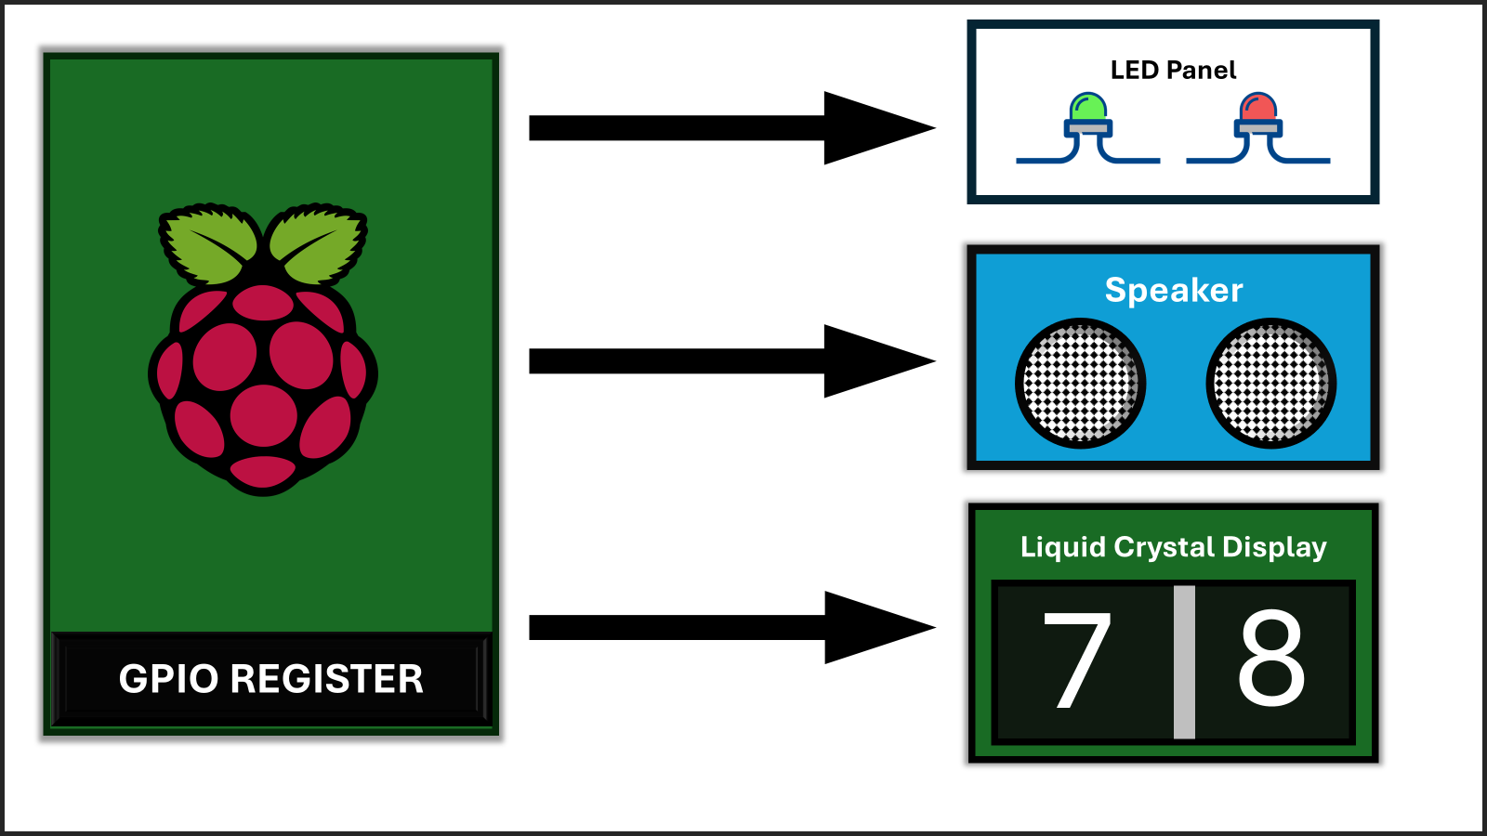
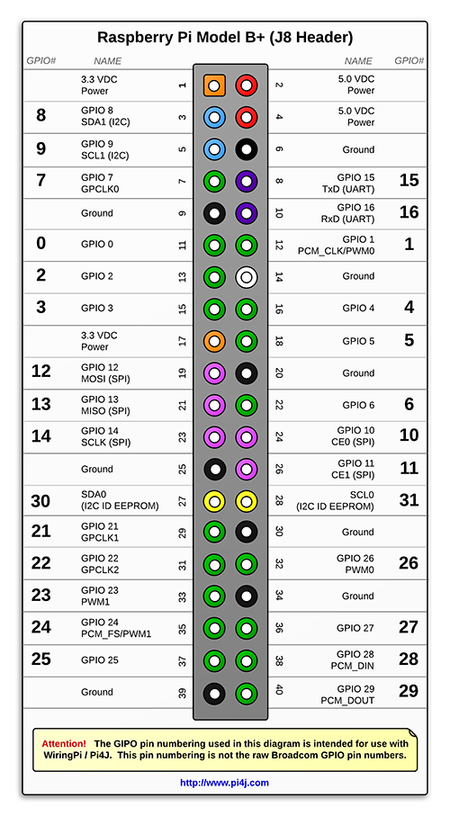
GPIO to include LED Panel, Speaker, & LCD
Notes:
Sam

Slide 24
Hierarchy of Testing
Transmit data with low latency
Speaker, LED, LCD all Responsive and accurate
Chess Engine
Data Comm
GUI
GPIO
Run diagnostics on # of Successful Moves
Low Latency: Accurate Response
Notes:
Sam

Slide 25
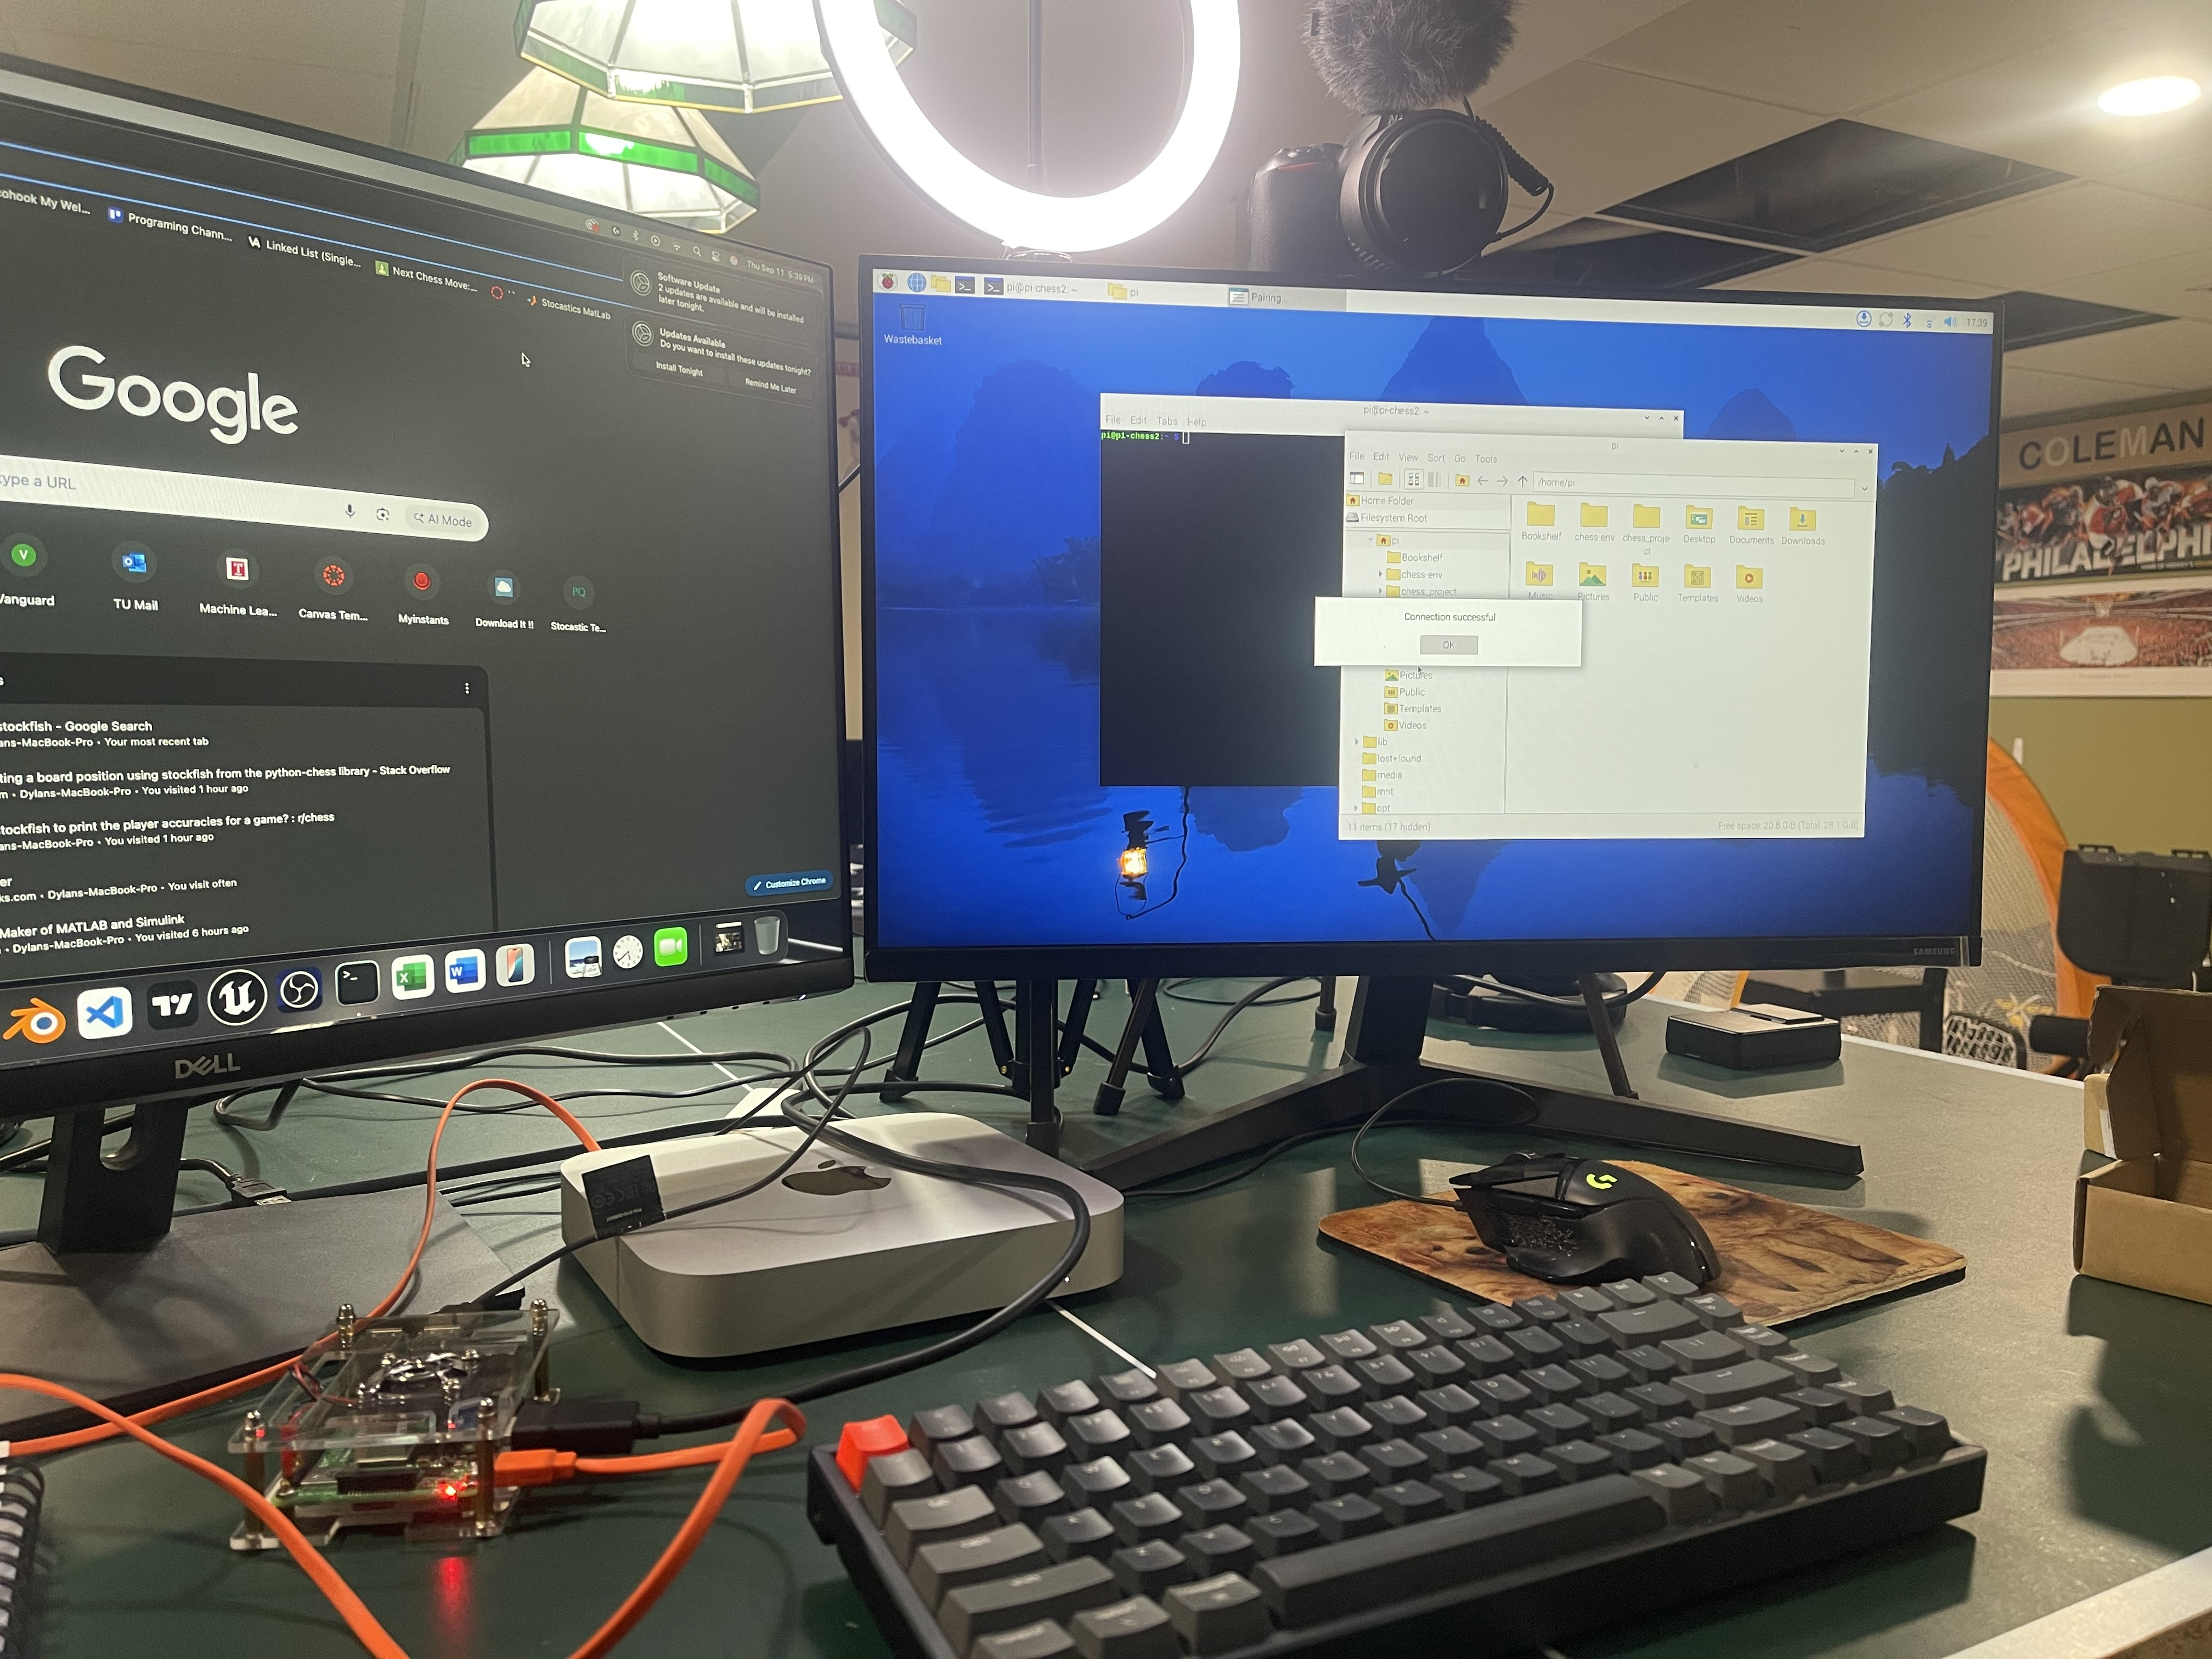
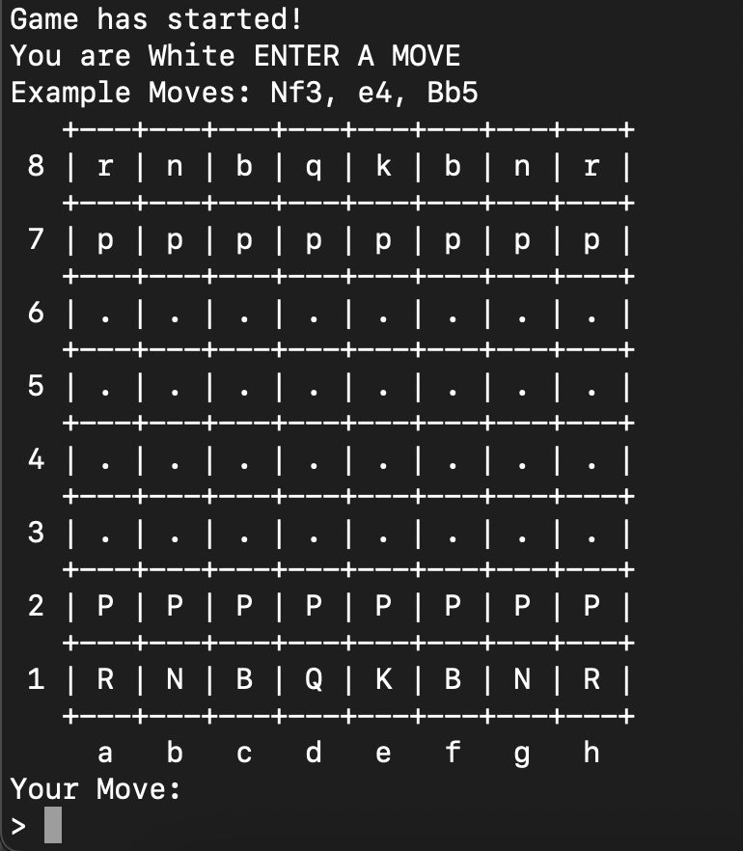
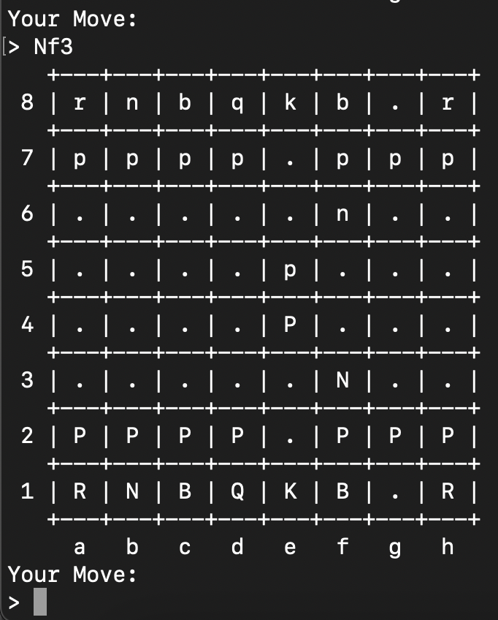
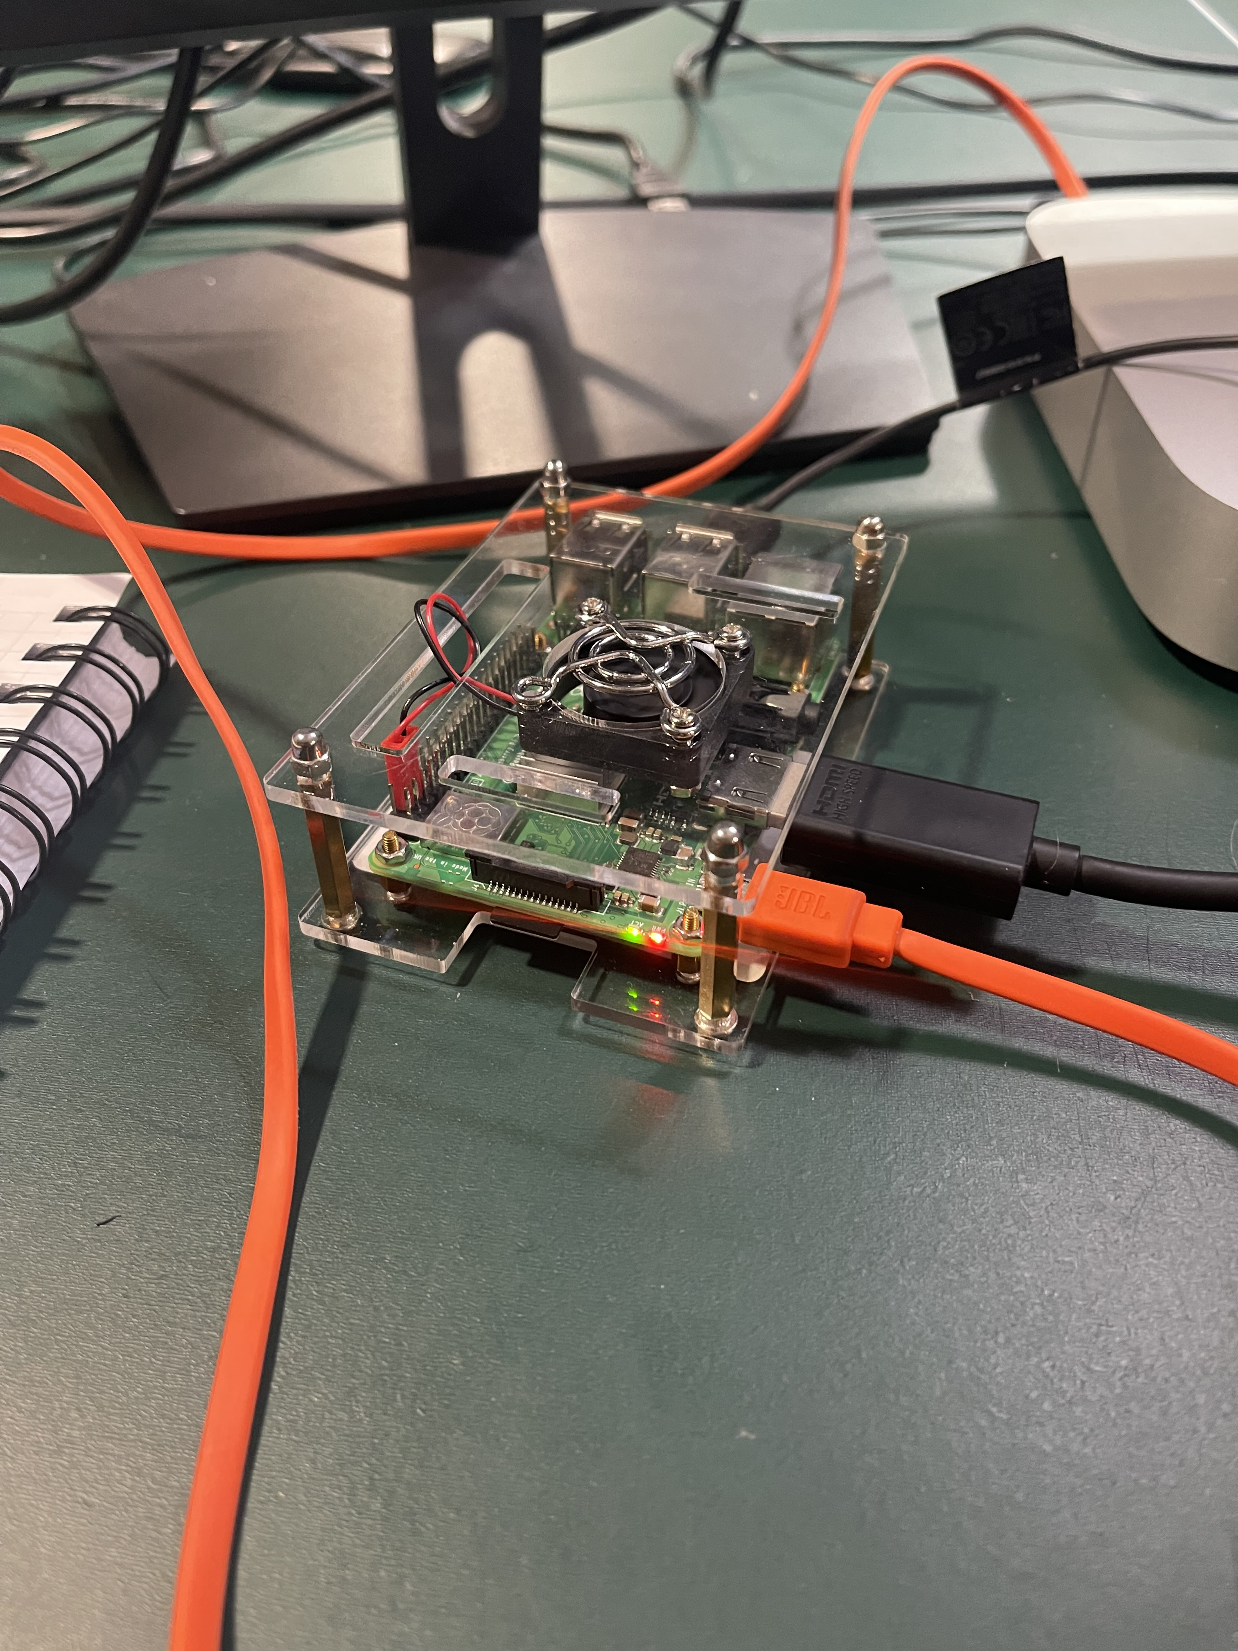
Current Testing
Notes:
Dylan

Slide 26
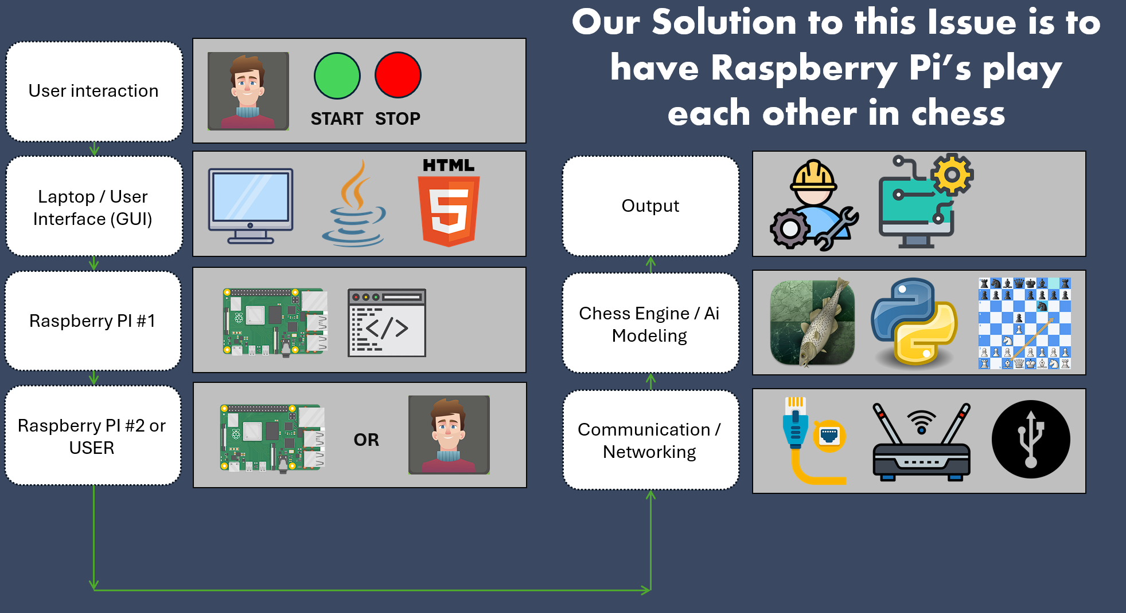
Questions?

