Slide 1

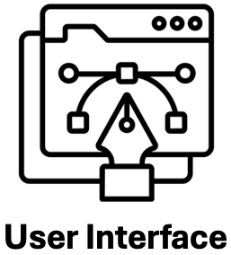
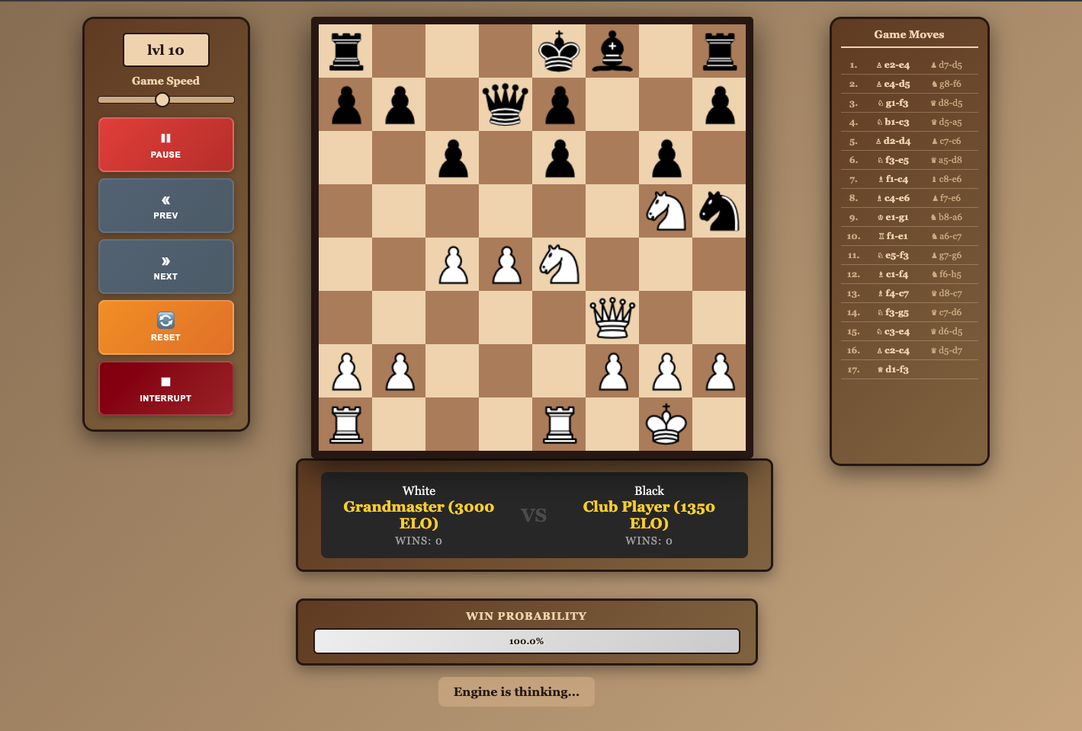
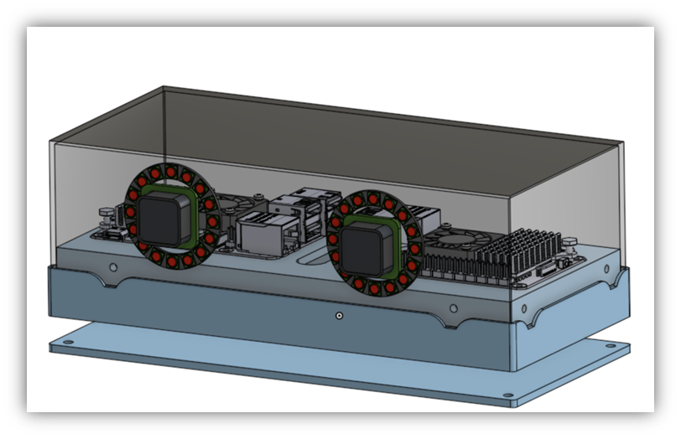



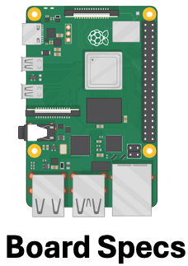
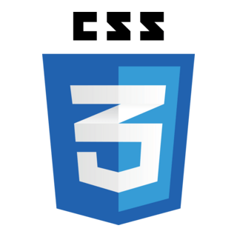
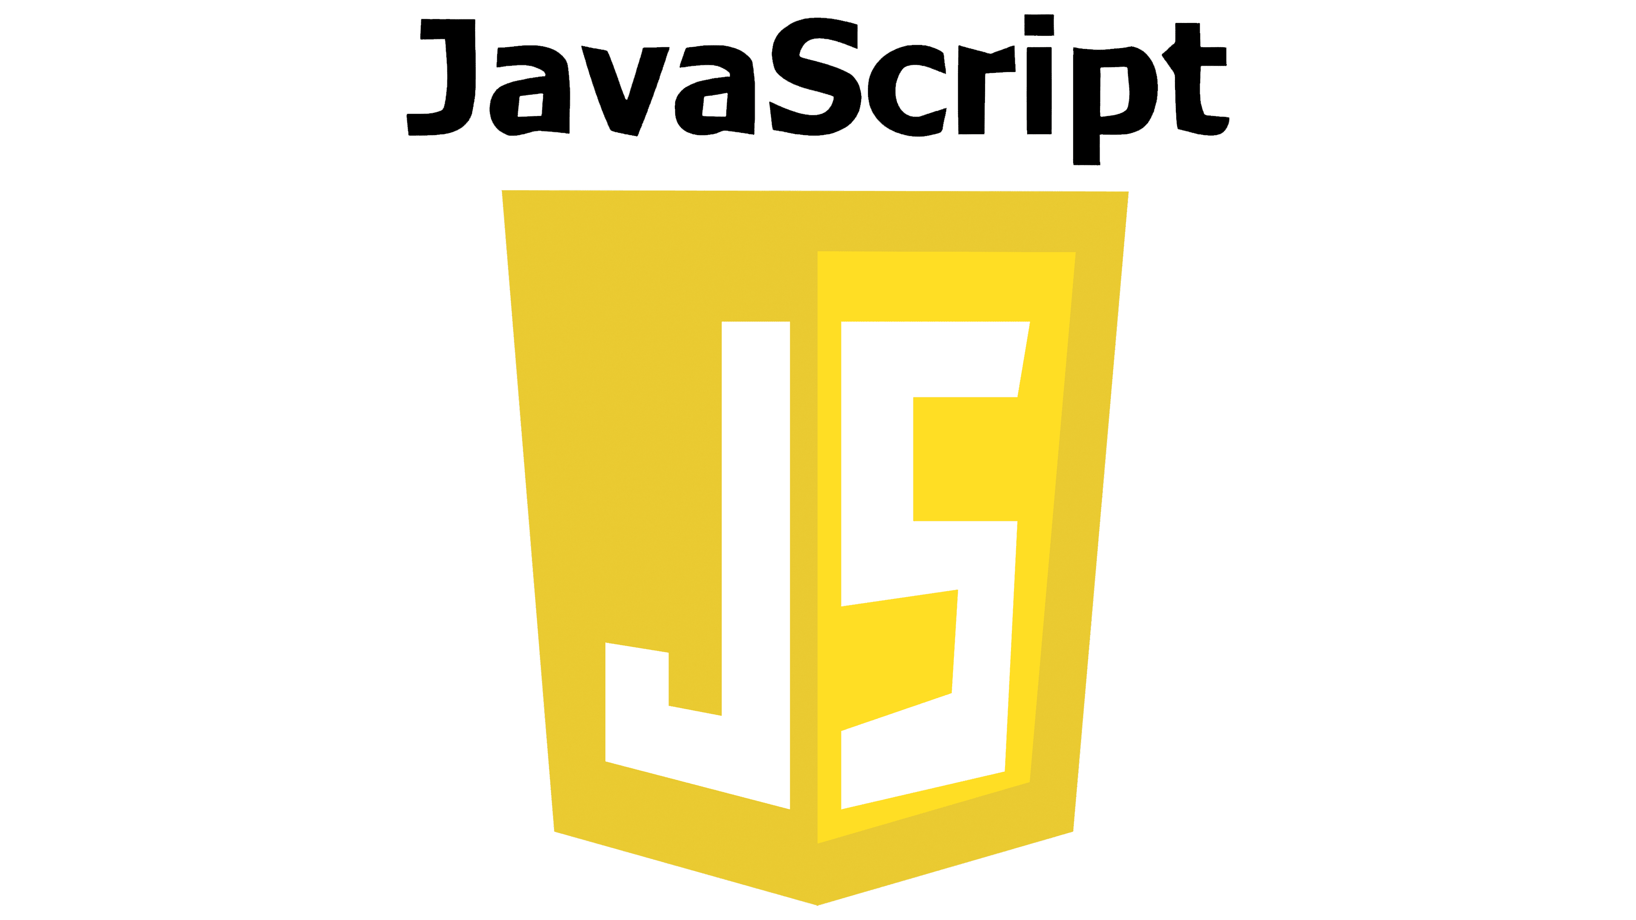

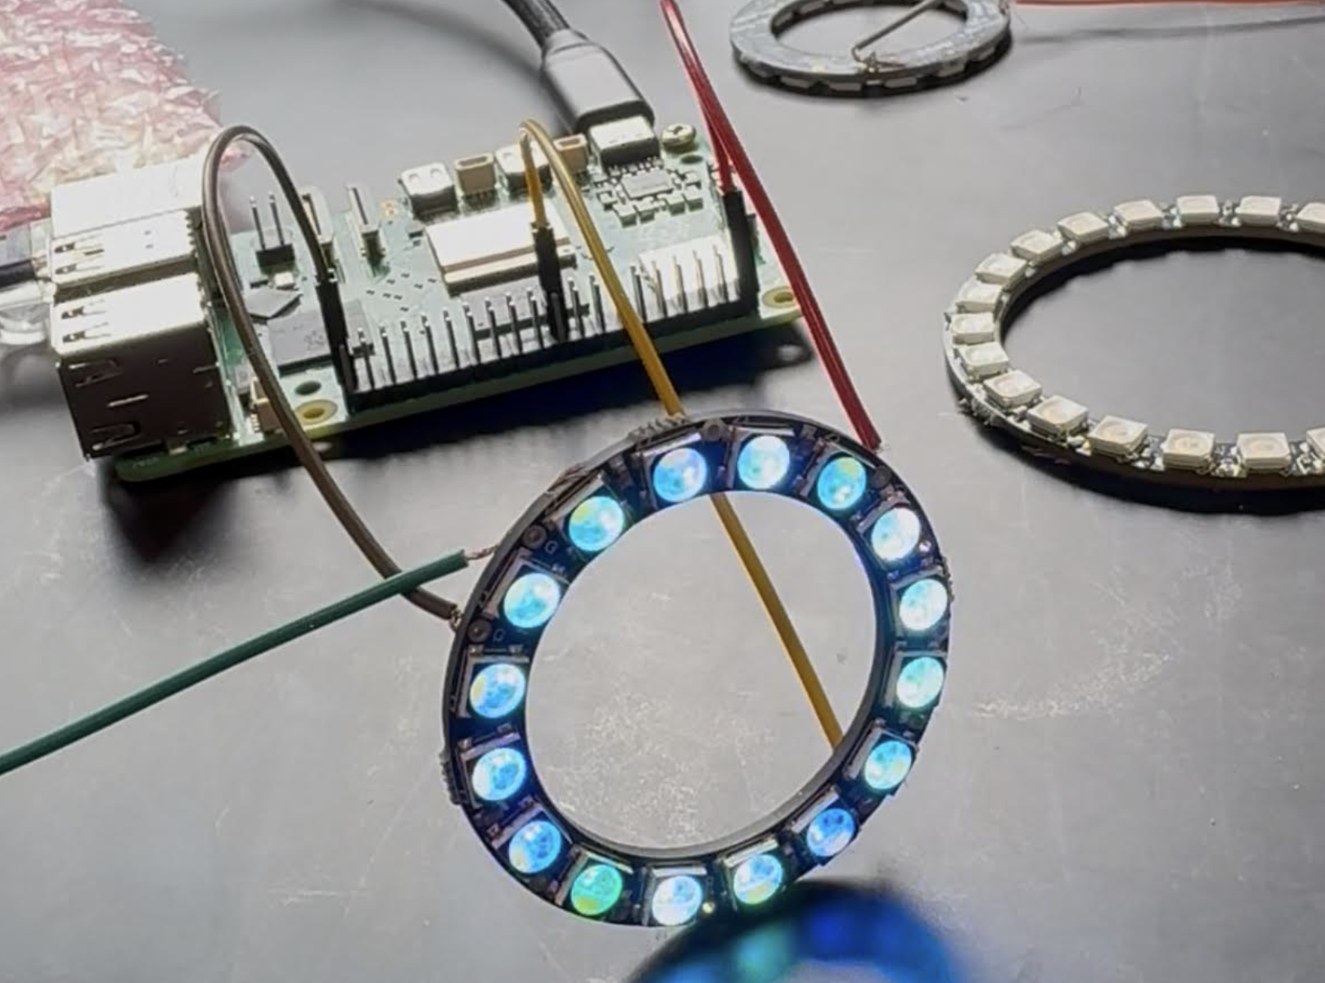
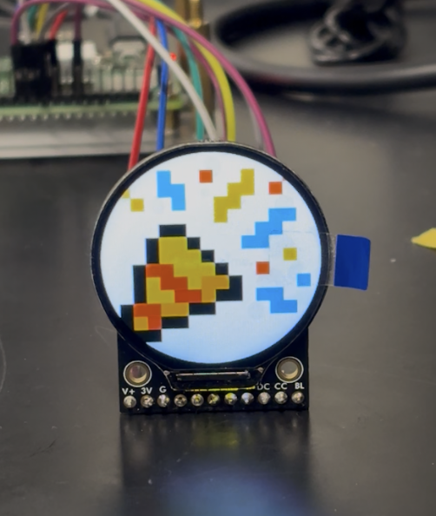

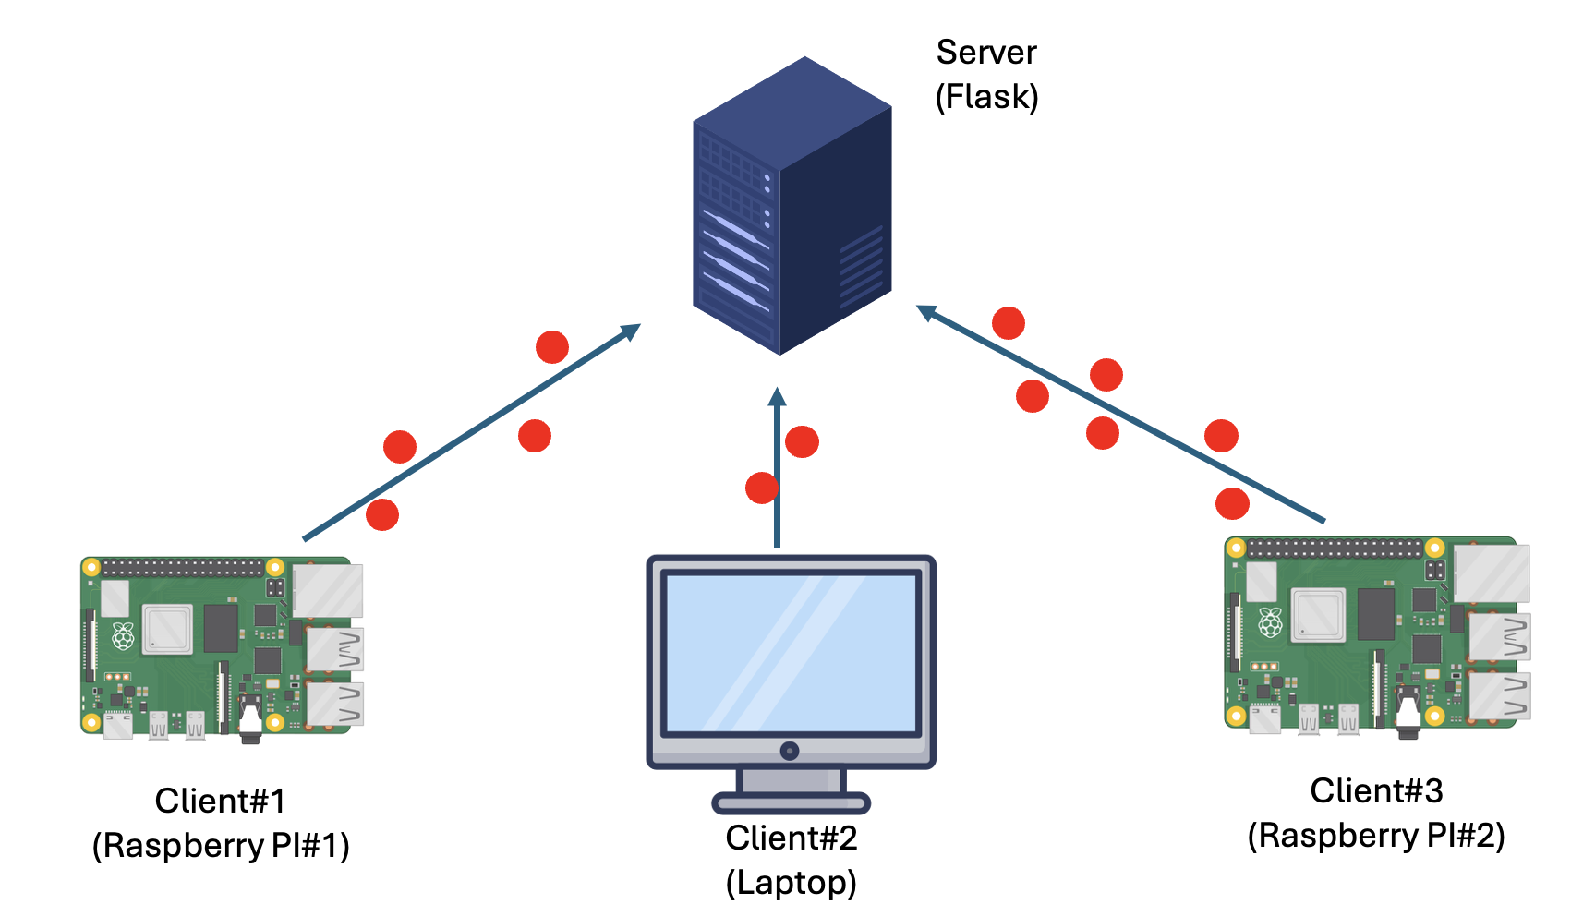
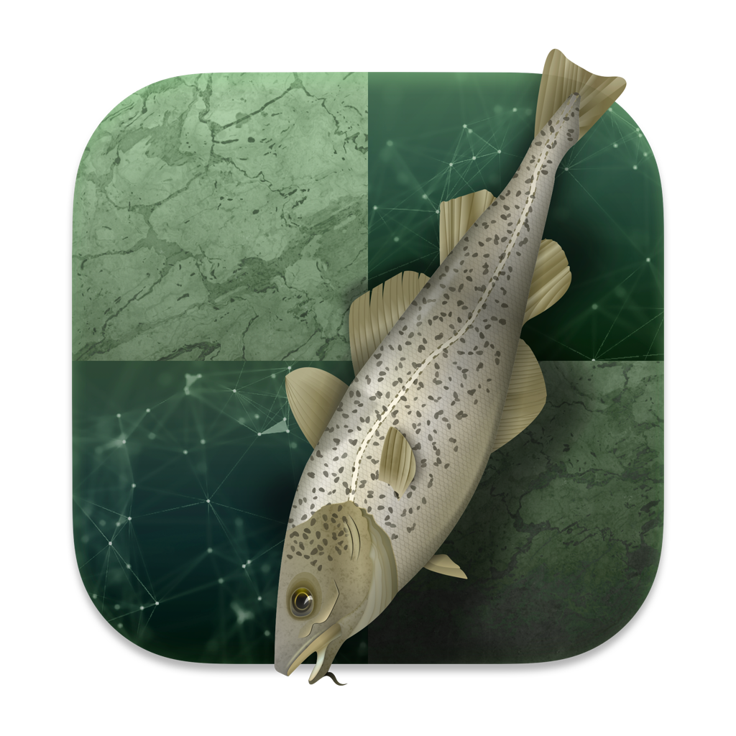
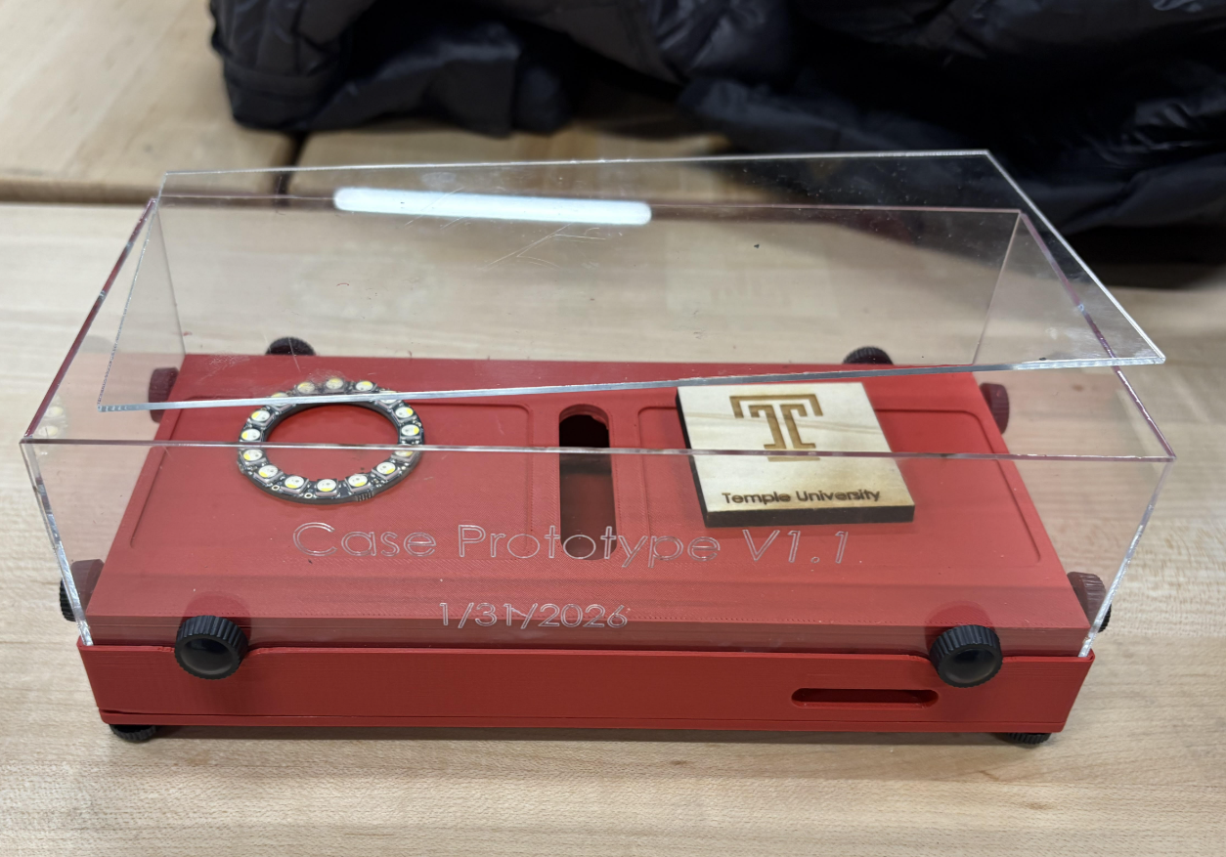
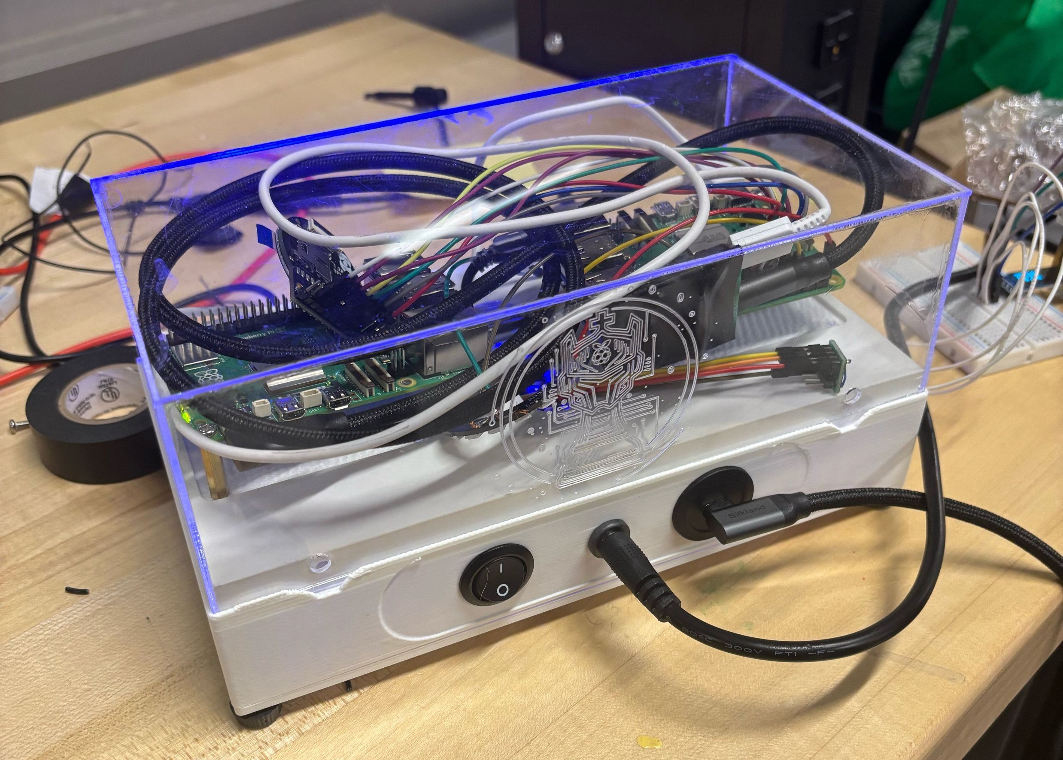
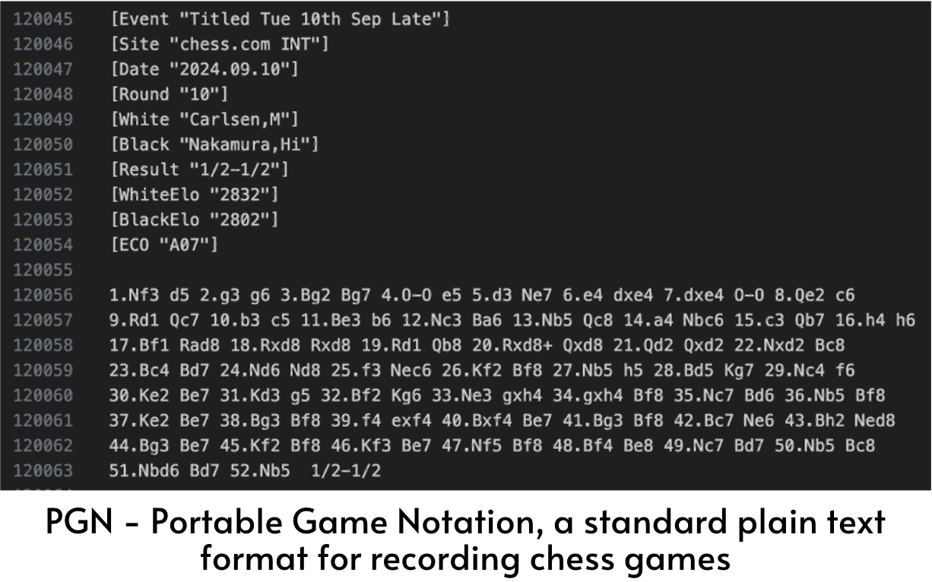
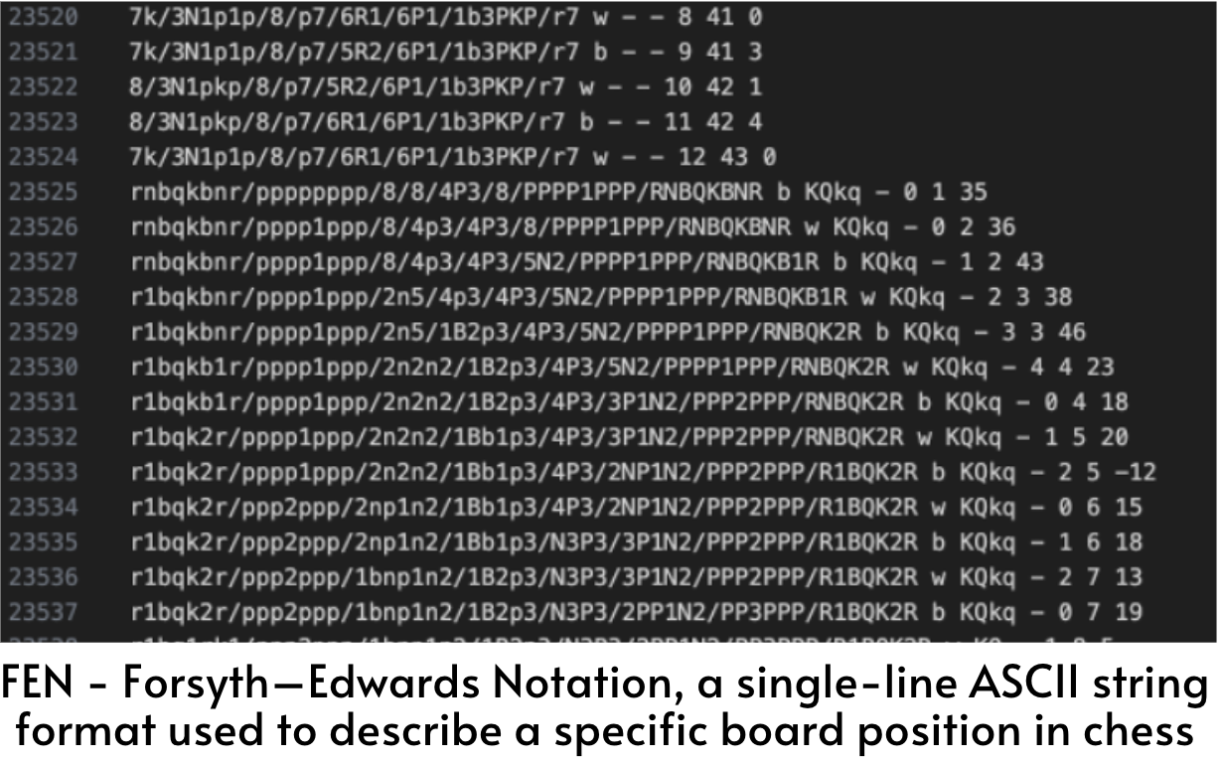
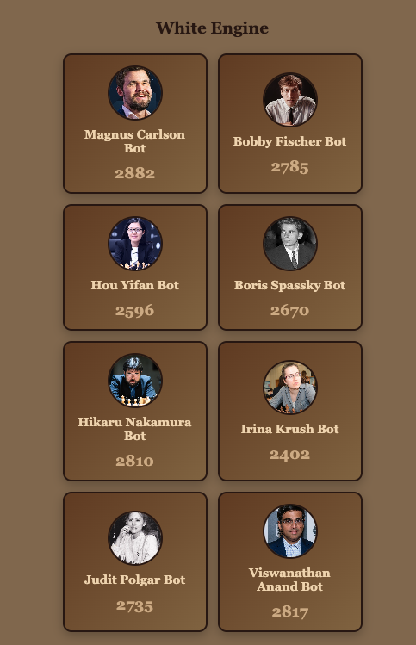
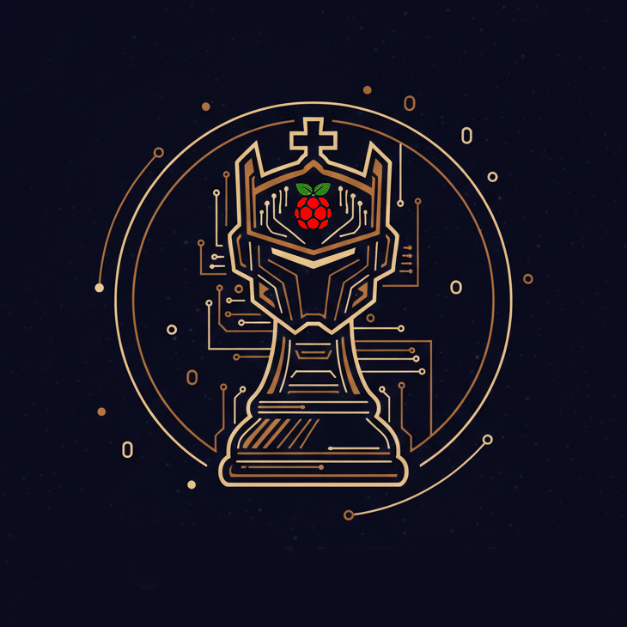
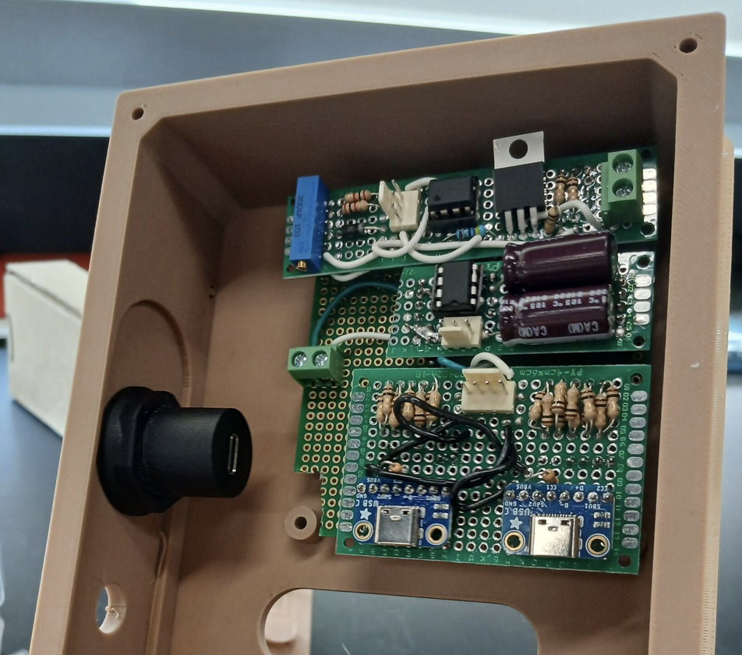
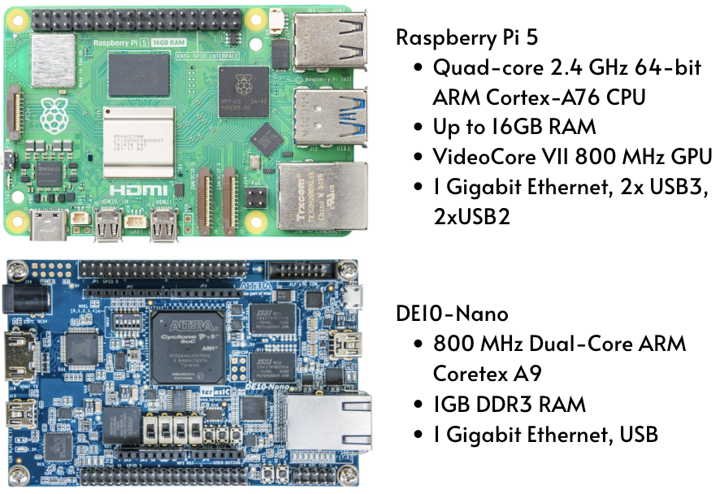
AI Chess: An Electrical and Computer Engineering Demo
Dylan Boles, Shane Mullin, Zephan Joseph, Samuel Georgi
Instructors: Dr. Brian Thomson & Dr. Maryam Alibeik | Advisor: Dr. Joseph Picone
Purpose
Over the past 20 years, applications to Computer Science (C.S.) programs have increased significantly, including a 25% rise in the last five years, while Computer Engineering (C.E.) programs have grown more modestly at approximately 15% during the same period (ASEE, 2021).
Meanwhile, C.E. remains comparatively lesser-known despite offering higher median salaries (Bureau of Labor Statistics, 2025), faster-than-average projected job growth, and career paths that integrate hardware, software, embedded systems, and AI.
There is a need to increase awareness of C.E as a dynamic, interdisciplinary field that bridges hardware design, embedded systems, machine learning, and more.
The purpose of this project is to address this awareness gap by developing a technical demonstration that highlights the many facets of C.E, uniquely illustrating a combination of artificial intelligence, embedded systems design, hardware interfacing, and system optimization.
Ultimately, this work aims to inspire greater interest in C.E. programs and contribute to a more balanced and diverse technical workforce.
Design Requirements
GUI Integration
Used Chess like design with CSS. Implementing User features like Probability, Game Moves, start stop and different game modes.
We implemented a tech stack using Python Flask for the base of the application and HTML, JavaScript and CSS as the framework.
Used HTTP Requests to allow the Raspberry Pis and Laptop to all send and get information from the Flask Server.
Additionally, we have 8 different Machine Learning bots that play like professional Chess players, as well as a Launchable app that allows faculty to download and run our program with the Pi 5s.
GPIO Usage and Case Manufacturing
Our final product needs to have a user interface that is easy to use and easy to understand.
The chess games should be easily customizable and interactive, with the user being able to vary game speed, difficulty, pause/play the game, and step through each move.
Our case must be portable, ideally being within range of 9”x5”x3.5” and equipped with thermal and overcurrent protection.
The software and specifically any libraries and frameworks used should be able to stay functional over time, hopefully being unaffected by system updates while being able to run on different operating systems/processors.
Hardware being used must provide sufficient RAM, CPU speed, and storage to run and store the programs that we run.
The final demo must run independently of any Wi-Fi, relying on wired connections (Ethernet) for board-to-board communications.
Raspberry PI Case
Packaging of both our Pis includes a removeable bottom to hide all wiring and store electrical devices.
Bottom portion of case designed in OnShape and manufactured by 3D printing with wood filament.
Laser cut acrylic glass used for transparent cover and protection around Pis and GPIO devices
Neopixel LED Round LCD
The Adafruit Neopixel LED ring and the Round 1.28” LCD display both simultaneously react and animate in conjunction with the game. Different patterns are projected depending on the game state (“win, “lose”, “thinking” etc…)
Chess Engine
We chose to base our demonstration around chess as it is a commonly played game that is strategically complex, requires deep thinking, and is supported by open-source software.
Typical chess engines produce a list of legal next moves, evaluate each of those moves to find the optimal one, and repeats recursively to predict moves well in advance.
Model Training and Data Collection
NNUE: a CPU-friendly neural network in Stockfish that quickly evaluates chess positions using learned patterns instead of manually written formulas
Using currently available code from Stockfish as a starting point we were able to produce an easy pipeline for creating custom NNUE’s, trained on data from real chess players.
Our process starts with a file containing real player PGN data gathered from sources online. Each move described in the PGN is converted to a FEN.
The FEN file is then converted to a .binpack file, using a feature set that matches Stockfish 17’s NNUE input format.
Training is performed on a GPU using PyTorch Lightning where batches of chess positions are fed through the network, error is computed using a loss function, and model weights are updated through backpropagation over multiple epochs.
The last trained checkpoint is then converted to a .nnue file using Stockfish’s serializing script
This is then imported into Stockfish as the engine’s main decision-making database, enabling us to create AI approximations of real chess players that we can implement in our demo.
We iterated through a few prototypes and settled on a design that incorporates a power switch, USB-C input, and DC power input, making our design portable and compact.
Our final product consists of wood PLA (3D printer filament composed of PLA plastic mixed with wood fibers) and acrylic welded together using a solvent.
We integrated Stockfish, one of the world’s strongest open-source chess engines that combines se arch algorithms with NNUE’s (Efficiently Updatable Neural Network), enabling the engine to make high quality evaluations while running on a CPU.
Prototype 1
Prototype 2
Hardware Breakdown
Our project was first formed with the idea of using an FPGA such as the DE10-Nano, but this proved to be unnecessarily complex as compared to other options.
We settled on using the Raspberry Pi 5, as provides sufficient specifications (CPU speed & storage) while also giving us multiple options for communications (Ethernet, Wi-Fi, and USB)
Case basement circuits
The Pi 5 also comes equipped with an operating system (Linux), allowing us to run complex processes written with object- oriented programming and high-level languages (Python)
Summary and Future Work
We hope our project showcases Electrical and Computer Engineering as an engaging and viable major to consider when applying to college programs.
In the near future, we hope to refine our product, fixing bugs and making aesthetic improvements.
We hope future groups can build off our ideas and work, keeping up with the evolving world of ECE.

