Slide 1
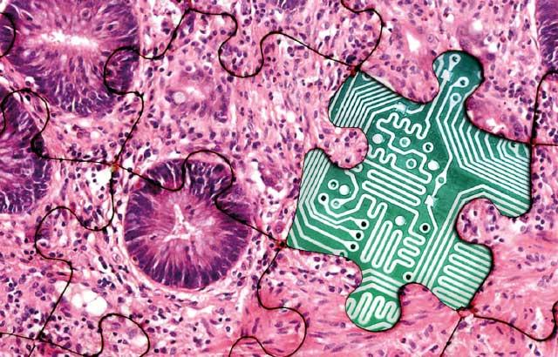

Feature-Enriched AI and
Quantum Methods in Digital Pathology
Presented By:
Claudia Dumitrescu
Department of Electrical and Computer Engineering,
Temple University
Submitted to:
Advisor:
Dr. Joseph Picone, Dept. of Electrical and Computer Engineering
Committee:
Dr. Iyad Obeid, Dept. of Electrical and Computer Engineering
Dr. Fauzia Ahmad, Dept. of Electrical and Computer Engineering
Dr. Philip Dames, Dept. of Department of Mechanical Engineering
External Reader:
Dr. Yaroslav Koshka, Dept. of Electrical and Computer Engineering, Mississippi State University
(Image: https://www.leicabiosystems.com/us/knowledge-pathway/digital-pathology/)

Slide 2
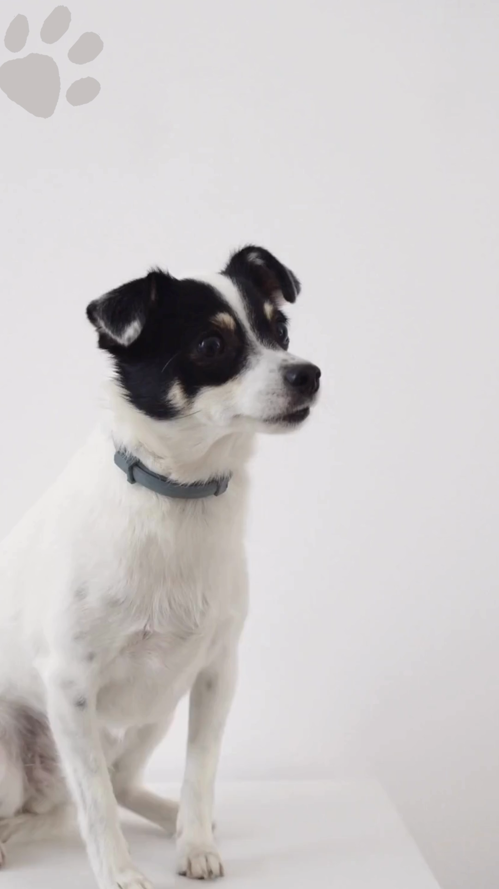
Abstract
Developing robust computational solutions for digital pathology requires more than large datasets (meaningful and representative features).
Feature extraction remains the cornerstone of AI performance, determining how well a model can generalize (biological patterns).
Quantum computing introduces a new paradigm for representation learning (capture non-linearity).
Carbonate content, alone, could distinguish benign and neoplastic sensitivity of 85% and specificity of 88% in cases.
Hybrid deep learning–quantum framework yields improved accuracy and efficiency in colorectal cancer classification (>98.9%).
The combination of graph neural networks (GNN; graph embeddings) with variational quantum classifier models spatial dependencies in tissue graphs to enhance tumor characterization (>71%).
Coherent progression - from data-centric enrichment to feature refinement (interpretable, feature-driven).

Slide 3
Three Selected Papers
The papers reviewed for this preliminary exam were:
Shin, Kseniya S., Mint Laohajaratsang, Shuaiqian Men, Benjamin Figueroa, Suzanne M. Dintzis, and Dan Fu. (2020). Quantitative Chemical Imaging of Breast Calcifications in Association with Neoplastic Processes. Theranostics 10, no. 13: 5865–78. https://doi.org/10.7150/thno.43325.
Ajay, Armaano, R. Karthik, Akshaj Singh Bisht, Abhay Karan Singh (2025). QDeepColonNet: A Quantum-Based Deep Learning Network for Colorectal Cancer Classification Using Attention-Driven DenseNet and Shuffled Dynamic Local Feature Extraction Network. Artificial Intelligence Review 58, no. 10: 304. https://doi.org/10.1007/s10462-025-11295-7.
Ray, Anupama (2024). Hybrid Quantum-Classical Graph Neural Networks for Tumor Classification in Digital Pathology. International Conference on Quantum Computing and Engineering. https://doi.org/10.1109/QCE60285.2024.00188.

Slide 4
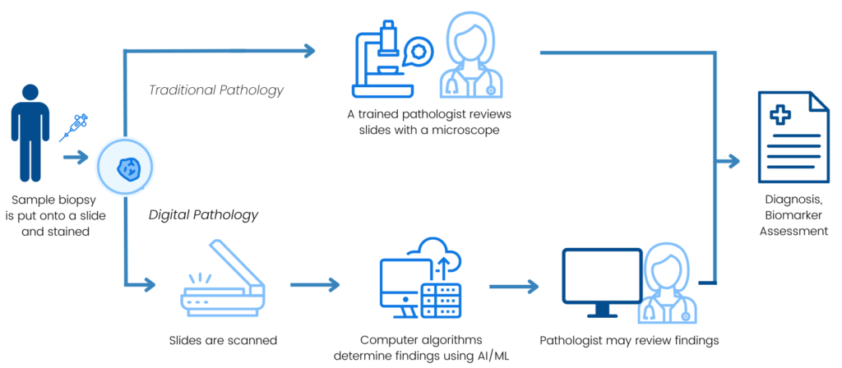
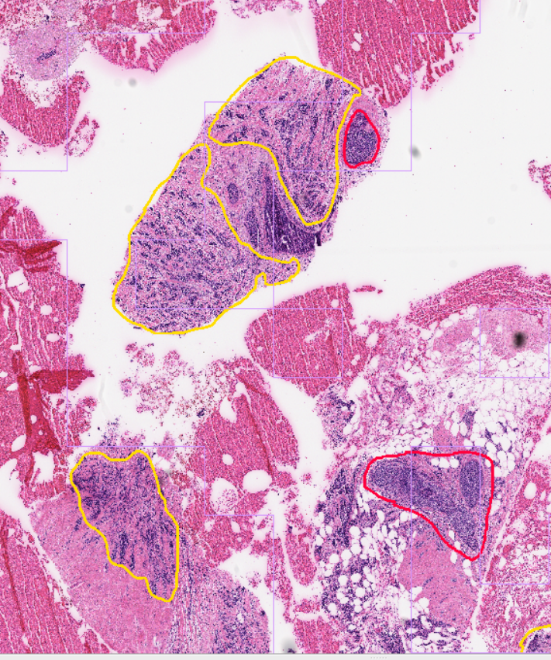
Introduction: Digital Pathology (DPATH)
Transformation of glass histopathology slides into high-resolution whole-slide images (WSIs) using digital scanners.
Enables quantitative and reproducible analysis of tissue morphology and biomarkers.
Data heterogeneity: scanner variability, staining protocols, and annotation bias.
Computational demand: high storage and processing requirements for WSIs.
Heterogeneity in study design: Mean sensitivity of 96.3% (CI 94.1-97.7) and mean specificity of 93.3% (CI 90.5-95.4). However, 99% of studies had at least one area at high or unclear risk of bias or applicability concerns (McGenity C. et al., 2024).
(Source: https://friendsofcancerresearch.org/digital-pathology/)

Slide 5
Introduction: State of the Art
Classical Machine Learning (ML)
Provided the first layer of automation to complement expert review.
Applications: tumor grading, metastasis prediction, risk assessment.
Limitations: dependence on handcrafted features; limited generalizability across datasets.
Deep Learning (DL)
Shifted the paradigm by learning hierarchical features directly from image data.
Key architectures: CNNs, Vision Transformers (ViTs), hybrid CNN – Transformer models.
Applications: object detection, grading, segmentation, and diagnostic support.
Trends and innovations:
Hybrid models (ConvMixer, multi-scale ConvLSTM, channel attention).
Lightweight networks (MobileNet variants, MRFO-tuned models).
Ensemble learning across backbones (EfficientNet, DenseNet, ConvNeXt) → best empirical results.
Quantum Machine Learning (QML)
Emerging field mapping classical data into quantum space for richer representations.
Approaches: Quantum Distance Classifiers, Quantum SVMs, hybrid quantum–classical CNNs, QuantumNet; classical encoders + variational quantum circuits (VQC/QNNs).
Applications: Brain tumor MRI (hybrid QNNs with channel/self-attention). Breast cancer and diabetic retinopathy prediction.
Challenges: Hardware noise, encoding costs, small datasets, optimization complexity.
Outlook: QML complements DL by enhancing feature embedding and separability, not replacing classical methods.

Slide 6
Introduction: Impact
Annotations (Supervised)
Feature Extraction
Classification
Social: Lowers the workflow of pathologists and assists in the diagnosis.
Time: By assisting the diagnosis, it both implies lower analysis time for doctors, as well as lower wait time for patients (transplants).
Decision-making: Reduces inter-observer variability and supports reproductibility.
Implies: Discovery of image-based biomarkers for prognosis, treatment stratification, and clinical trials.
Access: Enables remote diagnostics and telepathology, extending expert pathology services to underserved or resource-limited regions.
Efficiency: Digital workflows reduce glass slide storage, transport, and handling needs, lowering operational and environmental costs.
Education: Provides standardized visual references and AI-driven feedback, improving training quality for pathology residents and reducing the learning curve.

Slide 7
Introduction: Challenges
Whole-slide images are gigapixel-scale → massive storage, compute, and tiling complexities.
High dataset heterogeneity (stain, scanner, institution, doctor agreement) → domain shift and poor generalization.
Lack of transparency in research (post-processing)
Scarce, costly expert annotations: label noise, artifacts, and inconsistent standards.
Models often rely on morphology alone → limited biological specificity and interpretability.
Taking into consideration both long and short distance morphology: combining features from multiple scales; global context and local texture (fine-grained local patterns and short-range dependencies).
Regulatory, privacy, and clinical-validation barriers block real-world deployment (security).
Takeaway: Solving these technical, biological, and translational challenges is essential to move AI from promising demonstrations to safe, reliable, explainable, transparent, and robust clinical tools.

Slide 8
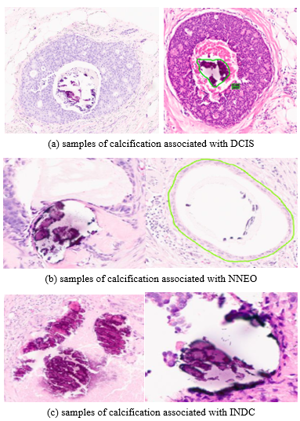
Crystallization I
Calcifications arise through active processes promoted by the presence of cancer that mirror aspects of human physiology.
Cancer cells and adjacent stromal tissue can undergo osteogenic-like reprogramming, characterized by upregulation of transcription factors (Runx2 and Osterix). This promotes the deposition of calcium phosphate, predominantly hydroxyapatite (Ca₁₀(PO₄)₆(OH)₂) and calcium oxalate (CaC₂O₄).
In breast lesions such as ductal carcinoma in situ (dcis) studies report that hydroxyapatite deposits are more frequent than in benign tissue. These deposits show reduced carbonate substitution and elevated magnesium-whitlockite, features that correlate with lesion grade and biological aggressiveness.

Slide 9
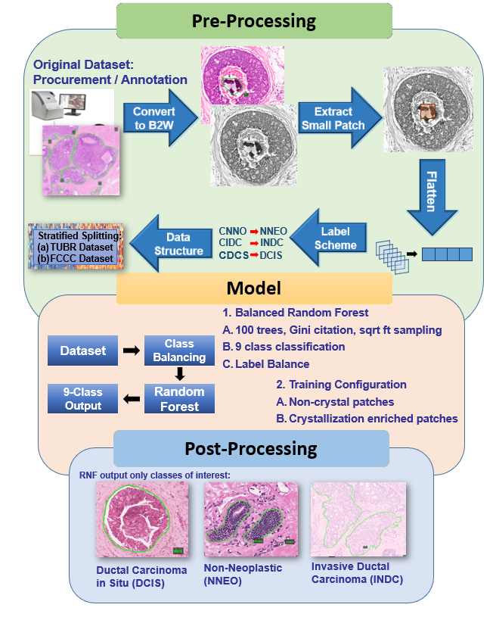
Crystallization II
An annotated subset comprising 439 patches categorized into Crystalline Non-Neoplastic (cnno: n = 51), Crystalline Ductal Carcinoma in Situ (cdcs: n = 168), and Crystalline Invasive Ductal Carcinoma (cidc: n = 220).
We conducted a baseline experiment comparing a balanced Random Forest classifier trained on (1) a standard, non-crystallization dataset (1,850 patches) versus (2) an enriched dataset including the crystallization annotations (2,243 patches).
Evaluated on 2 different datasets, (18,224 patches and 46,666 patches)
Incorporation of crystallization annotations more than doubled the overall accuracy: from 18.4% to 34.6% on FCBR and from 20.7% to 23.5% on TUBR.

Slide 10
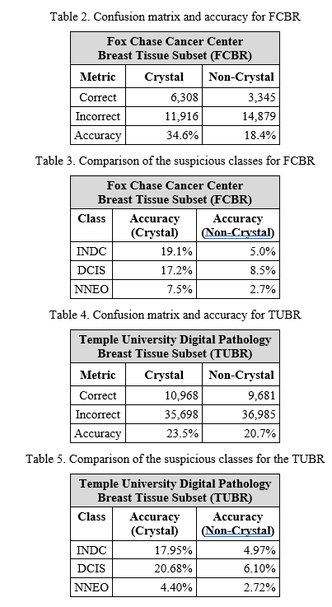
Crystallization III
On the FCBR dataset:
crystallization model:
NNEO (Precision = 0.12, Recall = 0.076, F1 = 0.09),
DCIS (Precision = 0.08, Recall = 0.18, F1 = 0.11),
INDC (Precision = 0.78, Recall = 0.23, F1 = 0.35).
non-crystallization model:
NNEO (Precision = 0.05, Recall = 0.03, F1 = 0.03),
DCIS (Precision = 0.08, Recall = 0.09, F1 = 0.08),
INDC (Precision = 0.78, Recall = 0.05, F1 = 0.09).
The 95% confidence interval for this accuracy difference is [15.37%, 17.15%], and the improvement was statistically significant (p < 0.01, McNemar’s test). The largest gains occurred in INDC (Δ = 14.1%) and DCIS (Δ = 8.7%).
FCBR:
TUBR:

Slide 11
Crystallization IV
On the TUBR dataset:
crystallization model:
NNEO (Precision = 0.45, Recall = 0.04, F1 = 0.08),
DCIS (Precision = 0.06, Recall = 0.21, F1 = 0.10),
INDC (Precision = 0.06, Recall = 0.18, F1 = 0.09).
non-crystallization model
NNEO (Precision = 0.38, Recall = 0.03, F1 = 0.05),
DCIS (Precision = 0.03, Recall = 0.06, F1 = 0.04),
INDC (Precision = 0.07, Recall = 0.05, F1 = 0.06).
The crystallization again outperformed the baseline (Δ = 2.76%, 95% CI = [2.23%, 3.29%], p < 0.05). Class-specific improvements were most pronounced for DCIS (Δ = 14.58%) and INDC (Δ = 13.00%).
FCBR:
TUBR:

Slide 12
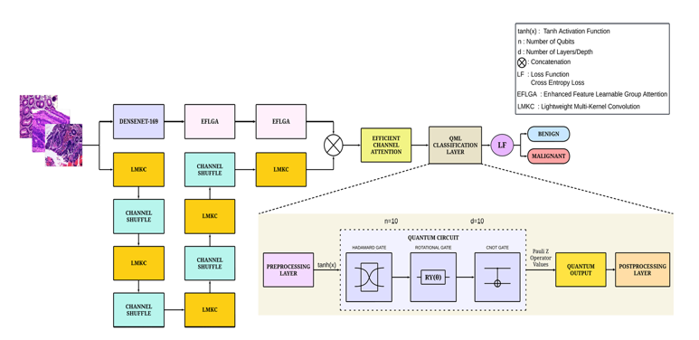
QDeepColonNet: Introduction
Employs a dual-track CNN for multi-scale feature extraction, augmented by a QML classifier.
The first track: DenseNet-169 backbone (focused on high-level features).
The second track: Shuffled Dynamic Local Feature Extraction Network (focused on short-range dependencies).
The EFLGA block + DenseNet capture mid-level features.
This underscores the critical importance of combining features from multiple scales (global context and local texture).
Efficient Channel Attention dynamically weighting feature channels to capture the most discriminative information.

Slide 13
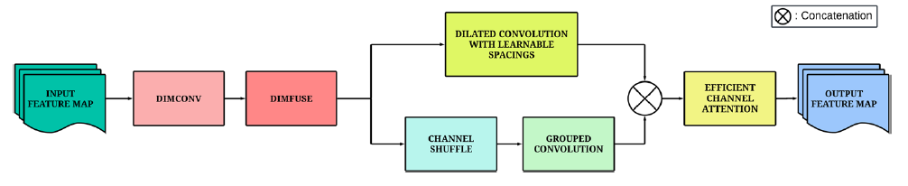
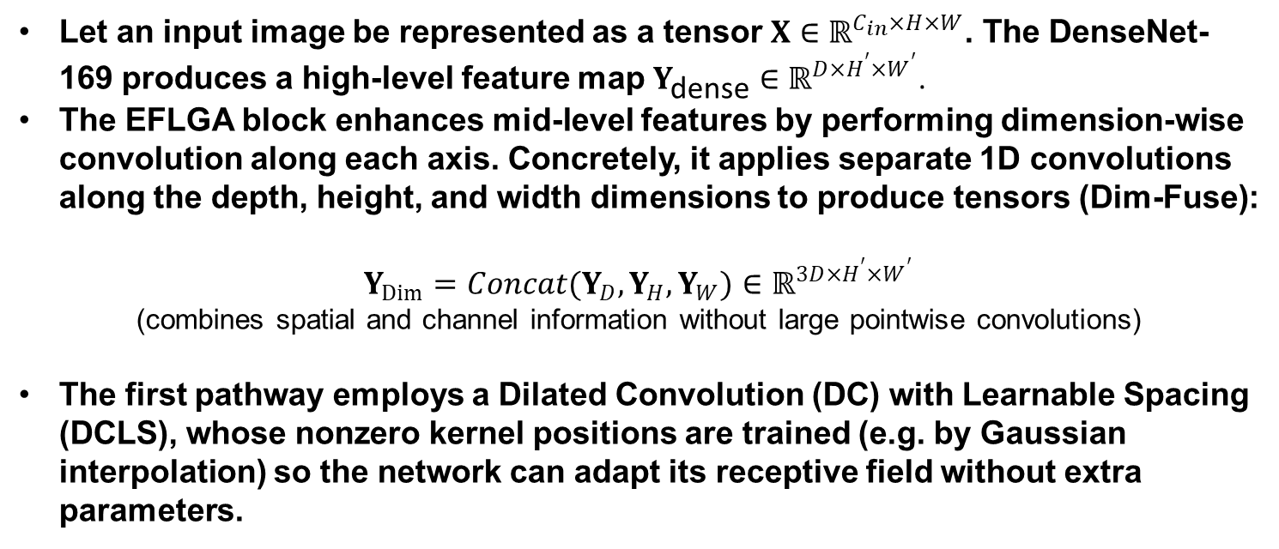
Enhanced Feature Learnable Group Attention (EFLGA) I
Let an input image be represented as a tensor $X∈ℝ^{C_{in}×H×W}$. The DenseNet-169 produces a high-level feature map $Y_{\text{dense}}∈ℝ^{D×H^{′}×W^{′}}$.
The EFLGA block enhances mid-level features by performing dimension-wise convolution along each axis. Concretely, it applies separate 1D convolutions along the depth, height, and width dimensions to produce tensors (Dim-Fuse):
$$Y_{Dim}=Concat(Y_{D},Y_{H},Y_{W})∈ℝ^{3D×H^{′}×W^{′}}$$
(combines spatial and channel information without large pointwise convolutions)
The first pathway employs a Dilated Convolution (DC) with Learnable Spacing (DCLS), whose nonzero kernel positions are trained (e.g. by Gaussian interpolation) so the network can adapt its receptive field without extra parameters.

Slide 14
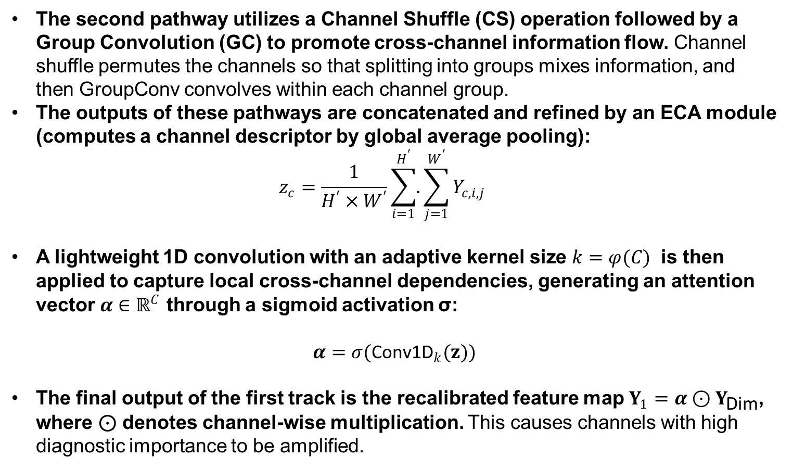
Enhanced Feature Learnable Group Attention (EFLGA) II
The second pathway utilizes a Channel Shuffle (CS) operation followed by a Group Convolution (GC) to promote cross-channel information flow. Channel shuffle permutes the channels so that splitting into groups mixes information, and then GroupConv convolves within each channel group.
The outputs of these pathways are concatenated and refined by an ECA module (computes a channel descriptor by global average pooling): $z_{c}=\frac{1}{H^{′}×W^{′}}\sum_{i=1}^{H^{′}}{.}\sum_{j=1}^{W^{′}}{Y_{c,i,j}}$
A lightweight 1D convolution with an adaptive kernel size $k=φ(C)$ is then applied to capture local cross-channel dependencies, generating an attention vector $α∈ℝ^{C}$ through a sigmoid activation σ:
$$α=σ({\text{Conv}\text{1}\text{D}}_{k}(z))$$
The final output of the first track is the recalibrated feature map $Y_{1}=α⊙Y_{\text{Dim}}$, where ⊙ denotes channel-wise multiplication. This causes channels with high diagnostic importance to be amplified.

Slide 15
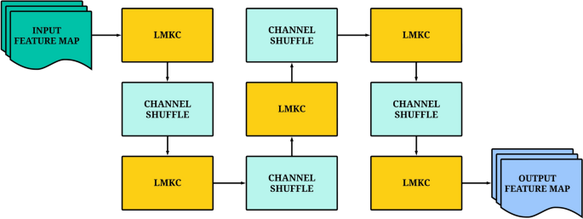
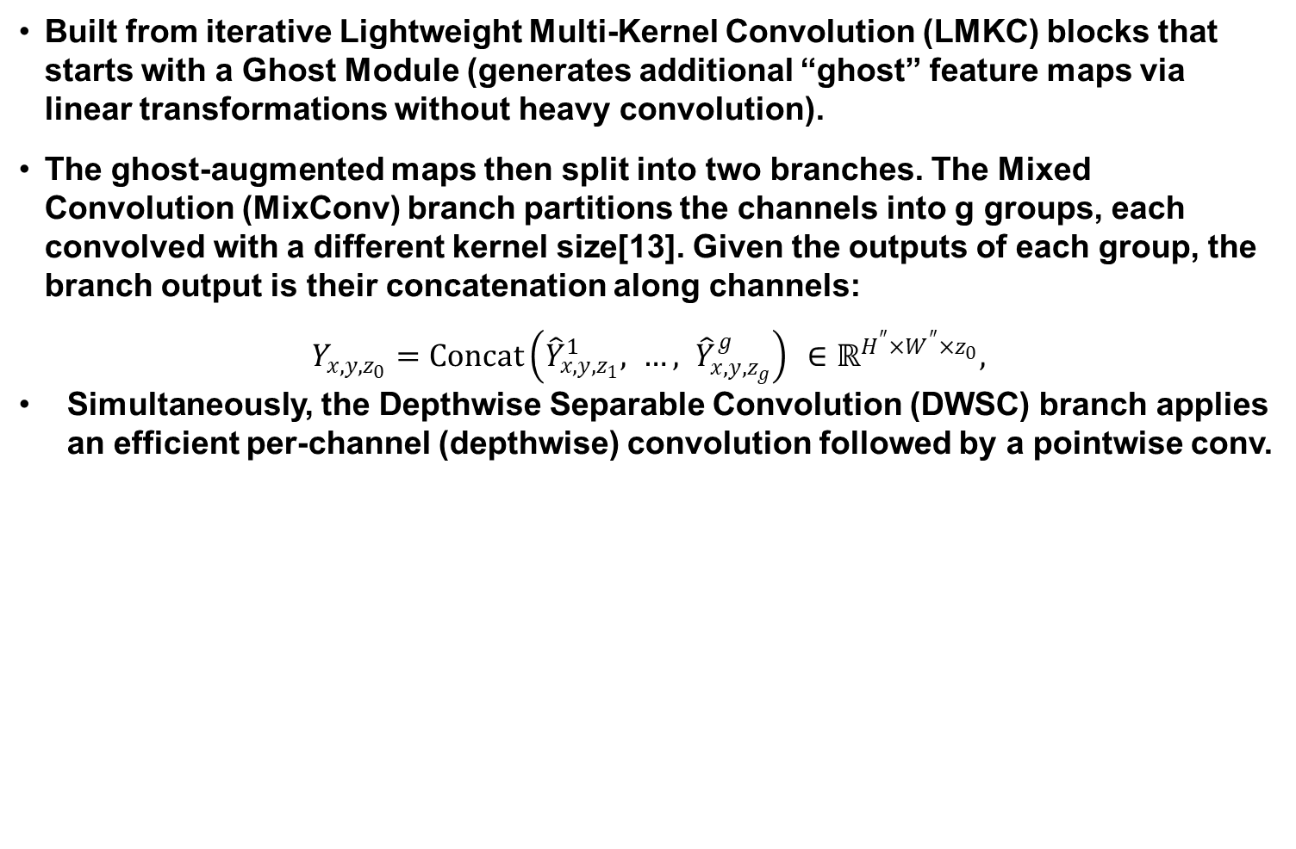
Shuffled Dynamic Local Feature Extraction Network (SDLFEN)
Built from iterative Lightweight Multi-Kernel Convolution (LMKC) blocks that starts with a Ghost Module (generates additional “ghost” feature maps via linear transformations without heavy convolution).
The ghost-augmented maps then split into two branches. The Mixed Convolution (MixConv) branch partitions the channels into g groups, each convolved with a different kernel size[13]. Given the outputs of each group, the branch output is their concatenation along channels:
$$Y_{x,y,z_{0}}=Concat\left({\hat{Y}}_{x,y,z_{1}}^{1}, …, {\hat{Y}}_{x,y,z_{g}}^{g}\right) ∈ℝ^{H^{″}×W^{″}×z_{0}},$$
Simultaneously, the Depthwise Separable Convolution (DWSC) branch applies an efficient per-channel (depthwise) convolution followed by a pointwise conv.

Slide 16
Shuffled Dynamic Local Feature Extraction Network (SDLFEN)
The concatenated features then go through a Dynamic Convolution (DC) layer.
In DC, multiple parallel kernels are applied and then combined via a squeeze-and-excitation mechanism: each kernel’s output is weighted by an attention value and summed.
The DC output is the final output of the LMKC block. Finally, a Channel Shuffle operation permutes channels before feeding into the next LMKC block to enable cross-channel information flow.
By stacking and repeating LMKC blocks with shuffles, the SDLFEN refines its output to capture detailed, short-range patterns.

Slide 17

Feature Fusion and Final Attention
After both tracks produce feature maps $Y_1$ and $Y_2$, they are concatenated along the channel dimension
This combined map is again passed through an ECA module (same mechanism as discussed) to yield the final refined feature map, then ECA computes:
$$z_{c}=\frac{1}{H W}\sum_{i=1}^{H}{\sum_{j=1}^{W}{X_{c,i,j}}}, k=φ\left(C\right), α=σ\left(Conv1D\left(z,k\right)\right), X′_{c}=α_{c} X_{c},$$
Finally, $Y_{\text{final}}$is globally average-pooled across its spatial dimensions and flattened into a vector $x∈ℝ^{N}$. (with N equal to the number of channels). This vector x summarizes the learned features of the input image.

Slide 18
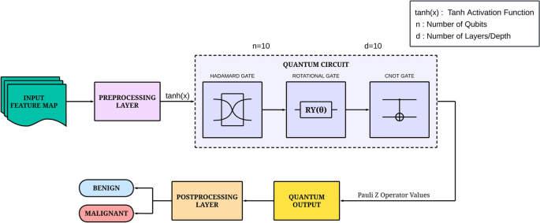

Quantum Encoding and Classification
This classical vector $x∈ℝ^{N}$ is encoded into a quantum state $ψ(x)⟩$ of n qubits, where $N≤2^{n}$. The encoding maps the classical information into the amplitudes of the quantum state:
$$∣ψ(x)⟩=\sum_{i=1}^{N}{\frac{x_{i}}{∥x∥}∣i⟩}$$ This state is then processed by a parameterized quantum circuit (PQC). The circuit consists of a feature map $U_{φ(x)}$ that encodes the input data, followed by a variational ansatz $V(θ)$ with tunable parameters $θ$. The full state preparation
$$\left|ψ\left(x,θ\right)⟩ = V\left(θ\right) U_{φ\left(x\right)} \right|0⟩^{⊗n}$$
The variational ansatz is composed of parameterized single-qubit rotations and entangling gates, such as the controlled-NOT gate.

Slide 19
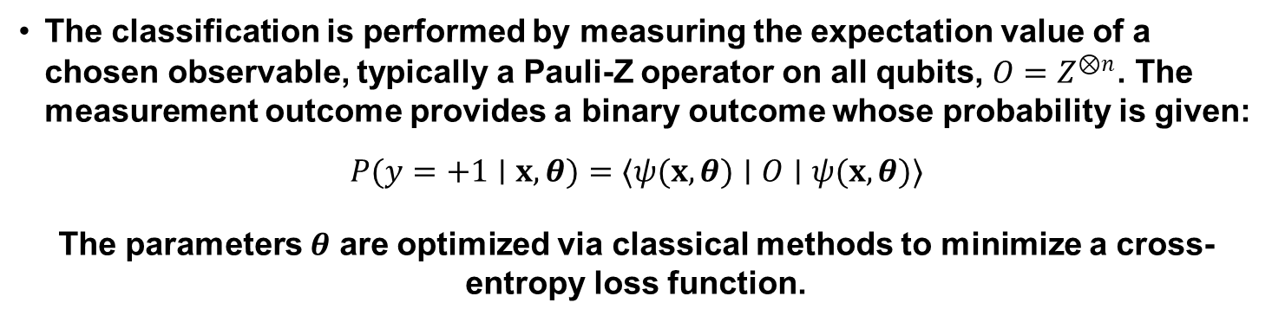
Ablation Study
Experiment | Metrics
 | Accuracy (%) | Precision (%) | Recall (%) | F1-Score (%)
SDLFEN Track Only | 95.34 | 95.21 | 95.24 | 95.22
DenseNet-169 Only | 95.70 | 96.42 | 96.40 | 96.41
DenseNet-169 + EFLGA | 96.06 | 96.49 | 96.48 | 96.48
Dual Track (DenseNet+EFLGA + SDLFEN) | 97.85 | 97.77 | 97.79 | 97.76
Dual Track + ECA + Classical Classifier | 98.57 | 98.36 | 98.37 | 98.36
Dual Track + ECA + QML Classifier (Proposed) | 98.92 | 98.94 | 98.94 | 98.93
The classification is performed by measuring the expectation value of a chosen observable, typically a Pauli-Z operator on all qubits, $O=Z^{⊗n}$. The measurement outcome provides a binary outcome whose probability is given:
$$P(y=+1∣x,θ)=⟨ψ(x,θ)∣O∣ψ(x,θ)⟩$$
The parameters $θ$ are optimized via classical methods to minimize a cross-entropy loss function.

Slide 20
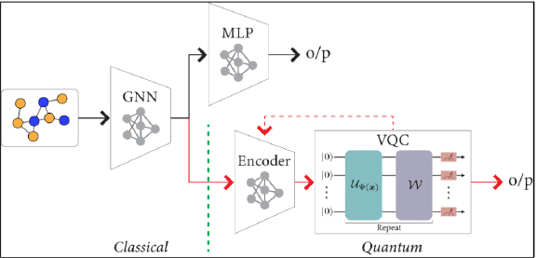
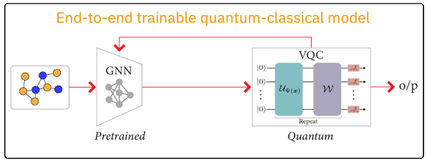

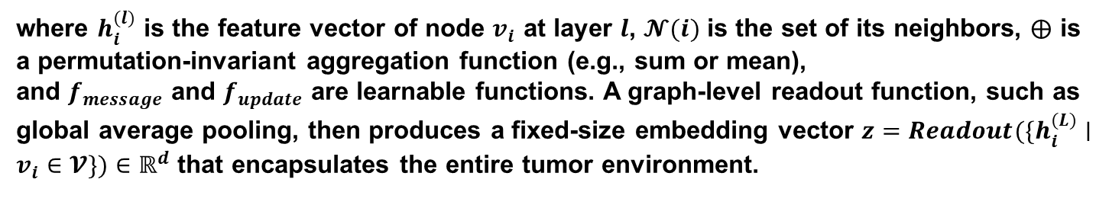
Graph Networks I
Series: GNN parameters $θ_{G}$ are fixed after classical pre-training, and only the VQC parameters $θ_{Q}$ are optimized.
The second, more powerful paradigm involves end-to-end training, where the loss from the quantum circuit is backpropagated through the entire hybrid system
The initial step involves constructing a hierarchical graph $𝓖=(𝓥,𝓔)$ from a WSI, where nodes $v_{i}∈𝓥$ represent biological entities (e.g., cells, tissue regions) and edges $e_{ij}∈𝓔$ represent their spatial or functional interactions.
The GNN (HACT-NET) learns node embeddings through a series of message-passing layers. For a node $v_{i}$ at layer $l$, the update function can be summarized
$$h_{i}^{(l)}=f_{update}(h_{i}^{(l−1)},\underset{j∈𝓝(i)}{⨁}f_{message}(h_{i}^{(l−1)},h_{j}^{(l−1)},e_{ij}))$$
where $h_{i}^{(l)}$ is the feature vector of node $v_{i}$ at layer $l$, $𝓝(i)$ is the set of its neighbors, $⨁$ is a permutation-invariant aggregation function (e.g., sum or mean), and $f_{message}$ and $f_{update}$ are learnable functions. A graph-level readout function, such as global average pooling, then produces a fixed-size embedding vector $z=Readout(\{h_{i}^{(L)}∣v_{i}∈𝓥\})∈ℝ^{d}$ that encapsulates the entire tumor environment.

Slide 21
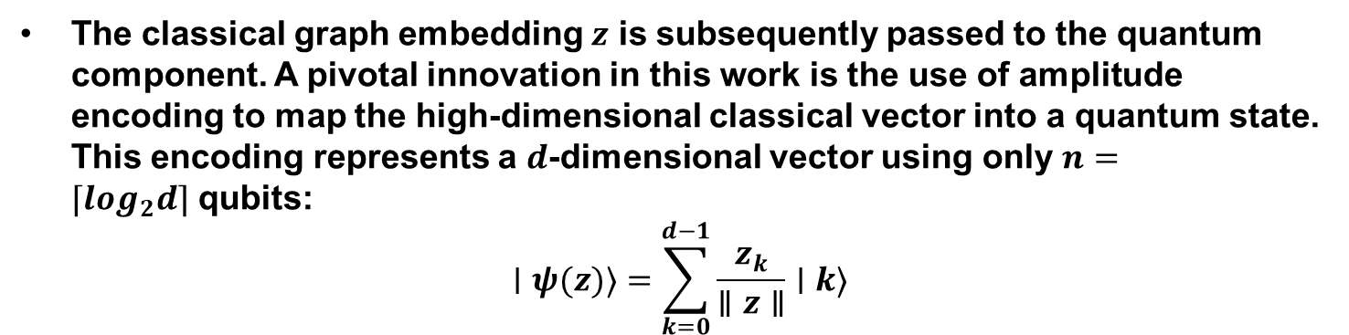

Graph Networks II
The classical graph embedding $z$ is subsequently passed to the quantum component. A pivotal innovation in this work is the use of amplitude encoding to map the high-dimensional classical vector into a quantum state. This encoding represents a $d$-dimensional vector using only $n=⌈\log_{2}d⌉$ qubits:
$$∣ψ(z)⟩=\sum_{k=0}^{d−1}{\frac{z_{k}}{∥z∥}∣k⟩}$$
This logarithmic compression is lossless and stands in contrast to classical dimensionality reduction techniques.
The quantum state $∣ψ(z)⟩$ is then fed into a variational quantum circuit $V(θ_{Q})$. The prediction for a binary classification task is derived from the expectation value:
$$p(y∣𝓖;θ_{G},θ_{Q})=⟨ψ(z)∣V^{†}(θ_{Q})OV(θ_{Q})∣ψ(z)⟩$$
where $O$ is a Hermitian observable defining the measurement.

Slide 22
Discussion: Feature Enriched AI
Shift from data-scale focus → physiologically meaningful feature extraction
Carbonate–malignancy correlation reveals diagnostic power
Hybrid architectures (QDeepColonNet) capture both multi-scale structure and local texture
Quantum classifiers project features into Hilbert space for enhanced separability
Quantum – Classical GNNs model the tumor microenvironment via amplitude encoding
Lossless graph compression preserves complex spatial-cellular interactions
End-to-end co-training aligns classical and quantum representations
Convergence of biologically relevant data and quantum-enhanced learning → transparent, robust, next-generation digital pathology systems

Slide 23
Conclusions
Prioritize feature relevance over scale: shift from bigger models/datasets (quantum) to extracting physiologically salient, mechanism-aware features.
Multi-scale extraction: architectures must capture global tissue context and local texture to reach higher diagnostic accuracy.
Biochemical and structural imaging grounds decisions: integrating quantifiable signals (e.g., mineral composition) improves biological plausibility, generalization, and clinical interpretability.
Hybrid quantum–classical methods are promising: they offer expressive separability and potential lossless compression for high-dimensional, enriched feature spaces, with the hardware downside.
Translate to multimodal, longitudinal practice: next steps include the fusion between histology biomarkers and feature-enriched methods.
Final takeaway: representable intelligence, not just scale for accurate, transparent, and clinically translatable digital pathology.

Slide 24
Additional References
McGenity, C., Clarke, E. L., Jennings, C., Matthews, G., Cartlidge, C., Freduah-Agyemang, H., Stocken, D. D., & Treanor, D. (2024). Artificial intelligence in digital pathology: a systematic review and meta-analysis of diagnostic test accuracy. NPJ digital medicine, 7(1), 114. https://doi.org/10.1038/s41746-024-01106-8
Ajay, Abhishek, Han Wang, Ali Rezvani, et al. “Assessment of Targets of Antibody Drug Conjugates in SCLC.” NPJ Precision Oncology (England) 9, no. 1 (2025): 1. https://doi.org/10.1038/s41698-024-00784-7.
Akpinar, Emine, and Murat Oduncuoglu. “Hybrid Classical and Quantum Computing for Enhanced Glioma Tumor Classification Using TCGA Data.” Scientific Reports 15, no. 1 (2025): 25935. https://doi.org/10.1038/s41598-025-97067-3.
Bülbül, Hande Melike, Gülen Burakgazi, and Uğur Kesimal. “Preoperative Assessment of Grade, T Stage, and Lymph Node Involvement: Machine Learning-Based CT Texture Analysis in Colon Cancer.” Japanese Journal of Radiology (Japan) 42, no. 3 (2024): 300–307. https://doi.org/10.1007/s11604-023-01502-2.
Gupta, Riddhi S., Carolyn E. Wood, Teyl Engstrom, Jason D. Pole, and Sally Shrapnel. “A Systematic Review of Quantum Machine Learning for Digital Health.” Npj Digital Medicine 8, no. 1 (2025): 237. https://doi.org/10.1038/s41746-025-01597-z.
Khan, Saif Ur Rehman, Sohaib Asif, Ming Zhao, Wei Zou, Yangfan Li, and Xiangmin Li. “Optimized Deep Learning Model for Comprehensive Medical Image Analysis across Multiple Modalities.” Neurocomputing 619 (February 2025): 129182. https://doi.org/10.1016/j.neucom.2024.129182.

Slide 25
Questions

Slide 26
Thank You

