Slide 1
Temple + Heights 2025:
Development of Artificial General Intelligence for Healthcare Applications
Diane Ngo
Ivan Li (L)
Montgomery Brown

Slide 2
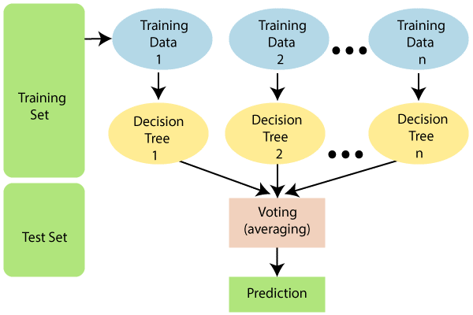
BACKGROUND
GOALS: Students will learn how to program machine learning algorithms in Python and how to apply this knowledge to the development of systems that automatically interpret physical signals.
In pathology, manual annotations and analyzation of disease can be a time-consuming process.
Developing an algorithm to run scans and annotate through data points can significantly improve efficiency by analyzing a larger data set without needing constant monitoring.
Random Forest Algorithm – Image by Vivek Salunkhe

Slide 3
Introduction
What is Machine learning?

Slide 4
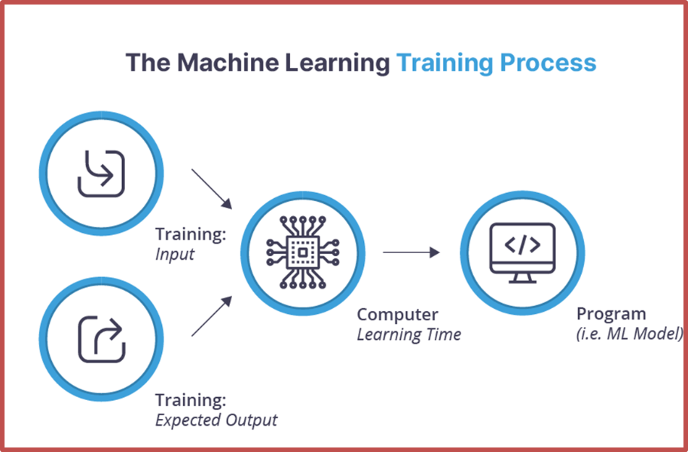
Introduction: Machine Learning
Machine learning (ML) is a type of artificial intelligence (AI) that allows for a computer model to learn from data to find patterns, make decisions, and predict outcomes.
The goal of ML is to get the model to be the most proficient at handling its given task.
Process of ML:
Training -> train the model to accomplish a task, may result in memorization.
Development -> addition of new data to test the effectiveness of the model in a broader space.
Evaluation -> determine the effectiveness of the model when compared to an eval data set (unchanged)

Slide 5
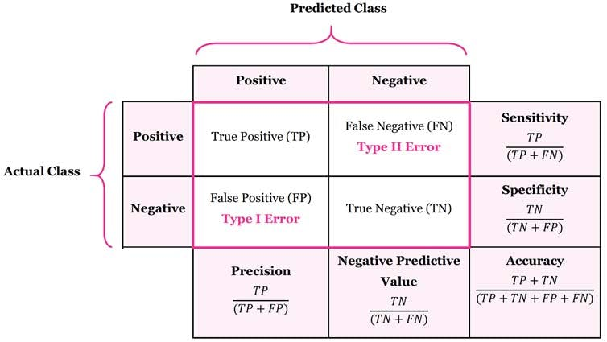
Introduction: Confusion Matrices
A confusion matrix refers to a chart displaying the performance of the training model through comparisons between the model's predictions and the actual data results.
True Positive
False Positive
False Negative
True Negative
Prediction | Actual Data
Positive (1) | Positive (1)
Positive (1) | Negative (0)
Negative (0) | Positive (1)
Negative (0) | Negative (0)
Specificity (or true negative rate) is the probability that measures how well the test avoids false alarms in healthy individuals.
Sensitivity (or true positive rate) is the probability that measures how well the test detects actual positives.​

Slide 6
EEG SYStem
An EEG (electroencephalogram) is a test that measures and records the electrical activity of the brain.

Slide 7
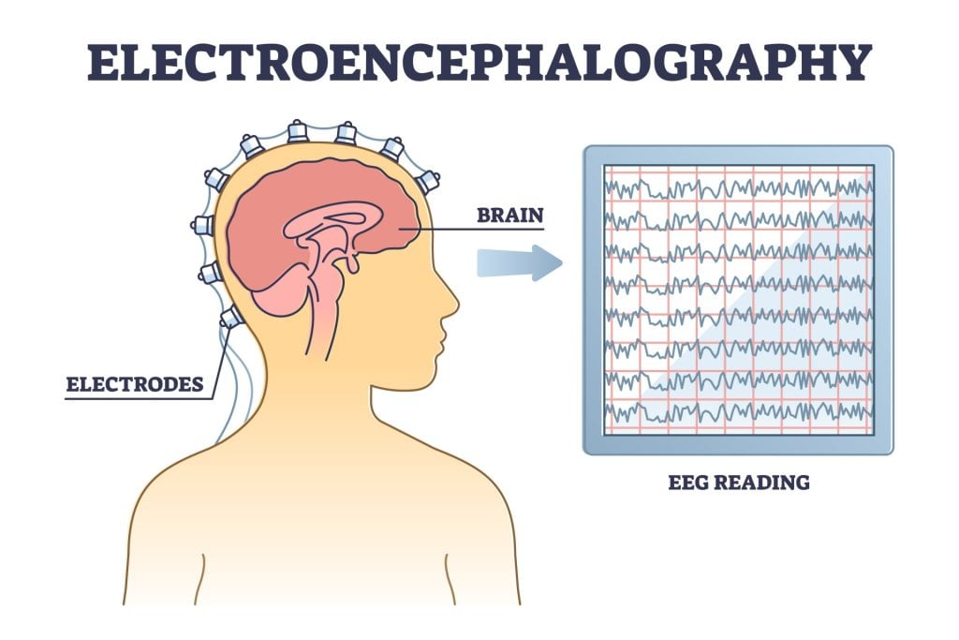
EEG System
An EEG (electroencephalogram) is a test that measures and records the electrical activity of the brain.
GOAL: to track electrical impulses in the brain and detect seizures in patients as well as predict them.
To run the system, use the Train, Decode, and Evaluation commands.
  Train: training the model using train and dev EDF and CVS files
  Decode: translate results into legible format
  Evaluation: cross reference data to determine
Notes:
When running our machine learning program, we use train, dev (development), and eval (evaluation). The model is first trained on a training set, but as training continues, the model tends to overfit (memorizing instead of generalizing) because it becomes too familiar with the data and eventually reaches 0% error.
This is when dev set is used to evaluate how well the model generalizes to slightly different data, as well to find the best model. We then select the dev data set with the lowest loss from the epoch and use that in eval. Eval contains hidden random data, which should never be modified. The confusion matrix then shows the accuracy.
When decoding, it tests the machine be having it create hypothesis annotation. Afterwards, another program cross references the hypothesis annotations with the reference annotations.

Slide 8
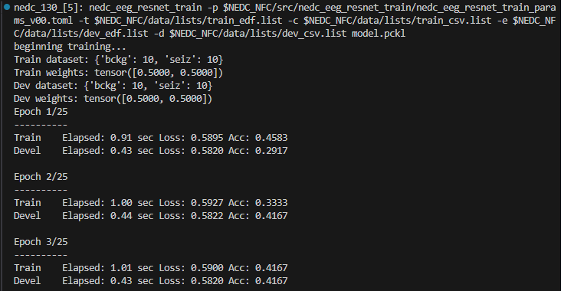
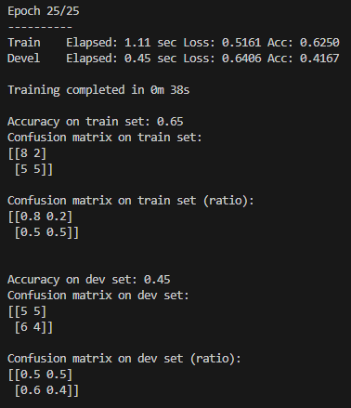
EEG SYSTEM TRAINING
First, the model is trained on a training set given 30 EDF and CSV training files and 30 EDF and CSV dev files.
  In training, the model tends to overfit (memorizing instead of generalizing).
  Dev set is used to evaluate how well the model generalizes to slightly different data.
In this instance, the train set has an accuracy of 0.65 while the dev set has an accuracy of 0.45
It's expected for the train set to have a higher accuracy rate as the model familiarizes itself with the data set. Since the dev set introduces unseen today, a lower accuracy rate is expected.

Slide 9
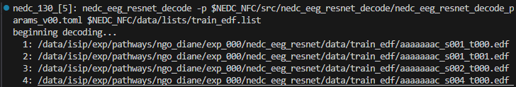
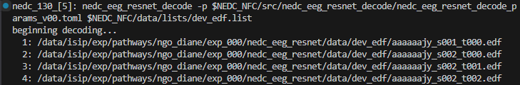
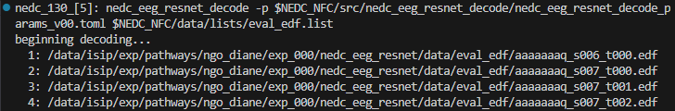
EEG SYSTEM DECODE
Decoding the files and predictions from the model training is the next step.
This translates the files into a legible format, in the form of a hypothesis annotations, for cross reference in evaluation.

Slide 10
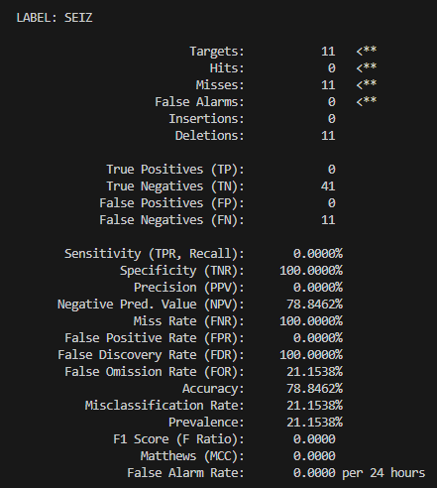
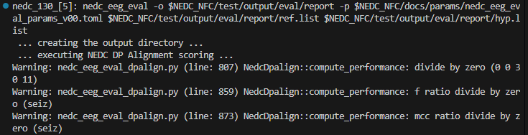
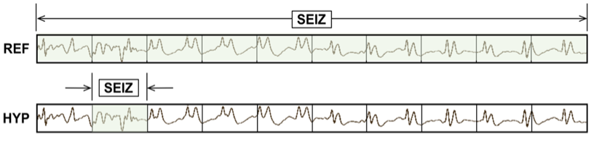
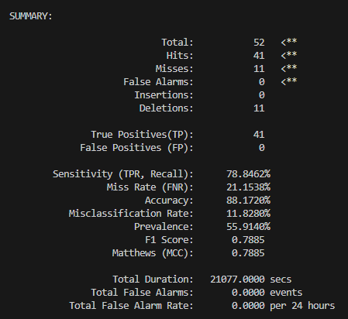
EEG SYSTEM EVALUATION
Cross references the hypothesis annotations with the reference annotations.
The summary is then compiled and outputted as a scoring report ->
Main data points to examine are the Sensitivity and False Alarm Rate to identify the most effective model.

Slide 11
Python Programming
A quick lesson on python

Slide 12

What is python?
Python is a programming language released back in 1991.
Python is one of the most popular programming languages of today. This is because Python's syntax is very easy to understand, making it a perfect beginner language to learn.
It is also a very versatile language, meaning you can use it for all kinds of programming, like object-oriented programming.

Slide 13
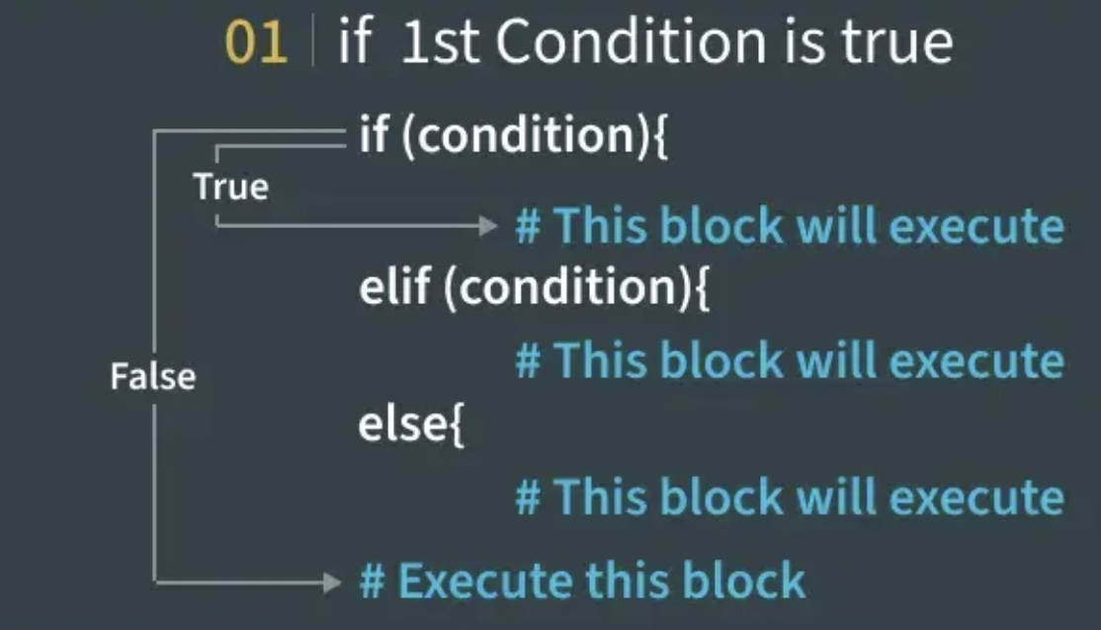
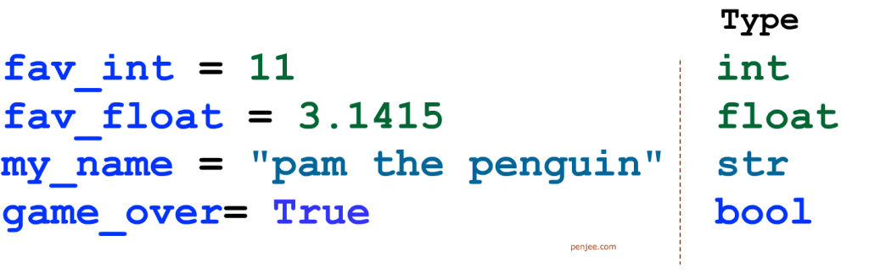
What does python have?
Python, like many programming languages, has variables with different datatypes, conditionals, functions, loops, lists, dictionaries, and classes.
Conditionals: A way of checking if something is True or False. You accomplish this with the syntax "if …" You can also use "else …" in case you have a conditional where you want something to always happen if it doesn't meet the requirements of the "if …" statement.
Variable: a placeholder that contains data. There are different data types like integers, floats or decimals, booleans like True or False, and String, just to name a few. Variables in java don't need to have their datatype declared, just the name and data assigned to the variable.

Slide 14
What does python have? (cont.)
Functions/methods: reusable blocks of code that perform a specific task. You define them outside the main function and call them inside main. Functions can take arguments, which are values passed in for the method to use—but arguments aren’t required if the method doesn’t need input to run.
Loops: repeat code multiple times. They run as long as a given condition is true. Loops are useful for tasks like going through a list or repeating an action until a goal is met.
Lists: a way to store multiple pieces of data in one value. It is a literal list of data, with each element, or piece of data, having an index, or position in the list, assigned to them. The index starts at 0 and continues from there.
Dictionaries: also store multiple values, but instead of using indexes, they use keys to label each item. Each key is paired with a value. For example, in a dictionary with "Number" as a key and 1 as its value, accessing "Number" will return 1.

Slide 15
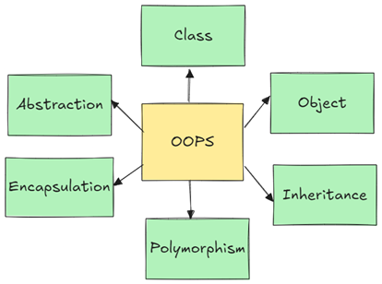
Object-oriented programming
Object-oriented programming (OOP) is a programming paradigm (relatively high-level way to conceptualize and structure the implementation of a program) based on the object, a software entity that lets you store variables and functions into one thing. When you create a class, you are creating an object. Think of the class as a blueprint, and your object follows that blueprint but contains some additional information in it now.
Classes contain three parts:
  Instance variable(s): Variables that are typically used to create new variables in the object. However, classes don't always need to have instance variables.
  Constructor(s): A way for the object to be created, assigning the instance variables to variables that will be used later on in the object. Constructors don't always need to do this, however.
  Function(s): Same thing as before, however, you can call these functions from your object.
Objects created using a class are created in the main function, then can be used anywhere in the program.

Slide 16
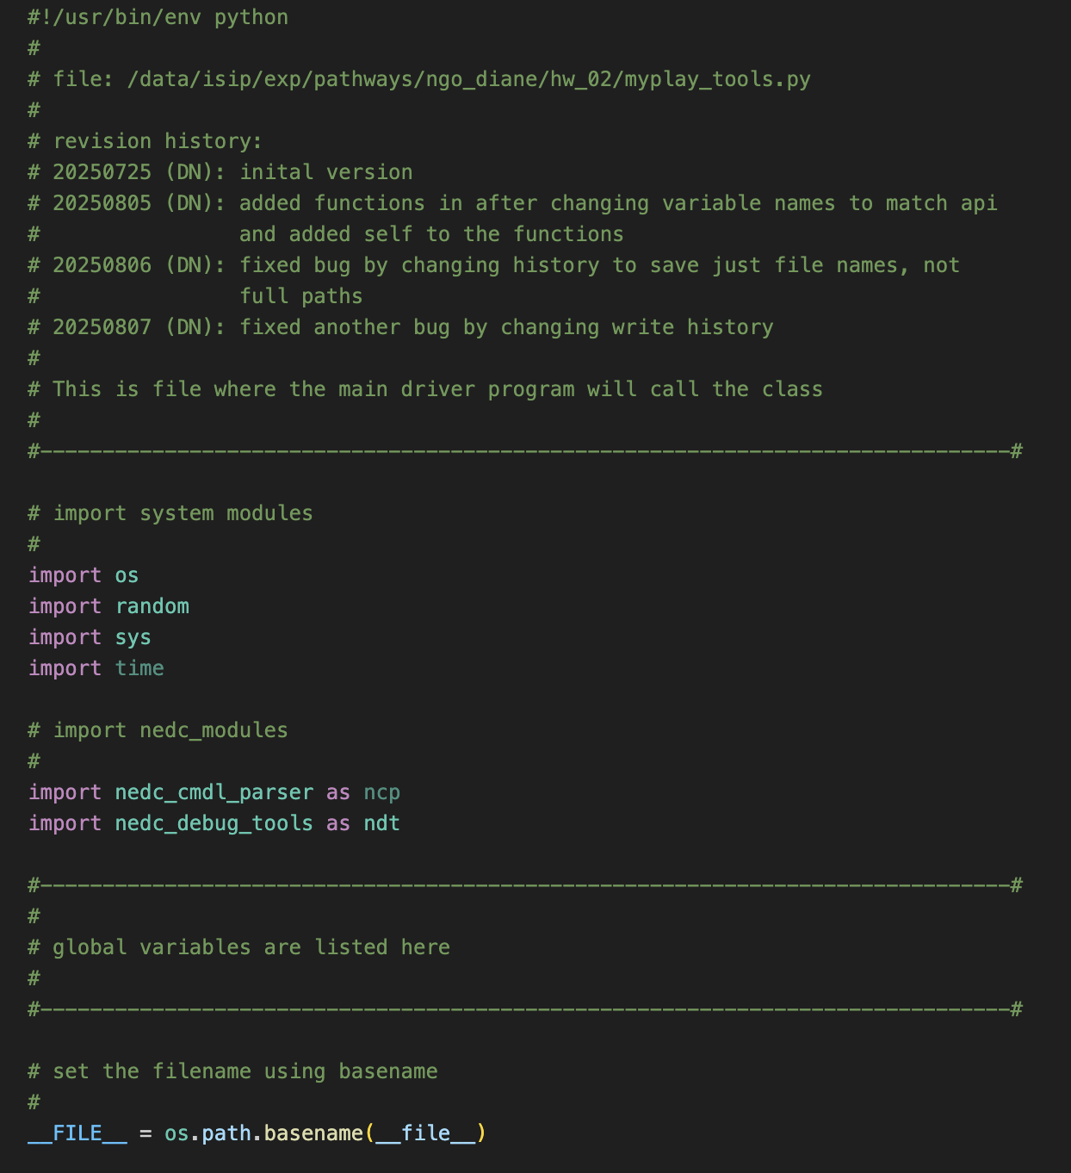
MP3
All of this applies to our projects during the program because we were tasked to create a pseudo MP3 player using Python as our beginning project. This was to help introduce us to Python as well as learn the standard formatting of the research group.
Unfortunately, we weren’t able to run DPATH (a large machine learning model used to detect cancer cells in breast tissue), and the EEG had a very small test dataset. We worked on this project all summer for about 5 weeks and our mentor advised us to add it in, which is why it’s included.
This is the format for how we start every code. At the top, we follow the ISIP style format, which includes the shebang (#!/usr/bin/env python), revision history, and a short description of the file. This structure helps keep the code organized and track changes easily over time.

Slide 17
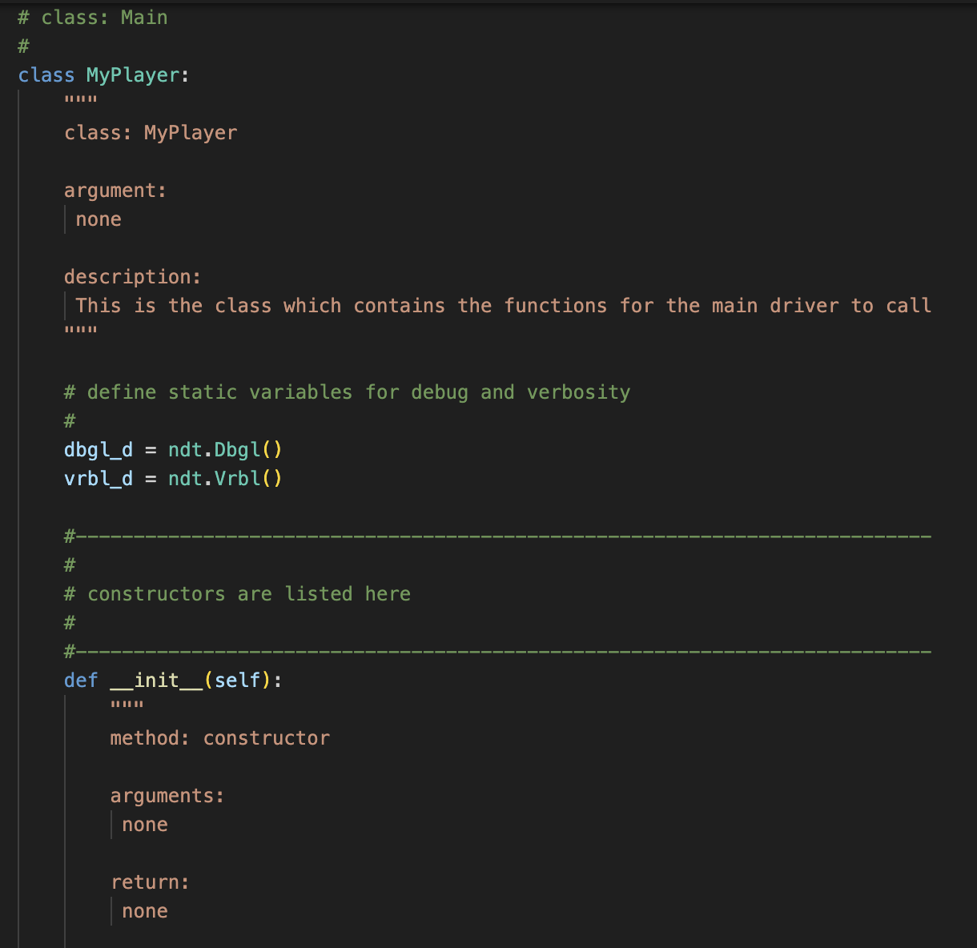
This is the beginning where we define our class MyPlayer. This class holds all of our functions/class methods. It is in a separate file called: myplayer_tools.py. The main function is in a file called: myplayer_new.py.
The constructor __init__() sets up the class when it's first created. Here, it just assigns the class name, but later functions will rely on this setup.
As you can see, we comment our code almost every line if we can. We also have docstring API comments after every function/class.

Slide 18
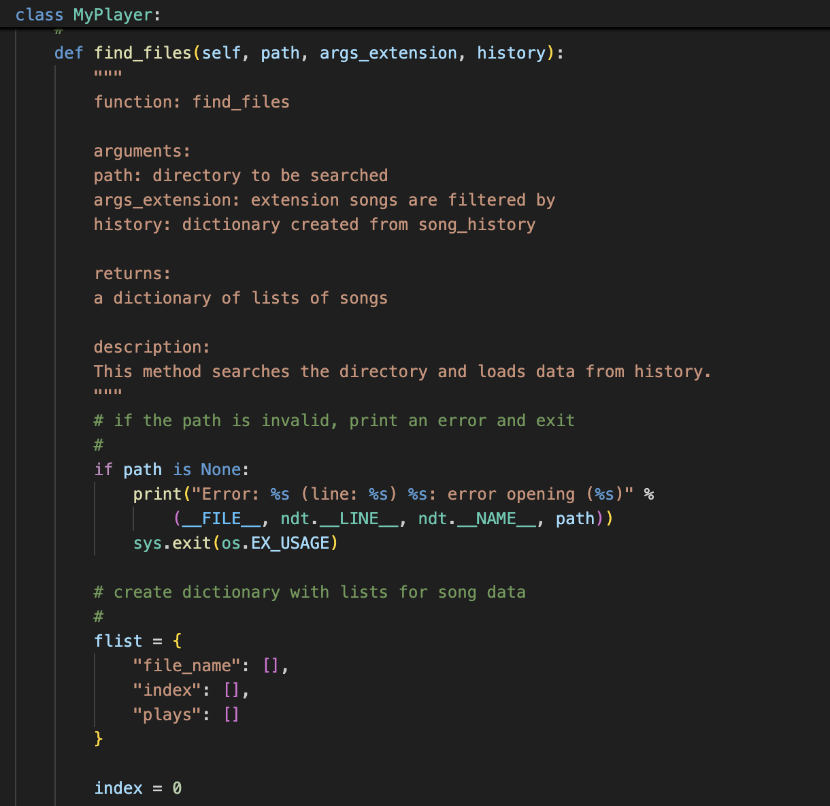
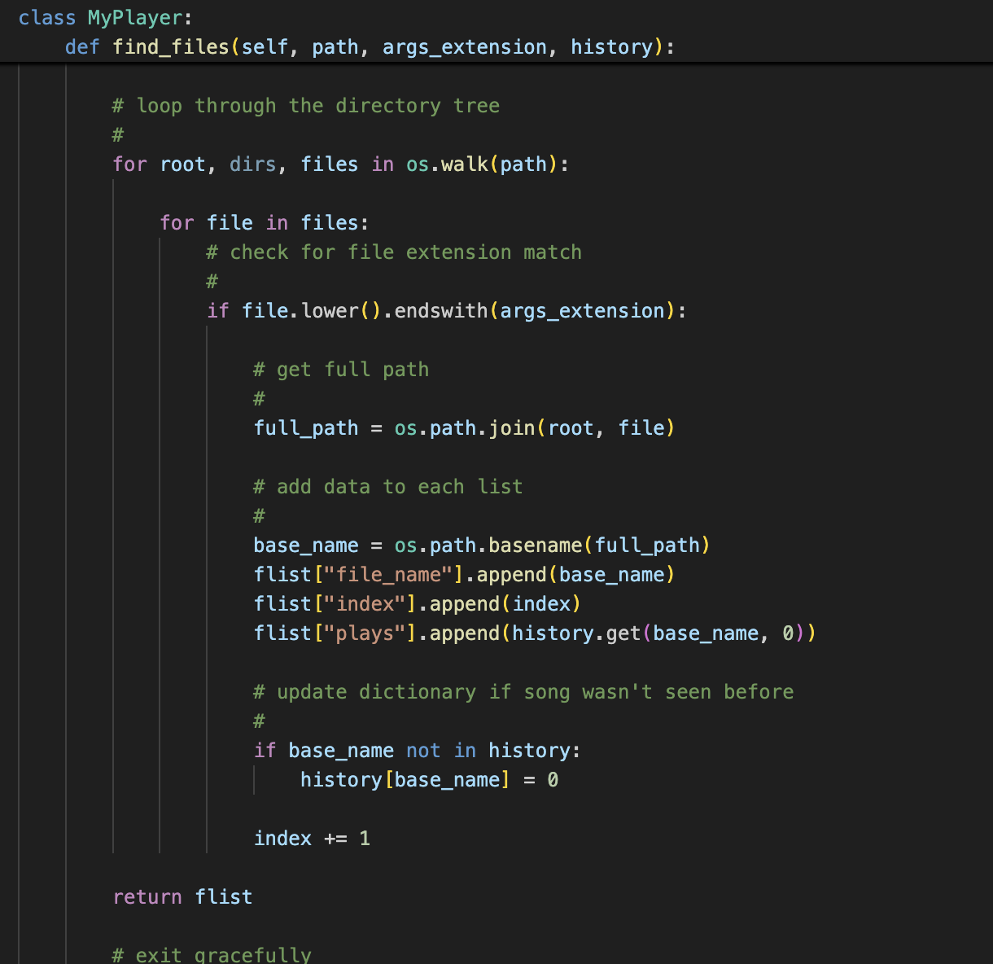
The find_files() function searches a given directory for files with a specific extension (like .mp3). It builds a dictionary that stores each song’s filename, index, and play count using the history data. If a song is new, it's added to the history with a play count of zero, preparing everything for playback and shuffling.

Slide 19
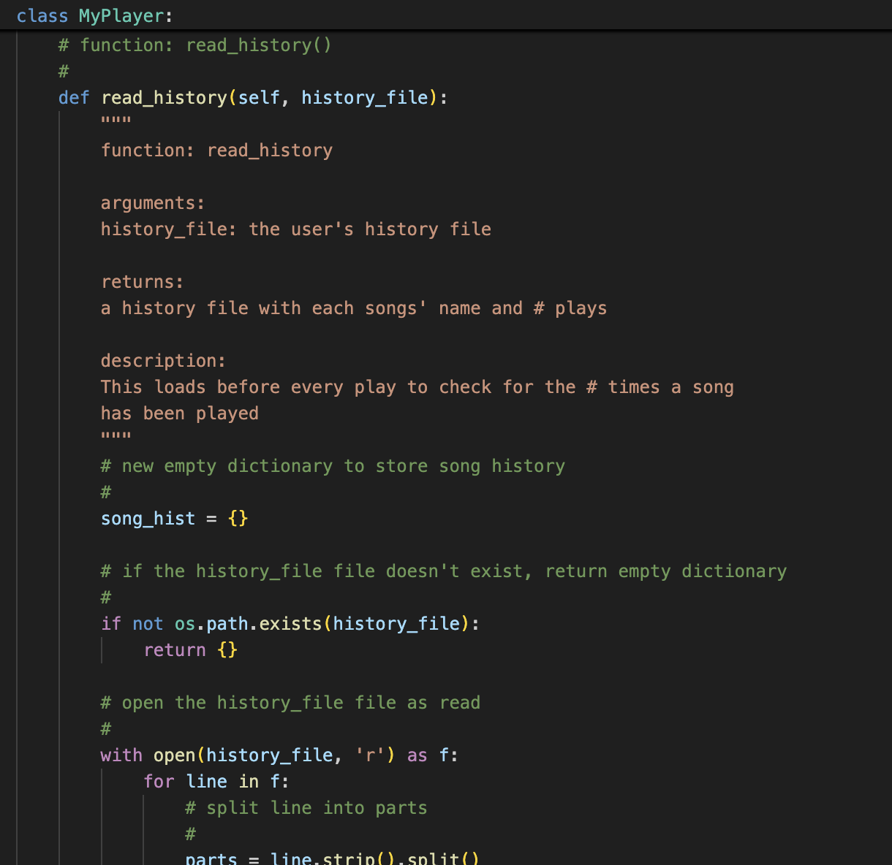
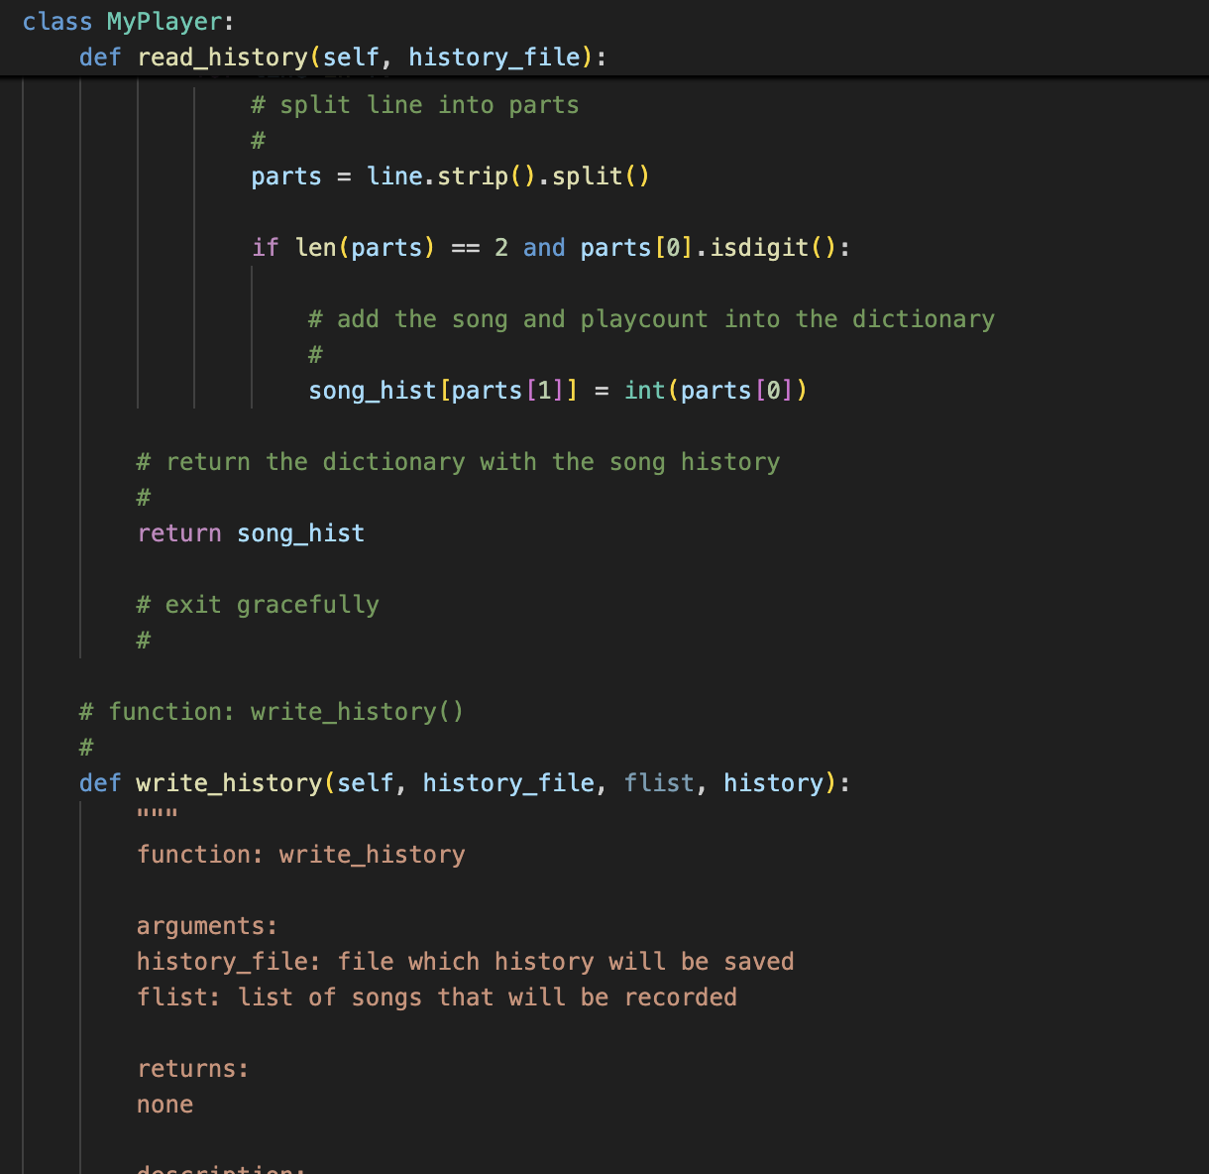
read_history() loads the song history from a file, storing how many times each song has been played. It creates an empty dictionary, then reads each line of the file and adds the play count and filename. If the file doesn’t exist, it returns an empty dictionary. This function runs before playing so the program saves and knows which songs have already been played and how often.

Slide 20
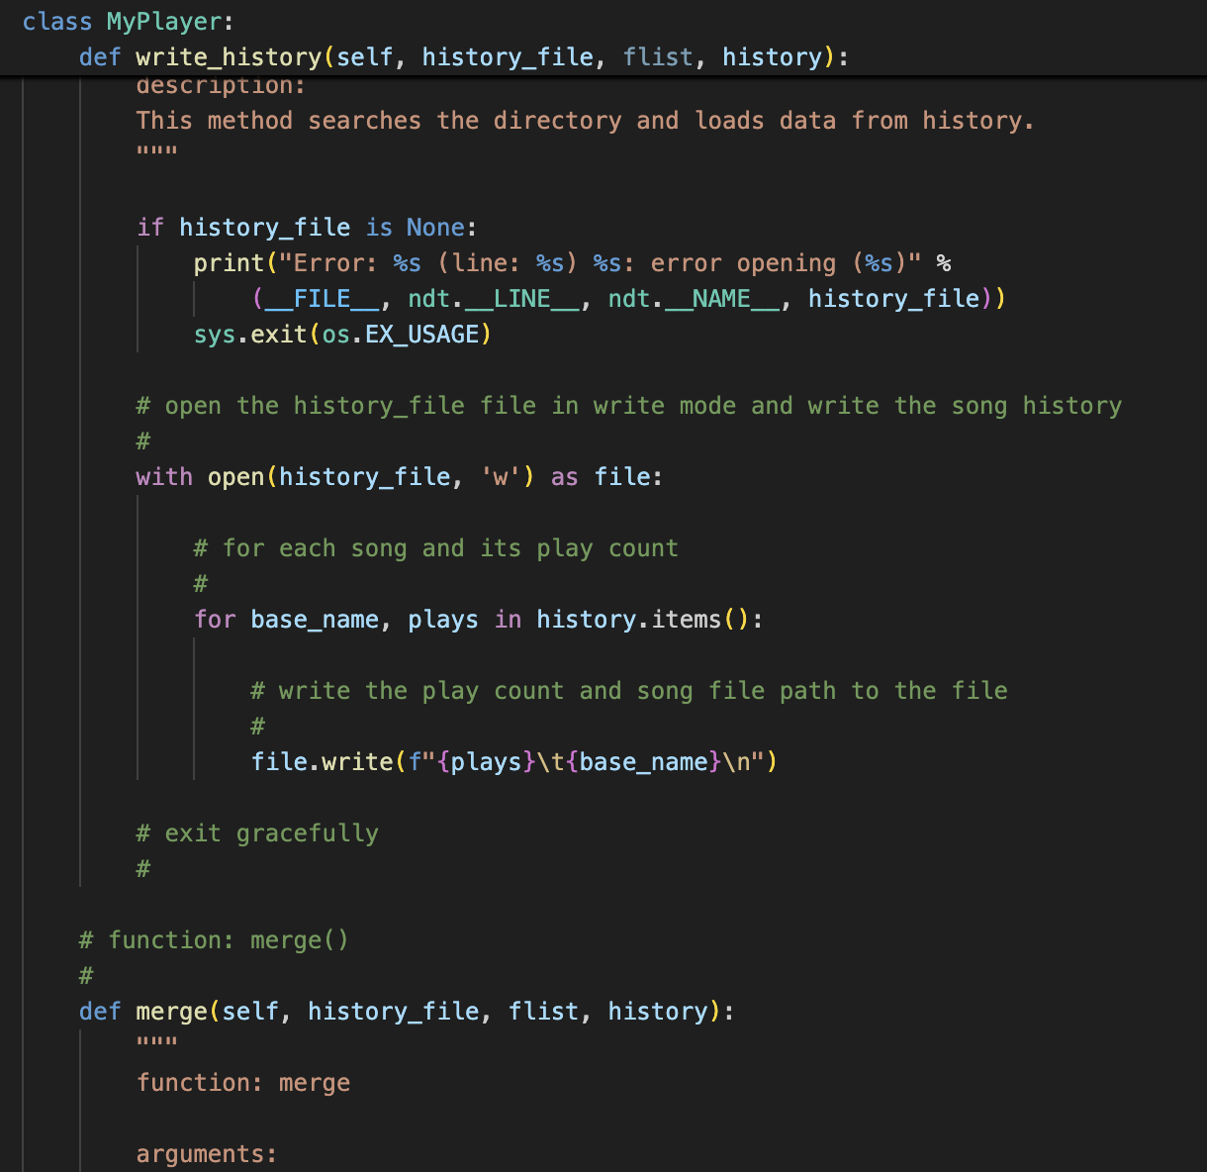
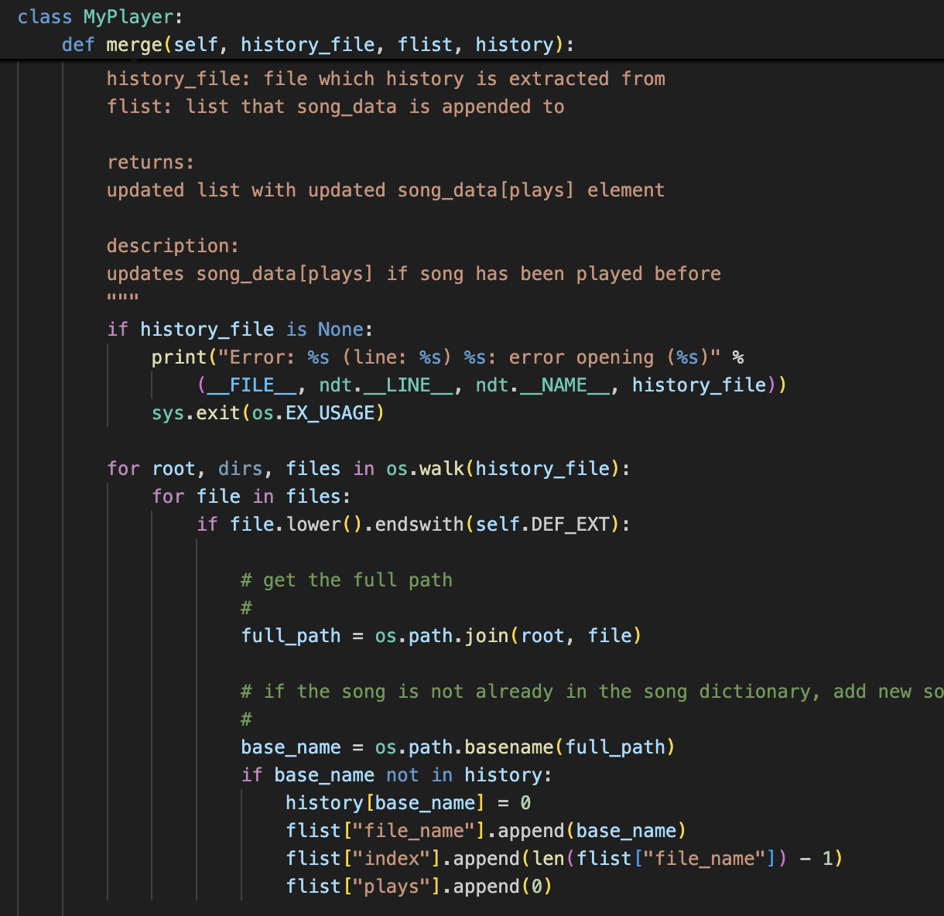
write_history() saves the current song history to a file, recording each song’s play count. It overwrites the file with updated data so progress is remembered next time the program runs. While merge() checks for any new songs not already in the play history and adds them to the list with 0 plays. This allows for new files to be smoothly added in.

Slide 21
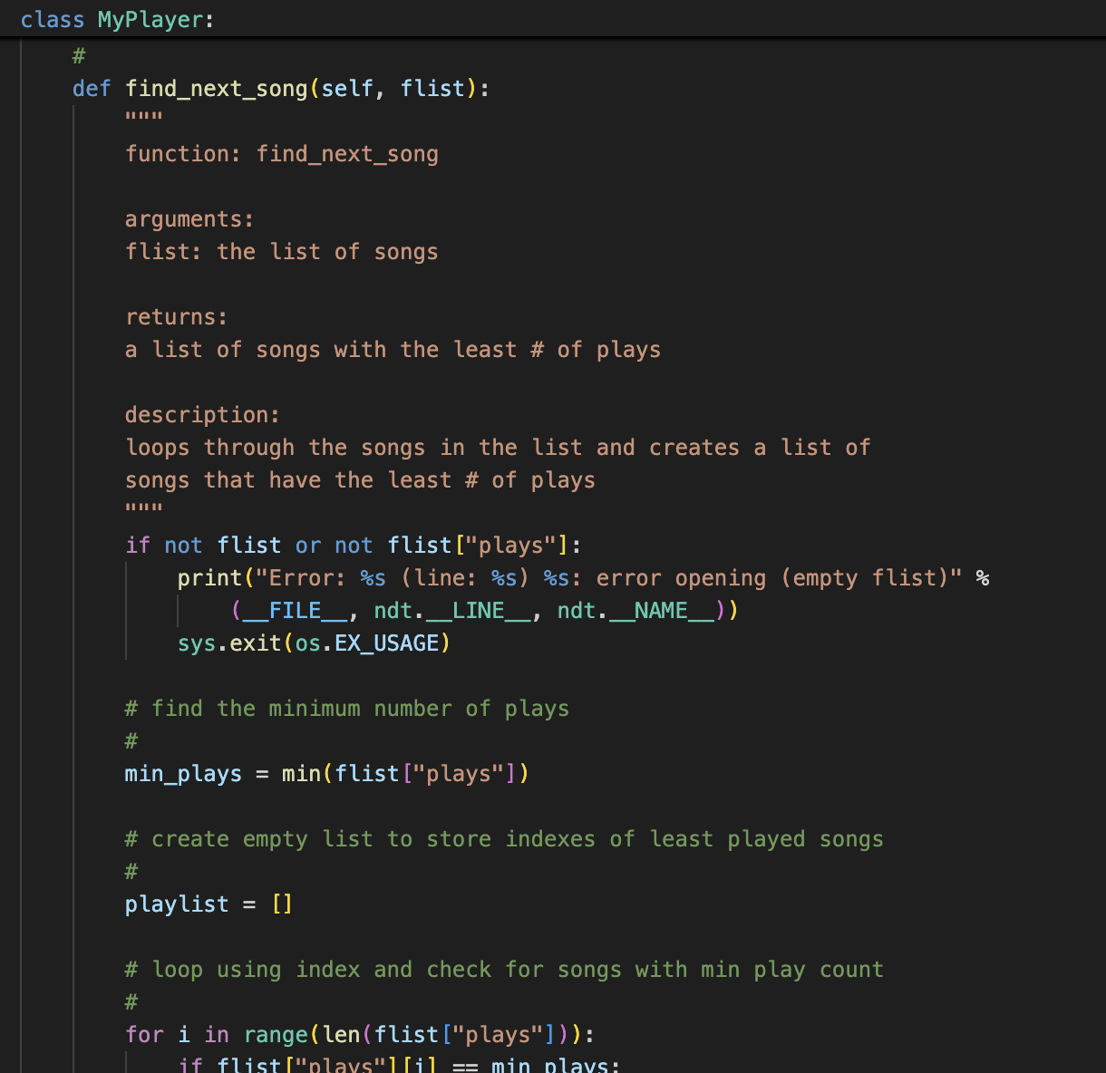
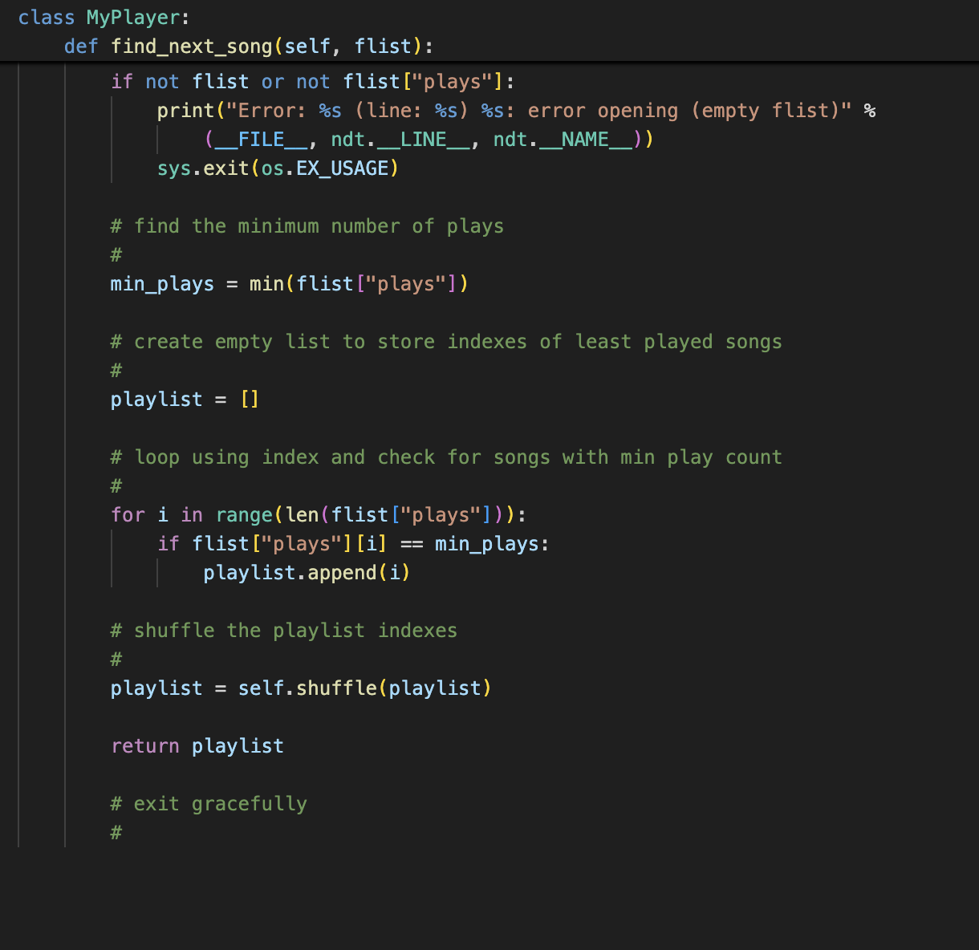
find_next_song() finds all songs with the lowest play count to find what to play next. It first checks if the song list is valid, then finds the minimum number of plays in the list. It collects the indexes of all songs that match that count and adds them to a new playlist. To make playback less predictable, it shuffles the resulting list before returning it.

Slide 22
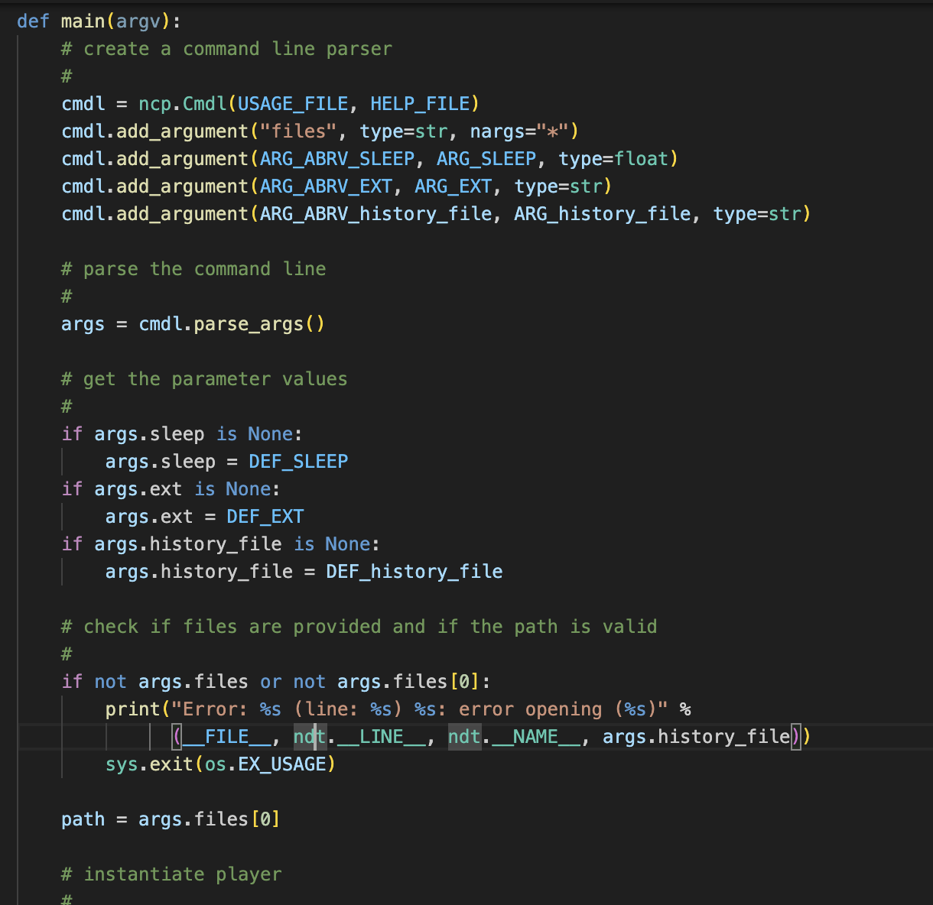
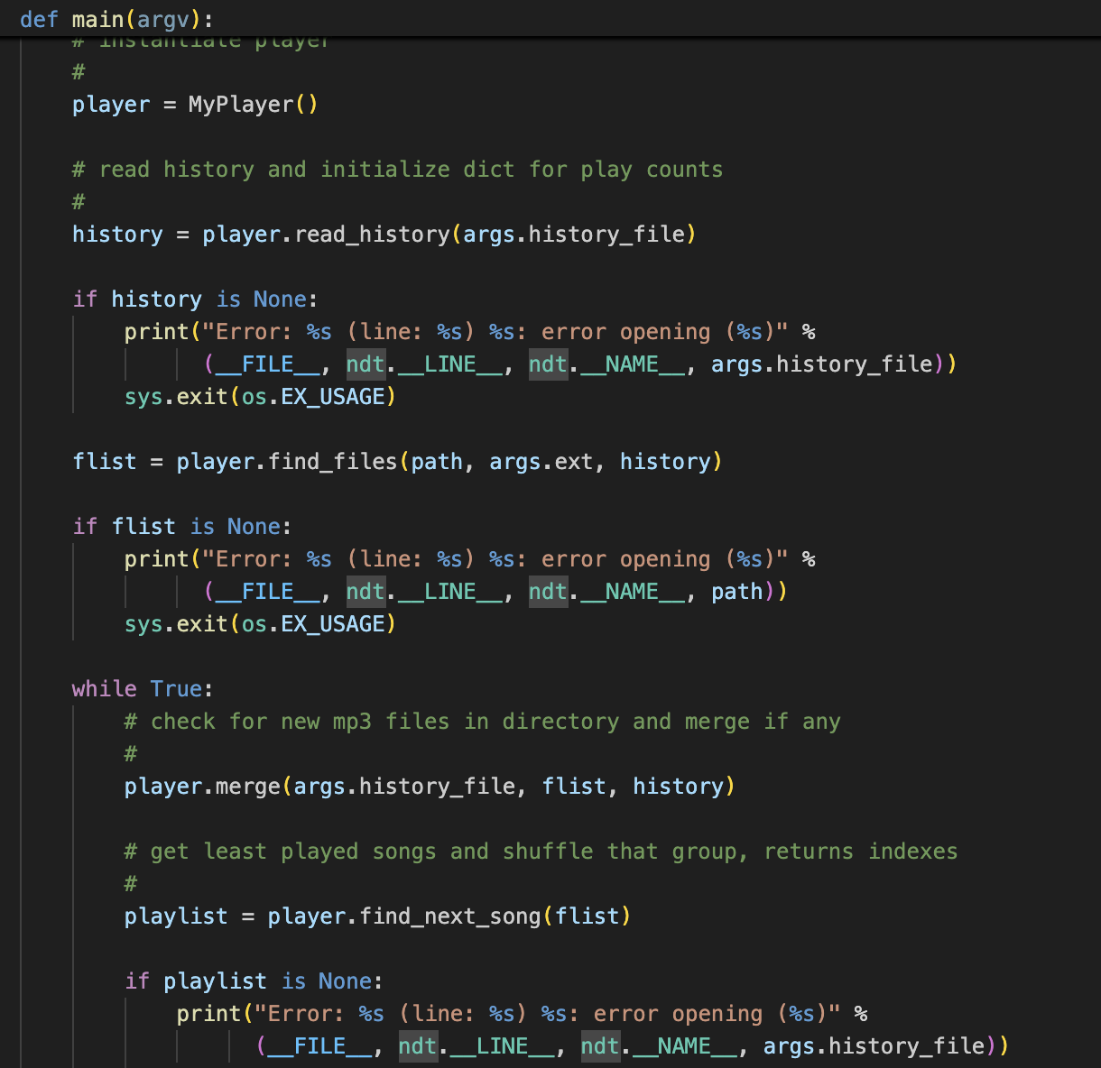
The main() function sets up and parses command-line arguments. It initializes the MyPlayer class, loads the song history, and builds a list of songs from the provided path. Then, in an infinite loop, it merges any new songs into the list, finds the least played songs, and shuffles them for fair, randomized playback.

Slide 23
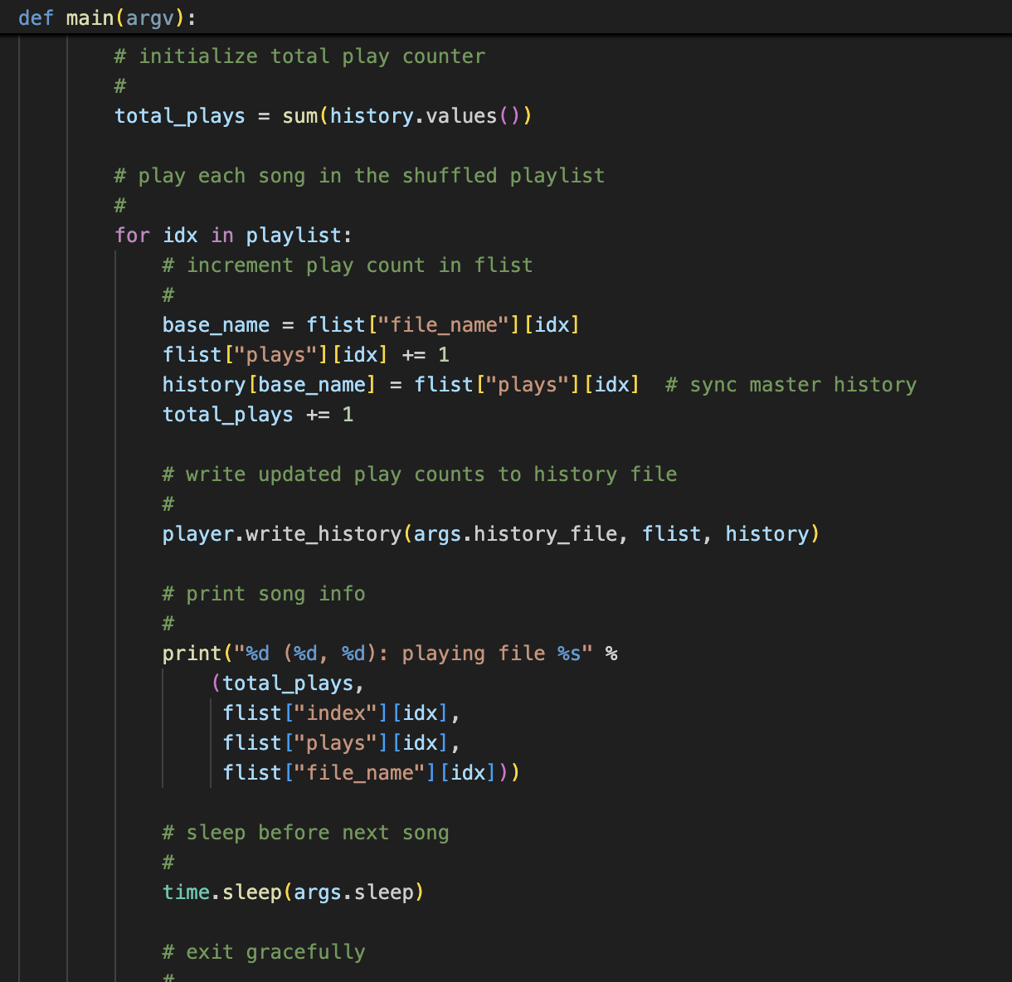
This last section of main() plays each song from the shuffled playlist one at a time. It updates the play count for each song in both the local list and the full history dictionary, keeping them in sync. After each song is played, it writes the updated history to the file so progress is saved. It prints out info about the song being played, including its total play count and index, and then waits before playing the next song. The program runs continuously until manually stopped.

Slide 24
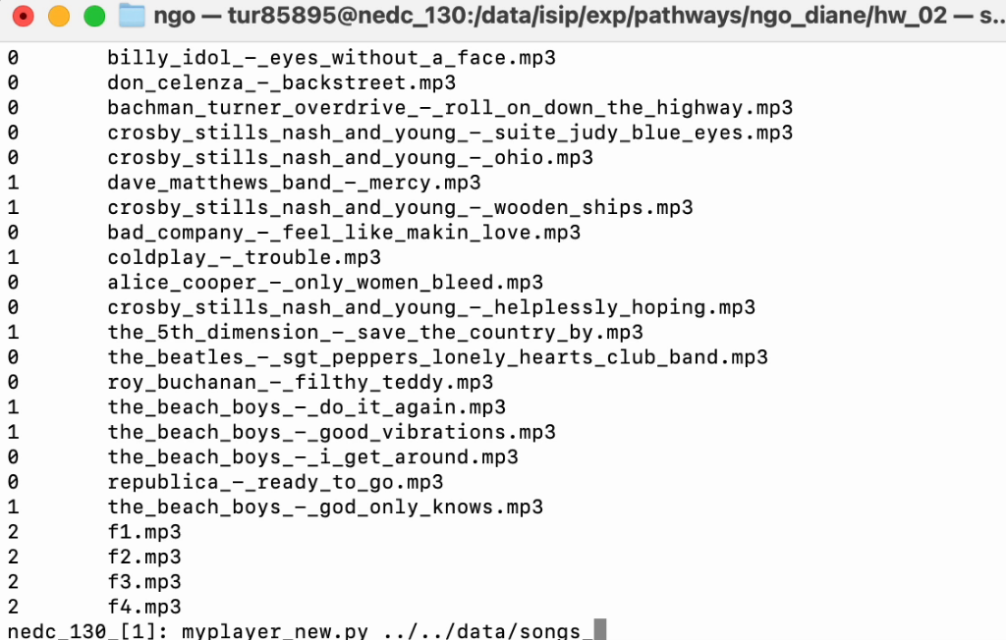
Here is a video of me playing the mp3 player. You can see how I specify the dictionary of the songs I want to play and how history is updated and saved between terminating.
The way it prints is ex. 16 (23, 1): playing file 'song name'.mp3.
The first number, 16, represents the total songs played so far, 23 represents the index of the song, and 1 represents the total times that specific song has been played.

Slide 25
cONCLUSION
In conclusion, these were our projects and tasks that we completed throughout the six-week program here at Temple. We learned:
How machine learning is applied in the medical field.
How to program in an actual work-based environment and adapt to a standard format.
Learned what it was like to work as a team and meet deadlines.
How to write detailed weekly reports.
Developed our knowledge in Unix machines, EMACs, and remote clusters.
The purpose of EEG systems, how to run them, and how to observe the results.

Slide 26
Summer experience Reflection
When we first started the program, we had no idea what to expect. We learned a whole new programming language, a new operating system, and had very strict expectations placed upon us. However, the program did help us grow as programmers and lab mates. Our mentors were friendly and helpful, we had thoughtful and instructional meetings, and overall had a pleasant work experience.
Now that we're at the end, we'd say we enjoyed our time very much and would return. We got to meet new people who shares our same interests, get an insight as to what it's like working a real programming job, and gained invaluable experience that we'll take with us into the future.

Slide 27



ACKNOWLEDGEMENTS
We would like to acknowledge and give our thanks and gratitude to Dr. Joseph Picone for his invaluable guidance and support throughout the program.
We are also deeply thankful to the graduate students, Claudia Dumitrescu and Abdullah Al Mamun, for their mentorship, assistance, and dedication in helping us understand python programming, Linux systems, and more throughout the program.
We also would like to give our thanks to Heights and Temple for this program opportunity. Thank you to Dr. Jeremy Heyman, Dr. Shawn Fagan, Caitlyn Obeng, Alondra Perez, and everyone else who helped make this program possible.

Slide 28
Thank you

Slide 29
rEFERENCES
Wikipedia Contributors. “Confusion Matrix.” Wikipedia, Wikimedia Foundation, 22 Oct. 2019, en.wikipedia.org/wiki/Confusion_matrix.
Wikipedia Contributors. “Sensitivity and Specificity.” Wikipedia, Wikimedia Foundation, 19 Jan. 2019, en.wikipedia.org/wiki/Sensitivity_and_specificity
“Object-Oriented Programming.” Wikipedia, Wikimedia Foundation, 5 Aug. 2025, en.wikipedia.org/wiki/Object-oriented_programming.
“Programming Paradigm.” Wikipedia, Wikimedia Foundation, 23 June 2025, en.wikipedia.org/wiki/Programming_paradigm.
Picone, Joseph. “The Institute for Signal and Information Processing.” Piconepress.com, 2024, isip.piconepress.com/. Accessed 1 Aug. 2025.

