Slide 1

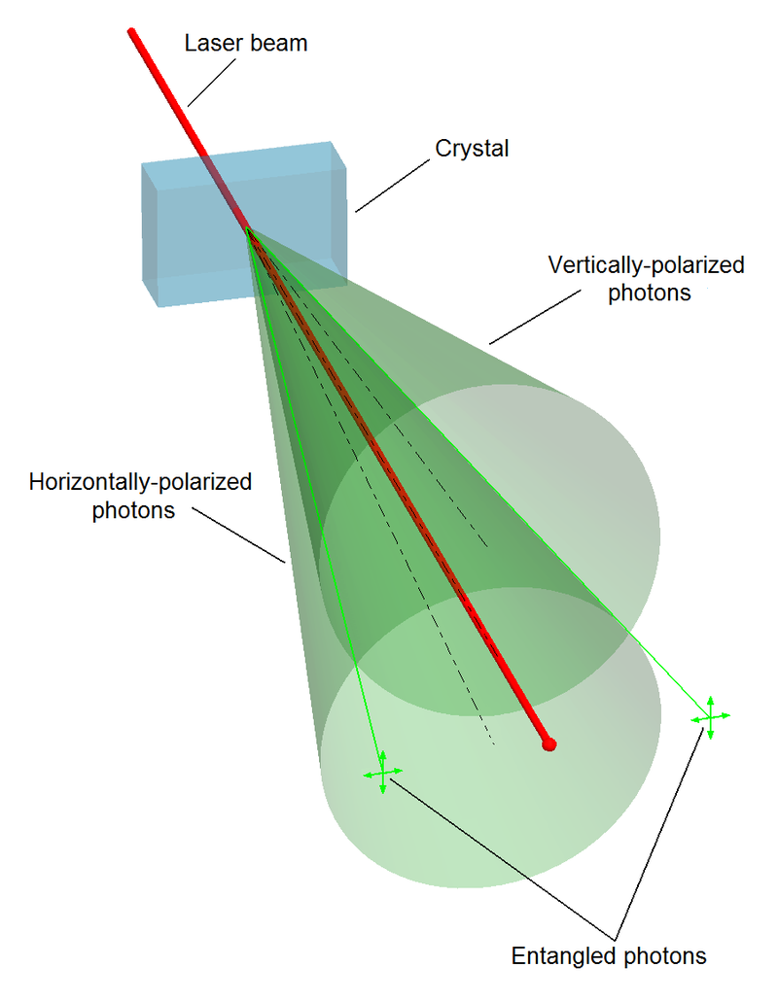
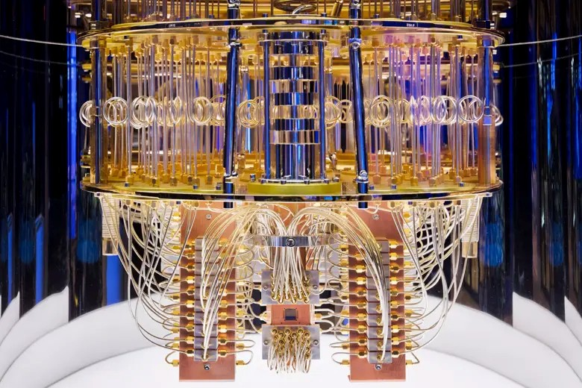
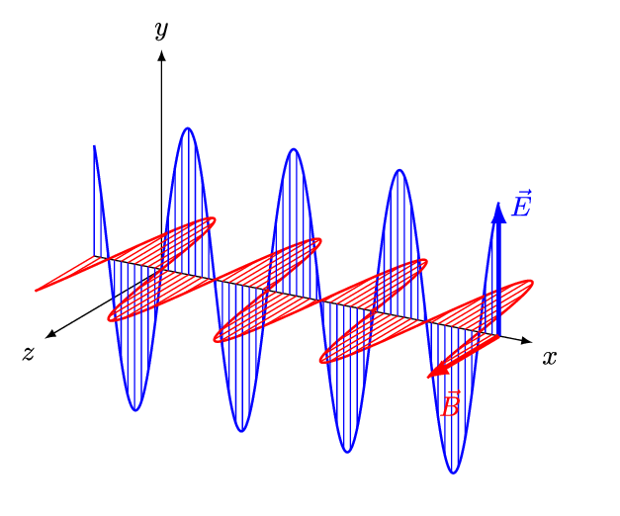
Quantum Machine Learning
Sadia Afrin Purba
Neural Engineering Data Consortium
Temple University

Slide 2
Experimental Setup
Dataset Read:
import nedc_edf_tools as net reader = net.Edf()
reader.get_header_from_file(str(edf_path))
hdr, sig_dict = reader.read_edf(str(edf_path), scale=True)
print(sig_dict)
>> T3-C3: [27.60472566 47.38845672 38.06796248 ... 76.33198385 62.6904942 75.42136085] C3-CZ: [ 1.73748077 10.6153825 14.86133551 ... -9.64939319 -6.94742309 -7.91241241]
each could have a shape of (15050,)
Number of channel combinations (pair-wise) = 190

Slide 3
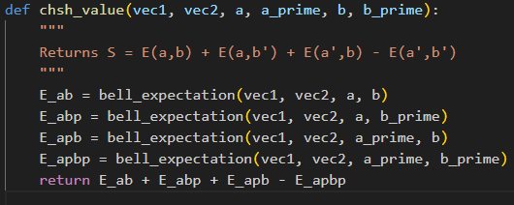
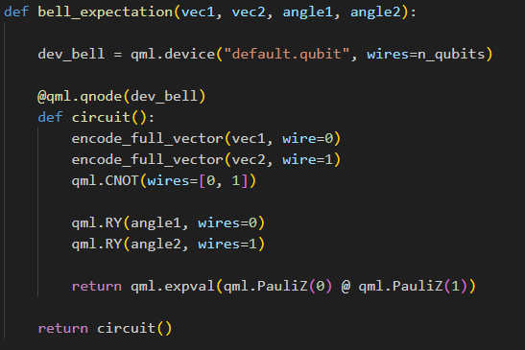
Experimental Setup
CHSH Bell Value:
$$S=E\left(a,b\right)+E\left(a, b^{′}\right)+E\left(a^{′}, b\right) −E(a^{′},b′)$$
Where, $a, b, a^{′}, b^{′}$ are the measurement angles.
Let, $a=0, b=\frac{π}{4}{, a}^{′}=\frac{π}{2}, b^{′}=−π/4$
Data: /data/isip/data/tuh_eeg_seizure/v2.0.3_50hz_corrected/edf/train
If $S≥ 2.0$, there is a CHSH bell value violation meaning the correlations measured in the two EEG channels cannot be explained by any local realistic (classical) theory.

Slide 4
Experimental Setup
Number of EDF files = 100
Exp | Encoding | Results
(1) Does correlation or mutual information change before and after quantum encoding of two EEG channels? | Basis | correlation: increase, mi: decrease
 | Angle | correlation: increase, mi: decrease
 | Amplitude | correlation: increase, mi: decrease
 | Custom | correlation: increase, mi: decrease
(2) If we invert the encoding, can we reconstruct the original data? | Basis | Yes
 | Angle | No
 | Amplitude | No
 | Custom | No
(3) Do we get the CHSH bell value violation? | Basis | Yes
 | Angle | Yes
 | Amplitude | Yes
 | Custom | Yes

Slide 5
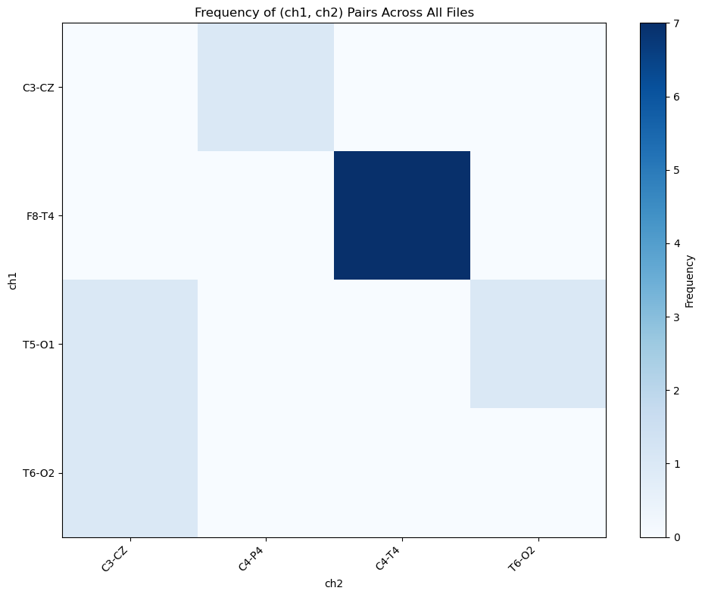
Experimental Setup
Encoding: Amplitude
CHSH bell value violation found in 2/100 EDF files

Slide 6
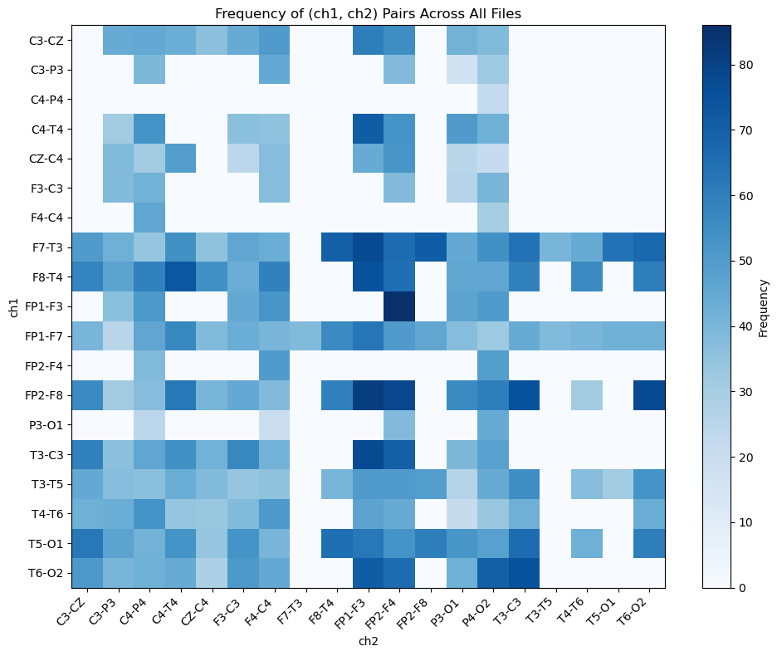
Experimental Setup
Encoding: Basis
CHSH bell value violation found in 28/100 EDF files

Slide 7
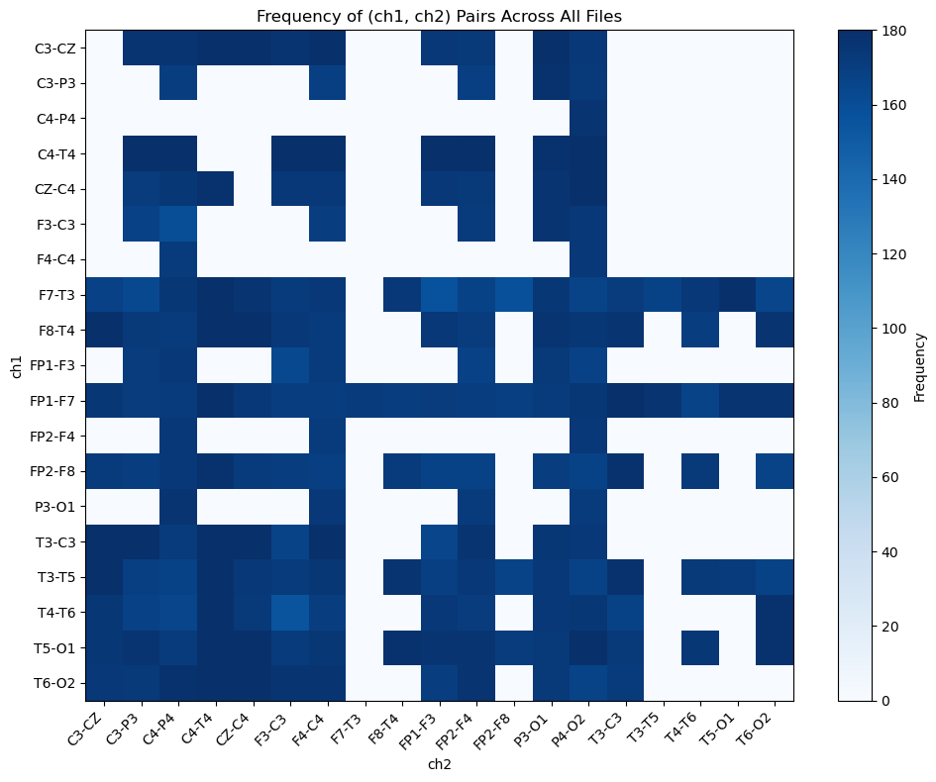
Experimental Setup
Encoding: Angle
CHSH bell value violation found in 28/100 EDF files

Slide 8
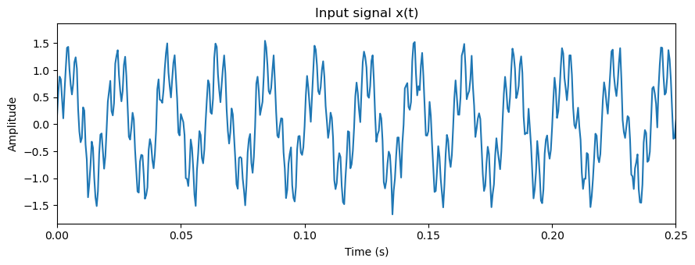
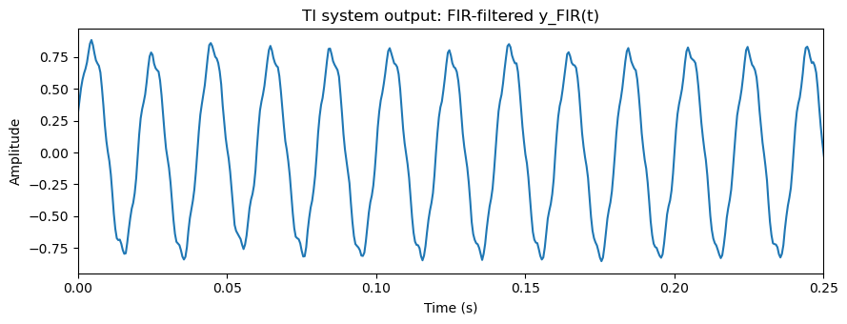
Shannon vs von Neumann Entropy

Slide 9
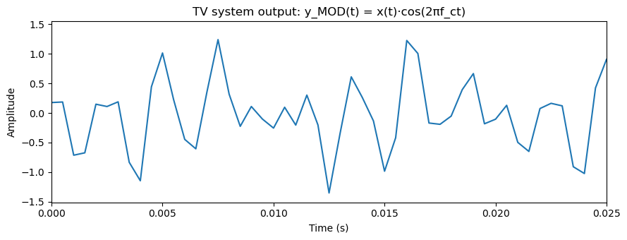
Shannon vs von Neumann Entropy

Slide 10
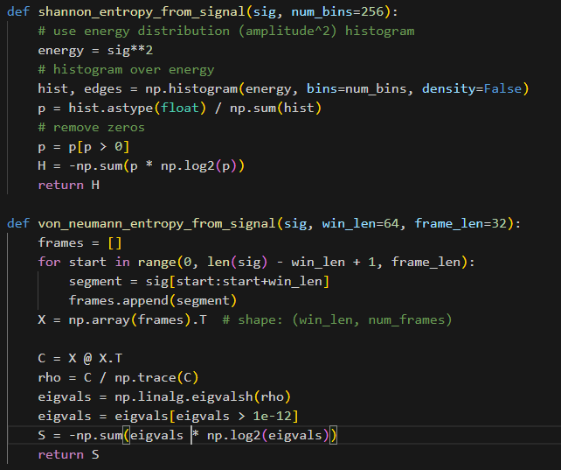
Shannon vs von Neumann Entropy

Slide 11
Shannon vs von Neumann Entropy
System | H(X) | S(X)
[[1 0] [0 1]] | 4.0942 | 0.0000
[[1. 0.5] [0.5 1. ]] | 3.8867 | -0.3774
[[0.5 0. ] [0. 0.5]] | 3.0942 | 1.0000
[[0.5 0.25] [0.25 0.5 ]] | 2.8867 | 0.8113
X(t) | 7.0448 | 1.1641
TI: FIR output | 7.5611 | 1.0019
TV: Modulated output | 6.2195 | 2.1413

Slide 12
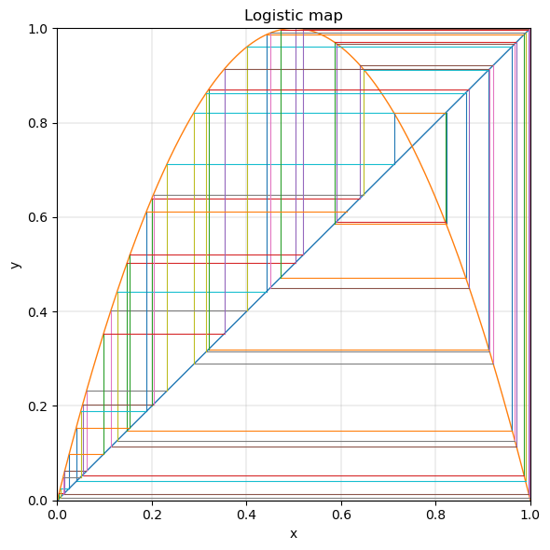
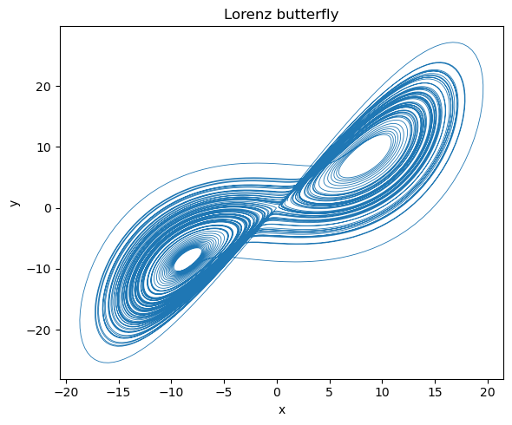
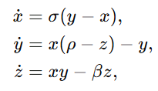

Shannon vs von Neumann Entropy
System | H(X) | S(X)
Logistic map | 6.3521 | 6.4442
Lorenz butterfly | 8.5842 | 10.0789

