Slide 1

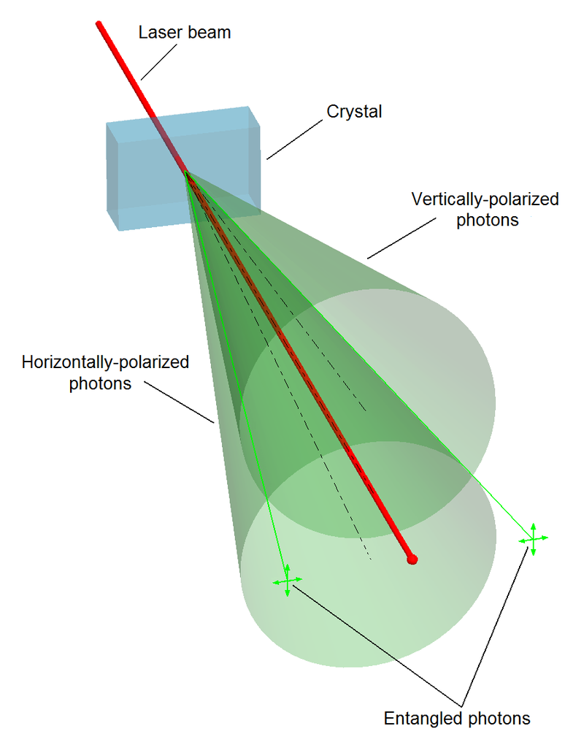
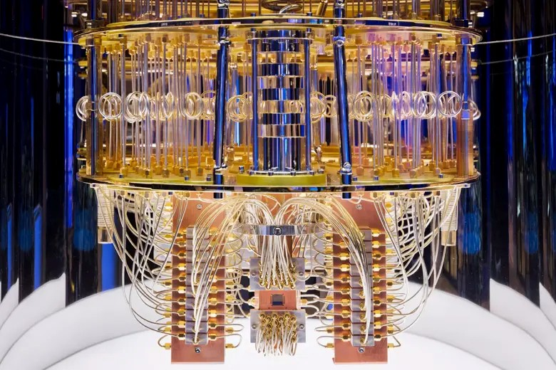
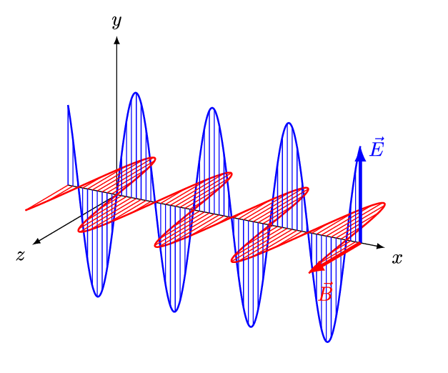
Quantum Machine Learning
Sadia Afrin Purba
Neural Engineering Data Consortium
Temple University

Slide 2
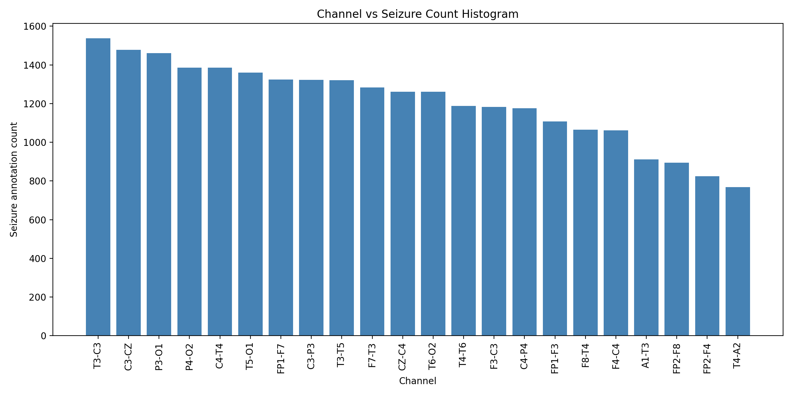
Data
Data: /data/isip/data/tuh_eeg_seizure/v2.0.3_50hz_corrected/edf/train

Slide 3
Experimental Setup
Dataset Read:
import nedc_edf_tools as net reader = net.Edf()
reader.get_header_from_file(str(edf_path))
hdr, sig_dict = reader.read_edf(str(edf_path), scale=True)
print(sig_dict)
>> T3-C3: [27.60472566 47.38845672 38.06796248 ... 76.33198385 62.6904942 75.42136085] C3-CZ: [ 1.73748077 10.6153825 14.86133551 ... -9.64939319 -6.94742309 -7.91241241]
each has shape=(15050,)
Number of channel combinations (pair-wise) = 190

Slide 4
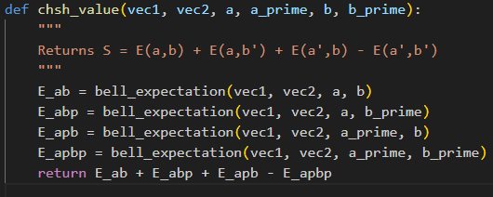
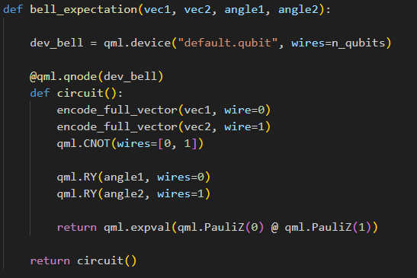
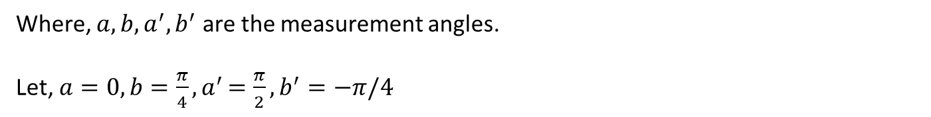
Experimental Setup
CHSH Bell Value:
$$S=E\left(a,b\right)+E\left(a, b^{′}\right)+E\left(a^{′}, b\right) −E(a^{′},b′)$$
Where, $a, b, a^{′}, b^{′}$ are the measurement angles.
Let, $a=0, b=\frac{π}{4}{, a}^{′}=\frac{π}{2}, b^{′}=−π/4$

Slide 5
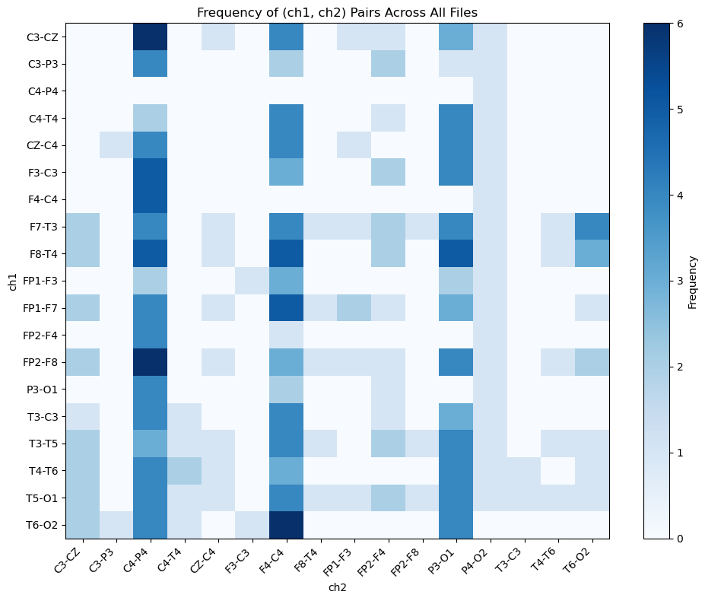
Results
Exp – 01: Considers the full vector (size = 15050)
CHSH violation happens for 24 files out of 100

Slide 6
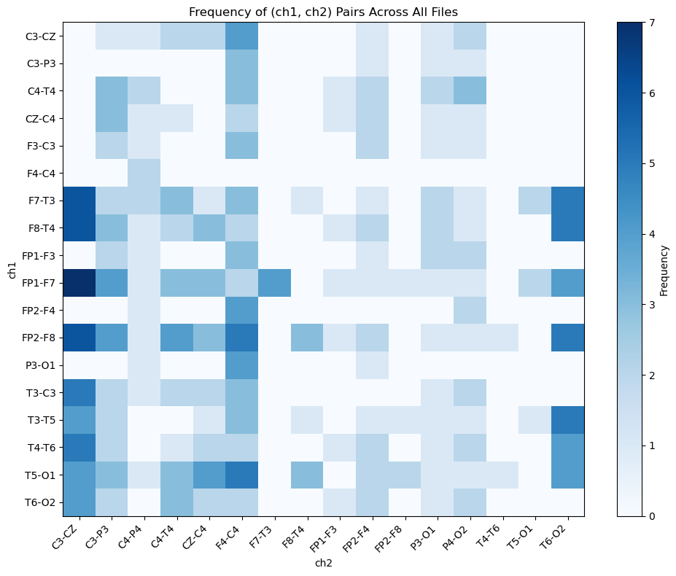
Results
Exp – 02: Considers only the seizure segments
CHSH violation happens for 16 files out of 100

Slide 7
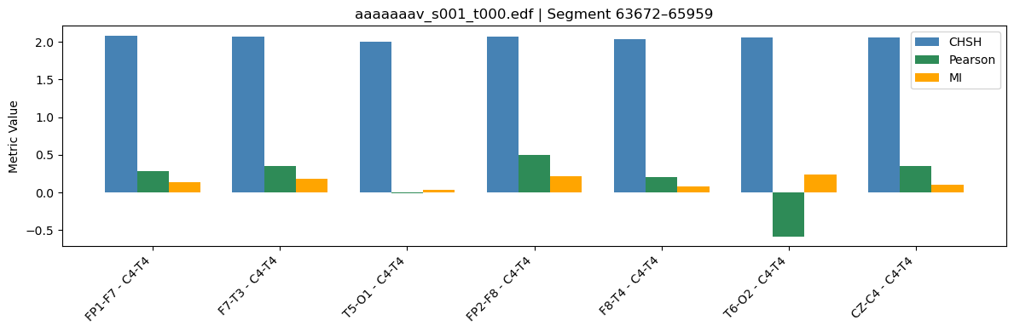
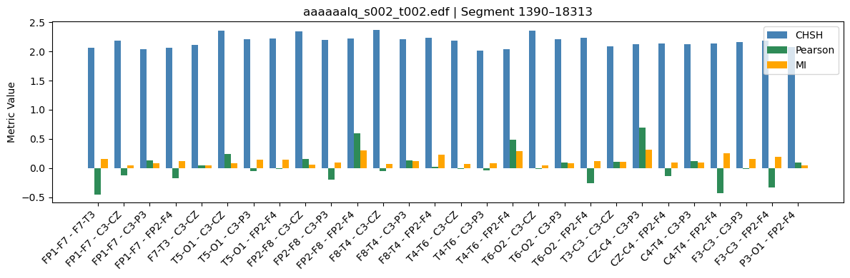
Results

Slide 8
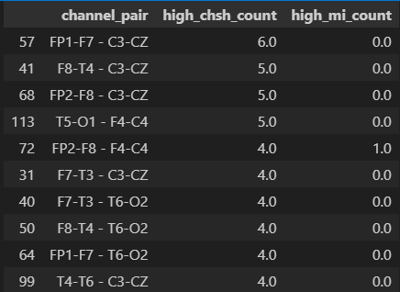
Results

Slide 9
Future Plan
Consider CHSH Bell value as an important feature selector
classical ML algorithm to classify seiz/bckg and compare with nedc_eeg_resnet.
quantum Algorithm to classify seiz/bckg and compare with nedc_eeg_resnet.

