Slide 1

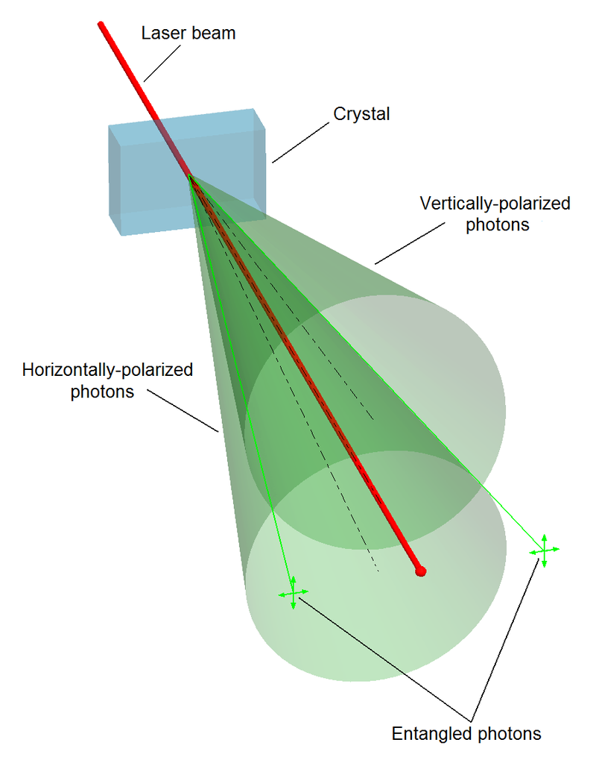
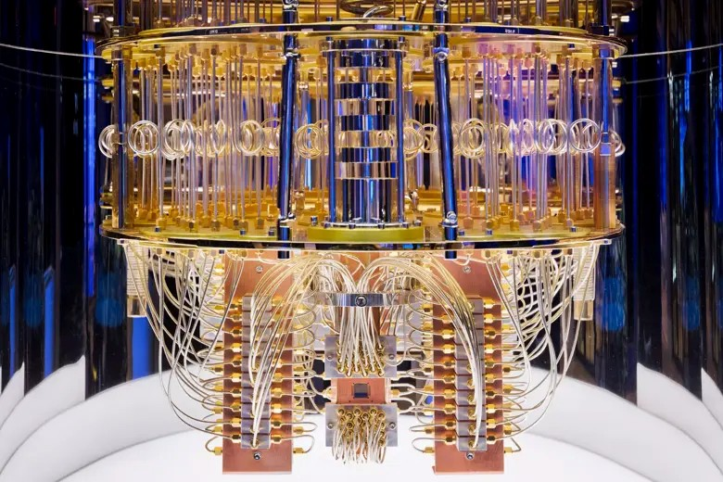
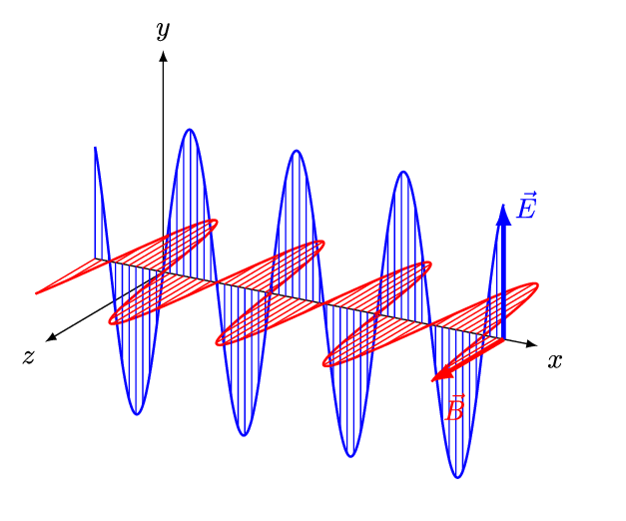
Quantum Machine Learning
Sadia Afrin Purba
Neural Engineering Data Consortium
Temple University

Slide 2
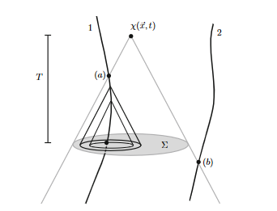
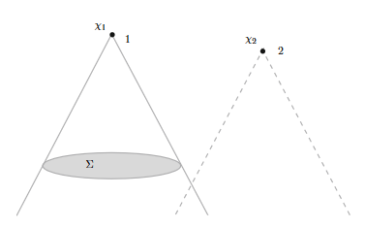

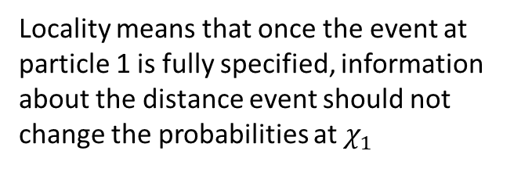

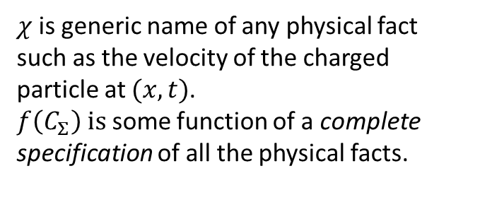
Bell’s Formulation of Locality
$$χ\left(x, t\right)=f(C_{Σ})$$
$χ$is generic name of any physical fact such as the velocity of the charged particle at $(x, t)$.
$f\left(C_{Σ}\right) is$ some function of a complete specification of all the physical facts.
Fig-1: Space-time diagram of Maxwell’s electrodynamics
$$P\left[χ_{1} | C_{Σ}\right]=P\left[χ_{1}\right|C_{Σ}, χ_{2}]$$
Locality means that once the event at particle 1 is fully specified, information about the distance event should not change the probabilities at $χ_{1}$
Fig-2: Bell’s generic definition of local causality

Slide 3


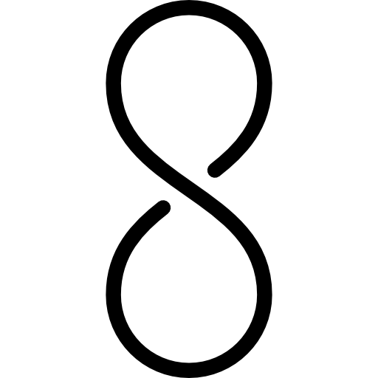




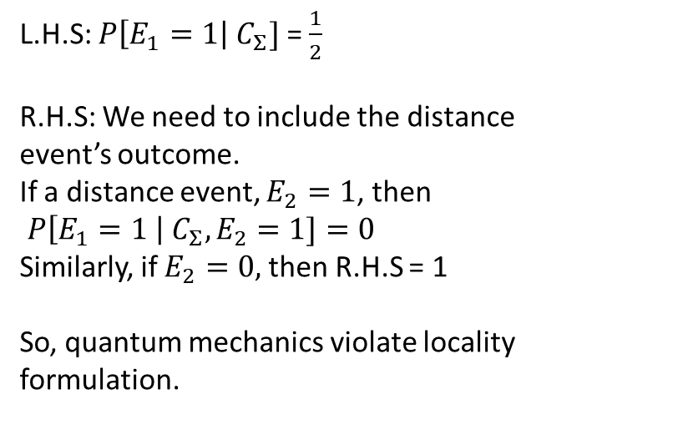
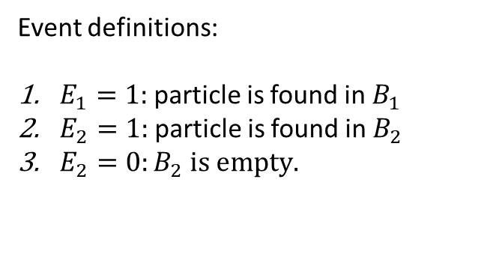

Violation of Bell’s Locality Formulation
$$P\left[χ_{1} | C_{Σ}\right]=P\left[χ_{1}\right|C_{Σ}, χ_{2}]$$
Event definitions:
$E_{1}=1:$particle is found in $B_{1 }$
$E_{2}=1:$particle is found in $B_{2}$
$E_{2}=0:B_{2} is empty.$
$$B_{1}$$
L.H.S: $P\left[E_{1}=1\right|{ C}_{Σ}]$ = $\frac{1}{2}$
R.H.S: We need to include the distance
event’s outcome.
If a distance event, $E_{2}=1$, then
$P\left[E_{1}=1 \right|{ C}_{Σ}, E_{2}=1]=0$
Similarly, if $E_{2}=0,$then R.H.S = 1
So, quantum mechanics violate locality formulation.
$$B_{2}$$
$$C_{Σ}=\left|ψ\right\rangle$$
$C_{Σ}=\left|ψ\right\rangle$ =$\left|ψ_{1}\right\rangle +\left|ψ_{2}\right\rangle$

Slide 4
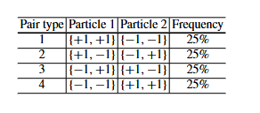

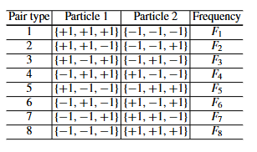

Bell’s Theorem
Axiom 1: In Bohm’s re-formulation, we consider a pair of spatially separated spin ½ particles in the spin “singlet” state
{+1, -1} for particle 1 and {+1, -1} for particle 2 would violate the perfect correlation property, and it’s not possible to happen.
Axiom 2: Bell generalised Bohm’s singlet state for all three possible measurement directions, and assumed “hidden variable” theory meaning, the particles knew about all possible values before measurement.

Slide 5
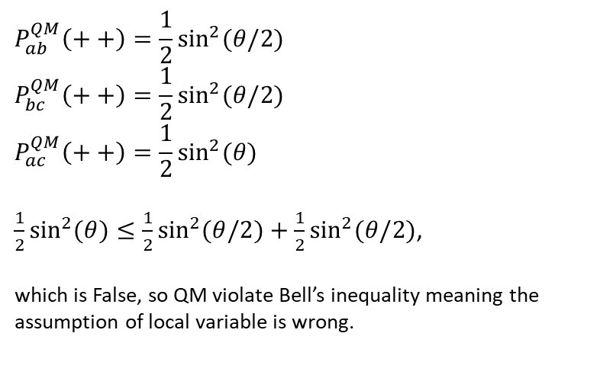
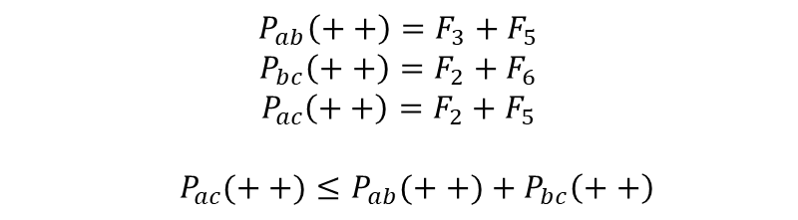
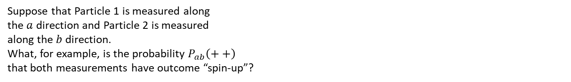
Bell’s Theorem (Toy Example)
Suppose that Particle 1 is measured along
the $a$ direction and Particle 2 is measured
along the $b$ direction.
What, for example, is the probability $P_{ab}\left(++\right)$
that both measurements have outcome “spin-up”?
$$P_{ab}^{QM}\left(++\right)=\frac{1}{2}\sin^{2}{(θ/2)}$$
$$P_{bc}^{QM}\left(++\right)=\frac{1}{2}\sin^{2}{(θ/2)}$$
$$P_{ac}^{QM}\left(++\right)=\frac{1}{2}\sin^{2}{(θ)}$$
$\frac{1}{2}\sin^{2}{(θ)}≤\frac{1}{2}\sin^{2}{(θ/2)}+\frac{1}{2}\sin^{2}{(θ/2)}$,
which is False, so QM violate Bell’s inequality meaning the assumption of local variable is wrong.
$$P_{ab}\left(++\right)=F_{3}+F_{5}$$
$$P_{bc}\left(++\right)=F_{2}+F_{6}$$
$$P_{ac}\left(++\right)=F_{2}+F_{5}$$
$${ P}_{ac}(++)≤P_{ab}(++)+P_{bc}\left(++\right)$$

Slide 6
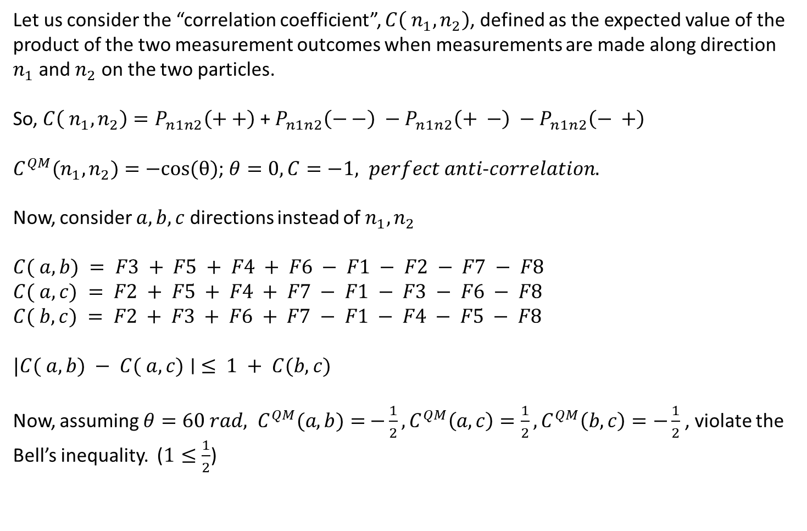
Bell’s Theorem
Let us consider the “correlation coefficient”, $C\left( n_{1}, n_{2}\right)$, defined as the expected value of the product of the two measurement outcomes when measurements are made along direction $n_{1}$ and $n_{2}$ on the two particles.
So, $C\left( n_{1}, n_{2}\right)=P_{n1n2}\left(++\right)$ + $P_{n1n2}\left(−−\right) −P_{n1n2}\left(+ −\right) −P_{n1n2}\left(− +\right)$
$C^{QM}(n_{1},n_{2})=−cos⁡(θ)$; $θ=0, C=−1, perfect anti$-$correlation.$
Now, consider $a,b,c$directions instead of $n_{1}, n_{2}$
$$C( a, b) = F3 + F5 + F4 + F6 − F1 − F2 − F7 − F8$$
$$C( a, c) = F2 + F5 + F4 + F7 − F1 − F3 − F6 − F8$$
$$C( b, c) = F2 + F3 + F6 + F7 − F1 − F4 − F5 − F8$$
$$|C( a, b) − C( a, c)∣ ≤ 1 + C(b, c)$$
Now, assuming $θ=60 rad,$ $C^{QM}(a, b)=$ $−\frac{1}{2},C^{QM}\left(a,c\right)=\frac{1}{2},C^{QM}\left(b,c\right)=−\frac{1}{2}$, violate the Bell’s inequality. ($1≤\frac{1}{2}$)

Slide 7
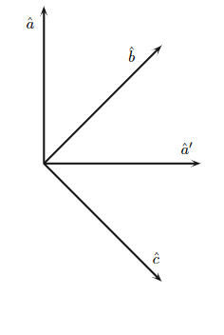

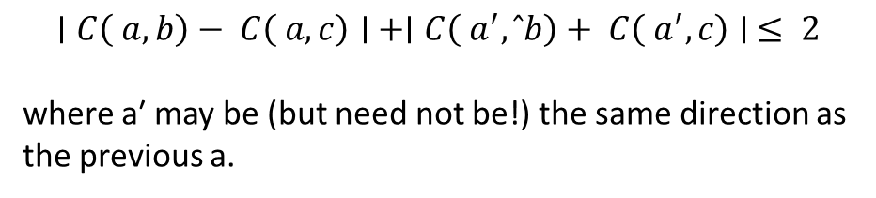
CHSH Inequality
$$|C( a, b) − C( a, c)∣ ≤ 1 + C(b, c)$$
$$∣C\left( a, b\right)− C\left( a, c\right)∣ +∣C\left( a^{′}, ˆb\right)+ C\left( a^{′}, c\right)∣ ≤ 2$$
where a′ may be (but need not be!) the same direction as the previous a.
$$C^{QM}(n_{1},n_{2})=−cos⁡(45)$$
This is a factor of √2 – i.e., about 40% – bigger than should be allowed if a local hidden variable theory is true.

Slide 8
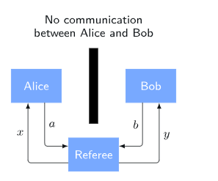
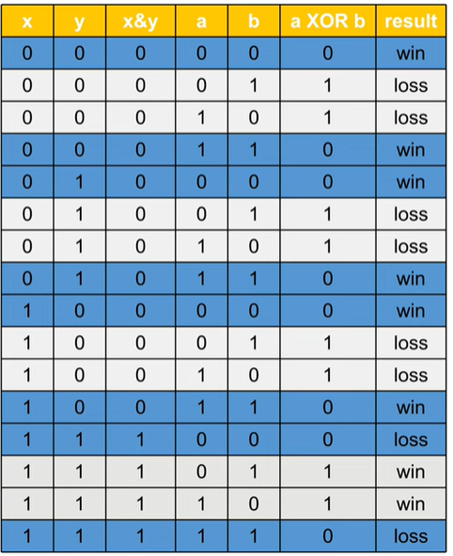
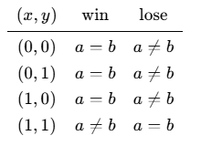


CHSH Game
$$x,y,a,b∈\left\{0, 1\right\}$$
Win if $a⊕b=x∧y$ and lose otherwise
In any classical strategy, there is at most 75% chance of winning the game.

Slide 9
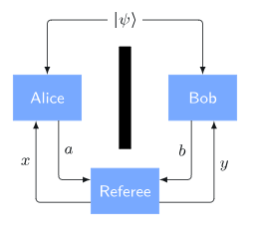
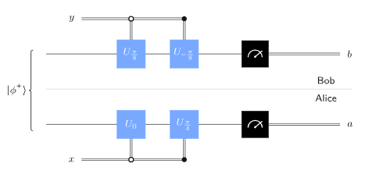

CHSH Game
$$x,y,a,b∈\left\{0, 1\right\}$$
In any quantum strategy, there is at most 85% chance of winning the game.

Slide 10
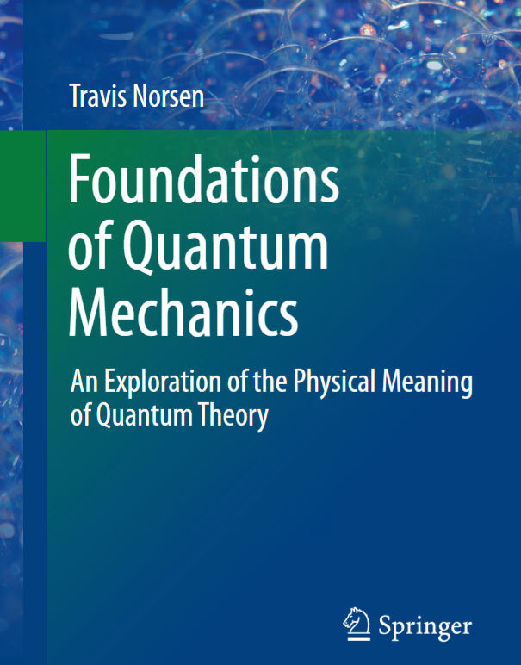
References
Qiskit’s Lesson
Chapter 1-2, 4, 8

