Slide 1

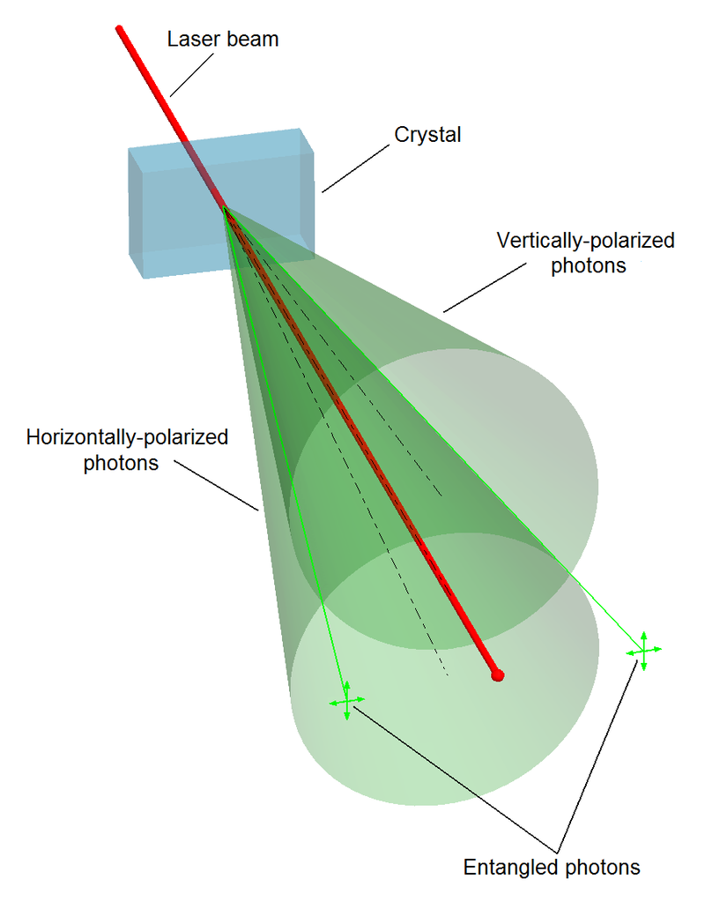
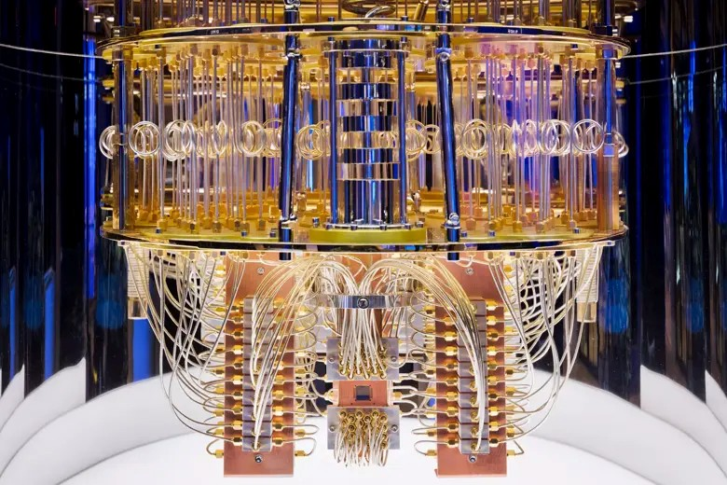
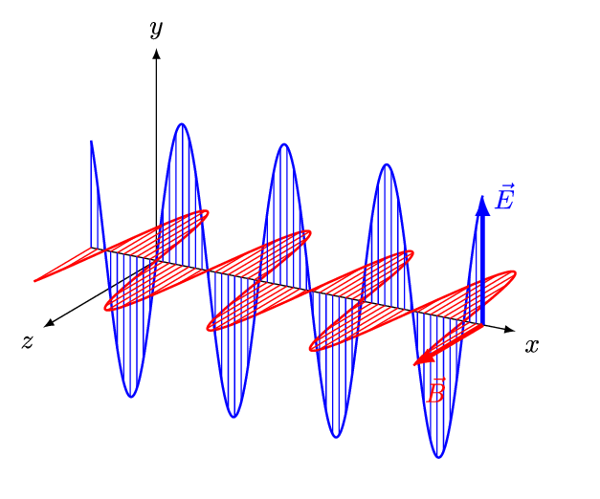
Quantum Machine Learning
Sadia Afrin Purba
Neural Engineering Data Consortium
Temple University

Slide 2
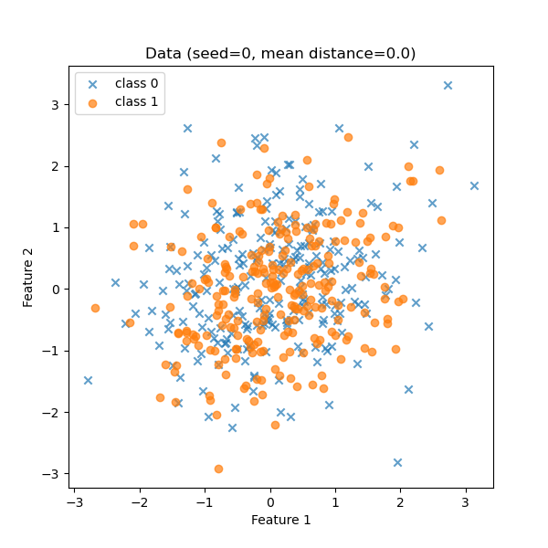
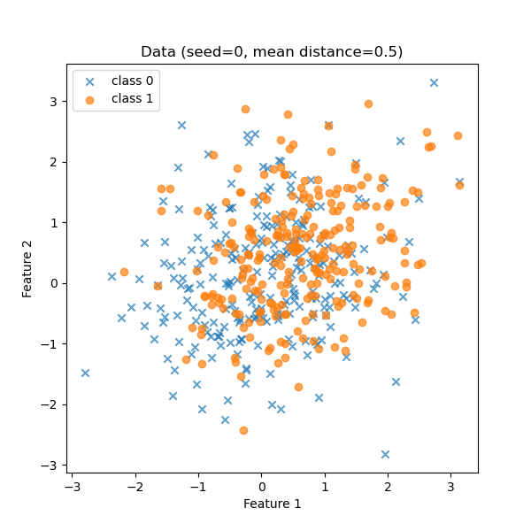
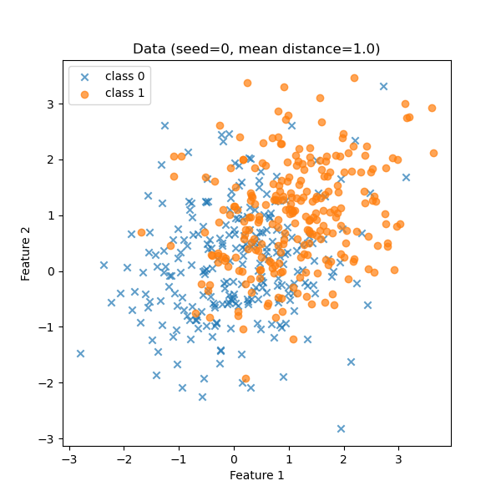
Overlapping 2D Gaussian Data

Slide 3
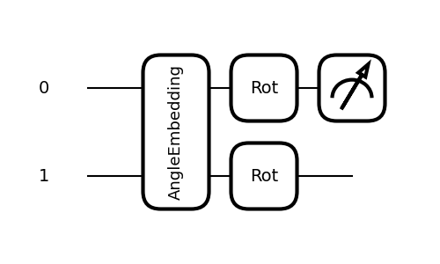

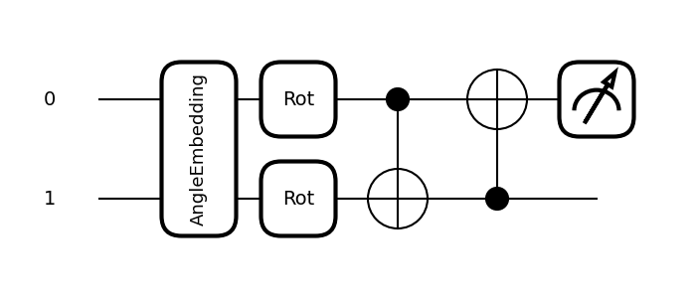
Quantum Circuit
Variation Quantum Circuit without Entanglement (L=1)
Variation Quantum Circuit with Entanglement (L=1)

Slide 4
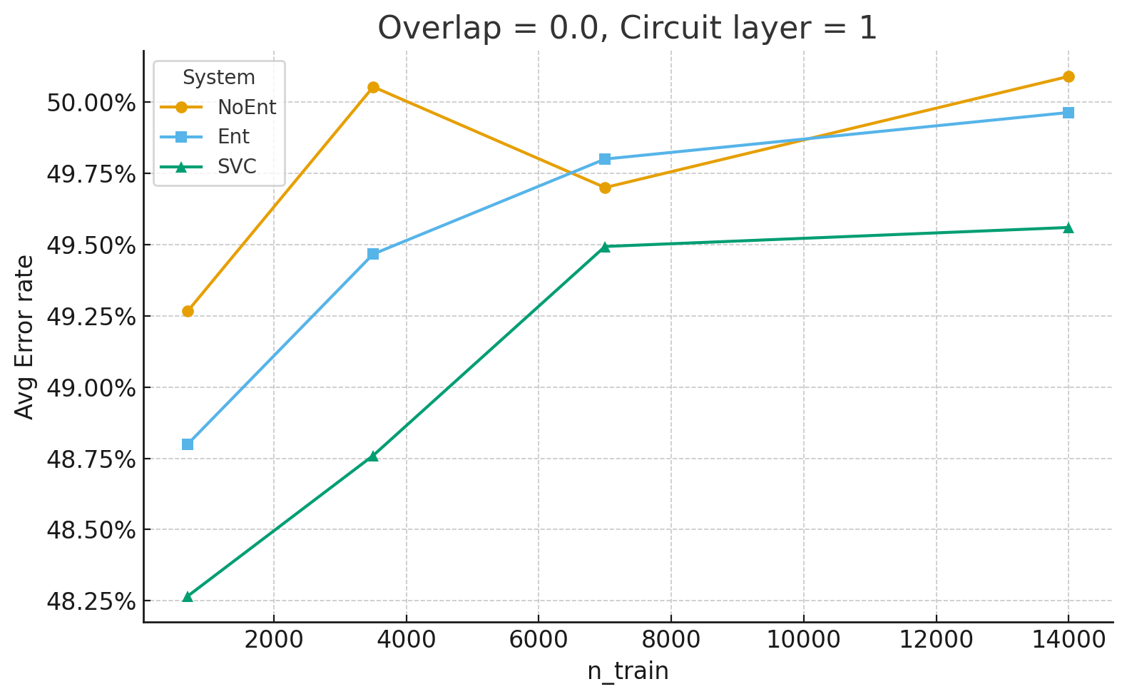
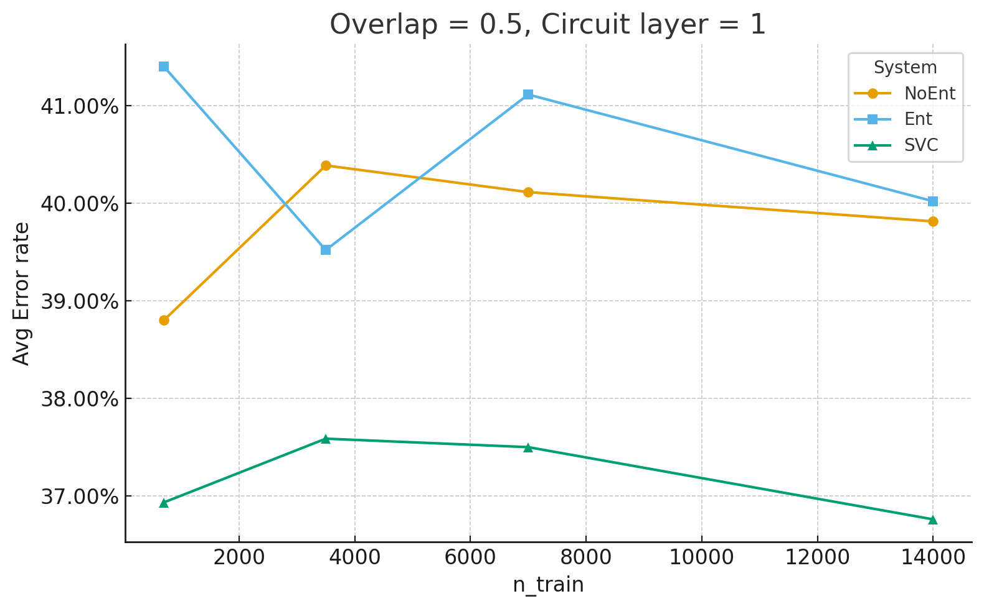
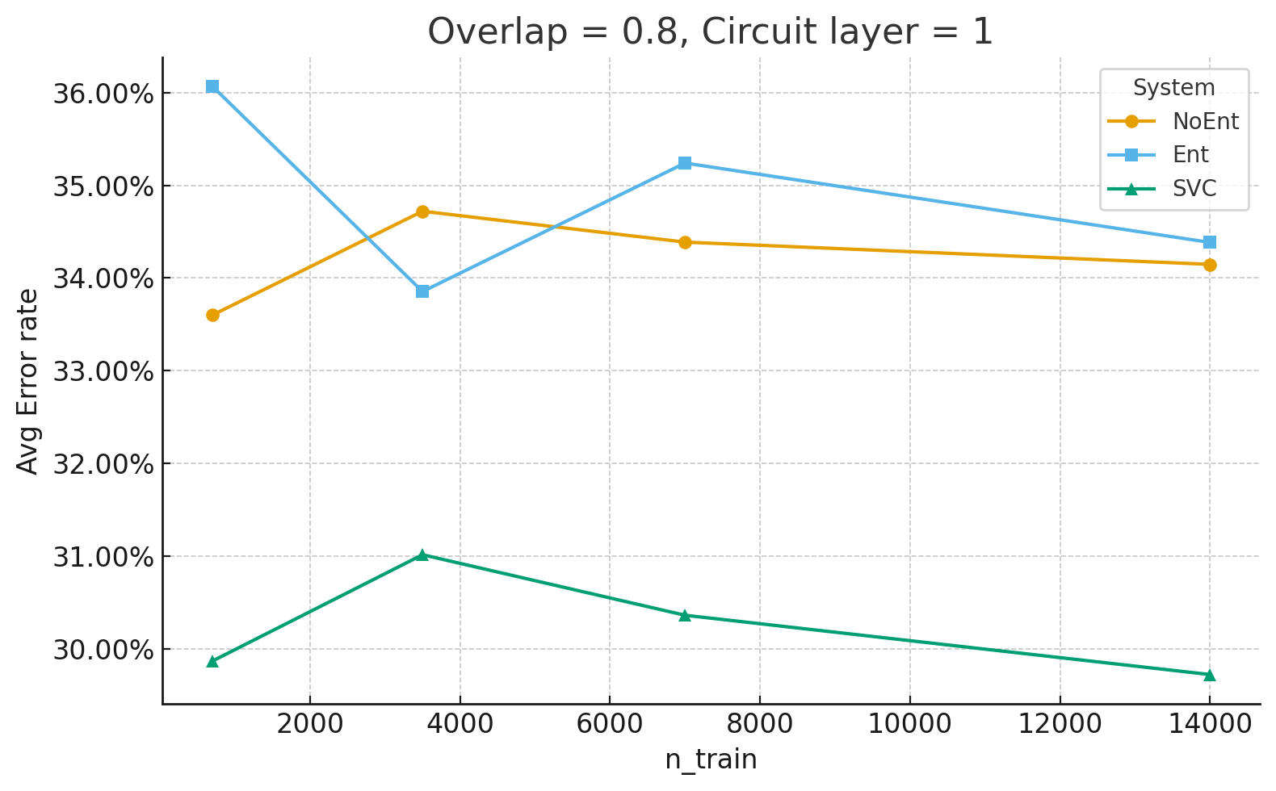
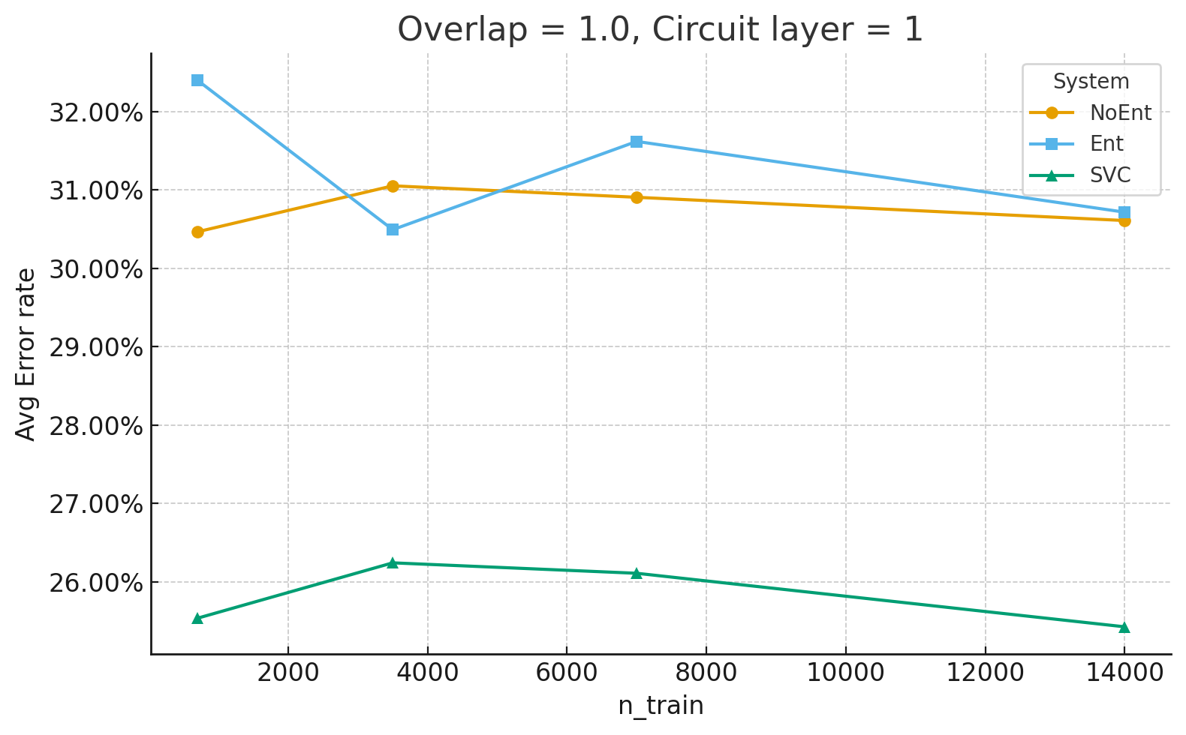
Results

Slide 5
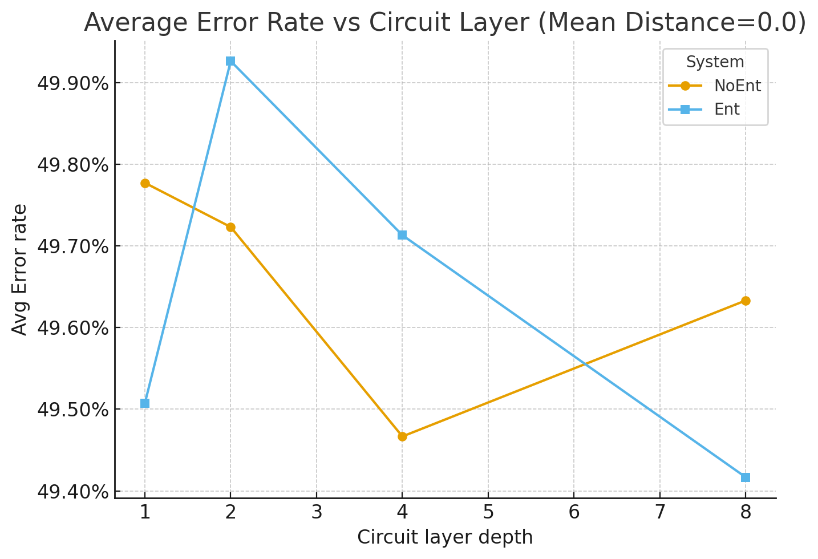
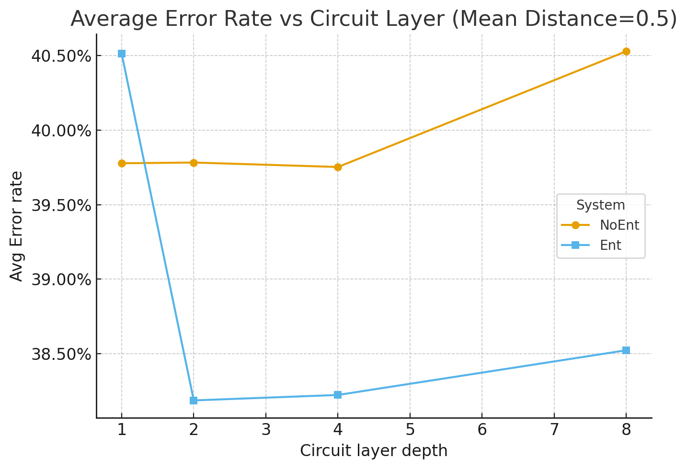
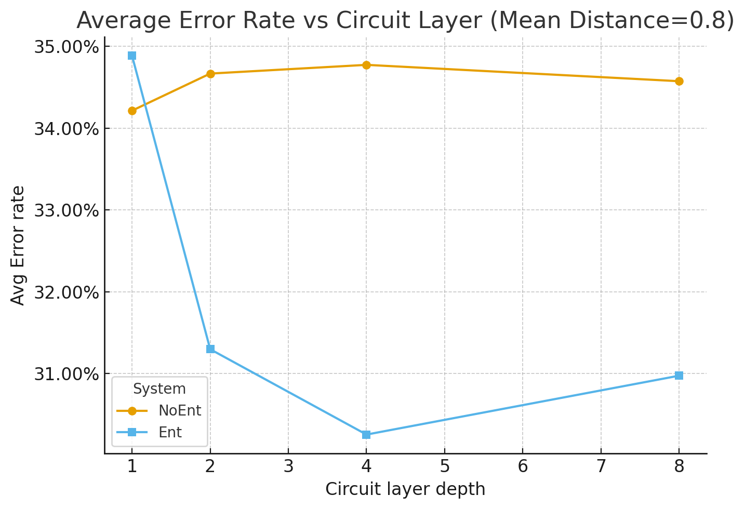
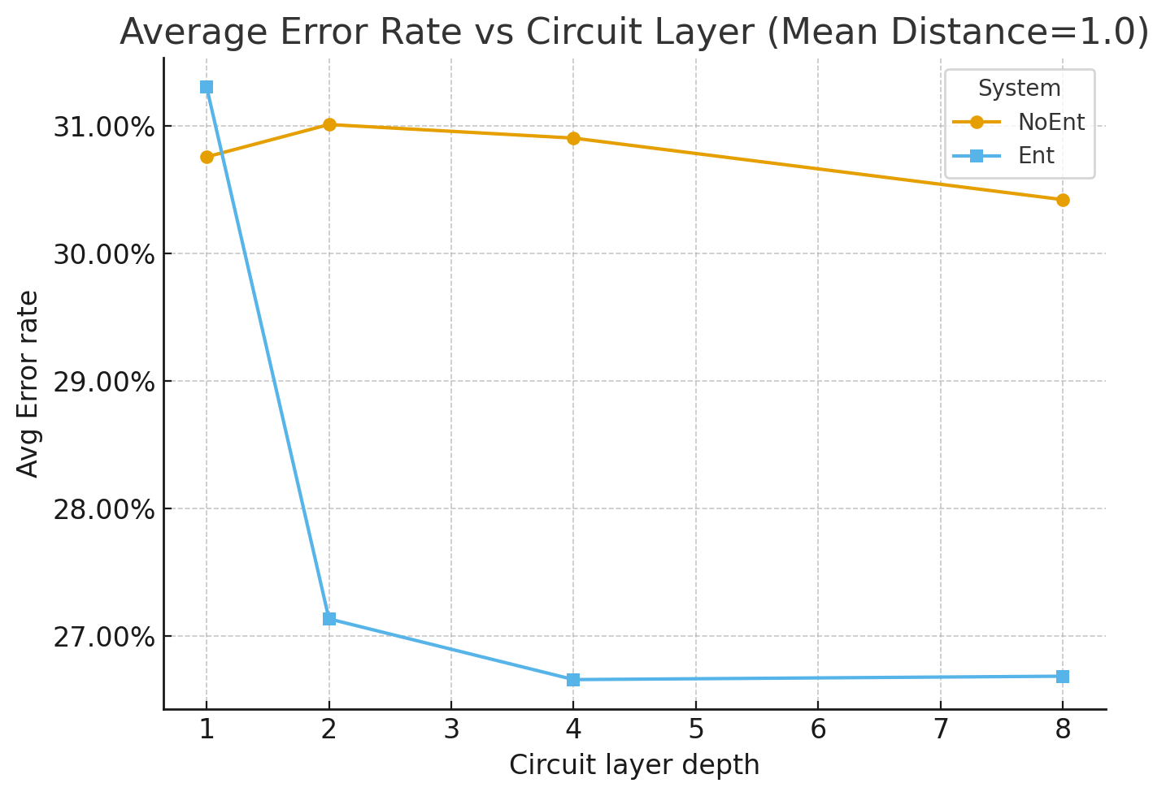
Results

Slide 6
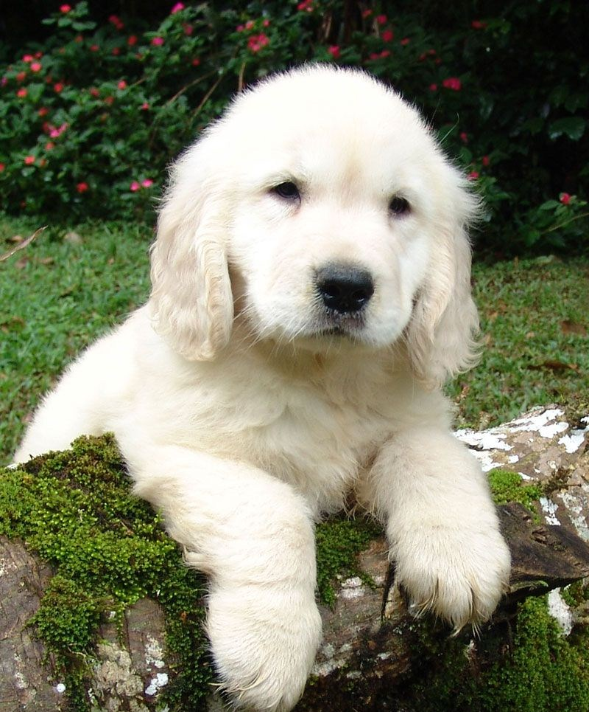

Are multimodal data entangled?
=== Text-Image ===
Classical Similarity: 0.6585
Quantum Similarity: 0.9655
CHSH Bell Value: 1.9954
Quantum Mutual Info: 0.5784
=== Text-Audio ===
Classical Similarity: 0.9984
Quantum Similarity: 0.5642
CHSH Bell Value: 0.4504
Quantum Mutual Info: 0.0334
=== Image-Audio ===
Classical Similarity: 0.6152
Quantum Similarity: 0.4057
CHSH Bell Value: 0.1625
Quantum Mutual Info: 0.2792
“a dog”
The CHSH Bell Value refers to the expected value of the CHSH correlator (often denoted as S) in an experiment to test Bell's theorem. For classical physics, the CHSH value must be less than or equal to 2, while quantum mechanics predicts a maximum value of 2√2 (approximately 2.828) for entangled states.

