Slide 1

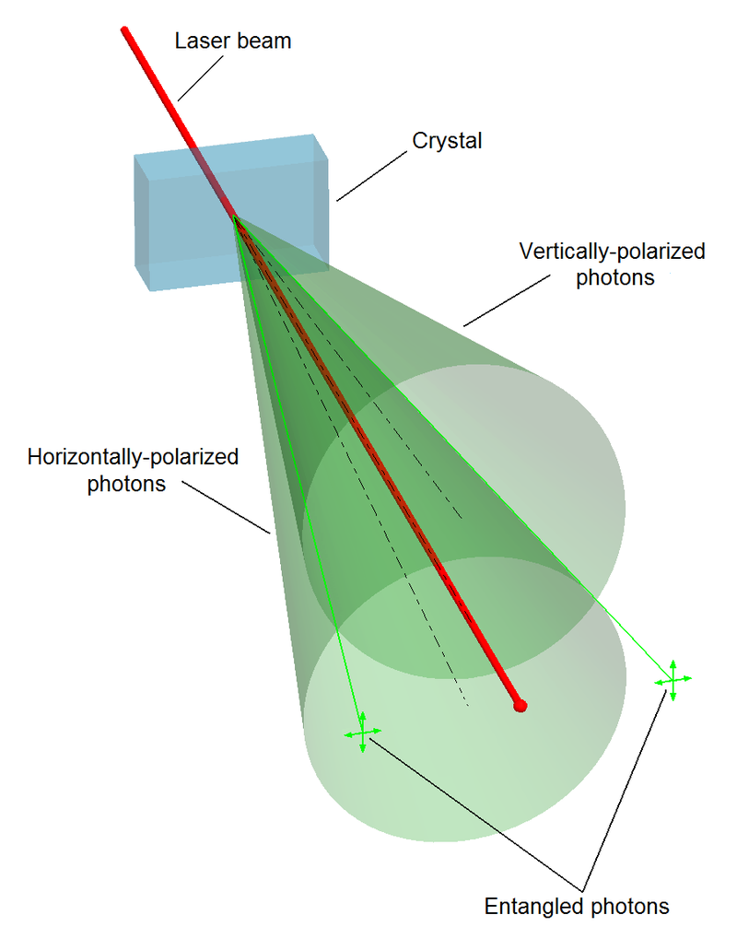
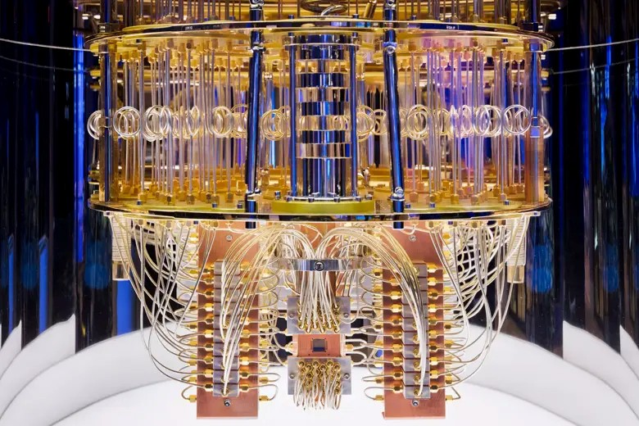
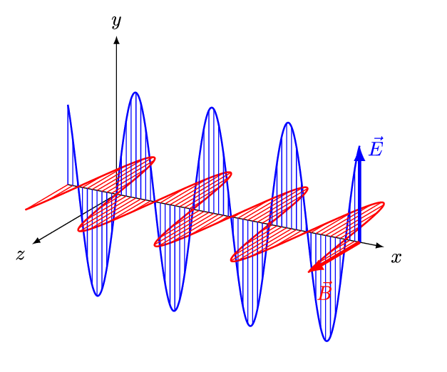
Quantum Machine Learning
Sadia Afrin Purba
Neural Engineering Data Consortium
Temple University

Slide 2
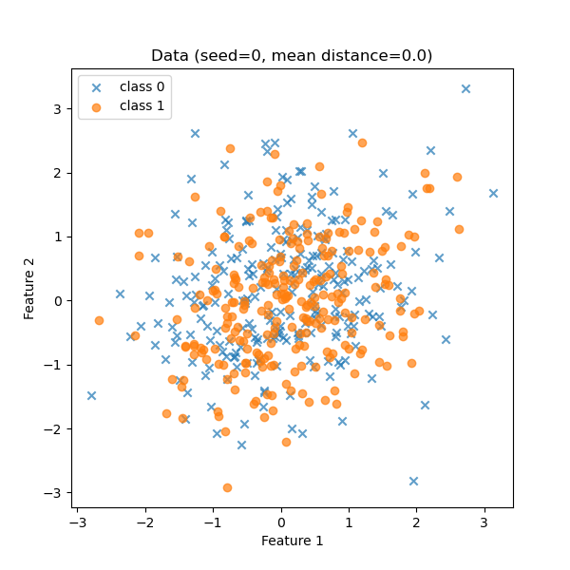
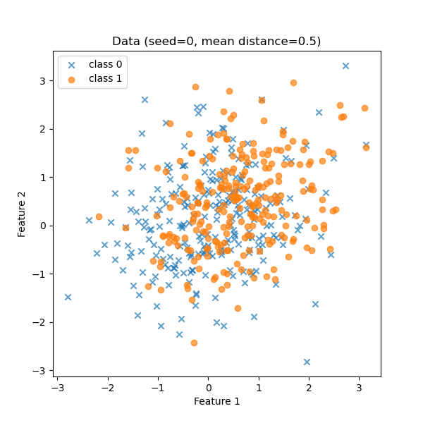
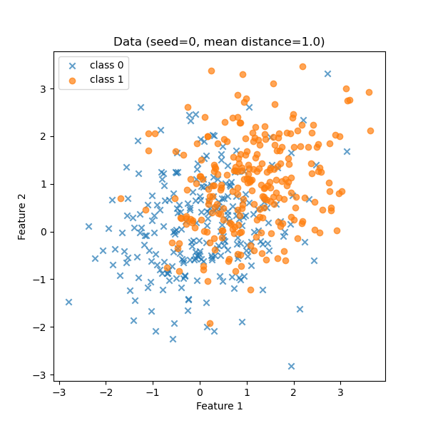
Overlapping 2D Gaussian Data

Slide 3
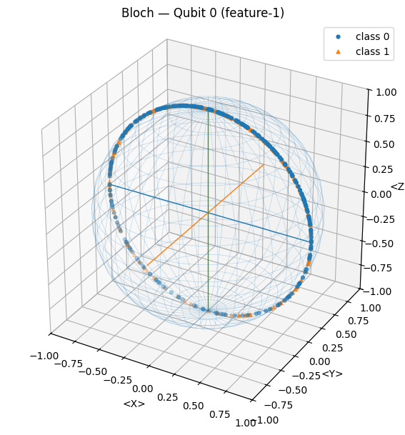
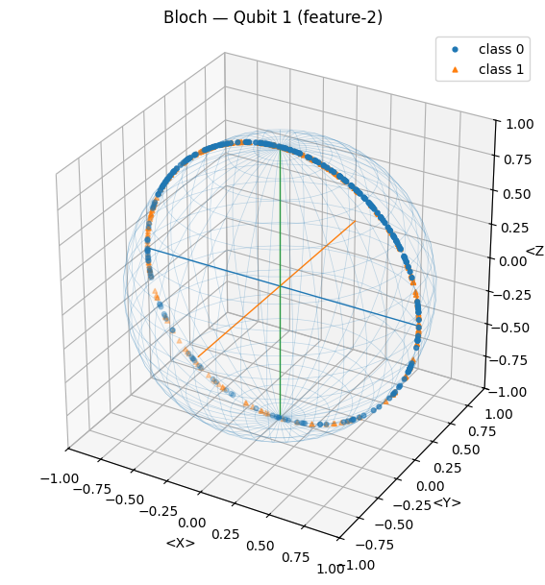
Quantum Embedding
Quantum Embedding

Slide 4
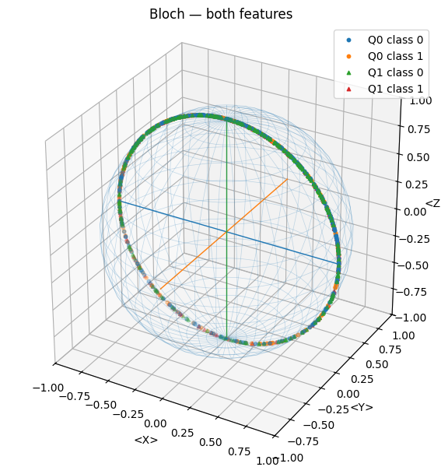
Quantum Embedding
Quantum Embedding

Slide 5
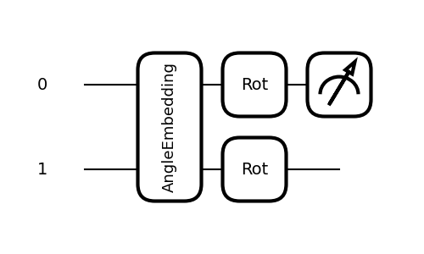

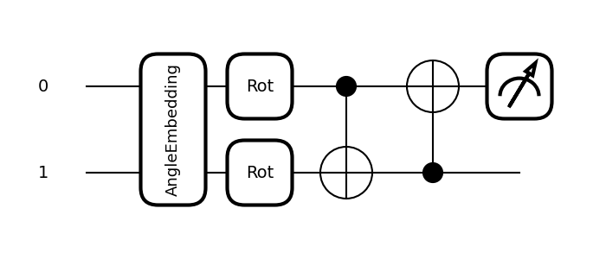
Quantum Circuit
Variation Quantum Circuit without Entanglement (L=1)
Variation Quantum Circuit with Entanglement (L=1)

Slide 6
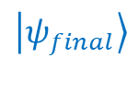
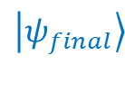
Quantum Circuit
$$\left|ψ_{final}\right\rangle$$
$$\left|ψ_{final}\right\rangle$$

Slide 7
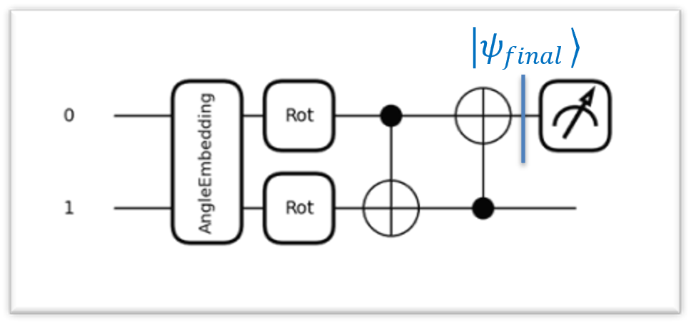
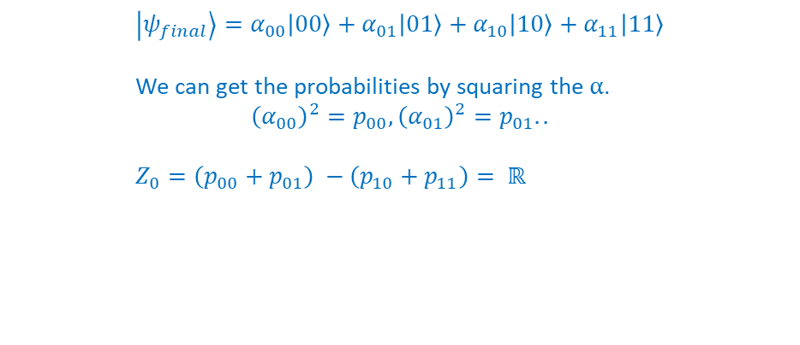
Quantum Circuit
$$\left|ψ_{final}\right\rangle =α_{00}\left|00\right\rangle +α_{01}\left|01\right\rangle +α_{10}\left|10\right\rangle +α_{11}\left|11\right\rangle$$
We can get the probabilities by squaring the $α$.
$${\left(α_{00}\right)}^{2}=p_{00}, {\left(α_{01}\right)}^{2}=p_{01}..$$
$Z_{0}=\left(p_{00}+p_{01}\right) −\left(p_{10}+p_{11}\right)= ℝ$

Slide 8
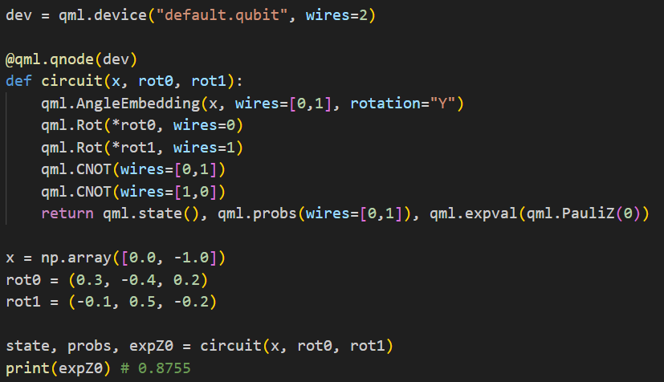
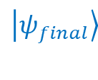
Quantum Circuit
$$\left|ψ_{final}\right\rangle$$

Slide 9
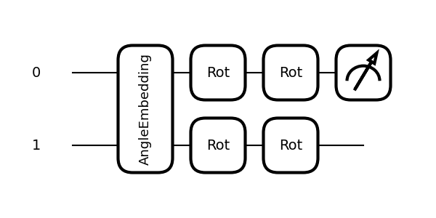
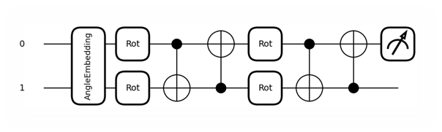
Varying Circuit Layers
L=2

Slide 10
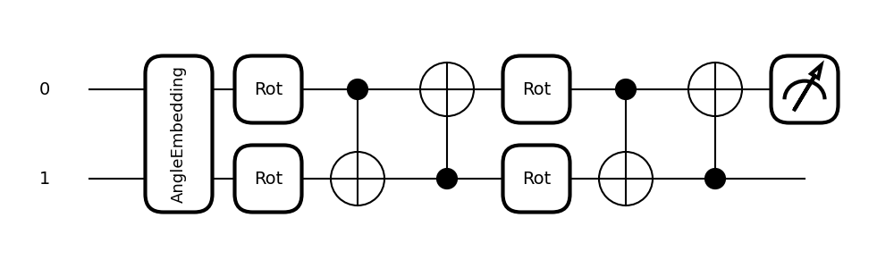
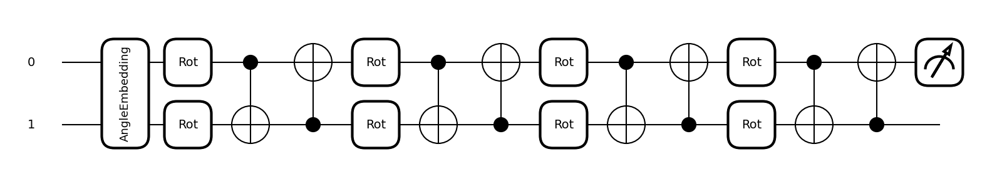
Varying Circuit Layers
L=2
L=4
$learnable_{params}$= $L ∗n_{params}∗n_{qubit}$
e.g. $L=1, n_{params}=3, n_{qubit}=2; learnable_{params}=6$

Slide 11
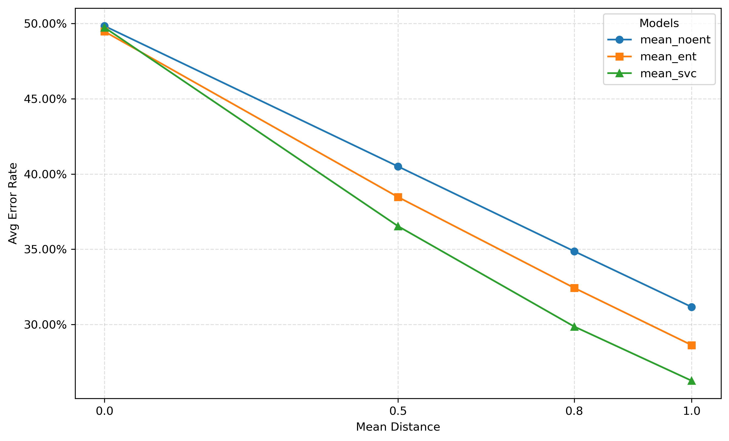
Results

Slide 12
Results
Circuit Layer | Mean Dist | No-ent VQA | Ent VQA | SVC (rbf)
1 | 0.0 | 0.5027 ± 0.0373 | 0.4907 ± 0.0203 | 0.4973 ± 0.0335
2 | 0.0 | 0.4933 ± 0.0271 | 0.4853 ± 0.0472
4 | 0.0 | 0.4960 ± 0.0219 | 0.4973 ± 0.0382
8 | 0.0 | 0.5013 ± 0.0292 | 0.5053 ± 0.0272

