Slide 1

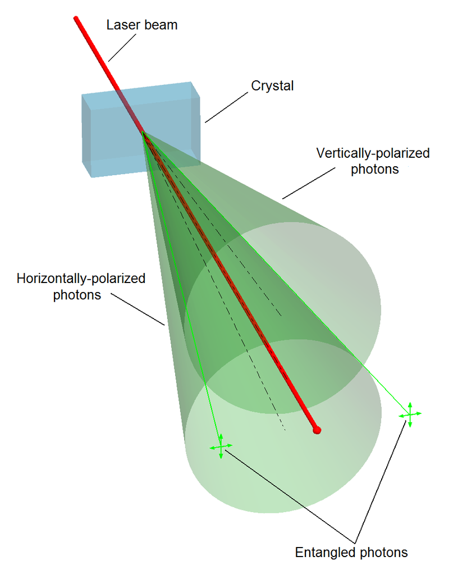
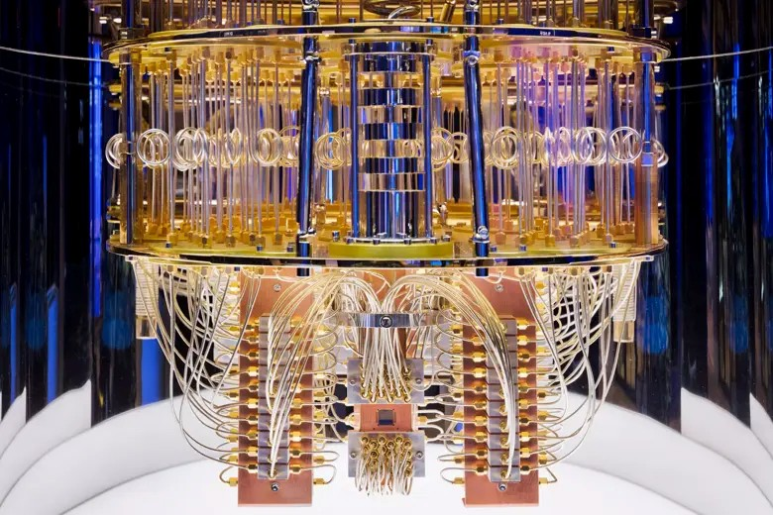
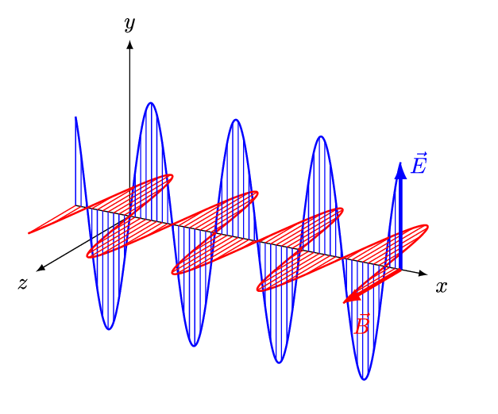
Quantum Machine Learning
Sadia Afrin Purba
Neural Engineering Data Consortium
Temple University

Slide 2
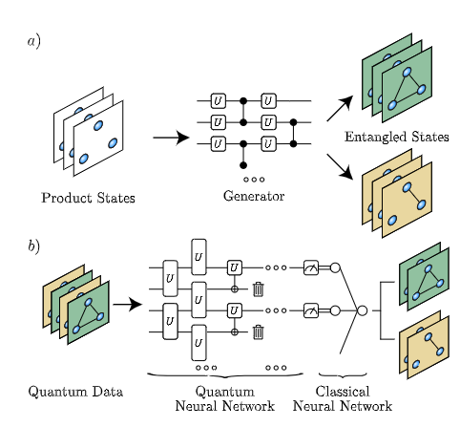
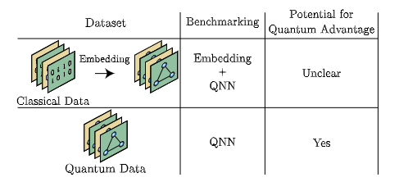
Quantum Entangled Dataset
Schatzki, L., Arrasmith, A., Coles, P. J., & Cerezo, M. (2021). Entangled datasets for quantum machine learning. arXiv preprint arXiv:2109.03400.
Dataset Name | Domain | Description
[1] OpenQDC | Chemistry | OpenQDC is an open-source hub of ML-ready quantum datasets. It contains 40+ quantum mechanics (QM) datasets, covering 1.5 billion geometrics across 70 atom species and 250+ QM method.
[2] OpenFermion | Chemistry | OpenFermion is an open-source library for compiling and analyzing quantum algorithms to simulate fermionic systems, including quantum chemistry.
[3] QCML dataset | Chemistry | A comprehensive dataset for training ML models for quantum chemistry, specifically predicting properties of chemical structure.
[4] QDataset | General | The QDataSet comprises 52 high-quality publicly available datasets derived from simulations of one- and two-qubit systems evolving in the presence and/or absence of noise.
[5] NTangled | General | Entanglement-based quantum datasets and generators for quantum machine learning.
[6] Tahoe-100M | Biology | Tahoe-100M contains information about 100 million single cells, measuring how 1,100 different small molecule perturbations impact 50 types of cancer cells.

Slide 3
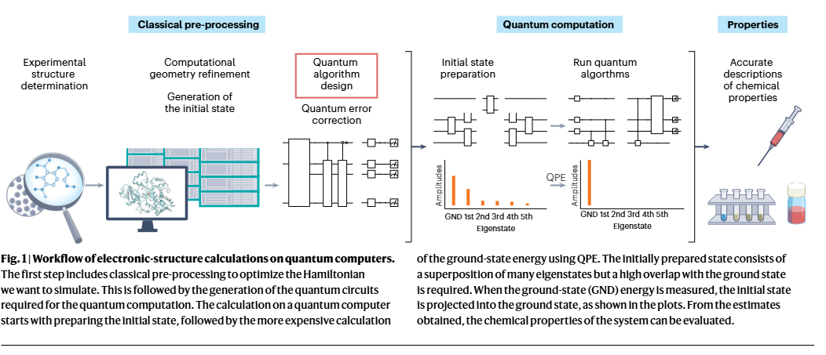
Drug Discovery in QC
Santagati, R., Aspuru-Guzik, A., Babbush, R. et al. Drug design on quantum computers. Nat. Phys. 20, 549–557 (2024). https://doi.org/10.1038/s41567-024-02411-5

