Slide 1

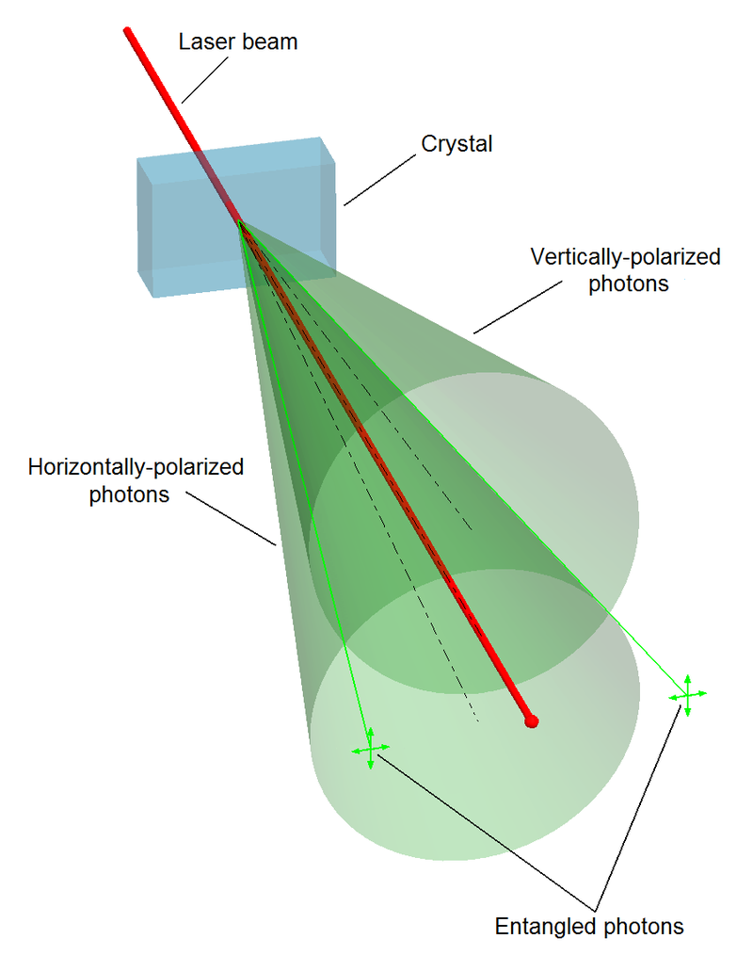
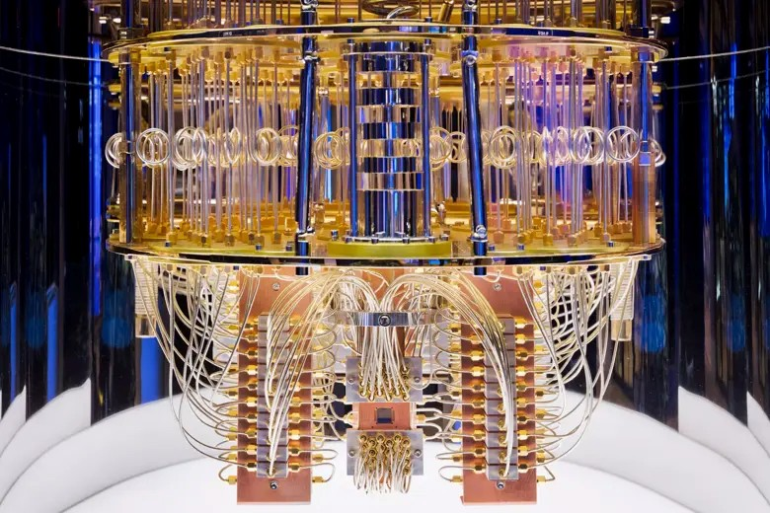
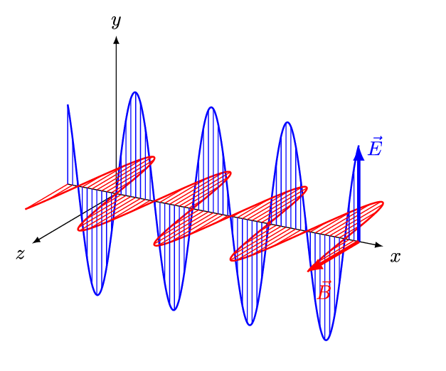
Quantum Machine Learning
Sadia Afrin Purba
Neural Engineering Data Consortium
Temple University

Slide 2
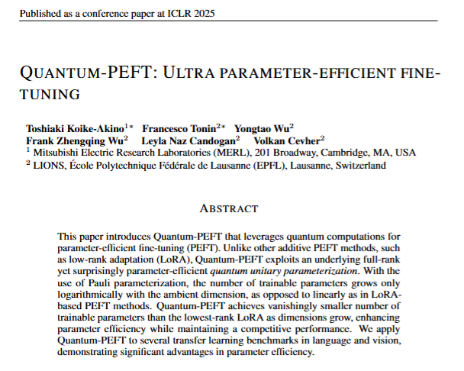
Paper Review
PEFT method that replaces LoRA’s trainable low-rank matrices with a quantum-inspired unitary parameterization
orders-of-magnitude fewer trainable parameters (often 5–25× fewer, even below rank-1 LoRA) with competitive accuracy on language and vision benchmarks
unexplored area: if this method has any positive effect on LLM’s hallucination
Salloum, H., Zhanalin, S., Badr, A.A. et al. Mini-scale traffic flow optimization: an iterative QUBOs approach converting from hybrid solver to pure quantum processing unit. Sci Rep 15, 22904 (2025). https://doi.org/10.1038/s41598-025-04568-2

Slide 3
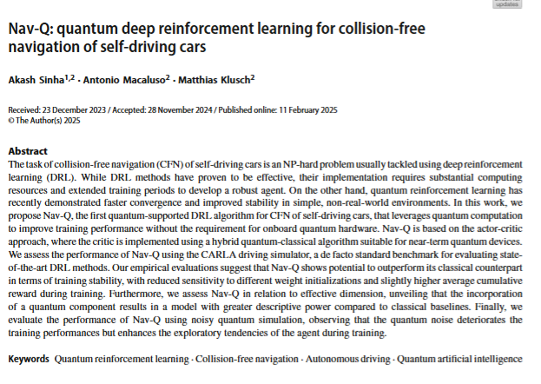
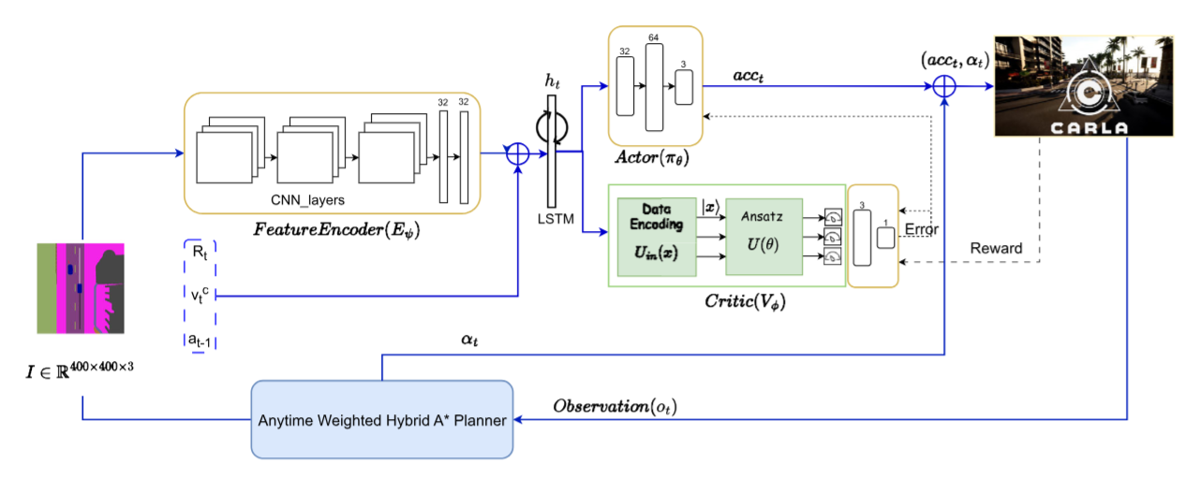
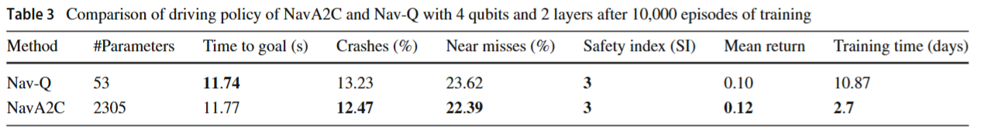
Paper Review
Quantum noise enhances the exploratory tendencies of the agent during training
Sinha, A., Macaluso, A., & Klusch, M. (2025). Nav-Q: quantum deep reinforcement learning for collision-free navigation of self-driving cars. Quantum Machine Intelligence, 7(1), 19.

Slide 4
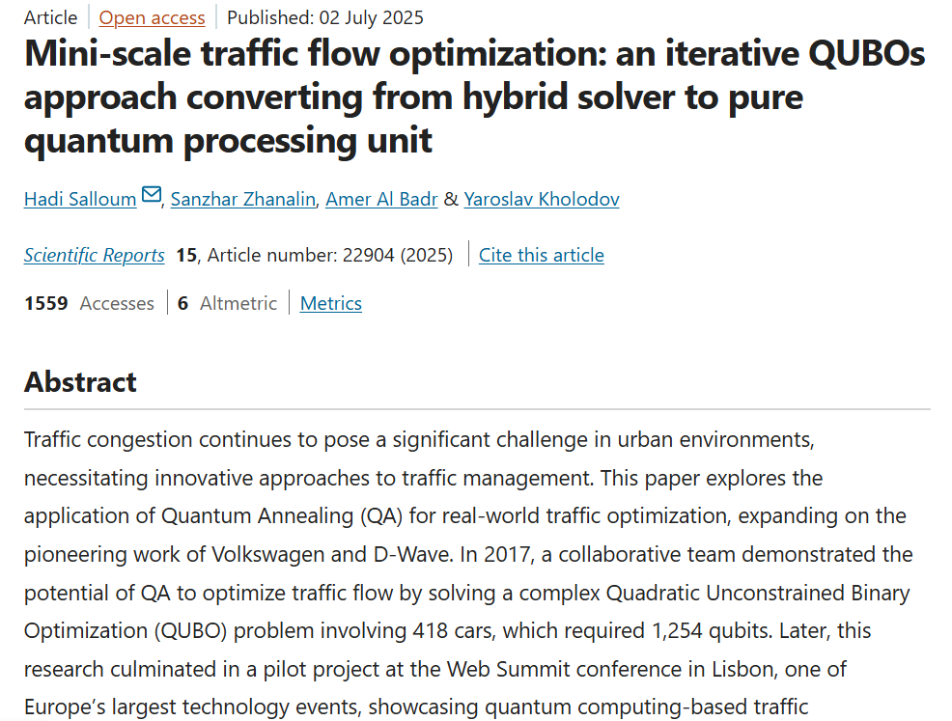
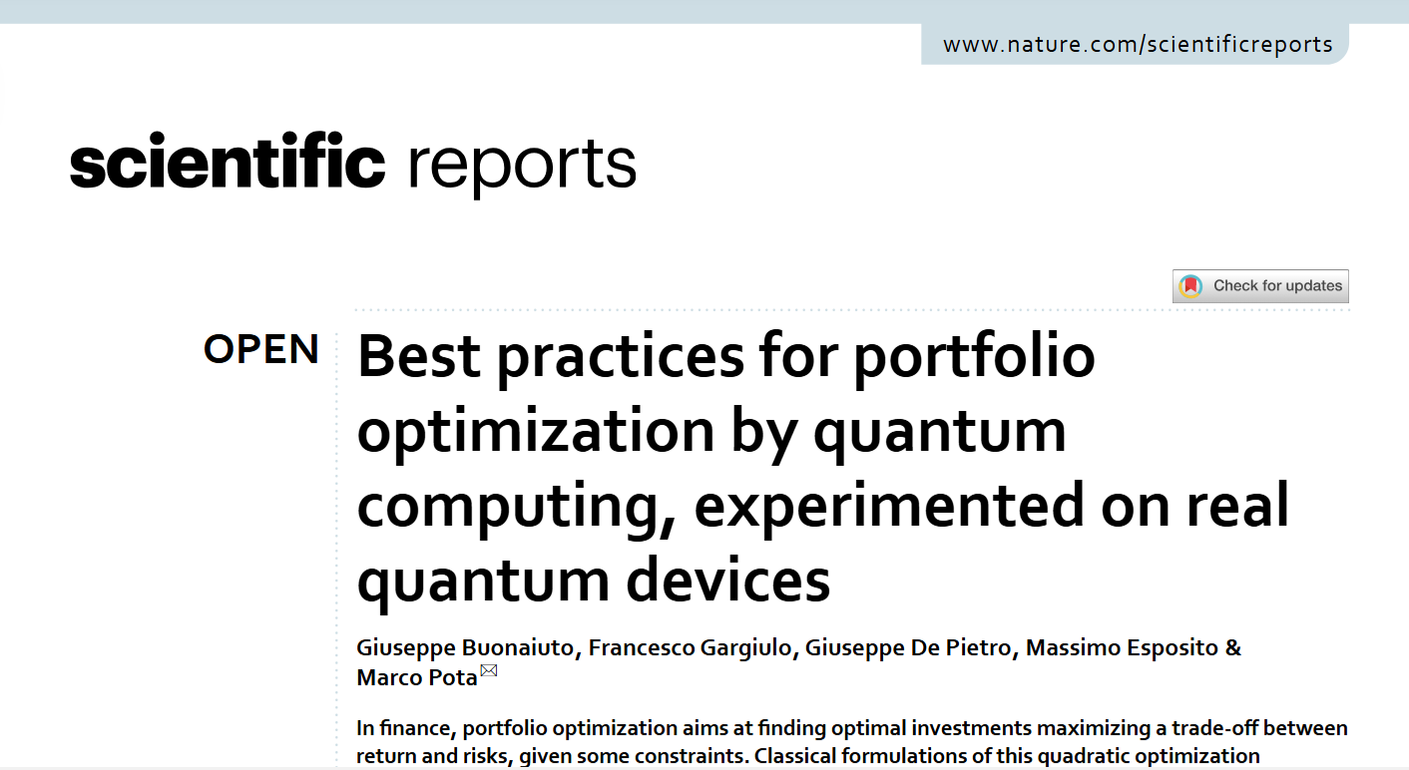
Paper Review
Salloum, H., Zhanalin, S., Badr, A.A. et al. Mini-scale traffic flow optimization: an iterative QUBOs approach converting from hybrid solver to pure quantum processing unit. Sci Rep 15, 22904 (2025). https://doi.org/10.1038/s41598-025-04568-2
Buonaiuto, G., Gargiulo, F., De Pietro, G., Esposito, M., & Pota, M. (2023). Best practices for portfolio optimization by quantum computing, experimented on real quantum devices. Scientific Reports, 13(1), 19434.

Slide 5
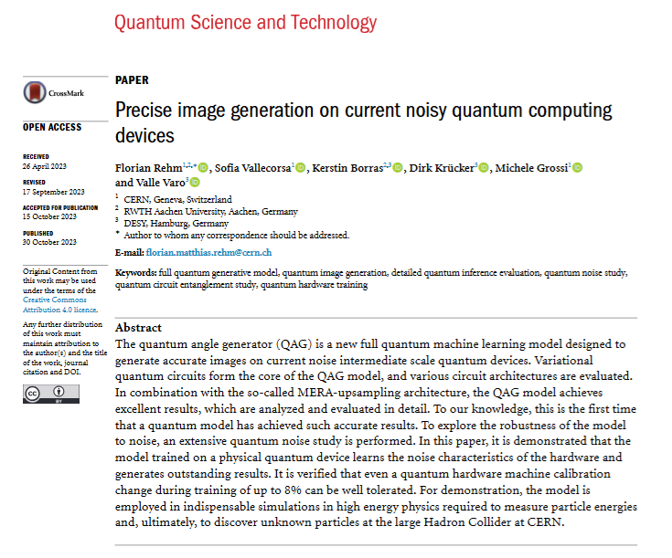
Paper Review
A fully quantum generative model uses Multi-scale Entanglement Renormalization Ansatz layout (MERA)—a hierarchical, scale-by-scale circuit
They generate particle-detector “shower” images for high-energy physics simulations, arguing this is the first time a quantum model achieves this level of image quality on real hardware
“Calorimeter shower simulation is a major bottleneck in the Large Hadron Collider computational pipeline”
They also exploit the device’s noise to get better results
Rehm, F., Vallecorsa, S., Borras, K., Krücker, D., Grossi, M., & Varo, V. (2023). Precise image generation on current noisy quantum computing devices. Quantum Science and Technology, 9(1), 015009.

