Slide 1
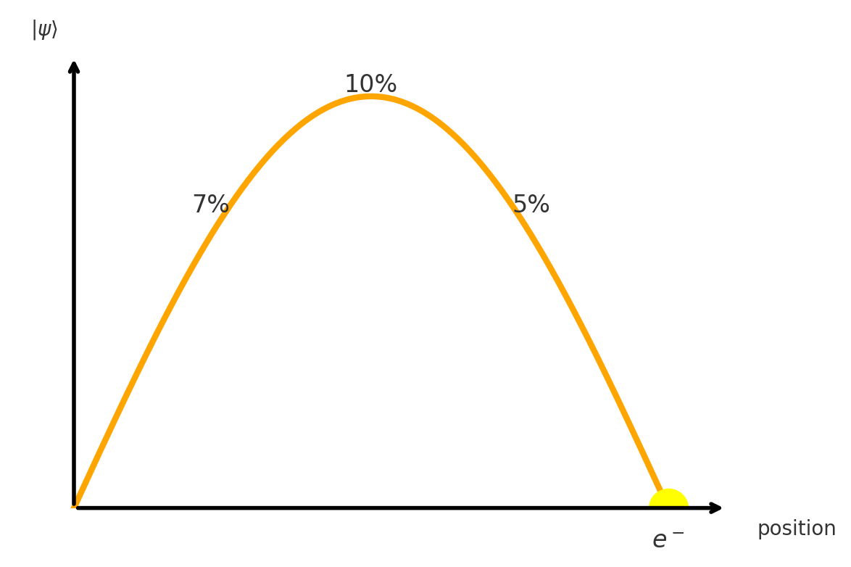
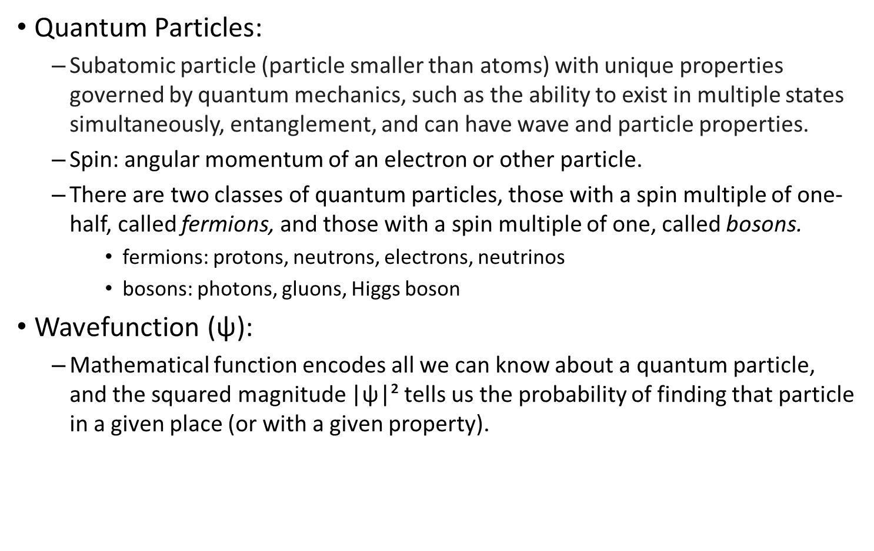
Quantum Computing Review
Quantum Particles:
  Subatomic particle (particle smaller than atoms) with unique properties governed by quantum mechanics, such as the ability to exist in multiple states simultaneously, entanglement, and can have wave and particle properties.
  Spin: angular momentum of an electron or other particle.
  There are two classes of quantum particles, those with a spin multiple of one-half, called fermions, and those with a spin multiple of one, called bosons.
    fermions: protons, neutrons, electrons, neutrinos
    bosons: photons, gluons, Higgs boson
Wavefunction ($\text{ψ}$):
  Mathematical function encodes all we can know about a quantum particle, and the squared magnitude |ψ|² tells us the probability of finding that particle in a given place (or with a given property).

Slide 2
Quantum Computing Review
Superposition:
  A quantum particle can exist in multiple states simultaneously.
  As quantum particles can show wave-like properties, they use quantum interference similar to wave interference to amplify or cancel out certain outcomes.
Entanglement:
  Quantum entanglement is a physical phenomenon where pairs or groups of particles remain connected so that the quantum state of each particle cannot be described independently of the others. So, entangled particles have some non-local correlation between them.
  In nature:
    When a particle decays into multiple particles, those particles are entangled.
    When an electron or atom emits two photons, they are entangled.
  Qubit
    Basic unit of quantum information.
    We try to simulate the properties of quantum particles to process quantum information.

Slide 3
Quantum Machine Learning Experimentation
Hypothesis: Quantum entanglement is a better correlation measure than a classical one for ML tasks.
Experiment Design:
  Generator: `sklearn.datasets.make_classification`
  Task: Multi-class classification
  Samples (n_samples): varied from 10 up to 10,000
  Features (n_features): varied from 10 up to 10,000
  Informative features (n_informative): 2
  Classes (n_classes): varied from 2 up to 10,000
  Class separation (class_sep): 0.5 (moderate overlap between clusters)
  Label noise (flip_y): 0.05 (5 % of labels randomly flipped)
  Hypercube flag: `hypercube=False` (clusters not confined to a unit hypercube)
  Random seed: ndt.RANDSEED (for reproducibility)
  Train/test split & evaluation
    Split: 80 % train / 20 % test
    Metric: test-set error rate
  Systems:
    Linear classifier on QC-entanglement-entropy features (qc_ent)
    Linear classifier on cosine-similarity features (cos-sim)
    3-layer MLP (fully-connected neural network) (mlp)

Slide 4
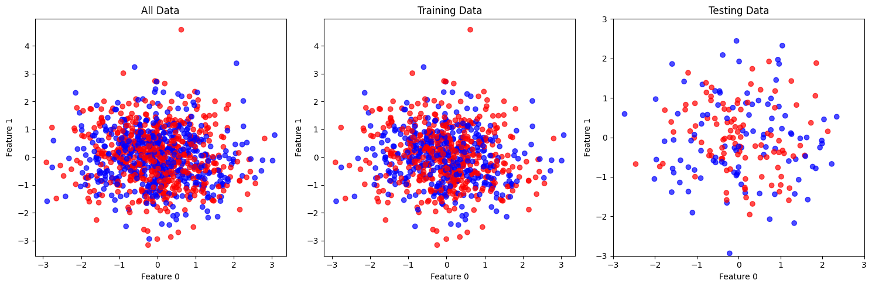
Quantum Machine Learning Experimentation
Data visualization of the two features of 1000 samples generated by make_classification method
# feats |  | # qubit |  | X_vec |  | W_Vec
10 |  | 8 |  | 4 |  | 4
50 |  | 12 |  | 6 |  | 6
100 |  | 14 |  | 7 |  | 7
1000 |  | 20 |  | 10 |  | 10

Slide 5
Quantum Machine Learning Experimentation
# samples |  | # feats |  | circuitdepth |  | cos-sim |  | mlp |  | qc
10 |  | 1000 |  | 1 |  | 100.00 |  | 100.00 |  | 00.00
50 |  | 50 |  | 1 |  | 60.00 |  | 70.00 |  | 40.00
50 |  | 100 |  | 1 |  | 70.00 |  | 40.00 |  | 30.00
50 |  | 1000 |  | 1 |  | 60.00 |  | 60.00 |  | 40.00
100 |  | 1000 |  | 1 |  | 60.00 |  | 45.00 |  | 40.00
10000 |  | 10 |  | 3 |  | 43.20 |  | 48.10 |  | 41.50

Slide 6
Quantum Machine Learning Experimentation
# samples |  | # feats |  | circuitdepth |  | cos-sim |  | mlp |  | qc
10 |  | 10 |  | 1 |  | 50.00 |  | 100.00 |  | 100.00
10 |  | 50 |  | 1 |  | 50.00 |  | 50.00 |  | 50.00
10 |  | 100 |  | 1 |  | 100.00 |  | 50.00 |  | 100.00
10 |  | 1000 |  | 1 |  | 100.00 |  | 100.00 |  | 0.00
10 |  | 3000 |  | 1 |  | 100.00 |  | 50.00 |  | 100.00
10 |  | 5000 |  | 1 |  | 50.00 |  | 50.00 |  | 50.00
50 |  | 10 |  | 1 |  | 40.00 |  | 30.00 |  | 40.00
50 |  | 50 |  | 1 |  | 60.00 |  | 70.00 |  | 40.00
50 |  | 50 |  | 2 |  | - |  | - |  | 60.00
50 |  | 50 |  | 3 |  | - |  | - |  | 60.00
50 |  | 50 |  | 4 |  | - |  | - |  | 60.00
50 |  | 100 |  | 1 |  | 70.00 |  | 40.00 |  | 30.00
50 |  | 1000 |  | 1 |  | 50.00 |  | 50.00 |  | 50.00

Slide 7
Quantum Machine Learning Experimentation
# samples |  | # feats |  | circuitdepth |  | cos-sim |  | mlp |  | qc
3000 |  | 10 |  | 1 |  | 38.83 |  | 48.33 |  | 51.67
3000 |  | 10 |  | 2 |  | - |  | - |  | 47.17
3000 |  | 10 |  | 3 |  | - |  | - |  | 47.33
3000 |  | 10 |  | 4 |  | - |  | - |  | 47.33
3000 |  | 10 |  | 5 |  | - |  | - |  | 47.33
3000 |  | 10 |  | 6 |  | - |  | - |  | 46.67
3000 |  | 50 |  | 1 |  | 47.67 |  | 45.17 |  | 50.50
3000 |  | 50 |  | 2 |  | - |  | - |  | 50.50
3000 |  | 50 |  | 3 |  | - |  | - |  | 50.50
3000 |  | 100 |  | 1 |  | 44.00 |  | 48.67 |  | 54.17
3000 |  | 100 |  | 2 |  | - |  | - |  | 54.17

Slide 8
Quantum Machine Learning Experimentation
# samples |  | # feats |  | Circuit depth |  | Rand Seed | cos-sim |  | mlp |  | qc
50 |  | 50 |  | 1 |  | 27 | 60.00 |  | 70.00 |  | 40.00
50 |  | 50 |  | 1 |  | 42 | 80.00 |  | 80.00 |  | 80.00
We need to more runs with different seed values for a better general rule.

Slide 9
Future Plan
Currently, we are running all the experiments using a noiseless CPU simulator, but we need simulation results with noisy CPU simulator for future publications.
Run the n_sample=100 and n_feature=1000 combination on the free IBM quantum hardware.
Multiple different non-parameterized quantum circuit.
Start experimenting with parameterized quantum circuits.
Start experimenting with time-series data on the entanglement entropy idea.
  simulated time-series data
  a subset of EEG data

Slide 10
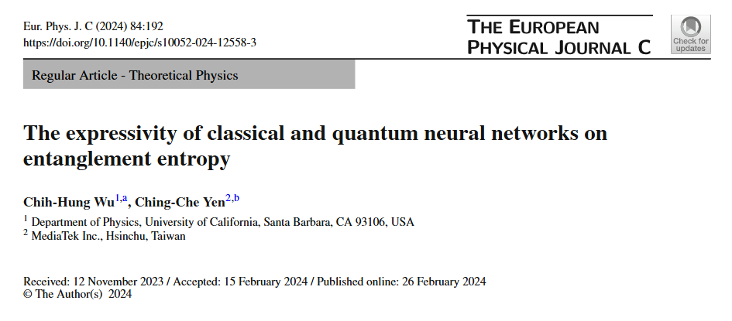
Paper Review
Wu, C. H., & Yen, C. C. (2024). The expressivity of classical and quantum neural networks on entanglement entropy. The European Physical Journal C, 84(2), 192.

