Slide 1

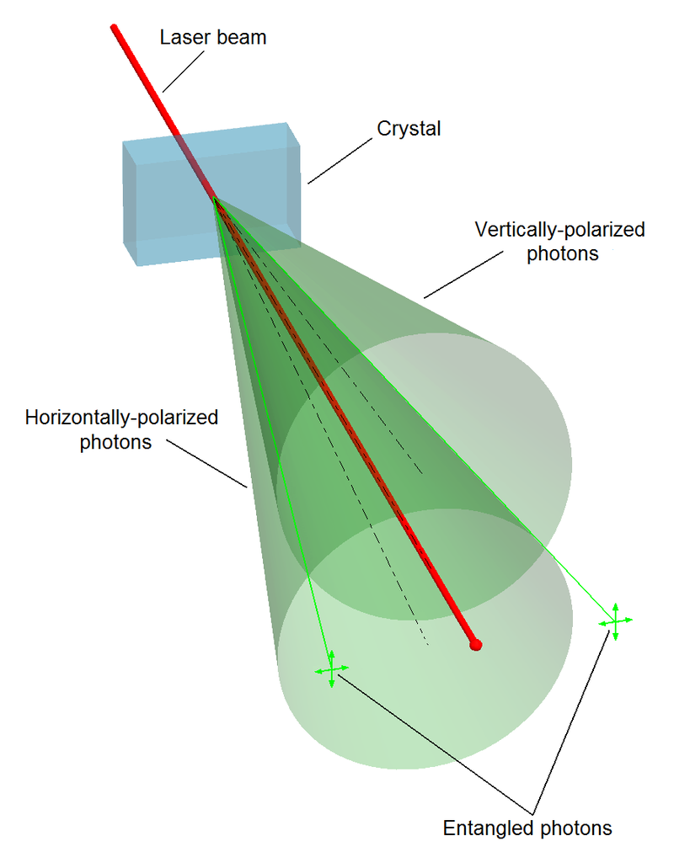
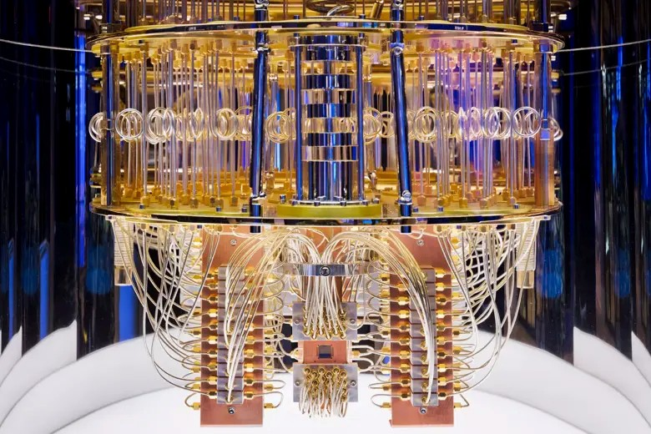
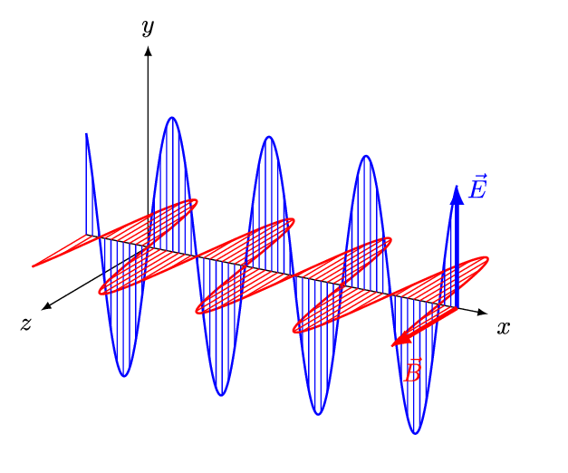
Quantum Machine Learning
Sadia Afrin Purba
Neural Engineering Data Consortium
Temple University

Slide 2
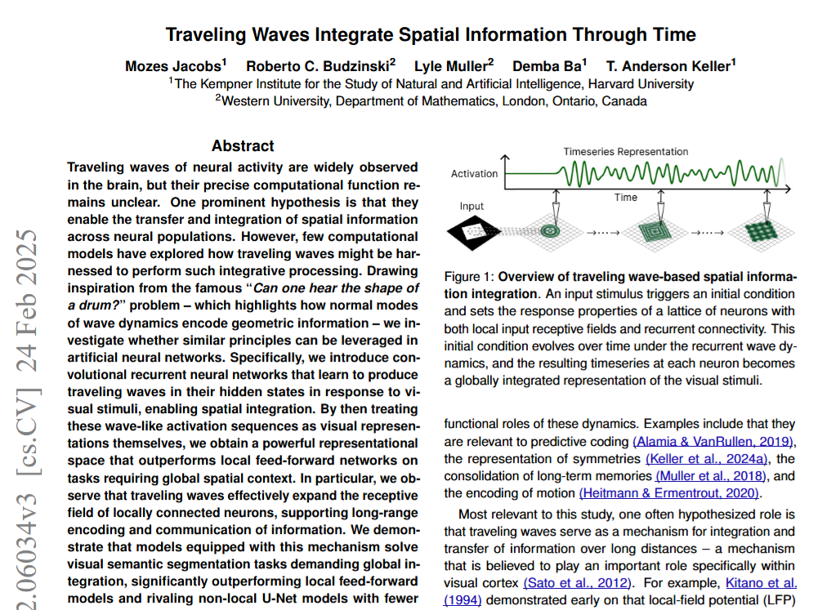
Paper Review
1. Jacobs, M., Budzinski, R. C., Muller, L., Ba, D., & Keller, T. A. (2025). Traveling Waves Integrate Spatial Information Into Spectral Representations. arXiv preprint arXiv:2502.06034.
2. Blog

Slide 3
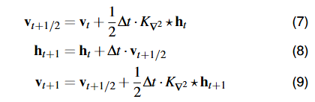
Main Idea
Introduce Neural Wave Machine (NWM) that integrate global spatial context via traveling waves.
Imitate 2D wave equation in a conv-RNN via Verlet integration (updates position h and velocity v).
Time-series readouts (FFT/Linear):
  Take the pixel’s activation signal over time and compute its Fourier transform. So, now they have a spectrum of “how much each frequency” is present. Different shapes or contexts produce different spectral patterns, so the classifier can tell them apart by looking at which frequency bands activated.
Outperforms local CNNs and U-Nets with fewer training parameters and greater training stability.
Semantic segmentation tasks:
  Polygons, Tetrominoes, MNIST, Multi‑MNIST

Slide 4
Main Idea
“Notably, these wave-based solutions—naturally spanning both spatial and frequency domains—could align more directly with EEG or MEG measurements in neuroscience, while on the machine learning side we speculate they could someday help alleviate the computational bottlenecks of global self-attention mechanisms.”

Slide 5
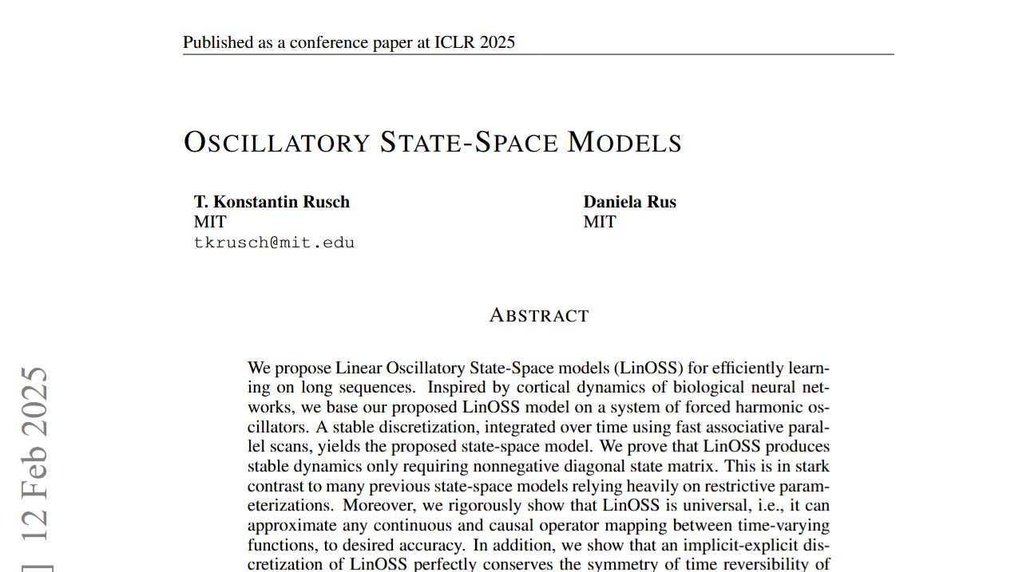
Paper Review
Rusch, T. K., & Rus, D. (2024). Oscillatory state-space models. arXiv preprint arXiv:2410.03943.

Slide 6
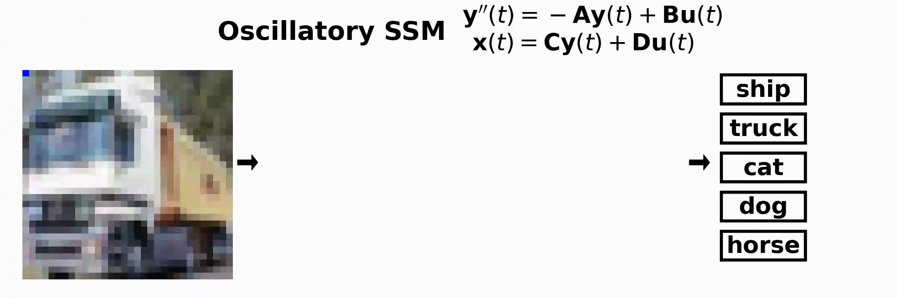
Paper Review

Slide 7


State-Space Model
A SS model can describe the dynamical system by two things:
  A hidden state that captures everything we need to know about the system up to time $t$.
  State update: how the state evolves, possibly with inputs.
  Observation: how we turn the state into the output we want to see.

Slide 8
Main Idea
Claiming that their method is efficient and stable of very long sequences (up to 50,000 steps).
Model hidden dynamics as forced harmonic oscillators.
LinOSS‑IM (implicit): dissipative, eigenvalues ≤ 1 → stable
LinOSS‑IMEX (implicit‑explicit): Its update rule mirrors the continuous wave system’s conservation laws, keeping the “size” of any region in the hidden state space constant over time.

Slide 9
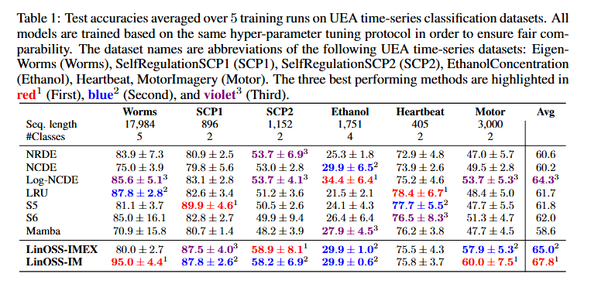
Paper Review

