Slide 1

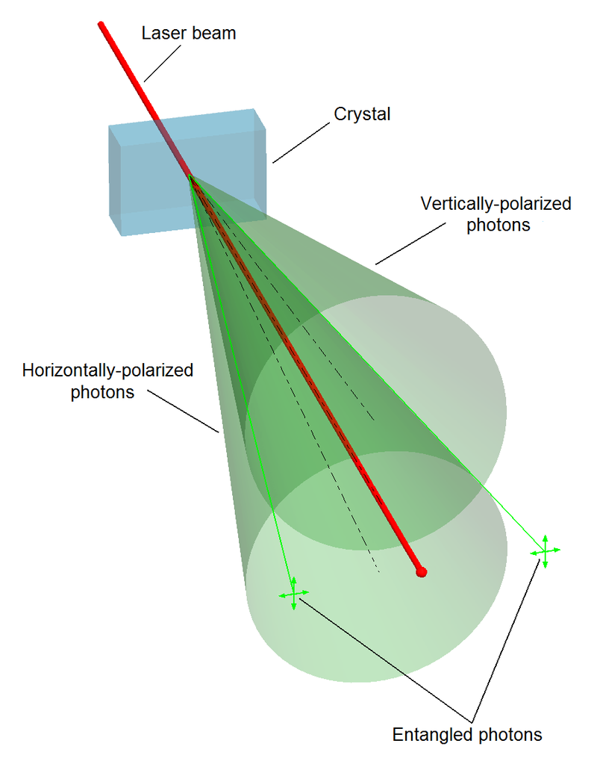
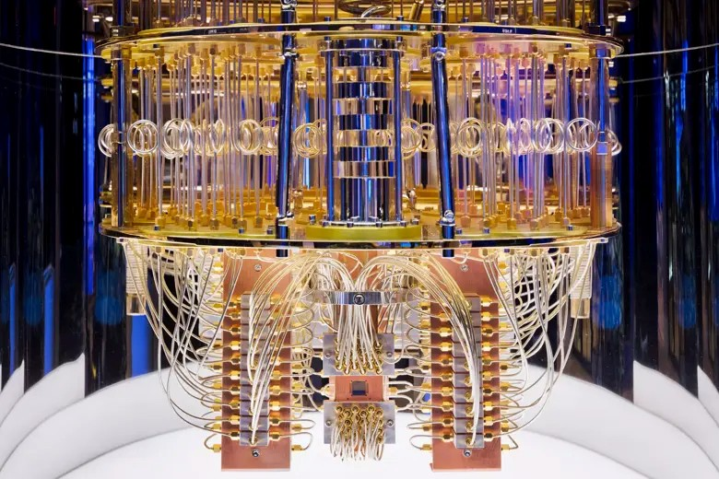
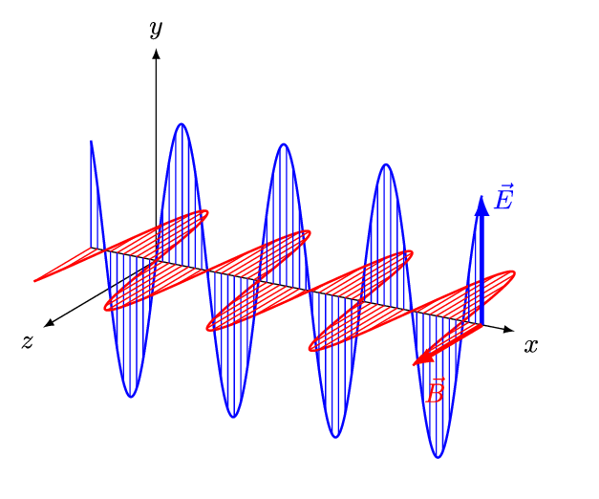
Quantum Machine Learning
Sadia Afrin Purba
Neural Engineering Data Consortium
Temple University

Slide 2
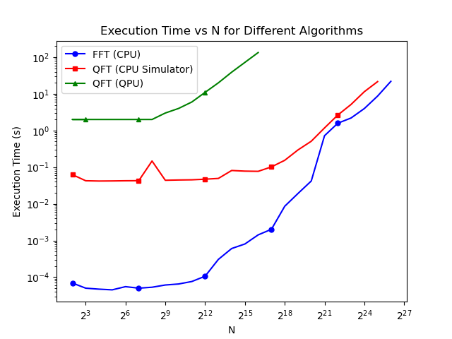
QFT

Slide 3
RBM vs QRBM
Dataset: TUH DPATH Breast data (v4.0.0)
DPATH Scoring
System | Train |  |  | Eval
 | Avg lbls (%) | Avg bckg (%) | Err Rate (%) | Avg lbls (%) | Avg bckg (%) | Err Rate (%)
RNF | 81.58 | 10.59 | 74.48 | 83.06 | 18.80 | 76.64
RBM | 80.00 | 100.00 | 82.00 | 80.00 | 100.00 | 82.00
QRBM | 83.44 | 7.83 | 75.88 | 90.34 | 11.61 | 82.47
QSVT | 80.00 | 100.00 | 82.00 | 80.00 | 100.00 | 82.00
XGBOOST | 1.37 | 0.04 | 1.23 | 68.74 | 11.54 | 63.02

Slide 4
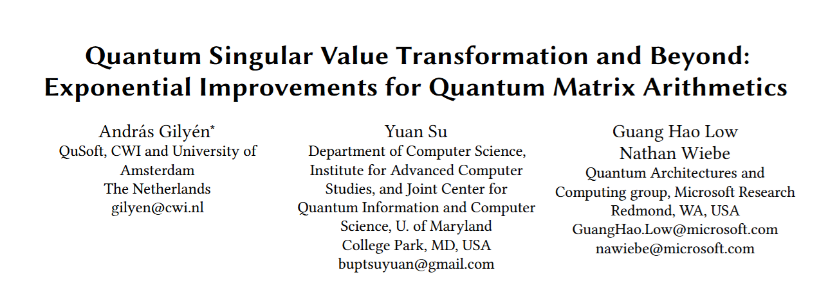
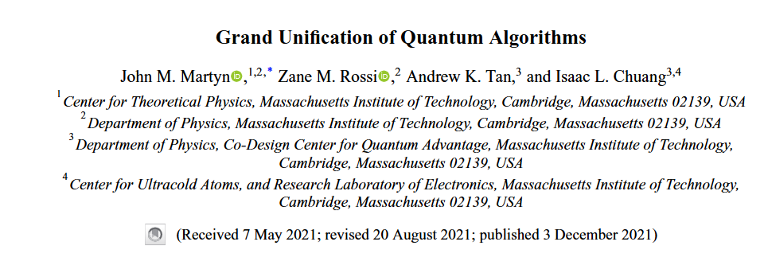
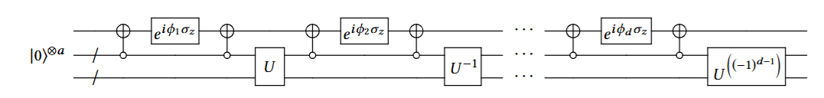
Quantum Singular Value Transformation (QSVT)
Gilyén, A., Su, Y., Low, G. H., & Wiebe, N. (2019, June). Quantum singular value transformation and beyond: exponential improvements for quantum matrix arithmetics. In Proceedings of the 51st annual ACM SIGACT symposium on theory of computing (pp. 193-204).
Martyn, J. M., Rossi, Z. M., Tan, A. K., & Chuang, I. L. (2021). Grand unification of quantum algorithms. PRX quantum, 2(4), 040203.

Slide 5
QSVT
Dataset: TUH DPATH Breast data (v4.0.0)
Scoring using DPATH Scoring
QSVT:
  Execution time: ~15 minutes
  Number of qubits: 12
Train | Dev
Scoring Summary: (0) norm = 100.0000% (2) nneo = 0.0000% (3) infl = 100.0000% (5) dcis = 100.0000% (6) indc = 100.0000% (8) bckg = 100.0000% avg lbls = 80.0000% avg bckg = 100.0000% score = 82.0000% <** | Scoring Summary: (0) norm = 100.0000% (2) nneo = 0.0000% (3) infl = 100.0000% (5) dcis = 100.0000% (6) indc = 100.0000% (8) bckg = 100.0000% avg lbls = 80.0000% avg bckg = 100.0000% score = 82.0000% <**

