Slide 1

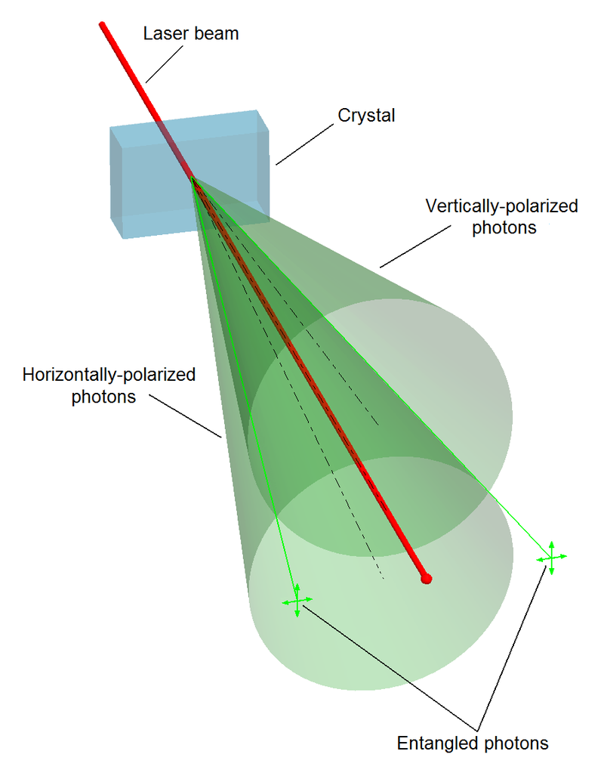
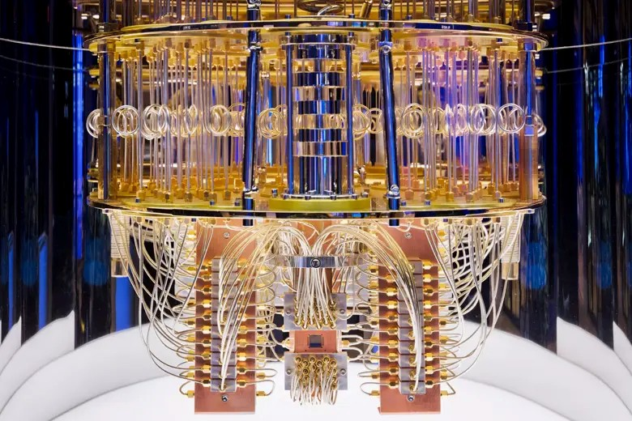
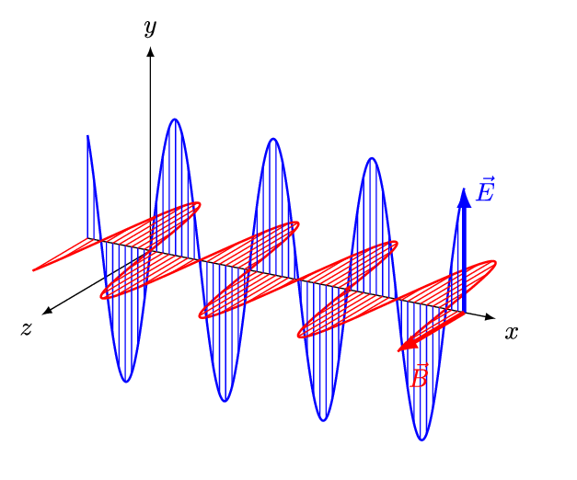
Quantum Machine Learning
Sadia Afrin Purba
Neural Engineering Data Consortium
Temple University

Slide 2
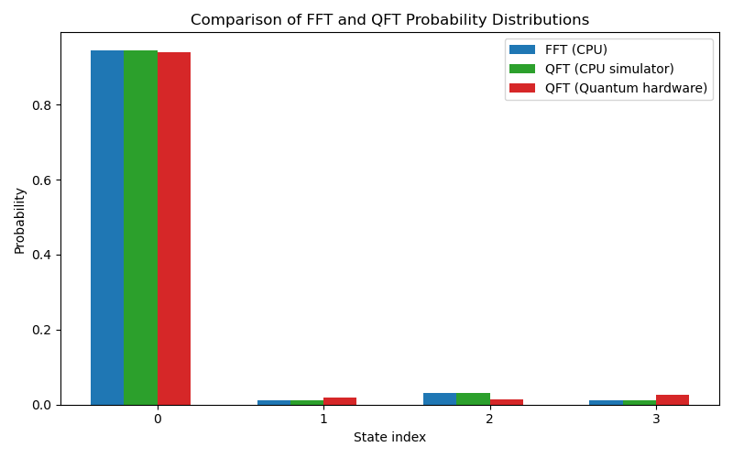
QFT
Fig-1: Comparison of probability distributions obtained from classical FFT and quantum Fourier transform (QFT). The FFT output is converted into a probability distribution by normalizing the squared magnitudes (power) of each frequency component at index, i (x-axis). The QFT results are shown from both a quantum simulator and actual quantum hardware, where probabilities represent measurement outcomes of quantum basis states.

Slide 3
QFT
System | N | Execution Time (sec)
FFT in classical computer | 4 | 0.000050
QFT in classical simulator | 4 | 0.06
QFT in quantum hardware | 4 | 1.92
FFT in classical computer | 8 | 0.000069
QFT in classical simulator | 8 | 0.04
QFT in quantum hardware | 8 | 2.97

Slide 4
RBM vs QRBM
Dataset: TUH DPATH Breast data (v4.0.0)
Scoring using DPATH Scoring
RNF:
  Train score: 46.08%
  Dev score: 50.93%
  Execution time: ~1 minute
RBM:
  Train score: 90.00%
  Dev score: 90.00%
  Execution time: ~23 minutes
  Parameters: hidden size=1024, num_of_k_neighbors=9
QRBM:
  Train score: 45.63%
  Dev score: 50.98%
  Execution time: ~10 minutes
  Parameters: hidden size=1024, num_of_k_neighbors=9

