Slide 1
Entanglement
Sadia Afrin Purba
02/26/2025

Slide 2
Basic Quantum Particles
Spin: angular momentum of an electron or other particle.
There are two classes of quantum particles, those with a spin multiple of one-half, called fermions, and those with a spin multiple of one, called bosons.
The spin quantum number of fermions can be s = +1/2, s = −1/2, or an odd multiple of s = ±1/2. Protons, neutrons, electrons, neutrinos, and quarks (the building blocks of protons and neutrons) are fermions.
The spin quantum number of bosons can be s = +1, s = −1, s = 0, or a multiple of ±1. Photons, gluons, higgs boson etc.
Source: https://www.sciencedirect.com/topics/mathematics/quantum-particle

Slide 3
Qubit
Physical information
Abstraction called qubit with the physical reality
  provide a glimpse at some of the properties of quantum particles we have to manipulate in order to process quantum information
Source: https://www.sciencedirect.com/topics/mathematics/quantum-particle

Slide 4
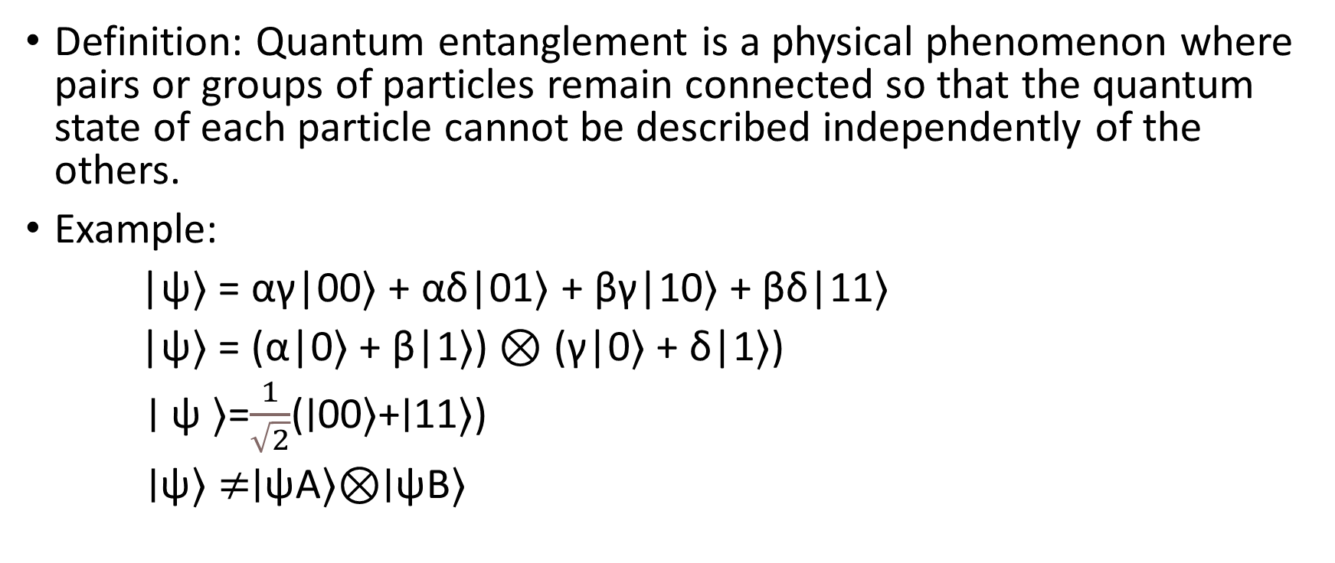
Entanglement
Definition: Quantum entanglement is a physical phenomenon where pairs or groups of particles remain connected so that the quantum state of each particle cannot be described independently of the others.
Example:
|ψ⟩ = αγ|00⟩ + αδ|01⟩ + βγ|10⟩ + βδ|11⟩
|ψ⟩ = (α|0⟩ + β|1⟩) ⊗ (γ|0⟩ + δ|1⟩)
∣ ψ ⟩=$\frac{1}{\sqrt{2}}$​(∣00⟩+∣11⟩)
∣ψ⟩ $≠$∣ψA​⟩⊗∣ψB​⟩

Slide 5
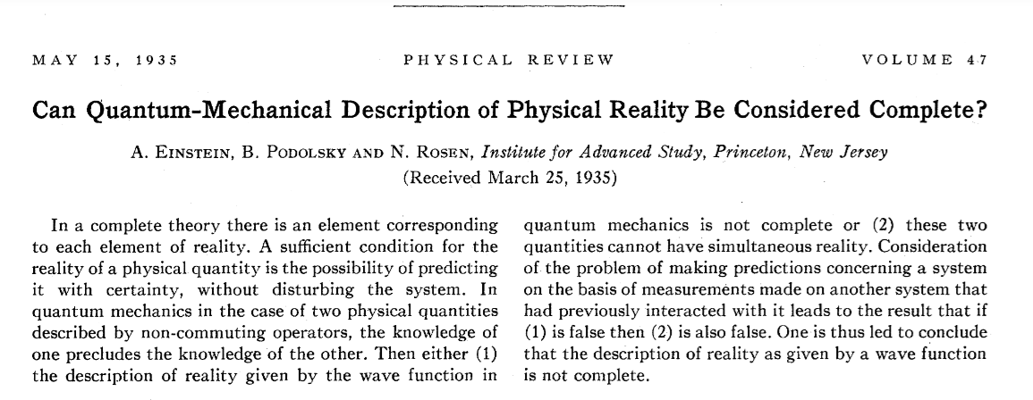
??
Sadia Afrin Purba
Einstein, A., Podolsky, B., & Rosen, N. (1935). Can quantum-mechanical description of physical reality be considered complete?. Physical review, 47(10), 777.

Slide 6
Main Idea
Quantum mechanics must be incomplete because:
If two particles interact and separate
Measuring one seems to instantly affect the other
This violates local realism (no faster-than-light influence)
EPR thought experiment:
Two particles with perfectly correlated positions and momenta
Measure position of particle 1 → instantly know position of particle 2
Measure momentum of particle 1 → instantly know momentum of particle 2
How could particle 2 "know" which property was measured?
Einstein's view:
There must be "hidden variables" carrying this information

Slide 7
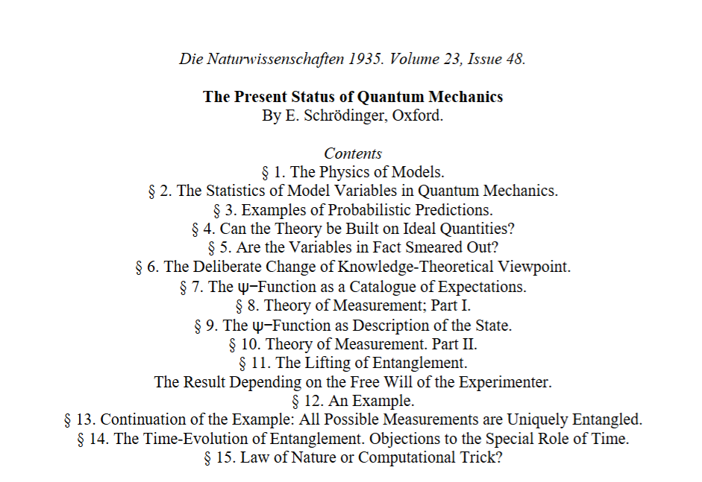
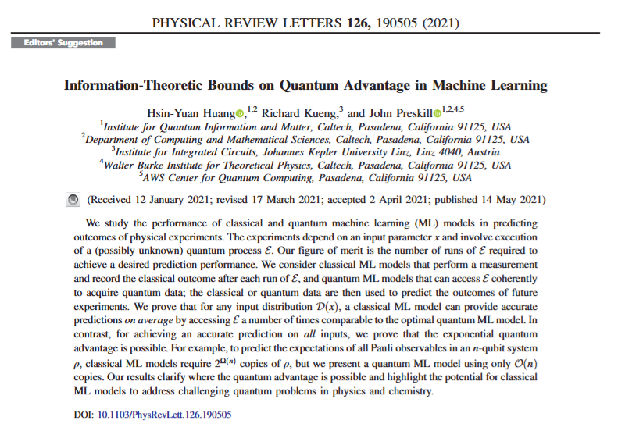
??
Sadia Afrin Purba
Schrödinger, E. (1935). The present status of quantum mechanics. Die Naturwissenschaften, 23(48), 1-26.

Slide 8
Main Idea
Erwin Schrödinger coined the term "entanglement" (Verschränkung).
Described entanglement as "the characteristic trait of quantum mechanics”.
Developed the famous "Schrödinger's cat" thought experiment partly to highlight the paradoxical nature of quantum superposition and entanglement.

Slide 9
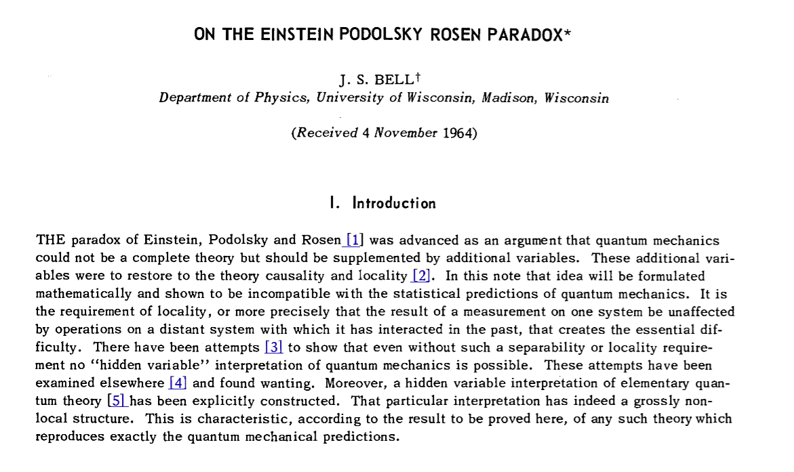
Sadia Afrin Purba
Bell, J. S. (1964). On the einstein podolsky rosen paradox. Physics Physique Fizika, 1(3), 195.

Slide 10
Main Idea
Bell created a mathematical formula that sets an upper limit on how correlated the distant objects could be if they were following classical physics.
Bell created a formula where any system with pre-existing properties (like Einstein believed must exist) would produce a value ≤ 2.
Quantum mechanics predicted the value could reach 2√2 (approximately 2.82).
The world doesn't work according to "local realism" where objects have definite properties that travel no faster than light.

Slide 11
Confirming Quantum Mechanics
  1) Clauser, Horne, Shimony, and Holt (CHSH, 1969):
  Refined Bell's inequality into experimentally testable form
  2) Alain Aspect's experiments (1981-1982):
  First convincing violation of Bell's inequality
  Used time-varying analyzers to ensure no classical communication
  3) Loophole-free tests (2015):
  Closed "locality loophole" and "detection loophole" simultaneously
  Conclusively showed violation of Bell's inequality
  Experiments by groups at NIST, TU Delft, and Vienna

Slide 12
2022 Nobel Prize in Physics
“For experiments with entangled photons, establishing the violation of Bell inequalities and pioneering quantum information science”
Recipients:
  Alain Aspect (Université Paris-Saclay, France)
  John F. Clauser (J.F. Clauser & Associates, USA)
  Anton Zeilinger (University of Vienna, Austria)
  Significance: Confirmed quantum mechanics' non-local nature and laid foundations for quantum technologies

Slide 13
Creating Entanglement in the Lab
Spontaneous Parametric Down-Conversion (SPDC):
  Send laser through nonlinear crystal (e.g., beta-barium borate)
  Single photon splits into two entangled photons with correlated polarizations
  Used in many Bell test experiments
Quantum Dots:
  Semiconductor nanostructures that trap electrons
  Can create entangled photon pairs when electrons recombine

Slide 14
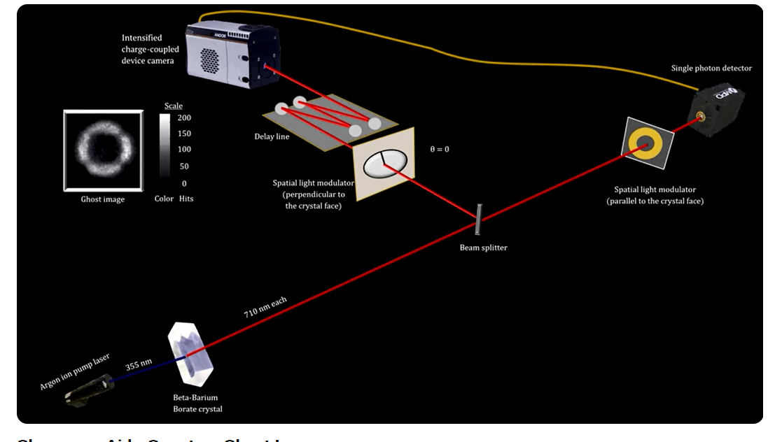
Source: https://www.youtube.com/watch?v=HrlcXEri4b0&t=14s&ab_channel=DavidButler

Slide 15
Entanglement in nature
When a particle decays into multiple particles, those particles are entangled.
When an electron or atom emits two photons, they are entangled.
Quantum entanglement during photosynthesis (https://newscenter.lbl.gov/2010/05/10/untangling-quantum-entanglement/)

