Slide 1
Literature Review
Sadia Afrin Purba
02/18/2025

Slide 2
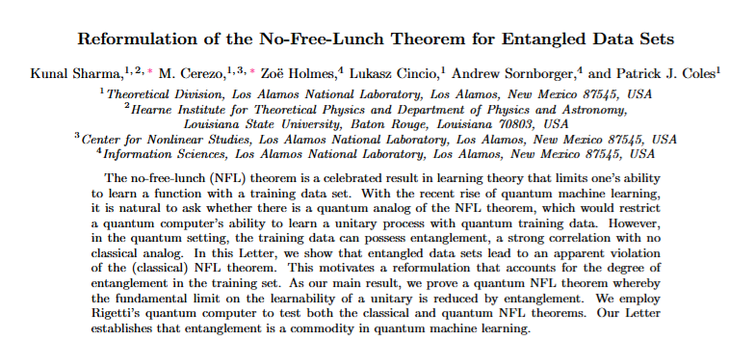
??
Sadia Afrin Purba
Sharma, K., Cerezo, M., Holmes, Z., Cincio, L., Sornborger, A., & Coles, P. J. (2022). Reformulation of the no-free-lunch theorem for entangled datasets. Physical Review Letters, 128(7), 070501.

Slide 3
Main Idea
Authors gave theoretical proof that entanglement is the key resource for quantum machine learning algorithms.
If we have N qubits and all of them are entangled, only one training sample is needed to achieve an accurate classification score.
More entangled data yields better performance.

Slide 4
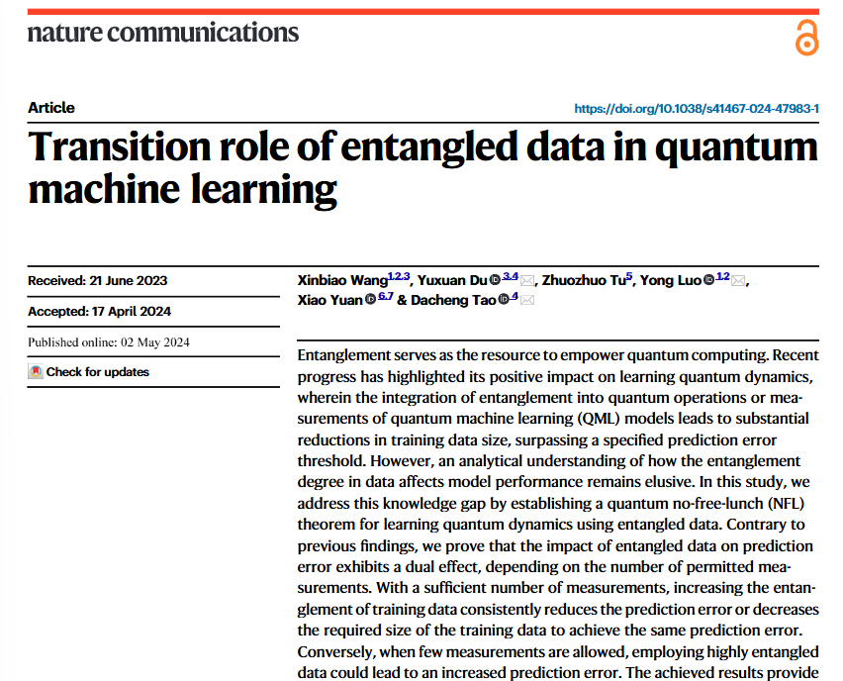
??
Sadia Afrin Purba
Wang, X., Du, Y., Tu, Z., Luo, Y., Yuan, X., & Tao, D. (2024). Transition role of entangled data in quantum machine learning. Nature Communications, 15(1), 3716.

Slide 5
Main Idea
Entangled data has a "transition role" or dual effect on prediction error, depending on the number of measurements allowed:
  With a sufficient number of measurements (m > 1000), increasing the entanglement of training data consistently reduces prediction error or decreases the required training data size to achieve the same error.
  When measurements are severely constrained (m ≤ 100), highly entangled data can actually hurt performance.

Slide 6
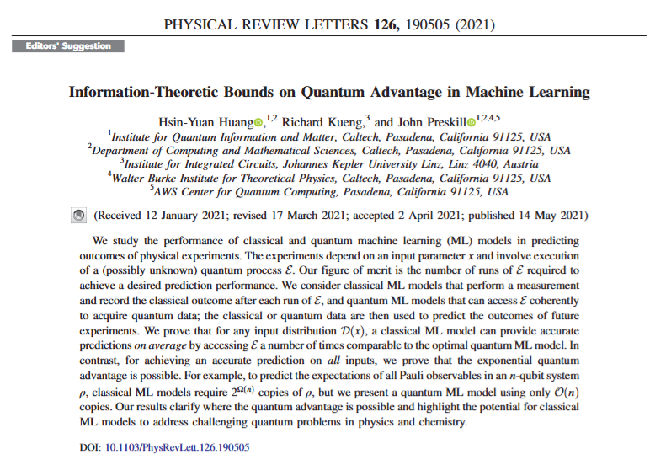
??
Sadia Afrin Purba
Huang, H. Y., Kueng, R., & Preskill, J. (2021). Information-theoretic bounds on quantum advantage in machine learning. Physical Review Letters, 126(19), 190505.

Slide 7
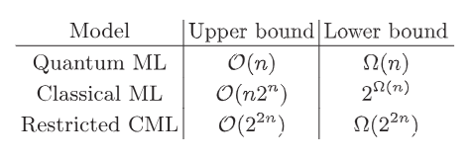
Main Idea
The key findings about training sample requirements are:
For average-case prediction error:
  No exponential quantum advantage exists - classical ML models can achieve similar prediction accuracy with comparable (polynomial factor more) training samples
For worst-case prediction error:
  Exponential quantum advantage is possible

Slide 8
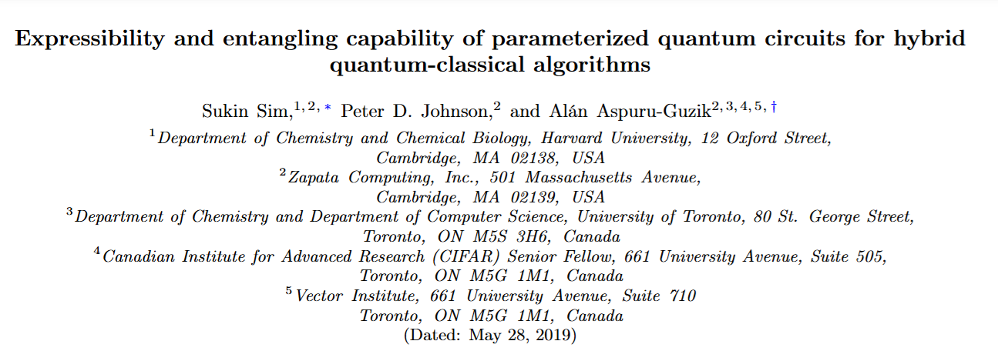
Sadia Afrin Purba
Sim, S., Johnson, P. D., & Aspuru‐Guzik, A. (2019). Expressibility and entangling capability of parameterized quantum circuits for hybrid quantum‐classical algorithms. Advanced Quantum Technologies, 2(12), 1900070.

Slide 9
Main Idea
Analyze 19 different quantum circuit designs varying in qubit connectivity and gate selection
  Expressibility "saturates" with increased circuit depth, with different circuits saturating at different values.
  Controlled-X rotation gates (CRX) generally provide better expressibility than controlled-Z rotation gates (CRZ).
  Ring or all-to-all qubit connectivity substantially improves performance compared to linear arrangements.

Slide 10
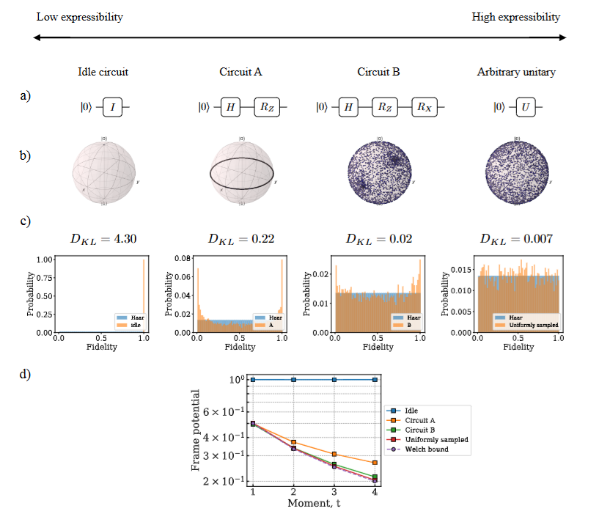
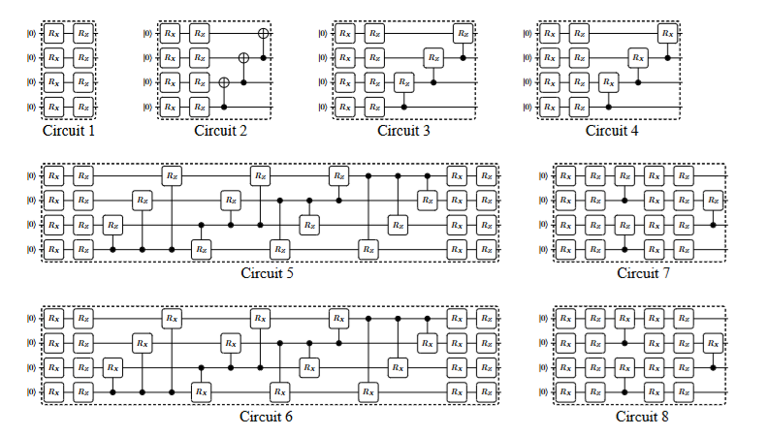
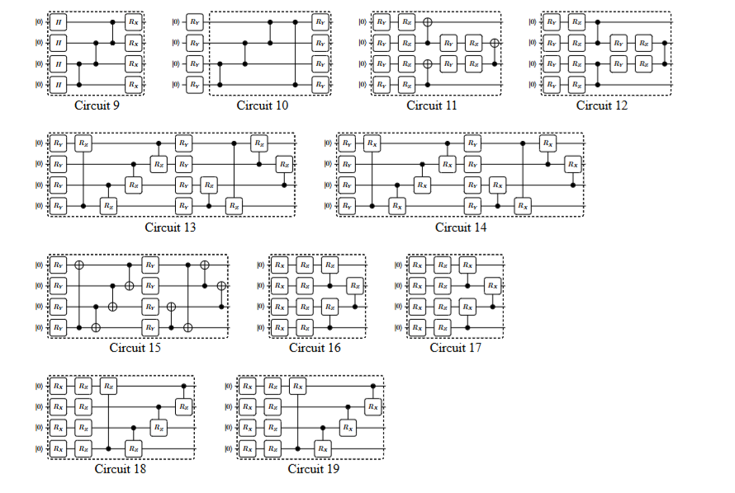

Slide 11
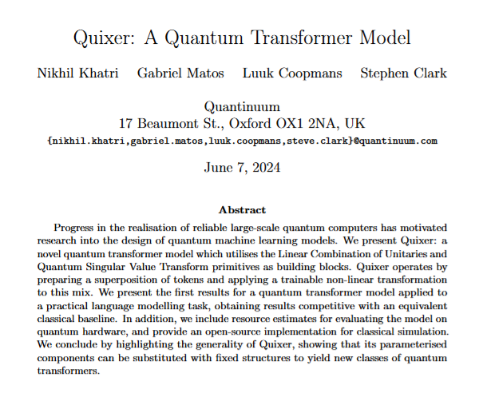
??
Sadia Afrin Purba
Khatri, N., Matos, G., Coopmans, L., & Clark, S. (2024). Quixer: A Quantum Transformer Model. arXiv preprint arXiv:2406.04305.

Slide 12
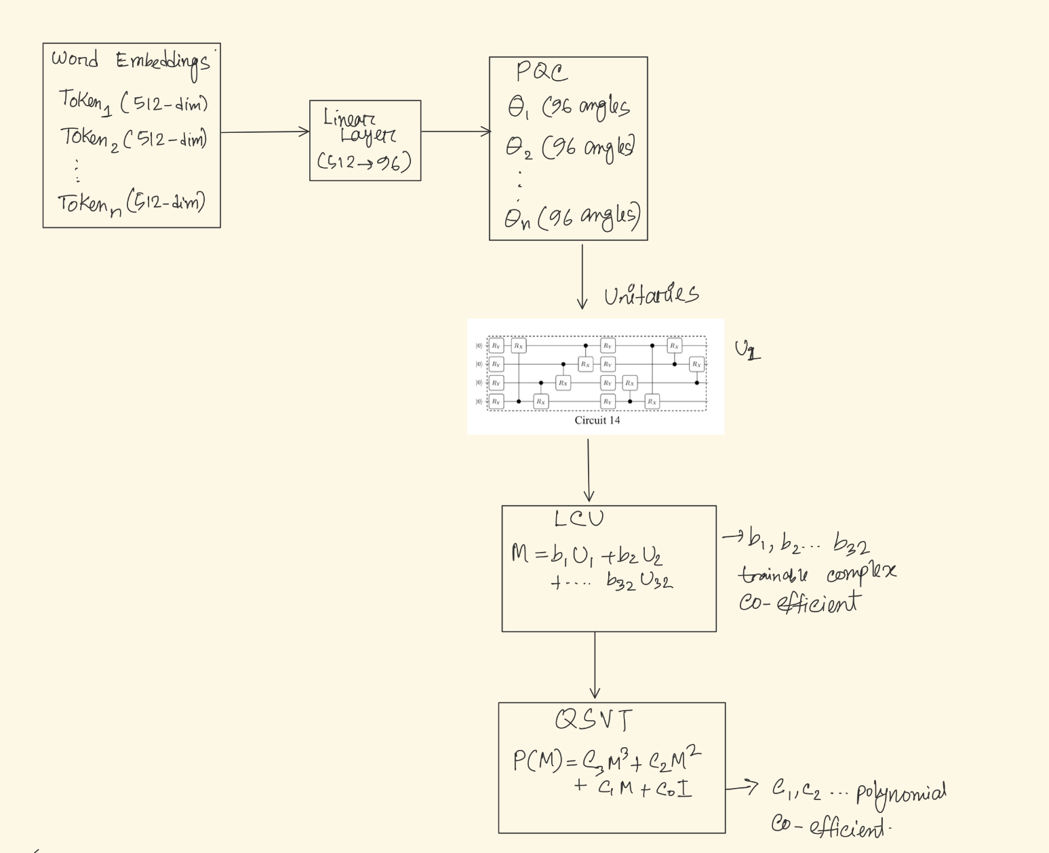
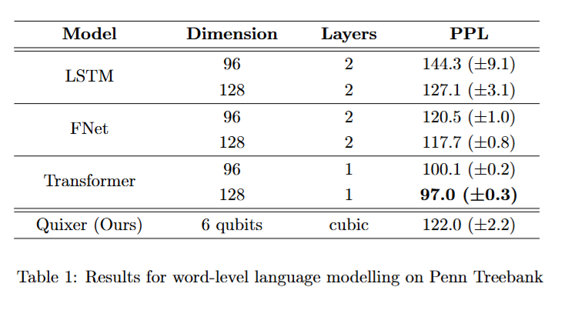

Slide 13
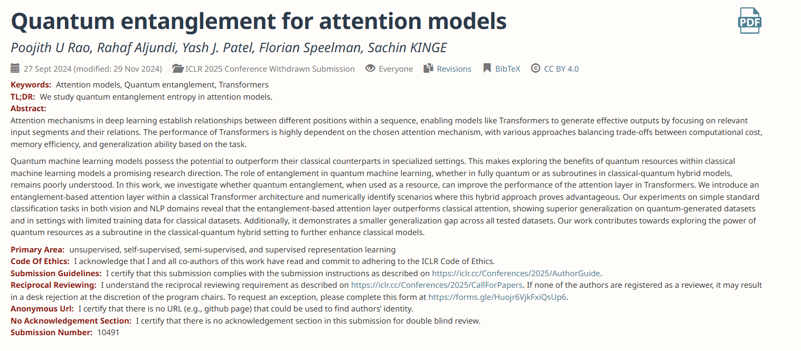
??
Dear Reviewers,
Upon conducting additional experiments, we found that some of our earlier observations regarding the generalization gap and quantum datasets no longer hold true. As a result, we have decided to withdraw the paper to conduct further experiments and refine our findings.
OpenReview: https://openreview.net/forum?id=3jRzJVf3OQ

Slide 14
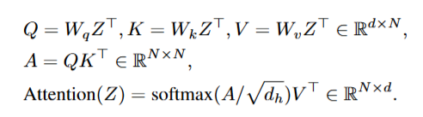
Main Idea
  They use an entanglement measure instead of the dot product when calculating the query and key matrices.
Use three different measure:
1. Von Neuman’s entanglement entropy
2. SWAP test
3. Using a Modified SWAP Test for Concurrence

Slide 15
Quantum Entanglement as a Superior Correlation Measure
I hypothesize that with a sufficient number of measurements, quantum entanglement provides a more comprehensive metric for measuring correlations between variables than classical correlation measures such as dot-product or classical entropy measures.
Specifically, I propose that entanglement-based metrics capture fundamental non-local correlations that remain undetected by traditional statistical methods, and it can lead to better predictive ML models.

Slide 16
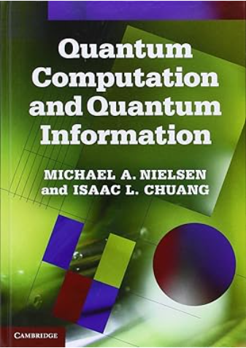
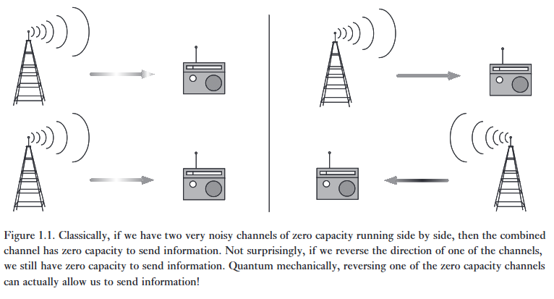
“Algorithm design for quantum computers is hard because designers face two difficult problems not faced in the construction of algorithms for classical computers.
First, our human intuition is rooted in the classical world. If we use that intuition as an aid to the construction of algorithms, then the algorithmic ideas we come up with will be classical ideas. To design good quantum algorithms one must ‘turn off’ one’s classical intuition for at least part of the design process, using truly quantum effects to achieve the desired algorithmic end.
Second, to be truly interesting it is not enough to design an algorithm that is merely quantum mechanical. The algorithm must be better than any existing classical algorithm!”
https://librarysearch.temple.edu/catalog/991013916669703811

