Slide 1
Literature Review
Sadia Afrin Purba

Slide 2
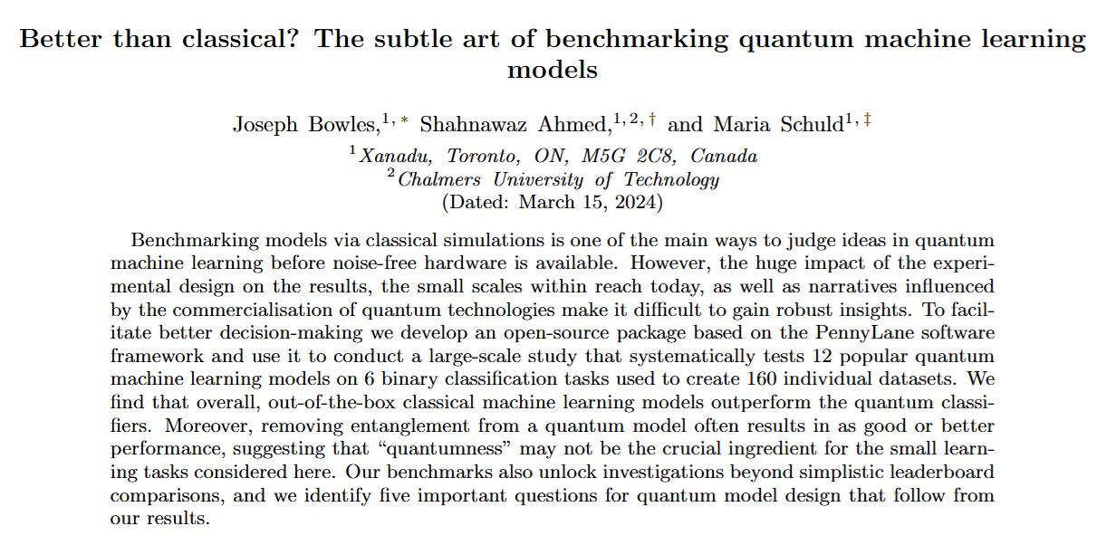
??
Sadia Afrin Purba
Code: https://github.com/XanaduAI/qml-benchmarks
Data: https://pennylane.ai/datasets/

Slide 3
Main Idea
Select QML models for classification and compare their accuracy with classical models
Highly influential 12 models
  six quantum neural network classifiers
  four quantum kernel based classifiers
  two quantum CNN based classifiers
160 datasets
  6 data generation procedures

Slide 4
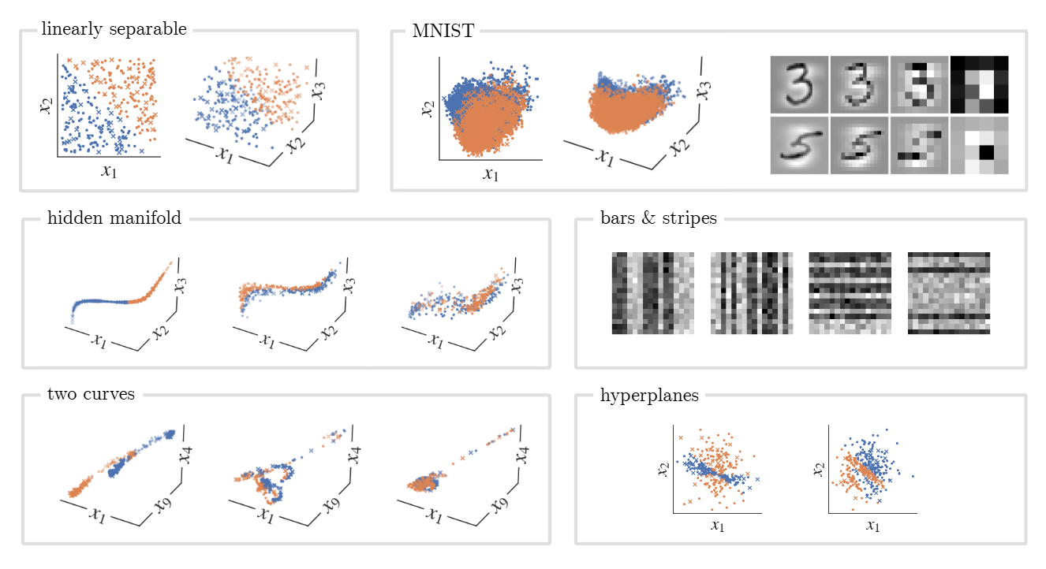

Slide 5
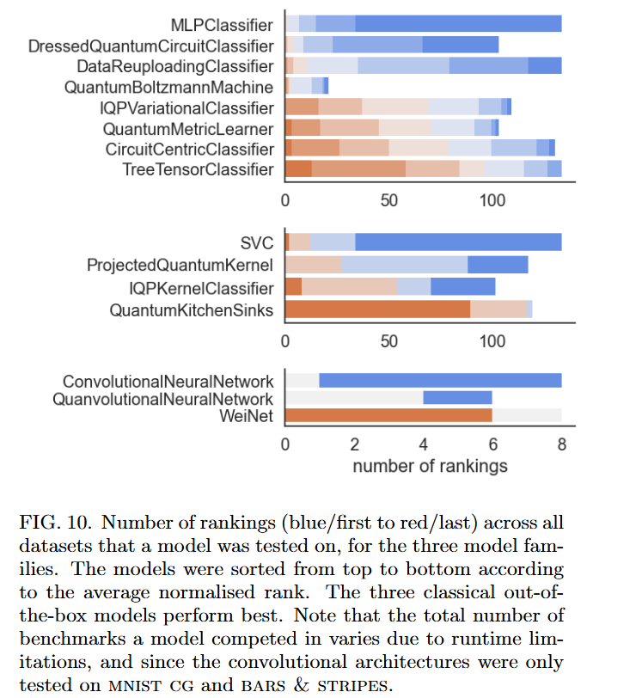
Bowles, J., Ahmed, S., & Schuld, M. (2024). Better than classical? the subtle art of benchmarking quantum machine learning models. arXiv preprint arXiv:2403.07059.

Slide 6
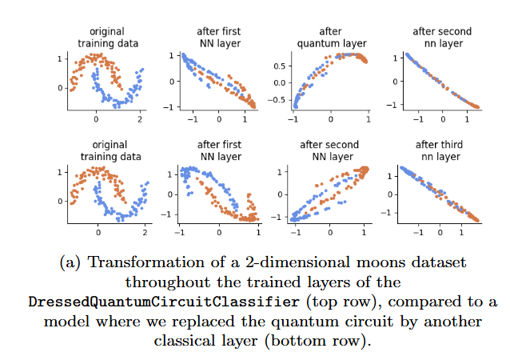
Bowles, J., Ahmed, S., & Schuld, M. (2024). Better than classical? the subtle art of benchmarking quantum machine learning models. arXiv preprint arXiv:2403.07059.

Slide 7
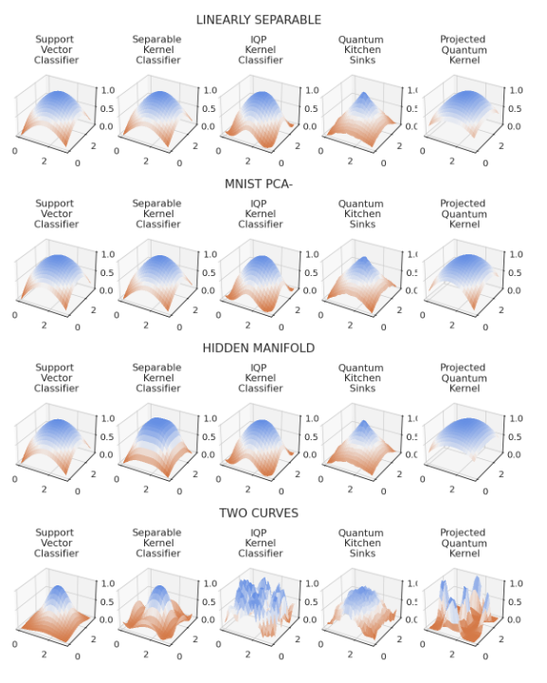
Bowles, J., Ahmed, S., & Schuld, M. (2024). Better than classical? the subtle art of benchmarking quantum machine learning models. arXiv preprint arXiv:2403.07059.

Slide 8
Summary
Classical models outperform quantum models
Quantum circuits without entanglement do well
QNN did not perform well due to “Barren Plateaus”
  In simpler term, barren plateaus is nothing but vanishing gradient problem when the number of qubits increases
Do quantum components in hybrid models help?
  For a simple hybrid-quantum NN
    the performance does not improve, but accuracy do not decrease dramatically
  For hybrid QCNN
    feature map actually degrades the data so that it is subsequently more difficult for the classical convolution to learn from

Slide 9
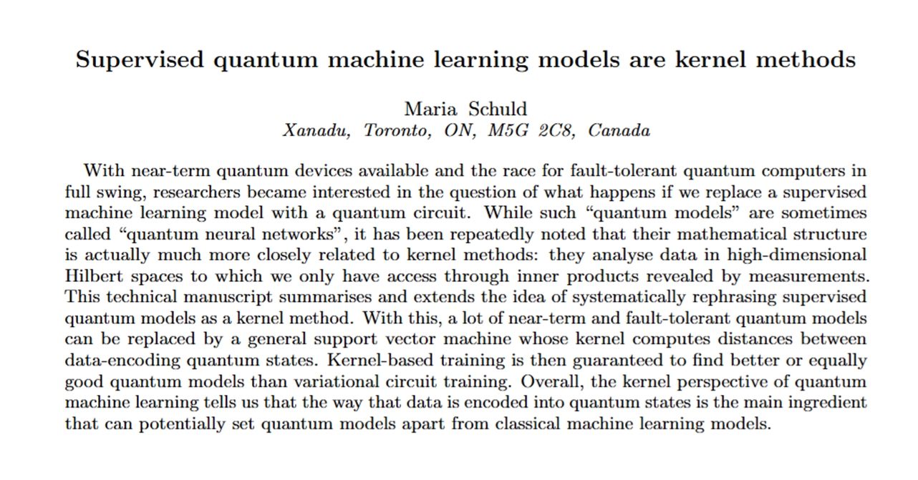
??
Sadia Afrin Purba
M. Schuld and F. Petruccione, Machine Learning with Quantum Computers, Quantum Science and Technology, https://doi.org/10.1007/978-3-030-83098-4_6

Slide 10
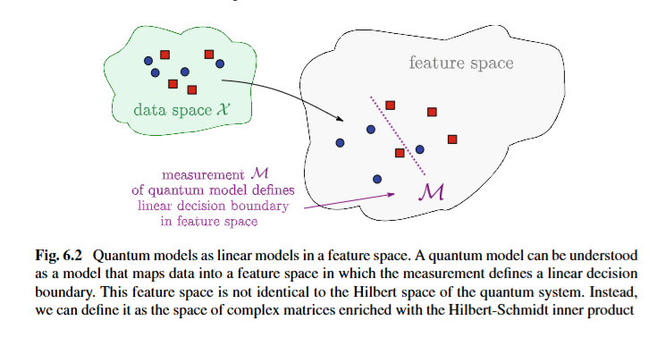
Sadia Afrin Purba
M. Schuld and F. Petruccione, Machine Learning with Quantum Computers, Quantum Science and Technology, https://doi.org/10.1007/978-3-030-83098-4_6

Slide 11
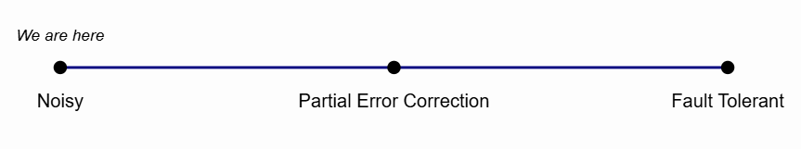
Summary
Quantum kernel methods can replace NN in fault-tolerant quantum computer
  “larger quantum computers will most likely enable us to reduce the quadratic scaling of kernel methods to linear scaling, which may make classical as well as quantum kernel methods a strong alternative to neural networks for big data processing one day”

Slide 12
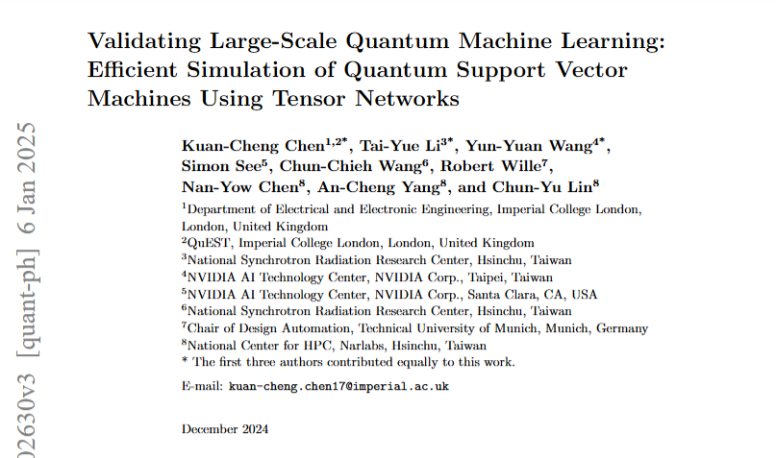
??
Sadia Afrin Purba
Code: https://github.com/Tim-Li/cuTN-QSVM

Slide 13
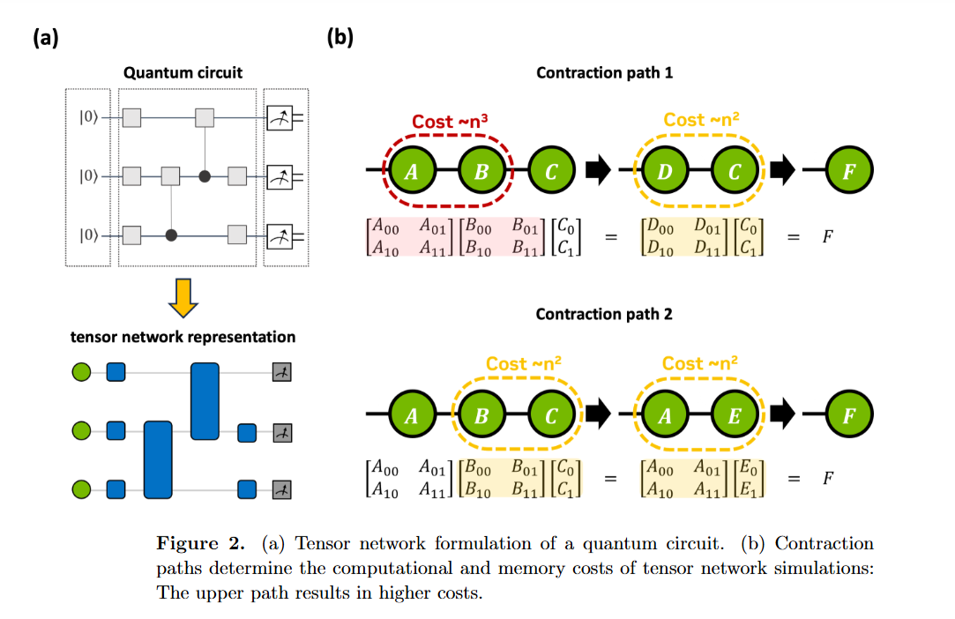
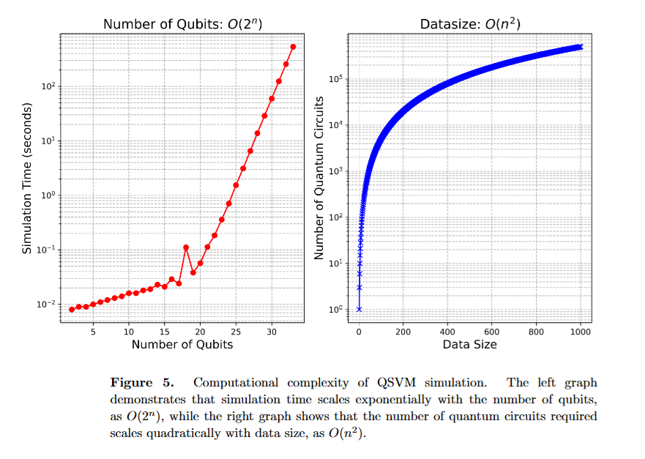
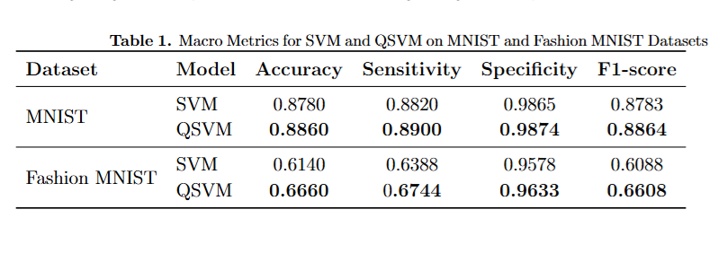

Slide 14
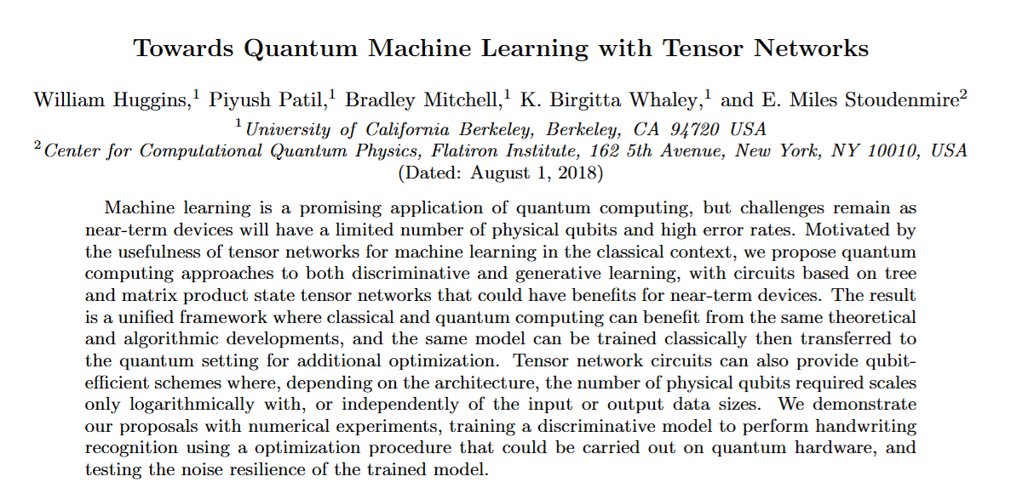
??
Sadia Afrin Purba
William Huggins et al 2019 Quantum Sci. Technol. 4 024001 DOI 10.1088/2058-9565/aaea94

Slide 15
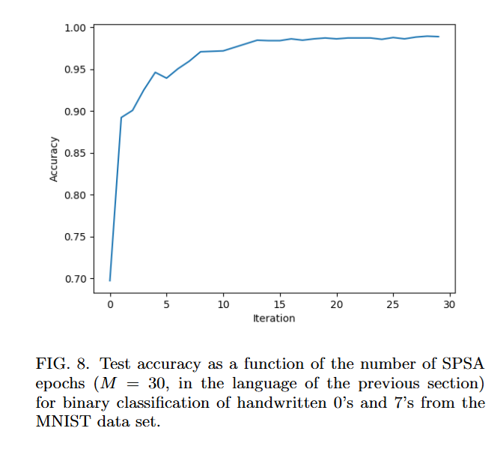
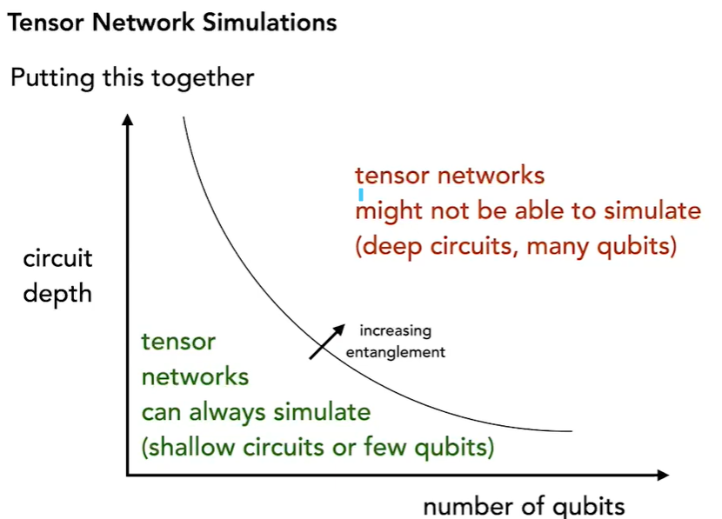
William Huggins et al 2019 Quantum Sci. Technol. 4 024001 DOI 10.1088/2058-9565/aaea94
https://www.youtube.com/watch?v=fq3_7vBcj3g

Slide 16
Summary
We can decompose any size of tensor using SVD
Matrix product state (MPS) tensor network -> take a bigger tensor and decompose as a tensor network
All quantum circuits can be represented as tensor networks
Sometimes tensor networks are so powerful
  we can flip the script: quantum algorithms become new "quantum inspired" classical algorithms
Need an extensive classical computing power
Noiseless

Slide 17
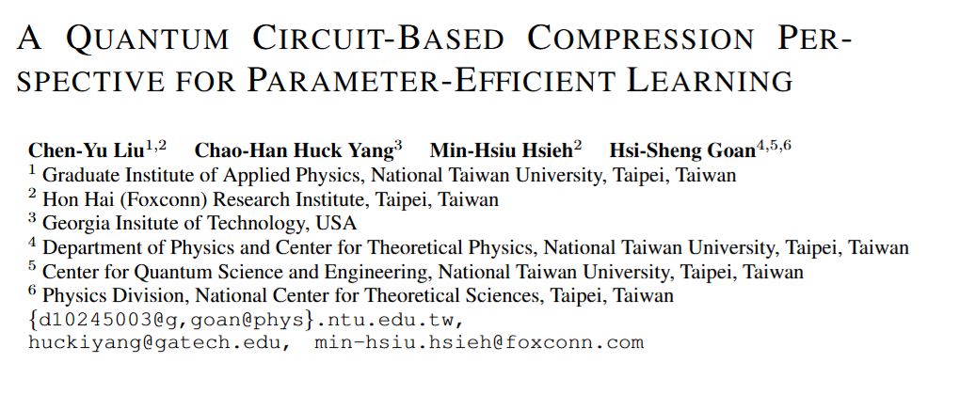
??
Sadia Afrin Purba
Liu, C. Y., Yang, C. H. H., Hsieh, M. H., & Goan, H. S. (2024). A Quantum Circuit-Based Compression Perspective for Parameter-Efficient Learning. International Conference on Learning Representations (ICLR 2025)

Slide 18
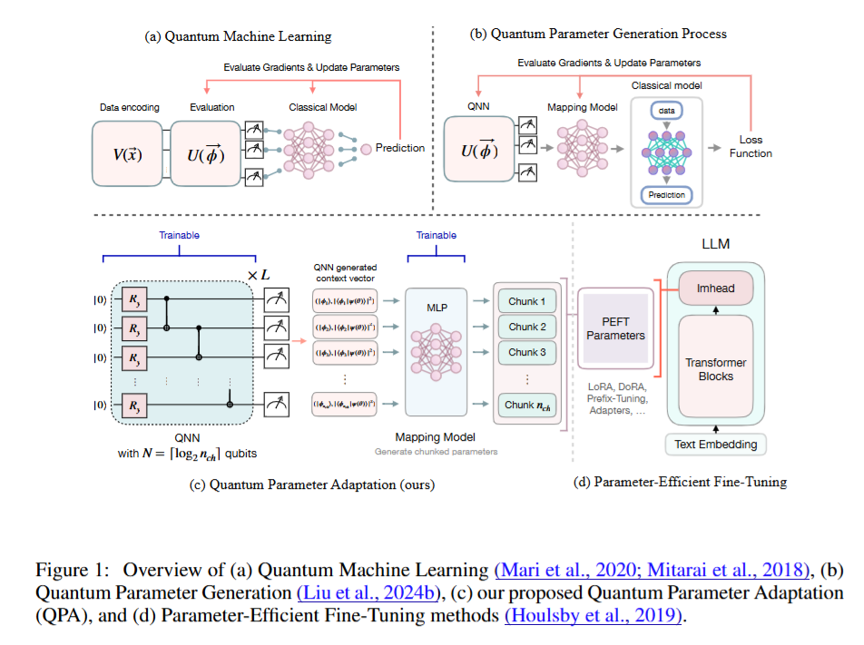
Liu, C. Y., Yang, C. H. H., Hsieh, M. H., & Goan, H. S. (2024). A Quantum Circuit-Based Compression Perspective for Parameter-Efficient Learning. International Conference on Learning Representations (ICLR 2025)

Slide 19
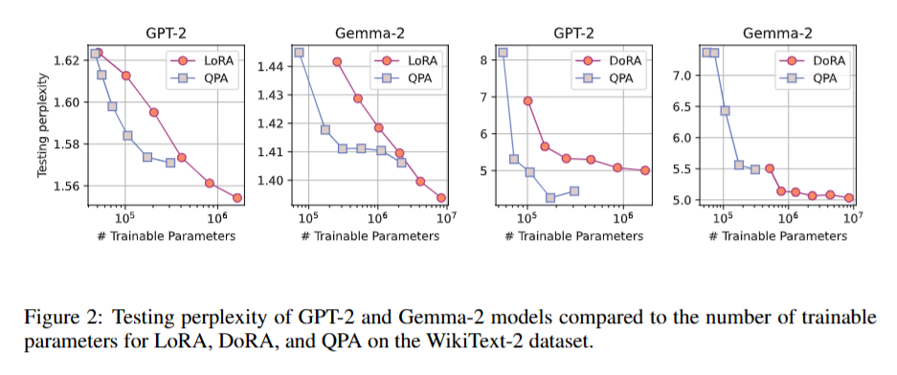
Liu, C. Y., Yang, C. H. H., Hsieh, M. H., & Goan, H. S. (2024). A Quantum Circuit-Based Compression Perspective for Parameter-Efficient Learning. International Conference on Learning Representations (ICLR 2025)

Slide 20
Summary
Introduces Quantum Parameter Adaptation (QPA), a novel approach that combines quantum computing with parameter-efficient fine-tuning (PEFT) methods for LLMs
QPA only requires 4-11 qubits
Quantum noise in QPA's circuit acts like beneficial noise seen in classical LLM fine-tuning, potentially helping explore parameter spaces more effectively

Slide 21
Where can we go from here??
How to solve Barren Plateaus phenomena in the quantum neural network for gradient-based learning; it’s a current bottleneck of this field?
Figure out what’s the role of entanglement in the quantum models and come up with mathematical theory?
Equivalency in quantum and classical operations?
  try to come up with better kernel function for SVM
Quantum transformers for classification problem?
Quantum parameter-efficient fine-tuning for LLMs?
Variational Quantum Embedding?
Quantum Reinforcement Learning?

