Slide 1
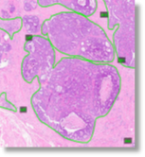
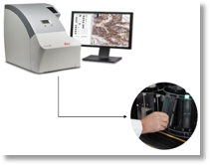
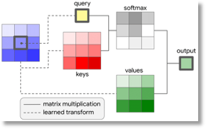
Segmentation Techniques in
Computer Vision
C. Dumitrescu
Temple University

Slide 2
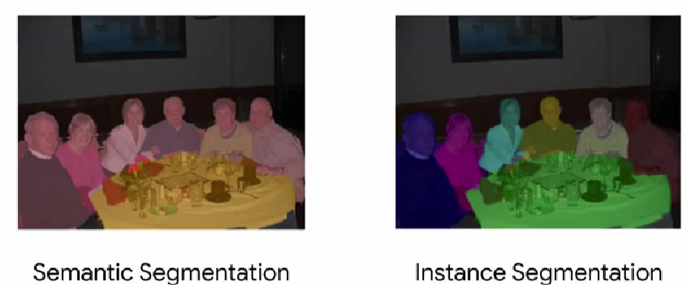
Introduction
Instead of locating an object within a rectangular bounding box, segmentation instead figures out the pixels that make up that object.
In this case, we have six people around a table, and instead of seven bounding boxes, we've colored the image to denote each of the detected objects.
(Source: coursera.org/learn/advanced-computer-vision-with-tensorflow)

Slide 3
Image Segmentation Basic Architecture
Image is processed with an encoder (~feature extractor). The encoder (CNN without the dense classification layers) extracts features from the image into a feature map. The earlier layers extract low level features such as lines and these lower level features are successfully aggregated into higher level features (pooling). The aggregation of successful higher level features is done with the help of downsampling (output = feature map).
The decoders takes the features that were extracted by the encoder and work on producing the output (= pixel mask) or prediction. The decoder assigns intermediate class labels to each pixel of the feature map, and then up samples the image to slowly add back the fine grained details of the original image. The decoder then assigns more fine-grained intermediate class labels to the up samples pixels and repeats this process until the images up sampled back to its original input dimensions.

Slide 4
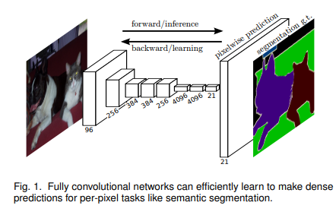
Popular Segmentation Architectures
Fully Convolutional Network (FCN) =/= Fully Connected Network
Segnet
U-Net
PSPNet
Mask R-CNN.
Fully Convolutional Models for Semantic Segmentation - Evan Shelhamer*, Jonathan Long*, Trevor Darrell, PAMI 2016, arXiv:1605.06211
This is an illustration of the architecture from the original paper. It shows an example of how filters are learned in the usual way through forward inference and backpropagation. At the end is a pixel-wise prediction layer that will create the segmentation map. The decoder has a number of options.

Slide 5
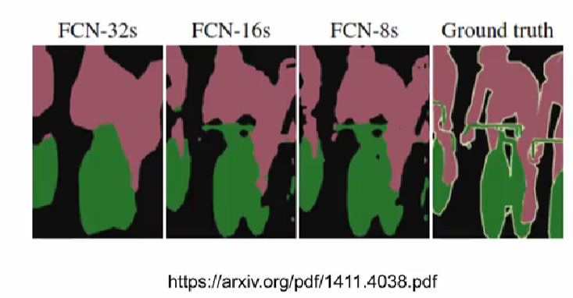
FCN Comparison
Fully convolutional neural networks, encoders are feature extractors like the feature extracting layers using object detection models. So you can reuse the layers of well-known object detection models as the encoder of the fully connected network (VGG16, ResNet 50, or MobileNet).
The decoder part of the FCN is usually called FCN-32, FCN-16 or FCN-8 with a number denotes the stride size during upsampling.
Stride in a convolutional layer determines how many pixels to shift the sliding window as it traverses the image. The difference between the decoder architectures ends up effectively being the resolution of the final pixel map.

Slide 6
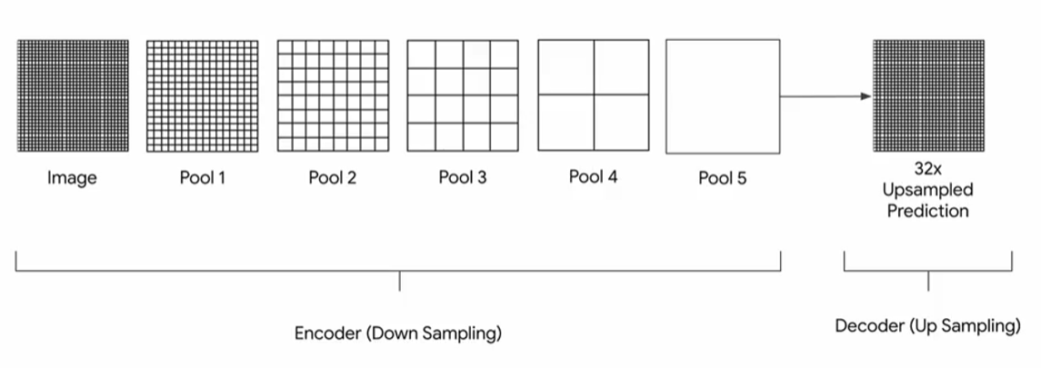
FCN-32
Example: When you pool an image with a 2 by 2 window size and a stride of 2 by 2, you'll reduce the image in half along each axis, so 256 by 256 image would get pooled to 128 by 128 and so on.
The architecture has five pooling layers. Each pooled result gets its dimensions reduced by half, five times. The original image gets reduced by a factor of 2^5 of 32. If the output of the final pooling layer (pool5) is upsampled back to the original image size, it needs to be upsampled by a factor of 32. This is done by upsampling with a stride size of 32 (each input pixel from Pool 5 is turned into a 32 by 32 pixel output). This 32 times upsampling is also the pixelwise prediction of classes for the original image.
Separately, we use the output of pool 4 to make a pixelwise prediction using a one by one convolution layer.

Slide 7
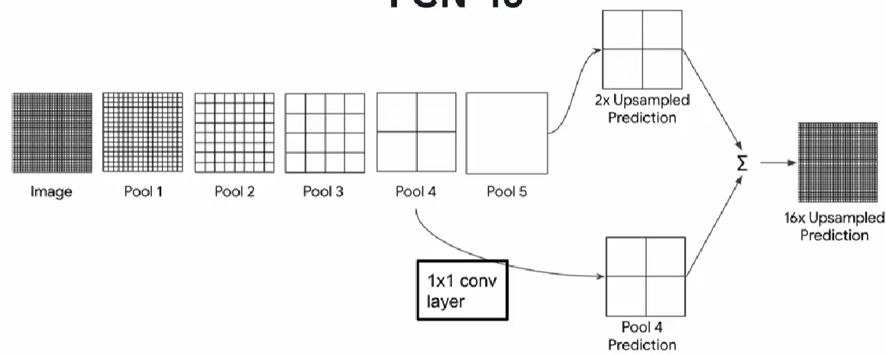
FCN-16
FCN-16 works similarly to FCN-32, but in addition to using pool 5, it also uses pool 4. In step 1, the output of pool 5 is upsampled by a factor of two, so the result has the same height and width as pool 4. Separately, we use the output of pool 4 to make a pixelwise prediction using a one by one convolution layer. The pool 4 prediction is added to the 2x upsampled output of pool 5. The output of this addition is then upsampled by a factor of 16 to get the final pixelwise segmentation map. Upsampling with a stride of 16 takes each input pixel and outputs a 16 by 16 grid of pixels.

Slide 8
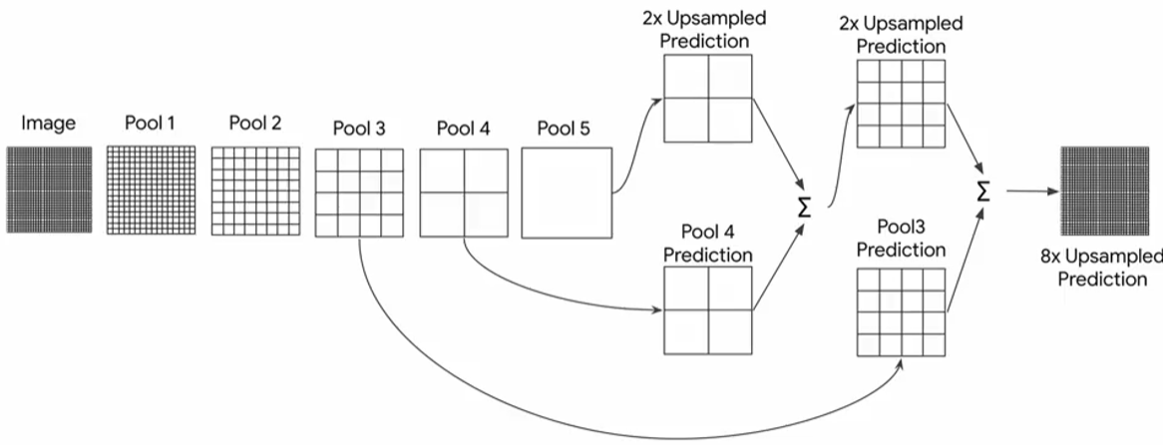
FCN-8
FCN-8 decoder works very similar with the same first two steps, but instead of upsampling the summation of the pool 4 and 5 predictions by 16, it will 2x upsample it, and then add that to the pool 3 prediction.
When the image is at a higher resolution, our segments are better defined. Thus, the FCN-8 looks better than the FCN-16, and better than the FCN-32.
the FCN-32 might be enough (depending on the task and resolution of the image).

Slide 9
U-Net
First introduced: Ronneberger, O., Fischer, P., Brox, T. (2015). U-Net: Convolutional Networks for Biomedical Image Segmentation.
U-Net is also a fully convolutional neural network, but with the key difference that in addition to the up sampling path, skip connections between the encoder and the decoder are also used. These skip connections are denoted by the horizontal arrows that reverse the U shape. Also, notice how the unit is drawn here, with various layers at different levels forming this U shape.
Conv 3x3, RELU
MaxPool 2x2
De conv 2x2
Crop and concat (skip connections)

Slide 10
U-Net (Encoder)
Similar to the FCNs, we have an image fed into convolution layers and then down sampled using max pooling. At the 1st level, if the image is fed in as a 128 by 128 and pass through two convolutional layers that have 64 filters each, the subsequent images when pooled, will be 64 by 64(not because of the number of filters, but because a max pooling layer with a 2 by 2 window and a stride of 2, can reduce the dimensionality by half). From the 1st -> 5th level, a 128x128 image is filtered and down sampled into 8x8 blocks.
Encoder Decoder
Conv 3x3, RELU
MaxPool 2x2
De conv 2x2
Crop and concat (skip connections)

Slide 11
U-Net (Decoder)
An additional element in the unit architecture, is a simple convolutional layer, which can further extract features, but it doesn't have a pooling layer to follow it. This layer is named the bottleneck.
Starting at the bottom, the 5th level with the 8 by 8 blocks gets up samples to 16 by 16. You'll take the 512 filters from the layer of the encoder that's at the same level as this decoder layer, in this case it's the 4th level. Notice that since the encoder layer and decoder layer are the same level in the unit, they also have the same height and width of 16 by 16 and they also have the same number of filters at 512 each. So, you'll then concatenate the filters from the encoder, with the filters of the decoder, for a total of 1024 filters. You'll then pass this concatenated set of 1024 filters, through 2 convolutional layers.
Encoder Decoder
Conv 3x3, RELU
MaxPool 2x2
De conv 2x2
Crop and concat (skip connections)

Slide 12
U-Net (Decoder)
And this pattern continues through the decoder, you'll up sample the blocks to 32 by 32 and move up to level 3. You'll take the filters from the encoder on the same level, concatenate them to the blocks from the decoder and pass the entire thing through 2 convolutional layers. This works as up sampling the image, it will get fed through two layers of convolutional filters, that match the one on the previous level. But with the additional ones that are the skip over, from the equivalent filters on the encoder side. So up sampled to 64 by 64, move up to level 2, combine the filters from the encoder with a decoder and pass them through two convolution layers. And finally, up sample to 128 by 128 and move up to level 1, concatenate the filters from the encoder and decoder and pass them through the two convolution layers. Finally, the output segmentation map is obtained, by performing 1 by 1 convolution, with the filters equal to the number of classes on the output.
Encoder Decoder
Conv 3x3, RELU
MaxPool 2x2
De conv 2x2
Crop and concat (skip connections)

Slide 13
Summary
Concept of Fully Convolutional Network
How it works (upsampling and downsampling)
Why it works
Use case: U-Net
What We Didn’t Talk About (Explainable AI):
Class activation map ( = class-discriminative saliency maps) CAM = a matrix that shows what parts of the image the model was paying attention to when deciding what class to assign the image. It's a map of which pixels of the image sent activations that we use to determine the class of the object
Saliency maps (Pixel Attribution / Vanilla Gradient): visualizations of the gradient in the network, activation maps focus more on the global importance of particular region to the final outcome
-GradCAM = class activation map that uses the gradients of the final classifications (combines Saliency with CAM).To access our resources

