Slide 1

NNEO vs Norm
By Dmitry

Slide 2
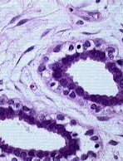
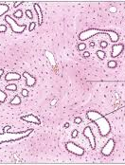
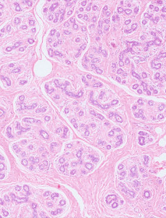
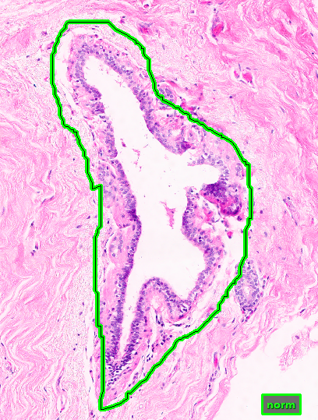
Normal

Slide 3
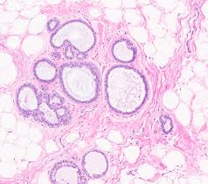
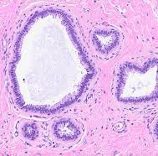
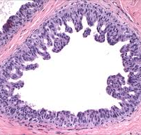
Nneo examples

Slide 4
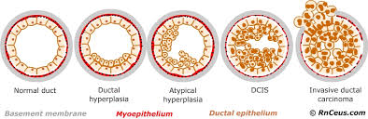
Transition from norm-nneo-dcis-indc
norm
Nneo
Dcis
Indc

Slide 5
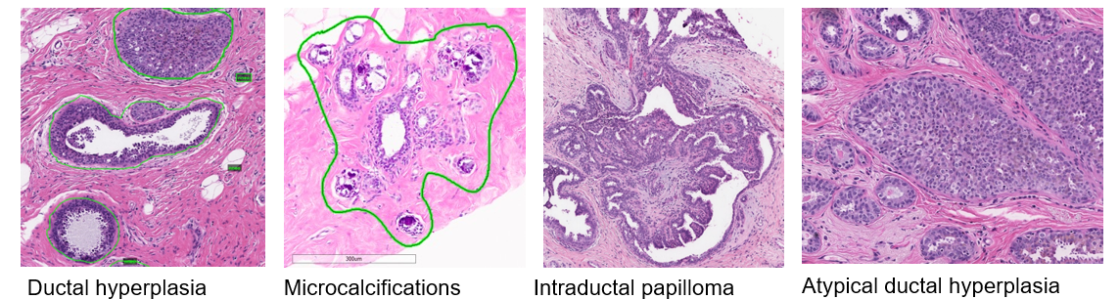
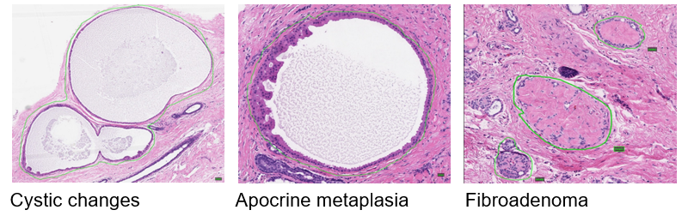
NNEO also Includes

Slide 6
Thoughts….
The transition between Norm-Nneo-Dcis is probably the most difficult thing to interpret as an annotator. For cancer, DCIS and INDC, we often have patient reports or csvm files to determine the difference; however, these files do not always indicate Nneo structures leaving interpretation to the annotator.

