Slide 1
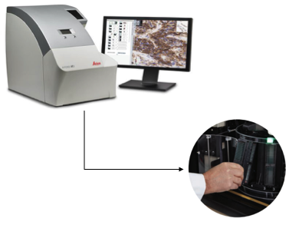
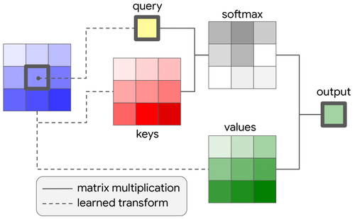


Automated Interpretation of Digital Pathology Images
Using Deep Learning
I. Obeid and J. Picone
College of Engineering
E. Dragut
College of Science and Technology
Y. Persidsky and N. Jhala
Lewis Katz School of Medicine
D. Connolly, C. Wu, Y. Gong, and H. Wu
Fox Chase Cancer Center

Slide 2
Abstract
Whole-slide imaging in digital pathology is rapidly advancing the need for automated digital image analysis. Ever-evolving guidelines for manual review of pathology images underscore the importance of AI-based algorithms that increase efficiency, improve productivity, and reduce fatigue. In this talk, we will review a collaboration between Fox Chase Cancer Center, Temple University Hospital, and the College of Engineering to detect and characterize cancerous cells in digitized images of pathology slides.
There are two main components to the project: (1) the development of an open source corpus of 100,000 digital pathology images to support training and development of state of the art machine learning systems, and (2) the development of deep learning-based technology to automatically segment and classify images.
We will discuss the pipeline we have developed for digitizing and annotating pathology images and introduce a machine learning system that segments breast tissue images and performs patch-level classifications at accuracies above 80%.
The data and open source tools developed in this project will accelerate pathologist productivity by prioritizing slides that need manual review. Such a translational capability will be transformative and evolve into additional areas of medical science involving images (e.g., prostate cancer) and multi-channel signals (e.g., electroencephalograms).
Notes:
Using stationary methods are usually very inefficient.
To decrease annotation error rates, annotation of the same data by multiple experts is needed, and that further drives up the cost of producing large amounts of data.

Slide 3
Primary Funding Enabling Our Digital Pathology Research
Funding Agency: NSF
Title: MRI: High Performance Digital Pathology Using Big Data and Machine Learning
PIs: J. Picone, T. Farkas, I. Obeid, Y. Persidsky
Details: $571K, Jan. 2018 – Dec. 2021
Title: CCRI: Planning: Digital Pathology Research Consortium
PIs: I. Obeid, J. Picone
Details: $100K, Jan. 2020 – Jun. 2021
Funding Agency: Temple University – Catalytic Collaborative Funding Initiative (CAT)
Title: Automatic Interpretation of Digital Pathology Images Using Deep Learning
PIs: I. Obeid, E. Dragut, Y. Persidsky, D. Connolly, J. Picone, N. Jhala,
H. Wu, Y. Gong
Details: $520K, Jan. 2022 – Dec. 2024.
Notes:
Using stationary methods are usually very inefficient.
To decrease annotation error rates, annotation of the same data by multiple experts is needed, and that further drives up the cost of producing large amounts of data.

Slide 4
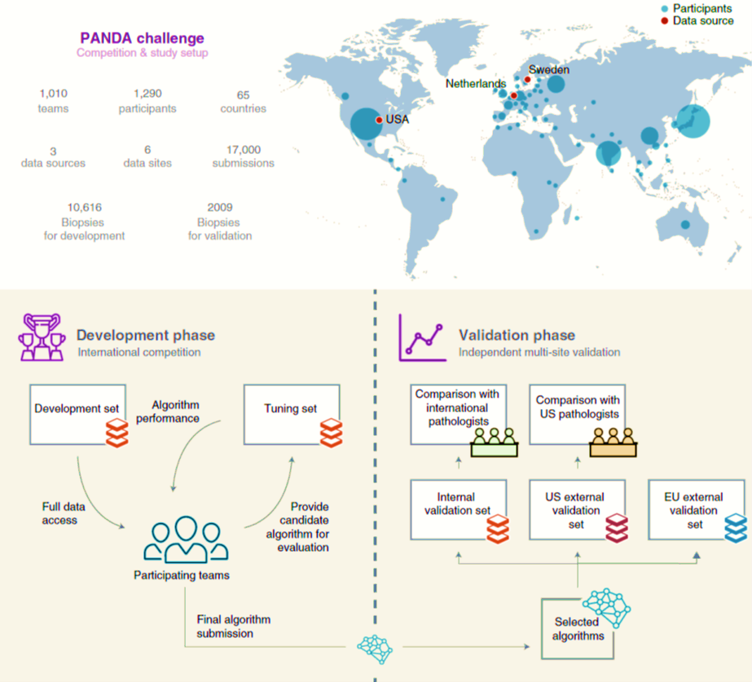
Digital Pathology Is Advancing Rapidly
The PANDA challenge focused on using machine learning to predict the Gleason score for prostate cancer.

Slide 5
The Classic Machine Learning Paradigm
Key issues:
  Is the data representative of the problem?
  Do the features capture meaningful differences between patterns?
  How do we find the best model?
  How do we estimate the parameters of the model?
  How do we evaluate performance?
Collect Data
Evaluate Classifier
Select Features
Train Classifier
Choose Model
Other considerations:
The answers are often application specific and data dependent.
Customers/users don’t often completely understand their requirements.
Data collection is often an on-going process that drives the technology.

Slide 6
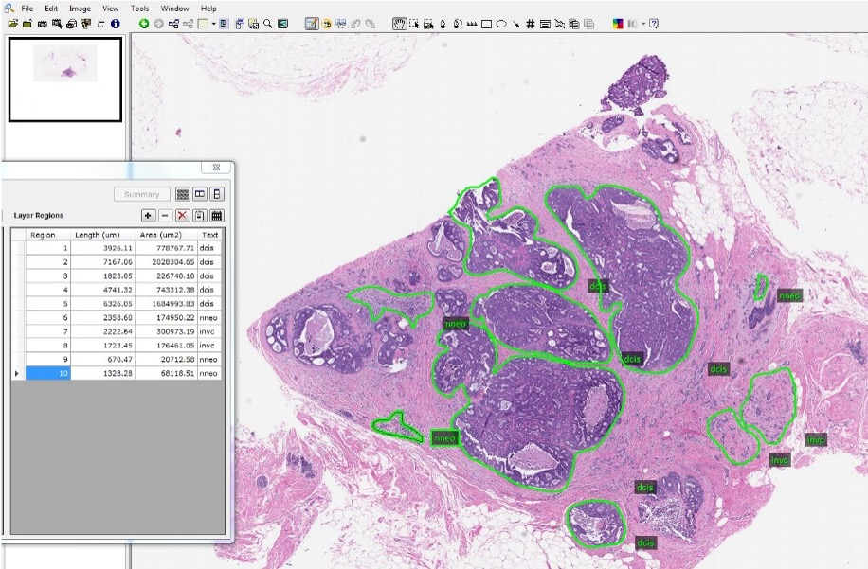
The TUH DPATH Corpus – Manual Annotation

Slide 7
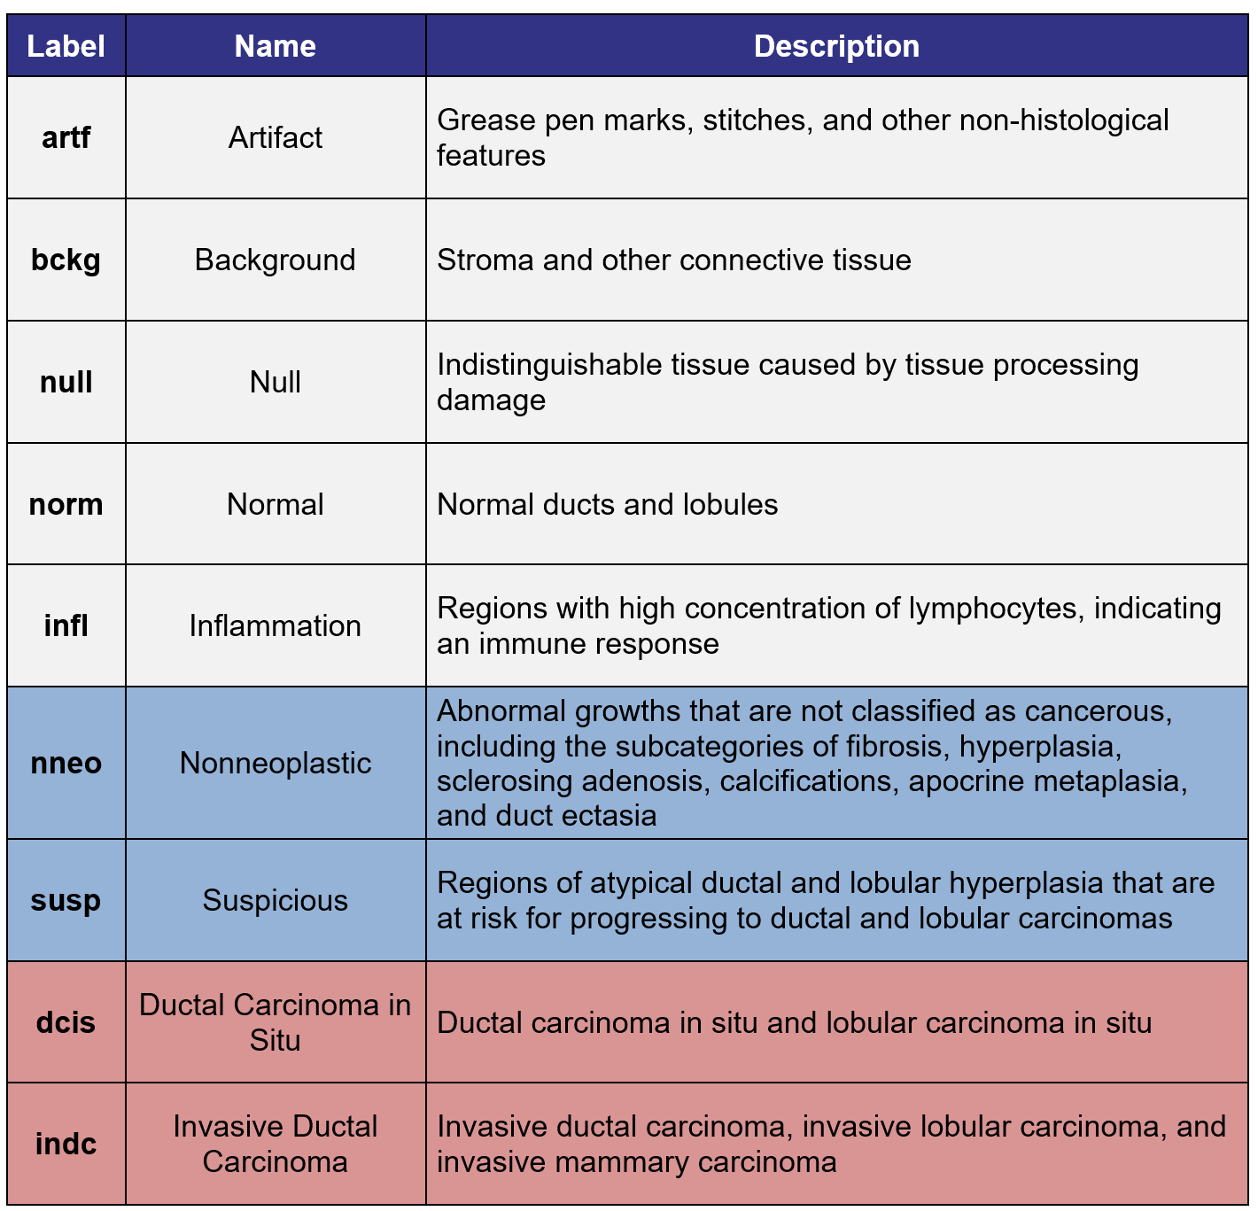
The TUH DPATH Corpus – Breast Tissue Subset
  3,505 images have been partially annotated
296 patients with an average of 11.8 slides per patient.
Of these 296 patients, 74 patients contain cancerous features (4.3% of the total annotated area): ductal carcinoma in situ or invasive ductal carcinoma.
Slides are scanned at a 20x magnification (0.50 microns per pixel) and stored in a compressed tiff SVS format.

Slide 8
The Fox Chase Cancer Center (FCCC) Corpus
The entire FCCC Biosample Repository (2022) was digitized – 14,288 slides collected from 13,230 subjects. Provides a wide range of cancer samples, with 10,906 instances of invasive ductal cancer (indc) and 1,222 instances of ductal carcinoma in situ (dcis).
1,463 breast tissue slides have been annotated using the nine labels.
Idx | Col | Name | Description | Example
11 | K | ICDO Code (Tissue Site) | the International Classification of Diseases for Oncology (ICDO) code for the tissue site | C15.9
12 | L | Tissue Site.1 | the anatomical site of the tissue site corresponding to the ICDO code for the tissue site | Esophagus, NOS
29 | AC | Histology | description of the cellular composition and characteristics of the tissue | Ductal Carcinoma NOS
32 | AF | Block Level Tissue Histology | description of the block level tissue histology based on an examination and analysis of the tissue sample | Ductal Carcinoma NOS
33 | AG | Gradeclin Desc | classification of the tumor grade based on clinical evaluation; indicates the degree of abnormality or aggressiveness of cancer cells compared to normal cells | Grade III Poorly Differentiated
34 | AH | Gradepath Desc | description or classification of the tumor grade based on the degree of differentiation of the tumor cells; is a measure of how abnormal the cancer cells look under the microscope | Grade cannot be assessed (GX); Unknown

Slide 9
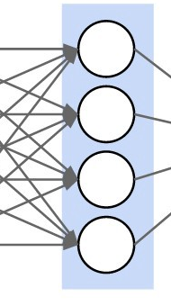
Deep Learning Technology
  Automated segmentation system based on ResNet18:
Input
(D₁, D₂)
Conv2D@D₁xD₂
kernel: 7x7
stride: 2x2
padding: 3x3
MaxPool2D@D₁xD₂
kernel: 3x3
stride: 2x2
padding: 1x1
dilation: 1x1
Basic Block
(D₁, D₂)
Downsample
(D₁, D₂)
BatchNorm@D₂
ReLU
Conv2D@D₁xD₂
kernel: 3x3
stride: 1x1
padding: 1x1
Conv2D@D₂xD₂
kernel: 3x3
stride: 1x1
padding: 1x1
Conv2D@D₁xD₂
kernel: 1x1
stride: 2x2
padding: 1x1
BatchNorm@D₂
BatchNorm@D₂
BatchNorm@D₂
ReLU
 | Input Layer | Layer 1 | Layer 2 | Layer 3 | Layer 4 | Output
Input | (3, 64) | --- | --- | --- | --- | ---
Basic Block | --- | (64, 64) | (64, 128) | (128, 256) | (256, 512) | ---
Downsample | --- | --- | (64, 128) | (128, 256) | (256, 512) | ---
Basic Block | --- | (64, 64) | (128, 128) | (256, 256) | (512, 512) | ---
Output | --- | --- | --- | --- | --- | (512, 2)
Output
(D₁, D₂)
Average Pooling
Linear@D₁ to D₂

Slide 10
Looking Towards The Future
New technology releases using large language model (LLM) deep learning technology (Vision Transfomer).
New data releases (doubled the number of annotated regions).
New Project: $100,000 PA Breast Cancer Coalition grant to explore high performance machine learning algorithms.
Reflections:
Big data drives machine learning research:
  Temple owns an extremely valuable repository of medical data.
  We have a good track record of providing important data that enables good machine learning research.
  Successful NIH proposals require ‘clinical impact’.
  Collaborations between machine learning researchers and healthcare professionals are critical to winning proposals.
  Emerging areas including cardiology (noninvasive prediction of cardiac failure) and neurology (seizure prediction).
  We hope we can find future areas for collaboration in digital pathology.

Slide 11
Brief Bibliography
Bagritsevich, M., Hackel, D., Obeid, I., & Picone, J. (2024). Annotation of the Fox Chase Cancer Center Digital Pathology Corpus. Proceedings of the IEEE Signal Processing in Medicine and Biology Symposium (SPMB), 1–4.
Shalamzari, S. S., Bagritsevich, M., Melles, Anne-Mai, Obeid, I., Picone, J., Connolly, D., Wu, C., Brown, B., James, J., Gong, Y., & Wu, H. (2023). Big Data Resources for Digital Pathology. Proceedings of the IEEE Signal Processing in Medicine and Biology Symposium, 1–19.
Shawki, N., Shadhin, M. G. M., Elseify, T., Jakielaszek, L., Farkas, T., Persidsky, Y., Jhala, N., Obeid, I., & Picone, J. (2020). The Temple University Digital Pathology Corpus. In I. Obeid, I. Selesnick & J. Picone (Eds.), Signal Processing in Medicine and Biology: Emerging Trends in Research and Applications (1st ed., pp. 67–104). doi: 10.1007/978-3-030-36844-9.
Bulten, W., et al., … Consortium, the Panda Challenge Consortium. (2022). Artificial intelligence for diagnosis and Gleason grading of prostate cancer: the PANDA challenge. Nature Medicine, 28(1), 154-163. doi: 10.1038/s41591-021-01620-2.
Shawki, N., Rodriguez Nunez, R., Obeid, I., & Picone, J. (2021). Automating Hyperparameter Optimization for Deep Learning Applications. In I. Obeid, I. Selesnick, & J. Picone (Eds.), Proceedings of the IEEE Signal Processing in Medicine and Biology Symposium (SPMB) (pp. 1–7). Philadelphia, Pennsylvania, USA.
Doshna, B., Wevodau, Z., Jhala, N., Akhtar, I., Obeid, I., & Picone, J. (2021). The Temple University Digital Pathology Corpus: The Breast Tissue Subset. In I. Obeid, I. Selesnick, & J. Picone (Eds.), Proceedings of the IEEE Signal Processing in Medicine and Biology Symposium (SPMB) (pp. 1–3). Philadelphia, Pennsylvania, USA. doi: 10.1109/SPMB52430.2021.9672275.
Hunt, I., Husain, S., Simons, J., Obeid, I., & Picone, J. (2019). Recent Advances in the Temple University Digital Pathology Corpus. I. Obeid & J. Picone (Eds.), Proceedings of the IEEE Signal Processing in Medicine and Biology Symposium (SPMB) (pp. 1-4). doi: 10.1109/SPMB47826.2019.9037859.
Houser, D., Golmohammadi, M. M., Anstotz, R., Campbell, C., Obeid, I., Picone, J., Farkas, T., Persidsky, Y. and Jhala, N. (2018). The Temple University Hospital Digital Pathology Corpus. Proceedings of the IEEE Signal Processing in Medicine and Biology Symposium (SPMB) (pp. 1–7). Philadelphia, Pennsylvania, USA. doi: 10.1007/978-3-030-36844-9.

Slide 12
Proposals Developed
Awarded:
Obeid, I., & Picone, J. (2023). Rapid and Inexpensive Precision Breast Cancer Screening Using Machine Learning. PA Breast Cancer Coalition Breast and Cervical Cancer Research Initiative, State of Pennsylvania, $100K, January 1, 2024 - December 31, 2024.
Submitted:
Obeid, I., & Picone, J. (2023). SCH: Unsupervised Deep Learning for Segmentation of Digital Pathology Images. Smart Health and Biomedical Research in the Era of Artificial Intelligence and Advanced Data Science, Directorate for Computer and Information Science and Engineering, National Science Foundation, $1.2M, July 1, 2024 - June 30, 2028.
Obeid, I., & Picone, J. (2022). SCH: Unsupervised Deep Learning for Segmentation of Digital Pathology Images. Smart Health and Biomedical Research in the Era of Artificial Intelligence and Advanced Data Science, Directorate for Computer and Information Science and Engineering, National Science Foundation, $1.2M, June 1, 2023 - May 31, 2027.
Obeid, I., & Picone, J. (2022). Prostate Cancer Screening Using Whole Slide Digital Pathology and Deep Learning. Congressionally Directed Medical Research Programs (CDMRP), Department of Defense, $1.5M, January 1, 2023 - December 31, 2025.

