Slide 1
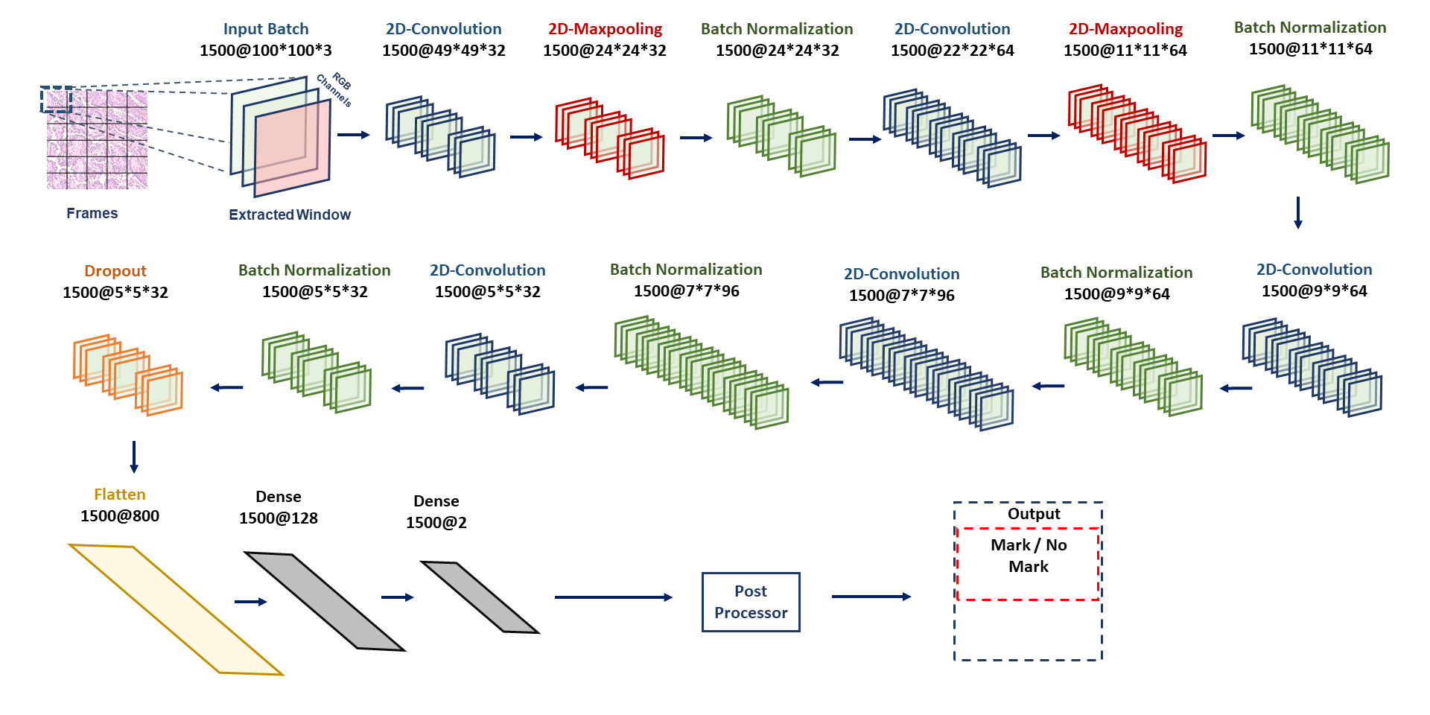
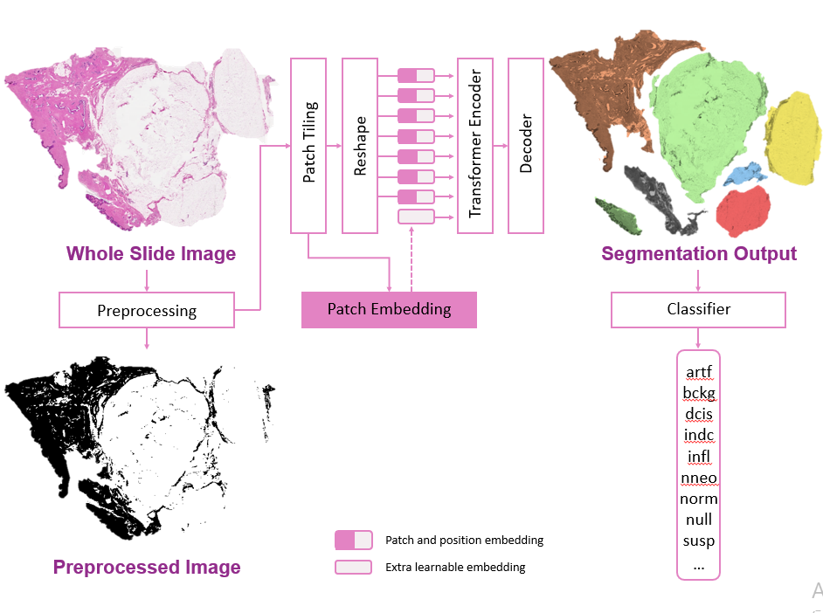
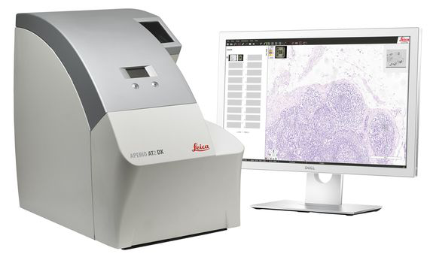
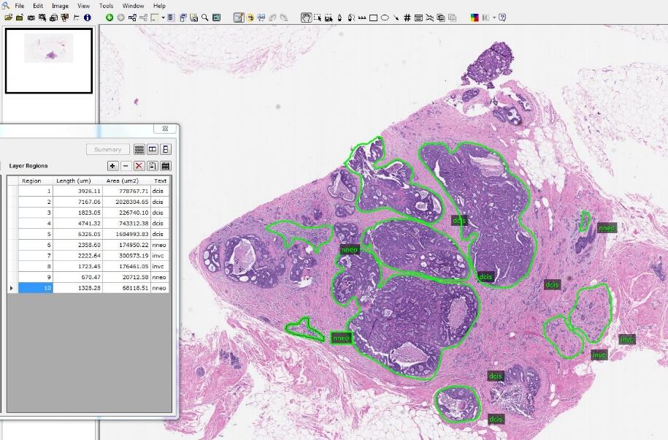
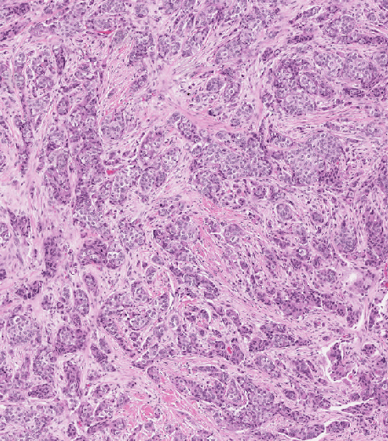
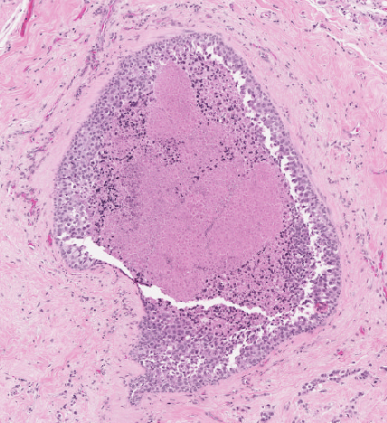
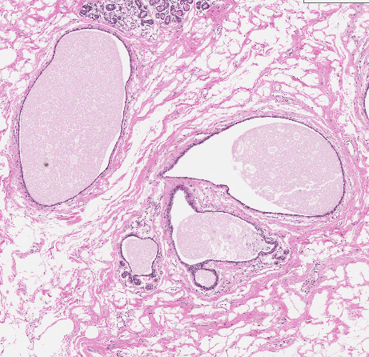
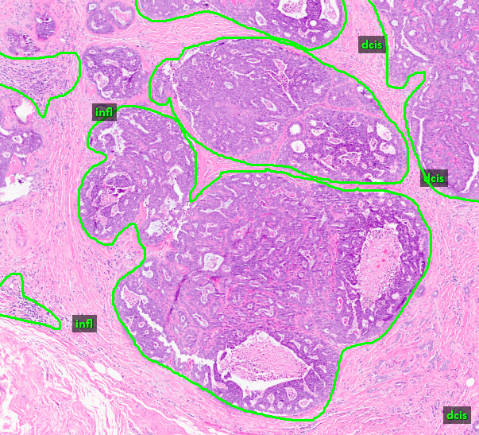
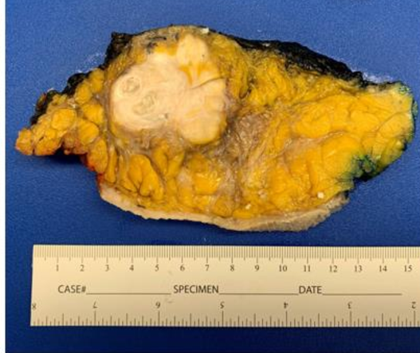
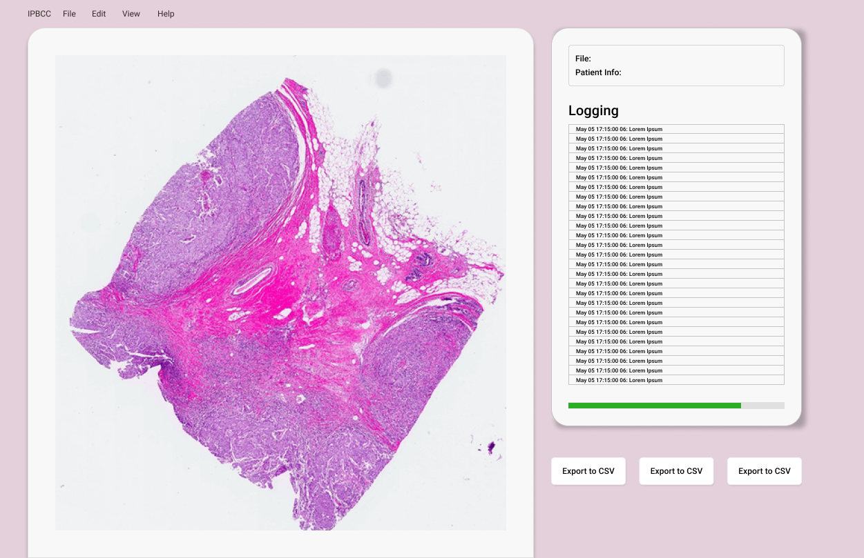
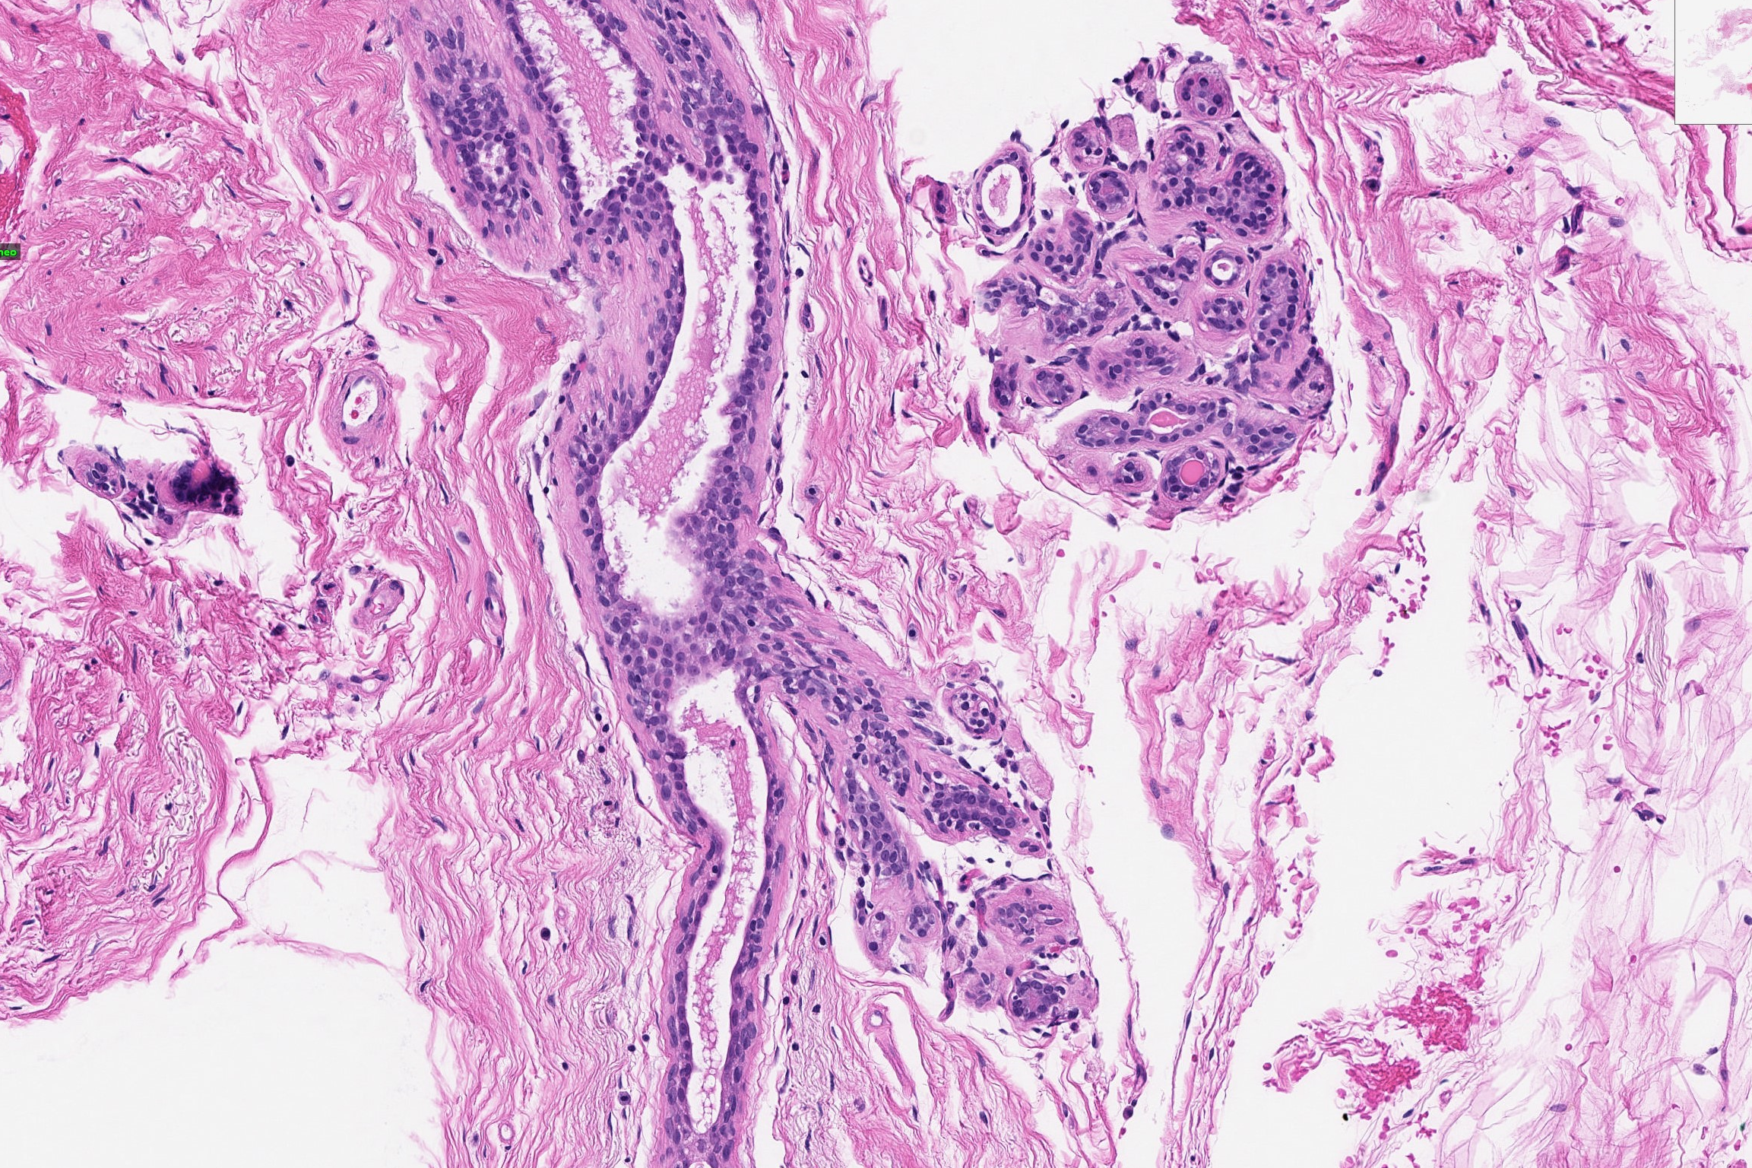
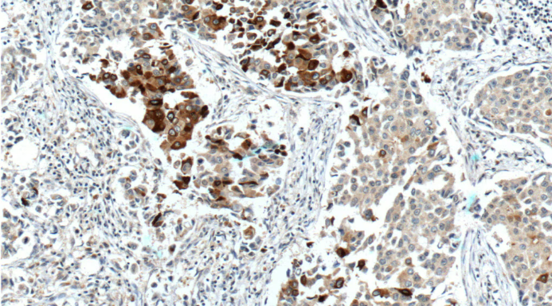
Automatic Interpretation of Digital Pathology Images Using Deep Learning
M. Bagritsevich, D. Hackel, C. Dumitrescu, E. Dragut Y. Persidsky and N. Jhala D. Connolly, C. Wu, Y. Gong, and H. Wu
I. Obeid and J. Picone College of Science and Technology Lewis Katz School of Medicine Fox Chase Cancer Center
College of Engineering Temple University Hospital
Abstract
Digital pathology can increase the speed, efficiency and accuracy of the diagnosis process.
A new generation of artificial intelligence algorithms are one of the most disruptive technologies of our lifetimes. But... they need massive amounts of data to achieve acceptable levels of performance.
The goal of this project is to generate open source annotated data that can fuel the development of artificial intelligence solutions.
The data is focused on breast cancer, which affects 13% of women in United States.
Pathology slides are digitized using a Leica Aperio scanner, manually annotated using ImageScope software.
Over 100,000 slides have been released, including over 14,000 slides from the Fox Chase Cancer Center Biosample Repository Facility.
Over 5,000 slides from breast tissue biopsies have been manually annotated to support machine learning research.
Open Source Resources
Two data sets described below have been released as open source resources. Data was annotated with the set of labels shown below:
Technology Development
A baseline CNN architecture (ResNet-18) was developed that can classify small patches of an image with an accuracy grater than 90%:
Today, powerful generative models that encode long-term spatial and temporal context are delivering unprecedented levels of performance (e.g., Visual Transformers).
In recent work, we are attempting to leverage these models to do high performance segmentation of cancerous regions in slides:
An interactive real-time demonstration of the technology has been developed that will allow pathologists to easily evaluate the accuracy of the automatically generated annotations, and can prioritize slides based on the severity of the cancer.
This tool, implemented in Python, will run on most popular computing platforms, and allow users to upload and analyze their own images.
Impact
Received $100,000 PA Breast Cancer Coalition grant to explore high performance machine learning algorithms to evaluate images for breast cancer.
Open source releases of three major corpora and our baseline deep learning classification system.
Active grant writing underway with DoD, NSF and NIH to extend these tools into high priority areas such as prostate cancer.
Has provided undergraduate research experiences for over 50 undergraduates and 5 graduate students.
Label | Description / Features
Normal (norm) | normal ducts and lobules
Background (bckg) | stroma, no ducts or lobules
Artifact (artf) | grease pen marks, stitches, foreign bodies, etc.
Non-Neoplastic (nneo) | fibrosis, hyperplasia, intraductal papilloma, adenosis, ectasia, etc.
Inflammation (infl) | areas of inflammation
Suspected (susp) | regions that are at risk of developing into cancerous regions
Ductal Carcinoma in Situ (dcis) | ductal carcinoma in situ, and lobular carcinoma in situ
Invasive Ductal Carcinoma (indc) | invasive ductal carcinoma, invasive lobular carcinoma, and invasive mammary carcinoma
Indistinguishable (null) | indistinguishable tissue, normally due to issues with the cut/stain
Summary and Future Work
We have released one of the world’s largest repositories of annotated digital pathology images to accelerate the rate of progress on applications of advanced machine learning algorithms to automatic interpretation of pathology images.
The combination of the FCCC and TUH resources provides a unique opportunity to develop techniques that are robust to changes in the way slides are prepared, stained and analyzed.
Future research is focusing on the use of unsupervised learning techniques to automatically classify and label the data. We are exploring ways to automatically detect stain and tissue type.
Key Publications
Bagritsevich, M., Hackel, D., Obeid, I., & Picone, J. (2024). Annotation of the Fox Chase Cancer Center Digital Pathology Corpus. Proceedings of the IEEE Signal Processing in Medicine and Biology Symposium (SPMB), 1–4.
Shalamzari, S. S., Bagritsevich, M., Melles, Anne-Mai, Obeid, I., Picone, J., Connolly, D., Wu, C., Brown, B., James, J., Gong, Y., & Wu, H. (2023). Big Data Resources for Digital Pathology. Proceedings of the IEEE Signal Processing in Medicine and Biology Symposium (SPMB), 1–19.
Doshna, B., Wevodau, Z., Jhala, N., Akhtar, I., Obeid, I., & Picone, J. (2021). The Temple University Digital Pathology Corpus: The Breast Tissue Subset. In I. Obeid, I. Selesnick, & J. Picone (Eds.), Proceedings of the IEEE Signal Processing in Medicine and Biology Symposium (SPMB) (pp. 1–3). Philadelphia, Pennsylvania, USA.
Acknowledgments
A large number of undergraduate and graduate students have contributed to the annotation of this data since the inception of this research in 2016. Several generations of graduate students and healthcare professionals have contributed to the development of the basic science and technology.
This material is based upon work supported in part by the National Science Foundation under grants under grants nos. CNS-1726188 and 1925494, by the Temple University Office of the Vice President for Research (FOAPAL 161977), and by the Temple University College of Engineering Summer Research Experience for Undergraduates program. Any opinions, findings, and conclusions or recommendations expressed in this material are those of the author(s) and do not necessarily reflect the views of the National Science Foundation or Temple University.
The FCCC Digital Pathology Corpus
The entire Fox Chase Cancer Center Biosample Repository was digitized.
Includes 14,288 slides collected from 13,230 subjects. Over 3.5G of data including comprehensive metadata.
1,463 breast tissue slides have been annotated using the nine labels shown above.
Provides a wide range of cancer samples, with 10,906 instances of invasive ductal cancer (indc) and 1,222 instances of ductal carcinoma in situ (dcis).
Challenges
High-resolution images (e.g., 50Kx50K pixels) pose computational challenges for machine learning algorithms. These difficulties are compounded by data imbalance. Certain cancer types are underrepresented (e.g., mucinous carcinoma: ~2%).
Building fast, efficient algorithms that can handle both the data scale and imbalance without compromising on accuracy is a complex task, requiring advanced optimization techniques and substantial computational power.
One of the unique challenges of digital pathology is ensuring annotation accuracy and uniformity between annotators. This was achieved through a collaboration with Temple Hospital and Fox Chase Cancer Center pathologists.
A particular challenge faced when generating these datasets is differentiating between ductal carcinoma in situ (carcinogenic, dcis) and ductal hyperplasia (benign, nneo). In clinical settings, a diagnosis is usually confirmed with immunohistochemistry stain, which is not always available to our annotators.
The TUH Digital Pathology Corpus
Over 100,000 slides were digitized from Temple University Hospital’s Department of Pathology archives.
This includes 3,505 slides from breast tissue biopsies collected from 296 subjects / 316 sessions.
Includes a wide sample spread of normal tissue and noncancerous labels (8,895 total labels), as well as tissue undergoing precancerous developments (5,362 total labels).
Includes a wide variety of stain types such as H&E, Reticulin, Alcian Blue, and Immunohistochemistry staining.
Over 5,000 urinary tract slides are currently being annotated using an extension of the above labels.
To learn more about our resources, please use this URL:
https://isip.piconepress.com/projects/nsf_dpath

Slide 2
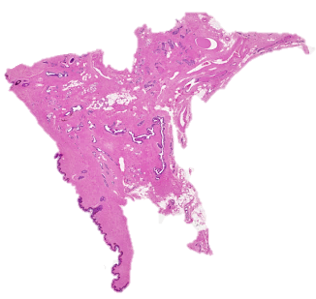
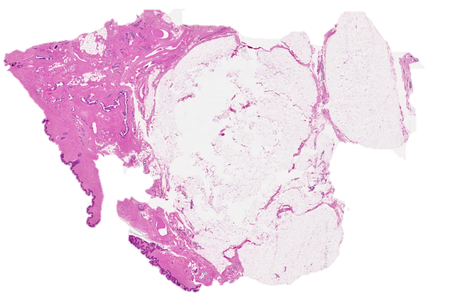
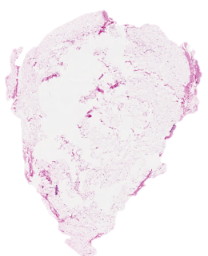





Patch Tiling
Transformer Encoder
Reshape
Decoder
Whole Slide Image
Segmentation Output
Preprocessing
Patch Embedding
Classifier
artf bckg dcis indc infl nneo norm null susp
…
Patch and position embedding
Extra learnable embedding
Preprocessed Image

