Slide 1
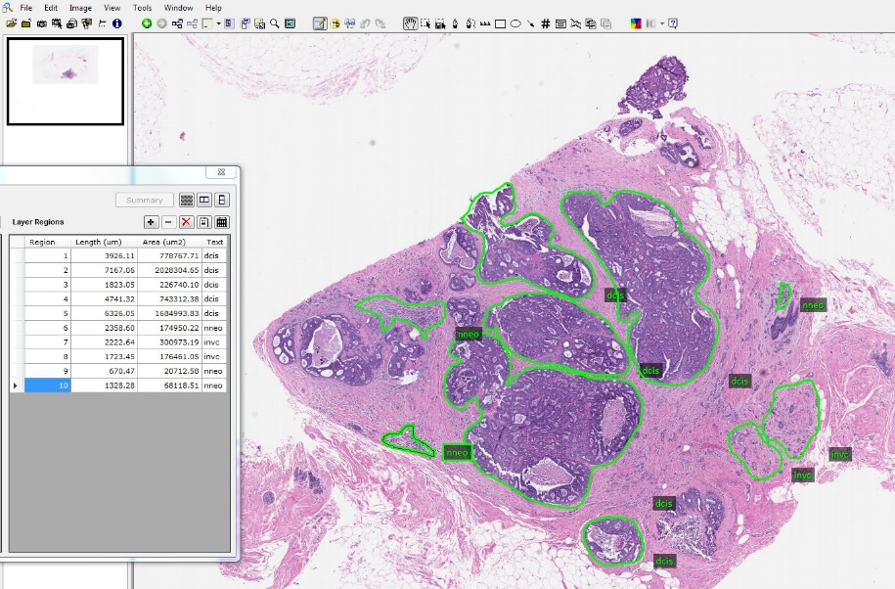
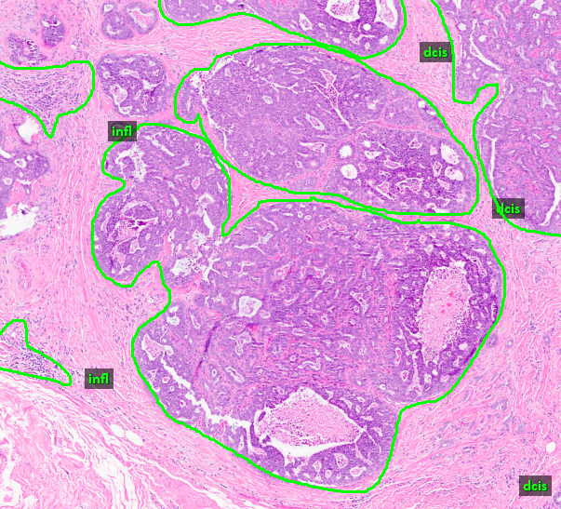
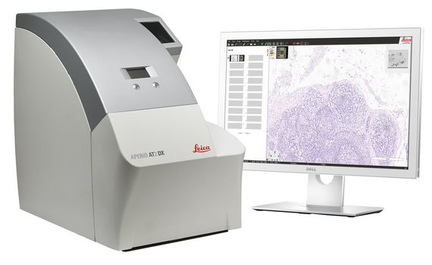
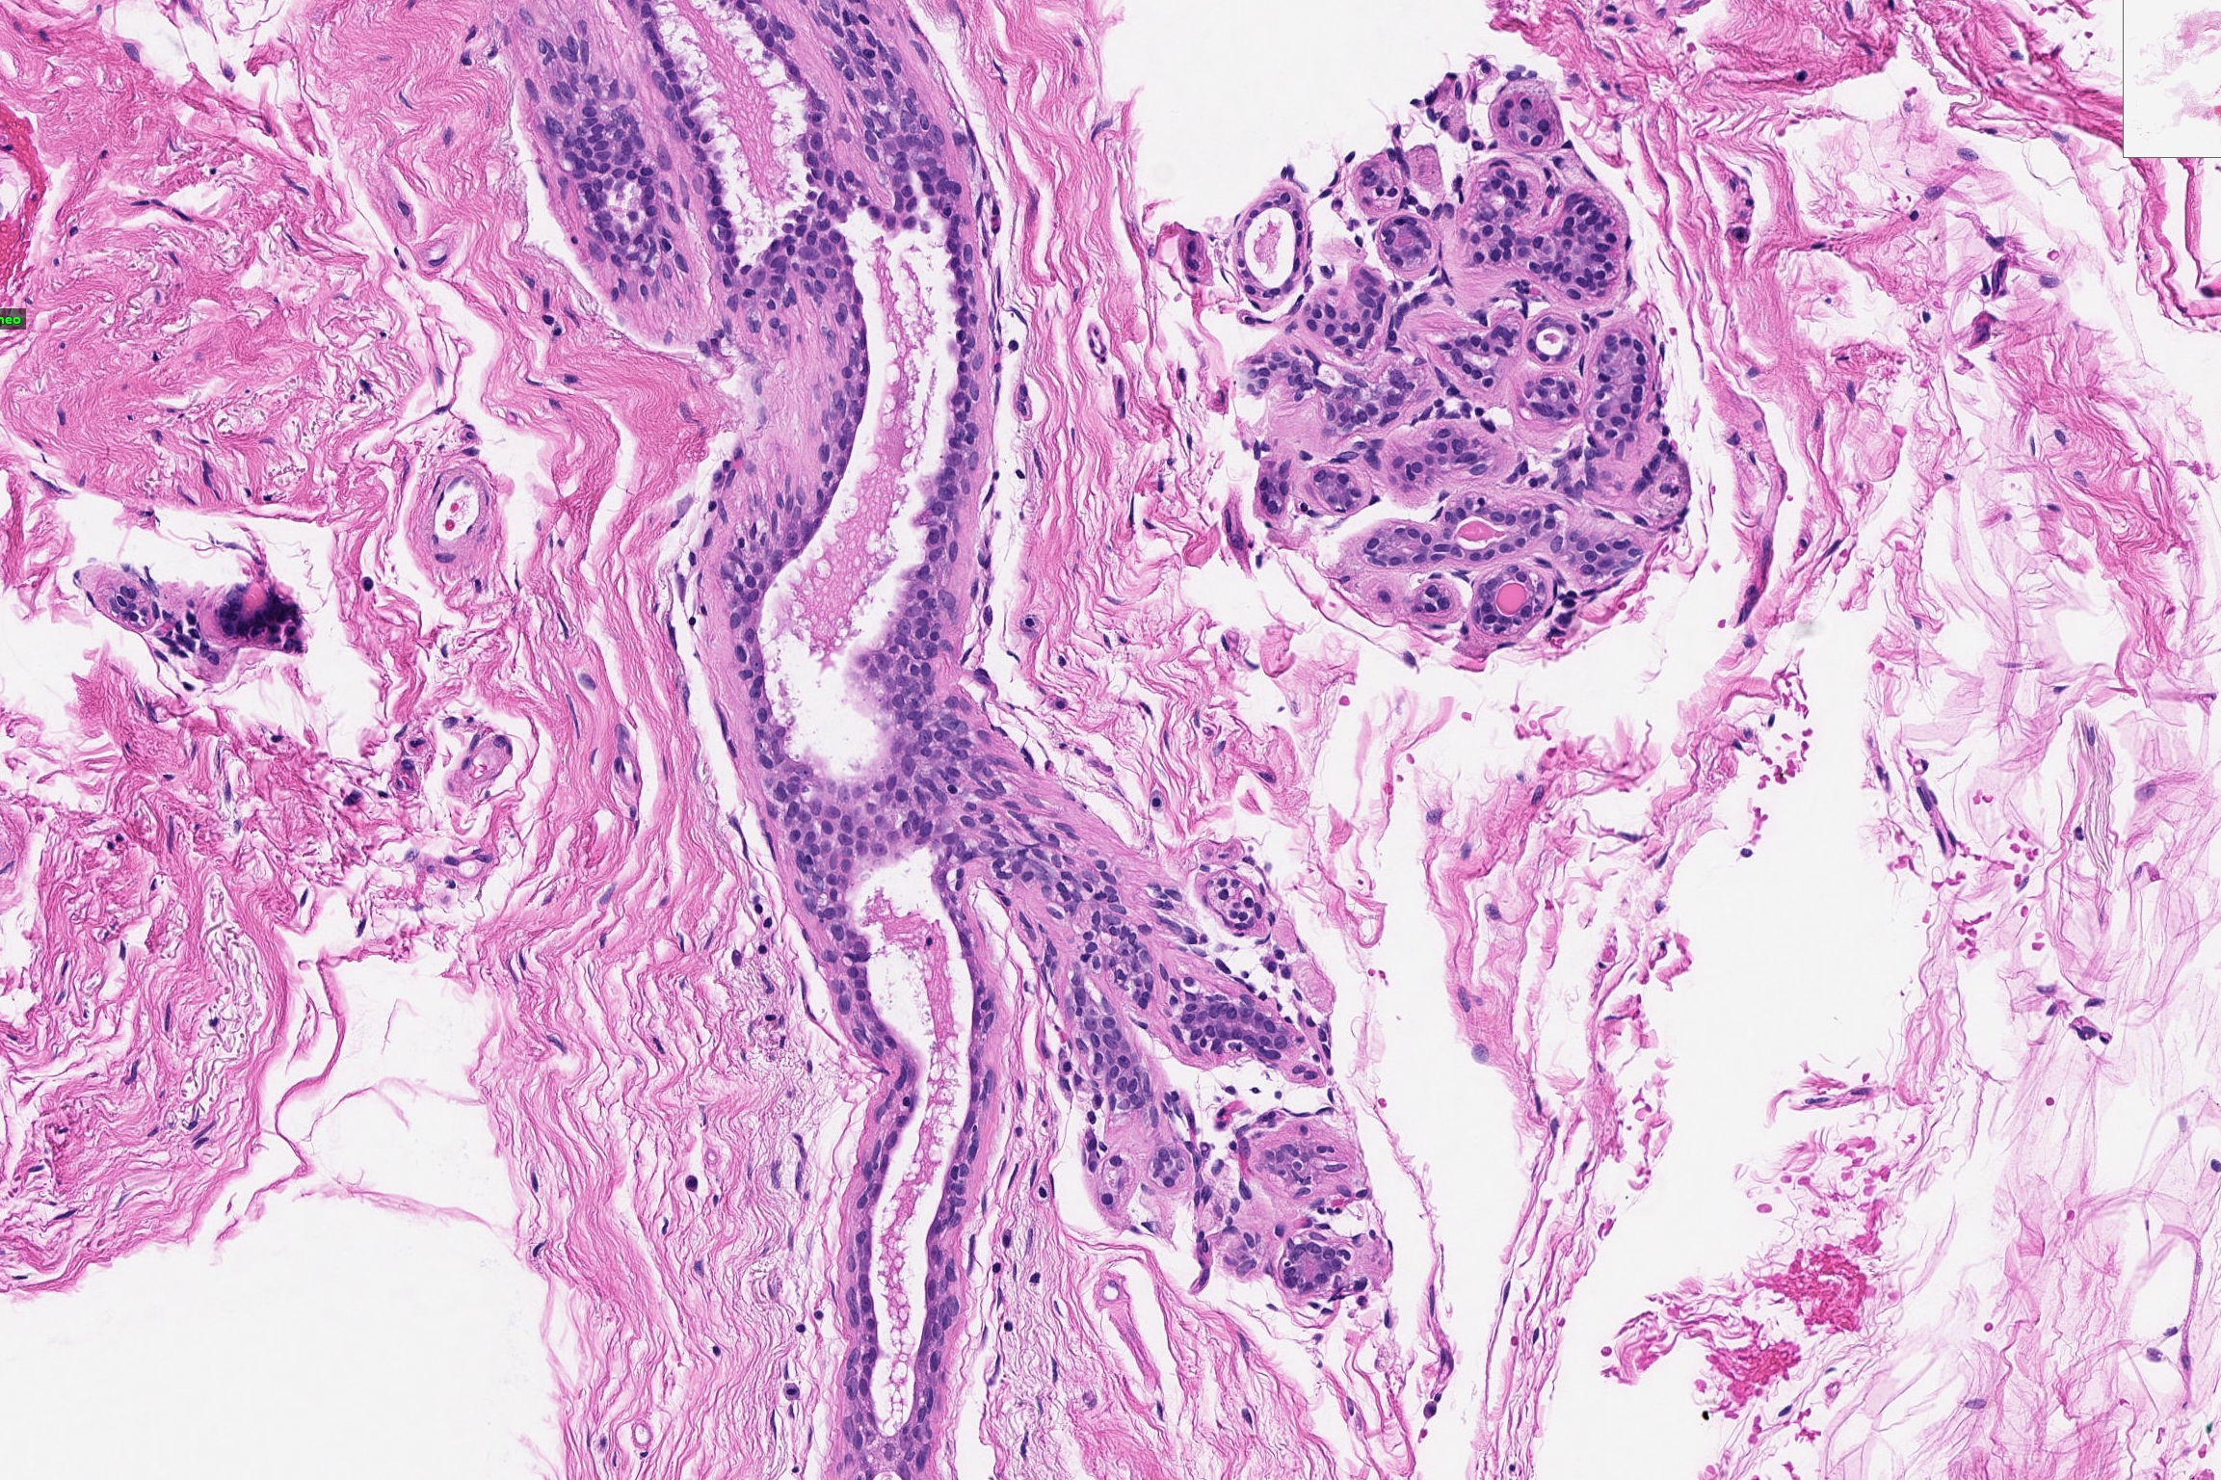
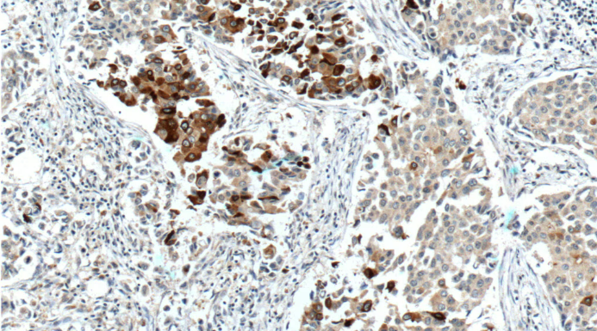
Big Data Resources for Digital Pathology
M. Bagritsevich, D. Hackel, C. Dumitrescu D. Connolly, C. Wu, B. Schultz, B. Brown,
I. Obeid, and J. Picone J. James, Y. Gong, and H. Wu
The Neural Engineering Data Consortium Fox Chase Cancer Center Temple University Temple University
www.nedcdata.org
Abstract
Aim of the project is to generate public access data to be used in machine learning. The data is focused on breast cancer diagnostics, which affects 13% of women in United States.
Digital pathology has the potential to ease the diagnosis, as well as its speed and accuracy.
Pathology slides are digitized using a Leica Aperio scanner, manually annotated using ImageScope software, and used to develop a machine learning model. The goal of the model is to be able to annotate novel pathology samples with high precision.
These resources can be used to develop a new generation of machine learning technology that is more robust and can classify a wider range of data and pathology types.
Data Sets:
Two data sets below allow to train on a wide range of cancerous and noncancerous tissue. Data is annotated with the set of labels presented below, which were developed to select distinct formations that can be found on a pathology slide.
Impact
Received PA Breast Cancer Coalition grant for $100,000, National Science Foundation MRI grant (Award No. 1726188) A Temple University CAT grant (CHECK, I got this info from fccc readme file)
Provides open source data for development of life saving technology
Has provided opportunity for Undergraduate Research to (number) over the last years.
Label | Description / Features
Normal (norm) | normal ducts and lobules
Background (bckg) | stroma, no ducts or lobules
Artifact (artf) | grease pen marks, stitches, foreign bodies, etc.
Non-Neoplastic (nneo) | fibrosis, hyperplasia, intraductal papilloma, adenosis, ectasia, etc.
Inflammation (infl) | areas of inflammation
Suspected (susp) | regions that are at risk of developing into cancerous regions
Ductal Carcinoma in Situ (dcis) | ductal carcinoma in situ, and lobular carcinoma in situ
Invasive Ductal Carcinoma (indc) | invasive ductal carcinoma, invasive lobular carcinoma, and invasive mammary carcinoma
Indistinguishable (null) | indistinguishable tissue, normally due to issues with the cut/stain
The FCCC Digital Pathology Corpus
Dataset generated form breast biopsy slides burrowed from Fox Chace Cancer Hospital. Includes 14,288 slides collected from 13,230 subjects
This data set provides a wide range of cancer samples, with 10906 instances of invasive ductal cancer (indc) and 1222 instances of ductal carcinoma in situ (dcis).
Challenges
One of the unique challenges of digital pathology is ensuring annotation accuracy and uniformity between annotators. This is done by working with pathologists from Temple Hospital and conducting cross-reviews of the data between annotators.
A particular challenge faced when generating these datasets is differentiating between ductal carcinoma in situ (carcinogenic, dcis) and ductal hyperplasia (benign, nneo) when annotating. In clinical setting diagnosis is usually confirmed with immunohistochemistry stain, which is not always available to annotators.
Summary and Future Work – Kept from IEEE SPMB 2023 for now
This abstract introduces the release of two substantial resources pertinent to digital pathology, all of which are publicly available.
We are currently in the process of annotating approximately 1,400 breast tissue images from FCDP to complement our TUDP release. These additional images will support a number of interesting studies including invariance and robustness.
Future research is focusing on the use of unsupervised learning techniques to automatically classify and label the data. We are exploring ways to automatically detect stain and tissue type.
Acknowledgments
This material is based upon work supported in part by the National Science Foundation under grants under grants nos. CNS-1726188 and 1925494, by the Temple University Office of the Vice President for Research, and by the Temple University College of Engineering Summer Research Experience for Undergraduates program. Any opinions, findings, and conclusions or recommendations expressed in this material are those of the author(s) and do not necessarily reflect the views of the National Science Foundation or Temple University.
The TUH Breast Digital Pathology Corpus
Dataset generated from breast biopsy slides borrowed from Temple University hospital. Includes 3505 slides from 296 patients, collected in a total of 296 biopsy sessions.
Includes a wide sample spread of normal tissue and noncancerous labels (8895 total labels), as well as tissue undergoing precancerous developments (5362 total labels).
Includes a wide variety of stain types such as H&E, Reticulin, Alcian Blue, and Immunohistochemistry staining.
To learn more about our resources, please use this URL:
https://isip.piconepress.com/projects/nsf_dpath

