Slide 1
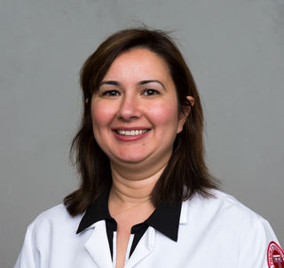
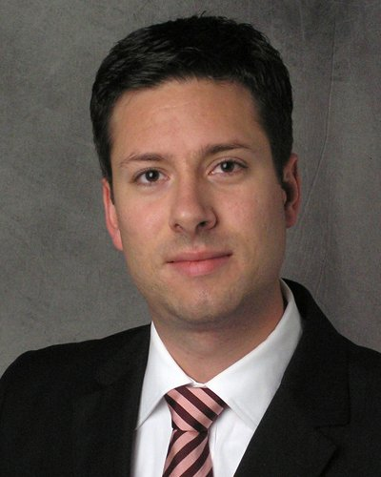
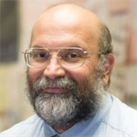
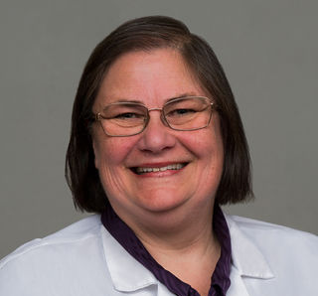
Modeling Movement through Heterologous Rigid Structures for Improved Antibiotic Delivery
Bacterial Aggregation and eDNA
Generate Protective Microenvironments from Antibiotics
Dr. Çagla Tükel
Microbiome and Infectious Disease
Center for Microbiology and Immunology, LKSOM
Dr. Gillian Queisser
Mathematical Modeling
Center for
Mathematical and Computational Modeling
Dr. Joseph Picone
Machine Learning
Engineering
Signal Information and Processing (ISIP) Lab
Dr. Bettina Buttaro
Bacterial Biofilms
Sol Sherry Thrombosis Research Center and CMI, LKSOM

Slide 2
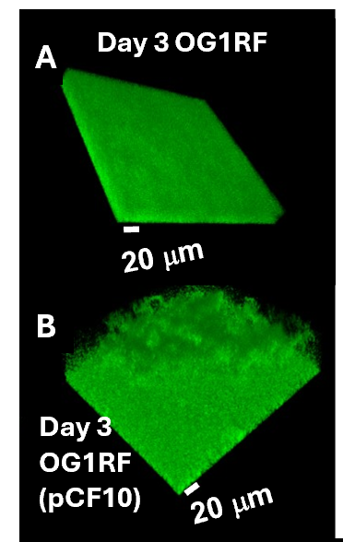
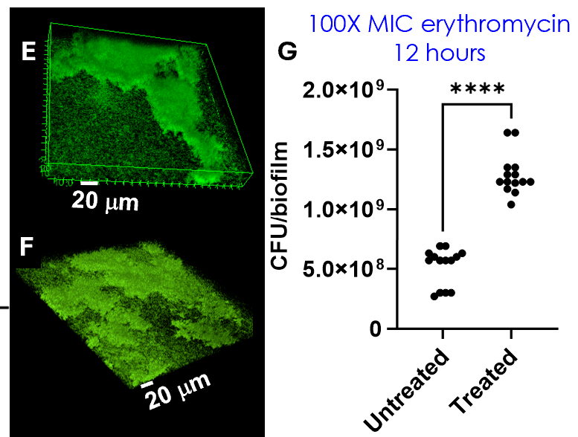
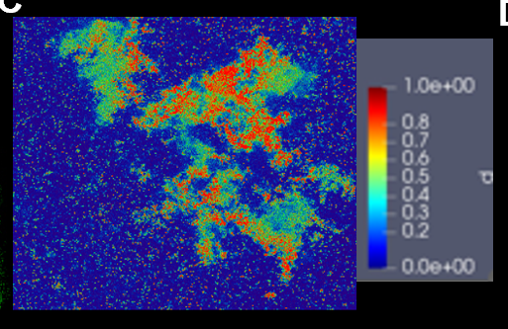
The acquisition of a virulence plasmid remodels the E. faecalis biofilm
and confers antibiotic resistance
Commensal in GI tract
pCF10 is a member of the family of pheromone responsive plasmids
present in 60-80% of all clinical isolates
Structures are complex with heterogenous cellular density including aggregates (red)
Protective structures enable doubling of the bacterial population within 12 hours.
Disease-associated virulence plasmid =
Pathogen
Herby Jean-Baptiste Ph.D. Candidate

Slide 3
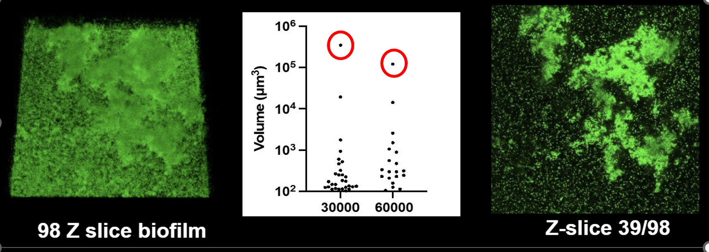
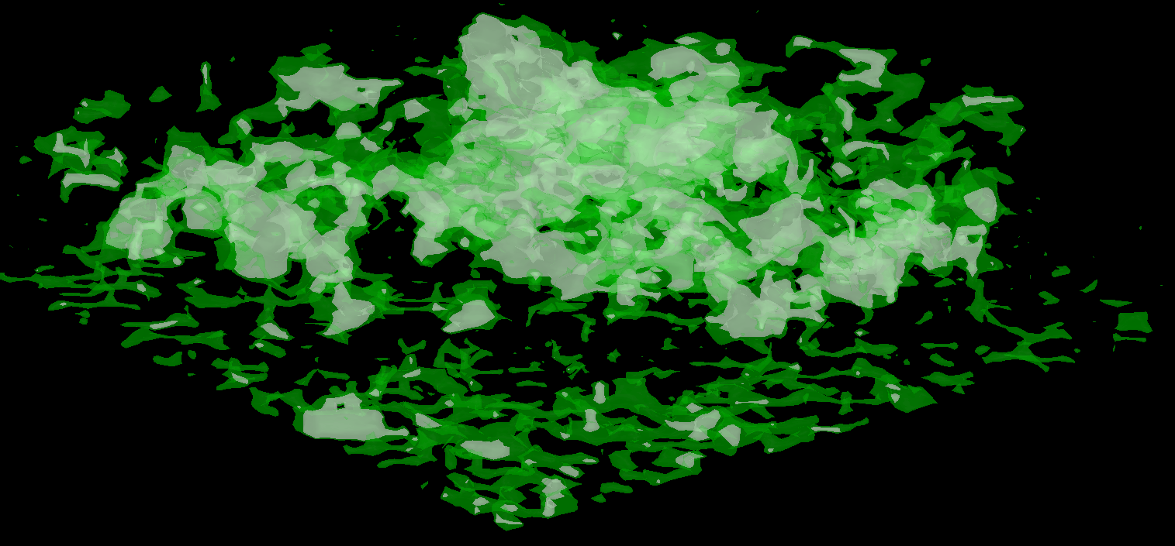
Mathematical Simulation Modeling
Images converted to computational grids
ProMesh is used to generate a rectangular mesh for the confocal tiff image
An averaging algorithm to assign greyscale cellular density values for grid elements at different resolutions.
1024 x1024 slice
0.25 μm
Whole rigid structure
Whole structure (30,000) Aggregates (60,000)
*new open-source toolbox
Example slice
Model uses the variability in the cellular density and cellular density-dependent absorption of antibiotic to limit transport of antibiotics throughout the biofilm
and permit growth in protected regions.
New open-source toolbox developed to quantitate volumes of the whole complex structure (green) and aggregated regions (white) [Logan Neishloch, undergraduate]
Brandi Henry Ph.D. (2024)

Slide 4
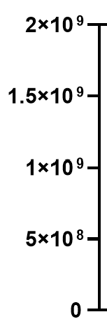
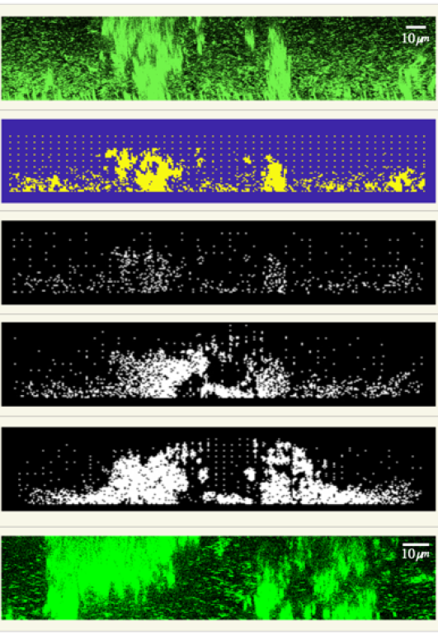
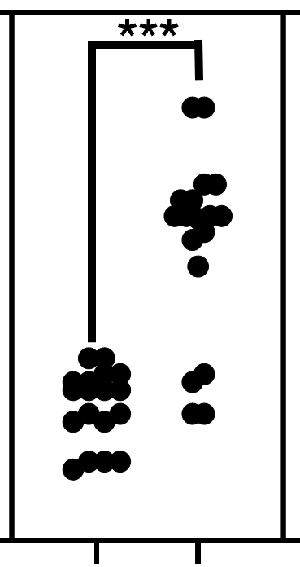
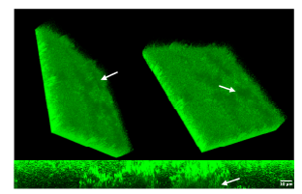
Stochastic Cellular Automata Model Reveals Role for eDNA
Biofilm images are searched for regions predicted to have large enough aggregated structures in the correct proximity to protect and converted to computational grid
Remodeling is rapid
and occurs within
1 hour of treatment
There is an eDNA (and eRNA) layer above the biofilm
Bulk boundary conditions
(structures only)
Untreated
Treated
Flux boundary structures + eDNA diffusion barrier
Flux boundary structures + eDNA diffusion & reaction
Treated biofilm image
Madison Shoraka
PhD Candidate

Slide 5
Interdisciplinary
Microbiome Research
Composition Gut/Oral /Lung
Biofilm
Spatial Organization
GI Clinical Models
Therapeutic approaches
Dysbiosis
Disease
Strategies :
Systems Biology
Mathematical Modeling
Machine Learning
Advanced Imaging
Sequencing and Transcriptomics
In vitro and in vivo models
Collaborators :
Biologists
Chemists
Mathematicians
Engineers
Biofilm Imaging Library
Linking Spatial Organization and Function
LKSOM, COE, CST, FCCC, Kornberg SD
Physicians
Microbiologists
Immunologists
Target Diseases:
Gut-brain Axis
Alzheimer’s Disease & Parkinson’s Disease
GI and Lung Infectious Diseases
Oral Dysbiosis and Disease
Antibiotic Resistance (intrinsic microbiota / pathogens)
Cardiovascular Disease
Autoimmune Diseases
Other Amyloidopathies
Cancer
2 publications submitted Nov/Dec
2 publications in preparation
NSF grant MCB $2.7 million submitted 2023 and being revised (Flow and predictions for other biofilms since aggregates are frequent features of biofilms).
Biofilm Imaging Library Parker, A., Smith, H., Buttaro, B., & Picone, J. (2024, September 13). CIRC: Planning C: Community Three-Dimensional Image Infrastructure for Sustainable Innovation in Biofilm Research. Community Infrastructure for Research in Computer and Information Science and Engineering (CIRC), NSF
Minority Supplement in collaboration with S. Kunapuli, Funded Herby Jean-Baptiste, [R21 and F30]
One of the projects in a pending Mathematics Cross-disciplinary training grant NSF DMS

