Slide 1
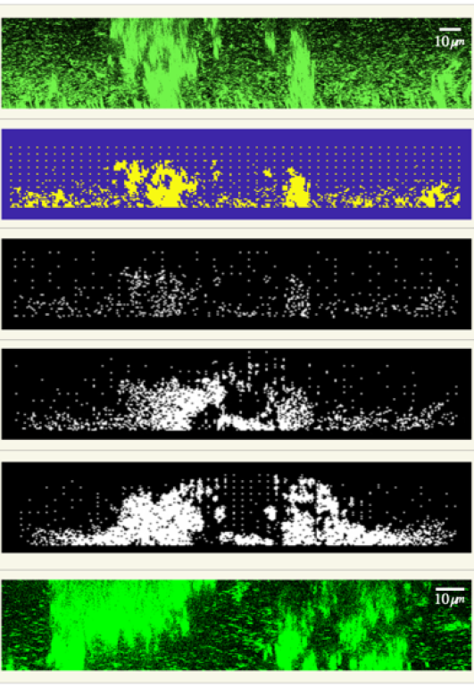
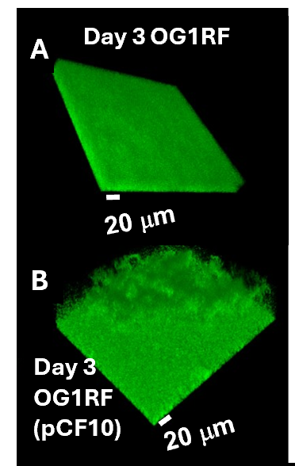
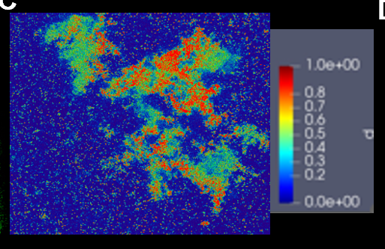
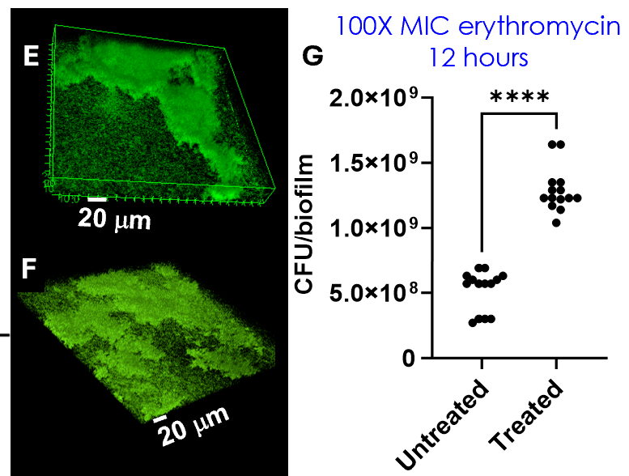
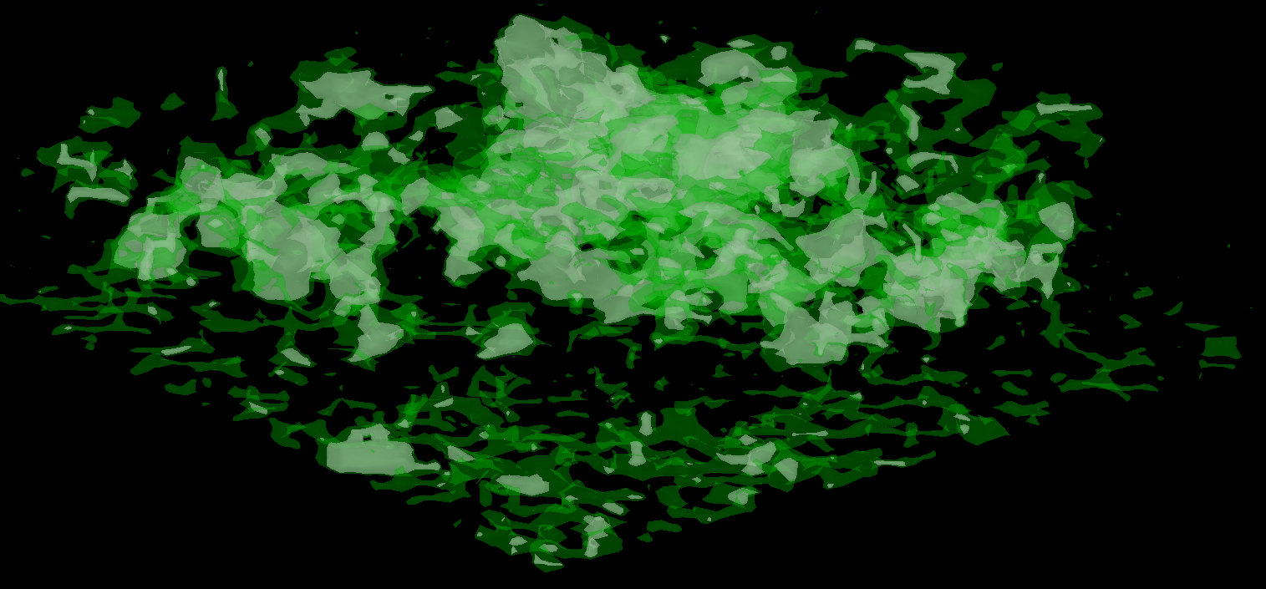
Modeling Movement through Heterologous Rigid Structures for Improved Antibiotic Delivery
Uncovering How Bacterial Aggregation
Creates Microenvironments that Enhance Antibiotic Resistance
Protective structures enable doubling of the bacterial population.
Mathematical simulation model with aggregation and eDNA providing protection for growth
Virulence plasmid reorganizes biofilms
complex structures with aggregated regions (red).
Paper submitted
New open-source toolbox developed to annotate aggregated regions (white) in complex heterogenous biofilms
Supervised
Machine Learning
Rules for organization of structures that confer resistance
In process
Paper being submitted Dec 2024
Grant submitted and under revision
Biofilm Imaging Library initiated with the Center for Biofilm Engineering at Montana State University
repository for 3D biofilm images and open-source tools
comparison between medical, environment and industrial biofilms for protection by aggregation
Planning grant pending (Buttaro, Picone, MSU)

