Slide 1
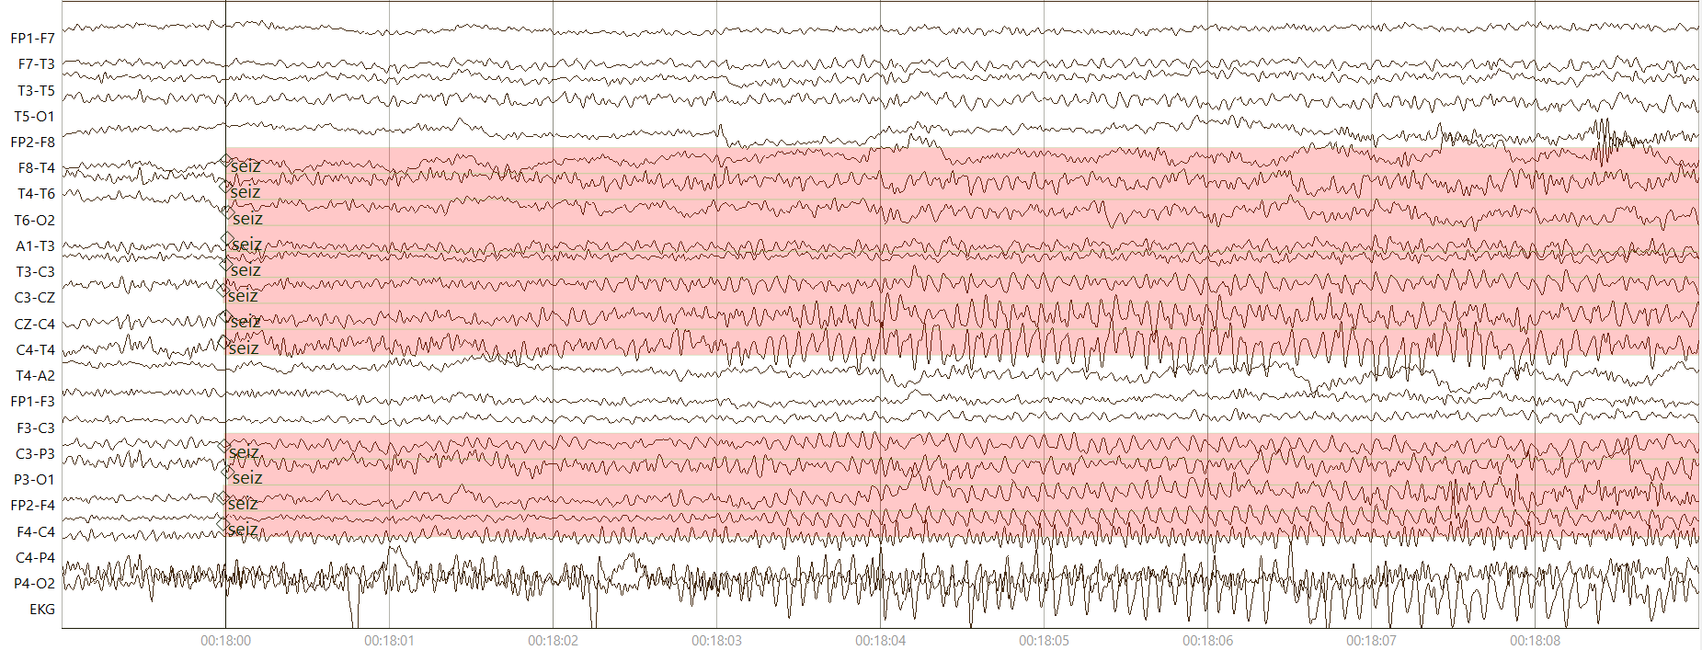
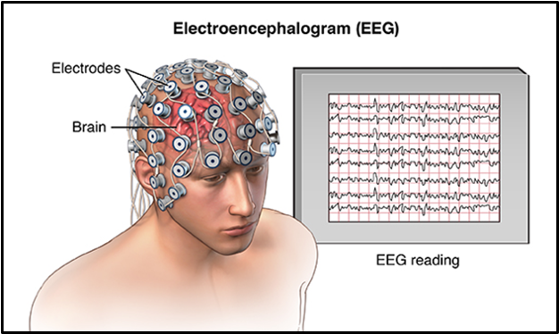
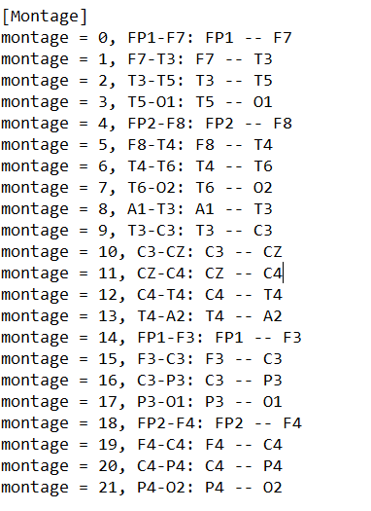
Annotation of Ambulatory EEG Data
Anne-Mai Melles
Advisor: Joseph Picone
College of Engineering
Temple University
www.nedcdata.org
OUR GOAL:
IMPORTANCE:
To provide the largest accessible EEG database for deep learning research in neuroscience,
comprising over 69,000 recordings from 2002 to the present,
suitable for research and commercial use.
Rare diseases are often hard to diagnose yet are critical to effective healthcare
Healthcare industry has vast amounts of unstructured data
Deep learning systems require large amounts of data for training to get high performance
EEG ANNOTATIONS
MACHINE LEARNING
Understanding the data
Overview of what happens after annotators are done
Previous work with Temple Hospital
Collected at Temple University Hospital from 2002 to Present
Recordings vary from 24 to 36 channels →
4 different montages
250 Hz or greater signals
Recordings up to 20 minutes
Key issues:
Is the data representative of the problem?
Do the features capture meaningful differences between patterns?
How do we find the best model?
How do we estimate the parameters of the model?
How do we evaluate the performance?
Thanks to deep learning system we can create and manage Big Data
AutoEEG is a hybrid system that uses three levels of processing to achieve high performance event detection on clinical data:
Pass 1 (P1): 2D Convolutional Neural Network (CNN)
Pass 2 (P2): Bidirectional Long Short Term Memory Network (B-LTSM)
Pass 3 (P3): A statistical language model is used to model event sequences
Outcomes:
Released database with 69,000+ recordings
Over 9,000 subscribers worldwide
The Neureka 2020 Epilepsy Challenge
Real-time seizure detection (AutoEEG)
Manually annotated subsets include seizure (TUHZ), artifacts (TUAR) and abnormal (TUAB)
Next steps:
Feed Natus data to machine
Adjust model accordingly
False alarm rate as low as possible: lessen false positives and negatives
The Classic Machine Learning Paradigm
Collect Data
Current project with Natus
Long-term recordings: up to 72 hours
Ambulatory monitoring
Manual annotation, using python tool nedc_eas
Following American Clinical Neurophysiology Society (ACNS) 2021 guidelines
Working with new type of activity:
Rhythmic Periodic Patterns (RPPs)
Brief Potentially Ictal Rhythmic Discharges (BIRDs)
Intermittent Rhythmic Delta Activity (SLOW)
All data is different, adjustments needed
Align with clinical workflow and machine learning needs
Technology has to be adjusted for the data
Ambulatory data is much noisier: artifacts and background information frequent
Different signals → new montages
Evaluate Classifier
Select Features
Train Classifier
Choose Model
Acknowledgements​
This material is supported most recently by the National Science Foundation under grants nos. CNS-1726188, IIP-1827565 and 1925494. Various other organizations have supported this work over the years including the Temple University Office of Research, College of Engineering and College of Science and Technology, as well as DARPA and NIH. Any opinions, findings, and conclusions or recommendations expressed in this material are those of the author(s) and do not necessarily reflect the views of the these organizations.​
References​
Khalkhali, V., Shawki, N., Shah, V., Golmohammadi, M., Obeid, I., & Picone, J. (2021). Low Latency Real-Time Seizure Detection Using Transfer Deep Learning. In I. Obeid, I. Selesnick, & J. Picone (Eds.), Proceedings of the IEEE Signal Processing in Medicine and Biology Symposium (SPMB) (pp. 1–7). IEEE. https://doi.org/10.1109/SPMB52430.2021.9672285.​
Next steps
Adjust TUH model’s parameters to Natus data
Annotate more data manually to feed to machine
Increase efficiency

