Slide 1
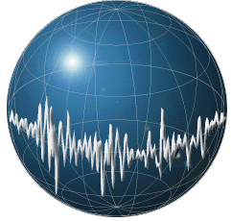
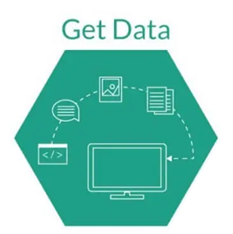
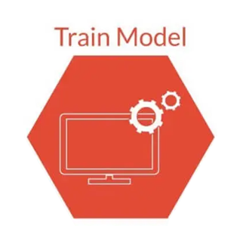
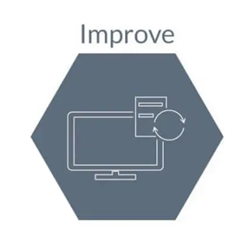
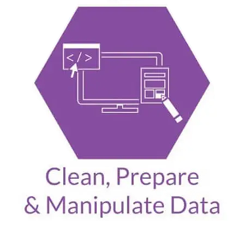
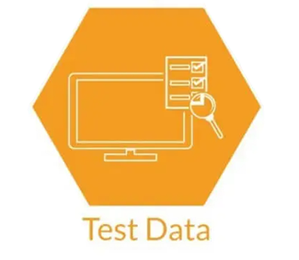
Machine Learning in Digital Pathology
Yuan Nghiem Leo Grant Berman Albert Bulik
Notes:
Leo
Morning Salutation
Introduce Everyone
Explain Graphic
Good morning, everyone! This is Team 1 and I am Albert, this is Leo, and this is Yuan. Our project is Machine Learning Applications in Digital Pathology. We are trying to build a Machine Learning System that can identify cancerous cells in biopsy slides of tissue samples. In the title slide we have a picture representation of a neural network which will be a key component in The Deep Learning algorithm we hope to implement later.

Slide 2
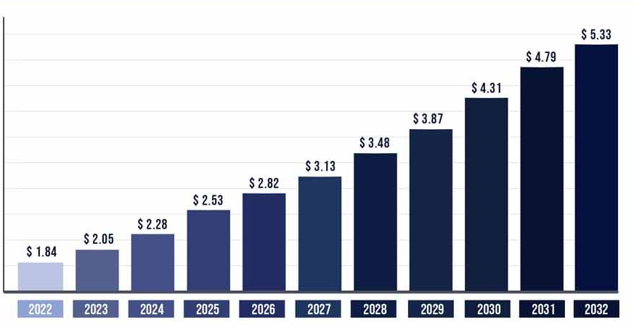
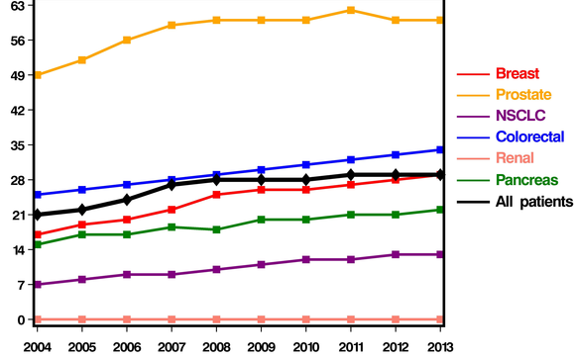
Problem Statement
The demand for cancer diagnosis is increasing.
As a result, time to treatment is increasing.
Market Size (USD Billions)
Time To Diagnosis(Days)
YEAR (2022 to 2032)
(Nova One Advisor)
DIAGNOSIS YEAR (2004 to 2013)
(Khorana et al.)
Notes:
Yuan
What are we addressing?
The demand for cancer diagnosis is increasing
X axis is years from 2022 to 2032
Y axis is predicted market size of the cancer diagnosis which indicated higher demand
As you all can see, as the years progress, the market size is expected to increase drastically in billions
As a result time to treatment is increasing
Each of these lines represents a type of cancer. Make sure to pay special attention to the red line in the middle here, that's breast cancer.
On the x axis we have years from 2004 to 2013
On the y axis we have time to diagnosis in days
As you can see, the time to diagnose breast cancer has increase by about 1 week despite advancements in technology
That’s where we come in. we want to create a system that is able to read biopsy slides and output a diagnosis with machine learning, much quicker than a pathologist looking through the slides manually
Breast cancer can be very aggressive so if we are able to diagnose it in a shorter amount of time, we can avoid aggressive treatment options such as double mastectomys
In our problem statement, as you can see from the graph on the left, the demand for cancer treatment has been steadily increasing every year. But, from the graph on the right, the technology and workforce for diagnosing cancer quickly has not been keeping up. This is critical since diagnosis time for every cancer type is taking longer and longer every year, and patients are missing out on early treatment, which is crucial for recovery.

Slide 3
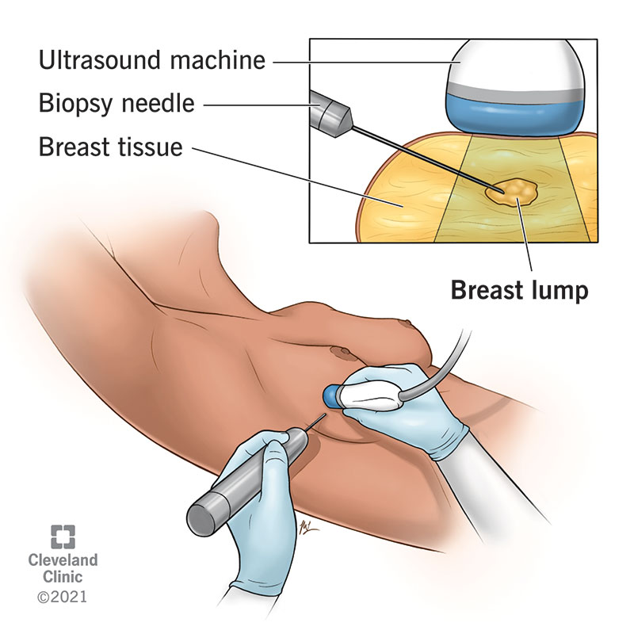
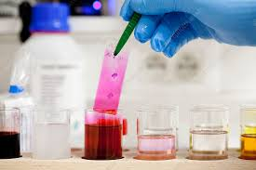
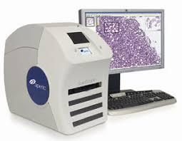
Temple University Health Digital Pathology Corpus
Biopsy
Staining
Scanning
Notes:
Yuan
So how do we gather data.
At the hospital, a doctor will perform something called a "needle biopsy". This is where a needle is inserted into breast tissue, and a small slice of that tissue is extracted and placed onto a slide.
Then the slide is stained as the tissue would be invisible otherwise.
Finally, the slide is scanned using an aperio scanner in the case of Fox Chase Medical Center

Slide 4
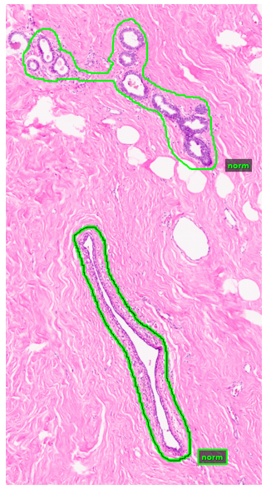
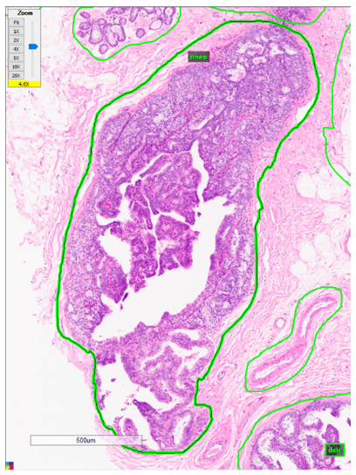
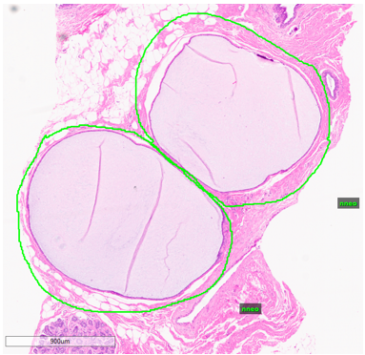
Labeled Data Types
Non-Cancerous Types
Potentially Cancerous Types
Cancerous Types
Notes:
YUAN
For our project, we are working with breast tissue only. The images we are given are annotated.
The first image is a zoomed in section of a tissue that is non-cancerous.
The green borders represent the region that is annotated.
The green text beside it are the labels of those regions.
There are nine different labels.
Four of them are non cancerous,
Three of them show signs that may lead to cancer
And two of them are cancerous.
What we want our system to do is to take biopsy slides and generate predictions of these areas of malignancy by using a machine learning model

Slide 5
OUR PRODUCT
Prediction Report
Scanning
System
(Data)
(Model)
(Output)
Notes:
Yuan
Once our product is ready, this is what will happen,
The hospitals will scan the images and send that to us.
The we feed those images to our system, which will then generate a prediction report.
The prediction report will contain a diagnosis,
and that is any malignancy classification and the location of the malignancy

Slide 6
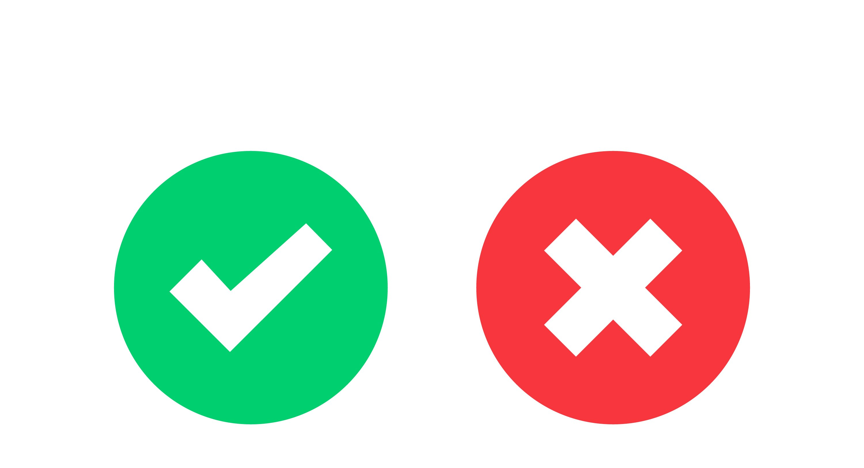
Design Criteria & Requirements
Image Classification
Whole-Slide Image Classification (Khened et al.)
Functional GUI:
Training Time: < 3 Days
Shows location of labeled areas
Display slide cancer statistics
Notes:
Leo
So what are the requirements
Firstly, our model has to have whole image classification. In other words, does the picture supplied to the system show signs of cancer or not. This is an industry standard.
Then, we need a functional GUI that has to do two things.
Show locations of areas/regions
Then show those areas probability of malignancy/type
This last self imposed metric is designed to allow us to have some form of results by the end of the semester, we need to be able to train our model in less than three days.

Slide 7
Design Criteria & Requirements
Model Predictions
Pathologist Predictions
F1 Score
Cohen's Kappa
.5 ( ) ( )
Cohen's Kappa: >60%
(Wetstein et al.)
F1 Score: >90%
(Shawki et al.)
Notes:
Leo
We also need to write our code in python since it's mostly maintained by the Neuronix research lab which mainly specializes in python.
We need a Cohen's kappa score of greater than 80%.
What Cohen's kappa essentially is, is taking our model's predicitions and comparing that with pathologist predictions
Finally, we need an F1 score.

Slide 8
Deeper Look AT F1 Score
Actual Classes
Predicted Classes
F1 Score
Apples
Bananas
True Positive = 4
True Positive = 0
False Negative = 0
False Negative = 1
False Positive = 1
False Positive = 0
.5 ( ) ( )
F1 Score = 89%
F1 Score = 0%
Notes:
Leo

Slide 9
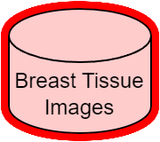
Basic Pipeline
Non-Cancerous Types
Carcinogenic-Signs Type
Cancerous Types
Notes:
Albert
How do we go from biopsy to diagnosis? We have 5 stages in our pipeline.
We start with breast tissue images as input, the images are segmented into a uniform grid and…
Fed to a pre-processor to condense their useful information,
We feed that to a model to obtain predictions,
Combine the model’s predictions into contiguous regions in the post-processor,
And, if the tissue images are labeled by a pathologist, we compare the model’s predictions to the pathologist’s annotation.

Slide 10
2-Dimensional Discrete Cosine Transform-II (DCT-II)
One-dimensional DCT
Two-dimensional DCT
Vertical pixel index
Vertical pixel index
Horizontal pixel index
Horizontal pixel index
Notes:
Albert
In the pre-processor, we condense useful information from tissue images. Images are matrices of red, green and blue color values. Information is measured by the amount variance in each color. To separate low-information and high-information components, we first convert colors to frequencies with a frequency transform. We previously used a 1-dimensional cosine transform, but migrated to a 2-dimensional transform because it retains greater detail in fewer frequencies.
To demonstrate, consider these identical images of the number 5 in handwriting. The images were transformed from pixels to frequencies and back without filtering any of their 784 frequencies. The left image used a 1-dimensional DCT and the right image used a 2-dimensional DCT.

Slide 11
2-Dimensional Discrete Cosine Transform-II (DCT-II)
One-dimensional DCT
Two-dimensional DCT
Vertical pixel index
Vertical pixel index
Horizontal pixel index
Horizontal pixel index
Notes:
Albert
Let’s perform the same transform and inverse transform but retain only 40 of the 784 frequencies. Both results are still recognizable.

Slide 12
2-Dimensional Discrete Cosine Transform-II (DCT-II)
One-dimensional DCT
Two-dimensional DCT
Vertical pixel index
Vertical pixel index
Horizontal pixel index
Horizontal pixel index
Notes:
Albert
But if we reduce the number of frequencies to 10, the image in the 1-dimensional DCT case on the left becomes unrecognizable; the image in the 2-dimensional DCT case still resembles the shape and structure of a number 5. The 2-dimensional transform retains greater information in fewer frequencies. The frequencies are what we call features in machine learning.

Slide 13
Principal Component Analysis
f1 | f2 | f4 | f7
f3 | f5 | f8 | f11
f6 | f9 | f12 | f14
f10 | f13 | f15 | f16
f1 | f2 | f4
f3 | f5
f6
PC1 | PC2 | PC4 | X
PC3 | PC5 | X | X
PC6 | X | X | X
X | X | X | X
Notes:
Leo
Once DCT generates the features, we use principal component analysis to trim features. PCA transforms features into principal components and uses the PCs with the highest variance, discarding all the rest. So both of these methods combined, DCT and PCA, reduce the number of features by orders of magnitude.
-----------------------
Principal component analysis allows us to reduce the number of features even further. PCA is a transform that maps features to principal components. We measure the amount of information that each feature or PC has by its variance.
Variance is more evenly distributed for features, but PCs are lopsided; some PCs have high variance but the majority have very low variance. This allows us to exclude the PCs with low variance and use fewer features without a significant hit in our predictions.
-----------------------
For those of you familiar with linear algebra, PCA is the eigendecomposition of features. This means that each principal component is a linear combination of all the features.

Slide 14
Training, Tuning, evaluation Pipelines
3,505 Tissue Images
1.23 Terabytes
Notes:
Albert
When our features are processed, we feed them to a model. A model is like a control system. It’s a collection of variables that represent the relationship between input and output. Like control systems, models are judged by the amount of error between input and output. To minimize error, we have to adjust the model’s variables and relationships.
To do so, we use 3 separate pipelines for 3 different sets—training, development and evaluation. Each dataset is fed to the pre-processor.
In the first pipeline, processed data is used to train or fit the model. This means adjusting the model’s variables until output and input match.
In the second pipeline, processed data is fed to the trained model from the development set. In this case, we vary the structure and relationships of the variables instead of the variables themselves. This is called tuning. We also use more advanced processing and scoring methods to compare results.
When we’re satisfied with the tuned model, we evaluate it against a third set. The reason for using 3 sets is that whenever we make a change to the model, we run the risk of biasing the model to the data. When a model is biased, it makes accurate predictions only on one dataset.
If the model looks good after evaluation, we keep it and use it in production. Otherwise, we continue training and tuning.
-------
We have our training data
Development data
Evaluation data
All of this combined makes up 3500 images and 1.2 terabytes of disk space
Why do we do this?
Well first we pre process all of the data so they are represented similarly in memory
Next we fit the model on the processed training data.
This gives us our rough cut model which has some flaws like being biased towards some of the bias that training data might have.
Next we take our processed development data and we feed that into our trained model
After we do some post processing on the results we get our refined model. By using multiple dataset we can remove some of the bias the model has towards development data
Next we take the processed evaluation data and feed that into our refined model
After we do the same post processing and scoring and we are happy with the result, we move our refined model into our production model

Slide 15
Machine Learning model Stage
Notes:
Leo
After preprocessing data, let’s take a deeper look at a model.
There are different models may work better than others for particular tasks.

Slide 16
Convolutional Neural Network
Notes:
Leo
-------------------------------------
When it comes to image recognition, there Is a model that excels in this. That is the convolutional neural network, CNN for short. CNNs are very good at learning features by themselves and operate by successively convolving input to reach a class label.
This is how the CNN operates
In the base layer, the convolution happens here. There are many operations that go on here such as multiple convolutions and activation functions.
The pooling layer condenses these output of the base layer into fewer features.
Then it goes to the flattening layer strings the features together into a single vector.
The dense layer also called the fully connected layer, takes the vector and connects all of the computed data so the model knows that the data are related in a way. and last produces a final prediction, the classification.
However, CNNs are much more difficult to implement, since the whole structure has to be customized and refined based on the results.
In the meantime, we are using a generic prebuilt algorithm to generate results.
-----------------------------

Slide 17
Input DATA
PC1 | PC2 | PC3 | PC4 | PC5 | PC6 | PC7 | PC8 | PC9 | PC10
Notes:
Leo
-------------------------------------
When it comes to image recognition, there Is a model that excels in this. That is the convolutional neural network, CNN for short. CNNs are very good at learning features by themselves and operate by successively convolving input to reach a class label.
This is how the CNN operates
In the base layer, the convolution happens here. There are many operations that go on here such as multiple convolutions and activation functions.
The pooling layer condenses these output of the base layer into fewer features.
Then it goes to the flattening layer strings the features together into a single vector.
The dense layer also called the fully connected layer, takes the vector and connects all of the computed data so the model knows that the data are related in a way. and last produces a final prediction, the classification.
However, CNNs are much more difficult to implement, since the whole structure has to be customized and refined based on the results.
In the meantime, we are using a generic prebuilt algorithm to generate results.
-----------------------------

Slide 18
Convolution Layer
Output Value 1
Output Value 2
Output Value 3
Output Value 4
Output Value 5
Output Value 6
Output Value 7
Output Value 8
PC1 | PC2 | PC3 | PC4 | PC5 | PC6 | PC7 | PC8 | PC9 | PC10
Notes:
Leo
-------------------------------------
When it comes to image recognition, there Is a model that excels in this. That is the convolutional neural network, CNN for short. CNNs are very good at learning features by themselves and operate by successively convolving input to reach a class label.
This is how the CNN operates
In the base layer, the convolution happens here. There are many operations that go on here such as multiple convolutions and activation functions.
The pooling layer condenses these output of the base layer into fewer features.
Then it goes to the flattening layer strings the features together into a single vector.
The dense layer also called the fully connected layer, takes the vector and connects all of the computed data so the model knows that the data are related in a way. and last produces a final prediction, the classification.
However, CNNs are much more difficult to implement, since the whole structure has to be customized and refined based on the results.
In the meantime, we are using a generic prebuilt algorithm to generate results.
-----------------------------

Slide 19
Convolution Layer
Filter 1 Output
Value 1
Value 2
Value 3
Value 4
Value 5
Value 6
Value 7
Value 8
Filter 2 Output
Value 1
Value 2
Value 3
Value 4
Value 5
Value 6
Value 7
Value 8
Filter 3 Output
Value 1
Value 2
Value 3
Value 4
Value 5
Value 6
Value 7
Value 8
Notes:
Leo
-------------------------------------
When it comes to image recognition, there Is a model that excels in this. That is the convolutional neural network, CNN for short. CNNs are very good at learning features by themselves and operate by successively convolving input to reach a class label.
This is how the CNN operates
In the base layer, the convolution happens here. There are many operations that go on here such as multiple convolutions and activation functions.
The pooling layer condenses these output of the base layer into fewer features.
Then it goes to the flattening layer strings the features together into a single vector.
The dense layer also called the fully connected layer, takes the vector and connects all of the computed data so the model knows that the data are related in a way. and last produces a final prediction, the classification.
However, CNNs are much more difficult to implement, since the whole structure has to be customized and refined based on the results.
In the meantime, we are using a generic prebuilt algorithm to generate results.
-----------------------------

Slide 20
MAX POOLING LAYER
Filter 1 Output
1
4
3
Value 1
Value 2
Value 3
2
5
3
1
2
Value 4
Value 5
Value 6
Value 7
Value 8
4
3
5
2
Notes:
Leo
-------------------------------------
When it comes to image recognition, there Is a model that excels in this. That is the convolutional neural network, CNN for short. CNNs are very good at learning features by themselves and operate by successively convolving input to reach a class label.
This is how the CNN operates
In the base layer, the convolution happens here. There are many operations that go on here such as multiple convolutions and activation functions.
The pooling layer condenses these output of the base layer into fewer features.
Then it goes to the flattening layer strings the features together into a single vector.
The dense layer also called the fully connected layer, takes the vector and connects all of the computed data so the model knows that the data are related in a way. and last produces a final prediction, the classification.
However, CNNs are much more difficult to implement, since the whole structure has to be customized and refined based on the results.
In the meantime, we are using a generic prebuilt algorithm to generate results.
-----------------------------

Slide 21
Fully Connected Layer
6
Class Probabilities
3
50%
30%
10%
10%
Class 1
Class 2
Class 3
Class 4
8
Notes:
Leo
-------------------------------------
When it comes to image recognition, there Is a model that excels in this. That is the convolutional neural network, CNN for short. CNNs are very good at learning features by themselves and operate by successively convolving input to reach a class label.
This is how the CNN operates
In the base layer, the convolution happens here. There are many operations that go on here such as multiple convolutions and activation functions.
The pooling layer condenses these output of the base layer into fewer features.
Then it goes to the flattening layer strings the features together into a single vector.
The dense layer also called the fully connected layer, takes the vector and connects all of the computed data so the model knows that the data are related in a way. and last produces a final prediction, the classification.
However, CNNs are much more difficult to implement, since the whole structure has to be customized and refined based on the results.
In the meantime, we are using a generic prebuilt algorithm to generate results.
-----------------------------

Slide 22
Post-Processing Stage
Notes:
Yuan
Now that we understand models, let’s go to the next stage of generating predictions.

Slide 23
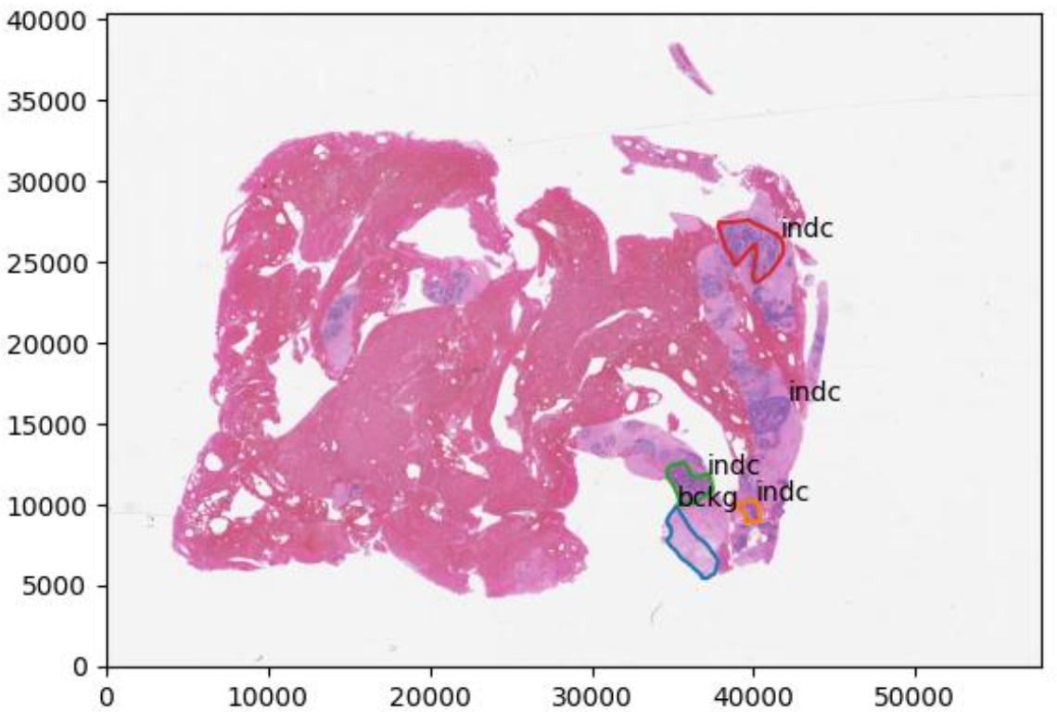
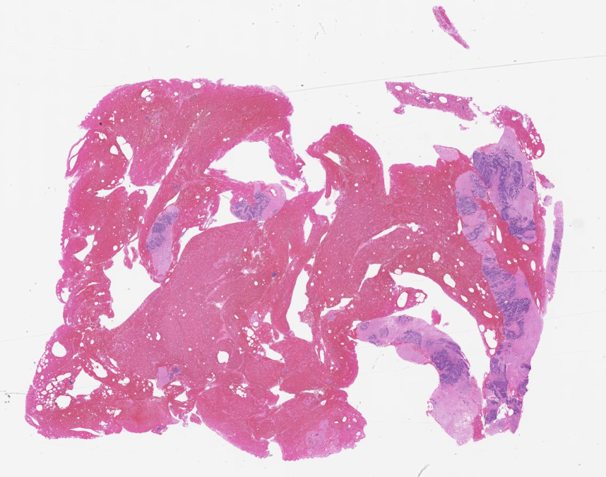
pixels
pixels
Notes:
Yuan
There are three levels that we have to get through: frame level, patch level, and image level
Lets start with the frame level first.
This image is a random slide pulled from our data with the x and y axis as pixels of the image.
Here’s a visual representation of that.
From our parameters, we get the frame size and window size
Segment the image by the framesize
The window size must be bigger than the frame so it could provide some context from the surrounding frames
We start iterating through each frame starting from the top left
As the image iterates through each frame, it will make predictions on the frames, whether malignant or nonmalignant.

Slide 24
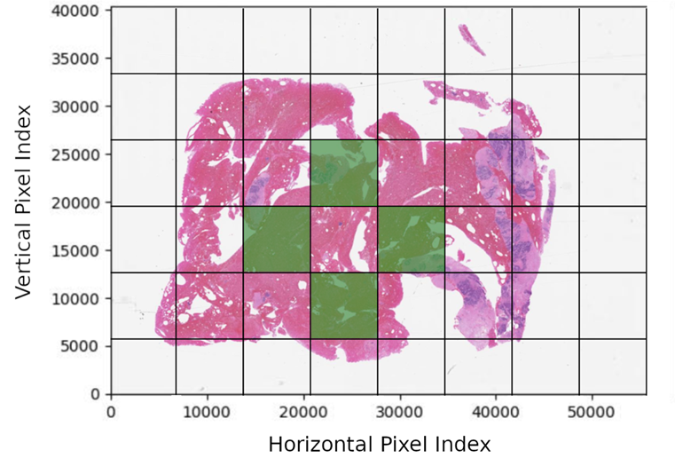
Frame to patch
Notes:
Albert
The model gives us predictions for each frame, but we need to go from frames to patches. Patches are what we call collections of neighboring frames with the same label. This is an example of a slide where green represents malignancy from the classifier's perspective.
In the last slide we saw that the algorithm splits an image into frames and assigns the frames labels, but sometimes the classifier correctly identifies the border of a malignancy while there are areas INSIDE the border that the frame classifier does NOT believe are malignant.
Maybe the tumor has white area from fatty or connective tissue. Whatever the case, we want to fill in the area between the malignant labels. This is how we do it.

Slide 25
pixels
pixels
Notes:
Albert
We make a copy of the image, use a flood-fill algorithm to flood the outer area with malignant labels, and invert the image, so malignant become non-malignant and visa versa.

Slide 26
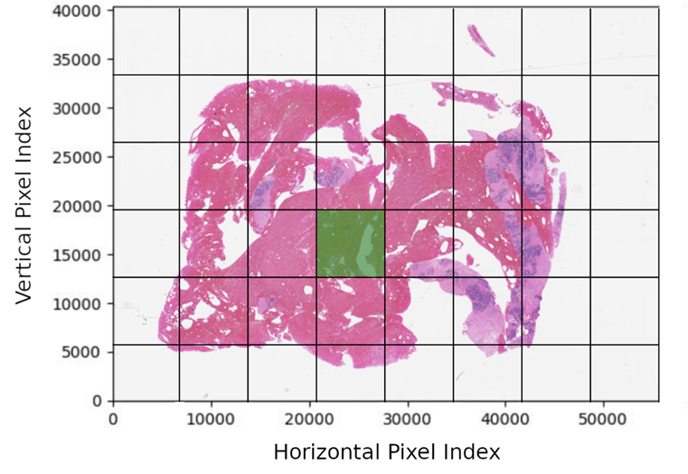
Frame to patch
Notes:
Albert
(The image copy is inverted, so malignant become non-malignant and visa versa.)

Slide 27
FRAME to patch
Notes:
Albert
On the left we have the original image and on the right the inverted fill. When the inverted image is superimposed onto the original…

Slide 28
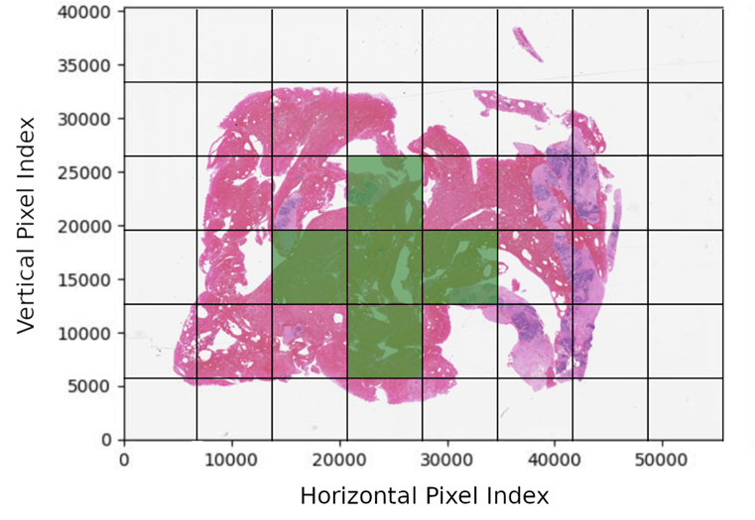
Frame to patch
Notes:
Albert
The interior is completely filled in. The result is a collection of frames that we call a patch.

Slide 29
patch to image level
Noncancerous
Carcinogenic sign
Cancerous
Noncancerous
Carcinogenic sign
Cancerous
Notes:
Yuan
From patches we need to classify entire images. When a pathologist searches through slide images, they should not need to inspect every individual label to understand that a slide contains cancerous tissue. We assign labels to an image based on a hierarchy of labels contained in the image.
This slide receives a normal label, this slide has patches that may develop into cancer, and this slide is labeled as cancerous.
----------------------
After classifiying all the patches of an image, we want to classify if an image is noncancerous, cancerous, or shows carcinogenic signs.
To do this, we based these labels as a hierarchy. Whatever different kinds of labeled patches is has, if it has only noncancerous labels, then it is noncancerous
If it contains noncancer and carginogenic signs, then the image may show signs of cancer but not yet cancerous
if it contains cancerous labels, then it is labeled as cancerous

Slide 30
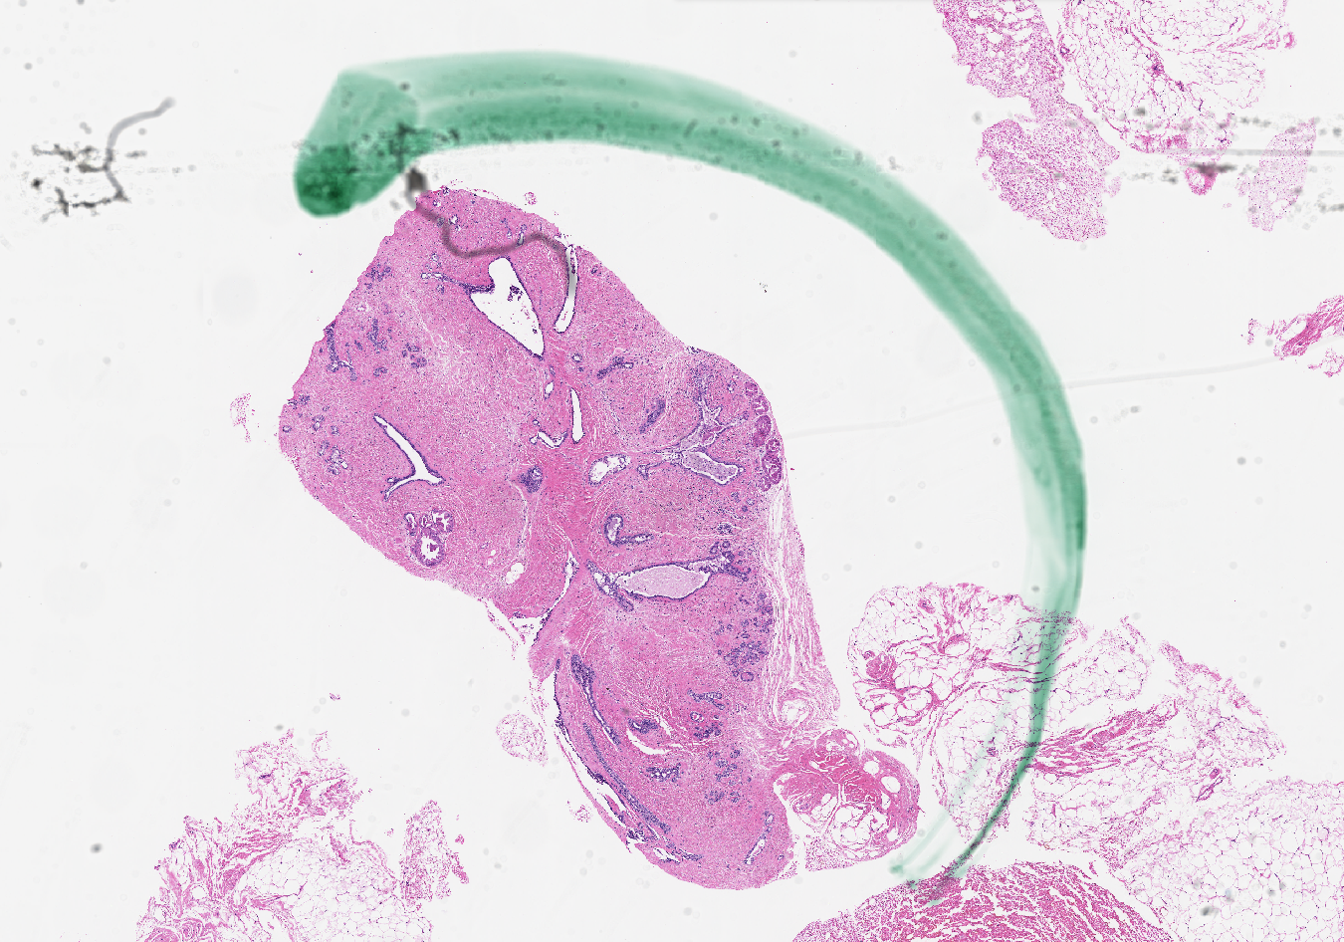
Slide Scoring
Legend:
Total Area [Pixels]:
Annotated by pathologist
Green: 6702
(7.6%)
Red: 80993
(92.4%)
Predicted by model
Overall: 87695
(100%)
Notes:
Albert
How do we know our model’s any good? We can look at error on a frame-by-frame basis, but we also want a holistic picture of the model’s performance. We developed a slide-scoring system that’s agnostic of the size, number and order of model predictions. Our scoring system only considers overlap between reference and hypothesis surfaces.
For example, suppose we have this region annotated by a pathologist with the artifact label.
And suppose that our model says that this area contains an artifact. How much did we get right and how much did we get wrong?
Well this green region wasn’t included, so we calculate its area and add it to the artifact’s false negative sum.
We got the red part right, so we add the area of this red set intersection to the true positive sum.
We normalize area figures by the total area of the annotation, and determine that we hit 92% of this target. We do this for every reference and hypothesis combination to populate our multiclass confusion matrix. And from the multiclass confusion matrix, we derive class-specific statistics, such as
true positives, false positives, true negatives, false negatives,
sensitivity, specificity,
F1 score and Cohen’s kappa coefficient.

Slide 31
Scoring Results
Train Set
 | RANDOM FOREST | CNN
F1 Score | 26.58% | 05.26%
Cohen’s Kappa | 18.69% | 0.00%
Dev Set
 | RANDOM FOREST | CNN
F1 Score | 02.79% | 02.20%
Cohen’s Kappa | 00.16% | 00.00
Notes:
Leo

Slide 32
Graphical User Interface (GUI)
Page displays
biopsy slides,
annotations,
model results
List to choose image
Image window
displays selected
image
Select button
Model accuracy
Notes:
Yuan
One of the requirements we had set in place was a functional graphical user interface, GUI for short.
This gui allows the user to view biopsy slides in different\ stages: the original image, the image with annotations, and the predictions made from the different ML models we used.
You can toggle between the images and the image stages.
The image stages will be output on separate window.
It also displays the accuracy for each model for each image at the bottom of this main window.
Now I will demo this gui.

Slide 33
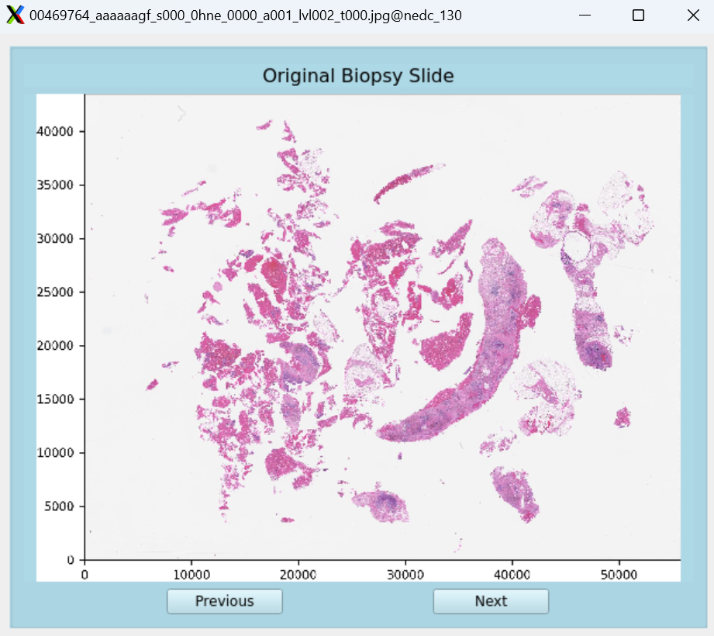
Graphical User Interface (GUI)
More button
Notes:
Yuan
One of the requirements we had set in place was a functional graphical user interface, GUI for short.
This gui allows the user to view biopsy slides in different stages: the original image, the image with annotations, and the predictions made from the different ML models we used.
You can toggle between the images and the image stages.
The image stages will be output on separate window.
It also displays the accuracy for each model for each image at the bottom of this main window.
Now I will demo this gui.

Slide 34
Requirements Met
Image Classification
Whole-Slide Image Classification (Khened et al.)
Functional GUI:
Training Time: < 3 Days
Shows location of labeled areas
Display slide cancer statistics
Notes:
Leo
So what do we have to do now? What we have right now is frame level of classification. *click*
We now need to develop a system that takes those frames and classifies patches*click*
Finaly, we have to take those patches and create a system that will classify the whole image *click*

Slide 35
Future work
Model Predictions
Pathologist Predictions
F1 Score
Cohen's Kappa
.5 ( ) ( )
Cohen's Kappa: >60%
(Wetstein et al.)
F1 Score: >90%
(Shawki et al.)
Notes:
Leo
So what do we have to do now? What we have right now is frame level of classification. *click*
We now need to develop a system that takes those frames and classifies patches*click*
Finaly, we have to take those patches and create a system that will classify the whole image *click*

Slide 36
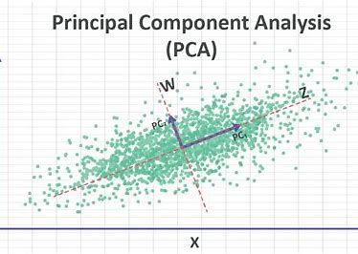
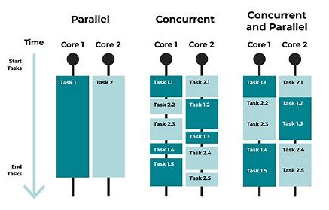
Lessons Learned
$$\frac{Quantitative Results}{Number of Classes}$$
Notes:
Leo
So what do we have to do now? What we have right now is frame level of classification. *click*
We now need to develop a system that takes those frames and classifies patches*click*
Finaly, we have to take those patches and create a system that will classify the whole image *click*

Slide 37
Questions?
Our Website:
https://isip.piconepress.com/projects/pabcc/
Acknowledgements:
Dr. Joseph Picone – Mentor & Data Coordinator Claudia Dimitrescu – AI Expert
Phuykong Meng – GUI Planning & Scoring
For the curious
Benefits of Machine Learning in Healthcare
Machine Learning in Healthcare
What is Machine Learning in Healthcare?
Significance of Machine Learning in Healthcare
The Potential for Artificial Intelligence in Healthcare

