Slide 1
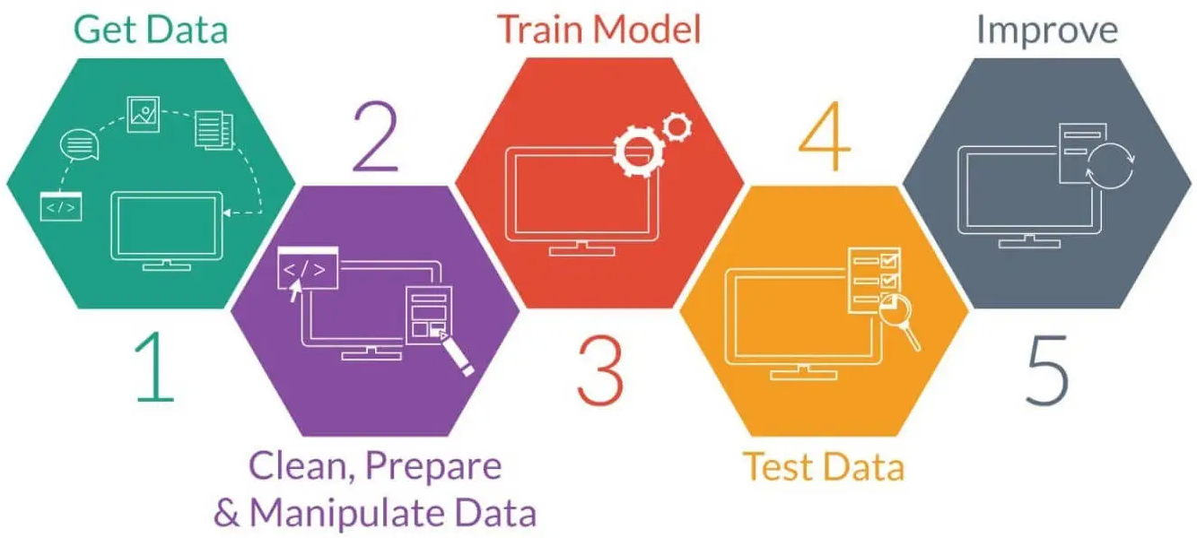
ML in Digital Pathology
Yuan Nghiem Leo Grant Berman Albert Bulik
Notes:
Leo
Morning Salutation
Introduce Everyone
Explain Graphic
Good morning, everyone! This is Team 1 and I am Albert, this is Leo, and this is Yuan. Our project is Machine Learning Applications in Digital Pathology. We are trying to build a Machine Learning System that can identify cancerous cells in biopsy slides of tissue samples. In the title slide we have a picture representation of a neural network which will be a key component in The Deep Learning algorithm we hope to implement later.

Slide 2
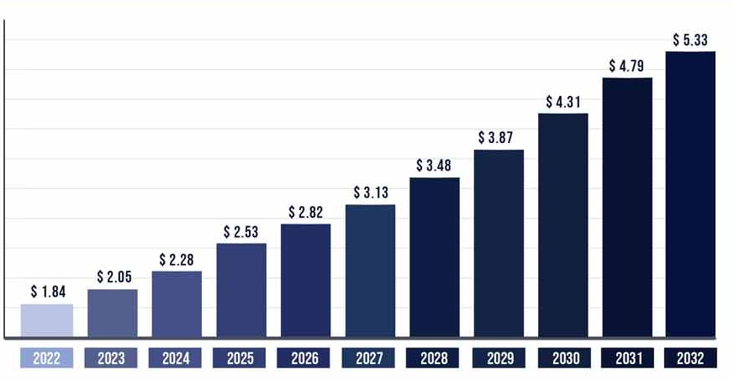
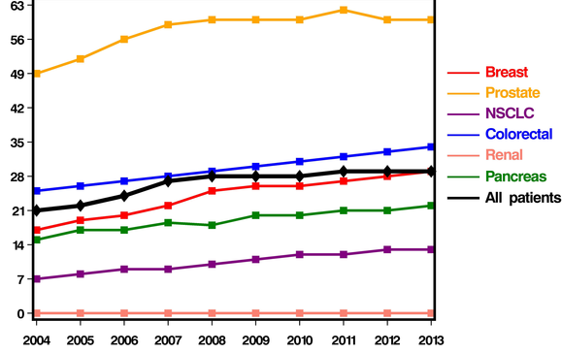
Problem Statement
The demand for cancer diagnosis is increasing.
As a result, time to treatment is increasing.
Market Size (USD Billions)
Time To Diagnosis(Days)
YEAR (2022 to 2032)
SOURCE
DIAGNOSIS YEAR (2004 to 2013)
SOURCE
Notes:
Leo
What are we addressing?
The demand for cancer diagnosis is increasing
X axis is years from 2022 to 2032
Y axis is project market size
As you all can see, the demand is increasing quite a bit
As a result time to treatment is increasing
Each of these lines represents a type of cancer. Make sure to pay special attention to the red line in the middle here, that's breast cancer.
On the x axis we have years from 2004 to 2013
On the y axis we have time to diagnosis in days
As you can see, the time to diagnose breast cancer has increase by about 1 week despite advancements in technology
Breast cancer can be very aggressive so if we are able to diagnose it in a shorter amount of time, we can avoid aggressive treatment options such as double mastectomys
In our problem statement, as you can see from the graph on the left, the demand for cancer treatment has been steadily increasing every year. But, from the graph on the right, the technology and workforce for diagnosing cancer quickly has not been keeping up. This is critical since diagnosis time for every cancer type is taking longer and longer every year, and patients are missing out on early treatment, which is crucial for recovery.

Slide 3
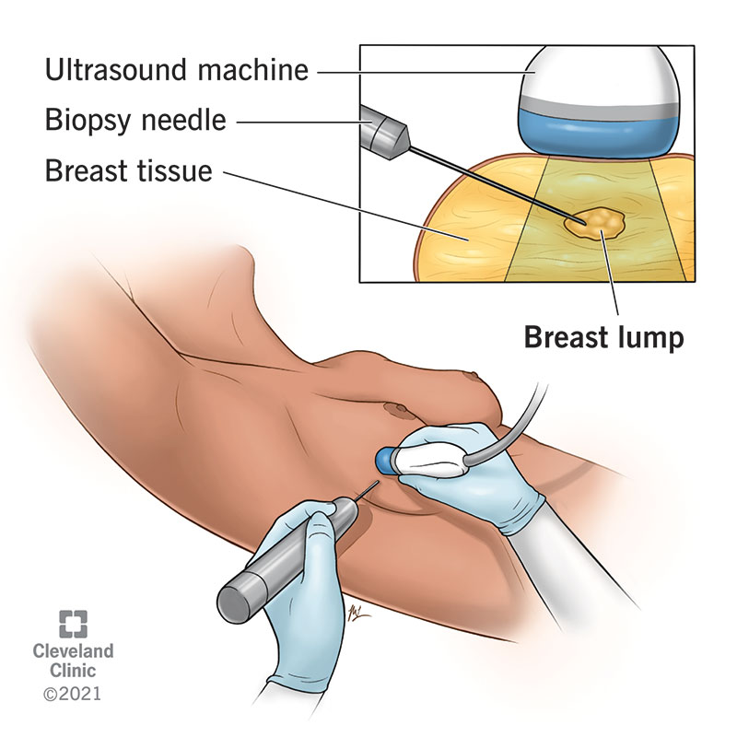
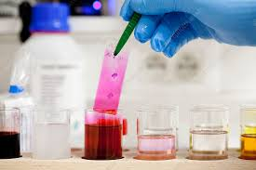
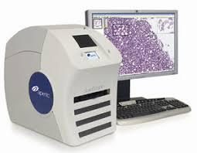
Temple University Health Digital Pathology (TUHDP) Corpus
Biopsy
Staining
Scanning
Notes:
Leo
So how do we gather data.
At the hospital, a doctor will perform something called a "needle biopsy". This is where a needle is inserted into breast tissue, and a small slice of that tissue is extracted and placed onto a slide.
Then the slide is stained as the tissue would be invisible otherwise.
Finally, the slide is scanned using an aperio scanner in the case of Fox Chase Medical Center

Slide 4
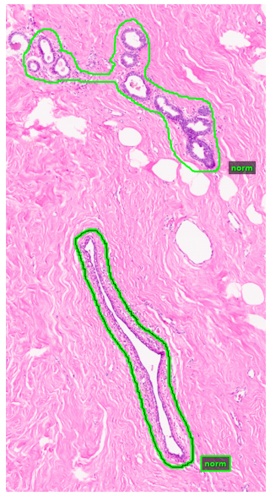
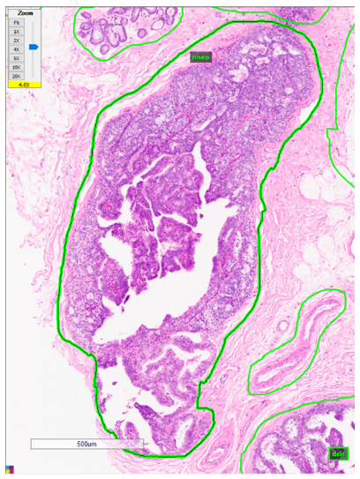
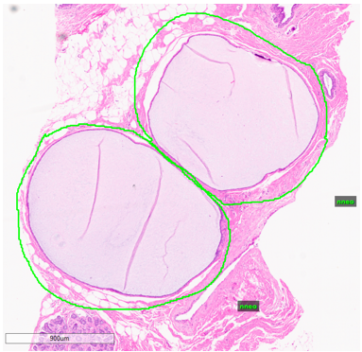
Labeled data Types
Non-Cancerous Types
Carcinogenic-Signs Type
Cancerous Types
Notes:
YUAN
For our project, we are working with breast tissue only. The images we are given are annotated.
The first image is a zoomed in section of a tissue that is non-cancerous.
The green borders represent the region that is annotated.
The green text beside it are the labels of those regions.
There are nine different labels.
Four of them are non cancerous,
Three of them show signs that may lead to cancer
And two of them are cancerous.
What we want our system to do is to take biopsy slides and generate predictions of these areas of malignancy by using a machine learning model

Slide 5
OUR PRODUCT
Scanning
System
Prediction Report
(Data)
(Model)
(Output)
Notes:
Yuan
Once our product is ready, this is what will happen,
The hospitals will scan the images and send that to us.
The we feed those images to our system, which will then generate a prediction report.
The prediction report will contain a diagnosis,
and that is any malignancy classification and the location of the malignancy

Slide 6
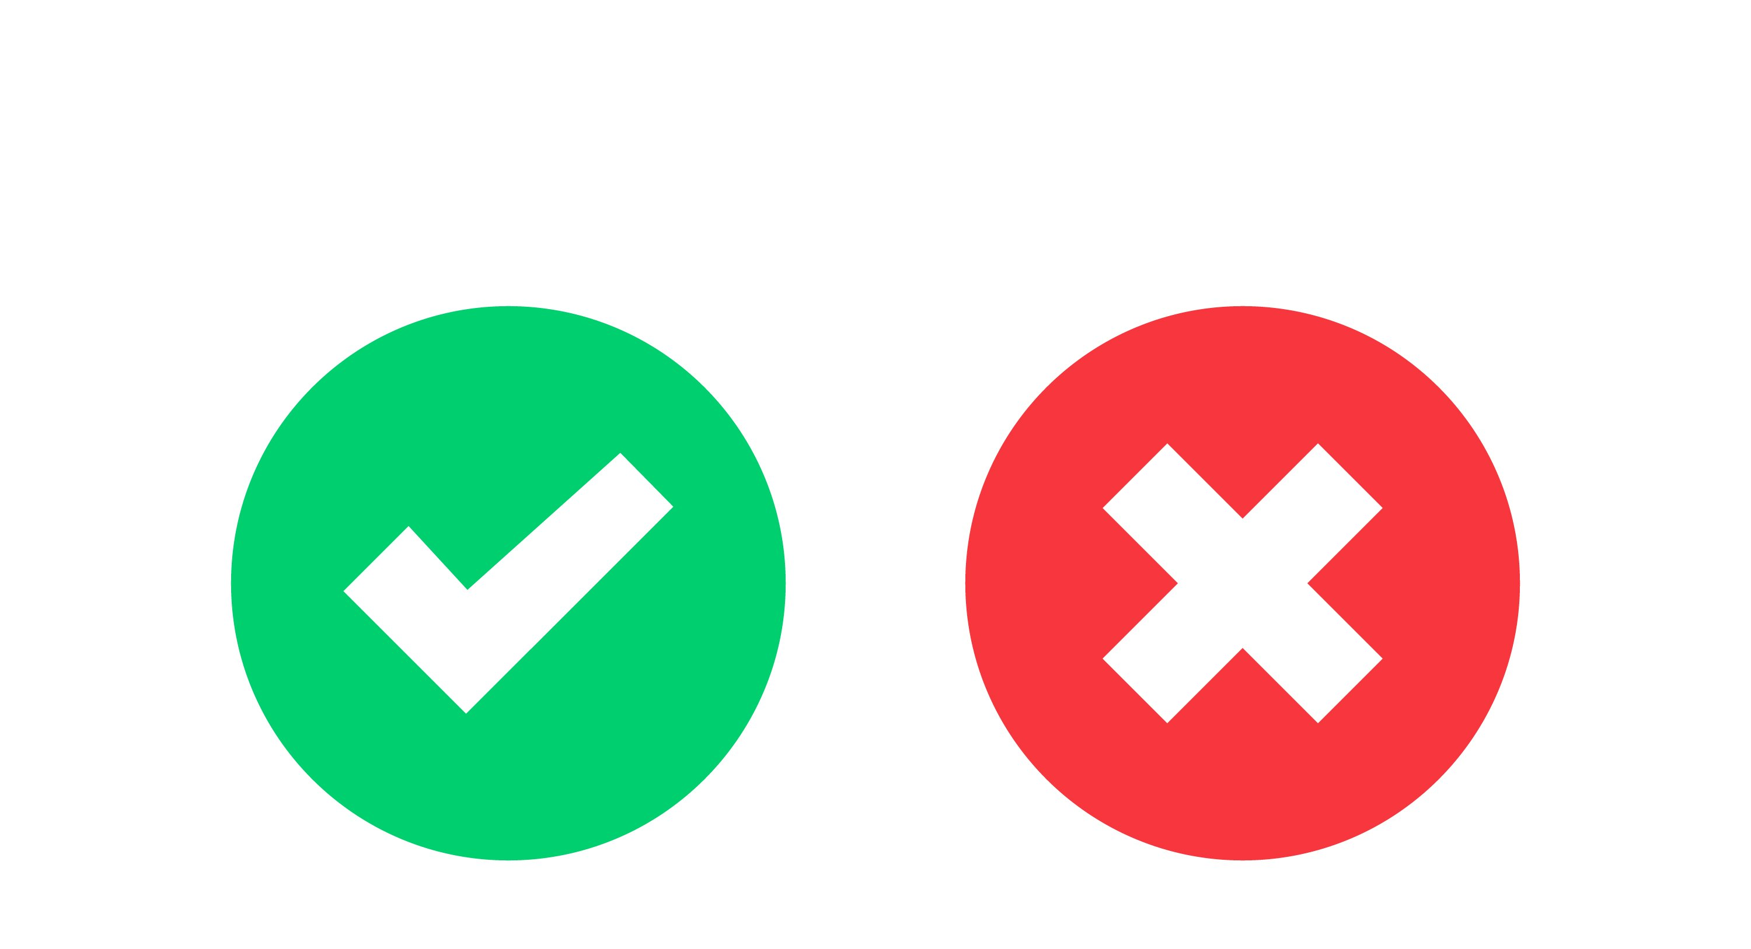
DESIGN CRITERIA / Requirements
Image Classification
Whole Slide Image Classification Source
Train Time < 3 Days
Functional GUI
Show location of areas
Show area's probability of malignancy
Notes:
Leo
So what are the requirements
Firstly, our model has to have whole image classification. In other words, does the picture supplied to the system show signs of cancer or not. This is an industry standard.
Then, we need a functional GUI that has to do two things.
Show locations of areas/regions
Then show those areas probability of malignancy/type
This last self imposed metric is designed to allow us to have some form of results by the end of the semester, we need to be able to train our model in less than three days.

Slide 7
DESIGN CRITERIA / Requirements
Model Predictions
Pathologist Predictions
F1 Score
Cohen's Kappa
.5 ( ) ( )
Cohen's Kappa > 60%
Source
F1 Score > 90%
Source
Notes:
Leo
We also need to write our code in python since it's mostly maintained by the Neuronix research lab which mainly specializes in python.
We need a Cohen's kappa score of greater than 80%.
What Cohen's kappa essentially is, is taking our model's predicitions and comparing that with pathologist predictions
Finally, we need an F1 score.

Slide 8
Deeper Look AT F1 Score
Actual Classes
Predicted Classes
F1 Score
Apples
Bananas
True Positive = 4
True Positive = 0
False Negative = 0
False Negative = 1
False Positive = 1
False Positive = 0
.5 ( ) ( )
F1 Score = 89%
F1 Score = 0%
Notes:
Leo

Slide 9
Preliminary Design
Notes:
Leo
- First we have the images of slides of breast tissue
Then we have the pre processing and this is where we prepare for feeding the data into the model
Next we have our Deep/Machine Learning Model which is where we do everything with training the model and refining
Next we have predictions which contains the output of the model as well as some postprocessing we do before we move onto our last point
Which is measurements of accuracy. This is where we score our predictions.

Slide 10
Preliminary Design
Notes:
Leo
Let’s explore our basic data pipeline

Slide 11
Training, Tuning, evaluation Pipelines
3,505 Tissue Images
1.23 Terabytes
Notes:
Leo
We have our training data
Development data
Evaluation data
All of this combined makes up 3500 images and 1.2 terabytes of disk space
Why do we do this?
Well first we pre process all of the data so they are represented similarly in memory
Next we fit the model on the processed training data.
This gives us our rough cut model which has some flaws like being biased towards some of the bias that training data might have.
Next we take our processed development data and we feed that into our trained model
After we do some post processing on the results we get our refined model. By using multiple dataset we can remove some of the bias the model has towards development data
Next we take the processed evaluation data and feed that into our refined model
After we do the same post processing and scoring and we are happy with the result, we move our refined model into our production model

Slide 12
Preliminary Design
Notes:
Albert
Now that we looked at the overall structure of pipelines, let’s go more into detail about the preprocessor stage. Everything after this point concerns progress made since the last presentation.

Slide 13
2-Dimensional DCT
One-dimensional DCT
Two-dimensional DCT
Belongs in the pre-processor stage
Vertical pixel index
Vertical pixel index
Converts colors to frequencies
Allows us to retain fewer features
Horizontal pixel index
Horizontal pixel index
Notes:
Albert
Since the last presentation, we migrated from 1d to 2d DCT because 2d DCT has certain advantages. As a reminder, DCT is a frequency transform similar to the discrete Fourier transform. It’s how we generate features as frequencies in the preprocessor stage.
On the right we have two images; these were transformed using DCT and recovered using inverse DCT. The left image uses 1-dimensional DCT and the right images utilizes 2-dimensional DCT. K is the number of frequencies used to recover the image. In this case all the frequencies available, 784, were used, and we have a perfect reconstruction of the original image.

Slide 14
2-Dimensional DCT
One-dimensional DCT
Two-dimensional DCT
Belongs in the pre-processor stage
Vertical pixel index
Vertical pixel index
Converts colors to frequencies
Allows us to retain fewer features
Horizontal pixel index
Horizontal pixel index
Notes:
Albert
If we lower the number of frequencies to 40, the image degrades for both 1d and 2d DCT.

Slide 15
2-Dimensional DCT
One-dimensional DCT
Two-dimensional DCT
Belongs in the pre-processor stage
Vertical pixel index
Vertical pixel index
Converts colors to frequencies
Allows us to retain fewer features
Horizontal pixel index
Horizontal pixel index
Notes:
Albert
However, if we’re only using 10 frequencies, the image starts to degrade faster for the 1-dimensional transform. The left image, for 1d DCT, is unrecognizable. On the right, however, even though we’re only using 10 frequencies, the basic form of the recovered image is retained; shape and structure. 2d DCT allows us to use fewer frequencies to describe the same amount of information.

Slide 16
Principal Component Analysis (PCA)
f1 | f2 | f4 | f7
f3 | f5 | f8 | f11
f6 | f9 | f12 | f14
f10 | f13 | f15 | f16
f1 | f2 | f4
f3 | f5
f6
PC1 | PC2 | PC4 | X
PC3 | PC5 | X | X
PC6 | X | X | X
X | X | X | X
Notes:
Albert
Once DCT generates the features, we use principal component analysis to trim features. PCA transforms features into principal components and uses the PCs with the highest variance, discarding all the rest. So both of these methods combined, DCT and PCA, reduce the number of features by orders of magnitude.
-----------------------
Principal component analysis allows us to reduce the number of features even further. PCA is a transform that maps features to principal components. We measure the amount of information that each feature or PC has by its variance.
Variance is more evenly distributed for features, but PCs are lopsided; some PCs have high variance but the majority have very low variance. This allows us to exclude the PCs with low variance and use fewer features without a significant hit in our predictions.
-----------------------
For those of you familiar with linear algebra, PCA is the eigendecomposition of features. This means that each principal component is a linear combination of all the features.

Slide 17
Preliminary Design
Notes:
Yuan
After preprocessing data, let’s take a deeper look at a model.
There are different models may work better than others for particular tasks.

Slide 18
Convolutional Neural Network
Base Layer
Flattening Layer
Final Prediction
Dense Layer
Pooling Layer
Notes:
YUAN
Yuan
-------------------------------------
When it comes to image recognition, there Is a model that excels in this. That is the convolutional neural network, CNN for short. CNNs are very good at learning features by themselves and operate by successively convolving input to reach a class label.
This is how the CNN operates
In the base layer, the convolution happens here. There are many operations that go on here such as multiple convolutions and activation functions.
The pooling layer condenses these output of the base layer into fewer features.
Then it goes to the flattening layer strings the features together into a single vector.
The dense layer also called the fully connected layer, takes the vector and connects all of the computed data so the model knows that the data are related in a way. and last produces a final prediction, the classification.
However, CNNs are much more difficult to implement, since the whole structure has to be customized and refined based on the results.
In the meantime, we are using a generic prebuilt algorithm to generate results.
-----------------------------

Slide 19
Preliminary Design
Notes:
Yuan
Now that we understand models, let’s go to the next stage of generating predictions.

Slide 20
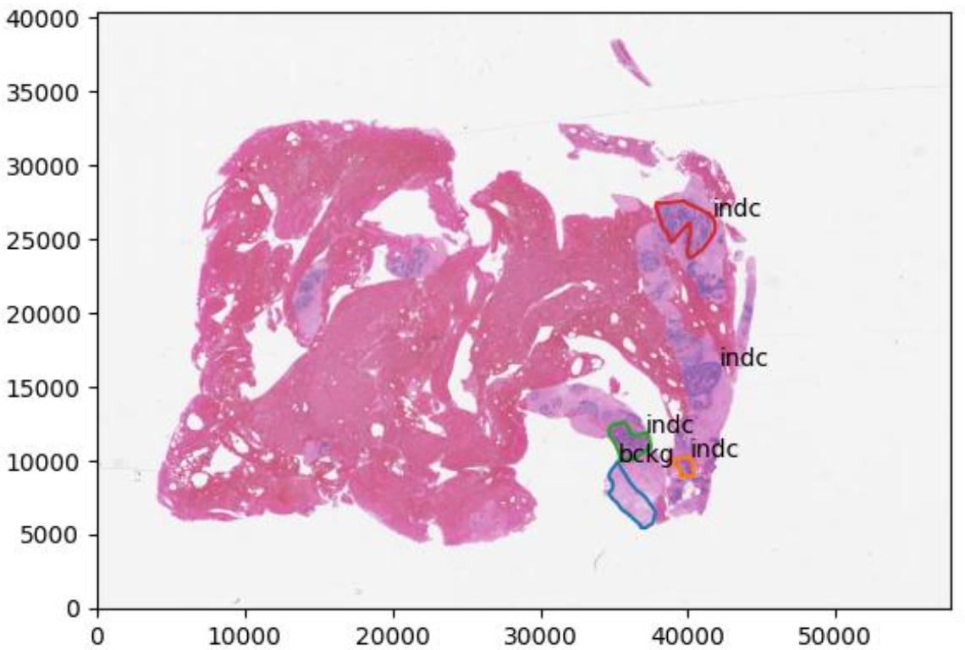
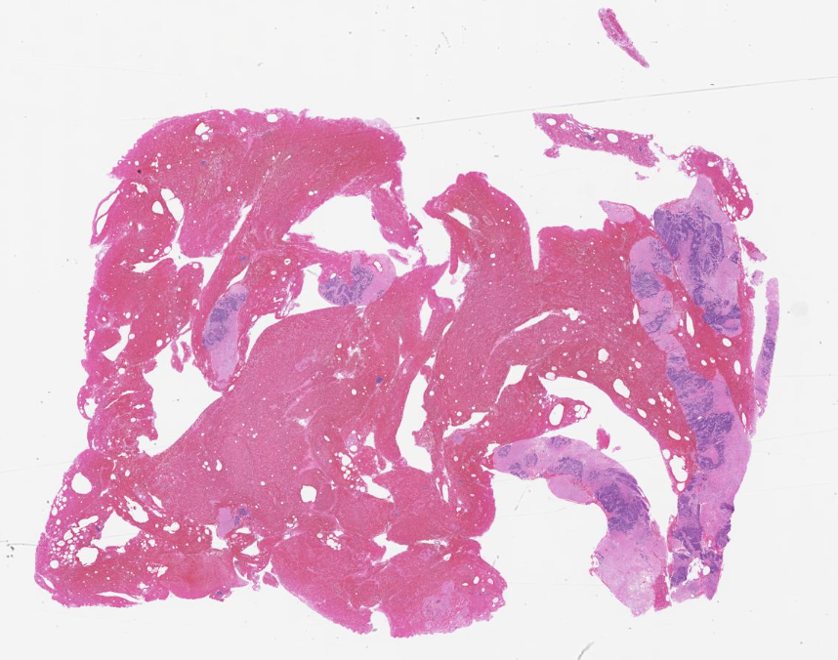
pixels
pixels
Notes:
Yuan
There are three levels that we have to get through: frame level, patch level, and image level
Lets start with the frame level first.
This image is a random slide pulled from our data with the x and y axis as pixels of the image.
Here’s a visual representation of that.
From our parameters, we get the frame size and window size
Segment the image by the framesize
The window size must be bigger than the frame so it could provide some context from the surrounding frames
We start iterating through each frame starting from the top left
As the image iterates through each frame, it will make predictions on the frames, whether malignant or nonmalignant.

Slide 21
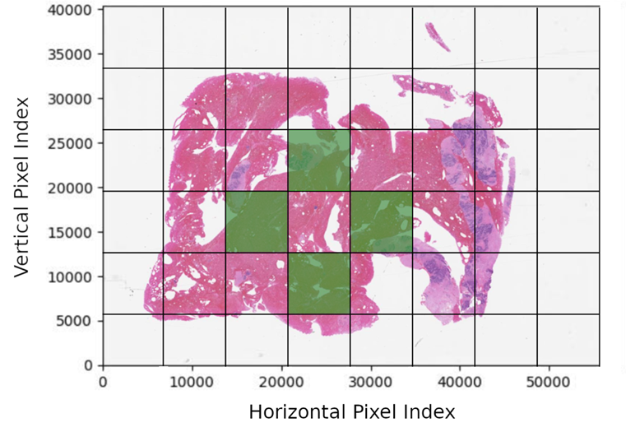
Frame to patch
Notes:
Albert
The model gives us predictions for each frame, but we need to go from frames to patches. Patches are what we call collections of neighboring frames with the same label.
In the last slide we saw that the algorithm splits an image into frames and gives the frames labels, but sometimes the classifier correctly identifies the border of a malignancy while there are areas INSIDE the border that the frame classifier does NOT believe are malignant.
Maybe the tumor has white area from fatty or connective tissue. This is an example of a slide where green represents malignancy from the classifier's perspective. Whatever the case, we want to fill in the area between the malignant labels. This is how we do it.

Slide 22
pixels
pixels
Notes:
Albert
We make a copy of the image, then use a flood-fill algorithm to flood the outside area with malignant labels.

Slide 23
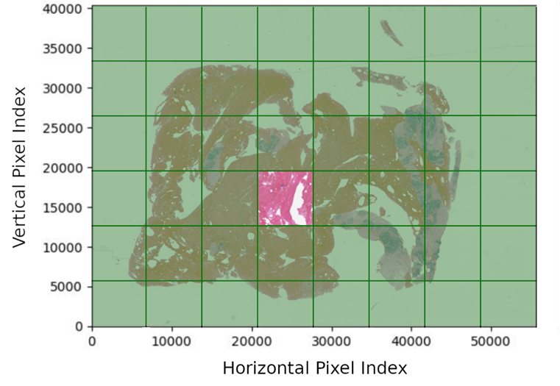
window to patch
Notes:
Albert
In the previous slide we saw how our algorithm splits an image into frames and gives the frames labels, but sometimes the classifier correctly identifies the border of a malignancy while there are areas INSIDE the border that the frame classifier does NOT believe are malignant. Maybe the tumor has white area from fatty or connective tissue. This is an illustrated example of a slide with pink representing malignancy from the classifier's perspective. Whatever the case, we want to fill in the bounded white area with the malignant label as well.
This is how we do it. We make a copy of the image, then use a flood-fill algorithm to fill in all unbounded regions with malignant labels. This image is inverted, malignant become non-malignant and visa versa. The inverted image is used as a mask. We superimpose the mask, and the malignancy is completely filled in. The result is a collection of frames that we call a patch.

Slide 24
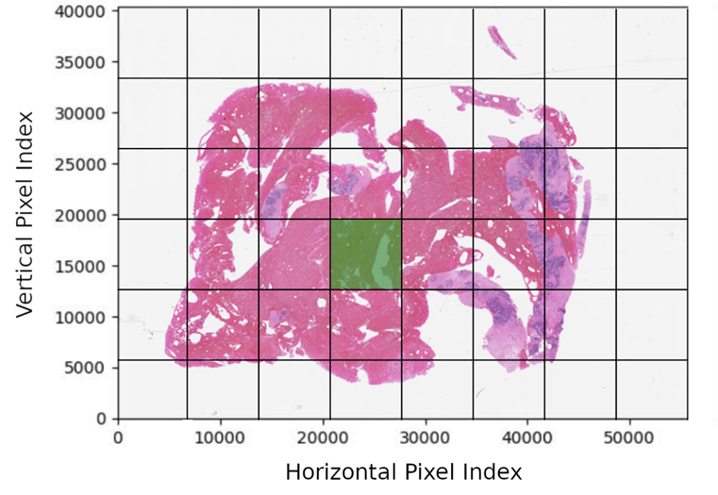
Frame to patch
Notes:
Albert
The image copy is inverted, so malignant become non-malignant and visa versa.

Slide 25
FRAME to patch
Notes:
Albert
And the inverted image is used as a mask. We superimpose the mask, and the malignancy is completely filled in. The result is a collection of frames that we call a patch.

Slide 26
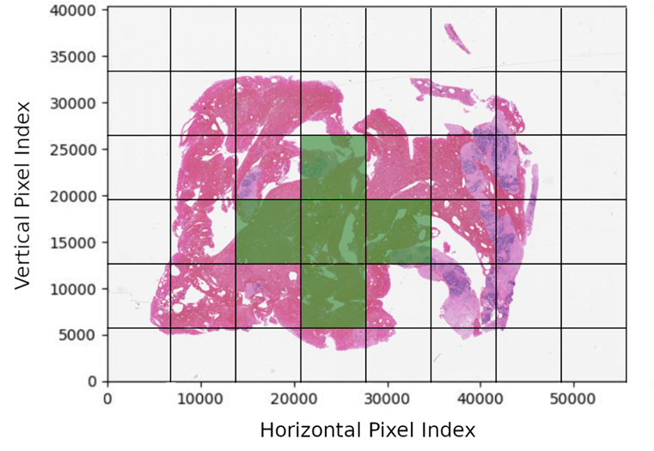
fRAME to patch
Notes:
Albert
In the previous slide we saw how our algorithm splits an image into frames and gives the frames labels, but sometimes the classifier correctly identifies the border of a malignancy while there are areas INSIDE the border that the frame classifier does NOT believe are malignant. Maybe the tumor has white area from fatty or connective tissue. This is an illustrated example of a slide with pink representing malignancy from the classifier's perspective. Whatever the case, we want to fill in the bounded white area with the malignant label as well.
This is how we do it. We make a copy of the image, then use a flood-fill algorithm to fill in all unbounded regions with malignant labels. This image is inverted, malignant become non-malignant and visa versa. The inverted image is used as a mask. We superimpose the mask, and the malignancy is completely filled in. The result is a collection of frames that we call a patch.

Slide 27
patch to image level
Noncancerous
Carcinogenic sign
Cancerous
Noncancerous
Carcinogenic sign
Cancerous
Notes:
Albert
From patches we need to classify entire images. When a pathologist searches through slide images, they should not need to inspect every individual label to understand that a slide contains cancerous tissue. We assign labels to an image based on a hierarchy of labels contained in the image.
This slide receives a normal label, this slide has patches that may develop into cancer, and this slide is labeled as cancerous.
----------------------
After classifiying all the patches of an image, we want to classify if an image is noncancerous, cancerous, or shows carcinogenic signs.
To do this, we based these labels as a hierarchy. Whatever different kinds of labeled patches is has, if it has only noncancerous labels, then it is noncancerous
If it contains noncancer and carginogenic signs, then the image may show signs of cancer but not yet cancerous
if it contains cancerous labels, then it is labeled as cancerous

Slide 28
Preliminary Design
Notes:
Leo
From the hipaa database
We get three different types of data
Training,development, and evaluation
Use the training data to build our diagnosis model
Development data to refine our model
Until it gives the scores that we want

Slide 29
Future work
Model Predictions
Pathologist Predictions
F1 Score
Image Classification
Cohen's Kappa
.5 ( ) ( )
Cohen's Kappa > 60%
Source
F1 Score > 90%
Source
No Sobel/Laplacian Filters
Notes:
Leo
So what do we have to do now? What we have right now is frame level of classification. *click*
We now need to develop a system that takes those frames and classifies patches*click*
Finaly, we have to take those patches and create a system that will classify the whole image *click*

Slide 30
Questions?
Acknowledgements:
Dr. Joseph Picone – Mentor & Data Coordinator Claudia Dumitrescu – AI Expert
Phuykong Meng – GUI Planning & Scoring
For the curious
Benefits of Machine Learning in Healthcare
Machine Learning in Healthcare
What is Machine Learning in Healthcare?
Significance of Machine Learning in Healthcare
The Potential for Artificial Intelligence in Healthcare

Slide 31
Progress SINCE LAST PRESENTATION
2D Discrete Cosine Transform (DCT)
Principal Component Analysis (PCA)
Convolutional Neural Network (CNN)
Notes:
Albert
We put in a lot of work since last month, here are some of the larger contributions we made to existing code. DCT and PCA are part of the preprocessor, and CNN is a machine learning model.

Slide 32
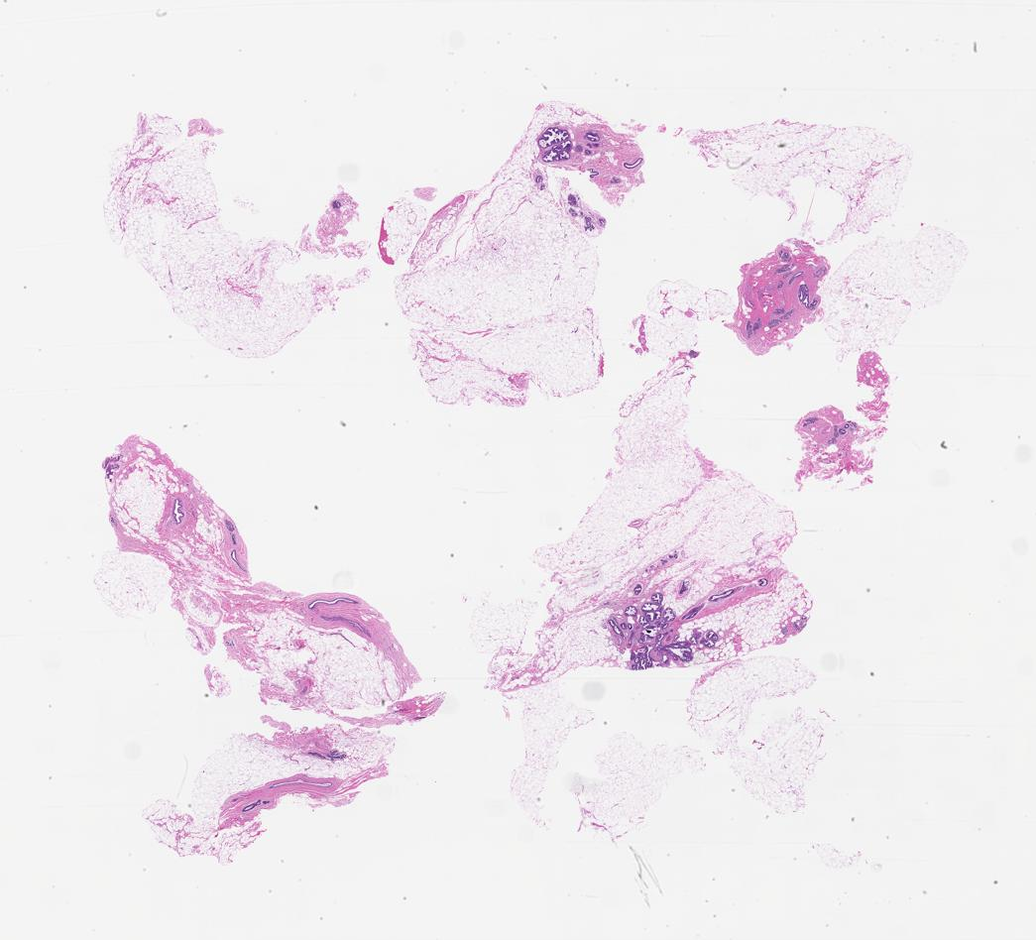
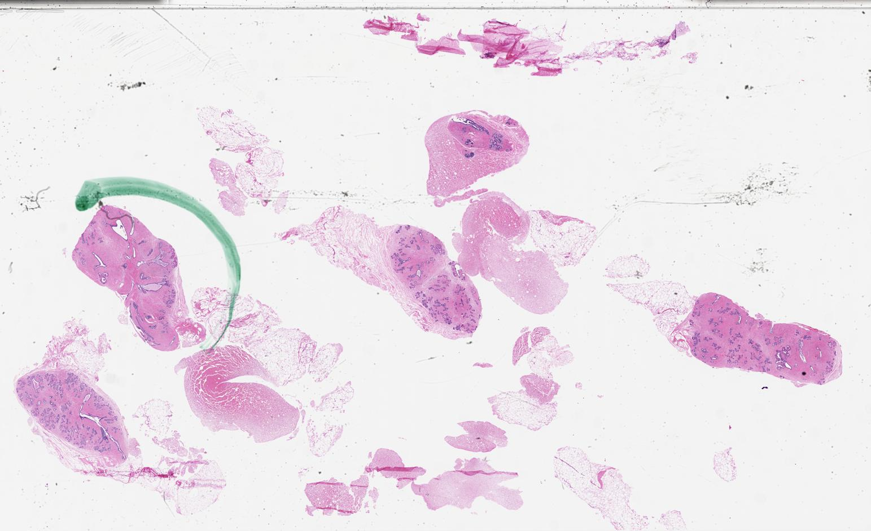
Tuhdp Biopsy Slide Sample
Notes:
Leo
Here are examples of what these slides might look like

Slide 33
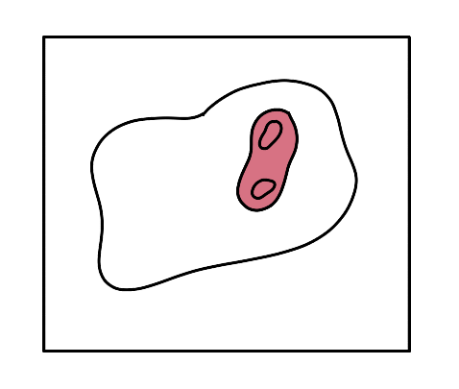
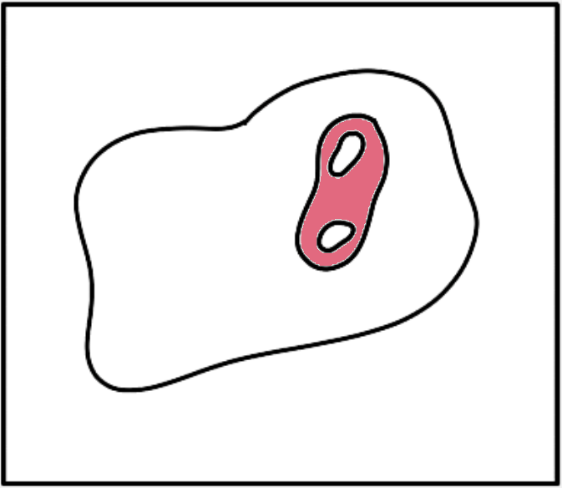
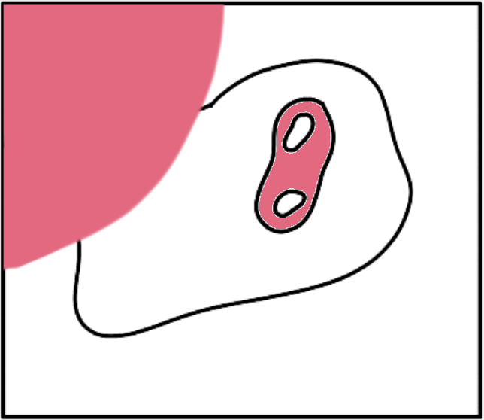
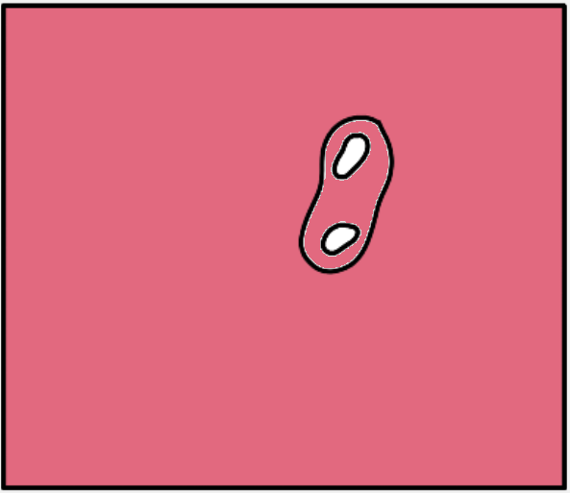
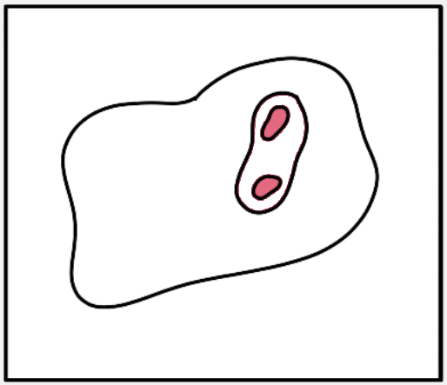
window to patch
Notes:
Albert
In the previous slide we saw how our algorithm splits an image into frames and gives the frames labels, but sometimes the classifier correctly identifies the border of a malignancy while there are areas INSIDE the border that the frame classifier does NOT believe are malignant. Maybe the tumor has white area from fatty or connective tissue. This is an illustrated example of a slide with pink representing malignancy from the classifier's perspective. Whatever the case, we want to fill in the bounded white area with the malignant label as well.
This is how we do it. We make a copy of the image, then use a flood-fill algorithm to fill in all unbounded regions with malignant labels. This image is inverted, malignant become non-malignant and visa versa. The inverted image is used as a mask. We superimpose the mask, and the malignancy is completely filled in. The result is a collection of frames that we call a patch.

Slide 34
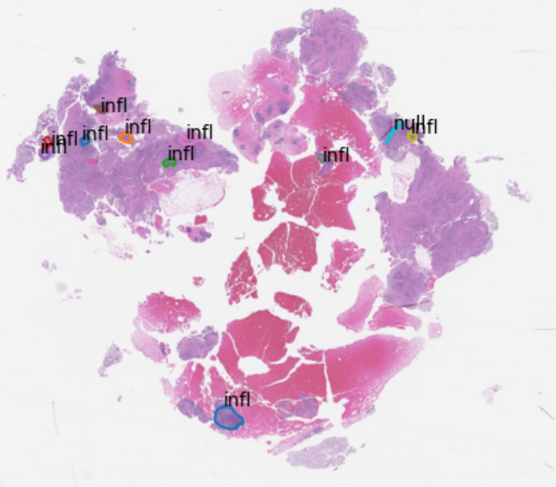
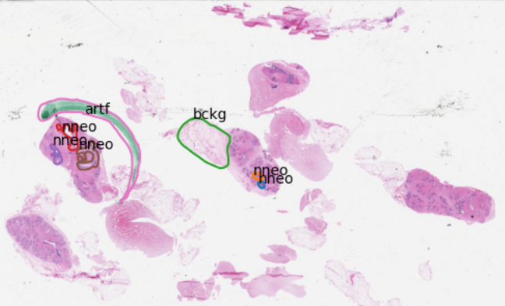
Tuhdp Biopsy Slide Sample
Notes:
YUAN
This is what we are working with.
They are less saturated, and instead of zoomed in sections, these are whole slide images.
On the images, there are some annotations which are made by the pathologists..
A lot bigger in scale than the previous images and may contain a lot more identified regions.
These are also annotated.
But in the future of our project, we want the algorithm we are building to
Predict these areas of malignancy and nonmalignancy while also classifying them correctly

Slide 35
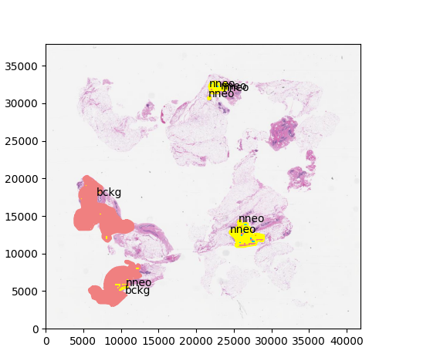
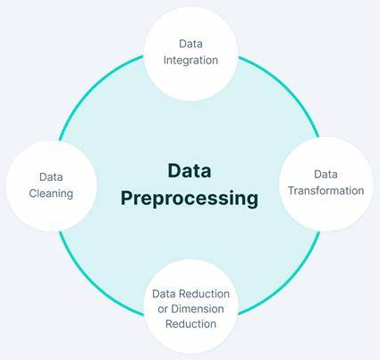
Deeper Look At Model I/O
NNEO
BCKG
Pixels
Pixels
Notes:
Leo
Here's a deeper look at Program I/O
Our system will take in an image
Then, we will process that image, that means cleaning it up, filtering it, extracting features from it, etc...
Next that will go into our machine learning model, this image is an example of what a decision tree based model might look like.
Finally, we output a decision report, and this is what one may look like with the type of tissue and the location.
Our solution proposes a Machine Learning based software that takes in inputs of biopsy slide images, performs a prediction on the image, and almost instantly outputs a result with an urgency system so that the doctor can look and then treat their patient in a timely manner.

Slide 36
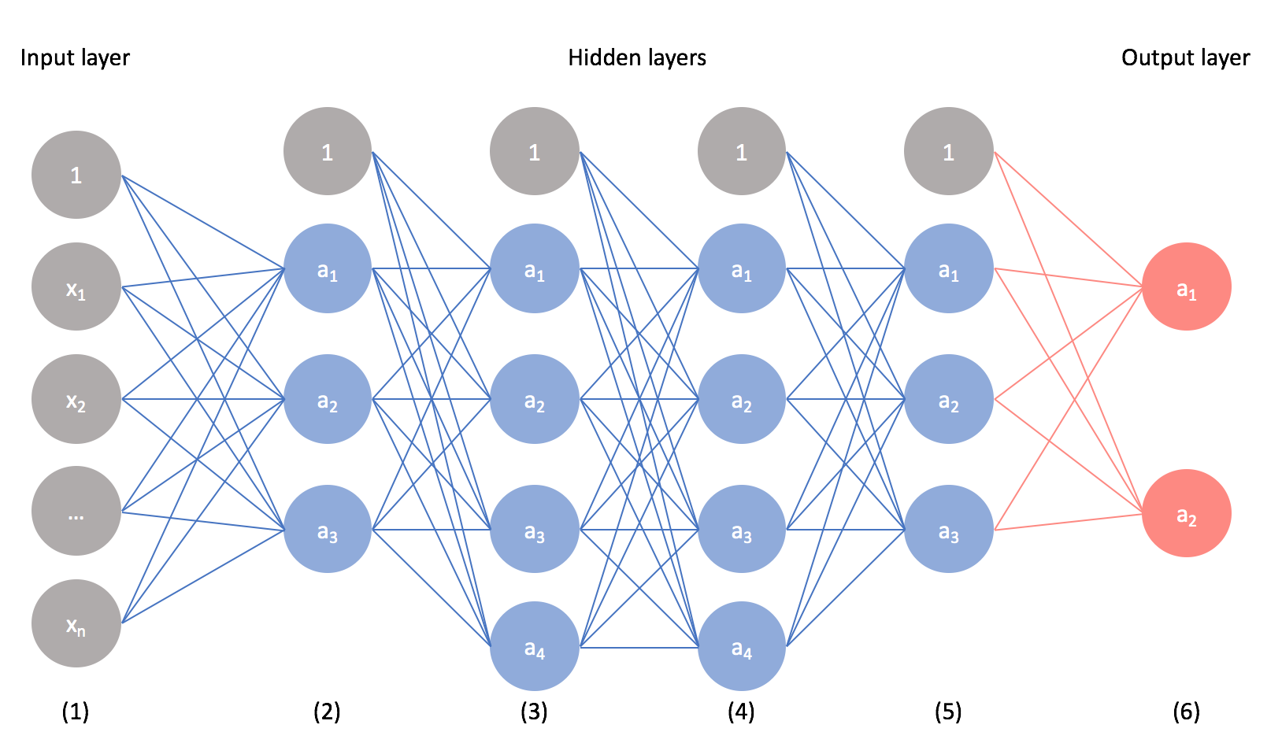
Convolutional Neural Network

Slide 37
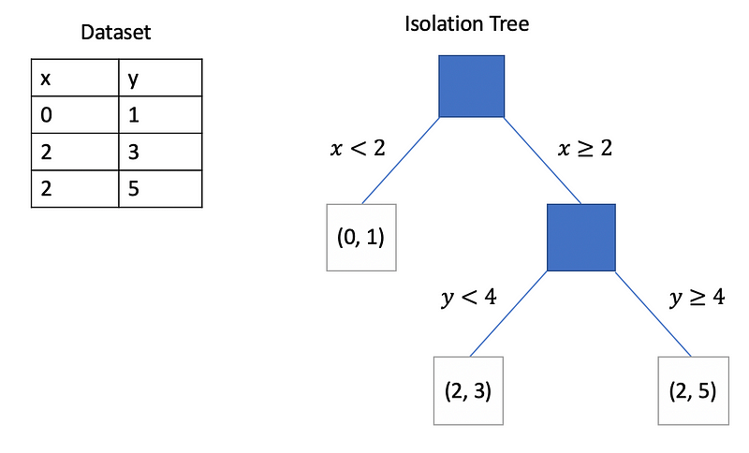
Random FOREST

Slide 38
What is A Model?
Three essential components for machine learning
Data
Model
Training algorithm
Model
Mathematical representation of relationships in the data
Training algorithm
Uses data
Adjusts variables in the model until output matches input

Slide 39
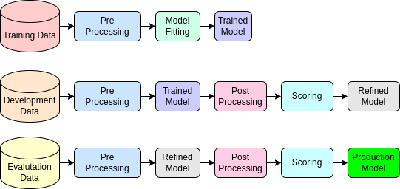
Temple University Health Digital Pathology Corpus
3,505 Tissue Images
1.23 Terabytes
Notes:
Yuan
From TUHDP,
We are given this many tissue images, about 1.23 terabytes.
This data is split into three groups, train, dev, and eval.
The train data makes up about half the data because this is what the model will be using to train itself.
The development data and evalulation data makes up the other half for fine tuning the model.
splitting our data into dev and eval helps against overfitting the model

Slide 40
Principal Component Analysis (Dimension Reduction)
After feature generation
Also belongs in the pre-processor stage after digitizing/segmenting slides and before training
Reduces the number of features while minimizing information lost from feature reduction
Fewer features compared to no PCA or dimension reduction

Slide 41
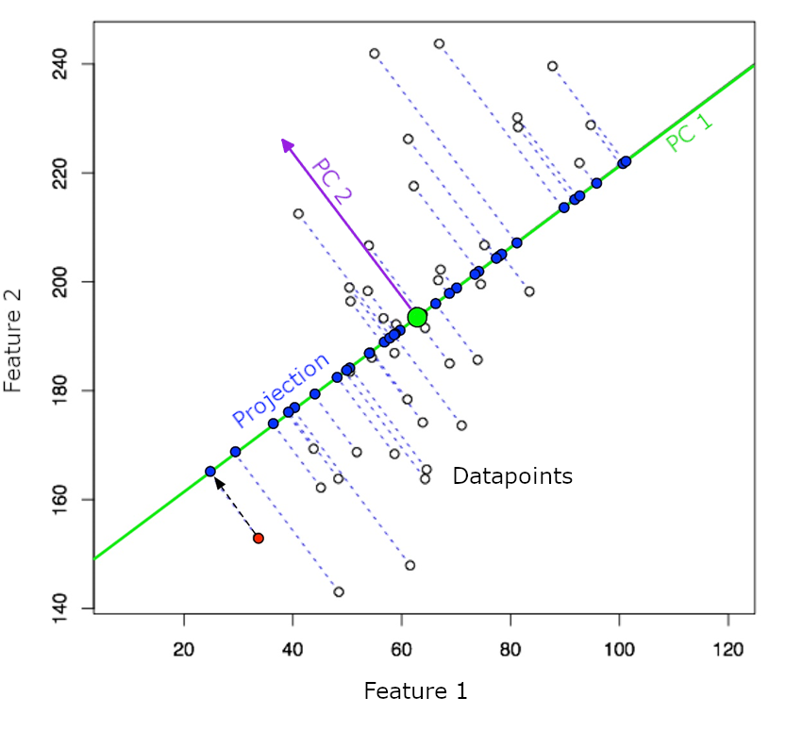

Slide 42
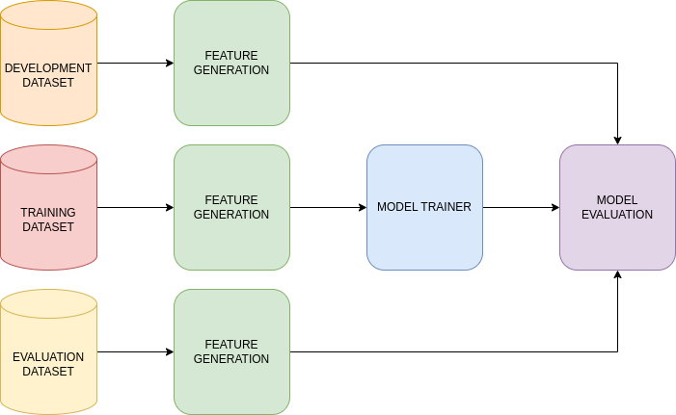
Testing GOALS
Notes:
Albert
To recap, we start with training data from Temple University Health in the form of biopsy slide images.
We process slide images and extract features interpretable by our machine learning model.
The model is trained using labels from the pathology lab and the features we extracted.
At this point, we need to see if the model's predictions are accurate and if any variables need to be adjusted to achieve better accuracy. This is the model evaluation phase.
We test the model on the development set and make adjustments.
Finally, when we're satisfied with the model's performance, we evaluate on the evaluation set for unbiased feedback. This will let us know if the model is overfit to training and development data.
----------------------
Our current testing process starts with the training data *click*
Next we are processing these images and creating features that a model could read *click*
We use these feature vectors to train a base model *click*
Next we want to evaluate our model on this train set *click*
Next we take the dev and eval set *click*
Put them through the same feature extraction process *click*
And finally evaluate the model on those datasets to see if we overtrained our model *click*

Slide 43
2-Dimensional DCT
Part of feature generation
Belongs in the pre-processor stage after digitizing/segmenting slides and before training
Greater spectral/energy density than one-dimensional DCT
Therefore, fewer features compared to one-dimensional DCT

Slide 44
2-Dimensional DCT
Belongs in the pre-processor stage
Converts colors to frequencies
Allows us to retain fewer features

Slide 45
Scoring
Find overlapping area between the model’s predictions and the human pathologist’s predictions
Use overlapping area to construct a confusion matrix
Use confusion matrix to generate $F_{1}$ scores and Cohen’s kappa coefficients

Slide 46
Overlapping Area
Model prediction: bckg

Slide 47
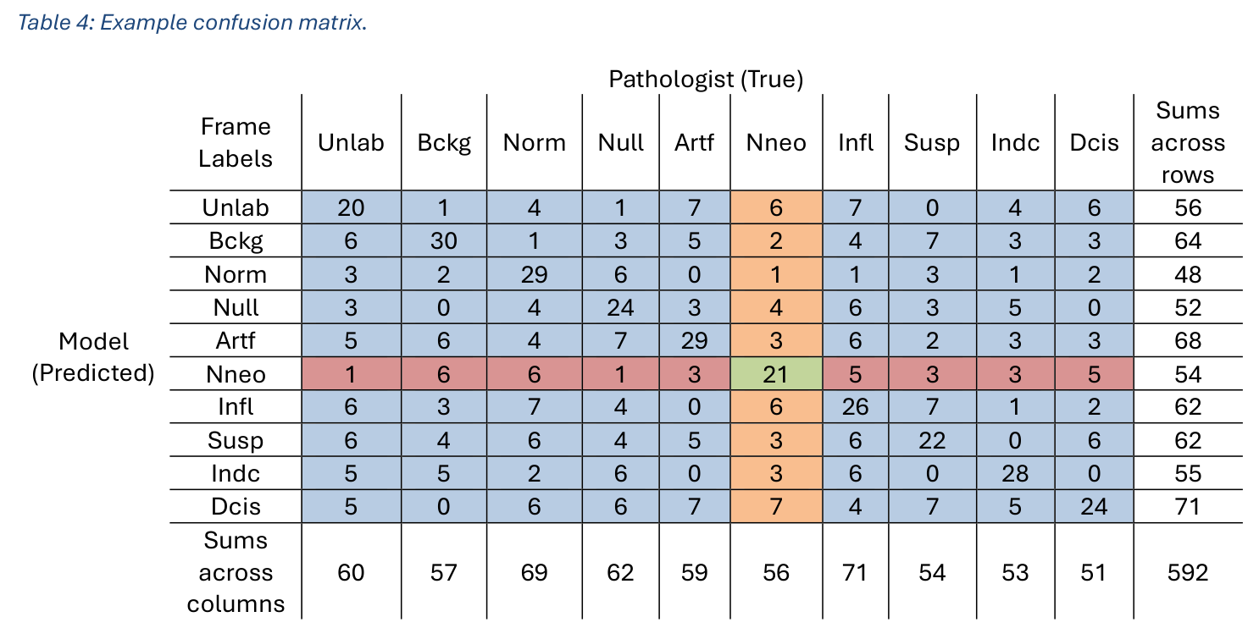

Slide 48
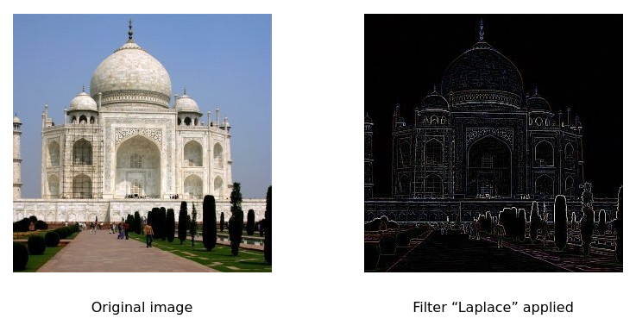
Filters
Notes:
One thing we're working on is outlining the borders of tissue regions. We want to accurately outline the border of a tumor within a frame.
[Remember that tissue samples are heterogeneous and a malignancy may be long and elongated or the size of a pin prick when viewed under magnification. We want to point that out, instead of just pointing to the frame that it's located.]
Luckily for us, we have a host of image processing algorithms to try. The filter pictured here is called a Laplace filter; it creates a border around image regions where a change in color or structure is detected.

Slide 49
Frame Level Evaluation Results
Dataset | Accuracy Rate [%]
TRAIN | 100.00
DEV | 86.33
EVAL | 85.87
Random Forest
Notes:
So here we are testing the two different algorithms. Quadratic Discriminant Analysis and Random Forest. Quadratic Driscriminant Analysis works by assuming all of the features have a Gaussian Distribution and Random Forest has more a decision tree type algorithm that learns information about each specific feature in a slightly more modular way. We tested both these algorithms on all 3 datasets. *click*
FIrst for QDA *click*
We can see that the accuracy was really poor. Since QDA assumes a Gaussian distribution for all features, it's very likely we weren't able to train it on enough data to accurately generalize these features into a Gaussian. *click*
However, Random Forest was able to get a higher accuracy rate, likely since the features we generated a pattern easily recognizable by the algorithm. *click*

Slide 50
Github and the server
The Server
GitHub
Changes On Same File
Firewall
Server
Local Computer
Local Computer
Local Computer
GitHub
Changes On Same File
Notes:
The two development tools we used were the departments Neuronix server. *click*
Now imagine someone on their local computer *click*
They can attempt to log in to the server and they will hit this firewall *click*
While we can get through this firewall with our credentials *click*
It prevents others from infiltrating into the database and is customizable so we can have access we need without sacrificing patient confidentiality.
Next we used GitHub *click*
Imagine two people working on separate computers *click*
Now what happens if they go to edit the same file? *click*
Here is where GitHub comes in *click*
When we send our changes to GitHub, it takes the last common entry for that file and merges the changes together and notifies us if there is a conflict so we can handle them by hand.

Slide 51
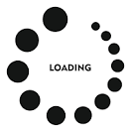
Explain Train, Dev, and Eval in the process
Initial Model
TRAIN
DEV
Final Model
EVAL
Notes:
Albert
----------------------
First we take our train data *click*
and we train our initial model. Then we evaluate on the dev set *click*
and based on those results we refine our model *click*
Finally we check our model on the evaluation set *click*
and once we are happy with those results *click*
we output our final model

Slide 52
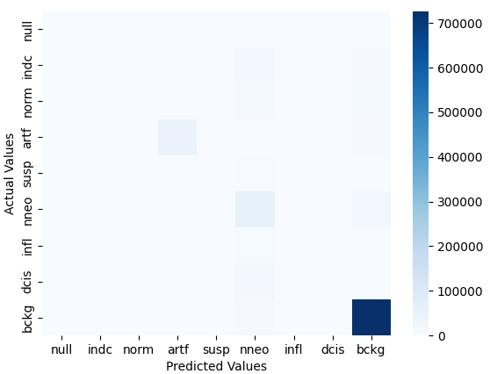
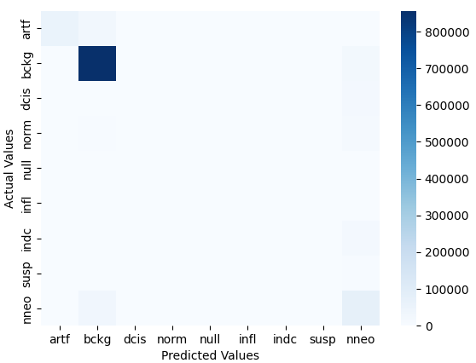
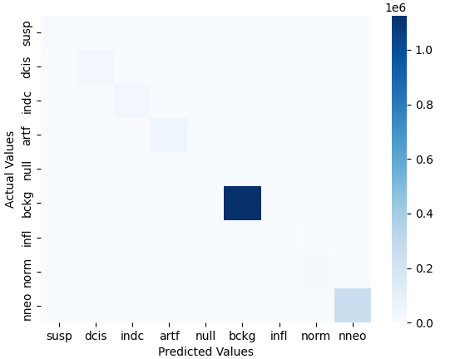
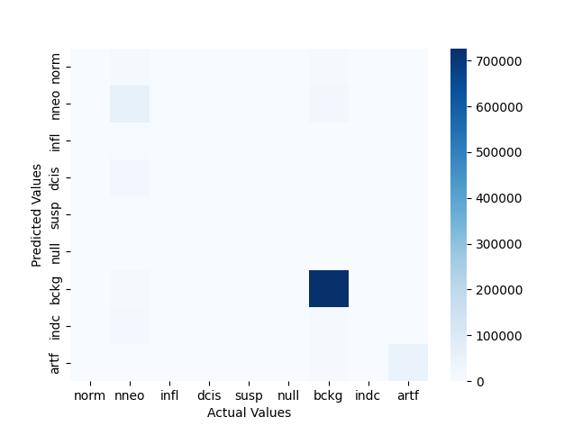
RNF Confusion Matrix
TRAIN
DEV
EVAL
Notes:
Muho

Slide 53
RNF Decision Surfaces
NNEO
BCKG
Pixels
Pixels
Notes:
Albert

Slide 54
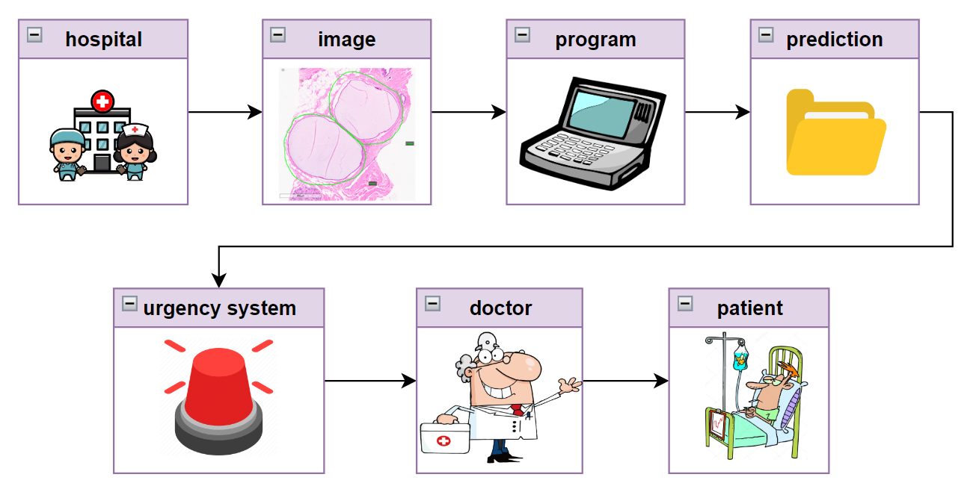
How THIS FITS
Notes:
Leo
When in production, our system will work like this.
First, a hospital will take a needle biopsy as discussed earlier
Once that is an image
It will be fed into our pre-trained system which will likely be fine tuned on their scanning equipment and staining colors
Our system will then output a prediction report as discussed earlier, this is where our hand in the process ends.
Finally, the hospital will use our prediction report however they want, possibly in an urgency system.
From there, the doctors will utilize this urgency system to ensure patients receive treatment in the way that best saves lives.
Our solution proposes a Machine Learning based software that takes in inputs of biopsy slide images, performs a prediction on the image, and almost instantly outputs a result with an urgency system so that the doctor can look and then treat their patient in a timely manner.

