Slide 1
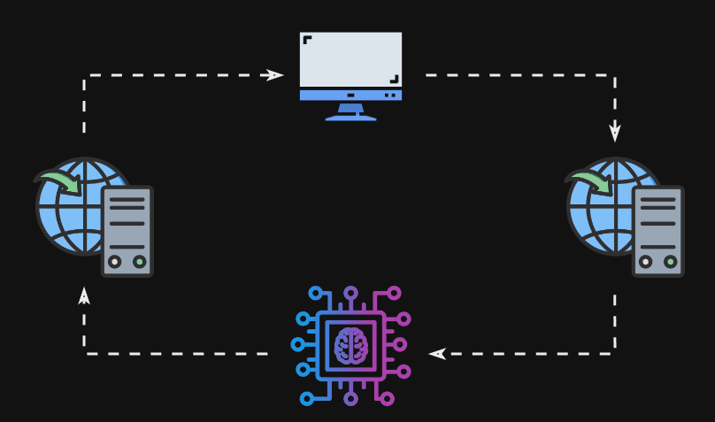
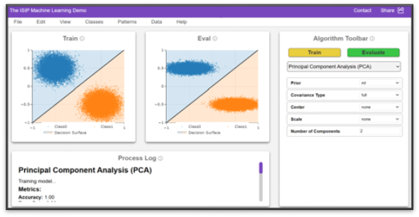
ISIP Machine Learning Demonstration
Shane McNicholas, Brian Thai, Kayla Toner, Raynel Lopez-morel
In Collaboration with The institute for signal and information processing
Notes:
(Shane) Introduce the team and the title. Talk about the images.
** Give higher level discussion of graphic on the right **

Slide 2
Problem Statement
“Machine learning is hard to learn due to a lack of visual feedback and accessibility.”
Notes:
(Shane) Pose the problem we are trying to solve. Trying to “demystify” machine learning.

Slide 3
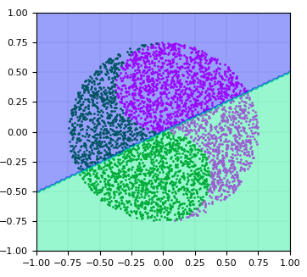
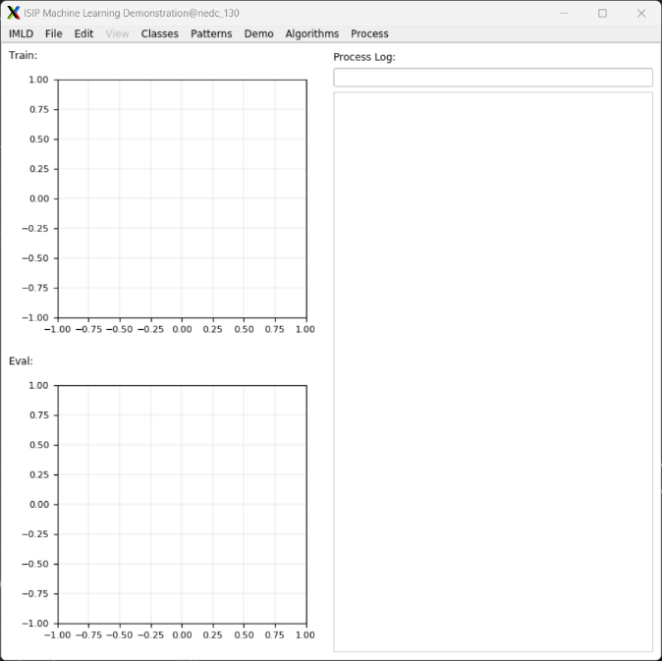

Proposed Solution
Interactive Machine Learning Algorithms
Intuitive User Interface
Educational Visualizations
Notes:
(Shane) Refresh the main components of IMLD. We are trying to create a solution that captures the 3 following elements.
Interactive Machine Learning Algorithms: A suite of pre-built machine learning algorithms that users can interact with and test.
**what does the picture of the interactive model mean, and how is it connected to the project?**
The brain in the center of the visual represents the core of the model, the learning and decision-making element. The extending lines symbolize inputs and outputs, representing the model’s ability to interact with data. This is representative of IMLD, which processes inputs, learns from it, and generates outputs.
2. Educational Visualizations: Simple visualizations that allows users to understand the advantages and disadvantages of each algorithm.
**clarify what the different colors in the middle image are representing**
The central visual illustrates the classification of two distinct colors. The green and pink dots represent the two classes within the input data, while the overlaid green and pink shading highlights the decision surface. This shading indicates how the model has separated the two classes, visually depicting the boundaries where the model predicts each class.
3. Intuitive User Interface: An intuitive user interface that allows users to quickly and effectively learn the principles of machine learning.

Slide 4
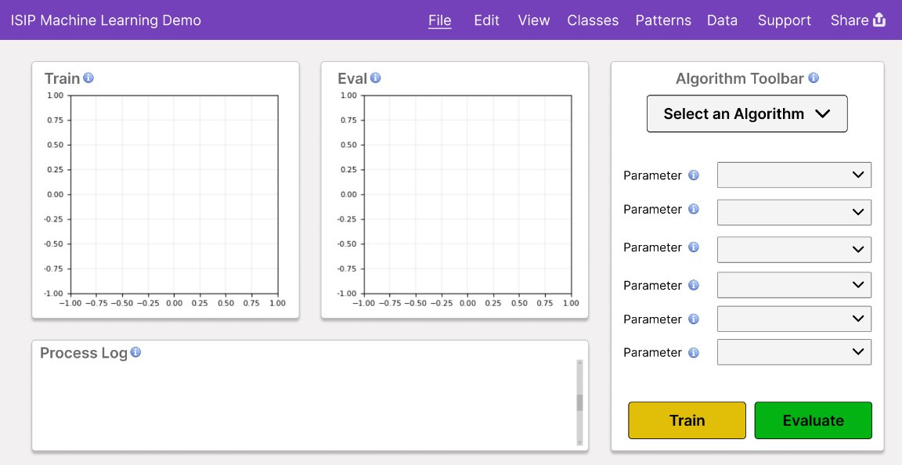
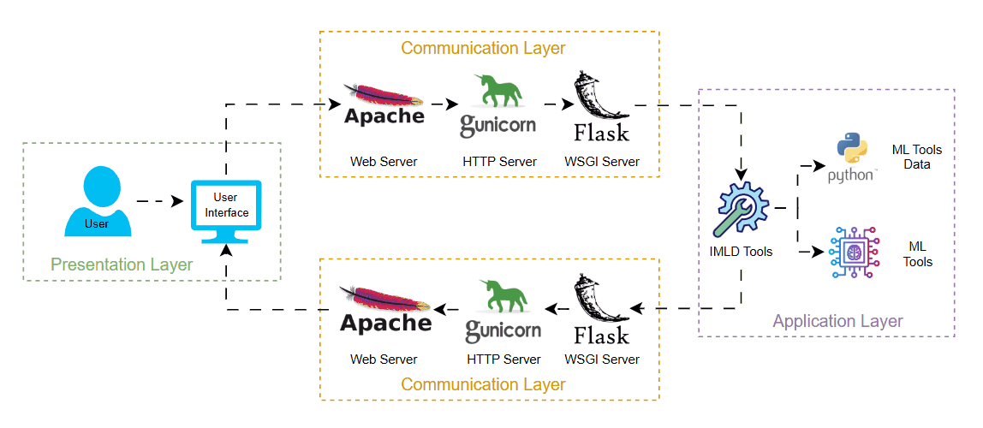
Proposed Solution
Notes:
(Shane): Talk about the next-generation of IMLD. Use the principles of the last generations of IMLD to design a modern web app, allowing people from all over the world to use the tool.
** describe each component of the architecture
“what are we showing?” – Thomson
Explain why we decided on this architecture – is it a common setup or newly designed? **

Slide 5
Design Requirements
Requirement
Metric
Target
Value,
Justification
Range,
or
pass/fail
Intuitive Data Loading Feature
Time to Complete Task
< 25 seconds
Ensures smooth user experience & fewer errors
Intuitive Algorithm Selection Feature
Time to Complete Task
< 35 seconds
Ensures smooth user experience & fewer errors
Intuitive Model Evaluation Feature
Time to Complete Task
< 7 seconds
Ensures smooth user experience & fewer errors
Scalability
Users
Maintain performance
With 100+ users
Scalable application ensures global accessibility
without compromising performance under load
Load Performance
Seconds
Within 2x baseline
Load datasets within 2x of baseline time to account
for network delays and maintain performance
Algorithm Performance
Seconds
Within 2x baseline
Computation within 2x of baseline time to account
for network delays and maintain performance
Algorithm Output Validation
Comparison
Pass/Fail
Consistent algorithm outputs between web and
legacy version ensures reliability & accuracy
Graph Output Validation
Comparison
Pass/Fail
Consistent graph outputs between web and legacy
version ensures reliability & accuracy
Notes:
(Rizznel)
Describe why we selected the target values for example 100 users
use evidence (sources) to describe why all the target values determined
For our target values, they were obtained from extensive testing user and simulation testing on the original IMLD, which will be explored more going forward
Intuitive data loading, Algorithm selection, and model evaluation >>>>>> the goal is to provide a design that allowed for a more stable user experience as opposed to a complicated and difficult to understand system.
Scalability >>>>>>> we want to have this application accessible globally, without having to compromise performance under a higher load, in short, will our website run similarly stable at 10 users, versus 100 users
Load and algorithm performance >>>>>> taking into consideration the nature of the websites design, we expected that loading and computing the data sheets have a 2x baseline to account for network delays over long distances, while also considering slower internet speeds depending on the location of our users.
Algorithm and graph validation >>>>>> ideally each simulation being ran would need to show consistent results between the web and legacy version, this ensures reliability and accuracy of our product.
Three Things to Go Into Detail:
1. Why we selected each requirement
2. Where the target values came from
3. Make sure the justification is truly justifying rather than restating

Slide 6
Design Constraints
Constraint
Metric
Target
Value,
Justification
Range,
or
pass/fail
Compatible on Modern
Web Browsers
Testing
Successful usage on Chrome,
Various compatibility provides seamless experience
Firefox, Safari
for broad range of users across popular browsers
Consistent Visual Design
Approval
Pass/Fail
Consistent visual design enhances usability and
creates a cohesive, professional user experience
Sufficient Documentation
Approval
50-60% comment-to-code ratio
High ratio improves code readability &
maintainability for future developers
Adherence to ISIP
Standards
Approval
100% adherence to
chosen guide
Adherence ensures high code quality, consistency,
and reduces technical debt with development team
Input Validation
Testing
100% of user inputs undergo
Ensures data is formatted properly, preventing
validation before processing
errors and more accurate performance
Cybersecurity
Testing
100% of user inputs undergo
Verifies safety of user inputs, preventing malicious
sanitization before processing
data from being processed and protecting the site
Hosted Entirely on
Neuronix
Status
Pass/Fail
Provides data security and control, reducing
reliance on external cloud services
Notes:
(Rizznel)
Use sources/evidence to justify target values selection a little more -
Compatibility with modern web browsers >>>>> in order for this product to be considered a success, it needs to provide a seamless experience for a larger range of users across multiple platforms and web browsers
This entails Consistant visual design >>>>>> to enhance usability and create a more professional user environment. An example of this would be if you were to run the website on firefox, but then for whatever reason you switch and run in on chrome or Microsoft edge
For sufficient code documentation, we follow a 50-60 percent comment to code ratio industry standard
Our current chosen guide requires us to adhere to isip standards, providing high code quality while reducing technical dept
Input validation >>>>>> in order for users to run our algorithm, we have to take into consideration data formating, we need to be able to test the format of their data in order to ensure an accurate performance
For cyber security, we want to be able to provide a safe space for user inputs while mitigating for malicious data being processed, in lamest terms, we want to allow people to test their own data, while making sure their data is safe to run
To accomplish this we are hosting the network on the neuronix servers in order to reduce reliance on external cloud servers
Three Things to Go Into Detail:
1. Why we selected each constraint
2. Where the target values came from
3. Make sure the justification is truly justifying rather than restating (explain input validation in more detail too)

Slide 7
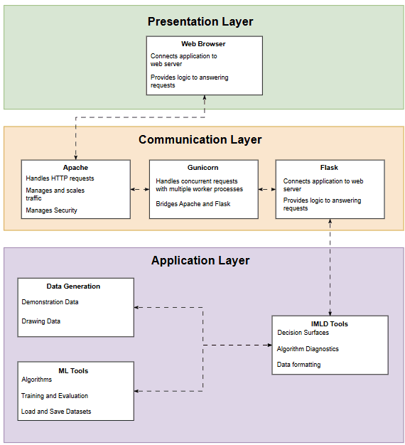
Architecture Overview
Notes:
(Kayla) Discuss the top-level architecture, describing the importance of each layer.
** how did we select these layers, what considerations went into selecting this architecture?
did we consider any other options when picking the architecture?
Is this a standard architecture?
What were the design tools used for this?

Slide 8

Architecture - Presentation Layer
Notes:
(Kayla)

Slide 9
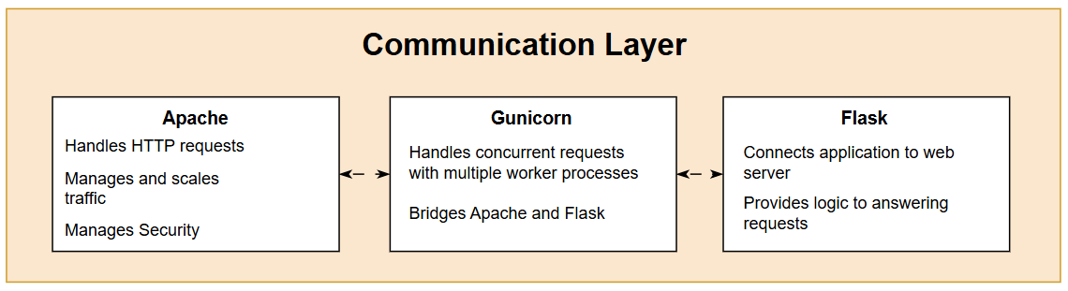
Architecture - Communication Layer
Notes:
(Kayla)
Add to original explanation:
Flask is a simple prototyping tool used for web development, allowing users to simply test out their created websites. It also allows us to run it as a WSGI server supported by Apache, while simultaneously allowing users to run it as a local server. This is our main reason for using Flask, as other frameworks would not allow users to run locally unless they were to host a more complex server.
In the future, if the load becomes too much to be handled by only Apache and Flask, we will experiment using Gunicorn, a more complex web framework that can be used in conjunction with Flask to support frontend interactions.
We chose to use Apache since our server will be run and hosted through Dr. Picone’s research lab which has an existing system with an Apache server. Choosing to maintain the same server for HTTP connections will create simplicity and efficiency, allowing us more time to focus on different aspects of the project.

Slide 10
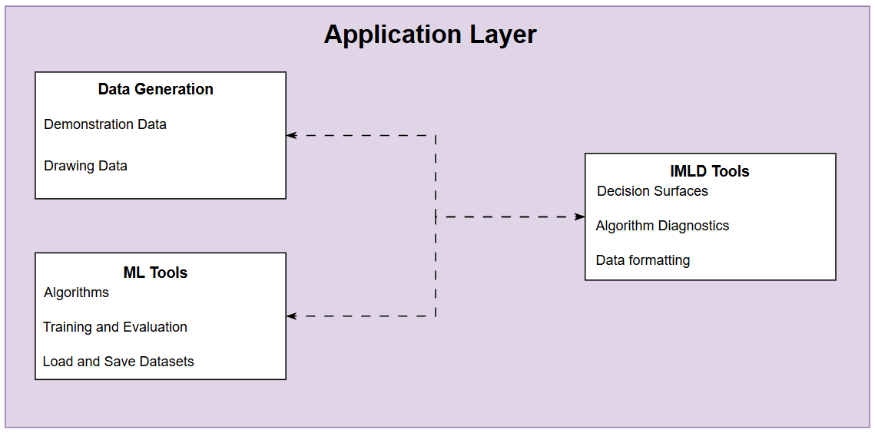
Architecture - Application Layer
Notes:
(Kayla)

Slide 11
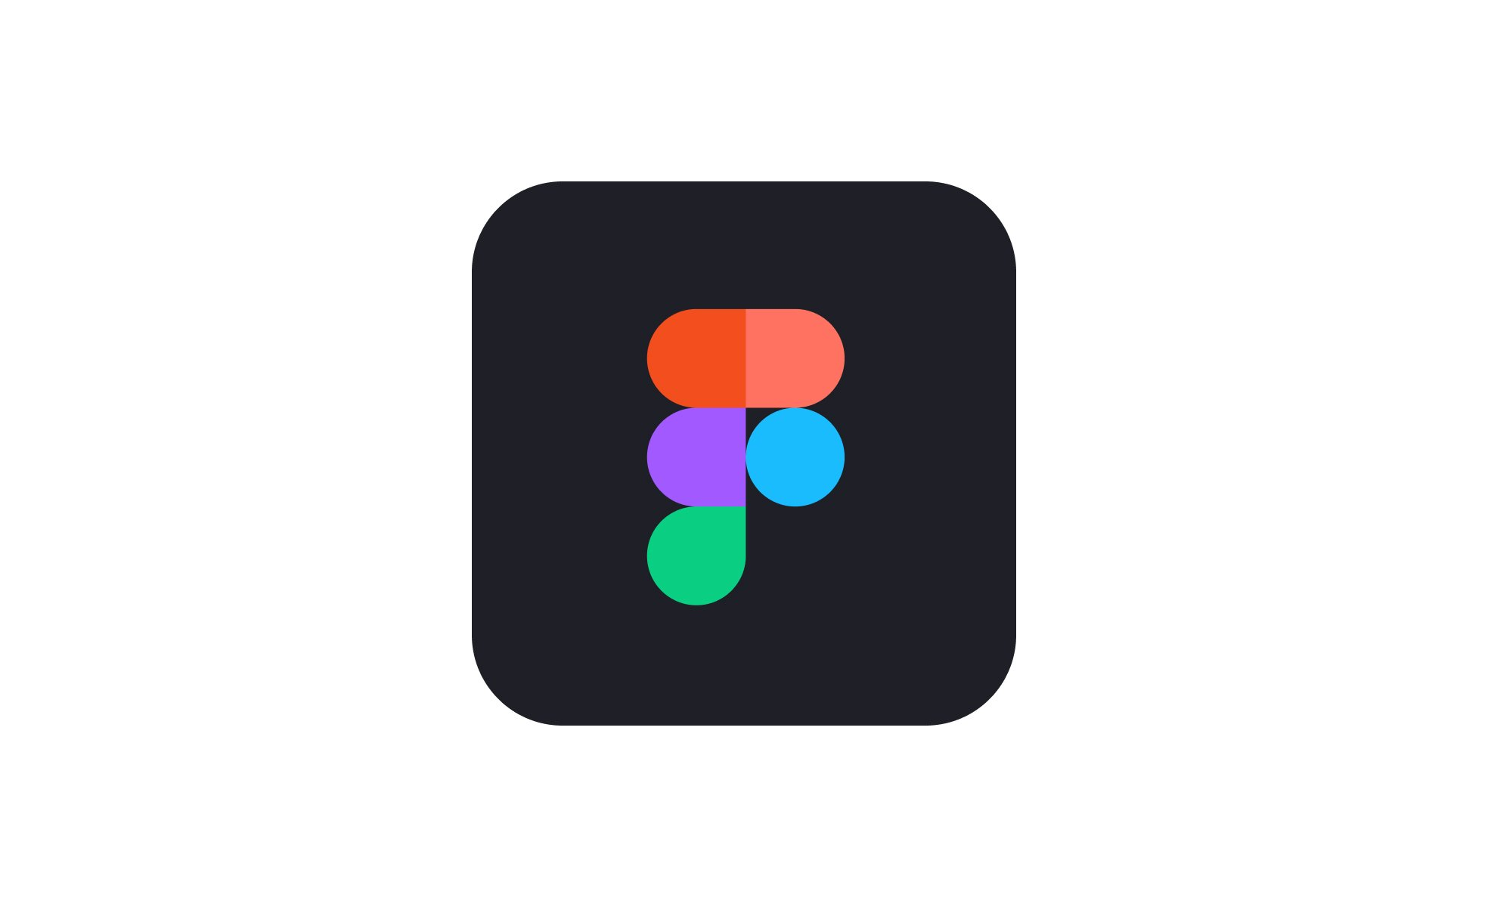

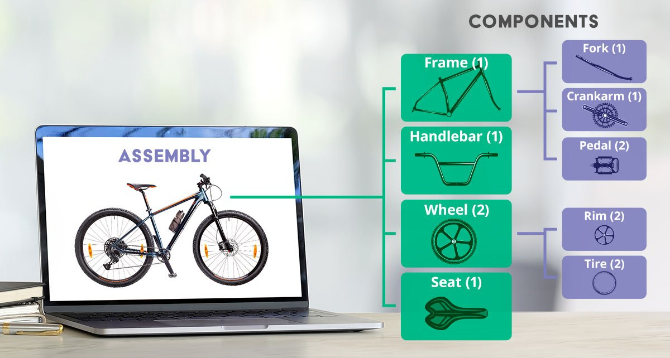

Designing Subsystems
</>
Component
</>
</>
Component
Component
</>
</>
Component
Component
Figma
Web Component Prototyping
Notes:
(Brian)

Slide 12






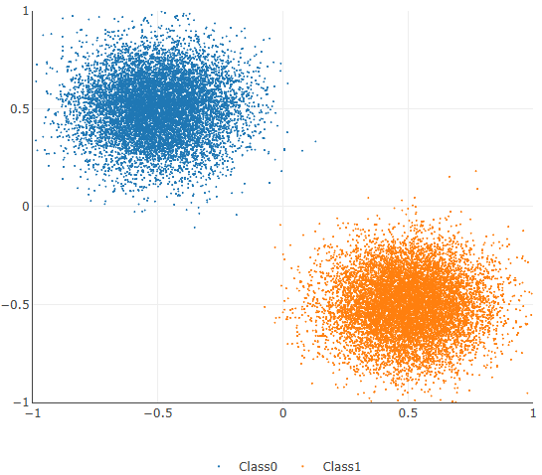
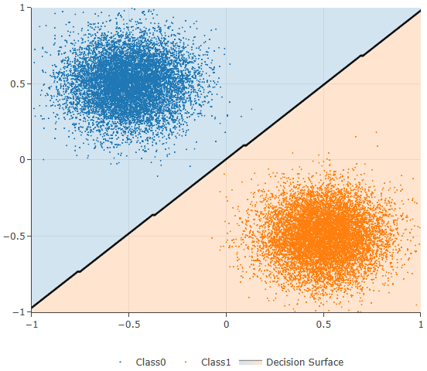


Integrating Subsystems
Generate Data
Train/Eval Data
Development Version
data
data
Clone to Neuronix cluster
IMLD Tools
Setup Configuration File
ML Tools Data
ML Tools
Backend-Frontend Communication
Deployment to the Web
Generated Data
Trained/Evaluated Data
Notes:
(Brian)
Show block diagram connecting backend-frontend communication, machine learning pipeline, hosting on internet(application-internet)

Slide 13
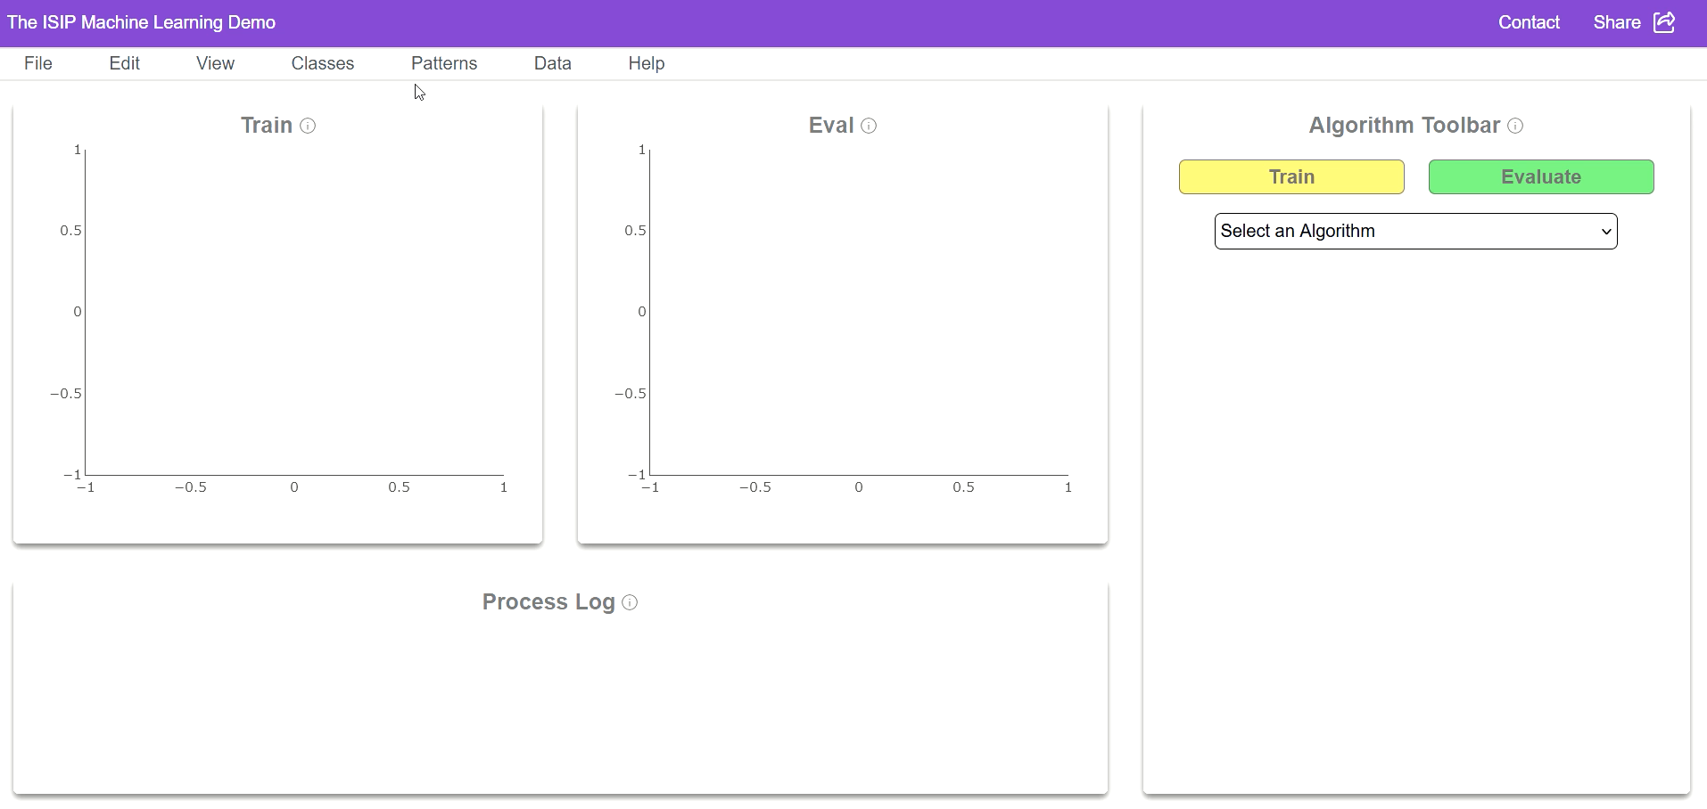
Final Prototype
Notes:
(Brian)
Explain the video well in what each part does, especially in process log and what the data is showing

Slide 14
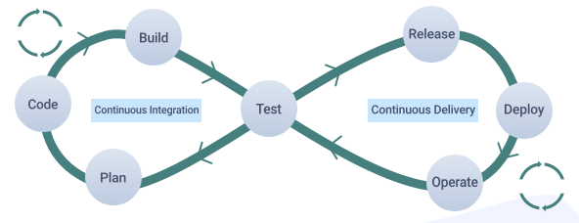


Testing Setup - Integration
Prepare Mock Data and API Endpoints
Automate Test Suites
Check Encryption and Data Integrity
Notes:
(Rizznel)
Integration Testing
Set up Mock Data and API Endpoints
Automated Test Suites
Continuous Integration (CI) Pipeline
Check Encryption and Data Integrity

Slide 15
Testing Setup - Intuitive Interface
Select 10 Random Users
Person #1
Data Loading
Algorithm Selection
Model Eval
Time Users and Generate Average
Person #2
Data Loading
Algorithm Selection
Model Eval
…
Data Loading
Algorithm Selection
Model Eval
Person #9
Data Loading
Algorithm Selection
Model Eval
Person #10
Data Loading
Algorithm Selection
Model Eval
Notes:
(Rizznel)
Performance Testing
Select 10 random classmates or acquaintances
Users are to perform 3 actions:
Data Loading
Algorithm Selection
Model Evaluation
Timing each user on each of these actions and generating an average time value

Slide 16
Testing Setup – Loading Performance
Calculate Average Run Time
Run 5 Times Per Size
Place time stamps
Select 3 Vector Sizes
10k
Run #1
Run #2
Run #3
Run #4
Run #5
Calculate Average Run Time
100k
Run #2
Run #3
Run #1
Run #2
Run #3
Run #4
Run #5
Run #1
Run #2
Run #3
50k
Run #2
Run #3
Run #4
Run #5
Calculate Average Run Time
Notes:
(Rizznel)

Slide 17
Testing Setup – Algorithm Performance
Place time stamps in both train and eval
Run 5 Times Per Algorithm
Calculate Average for Each Algorithm
PCA
Run #1
Run #2
Run #3
Run #4
Run #5
Select Algorithm & Run Train/Eval
KNN
Run #1
Run #2
Run #3
Run #4
Run #5
…
Run #1
Run #2
Run #3
Run #4
Run #5
Load 50k vector
SVM
Run #1
Run #2
Run #3
Run #4
Run #5
MLP
Run #1
Run #2
Run #3
Run #4
Run #5
Notes:
(Rizznel)

Slide 18

Testing Results – Requirements
Requirement
Metric
Target
Value,
Justification
Range,
or
pass/fail
Intuitive Data Loading Feature
Time to Complete Task
< 25 seconds
Ensures smooth user experience & fewer errors
Intuitive Algorithm Selection Feature
Time to Complete Task
< 35 seconds
Ensures smooth user experience & fewer errors
Intuitive Model Evaluation Feature
Time to Complete Task
< 7 seconds
Ensures smooth user experience & fewer errors
Load Time Average
25.576 seconds
Train Time Average
35.417 seconds
Eval Time Average
6.997 seconds
New Load Time Average
21.908 seconds
New Train Time Average
5.898 seconds
New Eval Time Average
1.968 seconds
Notes:
(Shane): With the project involving a rebuild of IMLD, we wanted to use this opportunity to

Slide 19

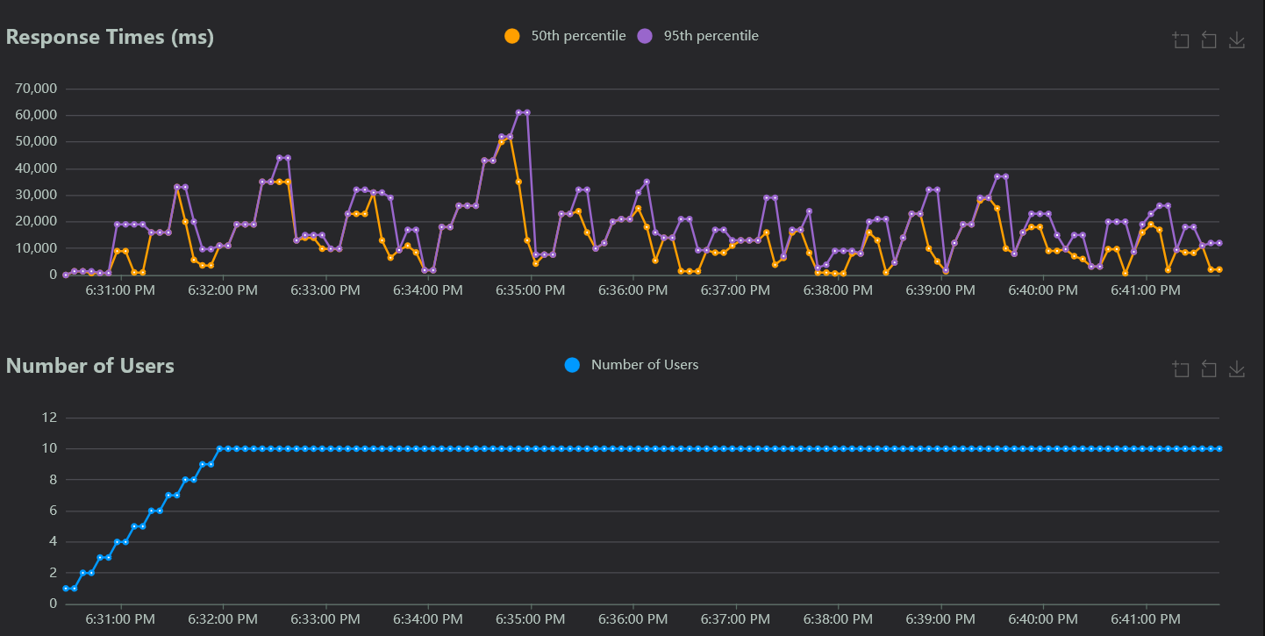
Testing Results – Requirements
Requirement
Metric
Target
Value,
Justification
Range,
or
pass/fail
Maintain performance
With 100+ users
Scalable application ensures global accessibility
without compromising performance under load
Scalability
Users
Notes:
(Shane)

Slide 20

Testing Results – Requirements
Requirement
Metric
Target
Value,
Justification
Range,
or
pass/fail
Load Performance
Seconds
Within 2x baseline
Load datasets within 2x of baseline time to account
for network delays and maintain performance
Algorithm Performance
Seconds
Within 2x baseline
Computation within 2x of baseline time to account
for network delays and maintain performance
 | Load Average
Vector Size 10k | 0.012 seconds
Vector Size 50k | 0.026 seconds
Vector Size 100k | 0.052 seconds
 | Train Average
PCA | 1.166 seconds
Naïve Bayes | 0.330 seconds
RNF | 1.768 seconds
 | Eval Average
PCA | 0.858 seconds
Naïve Bayes | 0.208 seconds
RNF | 0.208 seconds
 | New Load Average
Vector Size 10k | 0.247 seconds
Vector Size 50k | 0.266 seconds
Vector Size 100k | 0.314 seconds
 | New Train Average
PCA | 9.845 seconds
Naïve Bayes | 1.408 seconds
RNF | 5.827 seconds
 | New Eval Average
PCA | 2.254 seconds
Naïve Bayes | 0.880 seconds
RNF | 1.071 seconds
Notes:
(Brian)

Slide 21
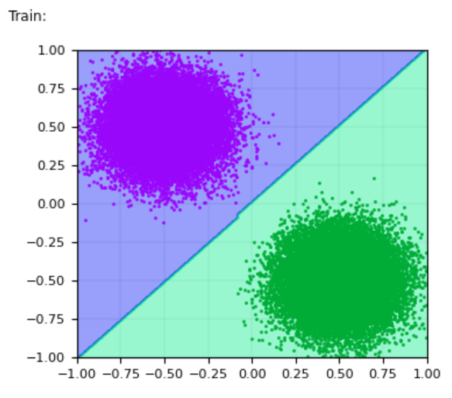
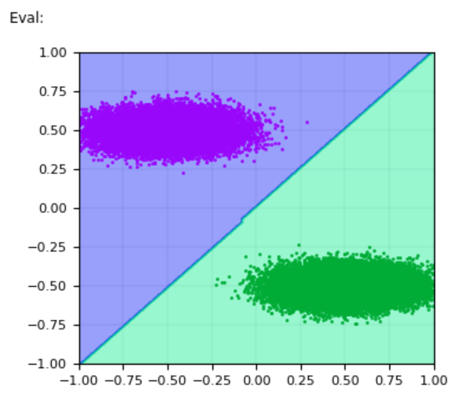
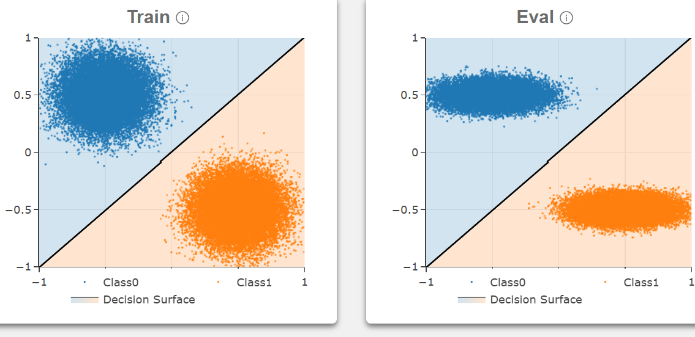
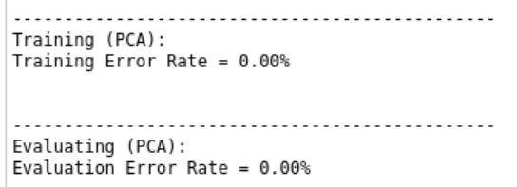
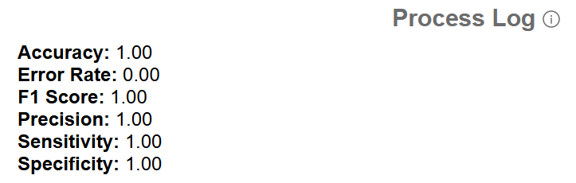
Testing Results – Requirements
Requirement
Metric
Target
Value,
Justification
Range,
or
pass/fail
Algorithm Output Validation
Comparison
Pass/Fail
Consistent algorithm outputs between web and
legacy version ensures reliability & accuracy
Graph Output Validation
Comparison
Pass/Fail
Consistent graph outputs between web and legacy
version ensures reliability & accuracy
Notes:
(Brian)

Slide 22



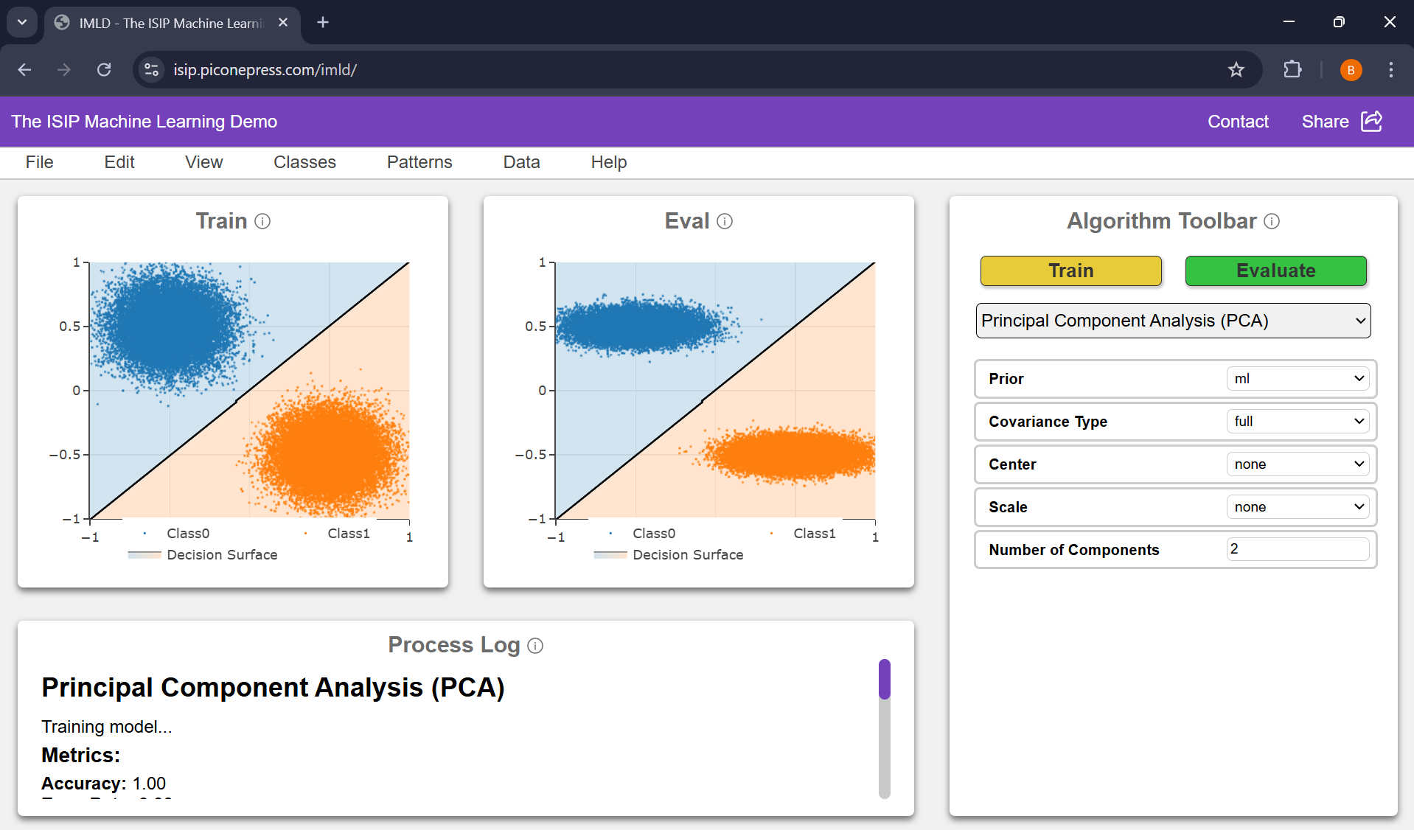
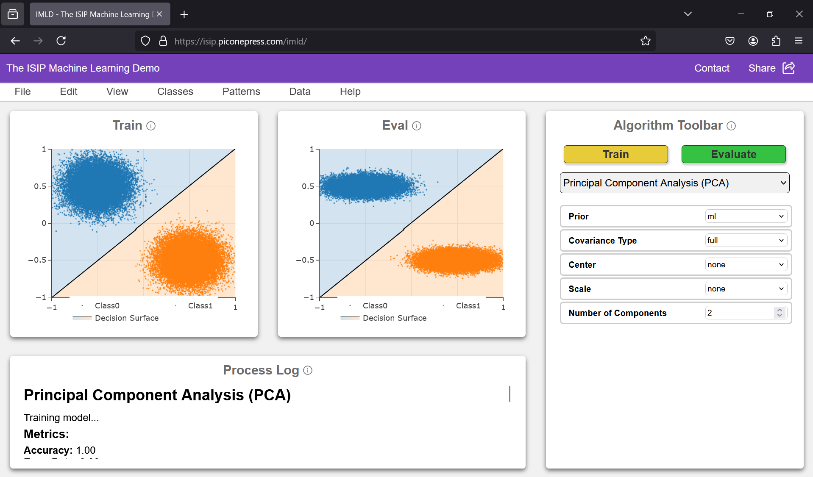
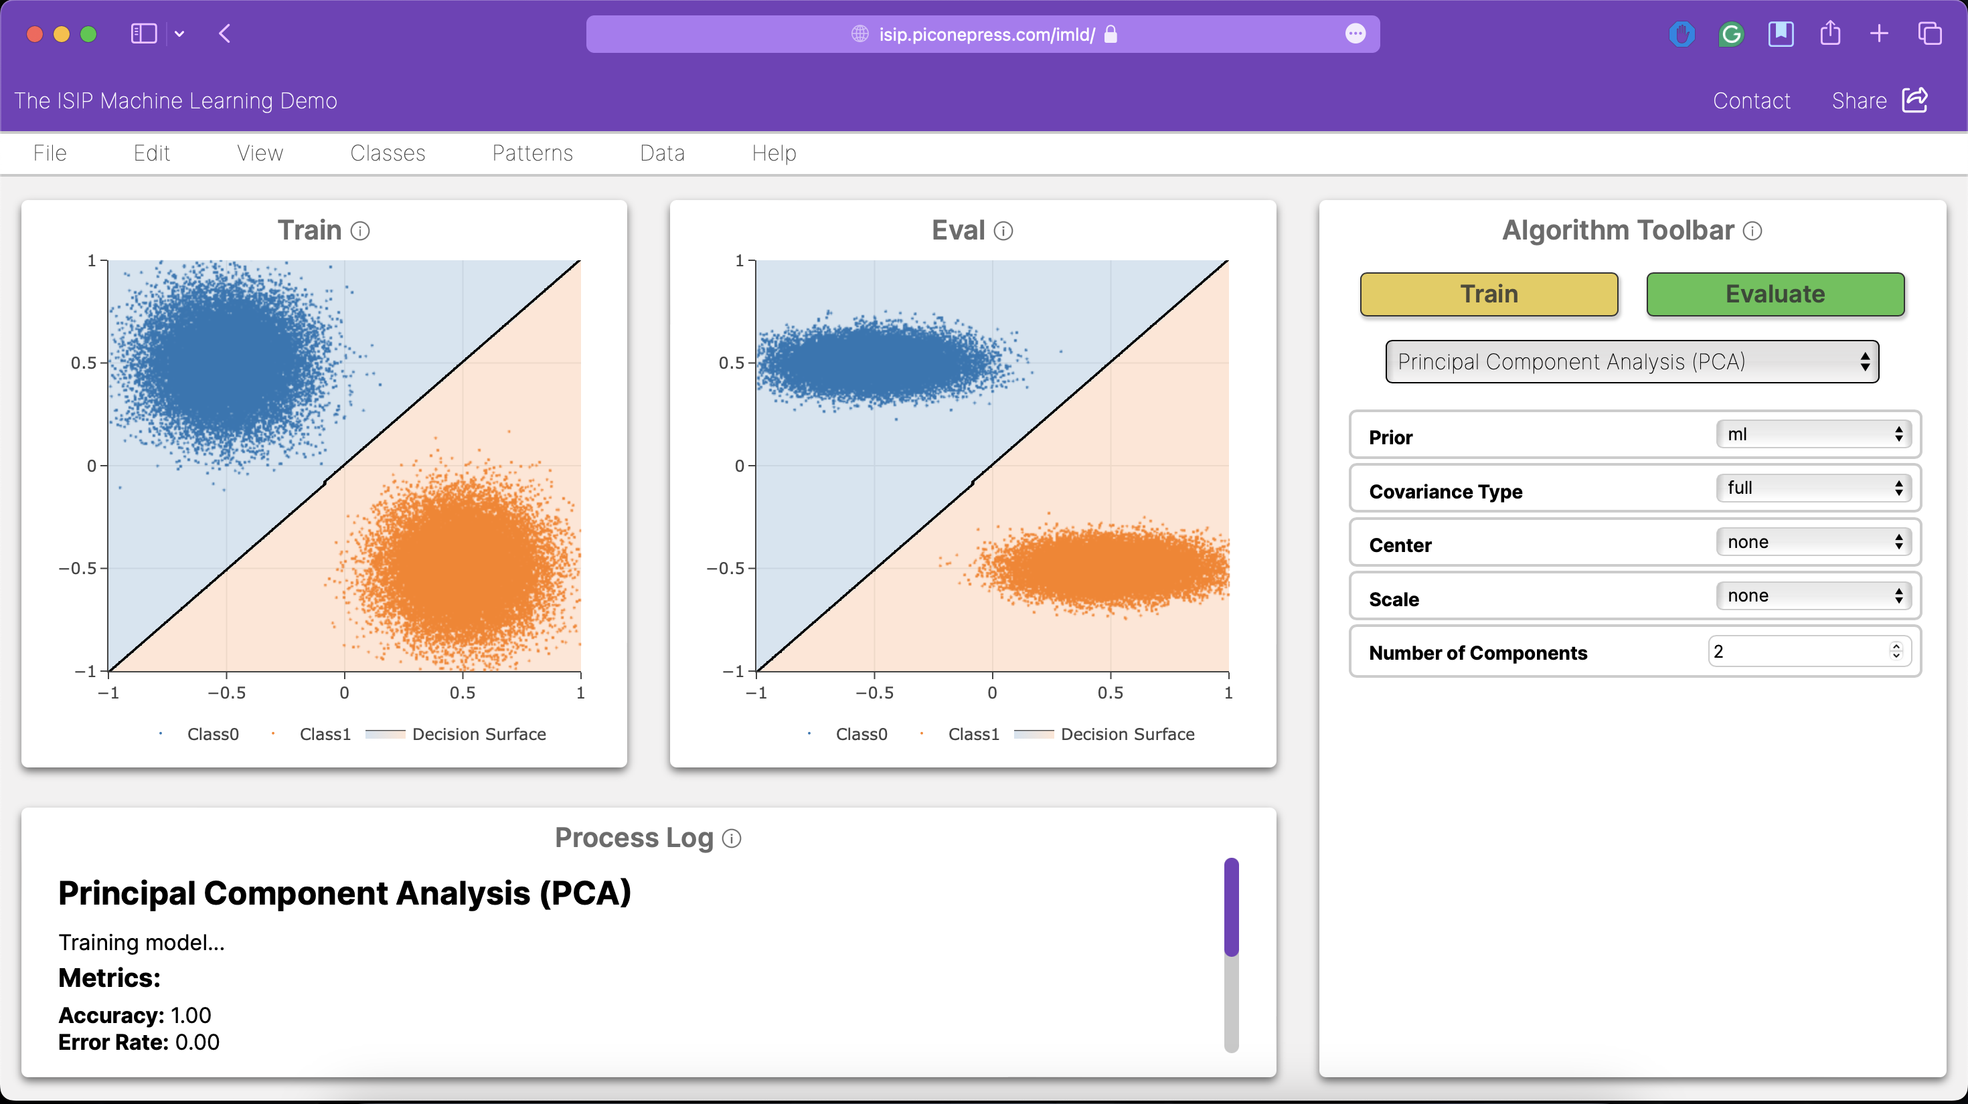
Testing Results – Constraints
Constraint
Metric
Target
Value,
Justification
Range,
or
pass/fail
Compatible on Modern
Web Browsers
Testing
Successful usage on Chrome,
Various compatibility provides seamless experience
Firefox, Safari
for broad range of users across popular browsers
Consistent Visual Design
Approval
Pass/Fail
Consistent visual design enhances usability and
creates a cohesive, professional user experience
Notes:
(Kayla)

Slide 23
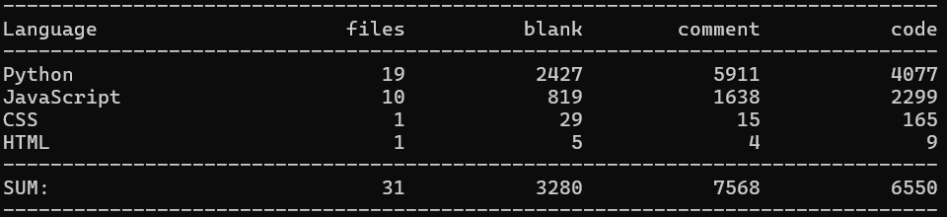

Testing Results – Constraints
Constraint
Metric
Target
Value,
Justification
Range,
or
pass/fail
Sufficient Documentation
Approval
50-60% comment-to-code ratio
High ratio improves code readability &
maintainability for future developers
Adherence to ISIP
Standards
Approval
100% adherence to
chosen guide
Adherence ensures high code quality, consistency,
and reduces technical debt with development team
Hosted Entirely on
Neuronix
Status
Pass/Fail
Provides data security and control, reducing
reliance on external cloud services
> 60% Comment-to-code ratio on most scripts
Followed commenting styling, variable naming conventions, object-oriented programming techniques
54% comment-to-code ratio
Notes:
(Kayla)

Slide 24


Testing Results – Constraints
Constraint
Metric
Target
Value,
Justification
Range,
or
pass/fail
Input Validation
Testing
100% of user inputs undergo
Ensures data is formatted properly, preventing
validation before processing
errors and more accurate performance
Cybersecurity
Testing
100% of user inputs undergo
Verifies safety of user inputs, preventing malicious
sanitization before processing
data from being processed and protecting the site
Notes:
(Brian)

Slide 25



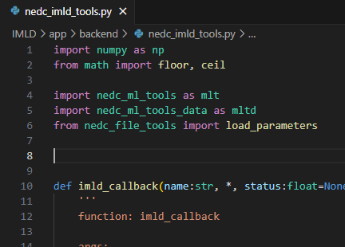
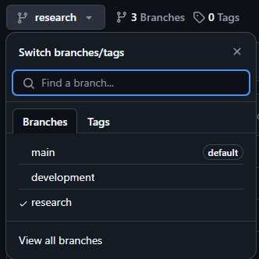

Standards
Production
Development
Research
(src)
Python Code Style Guide PEP 8 (src)
Hypertext Transfer Protocol Secure (HTTPS) (src)
Notes:
(Brian)
Research - Loosely structured, allows testing innovative ideas without impacting overall application, evaluate potential solutions to complex problems
Development - Well structured, continuous integration, comprehensive documentation, allows for automated testing and bug fixing
Production - Hosts live, user-facing version of application, thoroughly tested and reviewed code, only contains production-ready features
Coding Style follows PEP 8, style guide for Python code widely accepted by the Python community. (src)

Slide 26



Challenges & Improvements
Immediate Visual Feedback
ADA Accommodation
Responsive Design
Notes:
(Shane)

Slide 27
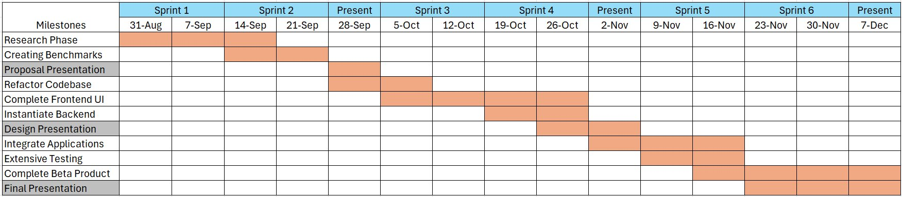
GANTT Chart / Milestones
Notes:
(Shane) Clarify the different labels on the chart to ensure users know what they mean

Slide 28

Questions?
https://isip.piconepress.com/imld/
Notes:
(Shane)

