Slide 1
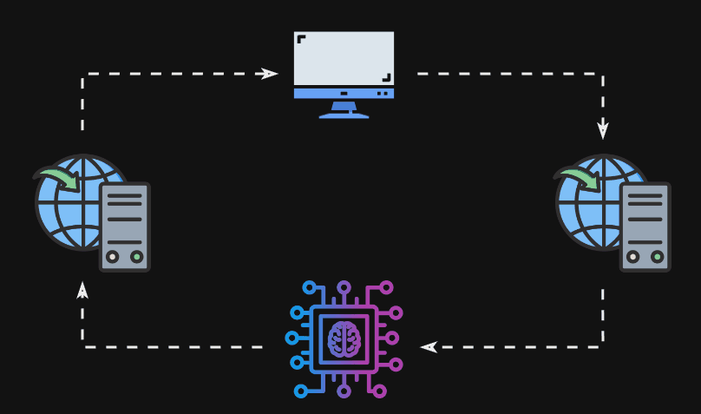
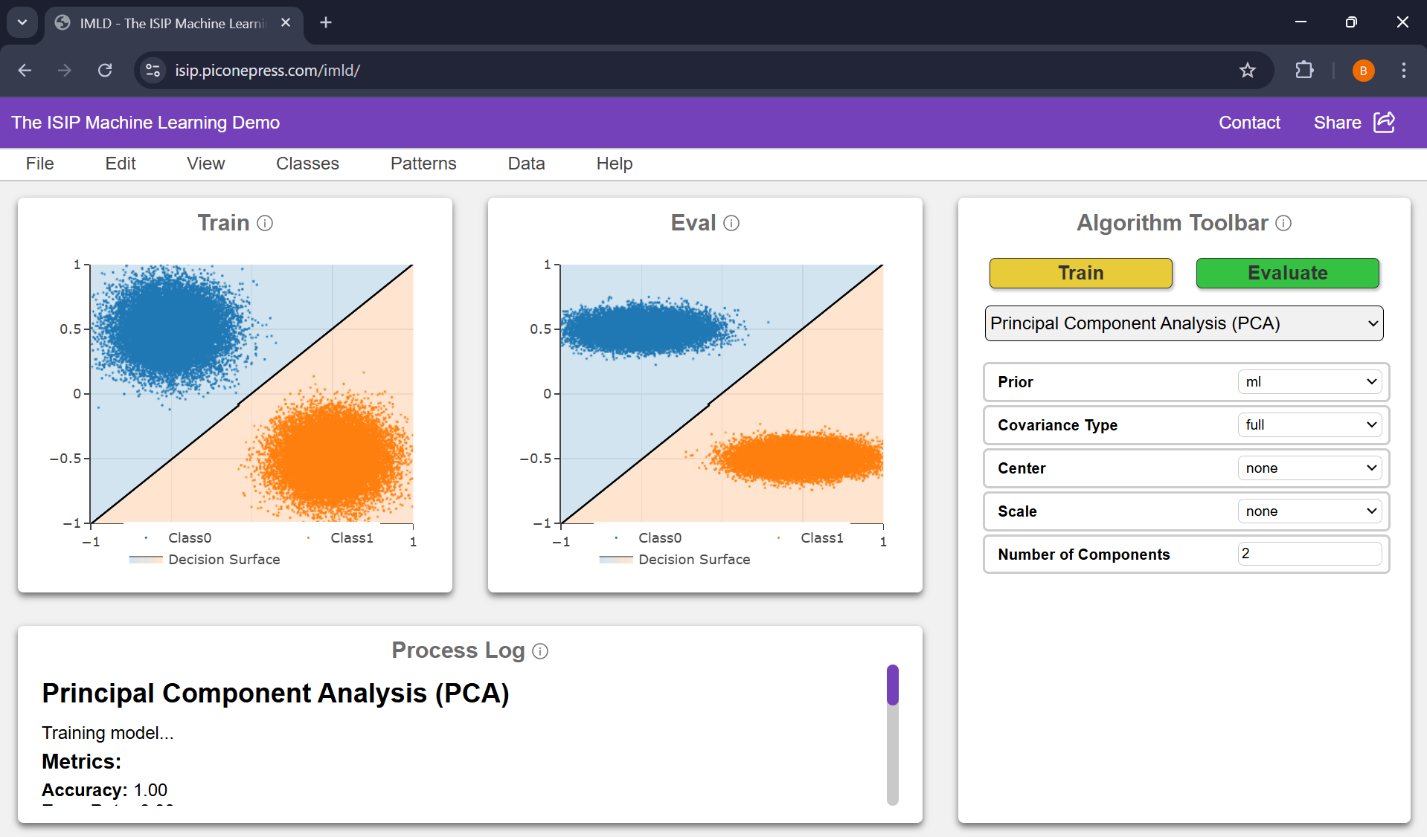
ISIP Machine Learning Demonstration
Shane McNicholas, Brian Thai, Kayla Toner, Raynel Lopez-morel
In Collaboration with The institute for signal and information processing
Notes:
(Brian) Introduce the team and the title. Talk about the images.
** Give higher level discussion of graphic on the right **

Slide 2
Design Requirements
Requirement
Metric
Target
Value,
Justification
Range,
or
pass/fail
Intuitive Data Loading Feature
Time to Complete Task
< 25 seconds
Ensures smooth user experience & fewer errors
Intuitive Algorithm Selection Feature
Time to Complete Task
< 35 seconds
Ensures smooth user experience & fewer errors
Intuitive Model Evaluation Feature
Time to Complete Task
< 7 seconds
Ensures smooth user experience & fewer errors
Load Time Average
21.908 seconds
Train Time Average
5.898 seconds
Eval Time Average
1.968 seconds
Notes:
(Shane): With the project involving a rebuild of IMLD, we wanted to use this opportunity to

Slide 3
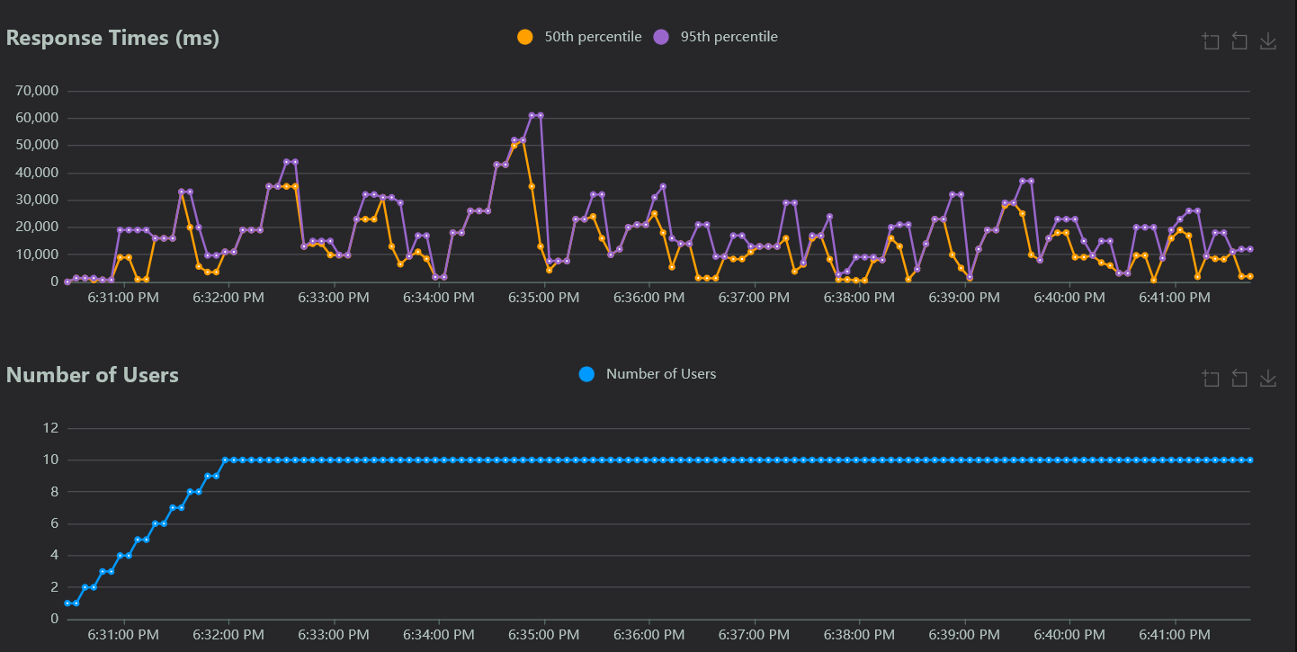
Design Requirements
Requirement
Metric
Target
Value,
Justification
Range,
or
pass/fail
Maintain performance
With 100+ users
Scalable application ensures global accessibility
without compromising performance under load
Scalability
Users
Notes:
(Shane)

Slide 4
Design Requirements
Requirement
Metric
Target
Value,
Justification
Range,
or
pass/fail
Load Performance
Seconds
Within 2x baseline
Load datasets within 2x of baseline time to account
for network delays and maintain performance
Algorithm Performance
Seconds
Within 2x baseline
Computation within 2x of baseline time to account
for network delays and maintain performance
 | Load Average
Vector Size 10k | 0.012 seconds
Vector Size 50k | 0.026 seconds
Vector Size 100k | 0.052 seconds
 | Train Average
PCA | 1.166 seconds
Naïve Bayes | 0.330 seconds
RNF | 1.768 seconds
 | Eval Average
PCA | 0.858 seconds
Naïve Bayes | 0.208 seconds
RNF | 0.208 seconds
 | New Load Average
Vector Size 10k | 0.247 seconds
Vector Size 50k | 0.266 seconds
Vector Size 100k | 0.314 seconds
 | New Train Average
PCA | 9.845 seconds
Naïve Bayes | 1.408 seconds
RNF | 5.827 seconds
 | New Eval Average
PCA | 2.254 seconds
Naïve Bayes | 0.880 seconds
RNF | 1.071 seconds
Notes:
(Brian)

Slide 5
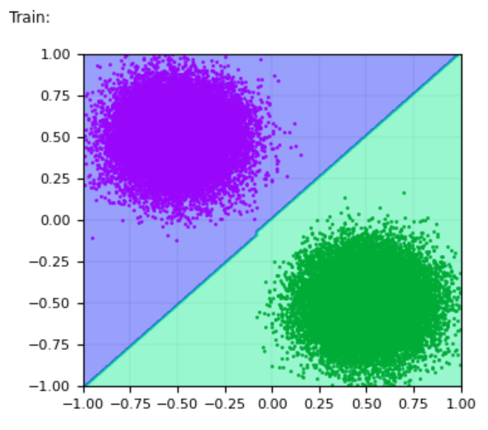
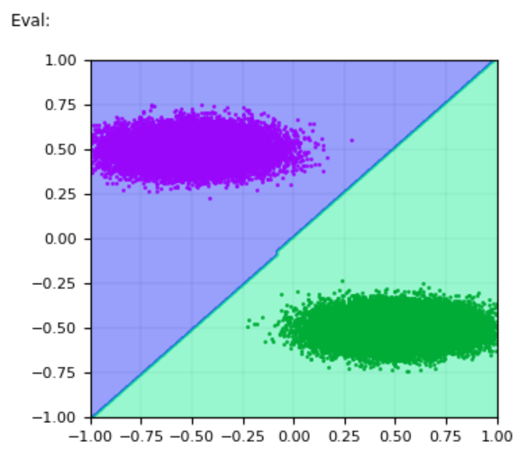
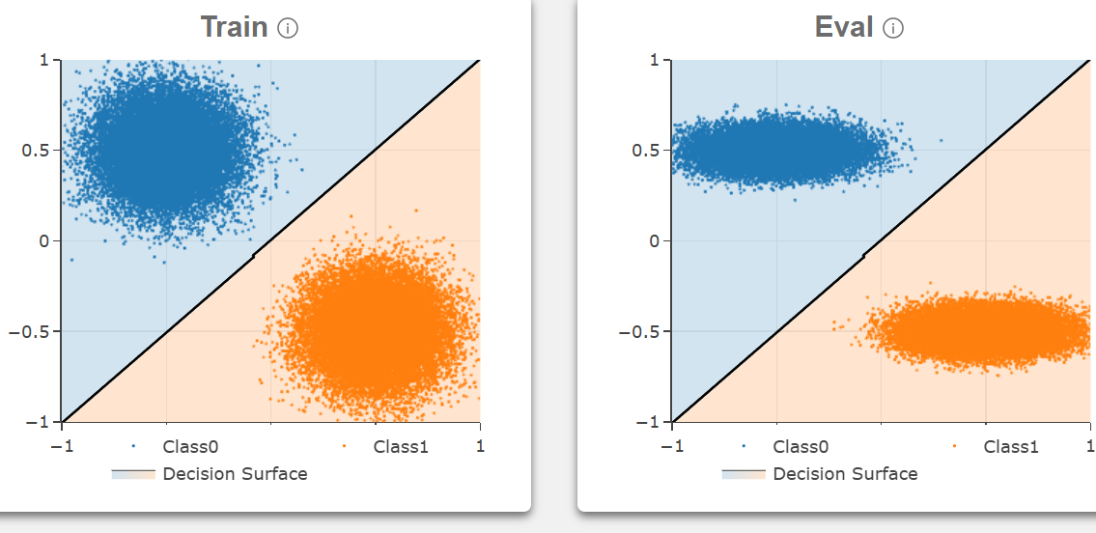
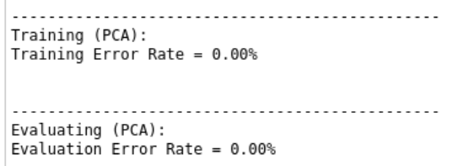
Design Requirements
Requirement
Metric
Target
Value,
Justification
Range,
or
pass/fail
Algorithm Output Validation
Comparison
Pass/Fail
Consistent algorithm outputs between web and
legacy version ensures reliability & accuracy
Graph Output Validation
Comparison
Pass/Fail
Consistent graph outputs between web and legacy
version ensures reliability & accuracy
Notes:
(Brian)

Slide 6
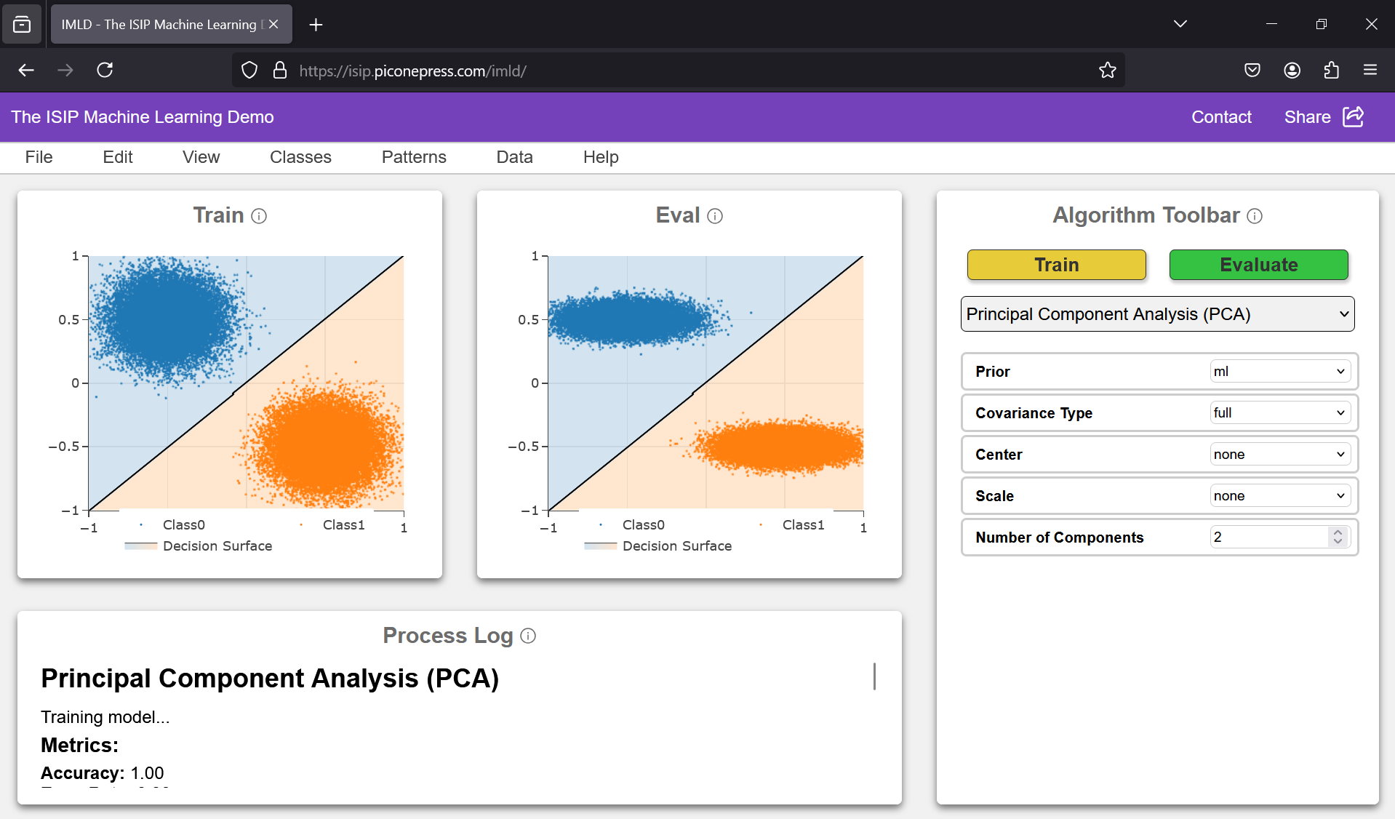
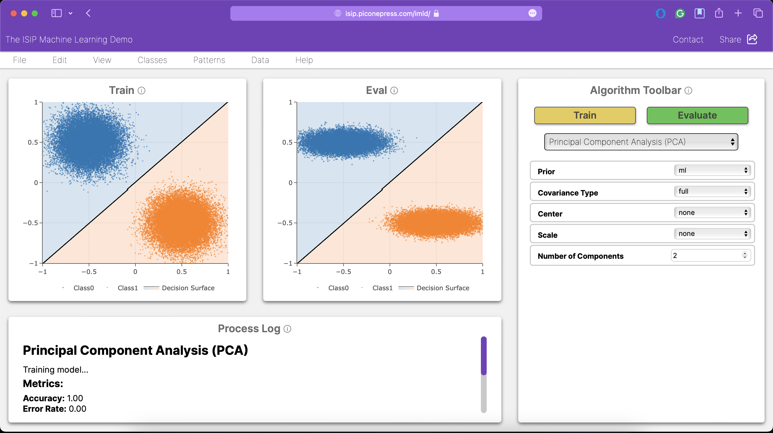
Design Constraints
Constraint
Metric
Target
Value,
Justification
Range,
or
pass/fail
Compatible on Modern
Web Browsers
Testing
Successful usage on Chrome,
Various compatibility provides seamless experience
Firefox, Safari
for broad range of users across popular browsers
Consistent Visual Design
Approval
Pass/Fail
Consistent visual design enhances usability and
creates a cohesive, professional user experience
Notes:
(Kayla)

Slide 7
Design Constraints
Constraint
Metric
Target
Value,
Justification
Range,
or
pass/fail
Sufficient Documentation
Approval
50-60% comment-to-code ratio
High ratio improves code readability &
maintainability for future developers
Adherence to ISIP
Standards
Approval
100% adherence to
chosen guide
Adherence ensures high code quality, consistency,
and reduces technical debt with development team
Hosted Entirely on
Neuronix
Status
Pass/Fail
Provides data security and control, reducing
reliance on external cloud services
> 60% Comment-to-code ratio on most scripts
Followed commenting styling, variable naming conventions, object-oriented programming techniques
54% comment-to-code ratio
Notes:
(Kayla)

Slide 8
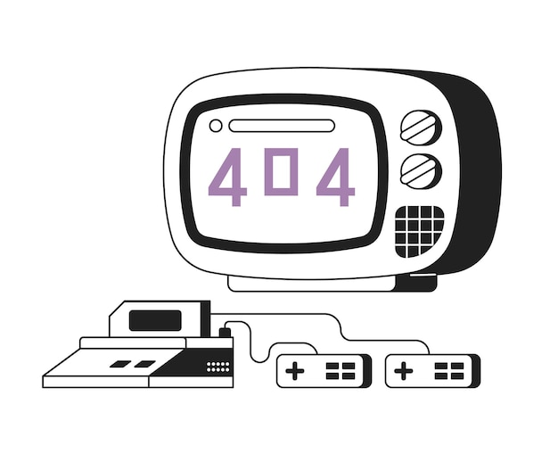
Design Constraints
Constraint
Metric
Target
Value,
Justification
Range,
or
pass/fail
Input Validation
Testing
100% of user inputs undergo
Ensures data is formatted properly, preventing
validation before processing
errors and more accurate performance
Cybersecurity
Testing
100% of user inputs undergo
Verifies safety of user inputs, preventing malicious
sanitization before processing
data from being processed and protecting the site
Notes:
(Brian)

Slide 9
Design Requirements
Requirement
Metric
Target
Value,
Justification
Range,
or
pass/fail
Intuitive Data Loading Feature
Time to Complete Task
< 25 seconds
Ensures smooth user experience & fewer errors
Intuitive Algorithm Selection Feature
Time to Complete Task
< 35 seconds
Ensures smooth user experience & fewer errors
Intuitive Model Evaluation Feature
Time to Complete Task
< 7 seconds
Ensures smooth user experience & fewer errors
Scalability
Users
Maintain performance
With 100+ users
Scalable application ensures global accessibility
without compromising performance under load
Load Performance
Seconds
Within 2x baseline
Load datasets within 2x of baseline time to account
for network delays and maintain performance
Algorithm Performance
Seconds
Within 2x baseline
Computation within 2x of baseline time to account
for network delays and maintain performance
Algorithm Output Validation
Comparison
Pass/Fail
Consistent algorithm outputs between web and
legacy version ensures reliability & accuracy
Graph Output Validation
Comparison
Pass/Fail
Consistent graph outputs between web and legacy
version ensures reliability & accuracy
Notes:
(Raynel)

Slide 10
Design Constraints
Constraint
Metric
Target
Value,
Justification
Range,
or
pass/fail
Compatible on Modern
Web Browsers
Testing
Successful usage on Chrome,
Various compatibility provides seamless experience
Firefox, Safari
for broad range of users across popular browsers
Consistent Visual Design
Approval
Pass/Fail
Consistent visual design enhances usability and
creates a cohesive, professional user experience
Sufficient Documentation
Approval
50-60% comment-to-code ratio
High ratio improves code readability &
maintainability for future developers
Adherence to ISIP
Standards
Approval
100% adherence to
chosen guide
Adherence ensures high code quality, consistency,
and reduces technical debt with development team
Input Validation
Testing
100% of user inputs undergo
Ensures data is formatted properly, preventing
validation before processing
errors and more accurate performance
Cybersecurity
Testing
100% of user inputs undergo
Verifies safety of user inputs, preventing malicious
sanitization before processing
data from being processed and protecting the site
Hosted Entirely on
Neuronix
Status
Pass/Fail
Provides data security and control, reducing
reliance on external cloud services
Notes:
(Raynel) Overall goal was achieved of getting a minimum-viable-product deployed by the end of the semester.

Slide 11
Technical Challenges
Immediate Visual Feedback
Data Pipelines
Responsive Design
Notes:
(Shane)
Data Pipelines: Consistent data formats between architecture layers. Efficiently transporting data between layers. Solved by making a consistent JSON format to transmit data between frontend components and between frontend-backend. Made a dictionary to move data between Flask APIs.
Immediate Visual Feedback: It is important to provide the user with visual updates especially when loading to ensure the user that the application is still working. We accomplished this by using the process log to update the user. Will continue to improve this by adding a progress bar. Responsive design: The hardest thing about making GUIs. Making sure the user interfaces are responsive to the users device, especially when resized. We have been making sure to keep this in mind throughout development. We have been using relative CSS units. Eventually, we will look to further improve this by making different layouts depending on the user’s screen size.

Slide 12
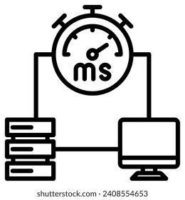
Prototype Reflections
Latency
Large Data
Notes:
(Shane):
Latency: Underestimated the amount of latency that goes into web applications. This caused unrealistic values for initial requirements. Also need to consider and standardize internet speed and website load when testing.
Large Data: Transferring large data sets over the network is computationally expensive and slow. Some requests reach up to 5Mb worth of data, which is quite large for common requests. We will look to improve this going forward using compression when sending requests through the network.

Slide 13
Questions?
Notes:
(Shane)

