Slide 1
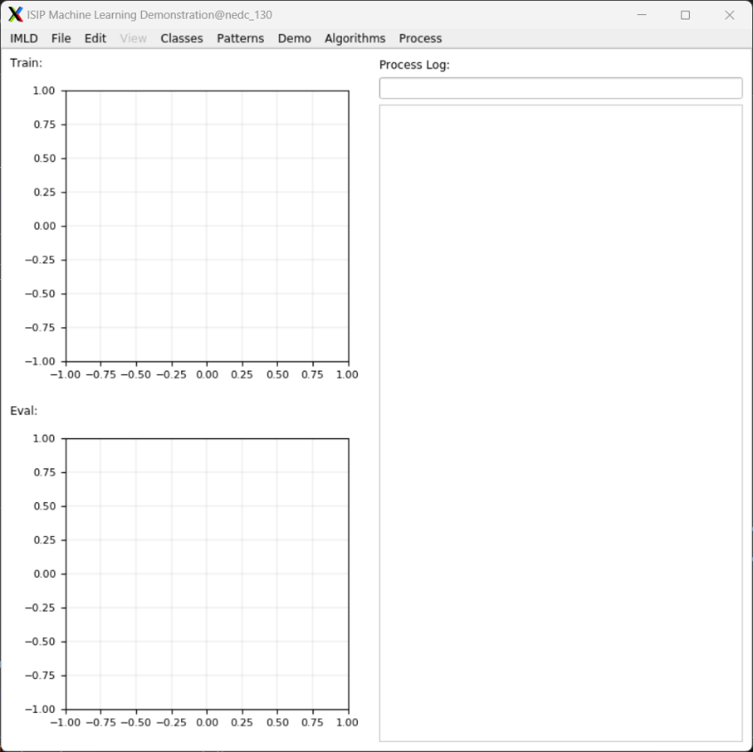

ISIP Machine Learning Demonstration
Shane McNicholas, Brian Thai, Kayla Toner, Raynel Lopez-morel
In Collaboration with The institute for signal and information processing
Notes:
(Shane) Introduce the team and the title. Talk about the images.

Slide 2
The Problem
“Artificial Intelligence, deep learning, machine learning — whatever you’re doing if you don’t understand it — learn it.”
- Mark Cuban [src]
Notes:
(Shane) Revisit the problem from the past presentation. Set the environment for why IMLD is important using these problems. Make sure to remind the audience that machine learning and AI is an essential for modern engineers.

Slide 3
The Problem
“Machine Learning is difficult to learn.”
“the failure rate of [college level] introductory statistics courses is around 50%.” [src]
“65% of the population are visual learners” [src]
Notes:
(Shane) Revisit the problem from the past presentation. Set the environment for why IMLD is important using these problems. Make sure to remind the audience that machine learning and AI is an essential for modern engineers.

Slide 4
Problem Statement
“Machine learning is hard to learn due to a lack of visual feedback and accessibility.”
Notes:
(Shane) Pose the problem we are trying to solve. Trying to “demystify” machine learning.

Slide 5
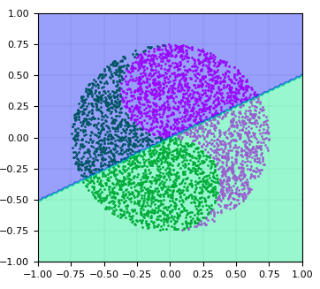


Proposed Solution
Interactive Machine Learning Algorithms
Intuitive User Interface
Educational Visualizations
Notes:
(Shane) Refresh the main components of IMLD. We are trying to create a solution that captures the 3 following elements.
Interactive Machine Learning Algorithms: A suite of pre-built machine learning algorithms that users can interact with and test.
Educational Visualizations: Simple visualizations that allows users to understand the advantages and disadvantages of each algorithm.
Intuitive User Interface: An intuitive user interface that allows users to quickly and effectively learn the principles of machine learning.

Slide 6
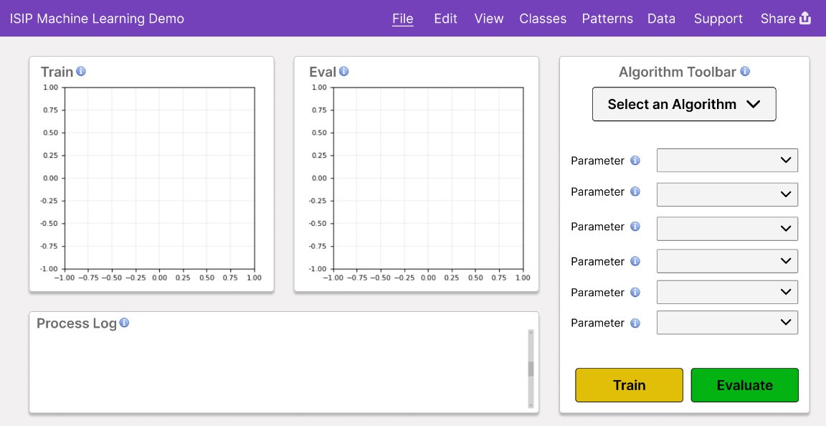
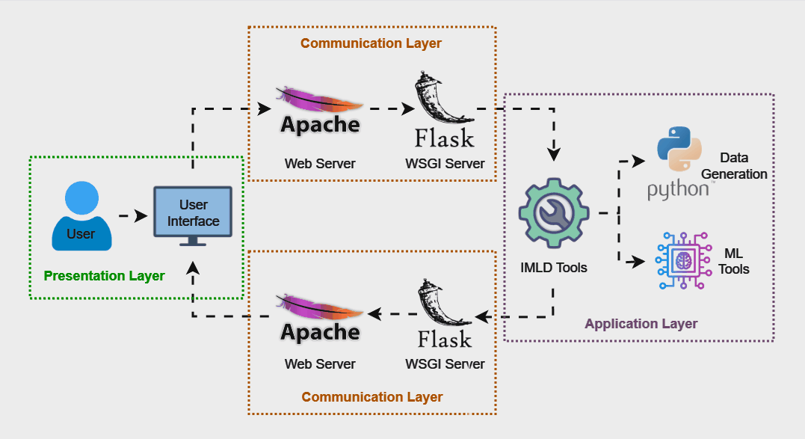
Proposed Solution
Notes:
(Shane): Talk about the next-generation of IMLD. Use the principles of the last generations of IMLD to design a modern web app, allowing people from all over the world to use the tool.

Slide 7
Design Requirements
Requirement
Metric
Target
Value,
Justification
Range,
or
pass/fail
Intuitive Data Loading Feature
Time to Complete Task
< 25 seconds
Ensures smooth user experience & fewer errors
Intuitive Algorithm Selection Feature
Time to Complete Task
< 35 seconds
Ensures smooth user experience & fewer errors
Intuitive Model Evaluation Feature
Time to Complete Task
< 7 seconds
Ensures smooth user experience & fewer errors
Scalability
Users
Maintain performance
With 100+ users
Scalable application ensures global accessibility
without compromising performance under load
Load Performance
Seconds
Within 2x baseline
Load datasets within 2x of baseline time to account
for network delays and maintain performance
Algorithm Performance
Seconds
Within 2x baseline
Computation within 2x of baseline time to account
for network delays and maintain performance
Algorithm Output Validation
Comparison
Pass/Fail
Consistent algorithm outputs between web and
legacy version ensures reliability & accuracy
Graph Output Validation
Comparison
Pass/Fail
Consistent graph outputs between web and legacy
version ensures reliability & accuracy
Notes:
(Ray)
For our target values, they were obtained from extensive testing user and simulation testing on the original IMLD, which will be explored more going forward
Intuative data loading , Algorithm selection, and model evaulation >>>>>> the goal is to provide a smoother and stable user experience with limited errors
Scalability >>>>>>> we want to have this application accessible globaly, without having to compromise performance under a higher load
Load and algorithm performance >>>>>> taking into consideration the nature of the websites design, we expect that loading and computing the data sheets have a 2x baseline to account for network delays
Algorithm and graph validation >>>>>> ideally each simulation being ran would need to consistant results between the web and legacy version, this ensures realiablilty and and accuracy of our product.
Three Things to Go Into Detail:
1. Why we selected each requirement
2. Where the target values came from
3. Make sure the justification is truly justifying rather than restating

Slide 8
Design Constraints
Constraint
Metric
Target
Value,
Justification
Range,
or
pass/fail
Compatible on Modern
Web Browsers
Testing
Successful usage on Chrome,
Various compatibility provides seamless experience
Firefox, Safari
for broad range of users across popular browsers
Consistent Visual Design
Approval
Pass/Fail
Consistent visual design enhances usability and
creates a cohesive, professional user experience
Sufficient Documentation
Approval
50-60% comment-to-code ratio
High ratio improves code readability &
maintainability for future developers
Adherence to ISIP
Standards
Approval
100% adherence to
chosen guide
Adherence ensures high code quality, consistency,
and reduces technical debt with development team
Input Validation
Testing
100% of user inputs undergo
Ensures data is formatted properly, preventing
validation before processing
errors and more accurate performance
Cybersecurity
Testing
100% of user inputs undergo
Verifies safety of user inputs, preventing malicious
sanitization before processing
data from being processed and protecting the site
Hosted Entirely on
Neuronix
Status
Pass/Fail
Provides data security and control, reducing
reliance on external cloud services
Notes:
(Ray)
Compatibility with modern web browsers >>>>> in order for this product to be considered a success, it needs to provide a seamless experience for a larger range of users acrorss platforms
This entails Consistant visual design >>>>>> to enhance usability and create professional user envirnment
This means having sufficient code documentation, following a 50-60 percent comment to code ratio industry standard
Our current chosen guide requires us to adhere to isip standards, providing high code quality while reducing technical dept
Input validation >>>>>> in order for users to run our algorithm, we have to take into consideration data formating, we need to be able to test the format of their data in order to ensure an accurate performance
For cyber security, we want to be able to provide a safe space for user inputs while mitigating for malicious data being processed.
To accomplish this we are hosting the network on the neuronix servers in order to reduce reliance on external cloud servers
Three Things to Go Into Detail:
1. Why we selected each constraint
2. Where the target values came from
3. Make sure the justification is truly justifying rather than restating (explain input validation in more detail too)

Slide 9
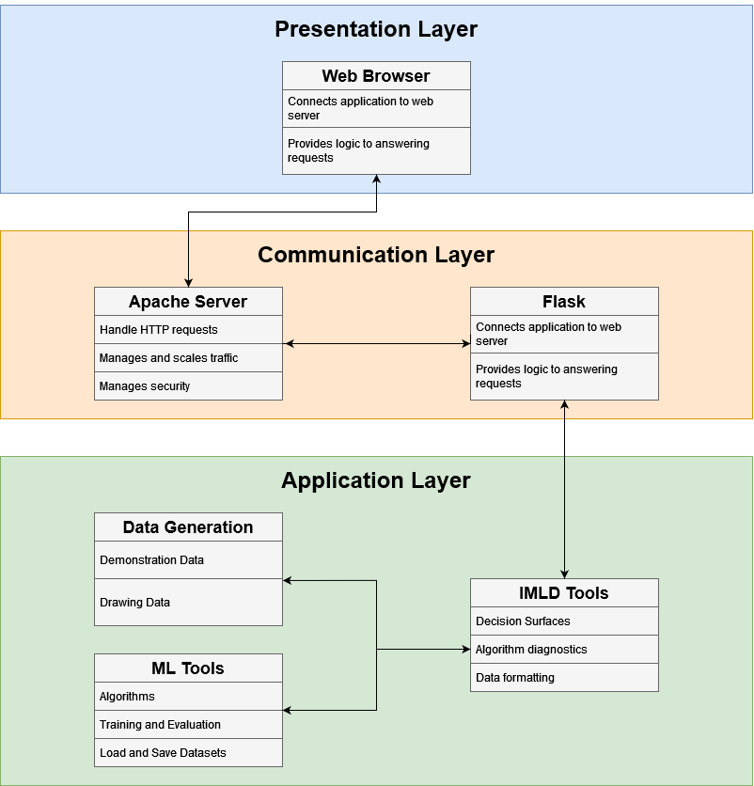
Architecture Overview
Notes:
(Kayla) Discuss the top-level architecture, describing the importance of each layer.

Slide 10
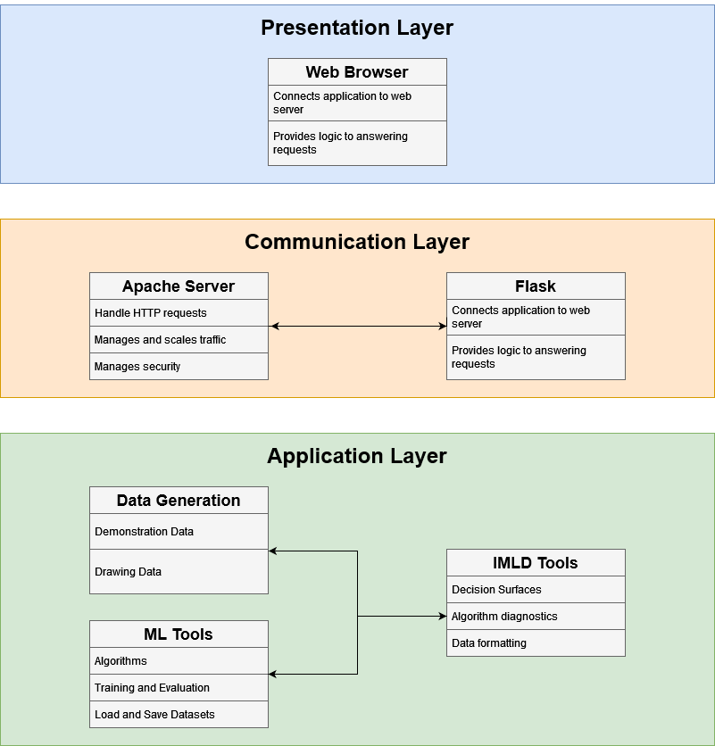
Architecture - Presentation Layer
Notes:
(Kayla)

Slide 11
Architecture - Communication Layer
Notes:
(Kayla)

Slide 12
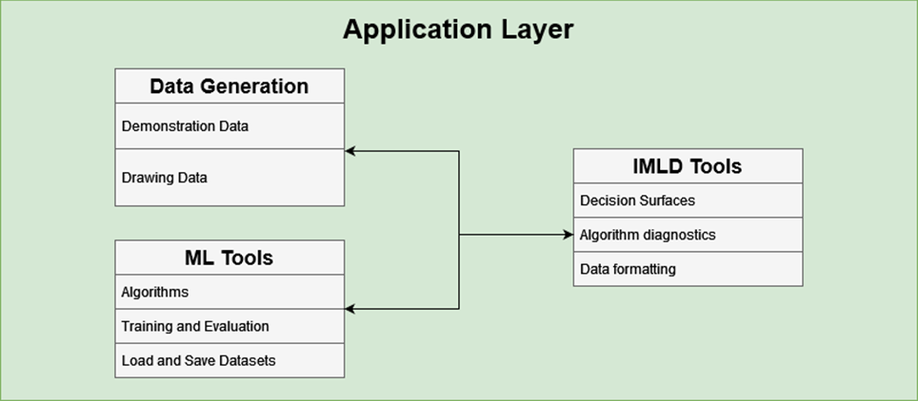
Architecture - Application Layer
Notes:
(Kayla)

Slide 13

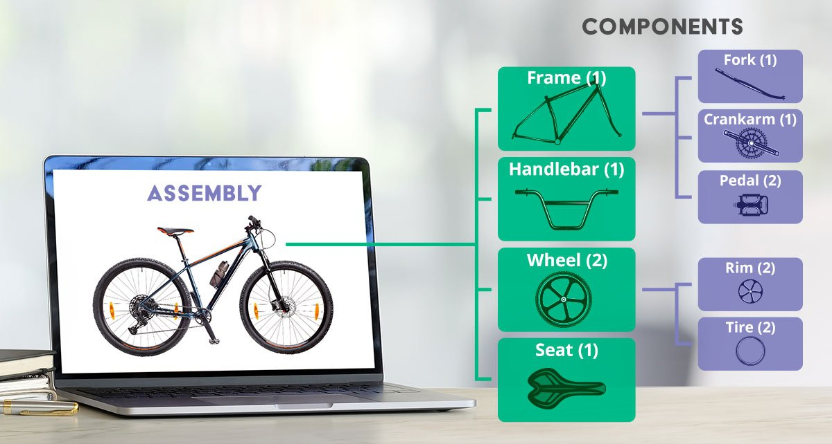
Designing Subsystems
Figma
Web Component Prototyping
Notes:
(Brian)

Slide 14
The Prototype
Notes:
(Brian)

Slide 15
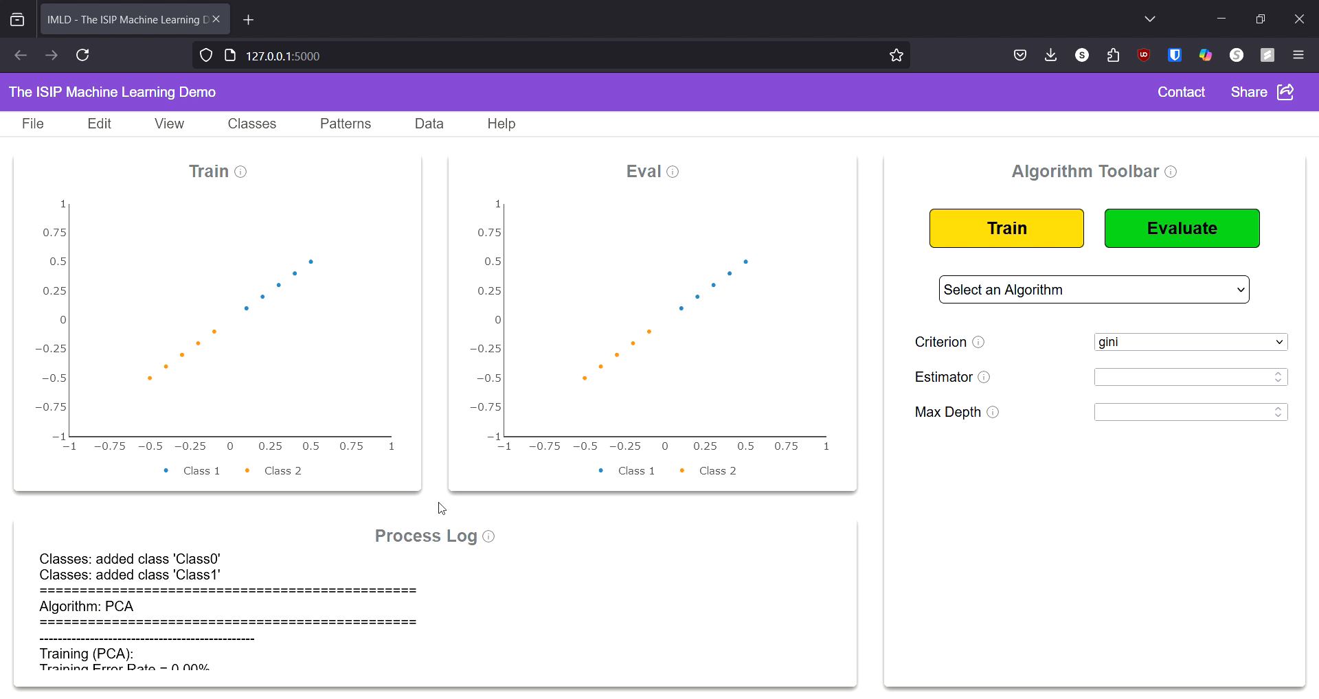
The Implementation
Notes:
(Brian)

Slide 16

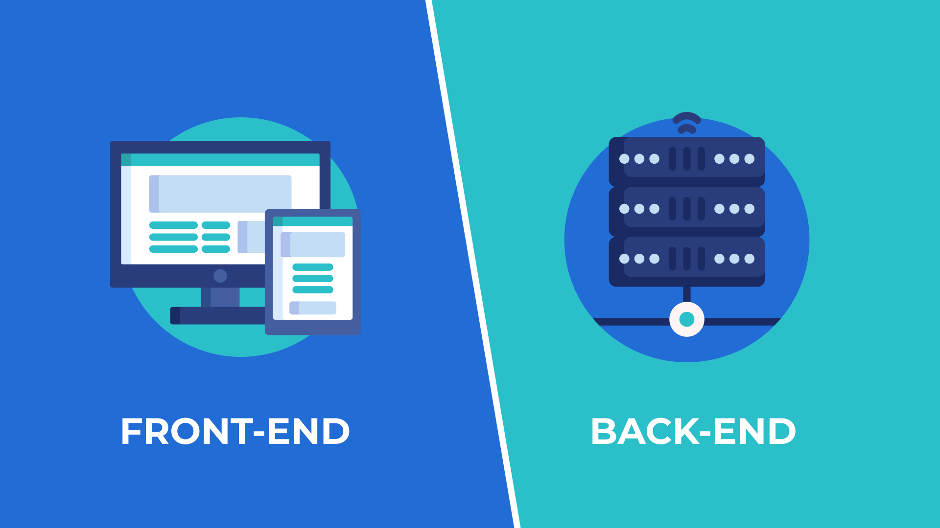




Integrating Subsystems
User Interface
Frontend-Backend Communication
Data Handling
Machine Learning
Real-Time Updates
Security and Authentication
Notes:
(Brian)

Slide 17
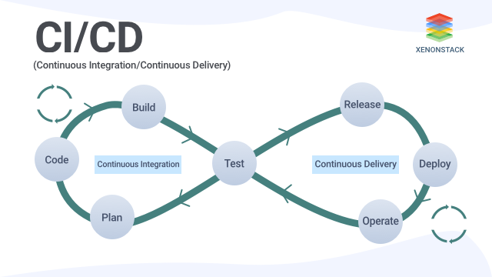


Testing Setup - Integration
Mock Data
Automated Tests
Notes:
(Brian)
Integration Testing
Set up Mock Data and API Endpoints
Automate Test Suites
Continuous Integration (CI) Pipeline
Check Encryption and Data Integrity
Performance Testing
Select 10 random classmates or acquaintances
Users are to perform 3 actions:
Data Loading
Algorithm Selection
Model Evaluation
Timing each user on each of these actions and generating an average time value

Slide 18


Testing Setup - Performance
Data Loading
Algorithm Selection
Model Evaluation
Select Random Users
Time Users
Notes:
(Brian)
Integration Testing
Set up Mock Data and API Endpoints
Automate Test Suites
Continuous Integration (CI) Pipeline
Check Encryption and Data Integrity
Performance Testing
Select 10 random classmates or acquaintances
Users are to perform 3 actions:
Data Loading
Algorithm Selection
Model Evaluation
Timing each user on each of these actions and generating an average time value

Slide 19
Testing – Performance Benchmarks
​ | Train (seconds)​ |  |  |  |  |  | Eval (seconds)​
 | Run Time #1​ | Run Time #2​ | Run Time #3​ | Run Time #4​ | Run Time #5​ | Average​ | Run Time #1​ | Run Time #2​ | Run Time #3​ | Run Time #4​ | Run Time #5​ | Average​
PCA​ | 1.200​ | 1.090​ | 1.190​ | 1.200​ | 1.150​ | 1.166​ | 0.900​ | 0.760​ | 0.890​ | 1.000​ | 0.740​ | 0.858​
Naive Bayes​ | 0.330​ | 0.370​ | 0.380​ | 0.290​ | 0.280​ | 0.330​ | 0.240​ | 0.120​ | 0.140​ | 0.130​ | 0.410​ | 0.208​
KNN​ | 2.780​ | 2.640​ | 2.590​ | 2.730​ | 2.800​ | 2.708​ | 1.460​ | 1.490​ | 1.540​ | 1.560​ | 1.510​ | 1.512​
RNF​ | 1.830​ | 1.750​ | 1.770​ | 1.750​ | 1.740​ | 1.768​ | 0.190​ | 0.280​ | 0.190​ | 0.190​ | 0.190​ | 0.208​
K-Means​ | 22.450​ | 23.330​ | 22.110​ | 21.680​ | 23.070​ | 22.528​ | 1.490​ | 1.410​ | 1.390​ | 1.470​ | 1.410​ | 1.434​
SVM​ | 0.500​ | 0.560​ | 0.450​ | 0.420​ | 0.410​ | 0.468​ | 0.290​ | 0.340​ | 0.350​ | 0.350​ | 0.170​ | 0.300​
MLP​ | 0.700​ | 0.810​ | 0.670​ | 0.760​ | 0.750​ | 0.738​ | 0.320​ | 0.210​ | 0.210​ | 0.260​ | 0.210​ | 0.242​
Totals​
Person​ | Load Time​ | Train Time​ | Eval Time​
Person #1​ | 19.990​ | 47.250​ | 14.940​
Person #2​ | 35.990​ | 41.670​ | 8.730​
Person #3​ | 28.730​ | 22.750​ | 6.840​
Person #4​ | 29.800​ | 23.800​ | 3.720​
Person #5​ | 40.630​ | 75.790​ | 12.130​
Person #6​ | 29.070​ | 39.730​ | 12.980​
Person #7​ | 17.160​ | 26.780​ | 4.090​
Person #8​ | 21.020​ | 11.300​ | 1.690​
Person #9​ | 19.460​ | 25.120​ | 3.320​
Person #10​ | 13.910​ | 39.980​ | 1.530​
Average​ | 25.576​ | 35.417​ | 6.997​
​ | Load Time (seconds)​
 | Run Time #1​ | Run Time #2​ | Run Time #3​ | Run Time #4​ | Run Time #5​ | Average​
Vector Size 10k​ | 1.750​ | 1.730​ | 1.930​ | 1.870​ | 1.520​ | 1.760​
Vector Size 50k​ | 1.890​ | 2.020​ | 1.810​ | 1.840​ | 1.720​ | 1.856​
Vector Size 100k​ | 1.970​ | 2.080​ | 2.310​ | 2.420​ | 1.860​ | 2.128​
Notes:
(Brian)

Slide 20


Testing - Integration
</>
Component
nedc_ml_tools.py
</>
</>
Component
Component
nedc_imld_tools.py
</>
</>
Component
Component
Notes:
(Brian)

Slide 21
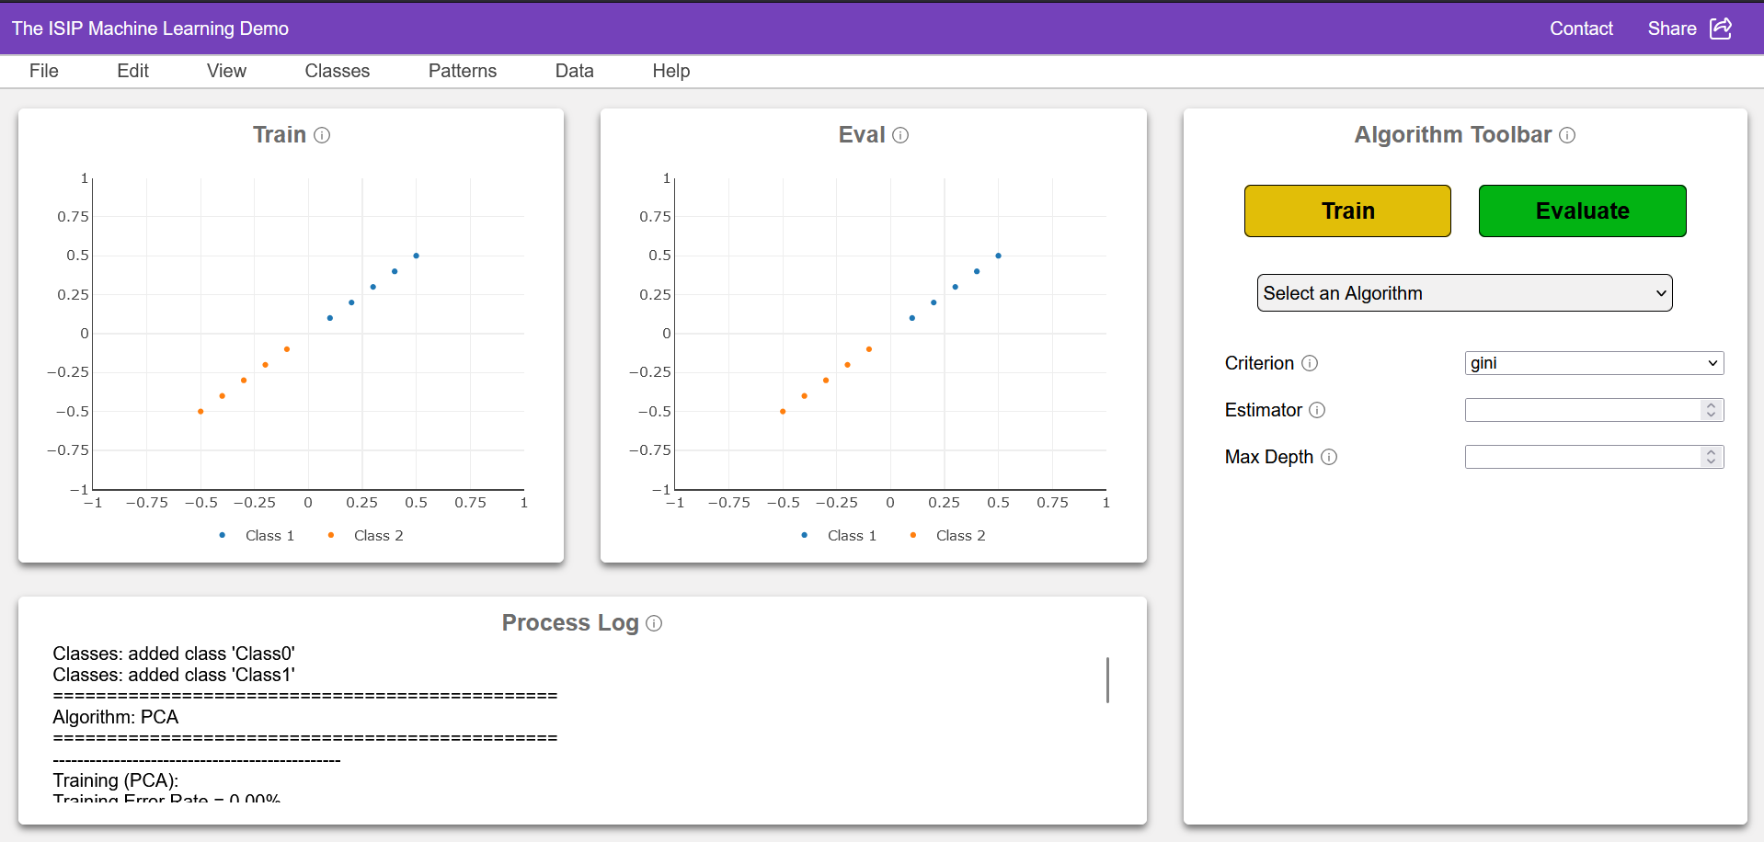
Results
Header/Toolbar Component
Algorithm Tool Component
Graph Component
Process Log Component
Notes:
(Ray)
figma prototypes for >>> and their corresponding sections are the current implementations in place

Slide 22


Standards
Production
Development
Research
Python Code Style Guide PEP 8 (src)
Comment to Code Ratio
of 50%-60%
Notes:
(Kayla)
Research - Loosely structured, allows testing innovative ideas without impacting overall application, evaluate potential solutions to complex problems
Development - Well structured, continuous integration, comprehensive documentation, allows for automated testing and bug fixing
Production - Hosts live, user-facing version of application, thoroughly tested and reviewed code, only contains production-ready features
Coding Style follows PEP 8, style guide for Python code widely accepted by the Python community. (src)
Comment to Code ratio stays within the range of 50%-60%.

Slide 23



Improvements
Subsystem Integration
Integration
Testing
Performance
Testing
Notes:
(Kayla) Designing & Prototyping to be done, Testing and Results to be done
we are finished with component prototyping (website), next step is integrating the subsystems (slide 16 items)
once we integrate the subsystems we will need to test how well they were integrated (slide 17)
Then we will have performance testing, previously performance testing was only done on the legacy version, so once the website is complete we will repeat this testing on the website. (slide 18)

Slide 24
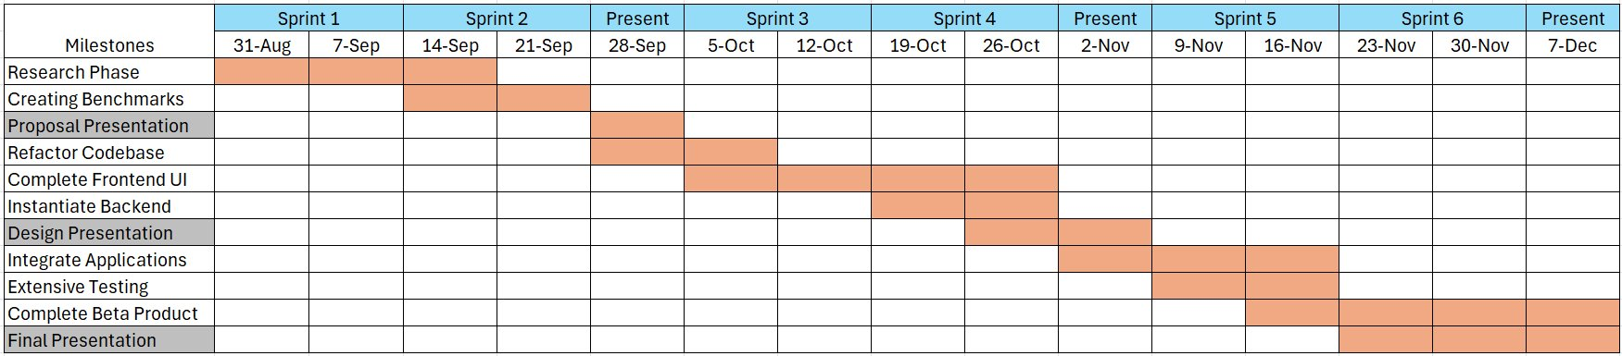
GANTT Chart / Milestones
Notes:
(Shane) Clarify the different labels on the chart to ensure users know what they mean

Slide 25

Questions?
Notes:
(Shane)

