Slide 1
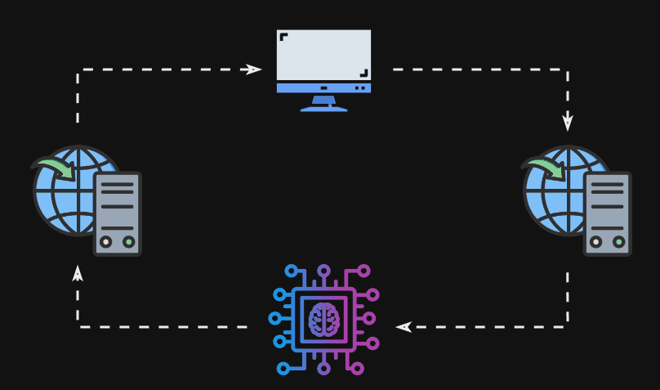
ISIP Machine Learning Demonstration
Shane McNicholas, Brian Thai, Kayla Toner, Raynel Lopez-morel
In Collaboration with The institute for signal and information processing
Notes:
(Shane) Introduce the team and the title

Slide 2
The Future is Machine Learning
“The development of full artificial intelligence could spell the end of the human race.”
- Stephen Hawking [src]
“Machine learning and deep learning will create a new set of hot jobs in the next 5 years.”
- Dave Waters [src]
“Artificial Intelligence, deep learning, machine learning — whatever you’re doing if you don’t understand it — learn it.”
- Mark Cuban [src]
Notes:
(Shane) Quickly discuss how the future is AI and how students need to learn it.

Slide 3
The Problem
“Machine Learning is difficult to learn.”
“the failure rate of [college level] introductory statistics courses is around 50%.” [src]
“65% of the population are visual learners” [src]
Notes:
(Shane) Ask how many people have used machine learning and how if people are comfortable using it. Start showing the problem of machine learning is how to learn due to math and visualizations.

Slide 4
Problem Statement
“Machine learning is hard to learn due to a lack of visual feedback and accessibility.”
Notes:
(Shane) Pose the problem we are trying to solve. Trying to “demystify” machine learning.

Slide 5
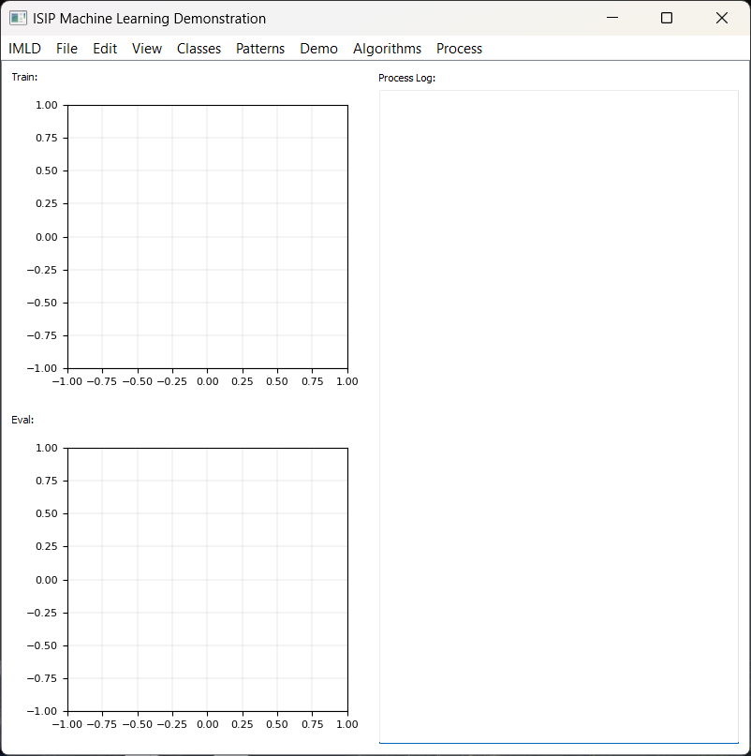
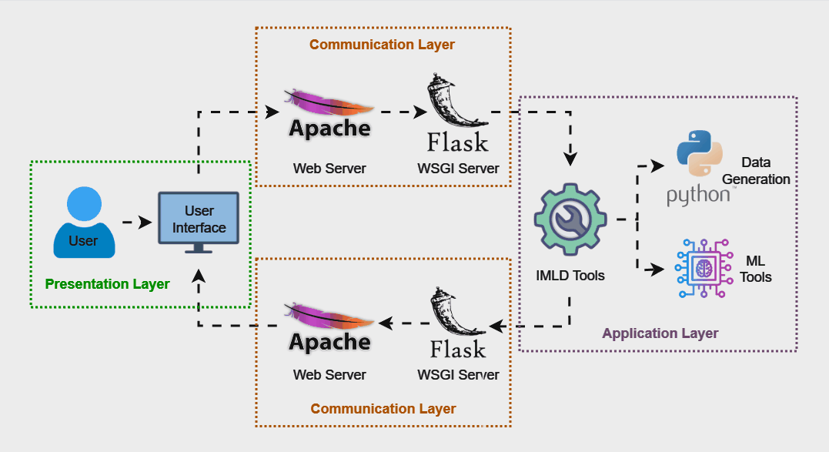
The Solution
Notes:
(Shane) Briefly describe the solution to the problem. Do not go too in detail.

Slide 6
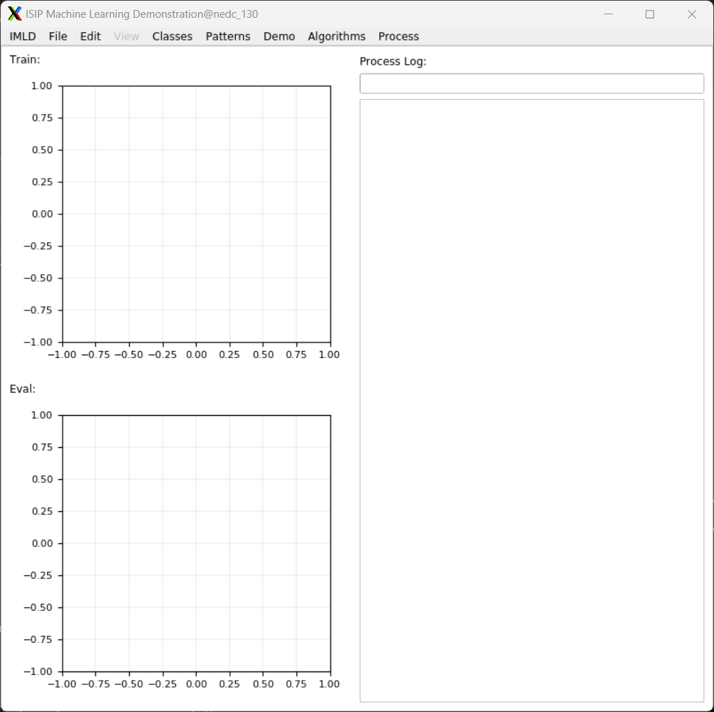
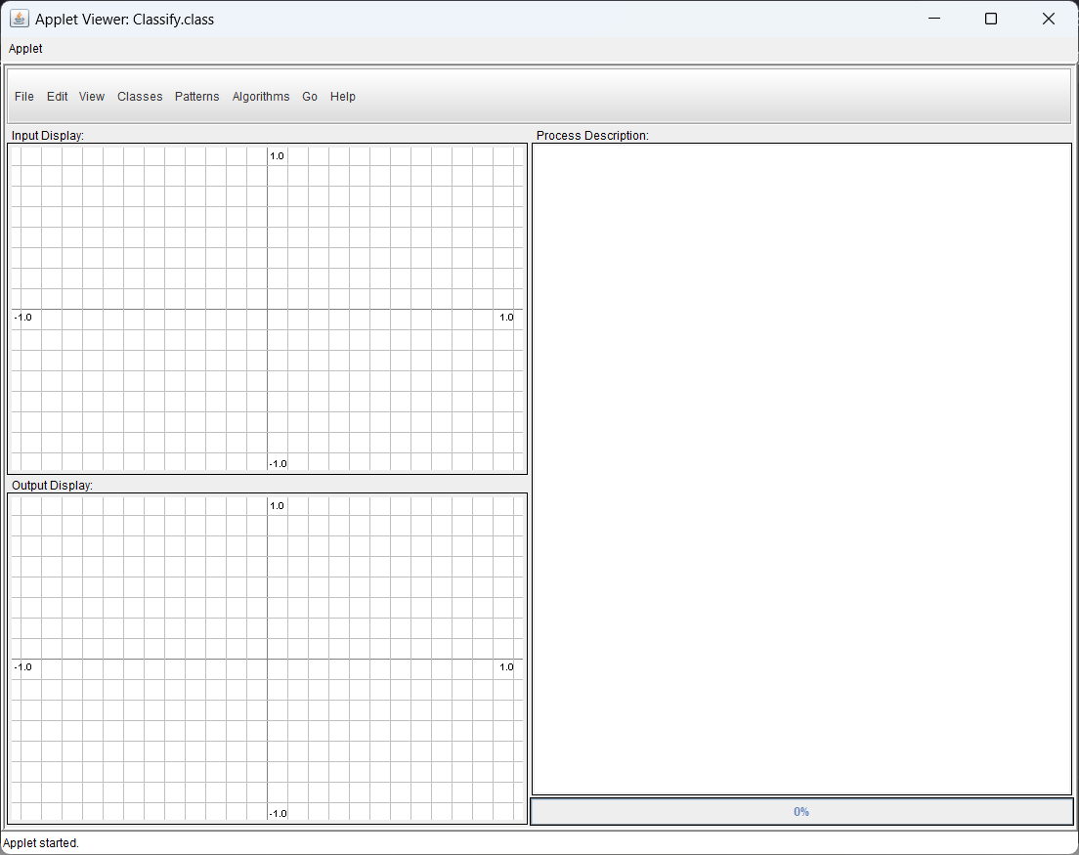
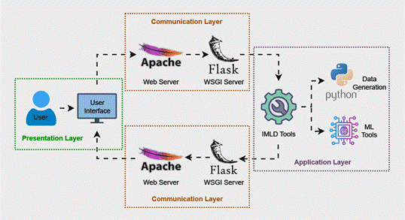
2000
2021
Now
Modern IMLD
Python App
Original IMLD
Java Applet
Future IMLD
Web App
Notes:
(Shane) Go through the history of IMLD. Discuss how it started as a Java Applet. Java Applets began to deprecate by mid 2010s. IMLD was then revived in 2021 as a Python app. To keep up with the times and reach a bigger audience, we are looking to transform IMLD into its next iteration.

Slide 7
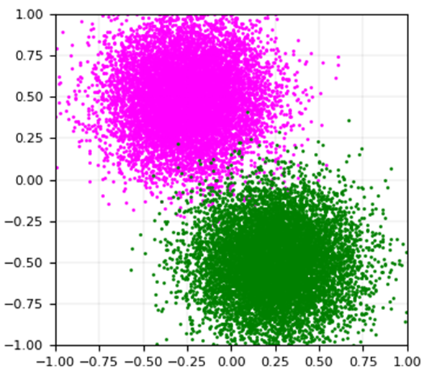
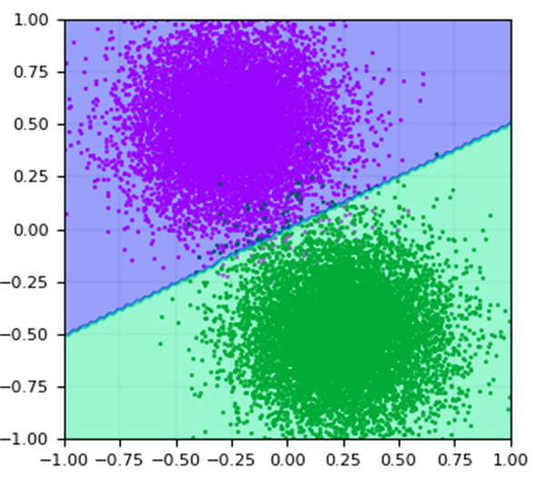

The Decision Surface
Training Data
Machine Learning Algorithm
A Trained Model
Notes:
(Brian)
As Shane mentioned, there is a demanding need for visualizations in machine learning, as it provides a good way to visualize what is happening.
So the heart of our application is the core logic, which is responsible for taking in training data, and then applying a machine learning algorithm, which then outputs a trained model. Essentially, this is a classification of the data sets to determine where they belong. Imagine a dataset of a bunch of points of cats and dogs, and the algorithm is trying to classify those points into the proper groups.

Slide 8
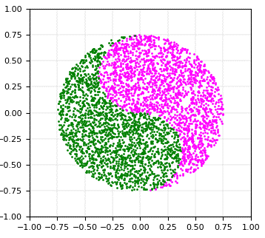

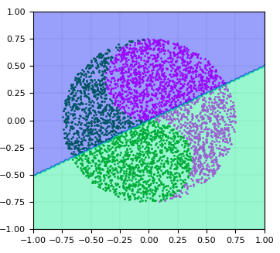
The Decision Surface
Performance on Unseen Data
An Unseen Dataset
A Trained Model
Notes:
(Brian)
So how many of you have used ChatGPT before? And how many of you have noticed that it can give you wrong answers, especially in math calculations? So here, using the trained model and inputting an unseen dataset, similar to asking a question to ChatGPT, a trained LLM, we then receive an evaluation output, similar to a ChatGPT response. Above, we can see the limitations of how a model can produce wrong answers, similar to ChatGPT giving you the wrong calculation. Visualization is a great tool as it provides the users, especially those unfamiliar with machine learning, to see the limitations of the modeling and how it can be improved.

Slide 9

The Web App
Full application running completely within the browser.
Greater product accessibility through simple web searches.
Can be accessed on any type of a device with a browser.
No need for complicated installations.
Notes:
(Brian)
Obviously, as we are transitioning to a web application version of IMLD, there are many benefits that come with this.
Go through the list of the benefits on the slide.

Slide 10
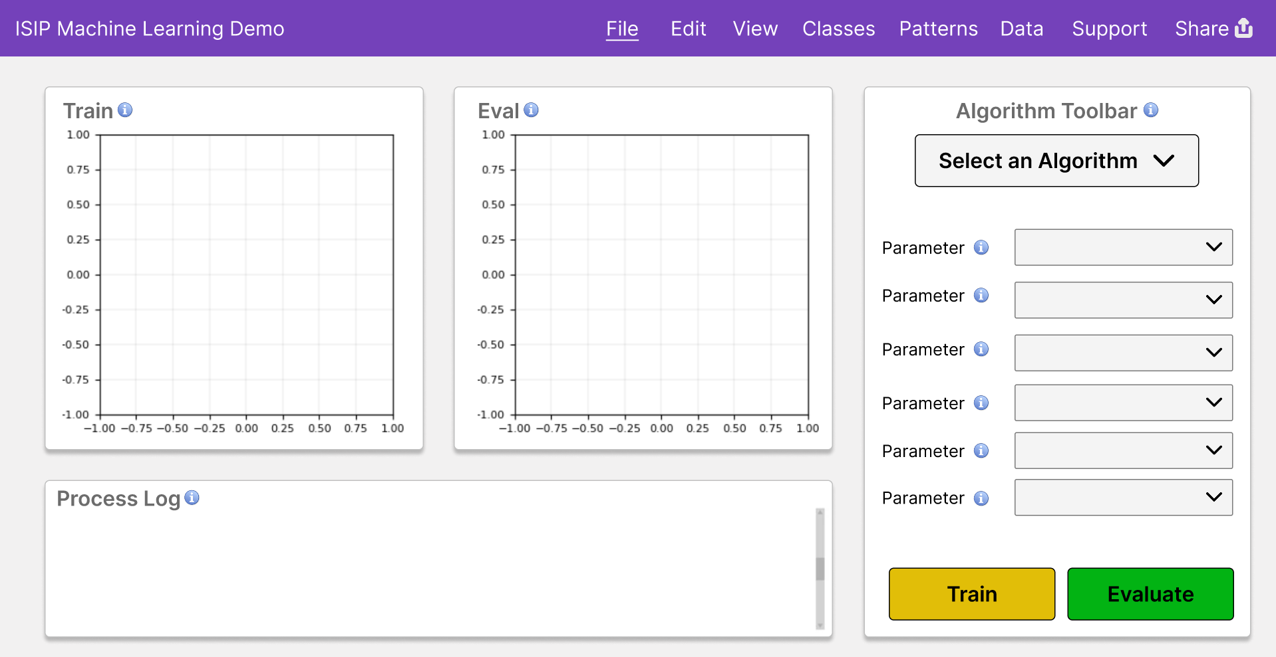
The Prototype
Notes:
(Brian)
In order to make machine learning easy and accessible to all, it is important for there to be an intuitive interface with many visualizations and support for the user. Here, we developed a prototype for us to follow as we will develop the UI of the web version of IMLD. In this design, a major change made from the previous one is the algorithm toolbar, where users are able to easily select between algorithms, adjust the corresponding parameters, and immediately train and evaluate the models created.

Slide 11
Design Requirements - Usability
Requirement | Metric | Target Value, Range, or pass/fail | Justification
Intuitive Data Loading Feature | Time to Complete Task | < 25 seconds | Make sure it is intuitive to upload datasets.
Intuitive Algorithm Selection Feature | Time to Complete Task | < 35 seconds | Make sure it is intuitive to select algorithms and train models.
Intuitive Model Evaluation Feature | Time to Complete Task | < 7 seconds | Make sure it is intuitive to evaluate trained models on datasets.
Scalability | Users | Maintain ideal performance while 100+ users/bots are interacting with the app online | The goal of this project is to build a product that can be used by people all over the world. Make sure that it can scale to handle decent load.
Notes:
(Ray) Discuss how important the GUI is in this application. Since ML is hard, we don’t want the interface to get in the way of the user. Make it easy for the user to learn ML. Discuss both requirements. Mention how the final metrics were based on tests done using the old IMLD.

Slide 12
Design Requirements - Performance
Requirement | Metric | Target Value, Range, or pass/fail | Justification
Load Performance | Seconds | Within range of 2x baseline time | For each of the selected dataset sizes to be loaded, the application should stay within 2x of the baseline time to account for network communications.
Algorithm Performance | Seconds | Within range of 2x baseline time | For each algorithm given a dataset with 50K vectors, the application should stay within 2x of the baseline time to account for network communications.
Algorithm Output Validation | Comparison | Pass/Fail | After running the algorithms, it is important that the results from them are the same in both the web version and the legacy version.
Graph Visualization Output Validation | Comparison | Pass/Fail | When displaying the run visually on the graph, the decision surfaces on the web version and the legacy version should be the same graph.
Notes:
(Ray) Since IMLD is moving to the web, make sure that the performance can match or exceed the original IMLD.

Slide 13
Design Constraints - Compliance
Constraint | Metric | Target Value, Range, or pass/fail | Justification
Compatible on Modern Web Browsers | Testing | Successful usage of IMLD program on 3 of the most popular browsers | Ensure the program is compatible with modern web browsers (Chromium, Firefox, Safari, etc...)
Consistent Visual Design | Approval | Pass/Fail | Maintain a consistent visual style through the webpage, including schemes, typography, spacing. Review frontend with mentor.
Sufficient Documentation | Approval | 15-25% comment-to-code ratio | Ensure that there are detailed comments for all code written. Pass code reviews run by software architect.
Adherence to ISIP Standards | Approval | 100% adherence to chosen style guide | Write all code in accordance with ISIP standards. Pass code reviews run by software architect.
Notes:
(Ray) To make IMLD more accessible, it will be moving to the web. Make sure that the new IMLD implementation can handle enough load to support our accessibility goals.

Slide 14
Design Constraints - Validation
Constraint | Metric | Target Value, Range, or pass/fail | Justification
Input Validation | Testing | 100% of all user inputs undergo validation before processing | The machine learning algorithms require specific formatting for data sets and parameters. This ensures that inputs are properly formatted.
Cybersecurity and Sanitization | Testing | 100% of all malicious user inputs are successfully sanitized before processing | Users may intend to harm the system or send malicious data to crash the system. Therefore, it is important to remove these threats when sent to the website.
Hosted Entirely on Neuronix | Status | Pass/Fail | Ensure that the web app is hosted entirely on the existing Neuronix server. Cloud computing services should not be used.
Notes:
(Ray) To make IMLD more accessible, it will be moving to the web. Make sure that the new IMLD implementation can handle enough load to support our accessibility goals.

Slide 15
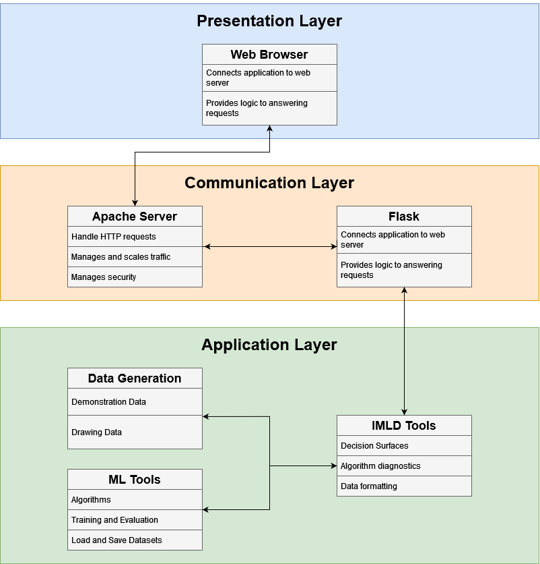
Architecture Overview
Notes:
(Shane) Discuss the top-level architecture, describing the importance of each layer.

Slide 16
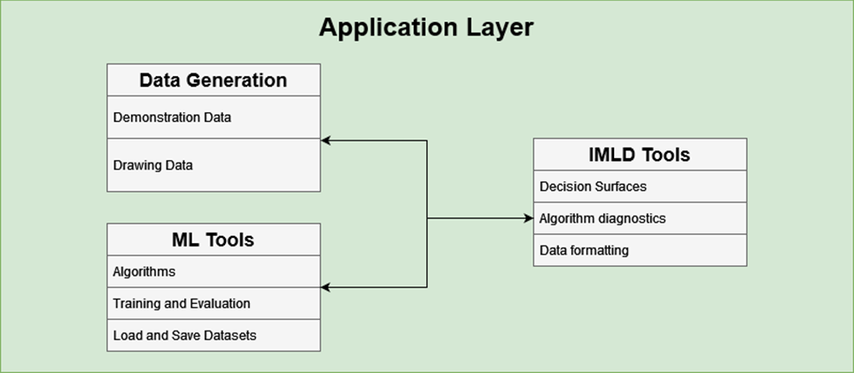
Application Layer
Notes:
(Kayla) Describe the application layer. This is where all the calculations will come from. It starts with ML Tools, where all the algorithm calculations (training and evaluation) will come from. ML Tools is paired with our data generation library, that generates the various distributions that can be used to train the algorithms. The most important part of machine learning is the data, so the data generation library is very important. Finally, the IMLD Tools library connects the two, providing functionality such as decision surfaces, plotting supplements, and error rates. IMLD Tools will be what the communication layer uses.

Slide 17
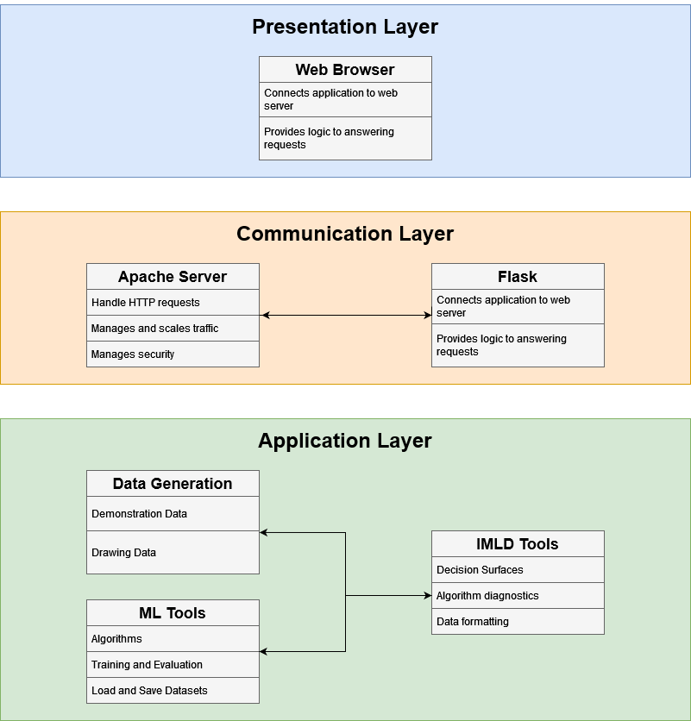
Communication Layer
Notes:
(Kayla) Discuss the communication layer and how it interfaces with the application layer. Discuss the important of each component. The components will be a web framework (Flask), and a web server (Apache). The layer starts with Flask, where the IMLD Tools library is exposed to the internet. Flask contains the logic for serving the client requests. The requests and responses are passed through an Apache server. The Apache server handles the HTTP requests, handling security and managing load. Discuss how the combination of Flask and Apache can make a production app.

Slide 18
Presentation Layer
Notes:
(Kayla) The presentation layer presents the backend to the user. The user’s browser will make requests to the communication layer through the Apache server. Users can select options that will make requests to the communication layer, acting as if a desktop app would.

Slide 19
Benchmarks
 | Train (seconds) |  |  |  |  |  | Eval (seconds)
 | Run Time #1 | Run Time #2 | Run Time #3 | Run Time #4 | Run Time #5 | Average | Run Time #1 | Run Time #2 | Run Time #3 | Run Time #4 | Run Time #5 | Average
PCA | 1.200 | 1.090 | 1.190 | 1.200 | 1.150 | 1.166 | 0.900 | 0.760 | 0.890 | 1.000 | 0.740 | 0.858
Naive Bayes | 0.330 | 0.370 | 0.380 | 0.290 | 0.280 | 0.330 | 0.240 | 0.120 | 0.140 | 0.130 | 0.410 | 0.208
KNN | 2.780 | 2.640 | 2.590 | 2.730 | 2.800 | 2.708 | 1.460 | 1.490 | 1.540 | 1.560 | 1.510 | 1.512
RNF | 1.830 | 1.750 | 1.770 | 1.750 | 1.740 | 1.768 | 0.190 | 0.280 | 0.190 | 0.190 | 0.190 | 0.208
K-Means | 22.450 | 23.330 | 22.110 | 21.680 | 23.070 | 22.528 | 1.490 | 1.410 | 1.390 | 1.470 | 1.410 | 1.434
SVM | 0.500 | 0.560 | 0.450 | 0.420 | 0.410 | 0.468 | 0.290 | 0.340 | 0.350 | 0.350 | 0.170 | 0.300
MLP | 0.700 | 0.810 | 0.670 | 0.760 | 0.750 | 0.738 | 0.320 | 0.210 | 0.210 | 0.260 | 0.210 | 0.242
Totals
Person | Load Time | Train Time | Eval Time
Person #1 | 19.990 | 47.250 | 14.940
Person #2 | 35.990 | 41.670 | 8.730
Person #3 | 28.730 | 22.750 | 6.840
Person #4 | 29.800 | 23.800 | 3.720
Person #5 | 40.630 | 75.790 | 12.130
Person #6 | 29.070 | 39.730 | 12.980
Person #7 | 17.160 | 26.780 | 4.090
Person #8 | 21.020 | 11.300 | 1.690
Person #9 | 19.460 | 25.120 | 3.320
Person #10 | 13.910 | 39.980 | 1.530
Average | 25.576 | 35.417 | 6.997
 | Load Time (seconds)
 | Run Time #1 | Run Time #2 | Run Time #3 | Run Time #4 | Run Time #5 | Average
Vector Size 10k | 1.750 | 1.730 | 1.930 | 1.870 | 1.520 | 1.760
Vector Size 50k | 1.890 | 2.020 | 1.810 | 1.840 | 1.720 | 1.856
Vector Size 100k | 1.970 | 2.080 | 2.310 | 2.420 | 1.860 | 2.128
Notes:
(Brian)
Here are some of the benchmarks that were tested in order to generate some of the requirements mentioned previously:
Top Left: Algorithm Performance for each algorithm on both training and evaluation
Bottom Left: Load Time for 3 different vector sizes - 10k, 50k, 100k
Right: UI Testing on 3 different tasks – loading in training and eval datasets, training that data, and then evaluating that data

Slide 20


Future Testing
Notes:
(Brian)
In the future, we will be performing the same tests to determine how the new application compares to the benchmarks
Obviously, we expect slower performance in algorithm performance as there is a communication layer with the web servers. However, we will also test a local version where users can download it, where performance should be comparable.
In terms of UI, we noticed in the legacy version, people took some time to realize that training a model required two steps: selecting and algorithm and then processing it. We hope that this time will improve with the new algorithm toolbar. The same goes for eval, as it will also be included in the toolbar.

Slide 21
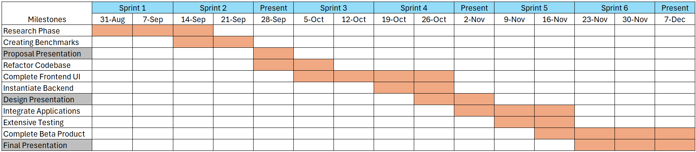
Milestones
Notes:
(Shane) Discuss the milestones for the semester here. Ultimately should end with a prototype for the ML class to test.

Slide 22

Questions?
Notes:
(Shane) Ask if anybody has any questions

