Slide 1


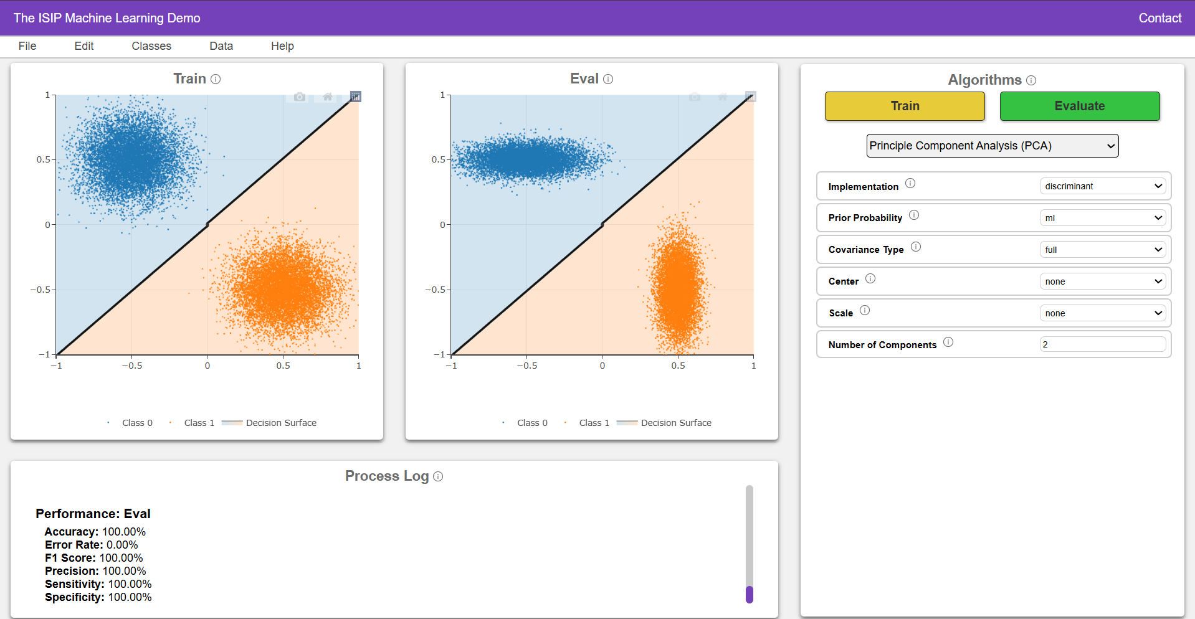
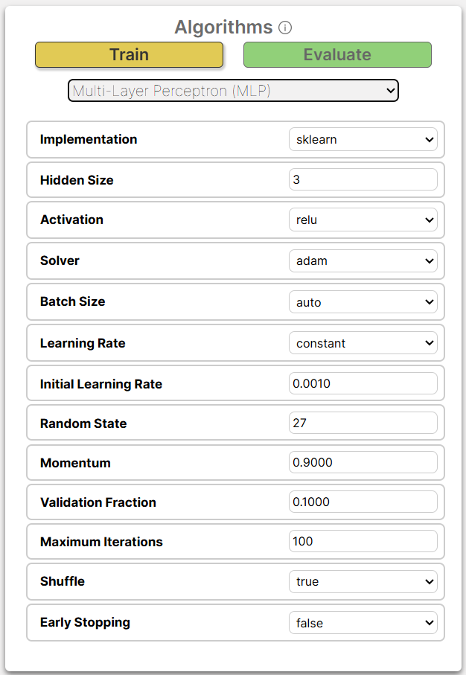
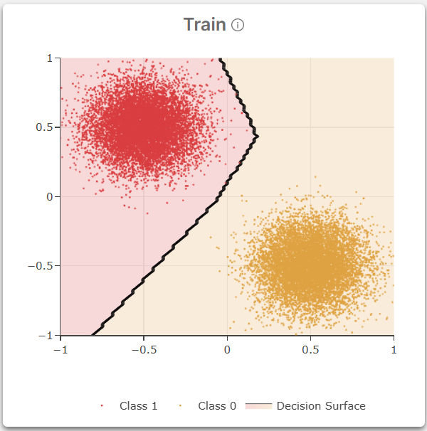
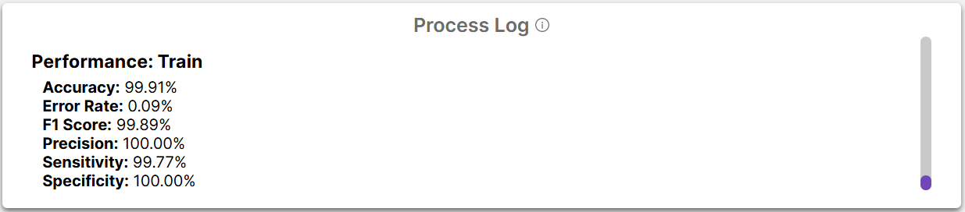
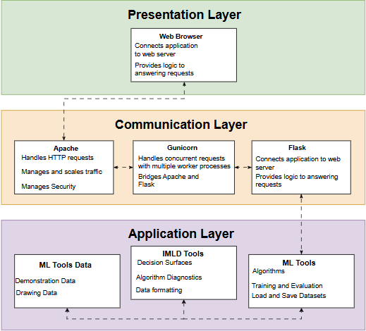
Team 14: The ISIP Machine Learning Demonstration (IMLD)
Raynel Lopez, Shane McNicholas, Brian Thai, & Kayla Toner
Instructor: Dr. Maryam Alibeik, Advisor: Dr. Joseph Picone
Department of Electrical and Computer Engineering, Temple University, Philadelphia, Pennsylvania
Abstract
Design Criteria
Results
Future Directions
The tables below outline the negotiable and non-negotiable design requirements used to evaluate the updated IMLD system.
These were chosen to ensure improvements in performance, accessibility, compatibility, and maintainability while supporting future integration.
Non-negotiable requirements are critical to the system’s core functionality and must be met for successful deployment.
The IMLD website is a stable, interactive platform for exploring machine learning.
The algorithm toolbar, seen in Fig. 5, handles all algorithm-related functionality.
Displays all available machine learning algorithms for classification.
Allows users to select an algorithm and adjust its parameters.
Designed to be intuitive and modular.
As we continue to develop IMLD, future work will focus on expanding accessibility, improving system performance and scalability, and incorporating a wider range of machine learning algorithms.
Improve algorithm processing times showing in Fig. 8 and ensure the platform can support more simultaneous users.
We plan to expand IMLD's compatibility to include mobile devices such as tablets and smartphones.
Integrate more relevant ML algorithms to better reflect the evolving landscape of AI to provide users with a more comprehensive learning experience.
These updates will help IMLD grow into a powerful online platform supporting further exploration of machine learning.
Requirement | Target Value | Description
Algorithm Independent | All processing is done in ML Tools | Frontend and machine learning tools are decoupled to allow integration of any algorithm without modifying the user interface, and vice versa. [2]
Data Loading Interface | < 25 seconds | Compared data loading times between legacy and web IMLD by timing the file upload process. [2]
Algorithm Selection Interface | < 35 seconds | Compared algorithm selection and model training times between legacy and web IMLD by timing the process to select an algorithm and train a model. [2]
Model Evaluation Interface | < 7 seconds | Compared model evaluation times between legacy and web IMLD by timing the process to evaluate.
Hosted Entirely on Neuronix | Pass/Fail | Web IMLD is to be hosted on Neuronix server, using an Apache server to manage web hosting and tasks.
HTTPS Protocol | Pass/Fail | Web IMLD is to utilize HTTPS Protocol to securely encrypt data between the client and server.
Comment-to-Code Ratio | 50-60% | Comment-to-code ratio calculated by Linux tool cloc, counting the number of comment and code lines.
PEP8 Python Style Guide | Pass/Fail | All written code must follow the standards of the PEP8 Python Style Guide to ensure consistency.
Fig. 1 IMLD User Interface
Fig. 5 Algorithm Toolbar
Machine Learning can be difficult to learn due to its abstract math and complexity. The ISIP Machine Learning Demonstration (IMLD) project helps address this by offering an interactive, web-based platform.
Visualizes core ML concepts to support learning.
Lowers barriers for students and educators
Originally a Java applet, then a Python app, IMLD is now fully online to support accessibility.
No installation needed—runs in any browser
Supports learning through hands-on experimentation
By letting users generate data, select algorithms, and see decision boundaries, IMLD bridges the gap between theory and intuition.
Designed for students, educators, and researchers
Encourages exploration and understanding through interaction
The Train and Eval plots are where visualizations of the machine learning algorithm occur.
Provides immediate feedback on how well the model separates the different classes.
Makes abstract concepts visually interpretable.
 | Baseline – Single User (s) | 10 Concurrent Users (s)
Data Generation Task | 0.600 | 0.690
Training Task | 0.750 | 1.400
Evaluation Task | 0.620 | 1.200
Fig. 6 Decision Surface on Train Plot
Fig. 10 Scalability Testing
The Process log tracks each step the user takes and outputs results from training and evaluation, as shown in Fig. 7.
Conclusion
Fig. 3 Non-Negotiable Design Requirements and Constraints
In conclusion, the redevelopment of IMLD into a fully functional web application marks a significant step toward making machine learning more accessible and engaging. By transforming a legacy Python application into a modern, scalable, and interactive platform, IMLD allows users to explore core ML concepts through visual and hands-on experimentation.
The project successfully met all non-negotiable design requirements and most negotiable ones, confirming its usability, performance, and reliability. With features such as user-uploaded datasets, custom data drawing, and support for 11 algorithms and 8 preloaded data distributions, IMLD delivers a comprehensive learning tool.
As the platform continues to grow with new algorithms in development and planned improvements in scalability, mobile compatibility, and accessibility, it is well-positioned to become a valuable resource for students, educators, and researchers alike.
Negotiable requirements are desirable but flexible, allowing trade-offs based on constraints like time, complexity, or resources.
Fig. 7 Process Log
Results demonstrate strong alignment with the established design criteria. All non-negotiable requirements were successfully met.
The data loading interface, algorithm selection interface, and model evaluation interface all showed significant improvement, as seen in Fig. 5.
The system is algorithm-independent, with all processing handled through the ML Tools library.
Website was deployed on Dr. Picone’s Neuronix server using HTTPS protocol, meeting hosting requirements.
Code quality standards were achieved with 52% comment-to-code ratio and full compliance with the PEP8 Python Style Guide [4].
Requirement | Target Value | Description
Performance | < 10 seconds | The performance was evaluated by measuring the training times of all machine learning algorithms.
Scalability | 90% of Users Experience Within 20% of Baseline Performance | Scalability was tested by having bots run three tasks – data generation, model training, and model evaluation, first with one user to establish a baseline performance, then with ten concurrent users to assess if the target values were met.
Output Validation | Same Output as IMLD v1.8.1 | Compared outputs in both plots and process logs between legacy and web IMLD to ensure accuracy.
ADA Compliance | Pass/Fail | ADA compliance ensured by evaluating IMLD's accessibility features to meet Compliance Level A [7].
Compatible with Modern Web Browsers | Successful usage on Chrome, Firefox, Safari | The same tasks were performed in IMLD on browsers Chrome, Firefox, and Safari, with outputs compared to validate consistent functionality.
Methods
 | Benchmark Time (s) | New Time (s)
Data Loading Interface | 25.576 | 21.908
Algorithm Selection Interface | 35.417 | 5.898
Model Evaluation Interface | 6.998 | 1.968
References
Fig. 4 Negotiable Design Requirements and Constraints
[1] Accessibility audit report for isip.piconepress.com/projects/imld/ resources/app,” Acsbace.com, Apr. 14,2025. https://acsbace.com/reports/67 fc72e16a6952e69a0ef611?brandId=67fd1f9354d1a7ff77055355 (accessed Apr. 21, 2025).
[2] D. F. Galletta, R. Henry, S. McCoy, and P. Polak, “Web Site Delays: How Tolerant are Users?,” AIS Electronic Library (AISeL), 2025. https://aisel.aisnet.org/jais/vol5/iss1/1/ (accessed Jan. 28, 2025).
[3] “Ergonomics of human-system interaction.” Available: https://cdn.standards.iteh.ai/samples/75258/83c8cf072187487686645aad04eff40e/ISO-9241-110-2020.pdf
[4] G. van Rossum, B. Warsaw, and N. Coghlan, “PEP 8 – Style Guide for Python Code,” peps.python.org, Jul. 05, 2001. https://peps.python.org/pep-0008/
[5] “ISO/IEC 25010,” iso25000.com, 2022. https://iso25000.com/index.php/en/iso-25000-standards/iso-25010
[6] Shaffer, J., Hamaker, J., & Picone, J. (1998). Visualization of signal processing concepts. Proceedings of the IEEE International Conference on Acoustics, Speech and Signal Processing, 3, 1853–1856. doi: 10.1109/ICASSP.1998.681824.
[7] wat_access, “Do All Websites Have to Be ADA Compliant? - Accessible Metrics,” Accessible Metrics, Sep. 10, 2019. https://www.accessiblemetrics.com/blog/do-all-websites-have-to-be-ada-compliant/ (accessed Feb. 03, 2025).
Testing Methods
Fig. 8 Interface Time Comparisons
The testing process began by first benchmarking the original IMLD application to establish a performance and usability baseline. Functional testing, performance testing, load testing, and output validation testing were all conducted.
Timing users completing tasks on key UI components to assess speed and ease of use improvements.
Algorithm response benchmarking
Load testing with varying dataset sizes
Simulated scalability testing with concurrent users.
Comparing decision surfaces and model metrics with legacy.
The testing methodology followed ISO 25010 [5] and ISO 9241 [3] standards to ensure functionality, efficiency, and usability.
Among the negotiable criteria, most were satisfied.
The application reached ADA Compliance Level A [1] and is compatible with modern web browsers.
Output validation confirmed consistency with results from the legacy IMLD.
All but K-means satisfied the algorithm performance target value, as seen in Fig. 6.
Scalability testing showed that data generation remained efficient under multiple users, but training and evaluation times increased beyond the target at 10 concurrent users.
Fig. 2 Architecture Overview
IMLD uses a three-tiered client-server design, which separates the user interface (frontend) from the processing logic (backend) to keep the design modular and scalable.
The Presentation layer provides the user interface.
The Communication layer manages the data flow between system components.
The Application layer contains the core logic and processing that drive the system’s functionality.
Alg. | Avg (s) | Alg. | Avg (s) | Alg. | Avg (s) | Alg. | Avg (s)
NB | 0.7663 | RNF | 2.0692 | Euclidean | 2.2404 | QDA | 1.7276
KNN | 6.4812 | SVM | 0.8423 | PCA | 2.5409 | QLDA | 1.6097
KMEANS | 10.0391 | MLP | 1.8584 | LDA | 1.7891 | - | -
Fig. 9 Algorithm Performance Times

