Slide 1

Machine Learning ​
applied to
Cardiology​
Dena Pan
Jahmosi Joslyn

Slide 2
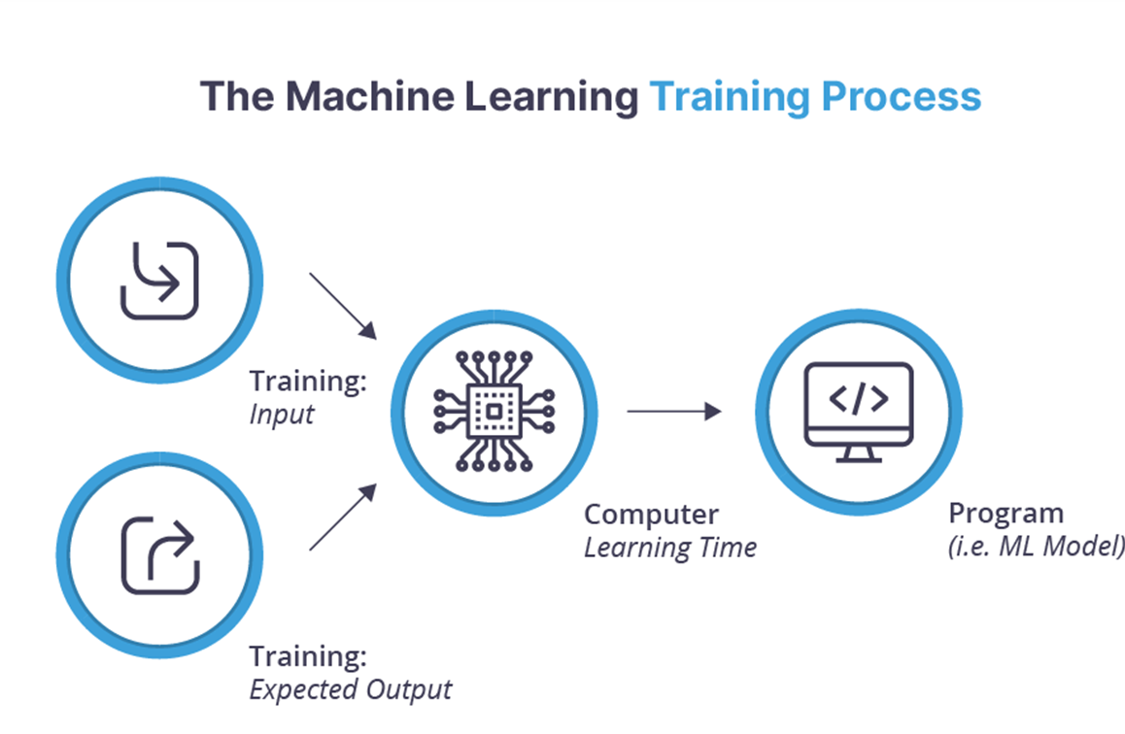
Introduction: Study of Machine Learning and Cardiology
What is machine learning?
computer systems that are able to learn and adapt to analyze and draw inferences from patterns in data.
Ideal in Cardiology:
transverse through large data
efficient
accounts for the large ranges of conditions
Goal:
utilizing machine learning to detect several of cardiology conditions

Slide 3
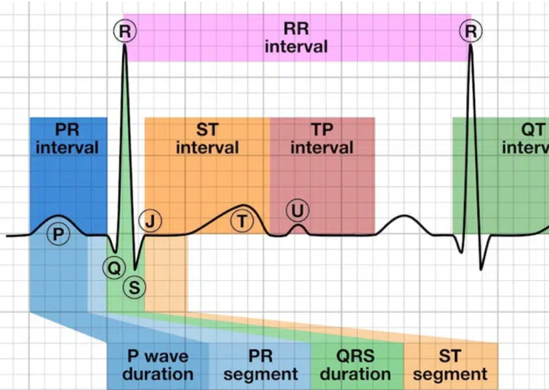
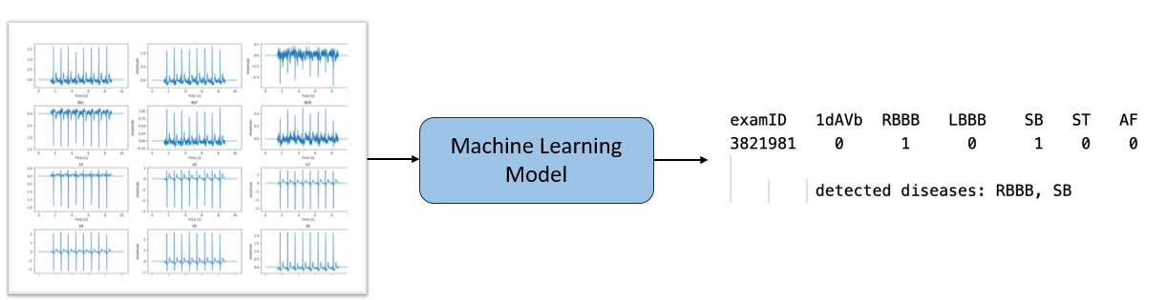
Introduction: Study of Machine Learning and Cardiology
data is a signal represented by a wavelength
the different patterns of peaks and troughs is then categorized into named interval
Cardionary Diseases:
anomalies in diseases also have certain wavelength pattern
the different trends of wavelength can correlate to the specifics of diseases

Slide 4
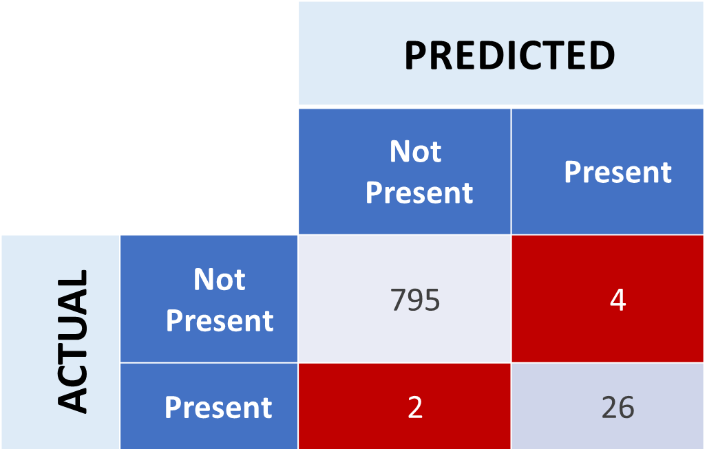
Data Introduction: Confusion Matrices
To make sure the output we are getting measures the accuracy of the model, it uses Confusion Matrices.
Confusion Matrices are a chart that contains information about predictions vs actual results.
The Confusion Matrix created has four different quadrants:
True Negative (Top-Left Quadrant)
False Positive (Top-Right Quadrant)
False Negative (Bottom-Left Quadrant)
True Positive (Bottom-Right Quadrant)

Slide 5
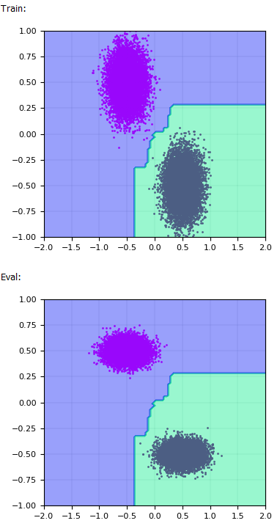
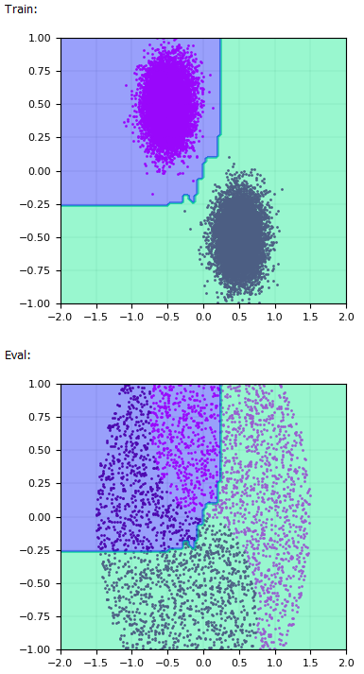
Basic Model of Machine Learning:IMLD
Machine Learning Demo
Linear Mapping:
visual tool basic understanding of machine learning
deals with simpler data sets and classification on an 2D plane
Process:
takes in data set opt for training
  the two set of classes defined
applies algorithm in this controlled state
apply the same algorithm for eval data: raw data

Slide 6
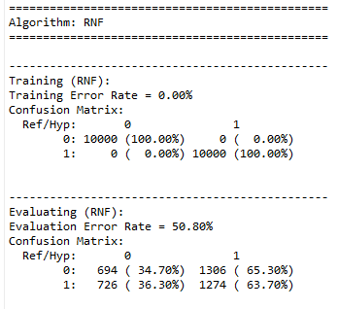
Data and Results: IMLD

Slide 7
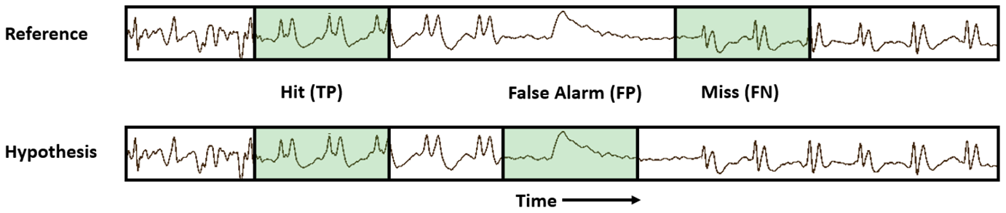
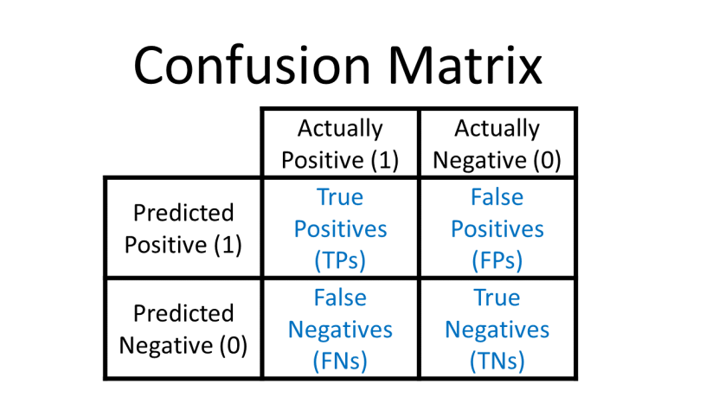
Data Concept: Confusion matrices
Used for Calculating:
Accuracy
Sensitivity
Precision
Specificity

Slide 8
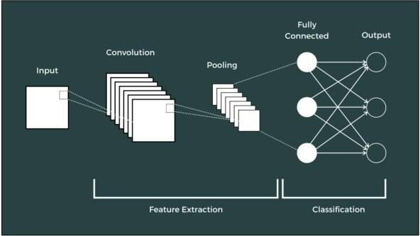
Method: Cardiology Experiment
In our experiment we trained a ResNet-18 model using a system
of 8 channel data and 2,000 training samples which outputs a prediction for presence or absence of six cardiac conditions.
There are three major key steps in our project, training, decoding and score. edf and csv files go in as inputs, and serve as the name of output models.

Slide 9
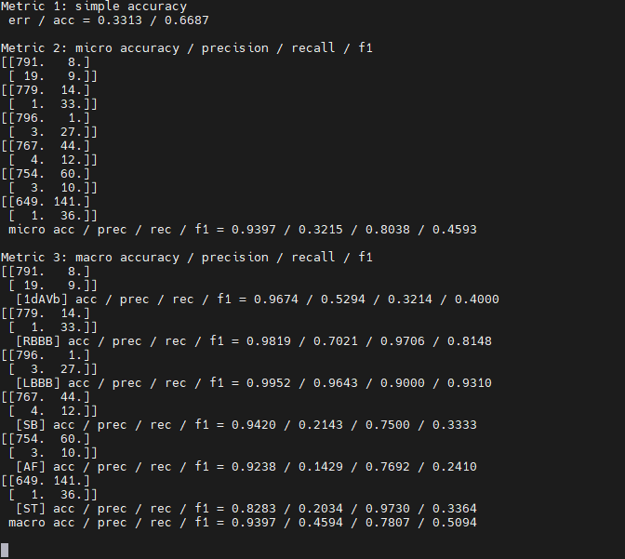
Data and results: Cardiology Experiment
The final output shows several metrics derived from confusion matrices for each disease, at the top it shows the error and accuracy rate. (0.3313 to 0.6687)
The most important output being the micro f1 scores, which are numerical value that summarizes findings of confusion matrices in terms of accuracy

Slide 10
Conclusion
Machine learning and and especially in cardiology aspect cannot be compacted into just one month however introduced
exposure to real life applications
there is always not enough data to analyze from
models, programs and research is always adapting

Slide 11
Reflection
Learned New topics, and opened opportunities for future choices in careers.
Projects such as an Python Mp3 Player helped build new coding skills
Learning Unix/Linux which is essential in Computer and Electrical Engineering.
Learned professional level skills that are useful in the workforce.

Slide 12
References
Ribeiro, Antônio H., et al. “Automatic Diagnosis of the 12-Lead ECG Using a Deep Neural Network.” Nature News, Nature Publishing Group, 9 Apr. 2020, www.nature.com/articles/s41467-020-15432-4.
Picone, Joseph. The Institute for Signal and Information Processing, isip.piconepress.com/. Accessed 31 July 2024.

Slide 13
Acknowledgments
We’d like to give our acknowledgments to our two mentors Dimitry and Dylan, for the help and support we’ve received over the summer and Dr.Picone, our professor, for guiding us.

