Slide 1
Performance Comparison of SVM and QSVM
Sadia Afrin Purba

Slide 2
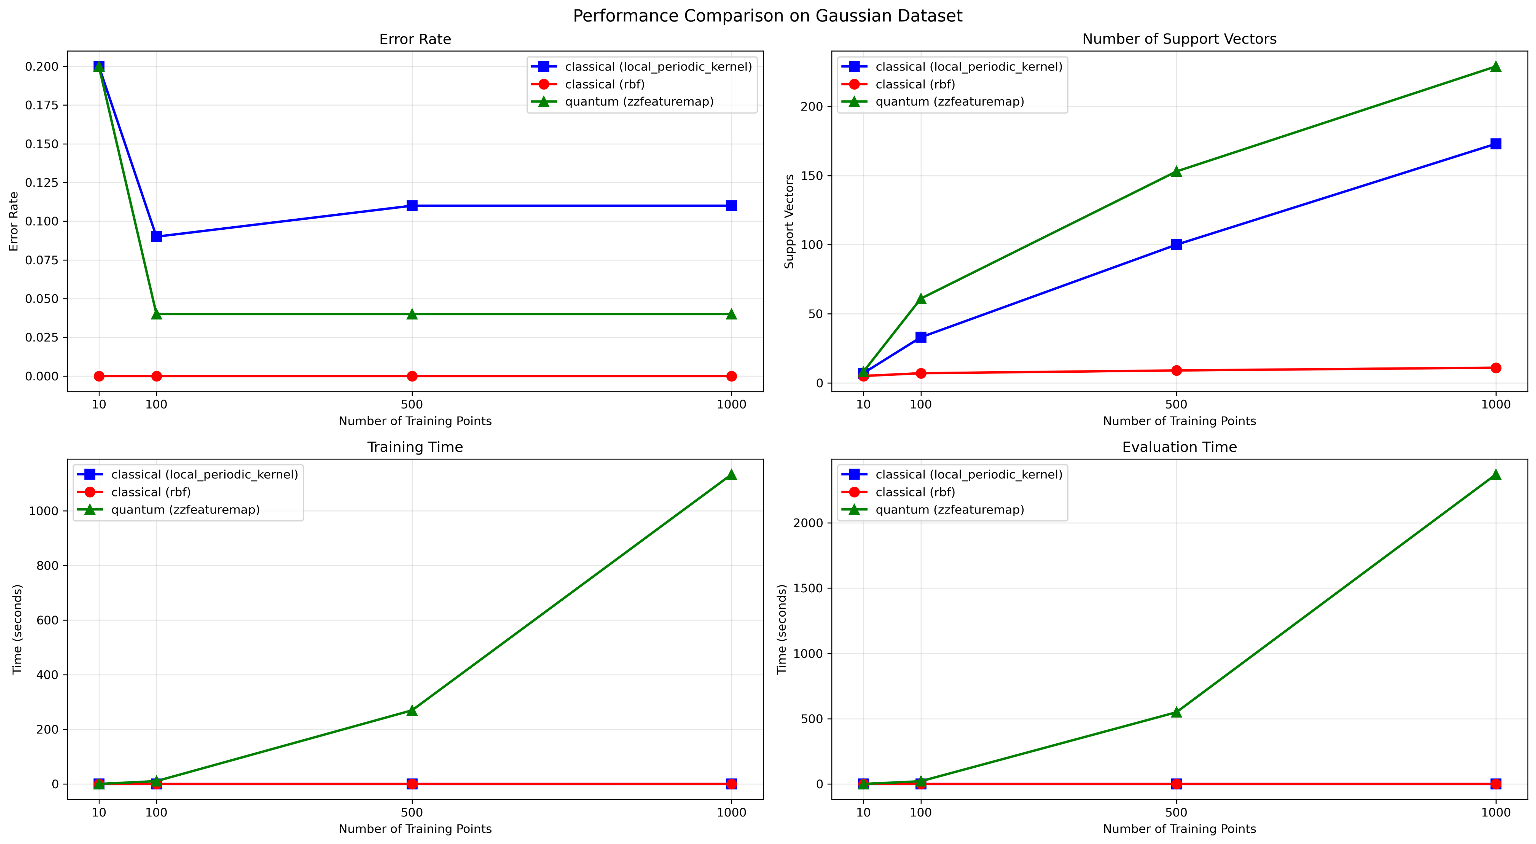
Dataset: Gaussian

Slide 3
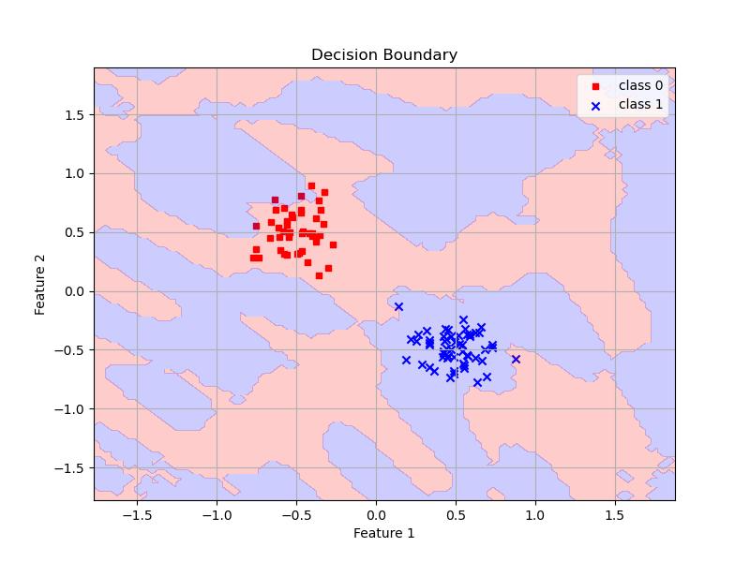
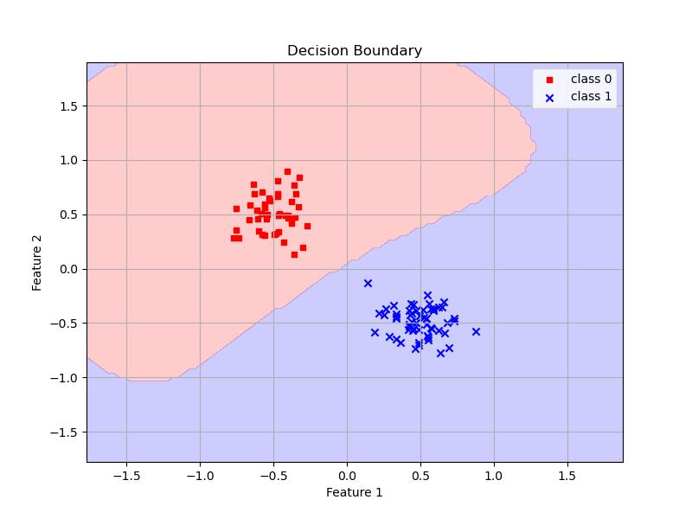
Dataset: Gaussian – 100 Samples
QSVC on Eval Set
SVC on Eval Set

Slide 4
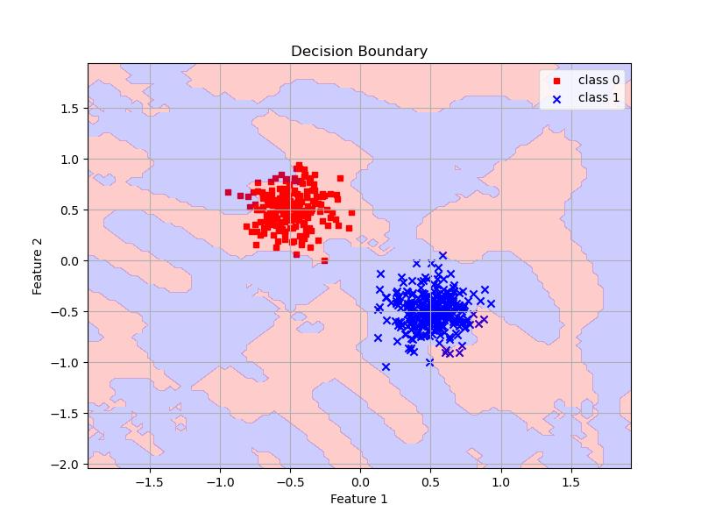
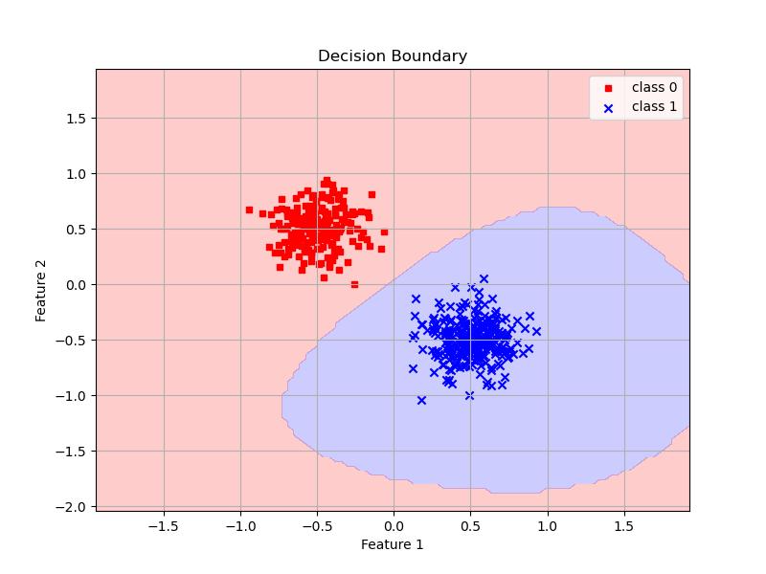
Dataset: Gaussian – 500 Samples
QSVC on Eval Set
SVC on Eval Set

Slide 5
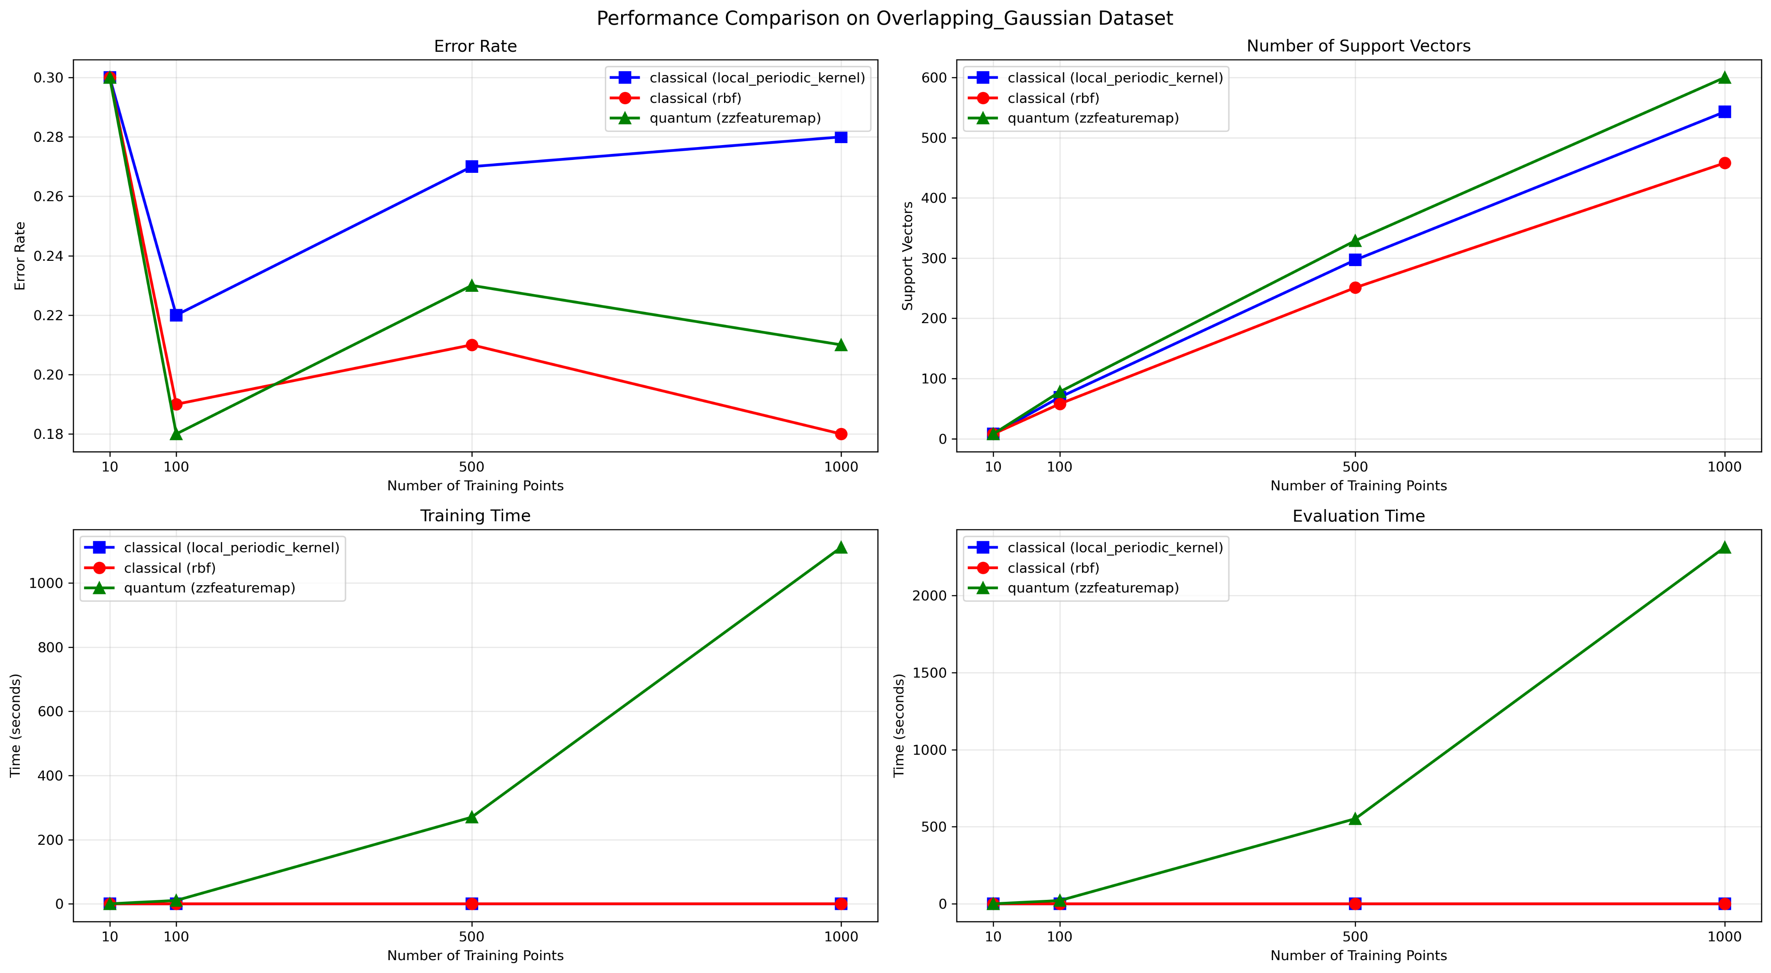
Dataset: Overlapping Gaussian

Slide 6
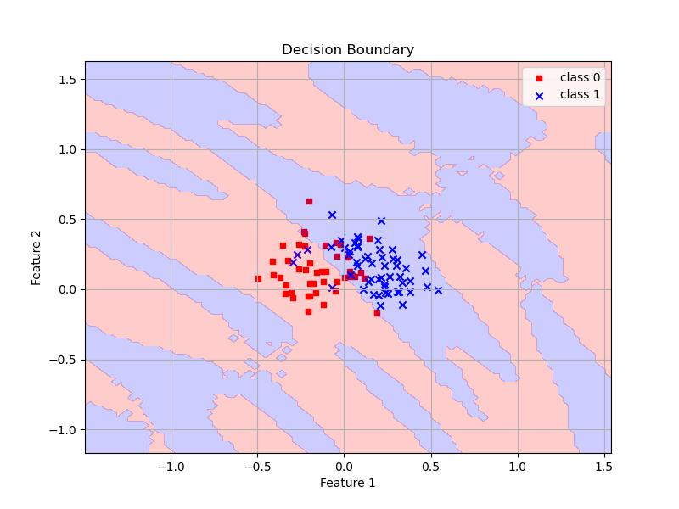
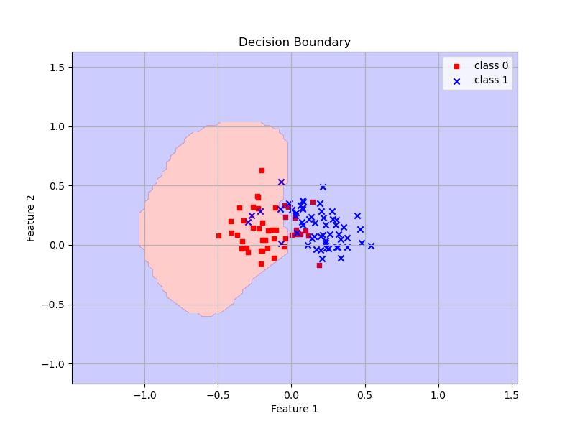
Dataset: Overlapping Gaussian – 100 Samples
QSVC on Eval Set
SVC on Eval Set

Slide 7
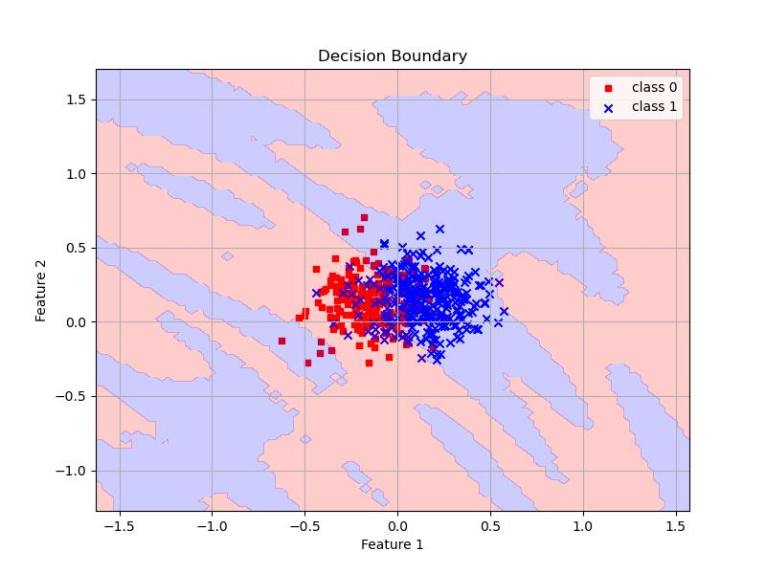
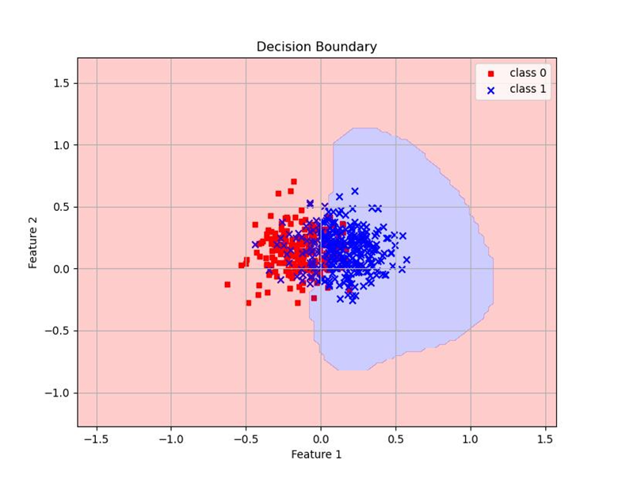
Dataset: Overlapping Gaussian – 500 Samples
QSVC on Eval Set
SVC on Eval Set

Slide 8
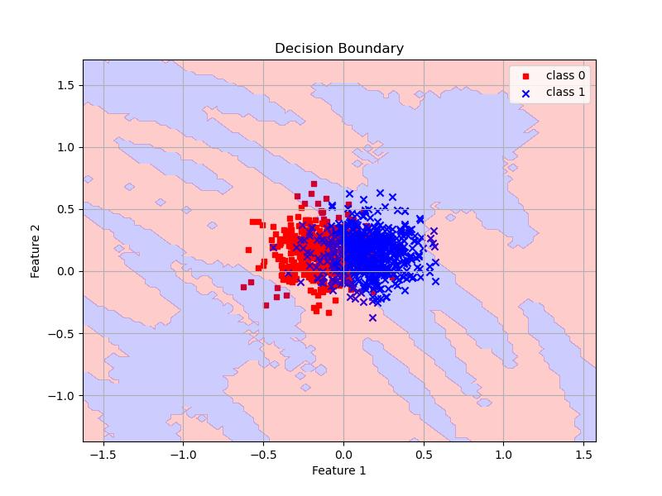
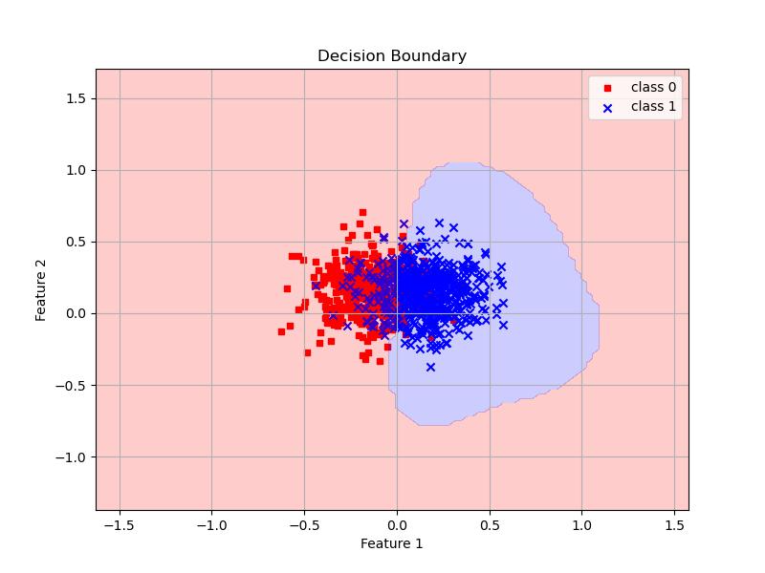
Dataset: Overlapping Gaussian – 1000 Samples
QSVC on Eval Set
SVC on Eval Set

Slide 9
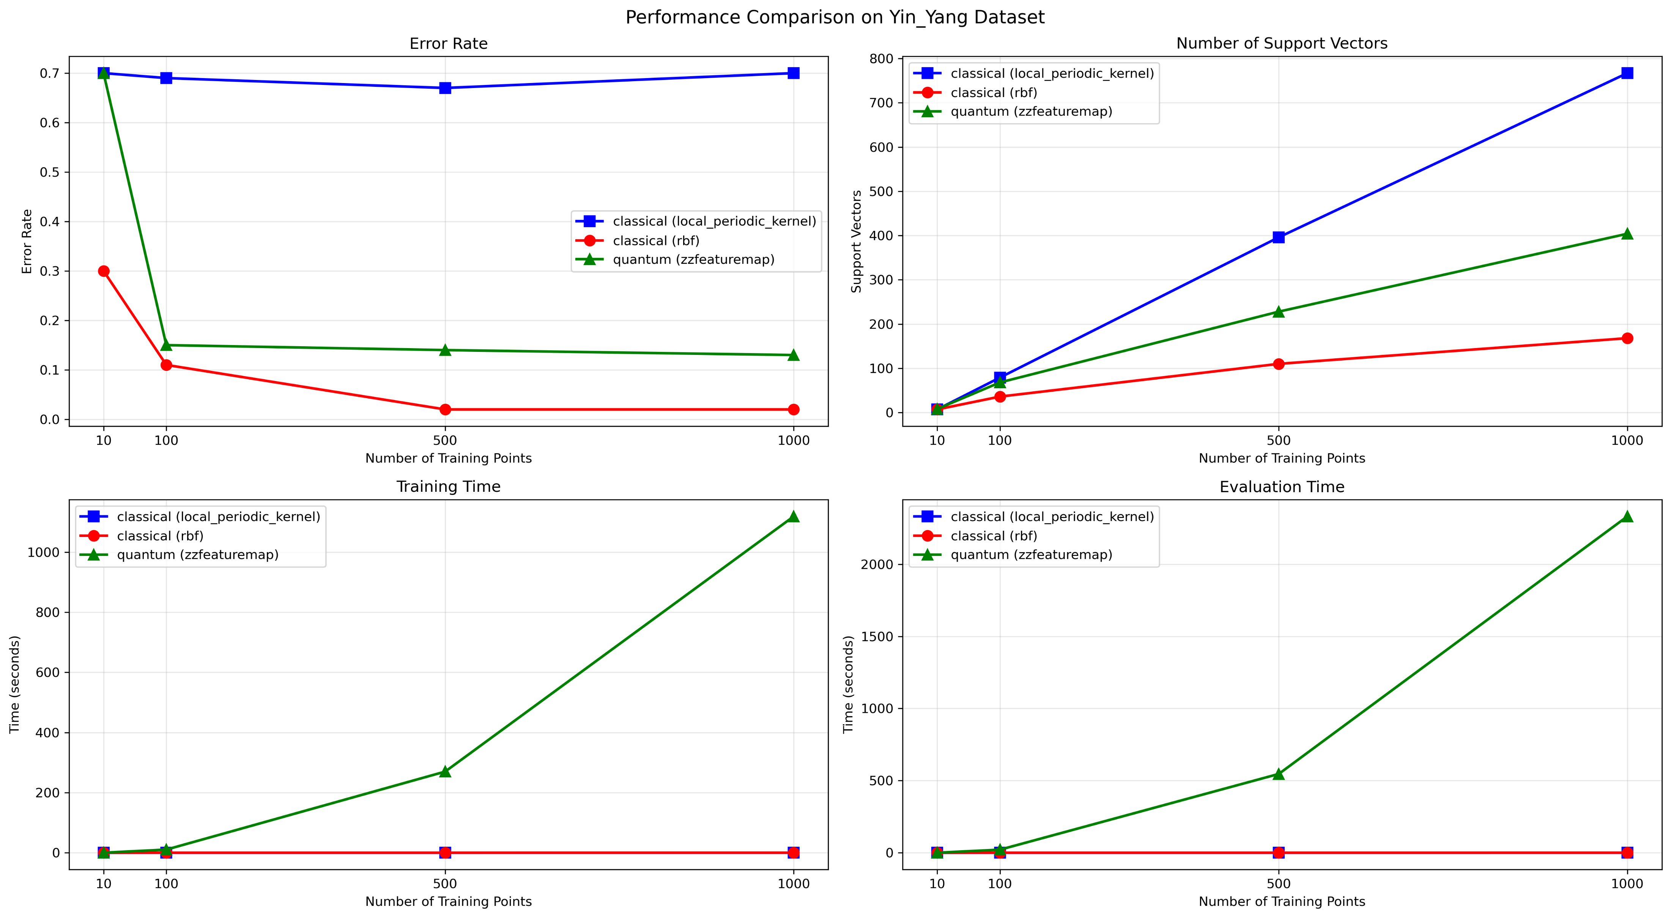
Dataset: Yin-Yang

Slide 10
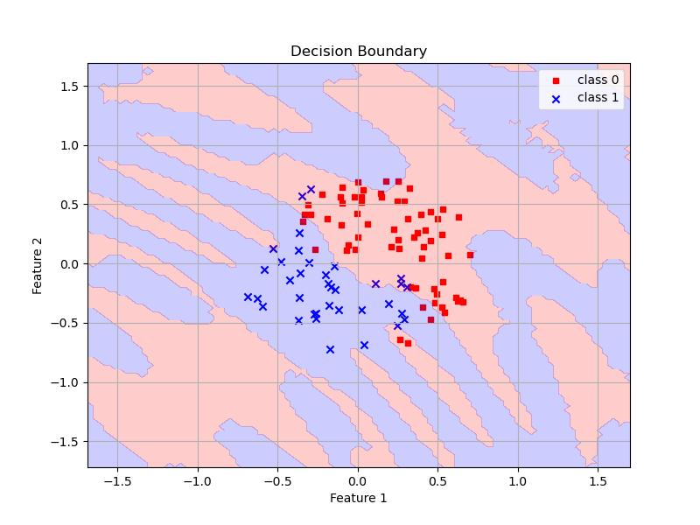
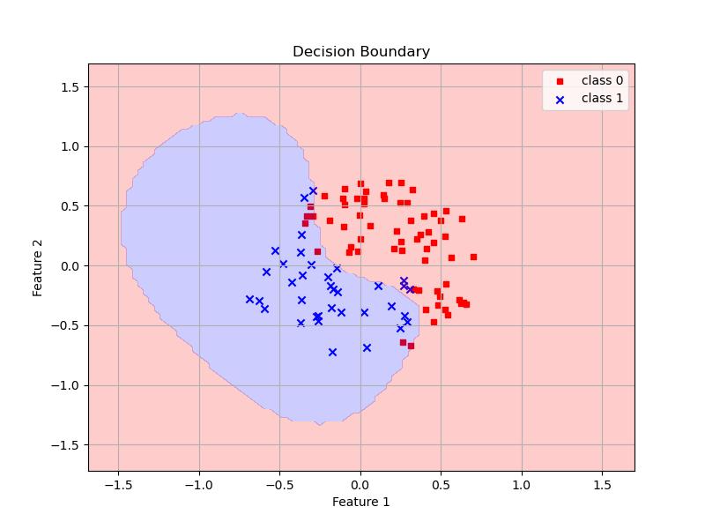
Dataset: Yin-Yang – 100 Samples
QSVC on Eval Set
SVC on Eval Set

Slide 11
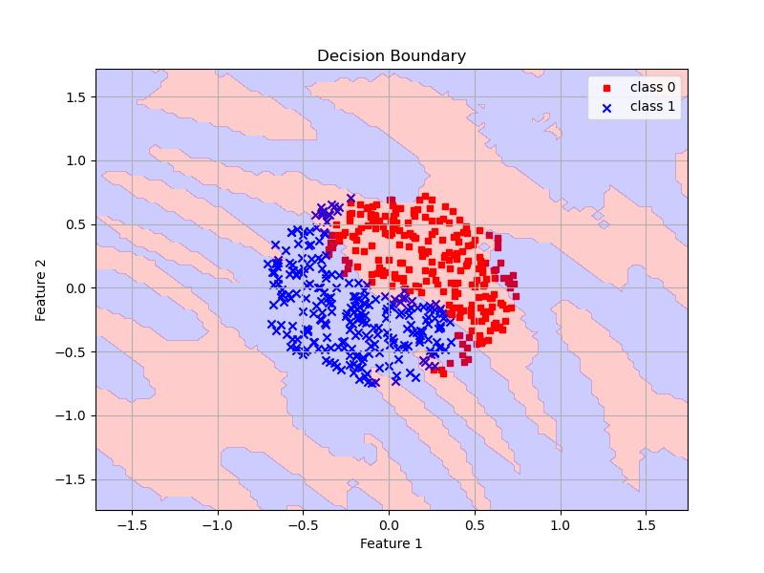
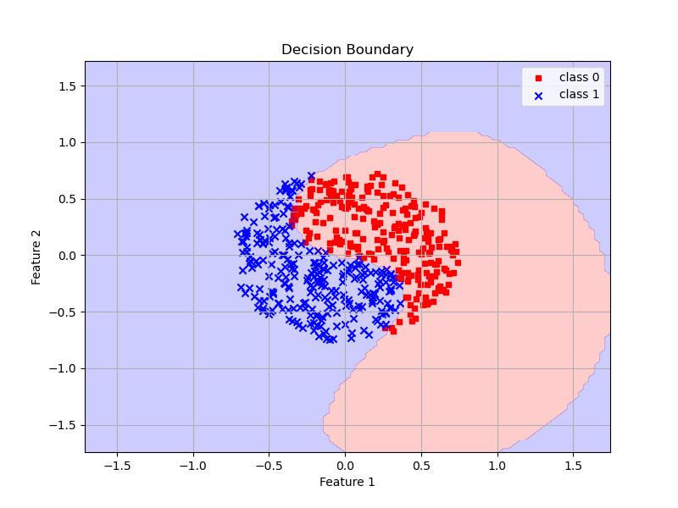
Dataset: Yin-Yang – 500 Samples
QSVC on Eval Set
SVC on Eval Set

Slide 12
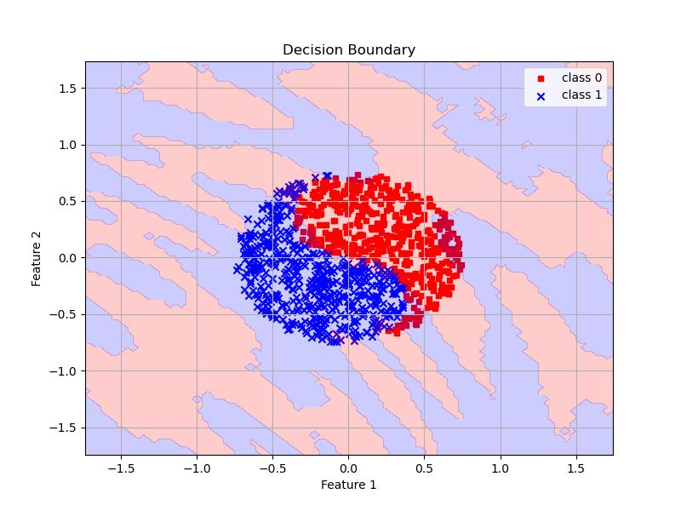
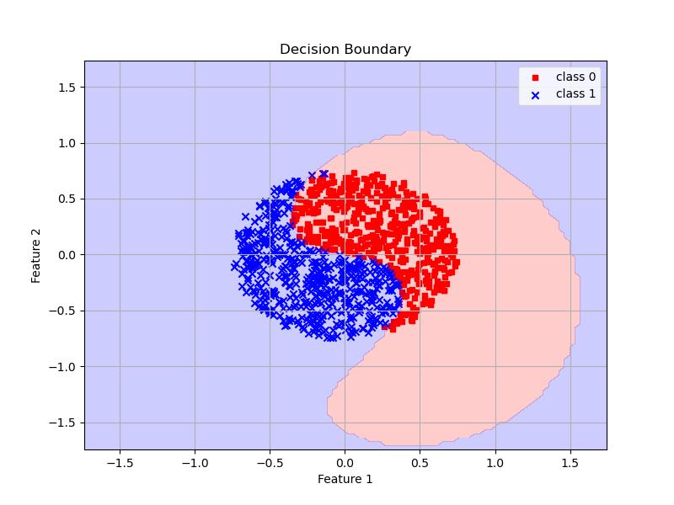
Dataset: Yin-Yang – 1000 Samples
QSVC on Eval Set
SVC on Eval Set

Slide 13
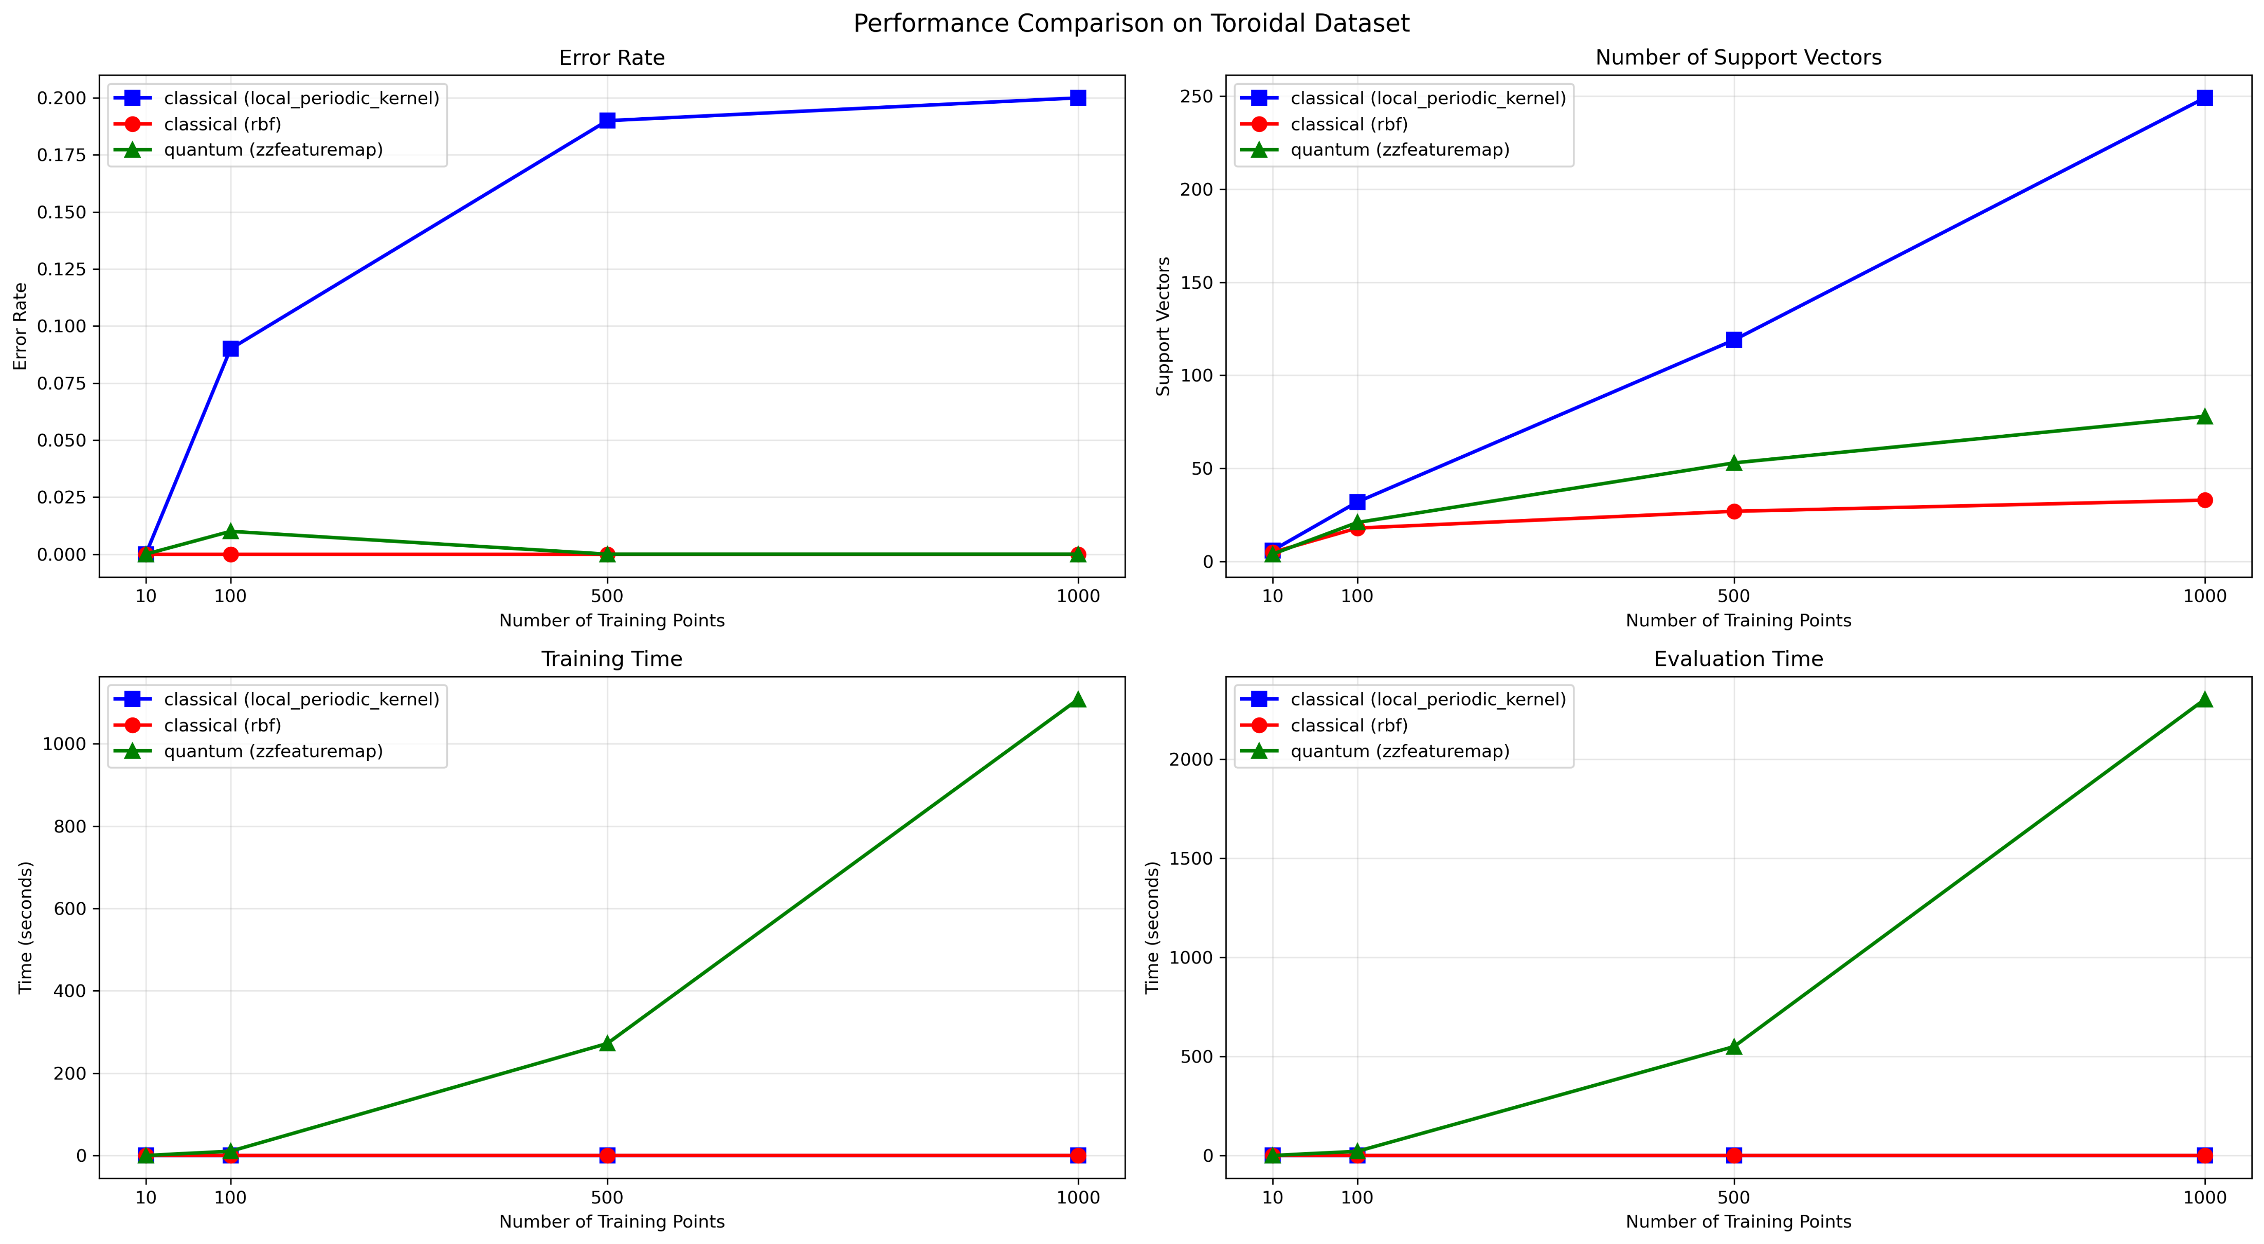
Dataset: Toroidal

Slide 14
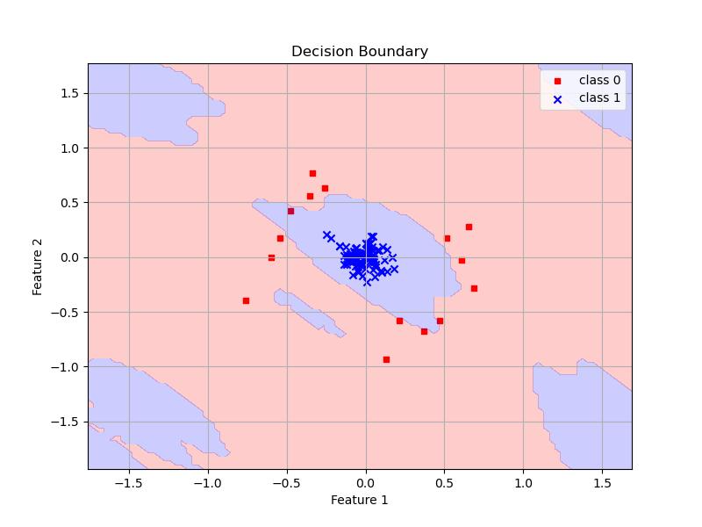
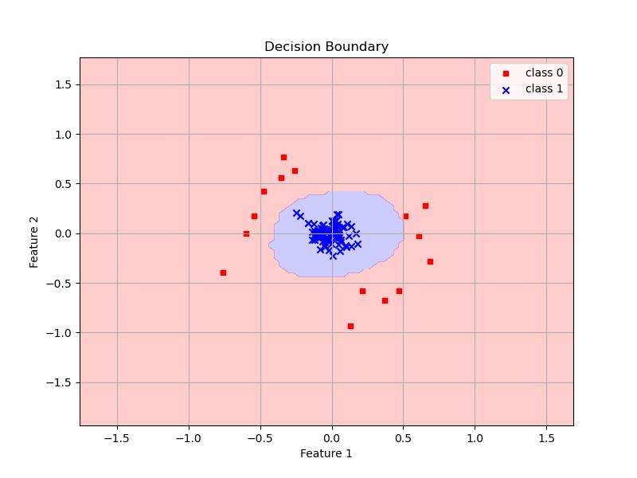
Dataset: Toroidal – 100 Samples
QSVC on Eval Set
SVC on Eval Set

Slide 15
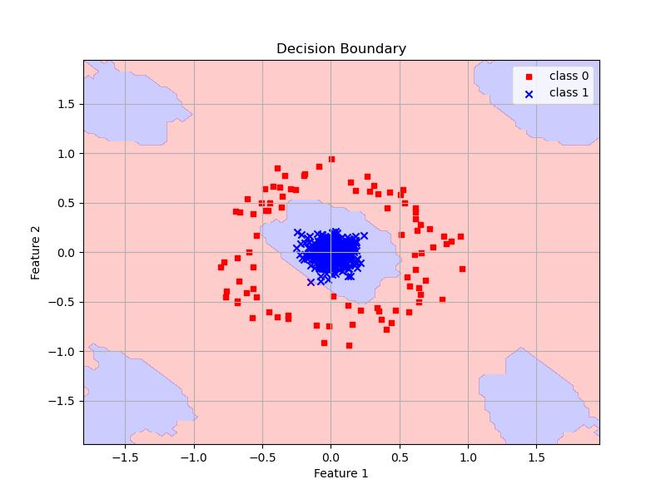
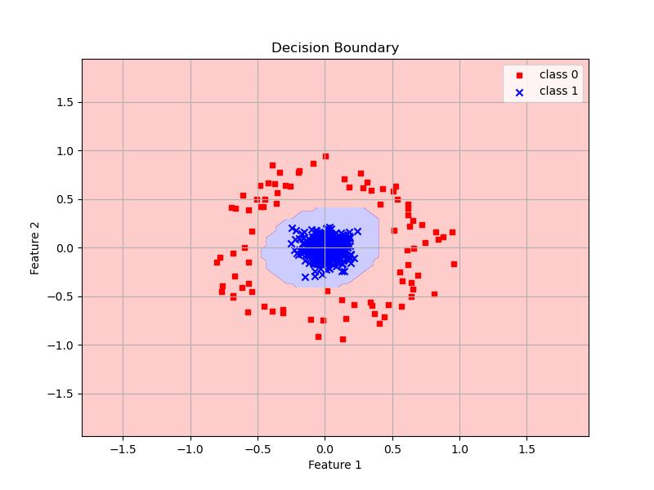
Dataset: Toroidal – 500 Samples
QSVC on Eval Set
SVC on Eval Set

Slide 16
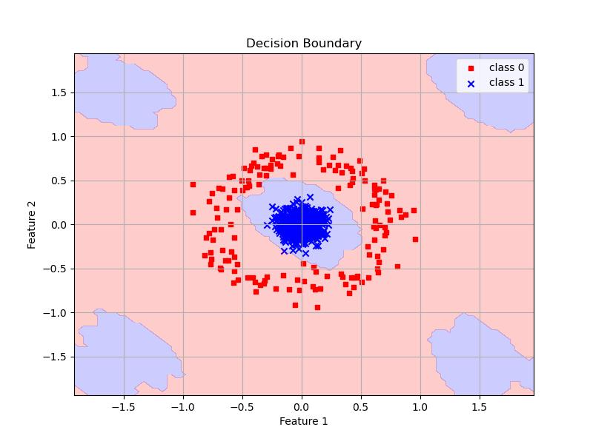
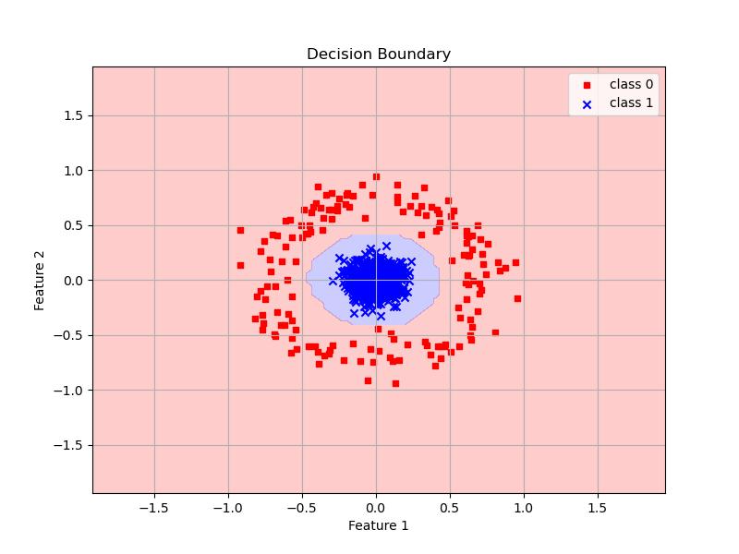
Dataset: Toroidal – 1000 Samples
QSVC on Eval Set
SVC on Eval Set

Slide 17
Periodic Kernel

Slide 18
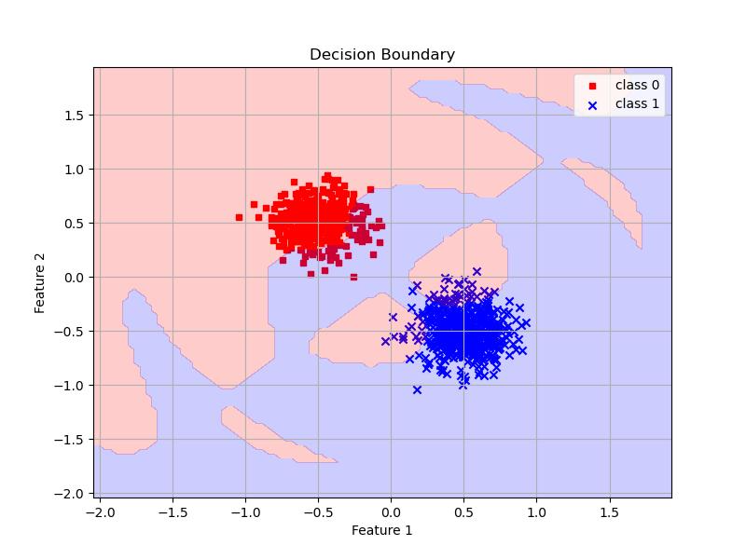
Classical SVM with Gaussian Data and Periodic Kernel – 1000 Samples

Slide 19
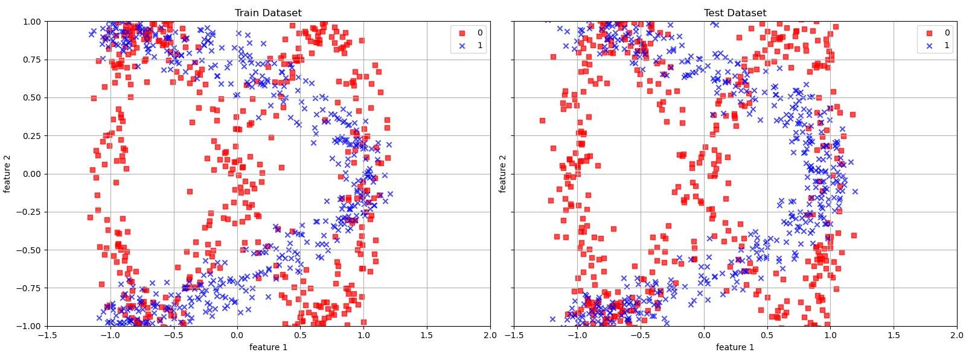
Generated Periodic Dataset

Slide 20
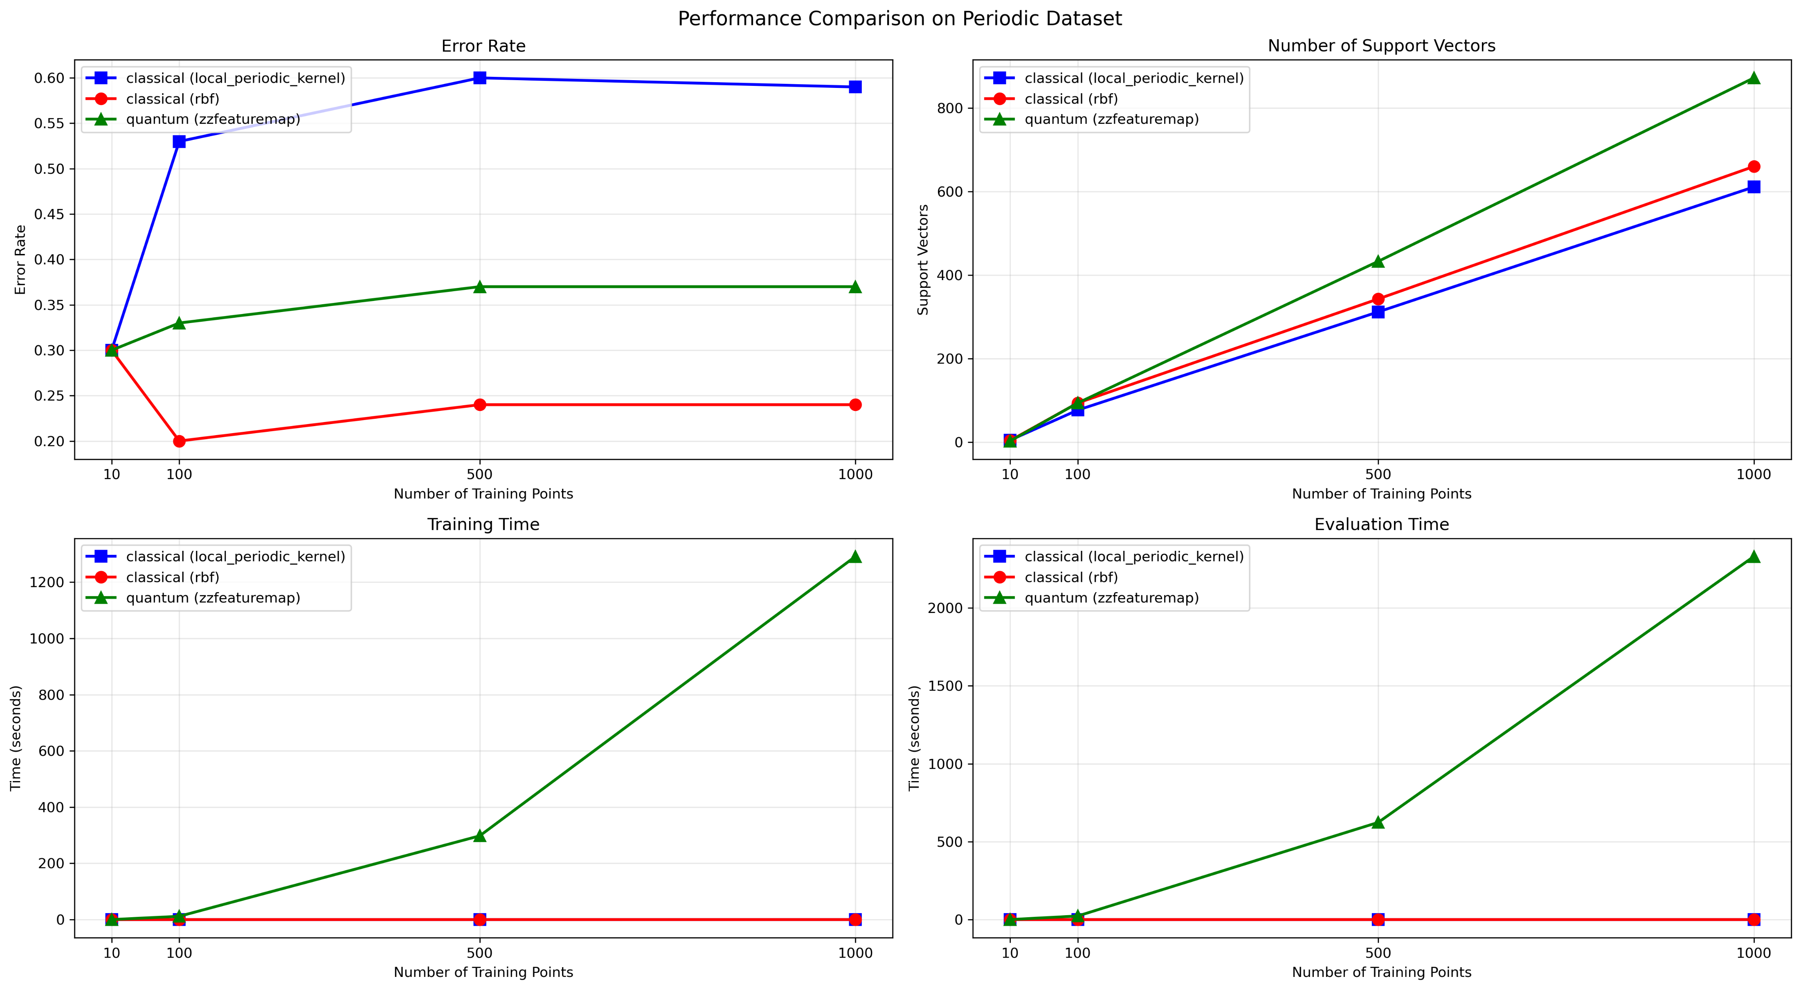
Dataset: Periodic Dataset

Slide 21
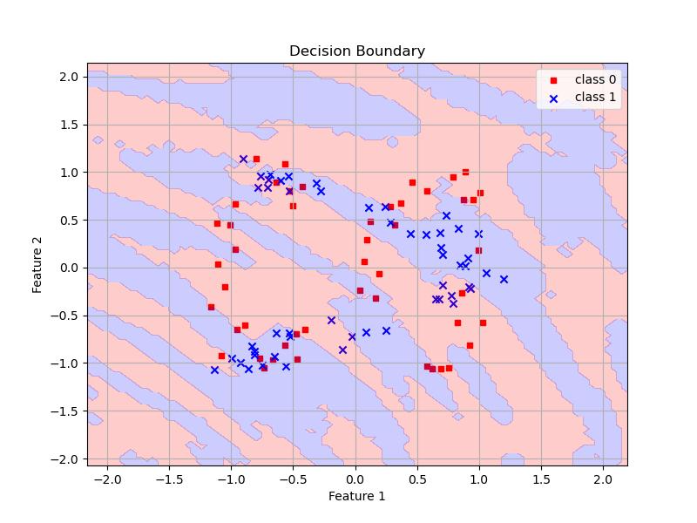
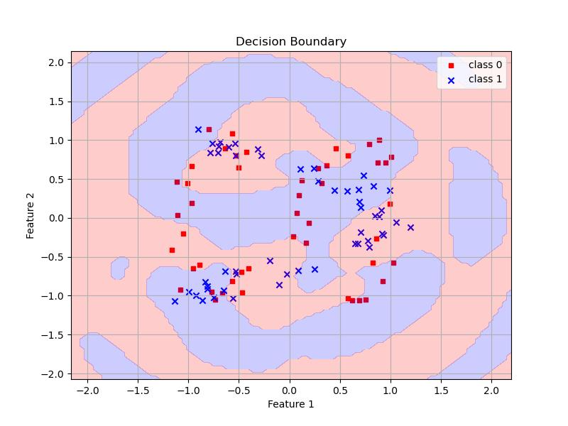
Dataset: Periodic – 100 Samples
QSVC on Eval Set
SVC on Eval Set

Slide 22
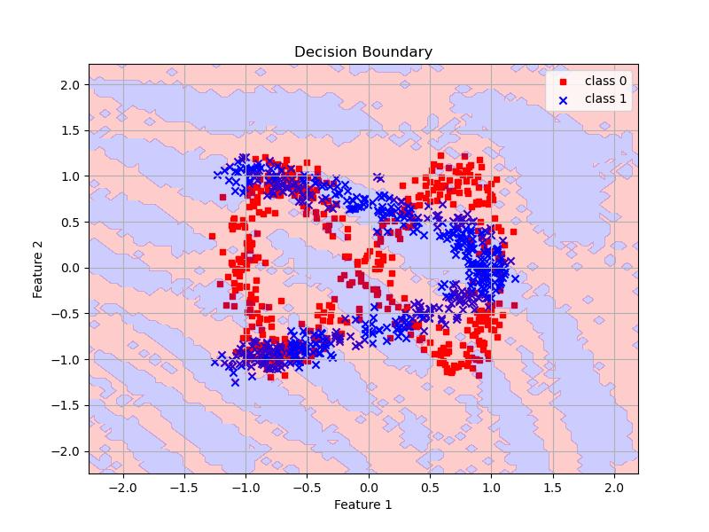
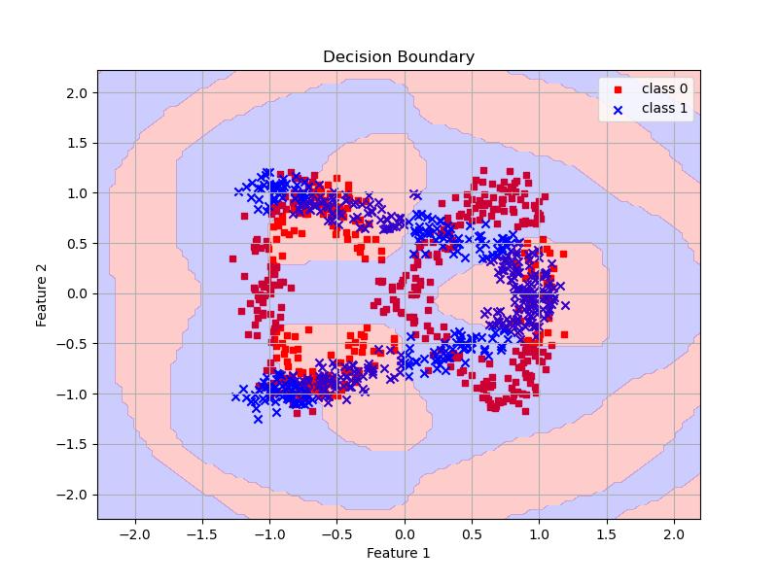
Dataset: Periodic – 1000 Samples
QSVC on Eval Set
SVC on Eval Set

Slide 23
Conclusion
The decision plots were generated using 100 samples
All quantum-based experiments were conducted using IBM's AerSimulator local simulation.
QSVM did not perform better than traditional SVM.
Feature Encoding:
  ZZFeatureMap encodes classical data into quantum states through rotations
  These rotations have a period of 2π
  The periodic nature of quantum rotations (based on sine/cosine) naturally creates these stripe-like patterns
For Gaussian and toroidal datasets, we can run the experiments on real quantum devices. I believe we can process 100 samples using the free tier.
Data: /data/isip/exp/quantum_ml/exp_0011/qsvm/data
Results: /data/isip/exp/quantum_ml/exp_0011/qsvm/output
Scripts:
  /data/isip/exp/quantum_ml/exp_0011/qsvm/run_classical.sh
  /data/isip/exp/quantum_ml/exp_0011/qsvm/run_quantum.sh

