Slide 1
Performance of the models as a function of number of training points
Sadia Afrin Purba

Slide 2
Plots number of data samples vs error rate

Slide 3
Set-10

Slide 4
Set-10

Slide 5
Set-10, 5000 training samples
QRBM training MSE
QRBM Training Samples

Slide 6
Set-10, 10,000 training samples
QRBM training MSE
QRBM Training Samples

Slide 7
Set-10, 60,000 training samples
QRBM training MSE
QRBM Training Samples

Slide 8
Set-09

Slide 9
Set-09

Slide 10
Set-09, 40K training samples
QRBM training MSE
QRBM training samples

Slide 11
QSVM

Slide 12
Quantum SVC (QSVC) – Set-10
Dev
Eval

Slide 13
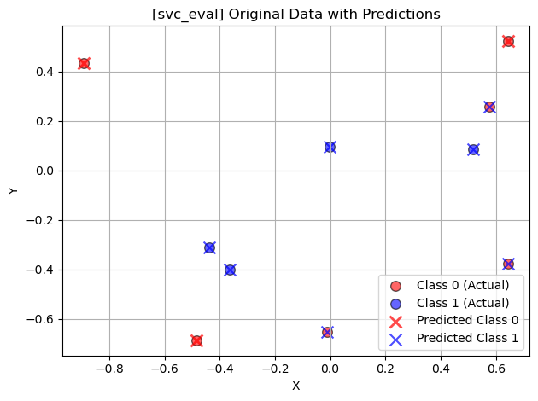
Quantum SVC (QSVC) – Set-10

Slide 14
Quantum SVC (QSVC) – Set-10

Slide 15
Quantum SVC (QSVC) – Set-10
QSVC Eval
SVC Eval

Slide 16
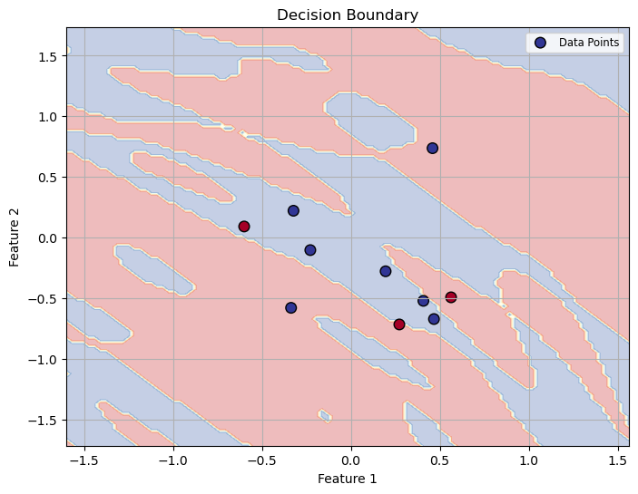
Quantum SVC (QSVC) – Set-10
QSVC Dev
SVC Dev

Slide 17
Quantum SVC (QSVC) – Set-10
QSVC Train
SVC Train

